Slide 1
Investigation of beam purity after in-trap decay and Coulomb excitation of ⁶²Mn-⁶²Fe
J. Cederkall, P. Delahaye, J. Van de Walle
PH department, ISOLDE, CERN, Switzerland
V.N. Fedosseev, B. Marsh, D. Voulot, F. Wenander
AB department, CERN, Switzerland
N. Bree, J. Diriken, O. Ivanov, M. Huyse,
N. Patronis, P. Van Duppen
IKS, KU Leuven, Belgium
E. Clement, GANIL, Caen, France
V. Bildstein, R. Gernhauser, T. Kroll, R. Kruecken, K. Wimmer
TUM, Garching, Germany
and the MINIBALL collaboration

Slide 2
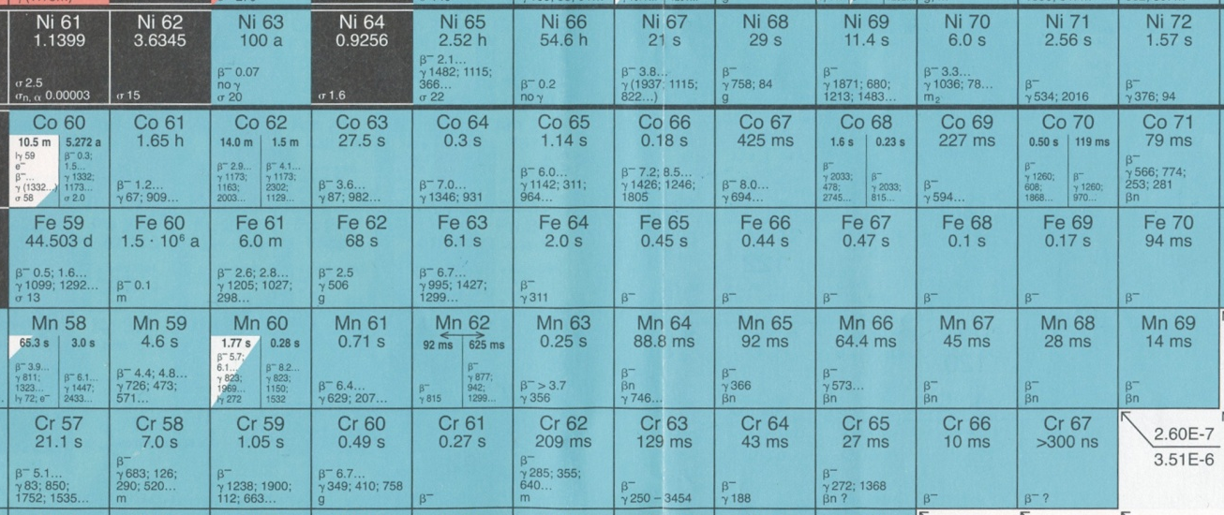
OUTLINE
1/ In-Trap decay and beam contamination : is there a problem ?
2/ Why investigating it ?
3/ Test beam and application : Coulomb excitation of ⁶²Mn/⁶²Fe
Z=28
26
24
35
40
43

Slide 3
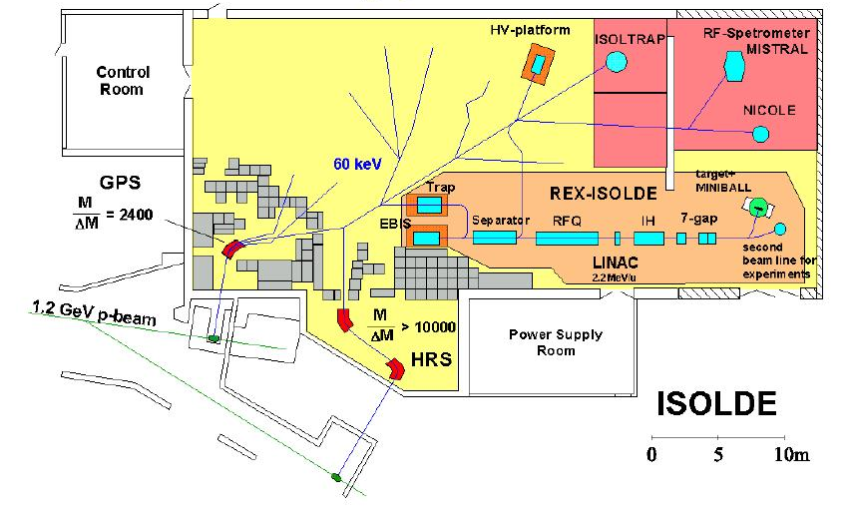
1/ In-Trap decay and beam contamination : is there a problem ?
2/ Why investigating it ?
3/ The application : Coulomb excitation of ⁶²Mn/⁶²Fe
1/ TRAPPING in REXTRAP
2/ CHARGE BREEDING in EBIS
20-200 ms (A≈30-120)
1.4

Slide 4
1/ In-Trap decay and beam contamination : is there a problem ?
2/ Why investigating it ?
3/ The application : Coulomb excitation of ⁶²Mn/⁶²Fe
1/ TRAPPING in REXTRAP
2/ CHARGE BREEDING in EBIS
20-200 ms (A≈30-120)
1.4
REXTRAP
EBIS
MINIBALL
Isotope of interest
Decay product

Slide 5
1/ In-Trap decay and beam contamination : is there a problem ?
2/ Why investigating it ?
3/ The application : Coulomb excitation of ⁶²Mn/⁶²Fe
Post accelerated beams < 2008 :
³¹Mg : 232(15) ms
³²Mg : 95(16) ms
⁸⁰Zn : 545(20) ms
ACCEPTED ¹²⁸Cd : 280(40) ms
REXTRAP
EBIS
MINIBALL
Isotope of interest
Decay product

Slide 6
1/ In-Trap decay and beam contamination : is there a problem ?
2/ Why investigating it ?
3/ The application : Coulomb excitation of ⁶²Mn/⁶²Fe
Post accelerated beams < 2008 :
³¹Mg : 232(15) ms
³²Mg : 95(16) ms
⁸⁰Zn : 545(20) ms
ACCEPTED ¹²⁸Cd : 280(40) ms
Decay losses during trapping and charge breeding become significant.
REXTRAP
EBIS
MINIBALL
Isotope of interest
Decay product

Slide 7
1/ In-Trap decay and beam contamination : is there a problem ?
2/ Why investigating it ?
3/ The application : Coulomb excitation of ⁶²Mn/⁶²Fe
Post accelerated beams < 2008 :
³¹Mg : 232(15) ms
³²Mg : 95(16) ms
⁸⁰Zn : 545(20) ms
ACCEPTED ¹²⁸Cd : 280(40) ms
Decay losses during trapping and charge breeding become significant.
… in the near future even shorter lived ?
REXTRAP
EBIS
MINIBALL
Isotope of interest
Decay product

Slide 8
1/ In-Trap decay and beam contamination : is there a problem ?
2/ Why investigating it ?
3/ The application : Coulomb excitation of ⁶²Mn/⁶²Fe
Post accelerated beams < 2008 :
³¹Mg : 232(15) ms
³²Mg : 95(16) ms
⁸⁰Zn : 545(20) ms
ACCEPTED ¹²⁸Cd : 280(40) ms
Decay losses during trapping and charge breeding become significant.
… in the near future even shorter lived ?
Why not benefit from the short half life …
REXTRAP
EBIS
MINIBALL
Isotope of interest
Decay product

Slide 9
1/ In-Trap decay and beam contamination : is there a problem ?
2/ Why investigating it ?
3/ The application : Coulomb excitation of ⁶²Mn/⁶²Fe
Post accelerated beams < 2008 :
³¹Mg : 232(15) ms
³²Mg : 95(16) ms
⁸⁰Zn : 545(20) ms
ACCEPTED ¹²⁸Cd : 280(40) ms
Decay losses during trapping and charge breeding become significant.
… in the near future even shorter lived ?
Why not benefit from the short half life …
REXTRAP
EBIS
MINIBALL
Ex. Fe mass measurements at ISOLTRAP with in-trap decay of mother ions (Mn)
A. Herlert et al. NJP 7 44 (2005)

Slide 10
1/ In-Trap decay and beam contamination : is there a problem ?
2/ Why investigating it ?
3/ The application : Coulomb excitation of ⁶²Mn/⁶²Fe
Post accelerated beams < 2008 :
³¹Mg : 232(15) ms
³²Mg : 95(16) ms
⁸⁰Zn : 545(20) ms
ACCEPTED ¹²⁸Cd : 280(40) ms
Decay losses during trapping and charge breeding become significant.
… in the near future even shorter lived ?
Why not benefit from the short half life …
to produce a post-accelerated beam of decay products.
REXTRAP
EBIS
MINIBALL
Ex. Fe mass measurements at ISOLTRAP with in-trap decay of mother ions (Mn)
A. Herlert et al. NJP 7 44 (2005)

Slide 11
1/ In-Trap decay and beam contamination : is there a problem ?
2/ Why investigating it ?
3/ The application : Coulomb excitation of ⁶²Mn/⁶²Fe

Slide 12
1/ In-Trap decay and beam contamination : is there a problem ?
2/ Why investigating it ?
3/ The application : Coulomb excitation of ⁶²Mn/⁶²Fe
WHY ?
1/ Nuclear physics interest in decay products ;
Hard to produce beam …
⇓
produce “easy beam” …
⇓
and let it decay to “interesting beam”
if the “easy beam” is short half life … !!!
REXTRAP
EBIS
MINIBALL

Slide 13
1/ In-Trap decay and beam contamination : is there a problem ?
2/ Why investigating it ?
3/ The application : Coulomb excitation of ⁶²Mn/⁶²Fe
WHY ?
1/ Nuclear physics interest in decay products ;
For example :
Ca
K
sufficiently short lived ?
Hard to produce beam …
⇓
produce “easy beam” …
⇓
and let it decay to “interesting beam”
REXTRAP
EBIS
MINIBALL

Slide 14
1/ In-Trap decay and beam contamination : is there a problem ?
2/ Why investigating it ?
3/ The application : Coulomb excitation of ⁶²Mn/⁶²Fe
WHY ?
1/ Nuclear physics interest in decay products ;
For example :
Fe
Mn
sufficiently short lived ?
Hard to produce beam …
⇓
produce “easy beam” …
⇓
and let it decay to “interesting beam”
REXTRAP
EBIS
MINIBALL

Slide 15
1/ In-Trap decay and beam contamination : is there a problem ?
2/ Why investigating it ?
3/ The application : Coulomb excitation of ⁶²Mn/⁶²Fe
WHY ?
1/ Nuclear physics interest in decay products ;
2/ Gain deeper insight in the (possible) loss of decay products in the REXTRAP/EBIS
( crucial for normalization of Coulomb excitation experiments )
REXTRAP
EBIS
MINIBALL

Slide 16
1/ In-Trap decay and beam contamination : is there a problem ?
2/ Why investigating it ?
3/ The application : Coulomb excitation of ⁶²Mn/⁶²Fe
WHY ?
1/ Nuclear physics interest in decay products ;
2/ Gain deeper insight in the (possible) loss of decay products in the REXTRAP/EBIS
( crucial for normalization of Coulomb excitation experiments )
Are decay products lost in the REXTRAP/EBIS ?
How long can these ions be trapped before there are significant losses ?
Can we monitor the change in beam composition with the available beam diagnostics ?
REXTRAP
EBIS
MINIBALL

Slide 17
1/ In-Trap decay and beam contamination : is there a problem ?
2/ Why investigating it ?
3/ The application : Coulomb excitation of ⁶²Mn/⁶²Fe
Are decay products lost in the REXTRAP/EBIS ?
Ion recoil energy after β-decay ⇒ order of few 100 eV (depends on Q-value)
Typical trap barrier height is of the same order of magnitude

Slide 18
1/ In-Trap decay and beam contamination : is there a problem ?
2/ Why investigating it ?
3/ The application : Coulomb excitation of ⁶²Mn/⁶²Fe
Are decay products lost in the REXTRAP/EBIS ?
Ion recoil energy after β-decay ⇒ order of few 100 eV (depends on Q-value)
Typical trap barrier height is of the same order of magnitude
1/ Poorly cooled daughter ions ⇒ worse emittance
⇒ worse transmission to EBIS
2/ Recoil energy sufficient to escape longitudinal potential well (~ 100 eV)
3/ Radius of transverse motion increases and collides with the walls
4/ Sideband cooling works for specific A/q (different for daughter product)
⇒Losses of daughter isotopes

Slide 19
1/ In-Trap decay and beam contamination : is there a problem ?
2/ Why investigating it ?
3/ The application : Coulomb excitation of ⁶²Mn/⁶²Fe
b) How long can these ions be trapped before there are significant losses ?
Produce intense beam of daughter isotopes
⇓
LONGEST POSSIBLE trapping/breeding time

Slide 20
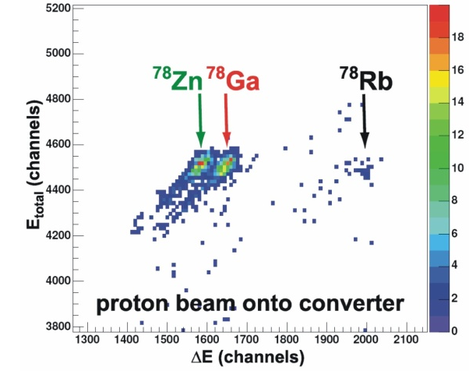
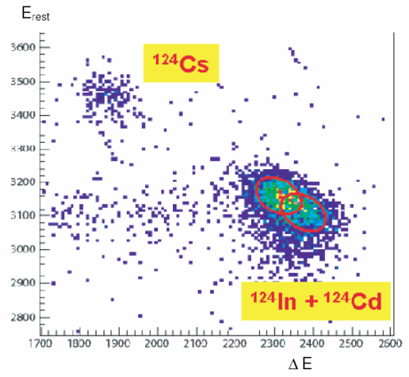
1/ In-Trap decay and beam contamination : is there a problem ?
2/ Why investigating it ?
3/ The application : Coulomb excitation of ⁶²Mn/⁶²Fe
c) Can we monitor the change in beam composition with the available beam diagnostics ?
1/ gas-Si dE-E telescope (zero degree beamline)
Z ~ 30 : ΔZ=1 resolved
Z ~ 50 : ΔZ =1 not resolved

Slide 21
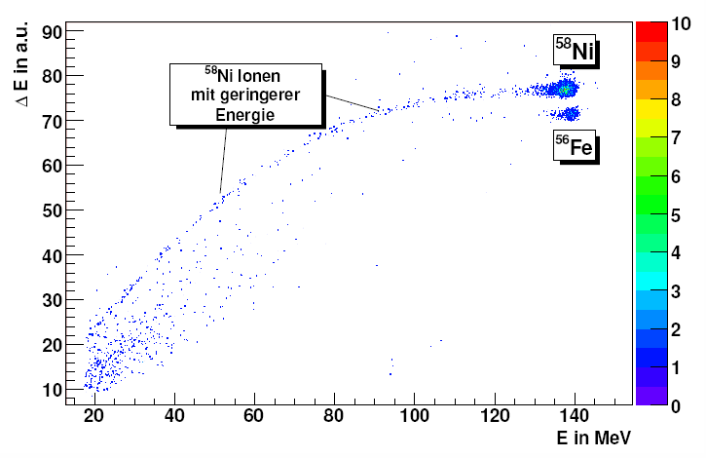
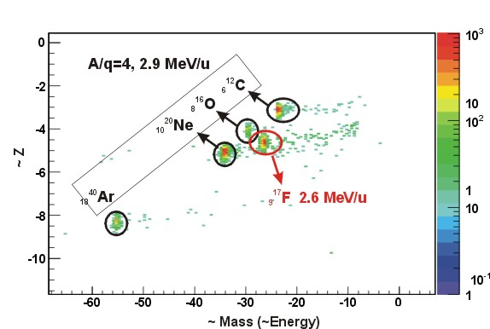
1/ In-Trap decay and beam contamination : is there a problem ?
2/ Why investigating it ?
3/ The application : Coulomb excitation of ⁶²Mn/⁶²Fe
c) Can we monitor the change in beam composition with the available beam diagnostics ?
1/ gas-Si dE-E telescope (zero degree beamline)
2/ Bragg chamber (in MINIBALL beamdump)
a/ Test at Tandem in Munich
b/ ONLINE REX 2007
P10 gas,
500 mbar,
⁵⁸Ni beam on ⁵⁶Fe target
CF4 gas,
400 mbar,
cocktail beam C,O,Ne,Ar
W. Weinzierl, Diplomarbeit, TUM, Munich, 2006

Slide 22
1/ In-Trap decay and beam contamination : is there a problem ?
2/ Why investigating it ?
3/ The application : Coulomb excitation of ⁶²Mn/⁶²Fe
c) Can we monitor the change in beam composition with the available beam diagnostics ?
1/ gas-Si dE-E telescope (zero degree beamline)
2/ Bragg chamber (in MINIBALL beamdump)
3/ Beamdump Germanium detector :
Monitor the change in γ-ray intensities with different trapping/breeding times

Slide 23
1/ In-Trap decay and beam contamination : is there a problem ?
2/ Why investigating it ?
3/ Test beam and application : Coulomb excitation of ⁶²Mn/⁶²Fe
CAN WE PRODUCE A “HARD-TO-GET”
POST-ACCELERATED BEAM OF DECAY PRODUCTS
AFTER IN-TRAP DECAY ???

Slide 24
1/ In-Trap decay and beam contamination : is there a problem ?
2/ Why investigating it ?
3/ Test beam and application : Coulomb excitation of ⁶²Mn/⁶²Fe
CAN WE PRODUCE A “HARD-TO-GET”
POST-ACCELERATED BEAM OF DECAY PRODUCTS
AFTER IN-TRAP DECAY ???
PROOF OF PRINCIPLE WITH Mn-Fe

Slide 25
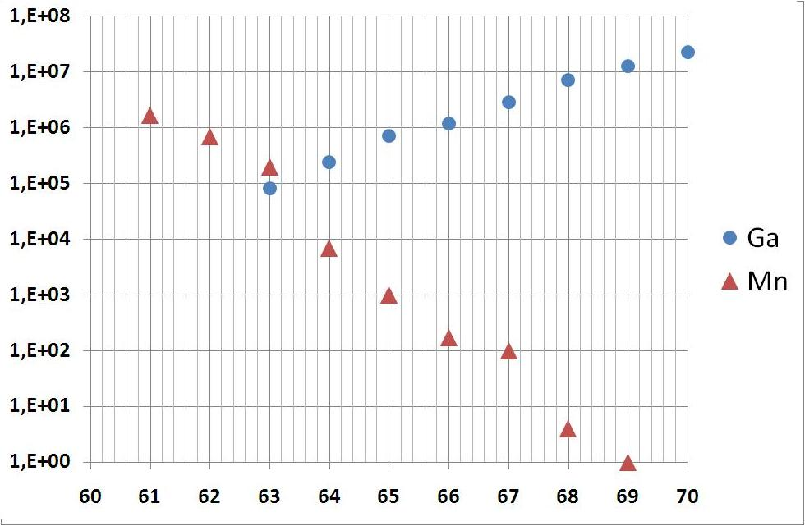
1/ In-Trap decay and beam contamination : is there a problem ?
2/ Why investigating it ?
3/ Test beam and application : Coulomb excitation of ⁶²Mn/⁶²Fe
Test beamtime : ⁶¹Mn – ⁶¹Fe : 4 shifts
Yield ⁶¹Mn = 1.7E6/μC (UC_{x} target + RILIS)
⁶¹Ga (T_{1/2}=168 ms) contamination minimal
Half life ⁶¹Mn = 0.67(4) s
Yield [ions/s]
A

Slide 26
1/ In-Trap decay and beam contamination : is there a problem ?
2/ Why investigating it ?
3/ Test beam and application : Coulomb excitation of ⁶²Mn/⁶²Fe
Test beamtime : ⁶¹Mn – ⁶¹Fe : 4 shifts
Yield ⁶¹Mn = 1.7E6/μC (UC_{x} target + RILIS)
⁶¹Ga (T_{1/2}=168 ms) contamination minimal
Half life ⁶¹Mn = 0.67(4) s
Change trapping + breeding time : 50 - 200 - 400 ms
Change only trapping/breeding time and fix breeding/trapping time
Test the usage of the RFQ as injector to EBIS
Monitor the change in beam composition

Slide 27
1/ In-Trap decay and beam contamination : is there a problem ?
2/ Why investigating it ?
3/ Test beam and application : Coulomb excitation of ⁶²Mn/⁶²Fe
Test beamtime : ⁶¹Mn – ⁶¹Fe : 4 shifts
Yield ⁶¹Mn = 1.7E6/μC (UC_{x} target + RILIS)
⁶¹Ga (T_{1/2}=168 ms) contamination minimal
Half life ⁶¹Mn = 0.67(4) s
T [*] | Fe content
 | Analytical | Simulation [**]
50 ms | 7% | 6%
200 ms | 26% | 12%
400 ms | 46% | 29%
[*] T = Trapping time = Charge breeding time
[**] From F. Ohlsson MSc thesis, Chalmers University 2007

Slide 28
1/ In-Trap decay and beam contamination : is there a problem ?
2/ Why investigating it ?
3/ Test beam and application : Coulomb excitation of ⁶²Mn/⁶²Fe
Test beamtime : ⁶²Mn – ⁶²Fe : 4 shifts
Yield ⁶²Mn = 7.0E5/μC (UC_{x} target + RILIS)
⁶²Ga (T_{1/2}=116 ms) contamination minimal
Half life ⁶²Mn = 0.671(5) s [1] + possible isomeric state of 92(13) ms
(1⁺) [3]
92(13) ms [2] P_{n} = 2.9(5)% [1]
(3⁺) [3]
671(5) ms [1] P_{n} = 6.4(2)% [1]
Both produced,
7.0E5/μC probably g.s.
[1] M. Hannawald, PhD Thesis, U. Mainz 1999
[2] O. Sorlin et al., NPA 669, 351-367 (2000)
[3] G. Audi et al., NPA 729 ,3-128 (2003)

Slide 29
1/ In-Trap decay and beam contamination : is there a problem ?
2/ Why investigating it ?
3/ Test beam and application : Coulomb excitation of ⁶²Mn/⁶²Fe
Test beamtime : ⁶²Mn – ⁶²Fe : 4 shifts
Yield ⁶²Mn = 7.0E5/μC (UC_{x} target + RILIS)
⁶²Ga (T_{1/2}=116 ms) contamination minimal
Half life ⁶²Mn = 0.671(5) s [1] + possible isomeric state of 92(13) ms
Fix trapping + breeding time to longest possible (≥T_{1/2})
Check beam composition (no problem with normalization)
Perform Coulomb excitation on 4.0 mg/cm² ¹⁰⁹Ag target

Slide 30
1/ In-Trap decay and beam contamination : is there a problem ?
2/ Why investigating it ?
3/ Test beam and application : Coulomb excitation of ⁶²Mn/⁶²Fe
Test beamtime : ⁶²Mn – ⁶²Fe : 4 shifts
Yield ⁶²Mn = 7.0E5/μC (UC_{x} target + RILIS)
⁶²Ga (T_{1/2}=116 ms) contamination minimal
Half life ⁶²Mn = 0.671(5) s [1] + possible isomeric state of 92(13) ms
T [*] | Fe content
 | Analytical | Simulation [**]
50 ms | 7% | 6%
200 ms | 26% | 12%
400 ms | 46% | 29%
[*] T = Trapping time = Charge breeding time
[**] From F. Ohlsson MSc thesis, Chalmers University 2007
[1] M. Hannawald, PhD Thesis, Universitat Mainz 1999

Slide 31
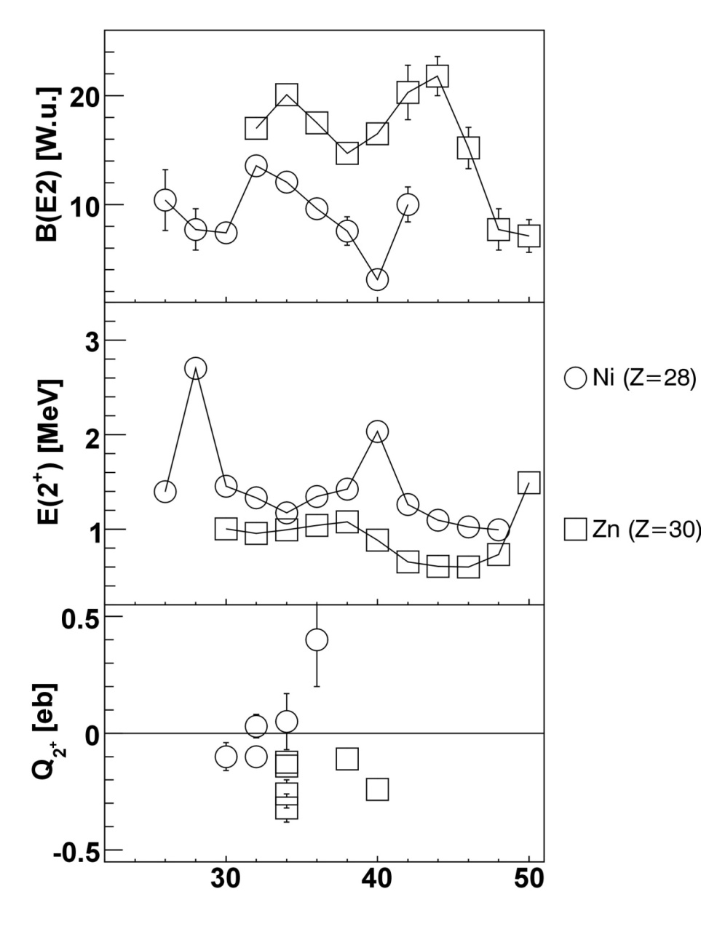
Nuclear Structure Interest
1/ In-Trap decay and beam contamination : is there a problem ?
2/ Why investigating it ?
3/ Test beam and application : Coulomb excitation of ⁶²Mn/⁶²Fe
Increased collectivity for Z>28 and 38<N<44
Neutron Number

Slide 32
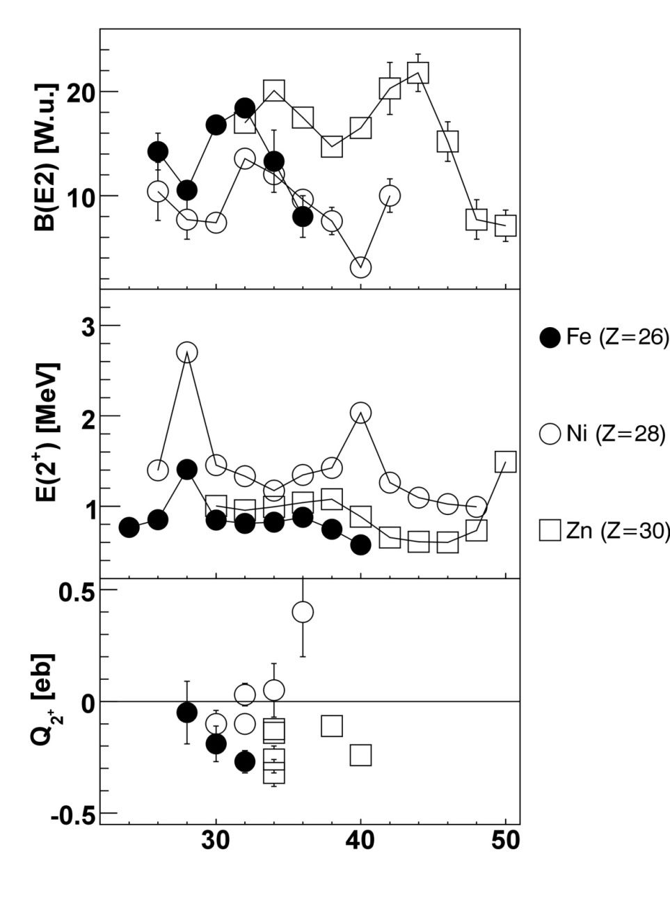
Nuclear Structure Interest
1/ In-Trap decay and beam contamination : is there a problem ?
2/ Why investigating it ?
3/ Test beam and application : Coulomb excitation of ⁶²Mn/⁶²Fe
Increased collectivity for Z>28
and 38<N<44
ALSO for Z<28, ex. Z=26 (Iron)
And 36<N< ??
Neutron Number

Slide 33
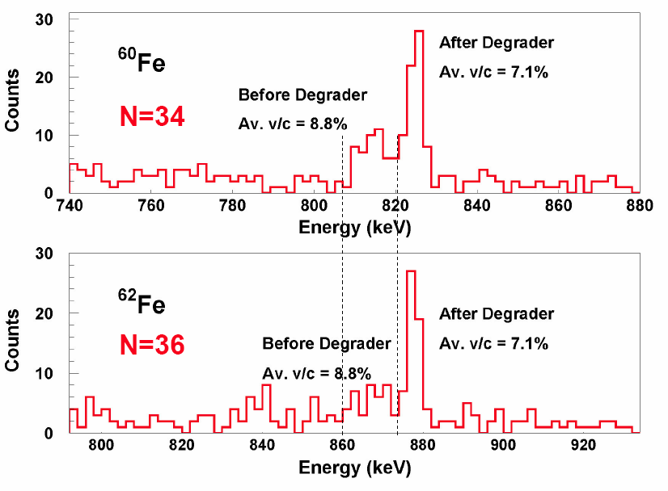
Nuclear Structure Interest
1/ In-Trap decay and beam contamination : is there a problem ?
2/ Why investigating it ?
3/ Test beam and application : Coulomb excitation of ⁶²Mn/⁶²Fe
2⁺ T_{1/2}=9.5(20)ps
B(E2)=8(2) W.u.
Lifetime measurements at Legnaro,
Picture from presentation by
A. Gadea, Conference on Trends in Nuclear Structure,
Zakopane 4-10 sept. 2006
Neutron Number

Slide 34
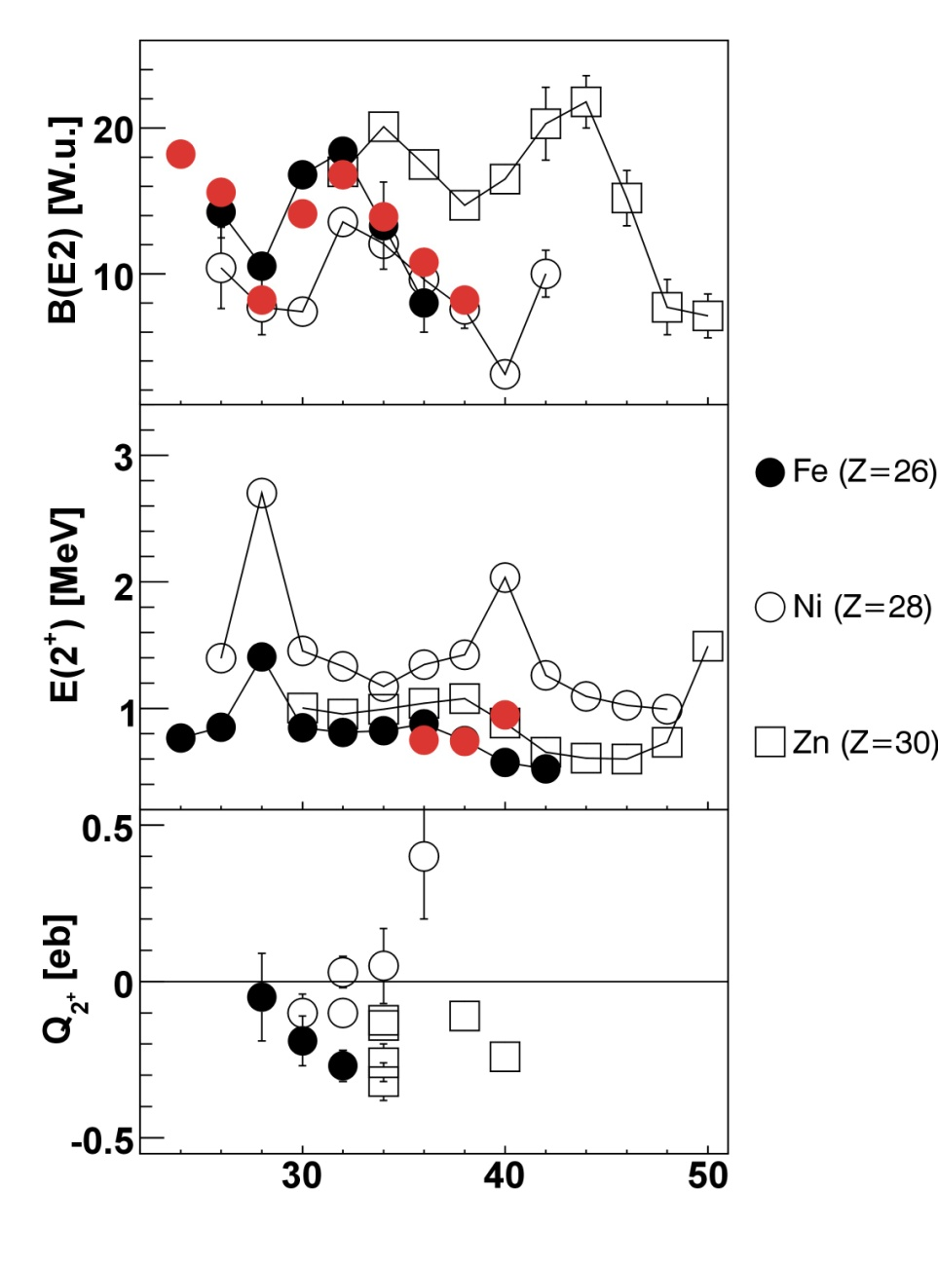
Nuclear Structure Interest
1/ In-Trap decay and beam contamination : is there a problem ?
2/ Why investigating it ?
3/ Test beam and application : Coulomb excitation of ⁶²Mn/⁶²Fe
Calculations from Caurier et al.
EPJA, 15, 145-150 (2002)
pf-shell (KB3G interaction )
Neutron Number

Slide 35
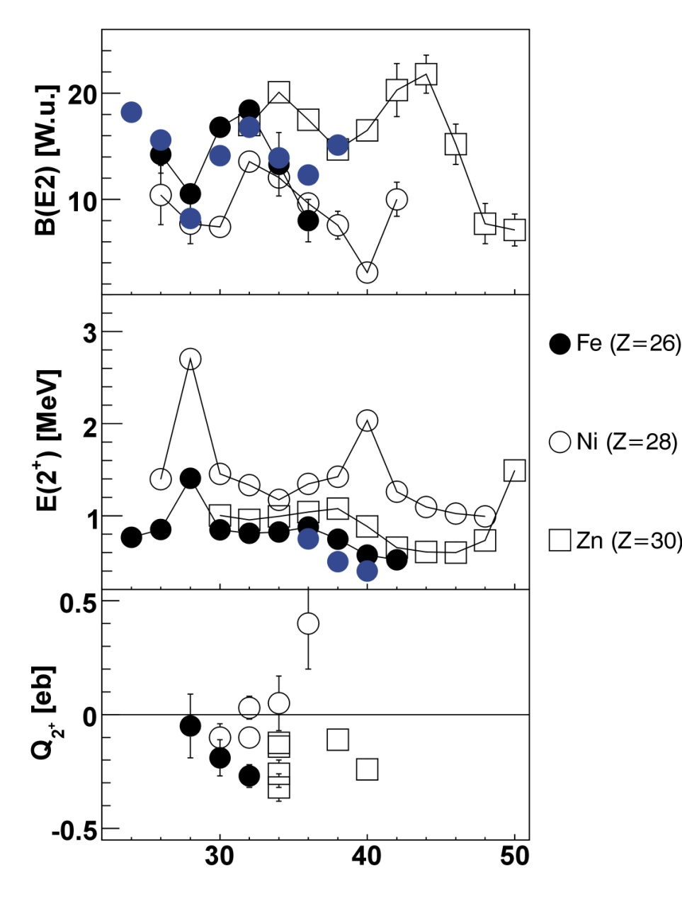
Nuclear Structure Interest
1/ In-Trap decay and beam contamination : is there a problem ?
2/ Why investigating it ?
3/ Test beam and application : Coulomb excitation of ⁶²Mn/⁶²Fe
Calculations from Caurier et al.
EPJA, 15, 145-150 (2002)
pf-shell (KB3G interaction )
pfgd (⁵²Ca core)
How do the 1g_{9/2} and possibly 2d_{5/2} neutron orbitals influence the quadrupole collectivity below Z=28 ?
Neutron Number

Slide 36
Nuclear Structure Interest
1/ In-Trap decay and beam contamination : is there a problem ?
2/ Why investigating it ?
3/ Test beam and application : Coulomb excitation of ⁶²Mn/⁶²Fe
Calculations from Caurier et al.
EPJA, 15, 145-150 (2002)
pf-shell (KB3G interaction )
pfgd (⁵²Ca core)
How do the 1g_{9/2} and possibly 2d_{5/2} neutron orbitals influence the quadrupole collectivity below Z=28 ?
(Re-)measure the (unpublished) B(E2) value in ⁶²Fe
Neutron Number

Slide 37
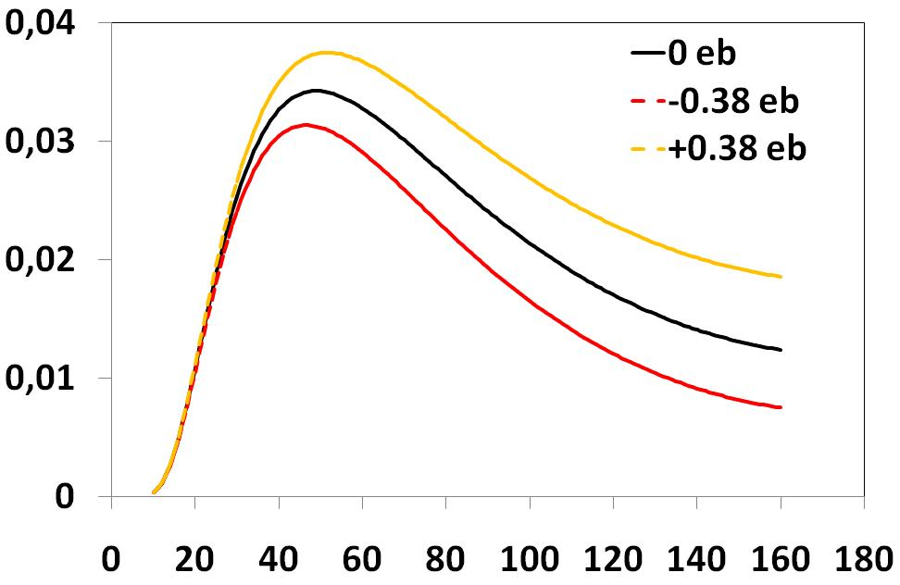
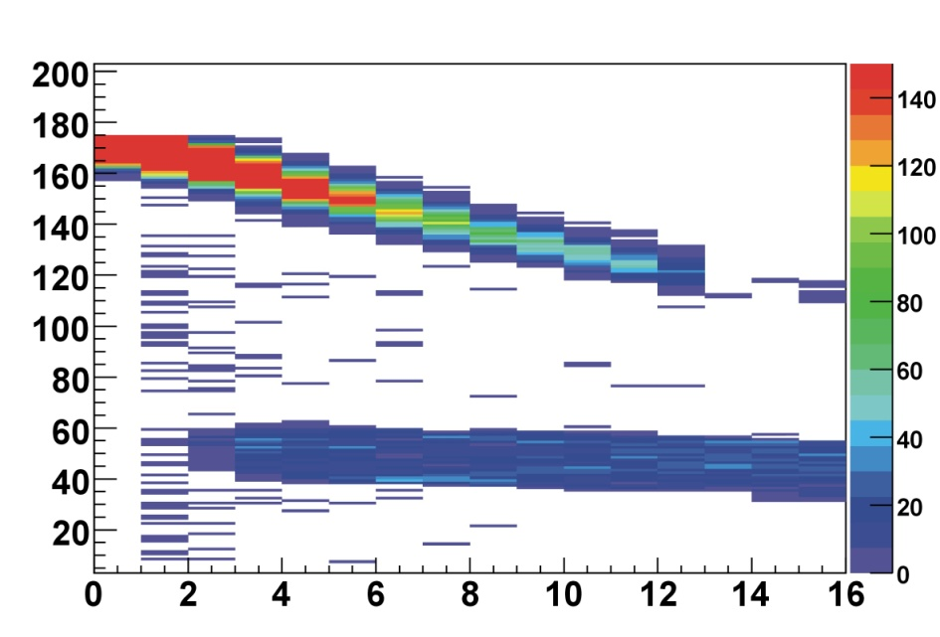
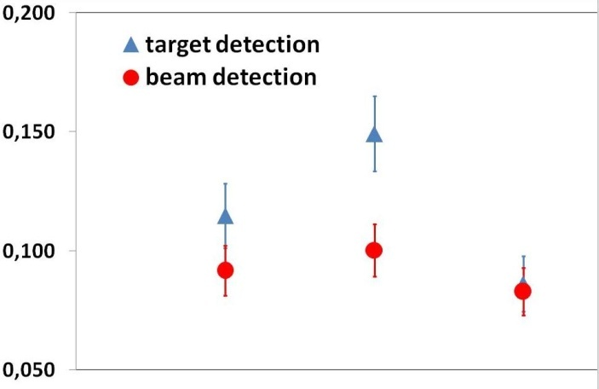
Nuclear Structure Interest
1/ In-Trap decay and beam contamination : is there a problem ?
2/ Why investigating it ?
3/ Test beam and application : Coulomb excitation of ⁶²Mn/⁶²Fe
Diff Cross section [b/srad]
Simulated particle spectrum
2.9 MeV/u – 4.0 mg/cm² ¹⁰⁹Ag
Energy [MeV]
CM scattering angle
CD strip number
Fe/Target excitation
Statistics in 4 shifts assuming :
200 ms trapping and breeding time
2 μA proton beam
4 mg/cm² ¹⁰⁹Ag target
Sensitivity to quadrupole moment :
Target and beam detection in CD detector
Combination with lifetime measurements
0.0
+0.38
-0.38
Quadrupole moment [eb]

Slide 38
Nuclear Structure Interest
1/ In-Trap decay and beam contamination : is there a problem ?
2/ Why investigating it ?
3/ Test beam and application : Coulomb excitation of ⁶²Mn/⁶²Fe
Sensitivity to quadrupole moment :
Target and beam detection in CD detector
Combination with lifetime measurements
Neutron Number

Slide 39
1/ In-Trap decay and beam contamination : is there a problem ?
2/ Why investigating it ?
3/ Test beam and application : Coulomb excitation of ⁶²Mn/⁶²Fe
CONCLUSION : RADIOACTIVE BEAM TIME REQUEST : 8 SHIFTS
4 shifts :
⁶¹Mn
1 shift optimization Bragg chamber + dE-E
3 shifts characterizing the change in beam composition
with different trapping/charge breeding times
4 shifts :
⁶²Mn
Coulomb excitation on Ag target to obtain a relevant physics result

