Slide 1
β-decay studies of neutron rich ⁶¹⁻⁷⁰Mn isotopes
with the new LISOL β-decay setup
J. Cederkall, P. Delahaye, J. Van de Walle
PH department, ISOLDE, CERN, Switzerland
V.N. Fedosseev, B. Marsh,
AB department, CERN, Switzerland
N. Bree, J. Diriken, O. Ivanov, M. Huyse, Y. Kudryavtsev,
D. Pauwels, P. Van den Bergh, P. Van Duppen
IKS, KU Leuven, Belgium
S. Franchoo, IPN Orsay, France
G. Georgiev, CSNSM, IN2P3-CNRS, Orsay, France
O. Sorlin, GANIL, Caen, France
U. Koster, ILL, Grenoble, France
W.B. Walters, University of Maryland, USA

Slide 2
β-decay studies of neutron rich ⁶¹⁻⁷⁰Mn isotopes
with the new LISOL β-decay setup
1. General Physics Motivation
2. Previous and proposed experiment
3. The LISOL β-decay setup
4. Contamination and Yields
5. Conclusions

Slide 3
E [MeV]
Fe systematics of 9/2⁺ states
4
9/2⁺
3
9/2⁺
2
9/2⁺
1
⁶³Fe
⁶⁵Fe
⁶⁷Fe
9/2⁺
???
???
???
3/2⁻
1/2⁻
3/2⁻
3/2⁻
5/2⁻
(3/2,5/2⁻)
(3/2⁻)
29
31
33
35
37
39
41
N
50
50
1g_{9/2}
1g_{9/2}
40
40
2p_{1/2}
2p_{1/2}
ll
1f_{5/2}
1f_{5/2}
llllll
2p_{3/2}
2p_{3/2}
llll
28
28
1f_{7/2}
lllllloo
1f_{7/2}
llllllll
sd-shell
sd-shell
π
ν

Slide 4
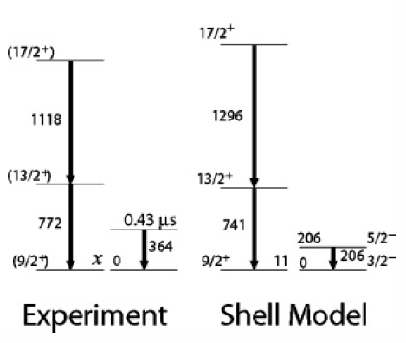
E [MeV]
Fe systematics of 9/2⁺ states
4
9/2⁺
3
9/2⁺
2
9/2⁺
1
⁶³Fe
⁶⁵Fe
⁶⁷Fe
9/2⁺
???
???
???
3/2⁻
1/2⁻
3/2⁻
3/2⁻
5/2⁻
(3/2,5/2⁻)
(3/2⁻)
29
31
33
35
37
39
41
N
50
50
1g_{9/2}
1g_{9/2}
40
40
2p_{1/2}
2p_{1/2}
ll
1f_{5/2}
1f_{5/2}
llllll
2p_{3/2}
2p_{3/2}
llll
28
28
1f_{7/2}
lllllloo
1f_{7/2}
llllllll
sd-shell
sd-shell
Lunardi et al. PRC 76 034303 (2007)
π
ν

Slide 5
E [MeV]
Fe systematics of 9/2⁺ states
4
9/2⁺
3
- TEST FOR RESIDUAL INTERACTION
9/2⁺
2
9/2⁺
1
⁶³Fe
⁶⁵Fe
⁶⁷Fe
9/2⁺
???
???
???
3/2⁻
1/2⁻
3/2⁻
3/2⁻
5/2⁻
(3/2,5/2⁻)
(3/2⁻)
29
31
33
35
37
39
41
N
50
50
1g_{9/2}
1g_{9/2}
40
40
2p_{1/2}
2p_{1/2}
ll
1f_{5/2}
1f_{5/2}
llllll
2p_{3/2}
2p_{3/2}
llll
28
28
1f_{7/2}
lllllloo
1f_{7/2}
llllllll
sd-shell
sd-shell
Lunardi et al. PRC 76 034303 (2007)
π
ν

Slide 6
E [MeV]
Fe systematics of 9/2⁺ states
4
9/2⁺
3
TEST FOR RESIDUAL INTERACTION
DEFORMATION and SHAPE CO-EXISTENCE
9/2⁺
(Z=24) Cr isotopes : Freeman et al. PRC 69 064301 (2004)
2
9/2⁺
1
⁶³Fe
⁶⁵Fe
⁶⁷Fe
9/2⁺
???
???
???
3/2⁻
1/2⁻
3/2⁻
3/2⁻
5/2⁻
(3/2,5/2⁻)
(3/2⁻)
29
31
33
35
37
39
41
N
50
50
1g_{9/2}
1g_{9/2}
40
40
2p_{1/2}
2p_{1/2}
ll
1f_{5/2}
1f_{5/2}
llllll
2p_{3/2}
2p_{3/2}
llll
28
28
1f_{7/2}
lllllloo
1f_{7/2}
llllllll
sd-shell
sd-shell
Lunardi et al. PRC 76 034303 (2007)
π
ν

Slide 7
E [MeV]
Fe systematics of 9/2⁺ states
4
9/2⁺
3
TEST FOR RESIDUAL INTERACTION
DEFORMATION and SHAPE CO-EXISTENCE
- ISOMERS
9/2⁺
2
9/2⁺
1
⁶³Fe
⁶⁵Fe
⁶⁷Fe
9/2⁺
???
???
???
3/2⁻
1/2⁻
3/2⁻
3/2⁻
5/2⁻
(3/2,5/2⁻)
(3/2⁻)
29
31
33
35
37
39
41
N
50
50
1g_{9/2}
1g_{9/2}
40
40
2p_{1/2}
2p_{1/2}
ll
1f_{5/2}
1f_{5/2}
llllll
2p_{3/2}
2p_{3/2}
llll
28
28
1f_{7/2}
lllllloo
1f_{7/2}
llllllll
sd-shell
sd-shell
Lunardi et al. PRC 76 034303 (2007)
π
ν

Slide 8
E [MeV]
Fe and Ni systematics of 2⁺ states
2⁺ Ni (Z=28)
⁶⁸Ni
2
2⁺ Fe (Z=26)
1
(*)
⁶⁶Fe
(*)
⁶⁸Fe
(**)
28
30
32
34
36
38
40
42 N
(**) β-decay study ⁶⁸Mn at GANIL (2006)
J.M. Daugas et al., AIP Conf Proc 831 p 427-429
50
50
(*) β-decay study ^{64,66}Mn at ISOLDE (1998)
Hannawald et al. PRL 82 1391 (1999)
1g_{9/2}
1g_{9/2}
40
40
1998 : “EXTENDED TARGET TEST” …
yielding surprisingly interesting physics !!!
β-decay study at ISOLDE of ^{64,66}Mn
M. Hannawald, PhD dissertation Mainz universitat 1999
2p_{1/2}
2p_{1/2}
ll
1f_{5/2}
1f_{5/2}
llllll
2p_{3/2}
2p_{3/2}
llll
28
28
1f_{7/2}
lllllloo
1f_{7/2}
llllllll
sd-shell
sd-shell
π
ν

Slide 9
β-decay studies of neutron rich ⁶¹⁻⁷⁰Mn isotopes
with the new LISOL β-decay setup
1. General Physics Motivation
2. Previous and proposed experiment
3. The LISOL β-decay setup
4. Contamination and Yields
5. Conclusions

Slide 10
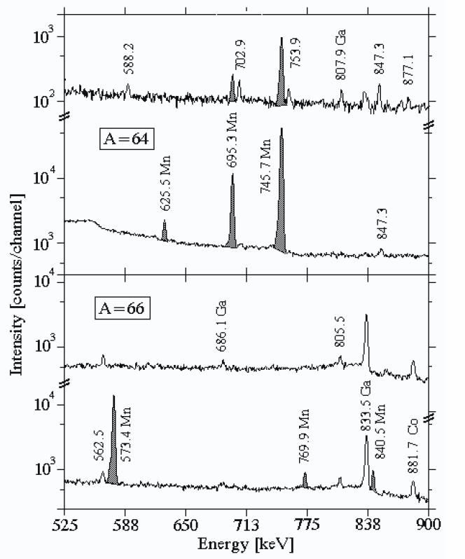
1998 : β-decay study at ISOLDE of ^{64,66}Mn
M. Hannawald, PhD dissertation Mainz universitat 1999
Only Single γ’s in time slices of 150 ms after proton impact
No β-gated γ-ray spectra
Two coaxial Germanium detectors
Only γ’s from ^{64,66}Mn were measured (experiment was an “extended target test”)
900-1050 ms
0-150 ms
900-1050 ms
0-150 ms

Slide 11
1998 : β-decay study at ISOLDE of ^{64,66}Mn
M. Hannawald, PhD dissertation Mainz universitat 1999
Only Single γ’s in time slices of 150 ms after proton impact
No β-gated γ-ray spectra
Two coaxial Germanium detectors
Only γ’s from ^{64,66}Mn were measured (experiment was an “extended target test”)
PROPOSAL 2008 : extended β-decay study at ISOLDE of ⁶¹⁻⁷⁰Mn
Singles AND β-gated γ-ray spectra
NEW TECHNOLOGY :
  Two segmented MINIBALL cluster detectors
  Digital electronics : TOTAL DATA READOUT
Use the unique Mn beams at ISOLDE again :
  one of the highest laser ionization efficiencies
  “standard” beam with UC_{x} target since 1998
Physics :
  Search for isomeric states ;
  Spin and parity assignments in ⁶¹⁻⁷⁰Fe ;
  Probe deformation and shape co-existence in this region ;

Slide 12
1998 : β-decay study at ISOLDE of ^{64,66}Mn
M. Hannawald, PhD dissertation Mainz universitat 1999
Only Single γ’s in time slices of 150 ms after proton impact
No β-gated γ-ray spectra
Two coaxial Germanium detectors
Only γ’s from ^{64,66}Mn were measured (experiment was an “extended target test”)
PROPOSAL 2008 : extended β-decay study at ISOLDE of ⁶¹⁻⁷⁰Mn
Singles AND β-gated γ-ray spectra
NEW TECHNOLOGY :
  Two segmented MINIBALL cluster detectors
  Digital electronics : TOTAL DATA READOUT
Use the unique Mn beams at ISOLDE again :
  one of the highest laser ionization efficiencies
  “standard” beam with UC_{x} target since 1998
Physics :
  Search for isomeric states ;
  Spin and parity assignments in ⁶¹⁻⁷⁰Fe ;
  Probe deformation and shape co-existence in this region ;
= The new LISOL β-decay setup

Slide 13
β-decay studies of neutron rich ⁶¹⁻⁷⁰Mn isotopes
with the new LISOL β-decay setup
1. General Physics Motivation
2. Previous and proposed experiment
3. The LISOL β-decay setup
4. Contamination and Yields
5. Conclusions

Slide 14
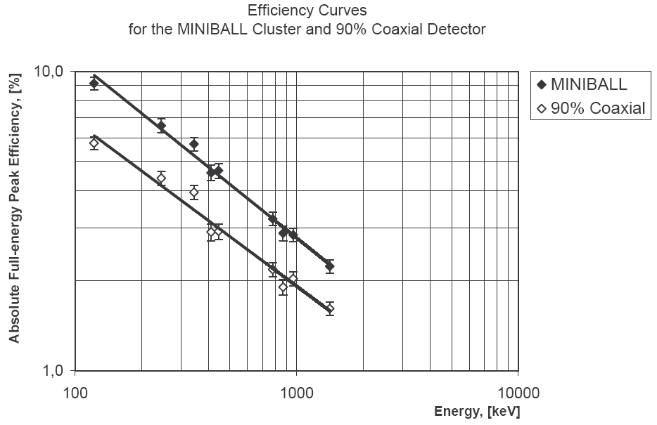
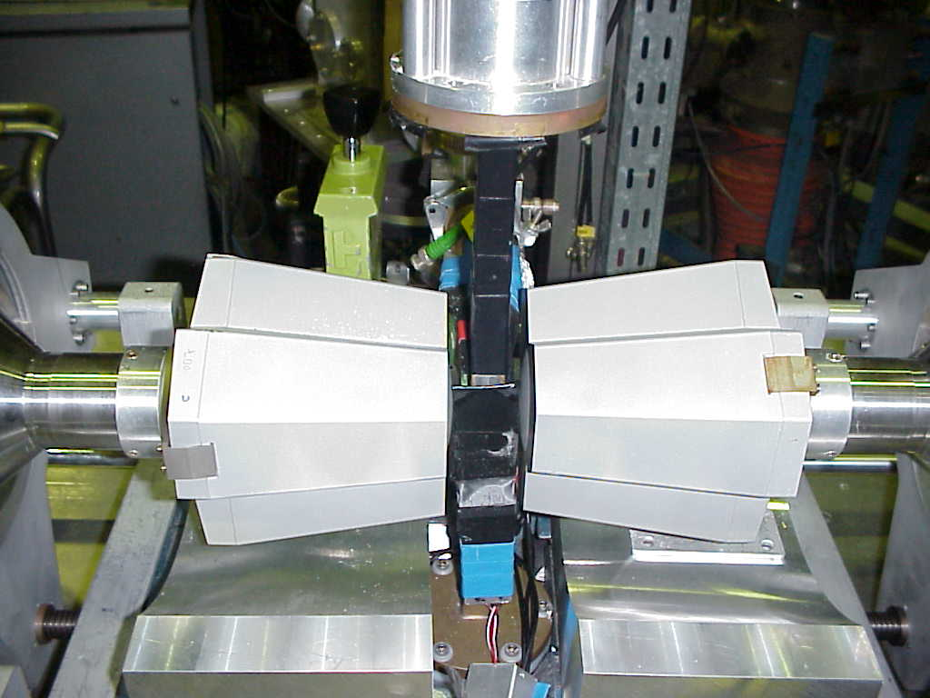
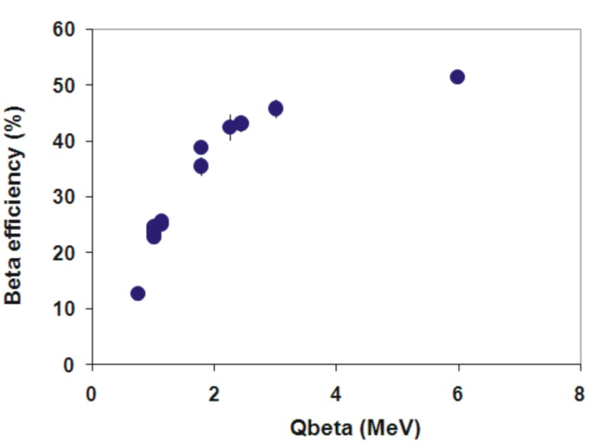
Pictures taken from O. Ivanov, PhD Thesis, KU Leuven, 2007
6-fold segmented MINIBALL Clusters
Beam
γ detection efficiency
3 Plastic ΔE β-detectors
shielding
(polyethylene-borax-Cu-Lead)
digital electronics readout
high segmentation (6 cores, 36 segments) reduces “true coincidence summing effects”
β detection efficiency

Slide 15
Pictures taken from O. Ivanov, PhD Thesis, KU Leuven, 2007
6-fold segmented MINIBALL Clusters
Beam
3 Plastic ΔE β-detectors
shielding
(polyethylene-borax-Cu-Lead)
digital electronics readout
high segmentation (6 cores, 36 segments) reduces “true coincidence summing effects”
Coincidences and Correlations (γ-γ, βγ-γ, …) are performed OFFLINE
TOTAL DATA READOUT

Slide 16
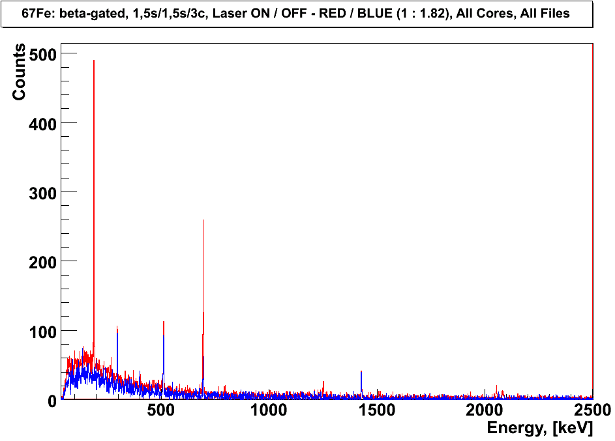
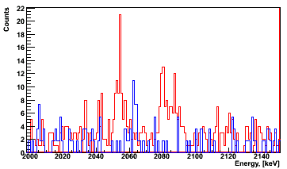
⁶⁷Fe-⁶⁷Co-⁶⁷Ni decay chain
D. Pauwels, NIM B, to be published 2008
T_{1/2}=411(32) ms
β-gated γ-spectra: Red: Laser ON Blue: Laser OFF
16h measuring time
⁶⁷Fe₄₁
β⁻
⁶⁷Fe
189 keV
β⁻
⁶⁷Fe₄₁
⁶⁷Co₄₀
2054
2080
2087
2054 keV
2080 keV
572
2087 keV
1251
189
⁶⁷Fe
1251 keV
⁶⁷Co₄₀
Pictures Courtesy D. Pauwels O. Ivanov, KU Leuven (2007)

Slide 17
⁶⁷Fe-⁶⁷Co-⁶⁷Ni decay chain
D. Pauwels, NIM B, to be published 2008
β-gated γ-spectra: Red: Laser ON Blue: Laser OFF
16h measuring time
T_{1/2}=411(32) ms
⁶⁷Fe₄₁
β⁻
β⁻
β⁻
⁶⁷Fe
189 keV
⁶⁷Fe₄₁
⁶⁷Co₄₀
⁶⁷Ni₃₉
2054
2080
2087
2054 keV
2080 keV
2087 keV
⁶⁷Co
694 keV
572
1251
⁶⁷Fe
1251 keV
189
(7/2⁻)
T_{1/2}=425(20) ms
⁶⁷Co₄₀
694
T_{1/2}=21 s
⁶⁷Ni₃₉
L. Weissman et al., PRC 59, 2004(1999).
Pictures Courtesy D. Pauwels O. Ivanov, KU Leuven (2007)

Slide 18
⁶⁷Fe-⁶⁷Co-⁶⁷Ni decay chain
D. Pauwels, NIM B, to be published 2008
β-gated γ-spectra: Red: Laser ON Blue: Laser OFF
16h measuring time
T_{1/2}=411(32) ms
⁶⁷Fe₄₁
β⁻
β⁻
β⁻
⁶⁷Fe
189 keV
⁶⁷Fe₄₁
⁶⁷Co₄₀
⁶⁷Ni₃₉
2054
2080
2087
2054 keV
2080 keV
2087 keV
⁶⁷Co
694 keV
572
1251
⁶⁷Fe
1251 keV
189
(7/2⁻)
T_{1/2}=425(20) ms
⁶⁷Co₄₀
694
T_{1/2}=21 s
⁶⁷Ni₃₉
L. Weissman et al., PRC 59, 2004(1999).
Pictures Courtesy D. Pauwels O. Ivanov, KU Leuven (2007)

Slide 19
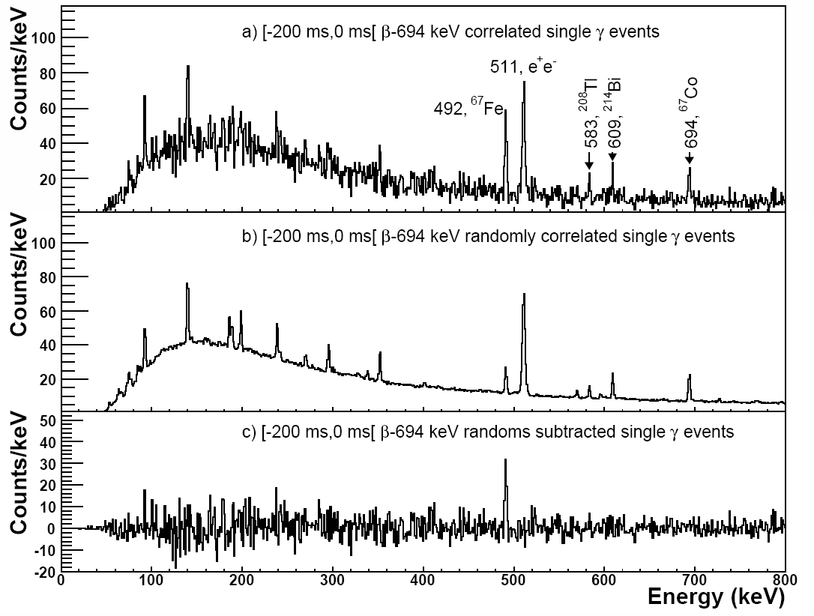
= β-694 keV (event trigger type)
START
…
STOP
Time (/25 ns)
T_{1/2}=411(32) ms
⁶⁷Fe₄₁
β⁻
2054
2080
2087
200 ms
572
Sum of all correlated historgrams
1251
189
(7/2⁻)
T_{1/2}=425(20) ms
⁶⁷Co₄₀
(5/2⁻)
694
T_{1/2}=21 s
(1/2⁻)
⁶⁷Ni₃₉
L. Weissman et al., PRC 59, 2004(1999).
Pictures Courtesy D. Pauwels O. Ivanov, KU Leuven (2007)

Slide 20
= β-694 keV (event trigger type)
START
…
STOP
Time (/25 ns)
T_{1/2}=411(32) ms
⁶⁷Fe₄₁
β⁻
2054
2080
2087
200 ms
572
Sum of all correlated historgrams
1251
189
(7/2⁻)
T_{1/2}=425(20) ms
⁶⁷Co₄₀
(5/2⁻)
694
T_{1/2}=21 s
(1/2⁻)
⁶⁷Ni₃₉
L. Weissman et al., PRC 59, 2004(1999).
Sum of all randomly correlated historgrams
Pictures Courtesy D. Pauwels O. Ivanov, KU Leuven (2007)

Slide 21
= β-694 keV (event trigger type)
START
…
STOP
Time (/25 ns)
T_{1/2}=411(32) ms
⁶⁷Fe₄₁
β⁻
2054
2080
2087
200 ms
572
1251
189
(7/2⁻)
T_{1/2}=425(20) ms
⁶⁷Co₄₀
(5/2⁻)
694
T_{1/2}=21 s
(1/2⁻)
⁶⁷Ni₃₉
L. Weissman et al., PRC 59, 2004(1999).
Pictures Courtesy D. Pauwels O. Ivanov, KU Leuven (2007)

Slide 22
START
…
STOP
Time (/25 ns)
T_{1/2}=411(32) ms
⁶⁷Fe₄₁
β⁻
2054
2080
2087
200 ms
572
1251
189
(7/2⁻)
T_{1/2}=425(20) ms
⁶⁷Co₄₀
(5/2⁻)
Time behavior of this correlated 491 keV
single γ-ray, BEFORE the β-694 keV γ-ray
694
T_{1/2}=21 s
(1/2⁻)
⁶⁷Ni₃₉
L. Weissman et al., PRC 59, 2004(1999).
Pictures Courtesy D. Pauwels O. Ivanov, KU Leuven (2007)

Slide 23
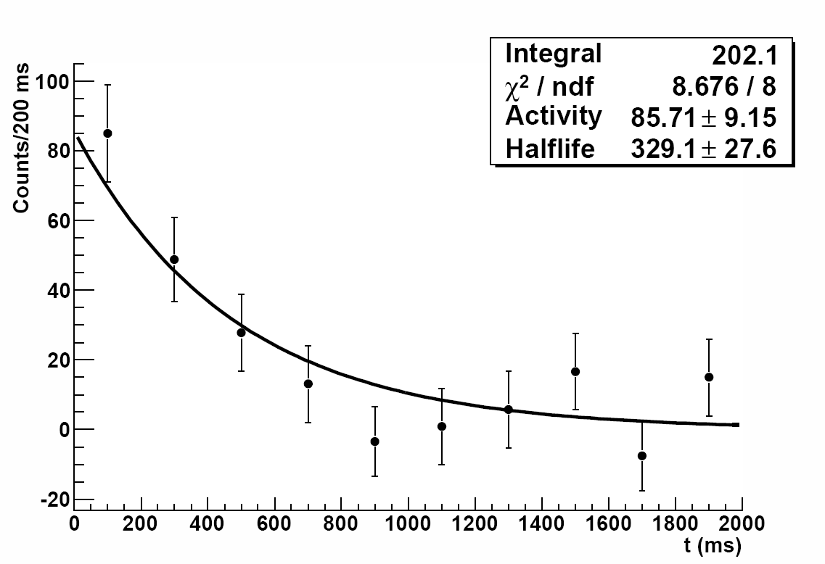
START
…
STOP
Time (/25 ns)
T_{1/2}=411(32) ms
⁶⁷Fe₄₁
β⁻
2054
2080
2087
200 ms
572
329(28) ms
1251
189
(7/2⁻)
T_{1/2}=425(20) ms
⁶⁷Co₄₀
(5/2⁻)
694
T_{1/2}=21 s
(1/2⁻)
⁶⁷Ni₃₉
L. Weissman et al., PRC 59, 2004(1999).
Time behavior of this correlated 491 keV
single γ-ray, BEFORE the β-694 keV γ-ray
Pictures Courtesy D. Pauwels O. Ivanov, KU Leuven (2007)

Slide 24
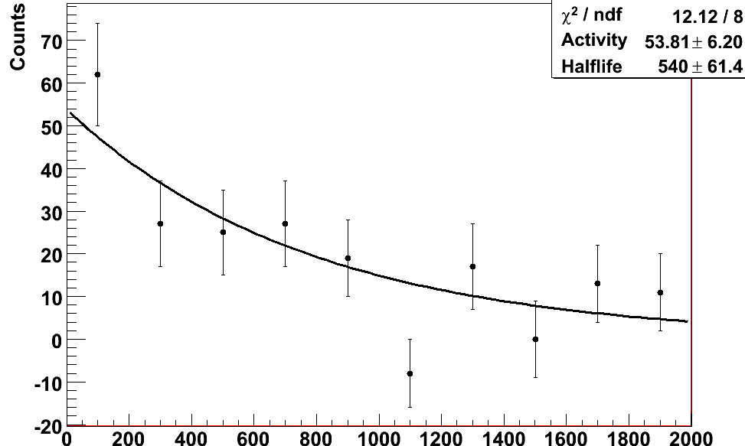
START
…
STOP
Time (/25 ns)
T_{1/2}=411(32) ms
⁶⁷Fe₄₁
β⁻
2054
2080
2087
200 ms
572
483(56) ms
1251
189
(7/2⁻)
T_{1/2}=425(20) ms
⁶⁷Co₄₀
(5/2⁻)
694
T_{1/2}=21 s
(1/2⁻)
⁶⁷Ni₃₉
L. Weissman et al., PRC 59, 2004(1999).
Time behavior of this correlated 491 keV
single γ-ray, AFTER the β-189 keV γ-ray
Pictures Courtesy D. Pauwels O. Ivanov, KU Leuven (2007)

Slide 25
START
…
STOP
Time (/25 ns)
T_{1/2}=411(32) ms
⁶⁷Fe₄₁
~50%
2054
2080
2087
An isomeric state was discovered thanks to the possibility to correlate events offline with digital electronics readout.
572
~50%
189
1251
T_{1/2}=483(56) ms
491
(7/2⁻)
T_{1/2}=329(28) ms
⁶⁷Co₄₀
(5/2⁻)
694
T_{1/2}=21 s
(1/2⁻)
⁶⁷Ni₃₉
L. Weissman et al., PRC 59, 2004(1999).
Pictures Courtesy D. Pauwels O. Ivanov, KU Leuven (2007)

Slide 26
Conditions for applicability :
-pure sources of radioactive ions
-element selectivity
-low background
-efficient detection system
-low count rate

Slide 27
Conditions for applicability :
-pure sources of radioactive ions
-element selectivity
low background
efficient detection system
-low count rate

Slide 28
Conditions for applicability :
-pure sources of radioactive ions
element selectivity
low background
efficient detection system
-low count rate
Laser ON and laser OFF measurements with RILIS

Slide 29
Conditions for applicability :
? pure sources of radioactive ions
element selectivity
low background
efficient detection system
? low count rate

Slide 30
β-decay studies of neutron rich ⁶¹⁻⁷⁰Mn isotopes
with the new LISOL β-decay setup
1. General Physics Motivation
2. Previous and proposed experiment
3. The LISOL β-decay setup
4. Contamination and Yields
5. Conclusions

Slide 31
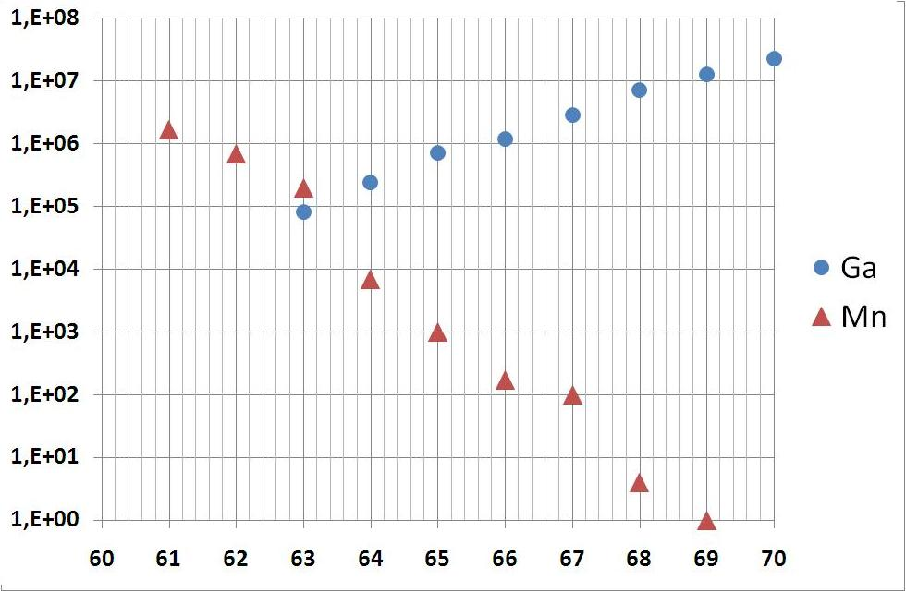
Ga production yields from fission cross section measurements of ²³⁸U with 1 GeV protons
http://www-w2k.gsi.de/charms/data-arb04.htm or
M. Bernas et al. Nucl. Phys. A 725 213 (2003) + 1% ionization efficiency
Mn yields from ISOLDE Yield database
Yield [ions/s]
A

Slide 32
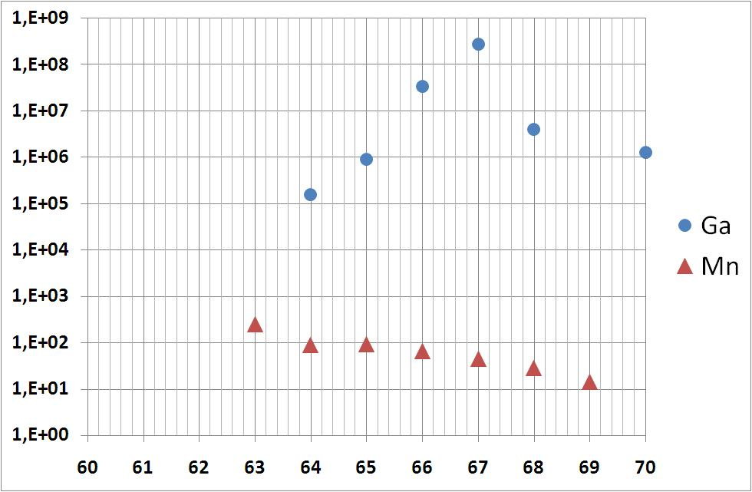
Yield [ions/s]
1/ Half Lives differ orders of magnitude
A
Half Life (T_{1/2}) [ms]
A

Slide 33
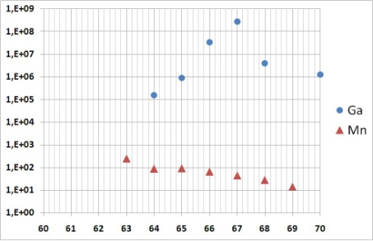
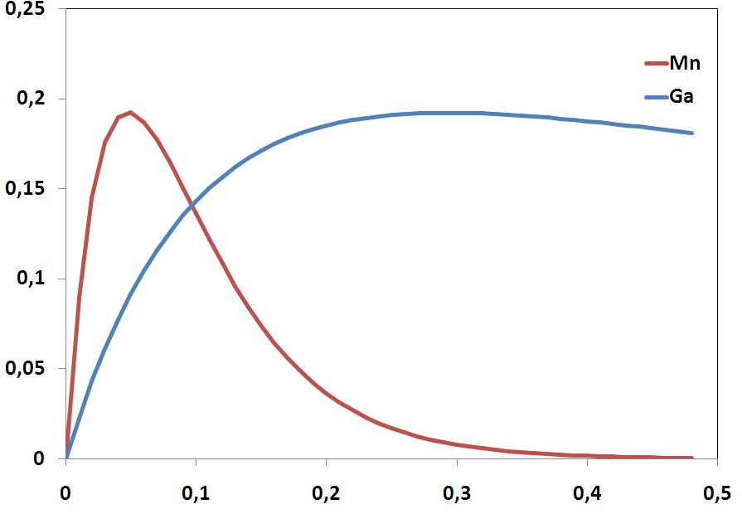
Half Life (T_{1/2}) [ms]
Release Curves : C(1-e^{-t/τr}).[αe^{-t/τf}+(1-α)e^{-t/τs}].e-^{t/τ}
T=2000˚C
Parameters taken from U. Koester, These 1999, TU Munchen
+ additional life time factor
1/ Half Lives differ orders of magnitude ;
2/ Different release times (macro gating) ;
Release [a.u.]
A=66
T1/2 :
Mn = 45 ms / Ga = 9h
MACRO GATING
With ISOLDE beam gate
(ex. 4 half lives)
Time since proton impact [s]

Slide 34
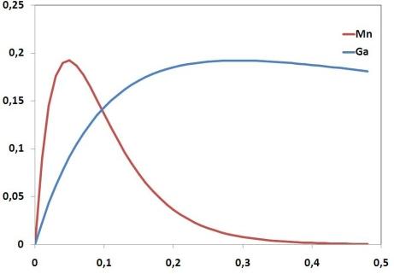
Half Life (T_{1/2}) [ms]
Release [a.u.]
A=66
T1/2 :
Mn = 45 ms / Ga = 9h
MACRO GATING
With ISOLDE beam gate
(ex. 4 half lives)
Time since proton impact [s]
1/ Half Lives differ orders of magnitude ;
2/ Different release times (macro gating) ;
3/ Micro gating of laser ionized isotopes ;

Slide 35
Half Life (T_{1/2}) [ms]
Release [a.u.]
A=66
T1/2 :
Mn = 45 ms / Ga = 9h
MACRO GATING
With ISOLDE beam gate
(ex. 4 half lives)
Time since proton impact [s]
1/ Half Lives differ orders of magnitude ;
2/ Different release times (macro gating) ;
3/ Micro gating of laser ionized isotopes ;
4/ Tape transport after each measuring cycle ;

Slide 36
Half Life (T_{1/2}) [ms]
Conditions for applicability :
pure sources of radioactive ions
element selectivity
low background
efficient detection system
low count rate
Release [a.u.]
A=66
T1/2 :
Mn = 45 ms / Ga = 9h
MACRO GATING
With ISOLDE beam gate
(ex. 4 half lives)
Time since proton impact [s]
1/ Half Lives differ orders of magnitude ;
2/ Different release times (macro gating) ;
3/ Micro gating of laser ionized isotopes ;
4/ Tape transport after each measuring cycle ;
5/ Good beam steering
1/ Half Lives differ orders of magnitude ;
2/ Different release times (macro gating) ;
3/ Micro gating of laser ionized isotopes ;
4/ Tape transport after each measuring cycle ;

Slide 37
CONCLUSION
ISOLDE provides the UNIQUE possibility to combine
1/ the new technology utilized with the LISOL β-decay setup
2/ the laser ionized neutron rich Mn beams at ISOLDE
1/ search for isomeric states in Iron and Manganese isotopes ;
2/ complement the knowledge of the nuclear structure below (neutron rich) Nickel isotopes (Co, Fe and Mn)

Slide 38
Nr of Shifts
Example ⁶⁷Fe LISOL
1.25 ions/s on tape
58h (or 7 shifts) measurement

Slide 39
Nr of Shifts
Example ⁶⁷Fe LISOL
1.25 ions/s on tape
58h (or 7 shifts) measurement
Similar for ^{68,69}Mn : 7 shifts / isotope
(6 laser on, 1 laser off)
⁶¹⁻⁶⁷Mn : average 1 shift / isotope
⁷⁰Mn : 2 shifts
24 SHIFTS

Slide 40
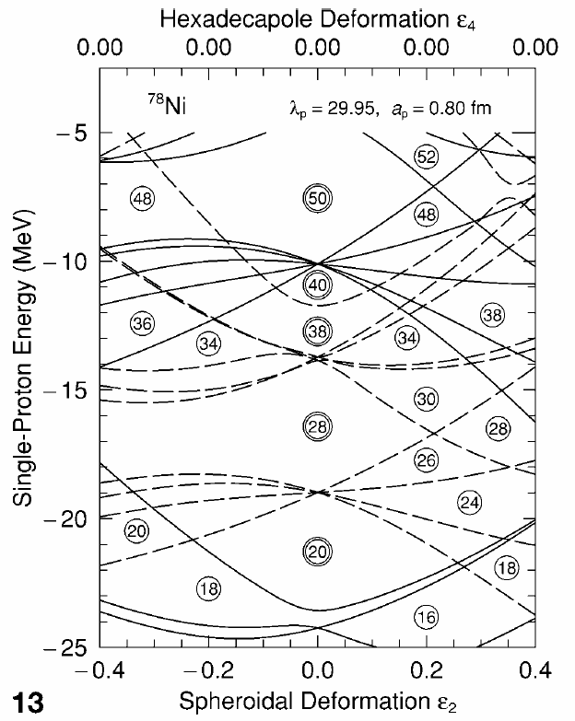
E [MeV]
Fe systematics of 9/2⁺ states
4
9/2⁺
3
9/2⁺
2
9/2⁺
1
⁶³Fe
⁶⁵Fe
⁶⁷Fe
9/2⁺
???
???
???
3/2⁻
1/2⁻
3/2⁻
3/2⁻
5/2⁻
(3/2,5/2⁻)
(3/2⁻)
29
31
33
35
37
39
41
N
50
50
1g_{9/2}
1g_{9/2}
l
ν 3/2[301]
40
40
2p_{1/2}
2p_{1/2}
ll
1f_{5/2}
1f_{5/2}
llllll
2p_{3/2}
2p_{3/2}
llll
28
28
1f_{7/2}
lllllloo
1f_{7/2}
llllllll
g.s. = 3/2⁻ state from β-decay feeding to ⁶⁷Co
D. Pauwels et al., to be published
sd-shell
sd-shell
π
ν

Slide 41
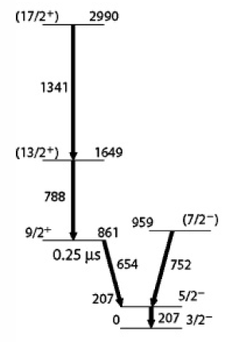
E [MeV]
⁶³Fe
⁶⁵Fe
⁶⁷Fe
1
9/2⁺
⁶¹Fe
???
???
???
3/2⁻
5/2⁻
(3/2,5/2⁻)
(3/2⁻)
35
37
39
41
N
Lunardi et al. PRC 76 034303 (2007)
M2 654 keV 9/2⁺→5/2⁻ : 239(5) ns

Slide 42
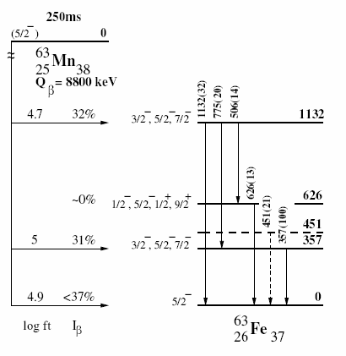
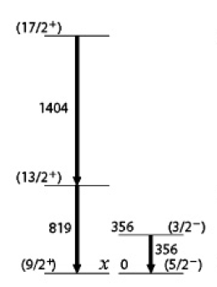
E [MeV]
⁶³Fe
⁶⁵Fe
⁶⁷Fe
1
9/2⁺
⁶¹Fe
???
???
???
3/2⁻
5/2⁻
(3/2,5/2⁻)
(3/2⁻)
35
37
39
41
N
1st forbidden GT transition 5/2⁻→9/2⁻⁺
Lunardi et al. PRC 76 034303 (2007)
M2 654 keV 9/2⁺→5/2⁻ : 239(5) ns
L. Gaudefroy, These Orsay 2005
⁶³Fe
Lunardi et al. PRC 76 034303 (2007)

Slide 43
E [MeV]
⁶³Fe
⁶⁵Fe
⁶⁷Fe
1
9/2⁺
⁶¹Fe
???
???
???
3/2⁻
5/2⁻
(3/2,5/2⁻)
(3/2⁻)
35
37
39
41
N
1st forbidden GT transition 5/2⁻→9/2⁻⁺
Lunardi et al. PRC 76 034303 (2007)
M2 654 keV 9/2⁺→5/2⁻ : 239(5) ns
L. Gaudefroy, These Orsay 2005
⁶³Fe
???
Lunardi et al. PRC 76 034303 (2007)

Slide 44
E [MeV]
⁶³Fe
⁶⁵Fe
⁶⁷Fe
1
9/2⁺
⁶¹Fe
???
???
???
3/2⁻
5/2⁻
(3/2,5/2⁻)
(3/2⁻)
35
37
39
41
N
1st forbidden GT transition 5/2⁻→9/2⁻⁺
Lunardi et al. PRC 76 034303 (2007)
M2 654 keV 9/2⁺→5/2⁻ : 239(5) ns
L. Gaudefroy, These Orsay 2005
⁶³Fe
???
< 350 keV ???
From deep-inelastic data (W.B. Walters, priv. comm.)
Lunardi et al. PRC 76 034303 (2007)

Slide 45
E [MeV]
⁶³Fe
⁶⁵Fe
⁶⁷Fe
1
9/2⁺
⁶¹Fe
???
???
???
3/2⁻
5/2⁻
(3/2,5/2⁻)
(3/2⁻)
35
37
39
41
N
1st forbidden GT transition 5/2⁻→9/2⁻⁺
Lunardi et al. PRC 76 034303 (2007)
M2 654 keV 9/2⁺→5/2⁻ : 239(5) ns
L. Gaudefroy, These Orsay 2005
9/2⁺ →5/2⁻ = μs isomer …
lost in prompt β-γ coincidences,
re-gained with the digital readout !

Slide 46
E [MeV]
⁶³Fe
⁶⁵Fe
⁶⁷Fe
1
9/2⁺
⁶¹Fe
???
???
???
3/2⁻
5/2⁻
(3/2,5/2⁻)
(3/2⁻)
35
37
39
41
N
Lunardi et al. PRC 76 034303 (2007)
M2 654 keV 9/2⁺→5/2⁻ : 239(5) ns
L. Gaudefroy, These Orsay 2005
⁶⁴Mn decay :
33(2)% β-delayed neutron branch
⇒Feeding of low-spin states in ⁶³Mn !!!

Slide 47
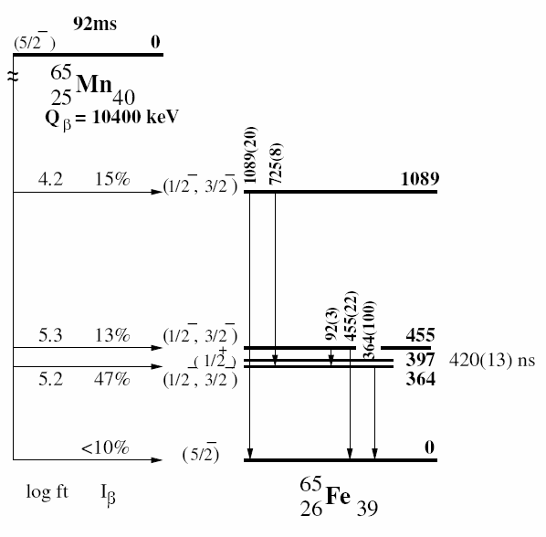
E [MeV]
⁶³Fe
⁶⁵Fe
⁶⁷Fe
1
9/2⁺
???
???
???
3/2⁻
5/2⁻
(3/2,5/2⁻)
(3/2⁻)
35
37
39
41
N
L. Gaudefroy, These Orsay 2005
+ MSU mass measurements :
isomer around 400 keV
Block et al. (MSU)
+ LISOL β-decay ⁶⁵Fe
Indication for β-decaying isomer
D. Pauwels et al. (KU Leuven)
Lunardi et al. PRC 76 034303 (2007)

Slide 48
E [MeV]
⁶³Fe
⁶⁵Fe
⁶⁷Fe
1
9/2⁺
???
???
???
3/2⁻
5/2⁻
(3/2,5/2⁻)
(3/2⁻)
35
37
39
41
N
L. Gaudefroy, These Orsay 2005
+ MSU mass measurements :
isomer around 400 keV
Block et al. (MSU)
+ LISOL β-decay ⁶⁵Fe
Indication for β-decaying isomer
D. Pauwels et al. (KU Leuven)
Lunardi et al. PRC 76 034303 (2007)

Slide 49
E [MeV]
⁶³Fe
⁶⁵Fe
⁶⁷Fe
1
9/2⁺
???
???
???
3/2⁻
5/2⁻
(3/2,5/2⁻)
(3/2⁻)
35
37
39
41
N
Experimental information to test
SHELL MODEL calculations !!!
L. Gaudefroy, These Orsay 2005
+ MSU mass measurements :
isomer around 400 keV
Block et al. (MSU)
+ LISOL β-decay ⁶⁵Fe
Indication for β-decaying isomer
D. Pauwels et al. (KU Leuven)
Lunardi et al. PRC 76 034303 (2007)

Slide 50
E [MeV]
⁶³Fe
⁶⁵Fe
⁶⁷Fe
1
9/2⁺
???
???
???
3/2⁻
5/2⁻
(3/2,5/2⁻)
(3/2⁻)
35
37
39
41
N

Slide 51
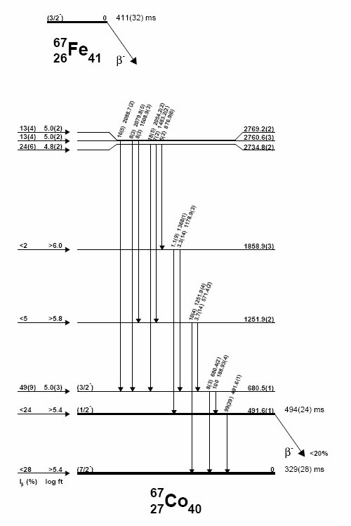
E [MeV]
⁶³Fe
⁶⁵Fe
⁶⁷Fe
1
9/2⁺
???
???
???
3/2⁻
5/2⁻
(3/2,5/2⁻)
(3/2⁻)
35
37
39
41
N
β-decay study of ⁶⁷Fe at LISOL (2007)
D. Pauwels et al., These KU Leuven 2008
(to be published) [1]
(3/2⁻)
[1]

Slide 52
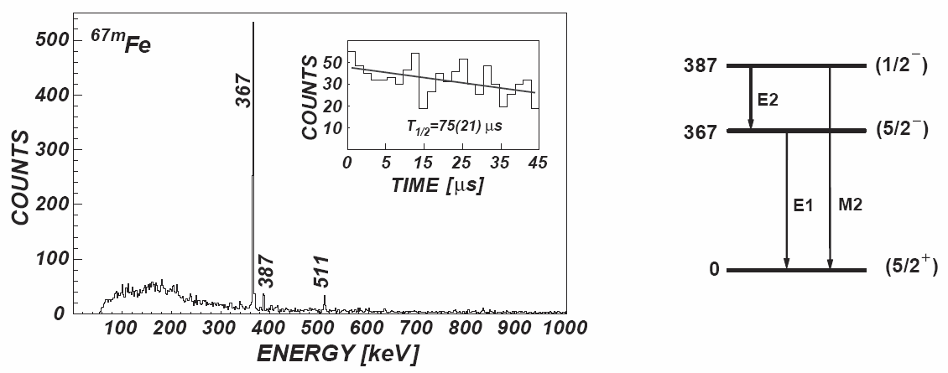
E [MeV]
⁶³Fe
⁶⁵Fe
⁶⁷Fe
1
9/2⁺
???
???
???
3/2⁻
5/2⁻
(3/2,5/2⁻)
(3/2⁻)
35
37
39
41
N
β-decay study of ⁶⁷Fe at LISOL (2007)
D. Pauwels et al., These KU Leuven 2008
(to be published) [1]
(3/2⁻)
[1]
75(21) μs [2]
(5/2⁺) [2]
⁶⁷Fe₄₁
In-flight separation and isomeric decay study at GANIL
M. Sawicka et al. EPJA 16 51-54 (2003) [2]

Slide 53
E [MeV]
⁶³Fe
⁶⁵Fe
⁶⁷Fe
1
9/2⁺
???
???
???
3/2⁻
5/2⁻
(3/2,5/2⁻)
(3/2⁻)
35
37
39
41
N
β-decay study of ⁶⁷Fe at LISOL (2007)
D. Pauwels et al., These KU Leuven 2008
(to be published) [1]
[3] = β-decay study of ⁶⁷Mn at GANIL
J.M. Daugas et al., AIP Conf Proc 831 p 427
No spin assignments (!)
(3/2⁻)
[1]
⁶⁷Mn
(5/2⁻)
β⁻
? [3]
75(21) μs [2]
(5/2⁺) [2]
⁶⁷Fe₄₁
In-flight separation and isomeric decay study at GANIL
M. Sawicka et al. EPJA 16 51-54 (2003) [2]

Slide 54
E [MeV]
⁶³Fe
⁶⁵Fe
⁶⁷Fe
1
9/2⁺
???
???
???
3/2⁻
5/2⁻
(3/2,5/2⁻)
(3/2⁻)
35
37
39
41
N
β-decay study of ⁶⁷Fe at LISOL (2007)
D. Pauwels et al., These KU Leuven 2008
(to be published) [1]
[3] = β-decay study of ⁶⁷Mn at GANIL
J.M. Daugas et al., AIP Conf Proc 831 p 427
No spin assignments (!)
(3/2⁻)
[1]
⁶⁷Mn
(5/2⁻)
β⁻
? [3]
75(21) μs [2]
[1] = new isomeric state at 492 keV
Discovered with the “slow correlation technique”
D. Pauwels et al. NIMB to be published
(5/2⁺) [2]
⁶⁷Fe₄₁
In-flight separation and isomeric decay study at GANIL
M. Sawicka et al. EPJA 16 51-54 (2003) [2]

Slide 55
E [MeV]
⁶³Fe
⁶⁵Fe
⁶⁷Fe
1
9/2⁺
???
???
???
3/2⁻
5/2⁻
(3/2,5/2⁻)
(3/2⁻)
35
37
39
41
N
Preliminary interpretation, related to
shape coexistence and deformation
D. Pauwels et al., These KU Leuven 2008
(to be published) [1]
π 7/2[303]
(1/2⁻)
π 1/2[301]
M3
π 1/2[321]
(7/2⁻)

Slide 56
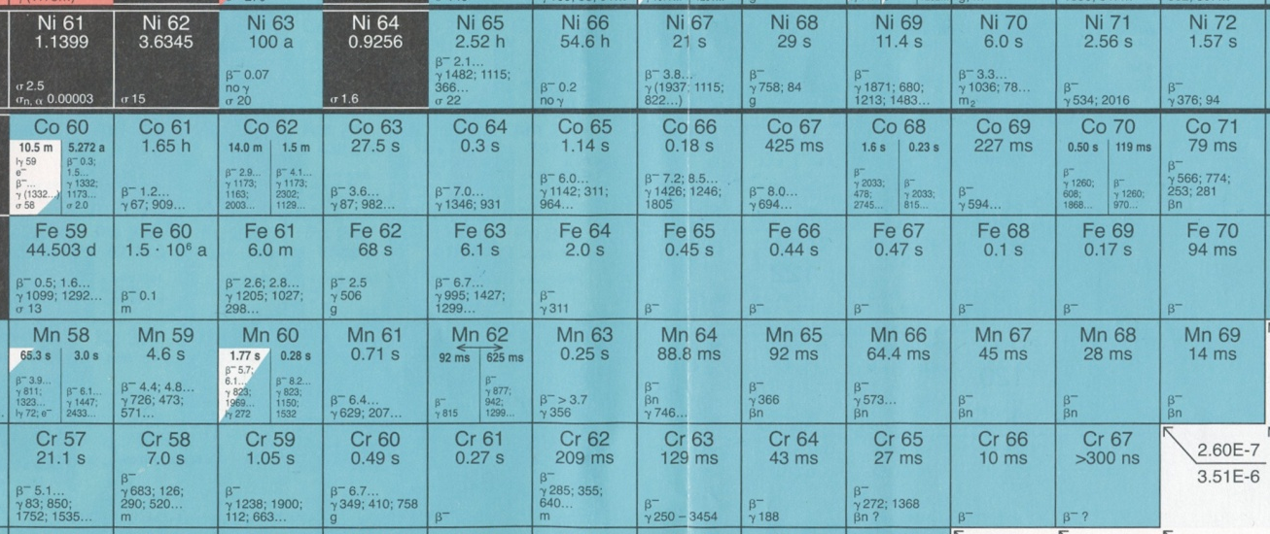
1. General Physics Motivation
E [MeV]
Fe and Ni systematics of 2⁺ states
2⁺ Ni (Z=28)
⁶⁸Ni
2
2⁺ Fe (Z=26)
1
(*)
⁶⁶Fe
(*)
⁶⁸Fe
(**)
28
30
32
34
36
38
40
N
Z=28
(**) β-decay study ⁶⁸Mn at GANIL (2006)
J.M. Daugas et al., AIP Conf Proc 831 p 427-429
(*) β-decay study ^{64,66}Mn at ISOLDE (1998)
Hannawald et al. PRL 82 1391 (1999)
26
24
35
40
43

Slide 57
1. General Physics Motivation
E [MeV]
Fe and Ni systematics of 2⁺ states
2⁺ Ni (Z=28)
⁶⁸Ni
2
2⁺ Fe (Z=26)
1
(*)
⁶⁶Fe
(*)
⁶⁸Fe
(**)
28
30
32
34
36
38
40
N
ONSET TO DEFORMATION IN NEUTRON RICH Fe ISOTOPES
(N>36)
Hannawald et al. PRL 82 1391 (1999)
Z=28
(**) β-decay study ⁶⁸Mn at GANIL (2006)
J.M. Daugas et al., AIP Conf Proc 831 p 427-429
(*) β-decay study ^{64,66}Mn at ISOLDE (1998)
Hannawald et al. PRL 82 1391 (1999)
26
24
35
40
43

Slide 58
1. General Physics Motivation
E [MeV]
Fe systematics of 9/2⁺ states
4
9/2⁺
⇒ Isomers
shape
seniority
single particle
3
9/2⁺
2
9/2⁺
1
⁶³Fe
⁶⁵Fe
⁶⁷Fe
9/2⁺
???
???
???
3/2⁻
1/2⁻
3/2⁻
3/2⁻
5/2⁻
(3/2,5/2⁻)
(3/2⁻)
29
31
33
35
37
39
41
N
+ MSU mass measurements :
isomer around 400 keV
Block et al. (MSU)
+ LISOL β-decay ⁶⁵Fe
Indication for β-decaying isomer
D. Pauwels et al. (KU Leuven)
+ GANIL : 397 keV 420(13) ns
Lunardi et al. PRC 76 034303 (2007)

Slide 59
1. General Physics Motivation
E [MeV]
N=35/37 systematics of 9/2⁺ states
N=35
9/2⁺
N=37
9/2⁺
1
9/2⁺
⁶¹Fe
9/2⁺
9/2⁺
0.5
9/2⁺
???
⁶³Fe
Cr
24
Fe
26
Ni
28
Zn
30
Ge
32
Se
34
Kr
36
50
50
1g_{9/2}
1g_{9/2}
40
40
2p_{1/2}
2p_{1/2}
1f_{5/2}
1f_{5/2}
lll
2p_{3/2}
2p_{3/2}
llll
28
28
1f_{7/2}
lllllloo
1f_{7/2}
llllllll
sd-shell
sd-shell
π
ν

Slide 60
1. General Physics Motivation
Weaker N=40 subsell
E [MeV]
N=35/37 systematics of 9/2⁺ states
N=35
9/2⁺
N=37
9/2⁺
1
9/2⁺
⁶¹Fe
9/2⁺
9/2⁺
0.5
9/2⁺
???
⁶³Fe
Cr
24
Fe
26
Ni
28
Zn
30
Ge
32
Se
34
Kr
36
50
50
9/2⁺ excitation energy drops
to low energy region
dominated by pf orbitals
Deformation
Shape co-existence
Ex. High spin study ⁵⁹Cr₃₅
Freeman et al PRC 69 064301 (2004)
Sorlin et al NPA 669 351-367 (2000)
1g_{9/2}
1g_{9/2}
40
40
2p_{1/2}
2p_{1/2}
1f_{5/2}
1f_{5/2}
lll
2p_{3/2}
2p_{3/2}
llll
28
28
1f_{7/2}
lllllloo
1f_{7/2}
llllllll
sd-shell
sd-shell
π
ν

Slide 61
3. The LISOL β-decay setup
Single γ-rays and β’s are individually “timestamped”
Only the energy of the γ-ray is registered
No hardware conditions are implied on the raw data !
⇒ Coincidences and Correlations (γ-γ, βγ-γ, …) are performed OFFLINE
THE “SLOW CORRELATION TECHNIQUE”
D. Pauwels, NIMA, to be published 2008
START
…
STOP
Time (/25 ns)
T
1- Event type definition : β-γ / single γ / … + time window definition (T)

Slide 62
3. The LISOL β-decay setup
Single γ-rays and β’s are individually “timestamped”
Only the energy of the γ-ray is registered
No hardware conditions are implied on the raw data !
⇒ Coincidences and Correlations (γ-γ, βγ-γ, …) are performed OFFLINE
THE “SLOW CORRELATION TECHNIQUE”
D. Pauwels, NIMA, to be published 2008
START
…
STOP
Time (/25 ns)
T
1- Event type definition : β-γ / single γ / … + time window definition (T)
(scan over full data set for these event types)

Slide 63
3. The LISOL β-decay setup
Single γ-rays and β’s are individually “timestamped”
Only the energy of the γ-ray is registered
No hardware conditions are implied on the raw data !
⇒ Coincidences and Correlations (γ-γ, βγ-γ, …) are performed OFFLINE
THE “SLOW CORRELATION TECHNIQUE”
D. Pauwels, NIMA, to be published 2008
START
…
STOP
Time (/25 ns)
N x 25ns
1- Event type definition : β-γ / single γ / … + time window definition (T)
2- Single γ-ray histograms in time slices (N x 25ns) before and after
the detected “event type” = CORRELATED HISTOGRAMS

Slide 64
3. The LISOL β-decay setup
Single γ-rays and β’s are individually “timestamped”
Only the energy of the γ-ray is registered
No hardware conditions are implied on the raw data !
⇒ Coincidences and Correlations (γ-γ, βγ-γ, …) are performed OFFLINE
THE “SLOW CORRELATION TECHNIQUE”
D. Pauwels, NIMA, to be published 2008
START
…
STOP
Time (/25 ns)
N x 25ns
1- Event type definition : β-γ / single γ / …
2- Single γ-ray histograms in time slices (N x 25ns) before and after
the detected “event type” = CORRELATED HISTOGRAMS
3- Single γ-ray histograms in the same time windows relative to the start of each cycle
= RANDOMLY CORRELATED HISTOGRAMS

Slide 65
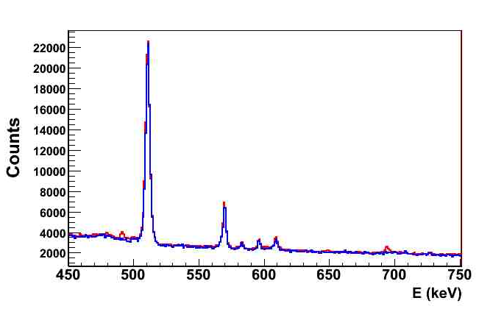
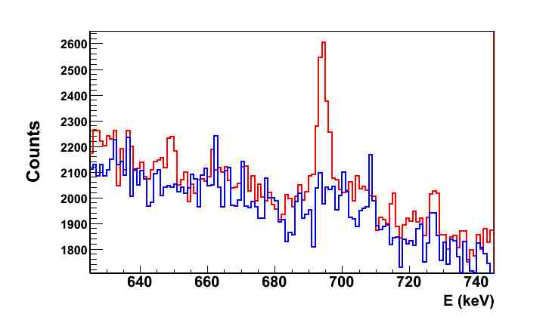
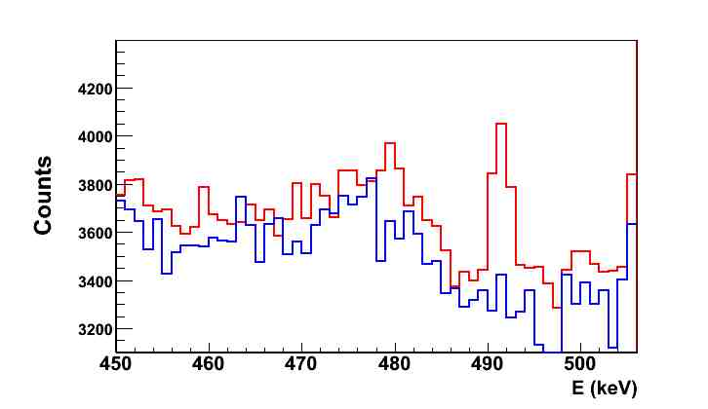
3. The LISOL β-decay setup
Singles γ-spectra : Red: Laser ON Blue: Laser OFF
T_{1/2}=411(32) ms
⁶⁷Fe₄₁
β⁻
694 keV
2054
2080
2087
572
1251
189
(7/2⁻)
T_{1/2}=425(20) ms
⁶⁷Co₄₀
(5/2⁻)
491 keV
694
T_{1/2}=21 s
(1/2⁻)
⁶⁷Ni₃₉
L. Weissman et al., PRC 59, 2004(1999).
Pictures Courtesy D. Pauwels O. Ivanov, KU Leuven (2007)

Slide 66
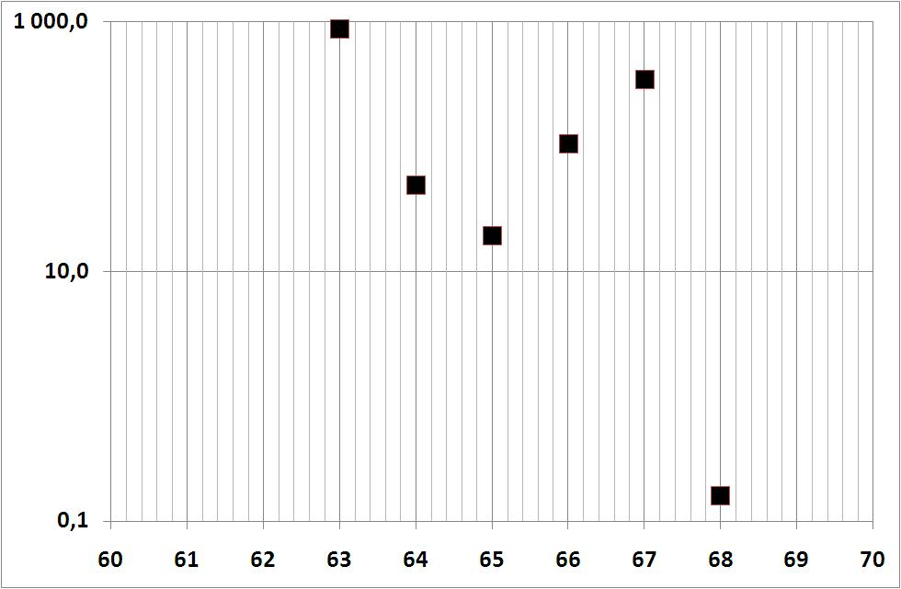
4. Contamination and Yields
2. Conditions for applicability :
? pure sources of radioactive ions
element selectivity
low background
efficient detection system
? low count rate
λ_{Mn}.Y_{Mn} / λ_{Ga}.Y_{Ga}
Yield [ions/s]
A
A

Slide 67
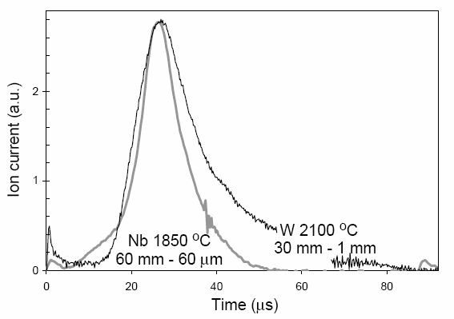
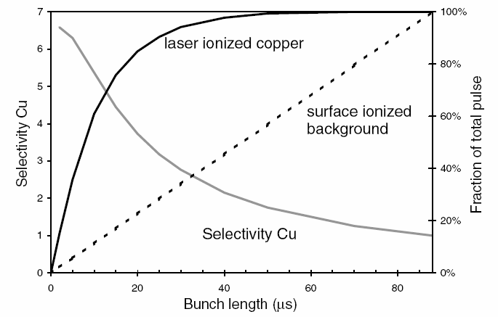
4. Contamination and Yields
2. Conditions for applicability :
? pure sources of radioactive ions
element selectivity
low background
efficient detection system
? low count rate
Pictures taken from U. Koester, These 1999, TU Munchen
Method is exemplified for 67Co isotopes
Yield [ions/s]
MICRO GATING
With fast beam chopper
A

Slide 68
2. Previous experiment (1998) and
Proposed experiment (2008)
1998 : β-decay study at ISOLDE of ^{64,66}Mn
M. Hannawald, PhD dissertation Mainz universitat 1999
Only Single γ’s in time slices of 150 ms after proton impact
No β-gated γ-ray spectra
Two coaxial Germanium detectors
Only γ’s from ^{64,66}Mn were measured (experiment was an “extended target test”)
900-1050 ms
150 ms
0-150 ms
…
…
…
Proton Impact
Time
900-1050 ms
= one measuring cycle
= one block of data
0-150 ms

