Slide 1
Collinear resonant ionization laser spectroscopy of rare francium isotopes
IPN Orsay, IKS Leuven, University of Manchester, New York University and University of Birmingham

Slide 2
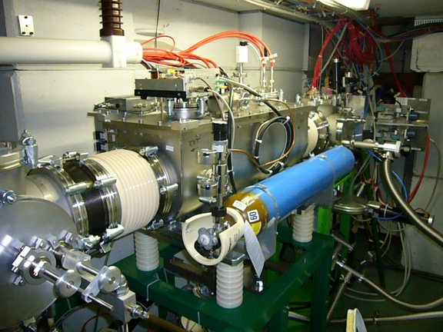
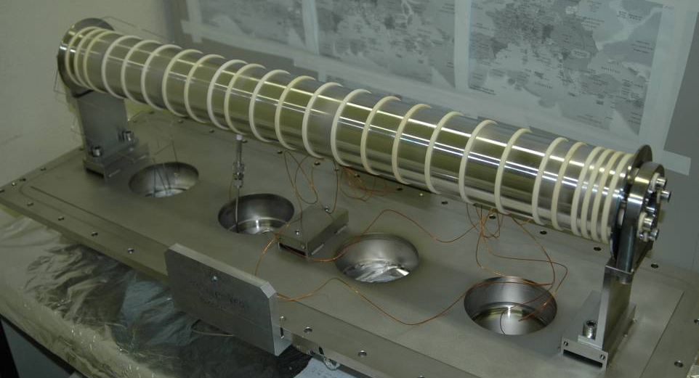
The first dedicated ISCOOL experiment
This proposal aims at pushing the limits of laser spectroscopy sensitivity.
To measure for the first time cases with yields of only 1 atom per second.
ISCOOL is essential to realize this project, by providing bunched ions beams.

Slide 3
Outline of proposal
New innovation in laser spectroscopy.
Ultra-high sensitivity and efficiency combined with high resolution.
New semi permanent beam-line.
New pulsed laser laboratory.
New versatile method of producing clean beams for decay spectroscopy.
Capability to study single atom yields even with large isobaric contamination

Slide 4
Physics Motivation:Francium
Initial case which forms part of larger study of this region of the nuclear chart.
Deformed (oblate) intruder π(s_{1/2}) state believed to be ground state of ¹⁹⁹Fr, and isomeric state in ^{201,203}Fr.
^{218,219}Fr border of region of reflection asymmetry, yielding important information on the transition from spherical to octupole-quadrupole deformed nuclear structure.

Slide 5
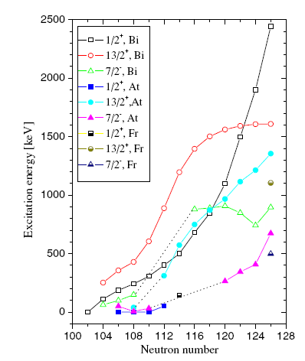
Intruder levels and large deformation in neutron deficient francium
Systematic reduction in energy of the
Deformed π(1/2+) in isotopes in
This region of the chart
7/2⁻
1/2⁺
1/2⁺
7/2⁻
π(1/2+) proton intruder state becomes the ground state in 195At and 185Bi
9/2⁻
9/2⁻
²⁰¹Fr
²⁰³Fr
The isomer shifts of ^{201,203}Fr
And their magnetic moments
will provide important
information to better
understand the evolution of
nuclear structure in this region.
Suggests that ¹⁹⁹Fr has
I=1/2⁺ ground state spin
with an associated large
oblate deformation.

Slide 6
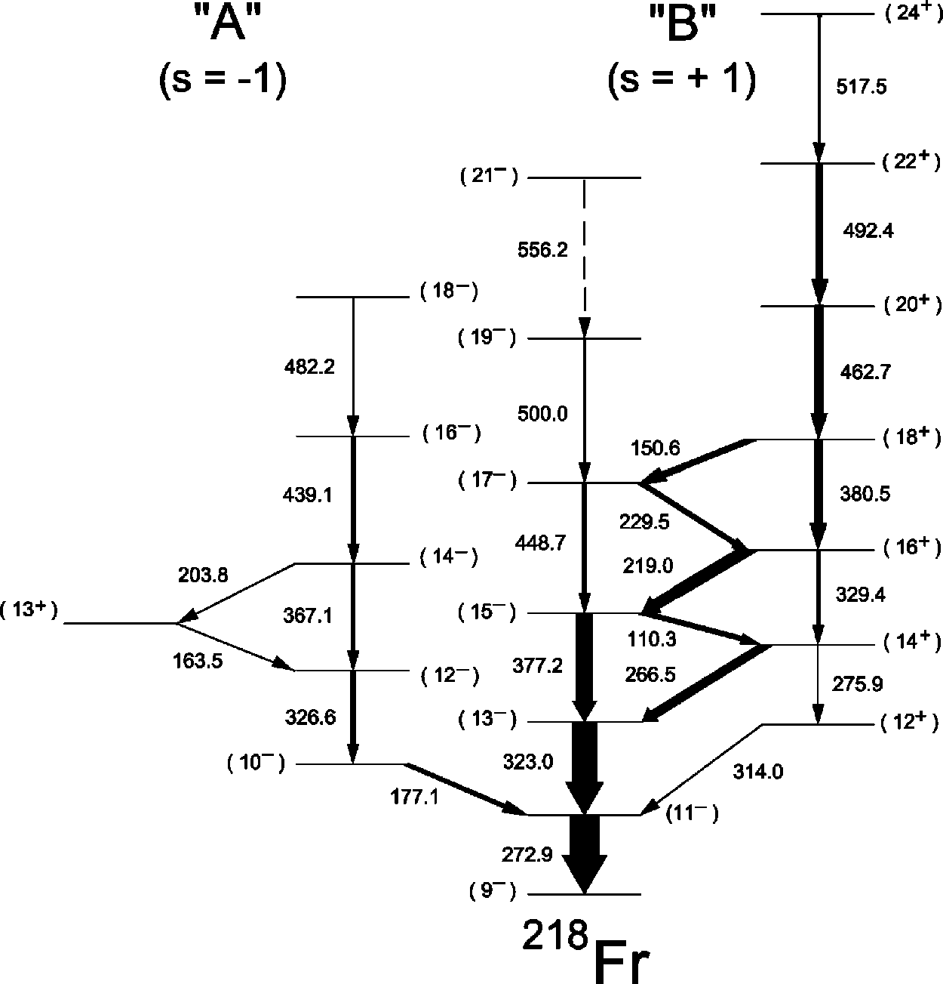
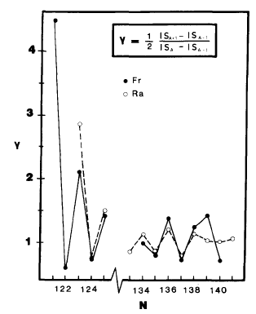
Border of the region of reflection asymmetry
Region characterised by reversal in odd-even staggering, which is attributed to presence of octupole-quadrupole deformation.
Also characterised in the interleaving alternating band structure connected by enhance E1 transitions

Slide 7
Previous and proposed isotopes
1
10²
10⁵
10⁶
10⁷
10⁶
10³
201
202
203
204
205
206
207
208
209
210
211
212
213
214
intruder 1/2+
isomer
Previous measurements
10³
10⁴
10⁴
10³
218
219
220
221
222
223
224
225
226
227
228
229
230
Region of reflection asymmetry

Slide 8

Beyond francium
Surrounding isotones Ra and Rn to complete the description of the π(1/2)⁺ level and border of region of reflection asymmetry.
Bi isotope chain out to ²¹⁸Bi (yield of 10³) and possibly even further from N=126.
Quadrupole moments and spin assignment in neutron deficient Po, Bi and Pb isotopes. Providing a full description of the shape evolution in this region.
Shape transitions beyond N=126

Slide 9
Nuclear Information from laser spectroscopy
Coupling of nuclear and atomic total angular momentum vectors giving rise to a hyperfine splitting of the atomic transitions.
It is possible to extract nuclear observables from these measurements without introducing nuclear model dependence.
Unambiguous assignment of the nuclear spin, nuclear moments and changes in charge radius across an isotope chain.
High resolution laser spectroscopy techniques are required to resolve the full structure.

Slide 10

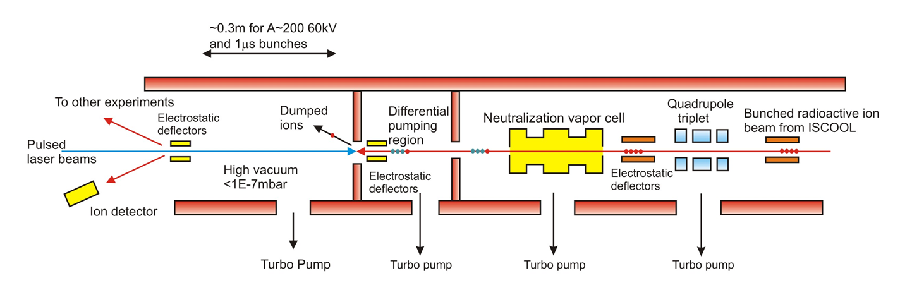
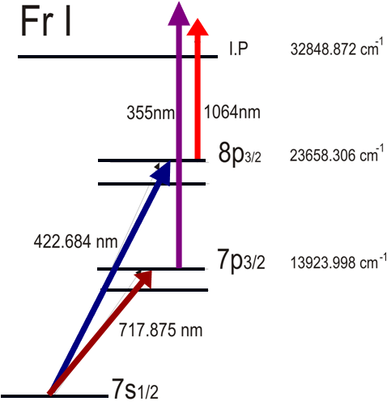
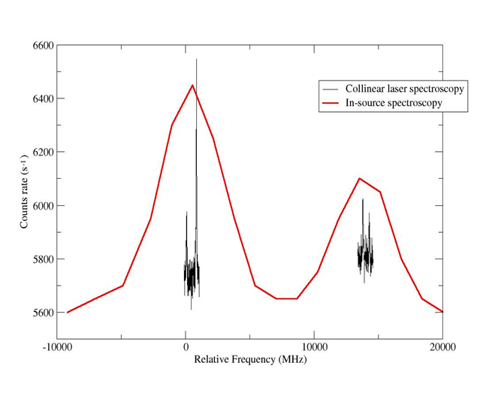
CRIS beam line and method
Combining high resolution
nature of collinear beams
method with high sensitivity
of in-source spectroscopy.
Allowing extraction of
B factors and quadrupole
moments.
⁶⁸Cu
Relative Frequency (MHz)

Slide 11
Collinear resonant ionization laser spectroscopy (CRIS)
RIS performed on a fast atomic bunched beam.
Pulsed Amplified CW laser has a resolution which is Fourier limited to π/t (dye).
Background events are due to non-resonant collisonal ionization, which is directly related to the vacuum
Very high total experimental efficiency
  Neutralization 50-90%
  Ionization efficiency 50-100% (no HFS)
  Detection efficiency almost 100%
  Transport through ISCOOL 70-80%
  Transport to experiment 80-90%
1:30 From Jyvaskyla off-line tests
( K. Flanagan, PhD)
Up to 50% efficiency possible

Slide 12
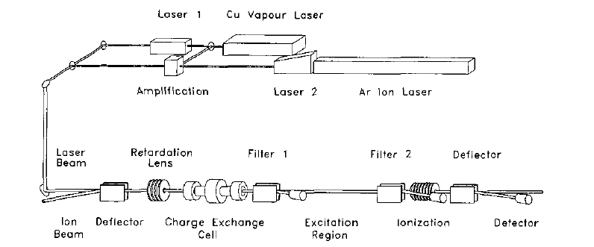
Previous CRIS of Yb at ISOLDE
Ch. Schulz et al., J. Phys. B, 24 (1991) 4831
Charge exchange efficiency into meta stable states
Below saturation on second step
CW beam and duty cycle losses due to lasers
Total efficiency
1:100 000
Previous work limited to yields
greater than 10⁷ ions/μC

Slide 13
Limiting factors:Efficiency and isobaric contamination
From the ISCOOL tests in November a limit of 10⁸pps were trapped and measured on an MCP.
Conservative efficiency of 1:30 (number from Jyvaskyla work) and a pressure of 10⁻⁹ mbar and a high isobaric contamination of 10⁷ (expect much lower).
Background suppression:
Pressure 10⁻⁹ mbar = 1:200 000
Detection of secondary electrons by MCP
Alpha decay detection allows removal of all isobaric contamination (50-100cts/s)
Limited to > 100pps
Limited >5pps
With 50% efficiency and signal limited noise regime = 0.3pps
This underlines the importance of improving
beam purity for future HIE-ISOLDE and ISCOOL work

Slide 14
Logistical planning
2008-2009
Finalize technical design and commence construction of beam line components March/April 2008
Purchasing and shipping of equipment to CERN Summer 2008
Installation of equipment winter shutdown 2008
Initial off-line optimization March/April 2009

Slide 15
Break down of beam time request
Year | Run | Isotopes | Number of shifts | Preparation requirements
2009 | 1 | 206-203 | 11 | 1 shift for Tl/Fr optimization
2010 | 2 | 218,219 | 9
2010 | 3 | 202,201 | 12
Total of 33 shifts requested over 2
year period.
Run 1. will work with ground state
yields between 10⁷-10⁵pps
Thank you for your attention

Slide 16
Available resources
Manchester: 2 Academics, 1 postdoc, 2 PhD students, 2 Technical staff.
Leuven: 1 Academic, 2 postdocs, 2 PhD students.
Orsay:2 Academic, 1 postdoc, 1 PhD student.
Birmingham: 1 Academic, 1 postdoc, 2 PhD students.
Total of 20 people

Slide 17
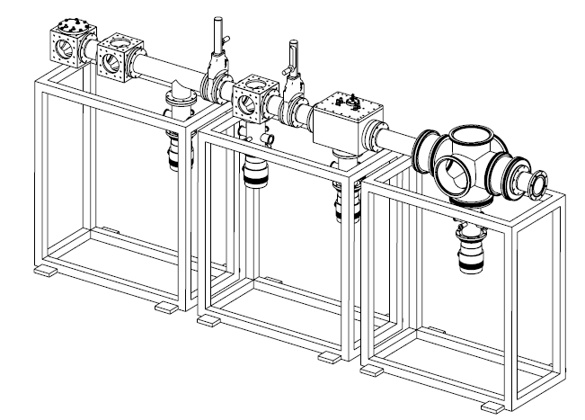
Technical Drawings
Preliminary

Slide 18
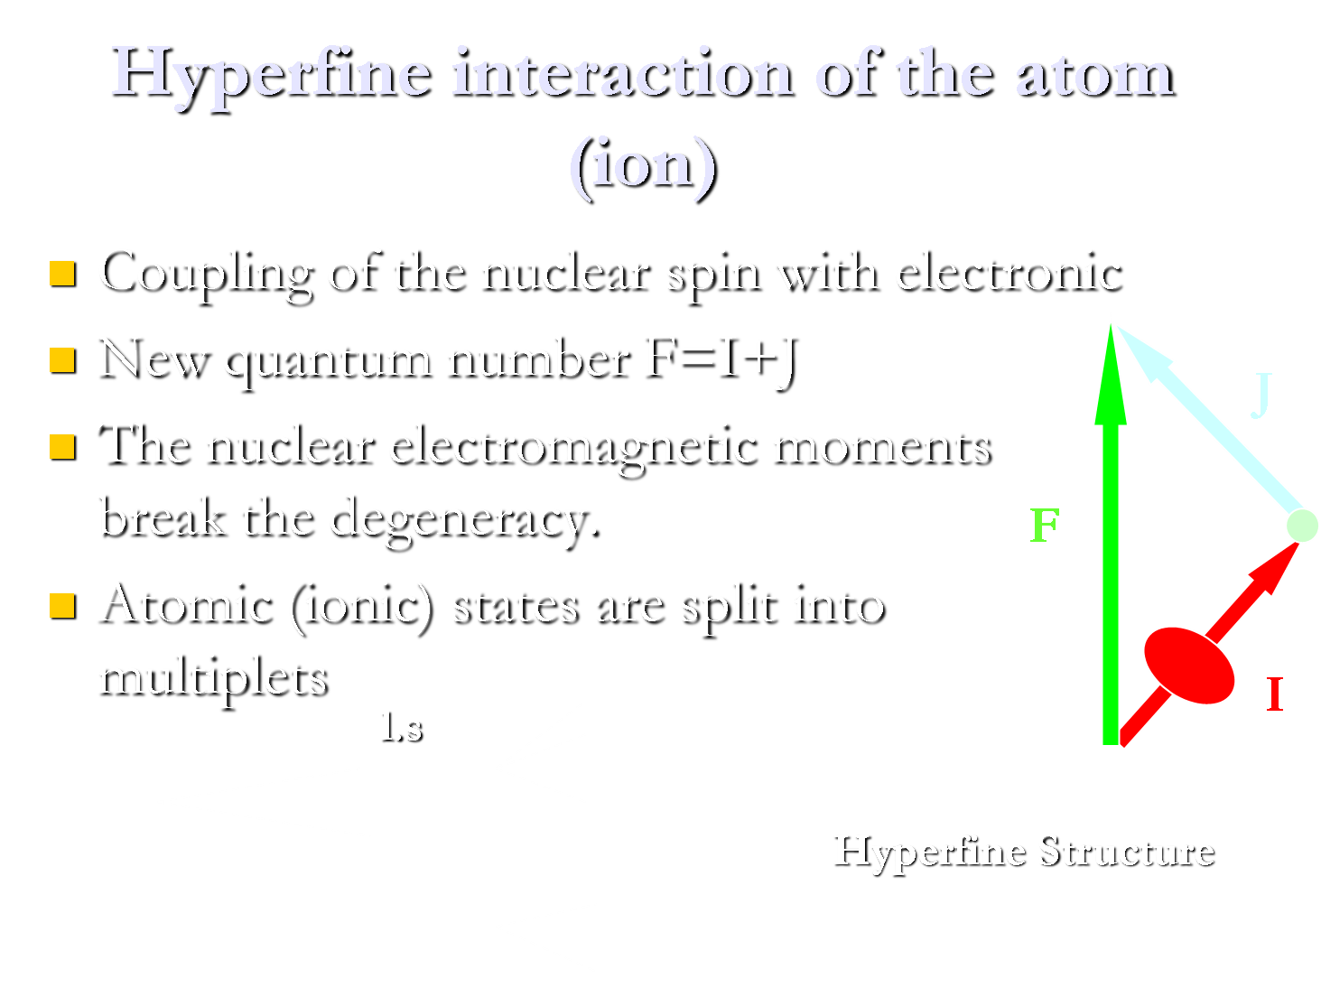

Slide 19
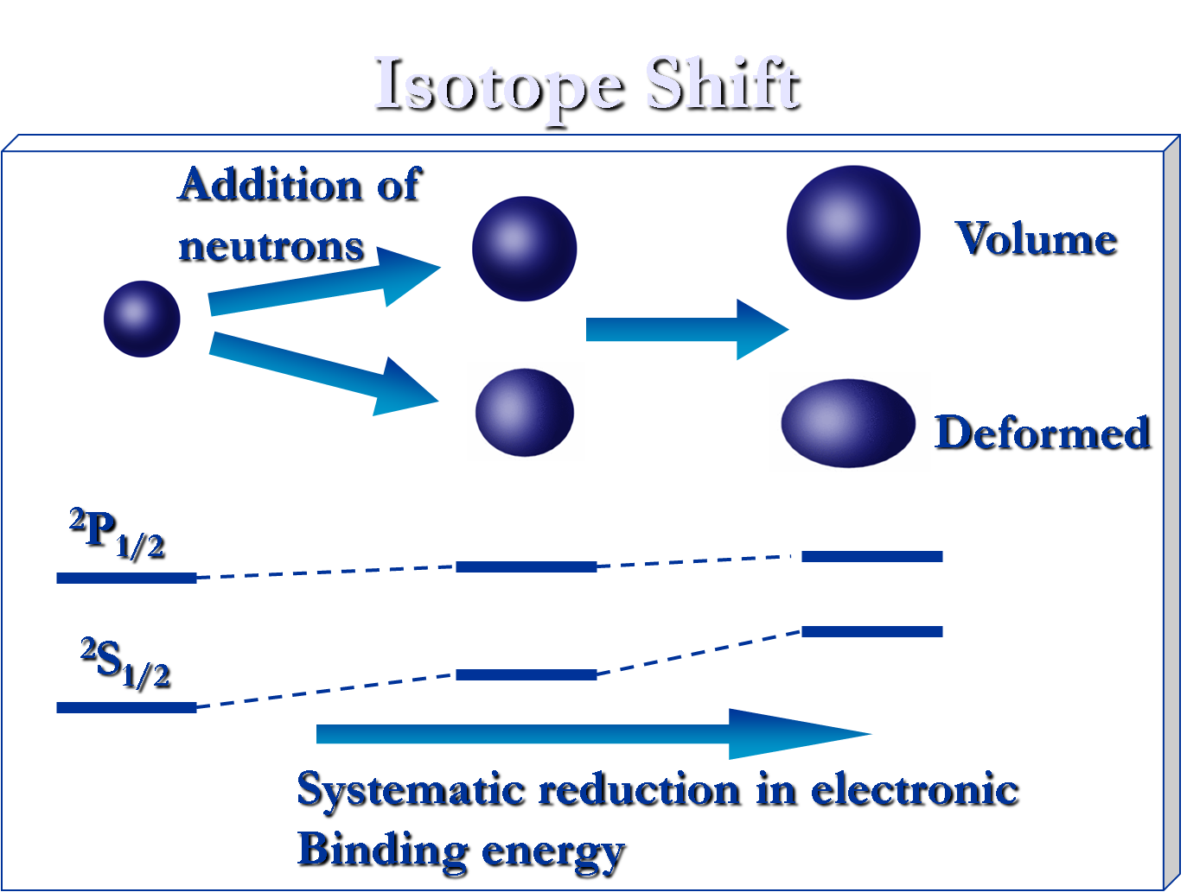

Slide 20
Signal to noise: Limits of detection
Signal Noise Ratio (SNR) > 5 for total confidence in laser spectroscopy.
SNR =(S/√(S+B))*√t where S is the signal rate, B is the background rate and t is the time in seconds
By eliminating the background the SNR reduces to √(S*t) which presents the ultimate limit on the time it takes to collect data.

