Slide 1




High Resolution optical spectroscopy in isotopically-pure Si using radioactive isotopes: towards a re-evaluation of deep centres
Mike Thewalt¹, Karl Johnston^{2a}, Martin Henry³
¹Dept of Physics, Simon Fraser University, Burnaby, British Columbia, Canada, V5A 1S6
²PH Dept, CERN, 1211 Geneva 23
³School of Physical Sciences, Dublin City University, Glasnevin, Dublin 9, Ireland
ªSpokesperson and Contact Person at ISOLDE

Slide 2
OUTLINE
Motivation for studying defects in semiconductors
Optical characterization of materials
Avogadro project
Optical Spectroscopy in isotopically pure Si: new information on old systems
What we want to look at here (¹⁹⁵Au)

Slide 3
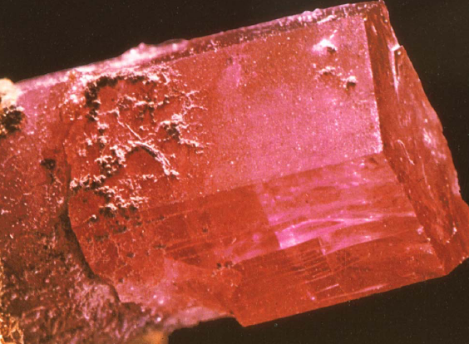
Quick Demonstration of the effect of impurities in materials I: Al₂O₃:Cr

Slide 4
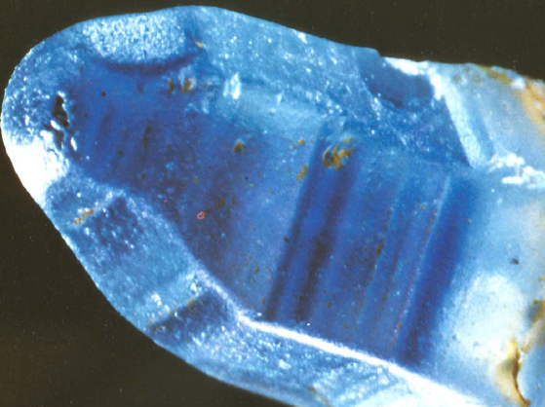
Quick Demonstration of the effect of impurities in materials II: Al₂O₃:Fe

Slide 5
Defects in semiconductors
Control of impurities in materials such as semiconductors important, nay vital.
Recently much of the focus has been on compound semiconductors such as ZnO etc because of their relevance for optoelectronics and new areas such as spintronics.
Si, although the pre-eminent semiconductor material, shouldn’t be regarded as a closed book.
Experiments using isotopically-pure material are casting new light on old results.
For the purposes of this proposal the experimental method used will be photoluminescence (PL)

Slide 6
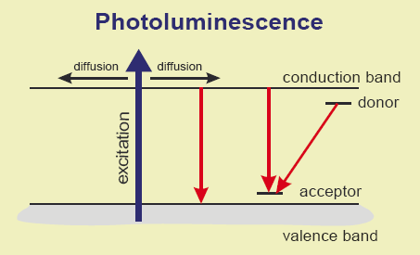
PL Characterisation of Semiconductors

Slide 7
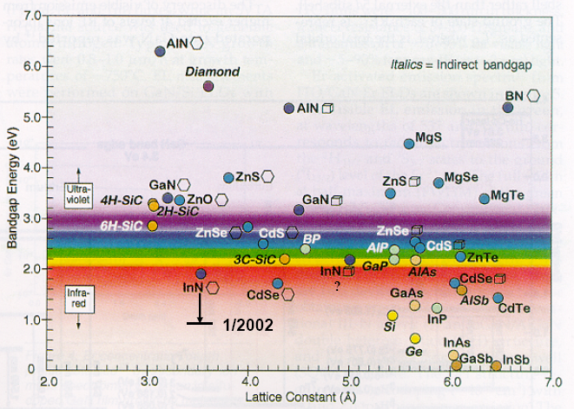
PL Characterisation of Semiconductors

Slide 8
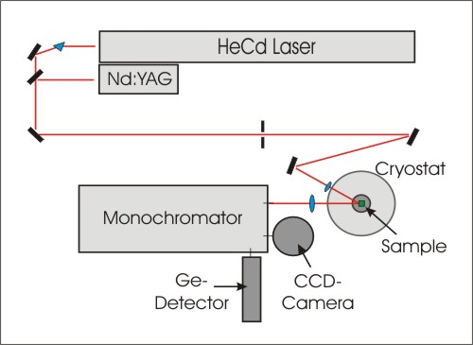
Typical PL apparatus

Slide 9
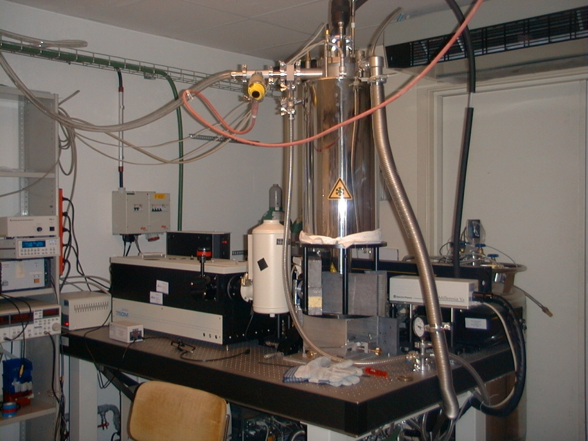
Typical PL apparatus

Slide 10
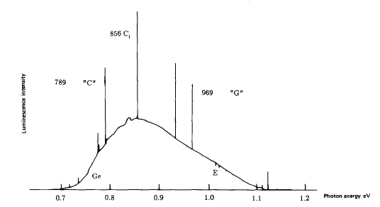
Example of typical PL spectrum from Si
Example of “deep” centre
Si band edge (1.1eV)
Taken from Davies Physics Reports 176 3&4(1989)

Slide 11
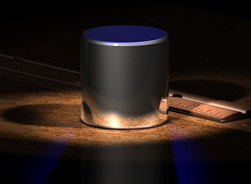
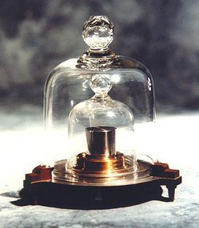
Interlude I: Avogadro project
Physical units are now defined in terms of measurable quantities rather than the artifacts of yore.
The remaining exception to this is the kilogram, which is still defined in terms of a Pt-Ir cylinder in Paris.
Now however, there is a project which aims to re-define the kg in terms of the number of atoms of Si in a sphere: the Avogadro project. Desired accuracy 4μg!!!!

Slide 12
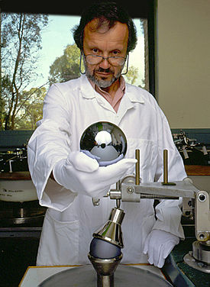



Avogadro Project: define kg in terms of number of Si atoms
Count the number of atoms using the X-ray crystal density molar mass method (XRCDMM).
Use a sphere of mono-isotope Si (²⁸Si)
Unexpected by-product of this is being able to study the pure mono-isotope Si using normal optical techniques and see if there are any differences between it and natural material: there are!!!!!!!!

Slide 13
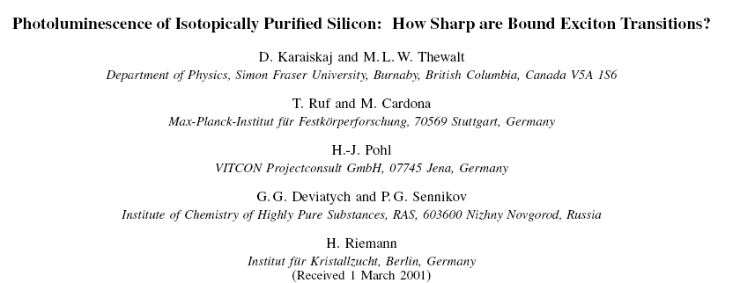
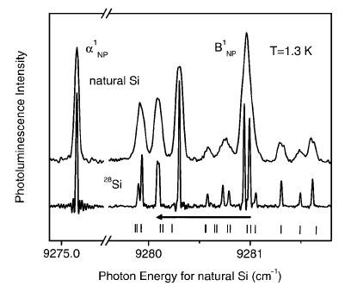
First thing that is striking about the pure material is the sharpness of the optical features
Si normally found in the ratio:
²⁸Si: ²⁹Si : ³⁰Si (92.23 : 4.68 : 3.09)
The pure material has optical features which can’t be resolved even with a state of the art Fourier transform spectrometer (0.014cm⁻¹).
Bound excitons involving P and B sharpen up considerably.
Also get information on the indirect band gap etc, but the real surprise was sharpness of optical features.
Karaiskaj et al PRL 86 (26) 2001
This sharpness allows one to see isotopic effects in much more detail than before, and from this, obtain new data.

Slide 14
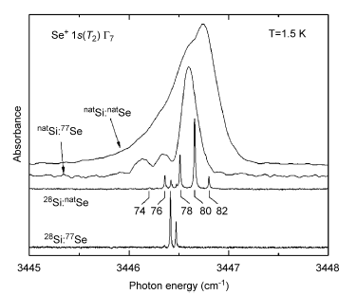
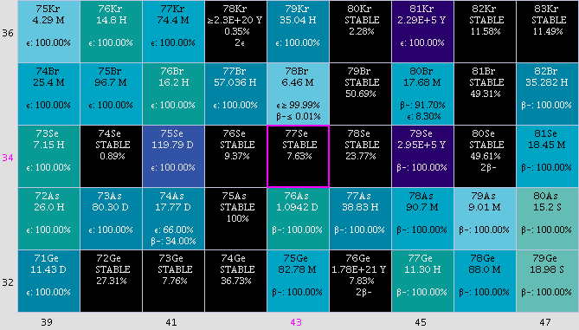
Again, similar behaviour for Se, a donor in Si.
Enables fine structure to be obtained, split in accordance to the natural distribution of Se in nature.
Also, when utilizing the nuclear spin of ⁷⁷Se, get hyperfine splitting in the ground state.
Possible applications in quantum computing?
Thewalt et al Physica B 401-402 587(2007)

Slide 15
Cu in Si: an old problem
Cu is a VERY fast diffuser in Si. At 900C the diffusion coefficient is more than 7 orders of magnitude greater than O₂.
As such, it has been a bane on the processing of Si since the 50s; it is nearly always present to some degree.
Cu leads to an optical feature at 1014meV. Triply-degenerate ground state (Γ4); doubly-degenerate excited state (Γ3).
In addition, there is a vibronic sideband with quanta of 7, 16.4 and 25.1 meV which results in a relatively complex spectrum.
The structure of this band has been the subject of quite a bit of work and two competing models are favoured: Cu pair (Cu_{s}-Cu_{i}) or a single substitutional Cu centre.

Slide 16
Cu in Si: Typical PL spectrum

Slide 17
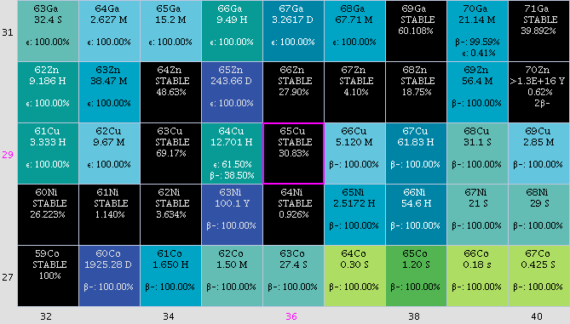
Interlude II: Cu isotopes
As the lines are so sharp, we can play some games in this pure Si

Slide 18
Cu in ²⁸Si: features sharpen up incredibly.
Spectrum below is a mixture of diffusion and introducing enriched ⁶³Cu and ⁶⁵Cu.
(Thewalt submitted to PRL (2008))

Slide 19
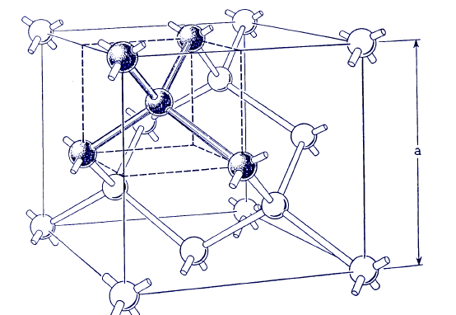
Surprising results!!! Need to re-think our knowledge on deep-levels in Si
The complexity of the results shown can not be explained by the previous model of only 2 Cu atoms
Need to invoke at least 4 Cu atoms to explain these data, based on the isotopic breakdown etc
These data are new: Exact model still unknown (for that perturbation techniques would be required)
However, it is apparent that metal impurities in Si are perhaps less understood than previously thought.
Look now at Ag and Au

Slide 20
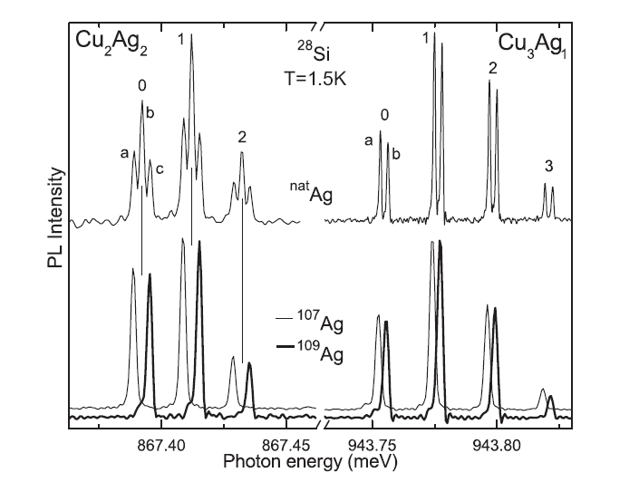
Ag in Si:
Optical feature previously thought to involve only Cu is shown to contain Ag also.
In particular 2 Cu atoms and 2 Ag ; 3 Cu and 1 Ag. (additional signal due to 4 Ag atoms).
What’s the big deal???
These impurities are produced even at low temperatures:
Surprising that complex “families” of impurities can “organize” themselves in this way.
Consequences for future applications of semiconductors: spintronics etc.
(Thewalt submitted to PRL (2008))

Slide 21
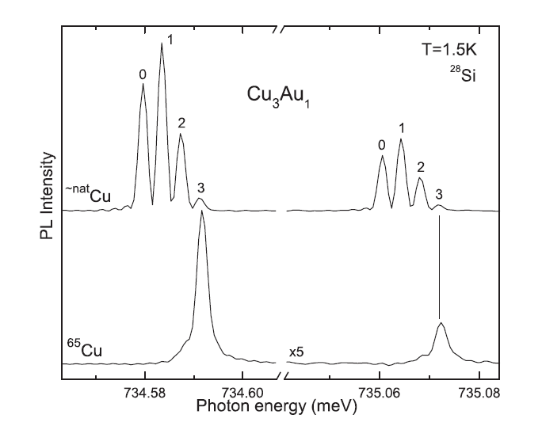
Where we’d like ISOLDE to help:
Au is probably the most-studied metallic defect in Si.
A centre previously thought to be due to Fe is revealed to originate from Cu and Au.
Preliminary data suggest that centre is also multi-atom i.e. Cu₃Au, but other possibilities of Au_{n} are hard to check: why?
Have Cu₄; Cu₃Ag₁; Ag₄, Cu₃Au; Au₄????????
(Thewalt submitted to PRL (2008))

Slide 22
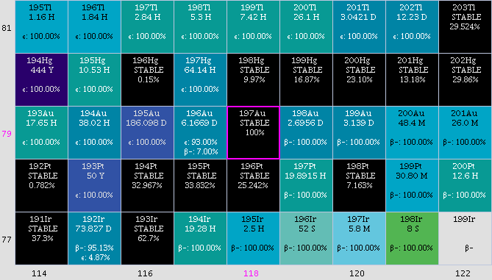
Problem: only one stable isotope of Au, but ¹⁹⁵Au can be obtained at ISOLDE

Slide 23
Request for this proposal
6 shifts of ¹⁹⁵Hg → ¹⁹⁵Au.
Obtainable through 2 means (as below). Half-life is ~ 186d enables us to do spectroscopy on the isotope as if it were stable. (also radioactive double-check).
Allows several samples to be made, with varying concentrations of ¹⁹⁵Au and ¹⁹⁷Au.
Samples will then be shipped to Canada for the PL measurements.
Possibility of new data on variety of isotopes in semiconductors may be offered: will require optimizing of the PL system at ISOLDE.
Unique opportunity to probe this new “class: of impurities in Si.
Isotope | Half-life | Implantation energy (keV) | Target | Ion Source
195Hg →195Au→ 195Pt | 40h/186d | 60 (or less) | Molten Pb | Plasma
195Pb→ 195Ti → 195Hg →195Au→ 195Pt | 15m / 186d | 60 (or less) | UCx | RILIS

