Slide 1



Future High Energy Collider Options
and Physics Prospects
Albert De Roeck
CERN, Geneva, Switzerland
Antwerp University Belgium
UC-Davis California USA
IPPP, Durham, UK
BUE, Cairo, Egypt
23th June 2014 Amsterdam

Slide 2

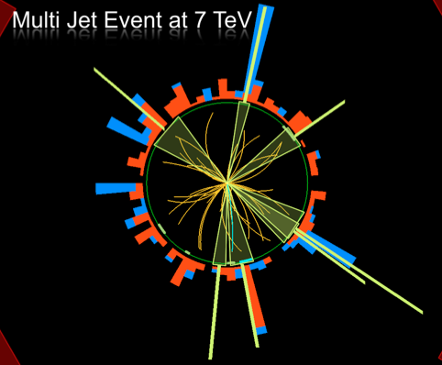
Outline
Introduction: Discussion on
the Future.
LHC schedule for the next
years of operation
LHC upgrade plans/projects
Beyond the LHC: where do
we go from here?
Conclusion

Slide 3
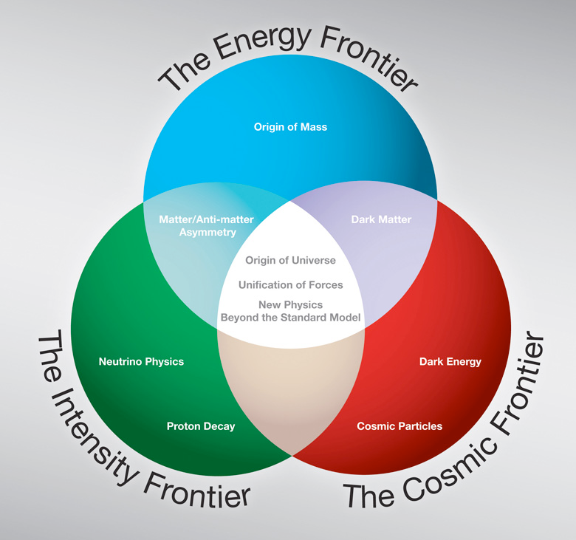
The Three Frontiers
Evaluated in all
regions: Europe
Asia, the Americas
2012-2014
•European strategy group
•Snowmass study and P5
•Japan strategy group
Recent released P5 report
much in accord with Europe
Will concentrate here on the Energy Frontier

Slide 4
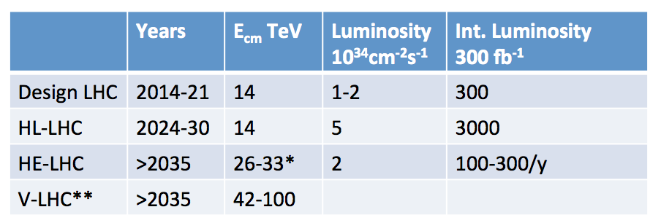
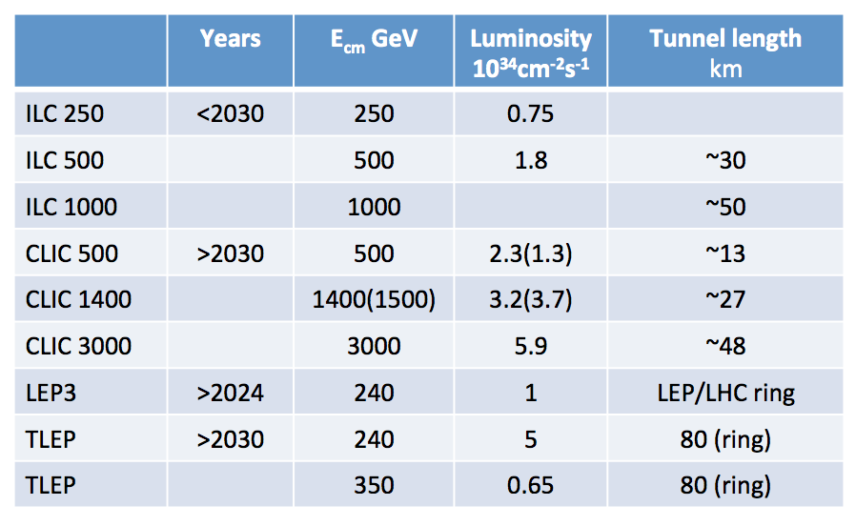
Projects Discussed in 2012/2013
pp colliders
e+e- colliders
+ proposals for photon colliders, muon collider,..

Slide 5
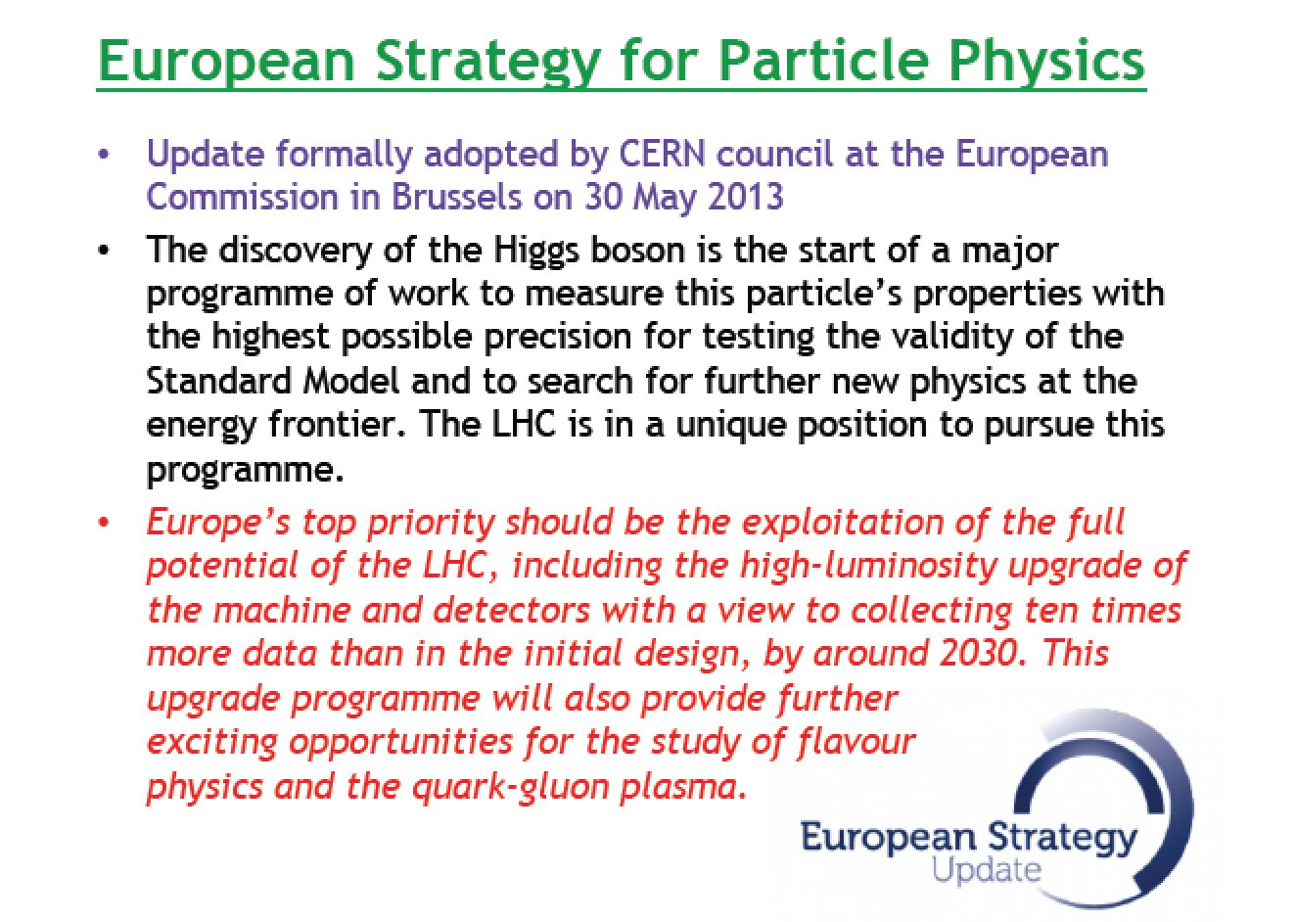
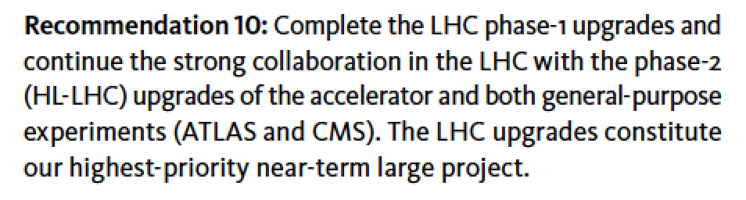
Europe Strategy Group and P5
Last Spring: European
Strategy Group
Last Month: P5
First recommendation on the list that is naming a project

Slide 6
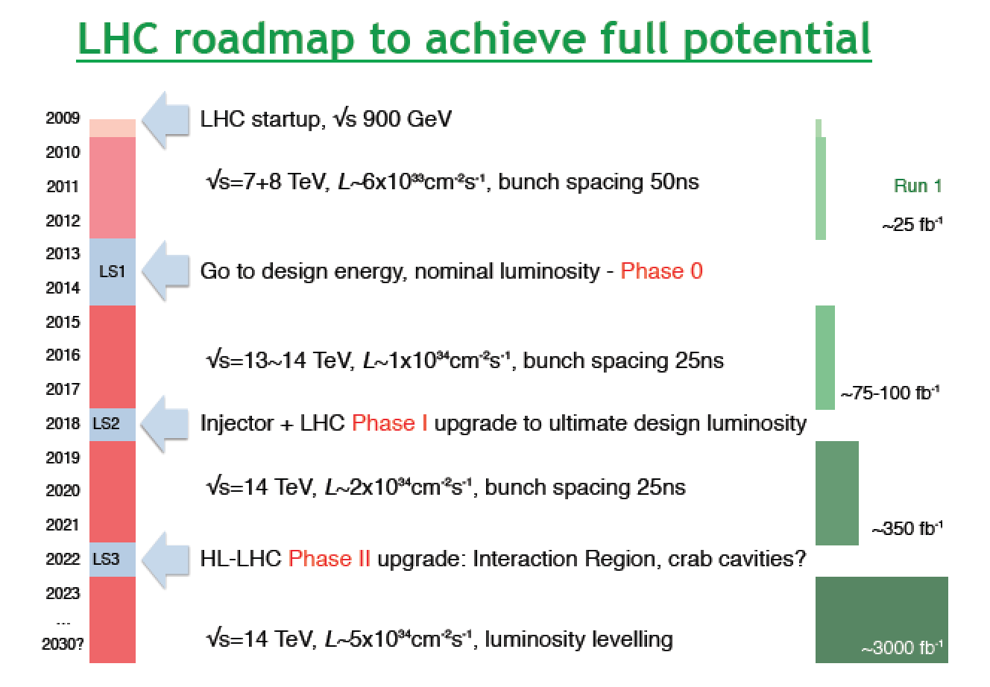
The LHC Schedule

Slide 7
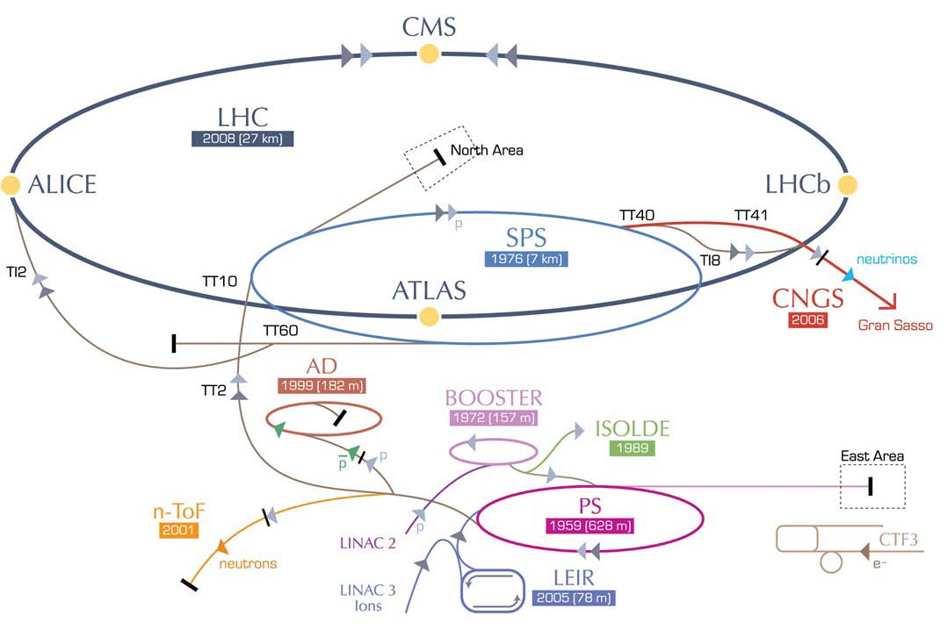
High Luminosity LHC (HL-LHC)
IR upgrade(detectors,
low-β quad’s,crab cavities, etc)
~2022
F. Zimmerman
SPS enhancements
(anti e-cloud coating,RF,
impedance), 2012-2022
Booster energy upgrade
1.4 → 2 GeV, ~2014
Does not come for
free: ~1,000 MCHF
(F Zimmerman
Sendai, June 2013)
Linac4,
~2014
+ Detector Upgrades

Slide 8
Beyond the LHC
•Proton-proton machines at higher energy…
•Electron-positron machines for high precision…
•Both? And allowing for electron-proton collisions..?
New projects will take 10-20 years before they turn
into operation, hence need a vision & studies now!

Slide 9

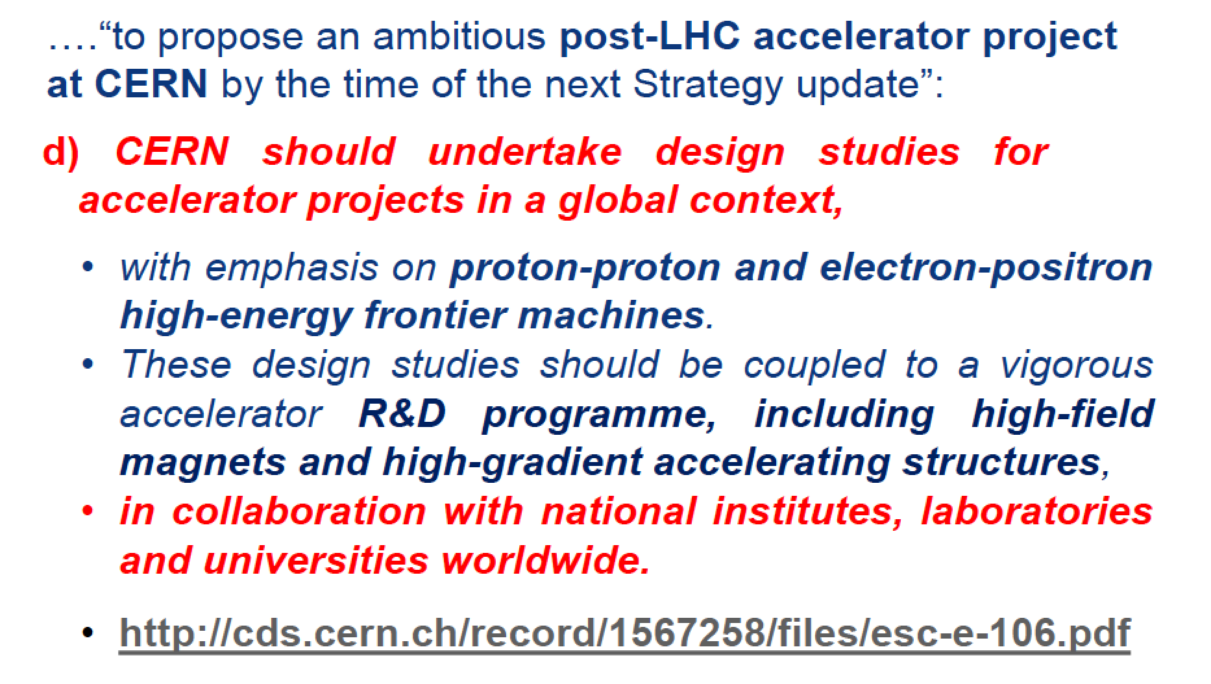
From the European Strategy Group
Similar recommendation from the Snowmass studies in the US

Slide 10
High Energy LHC (HE-LHC)
HE-LHC
2030-35
SPS+,
1.3 TeV, 2030-33
2-GeV Booster
Linac4

Slide 11
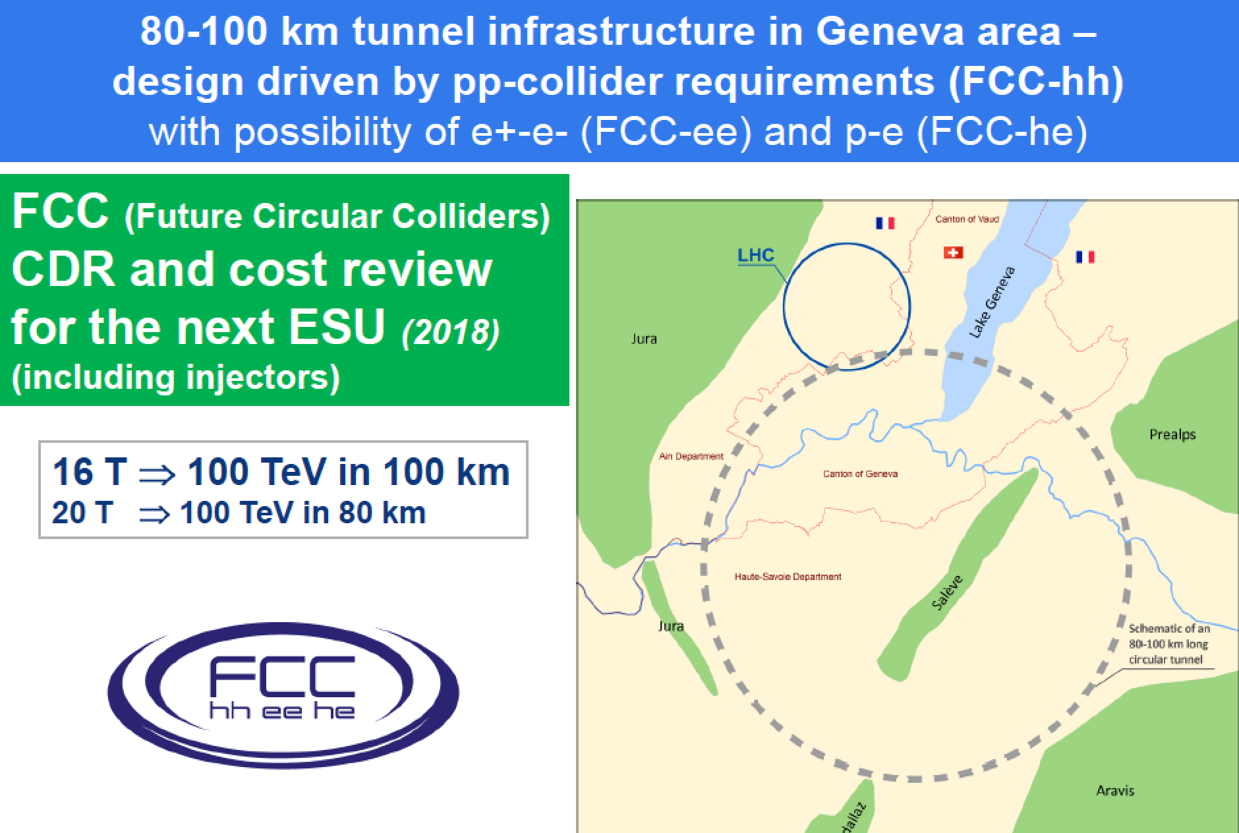
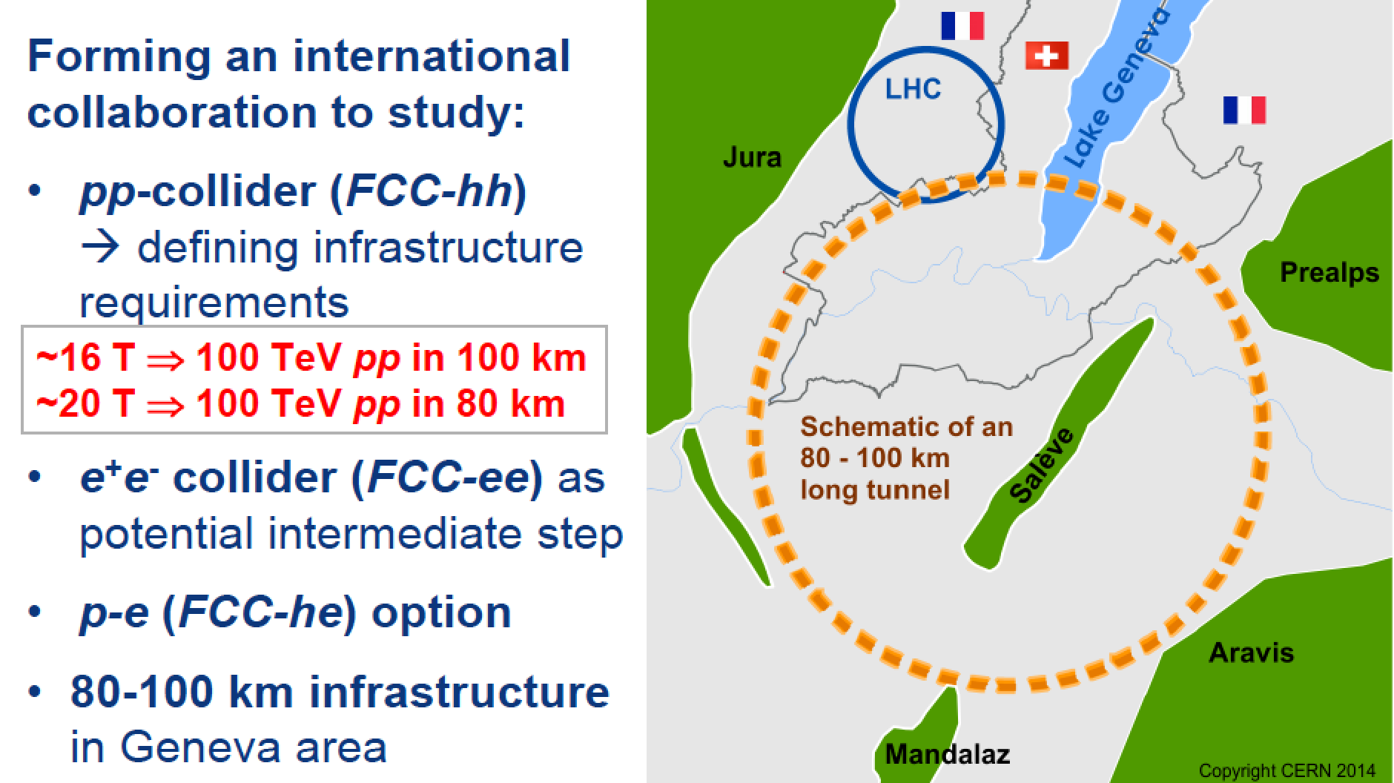
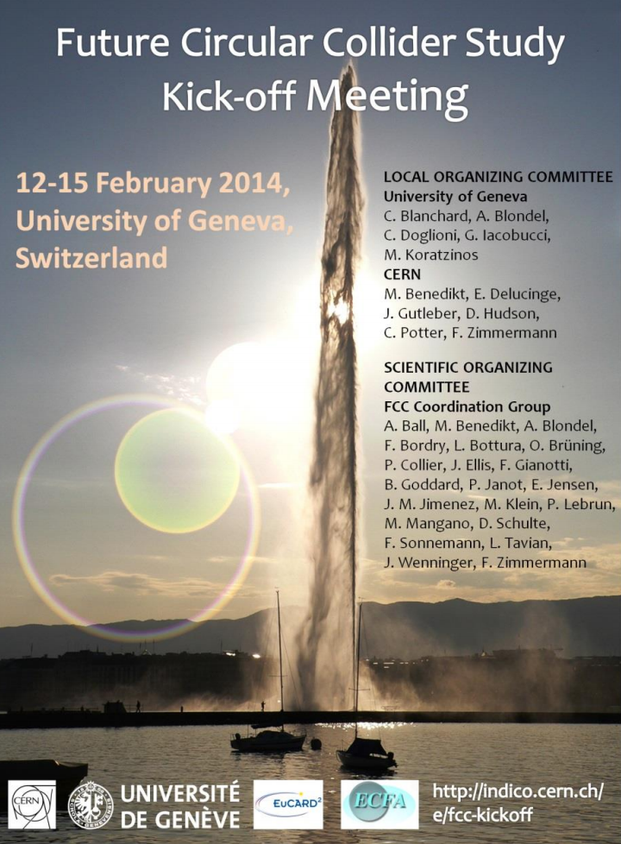
Recent CERN Initiative: FCC
Future Circular Colliders:
Plan: CDR and cost estimate in 2018

Slide 12
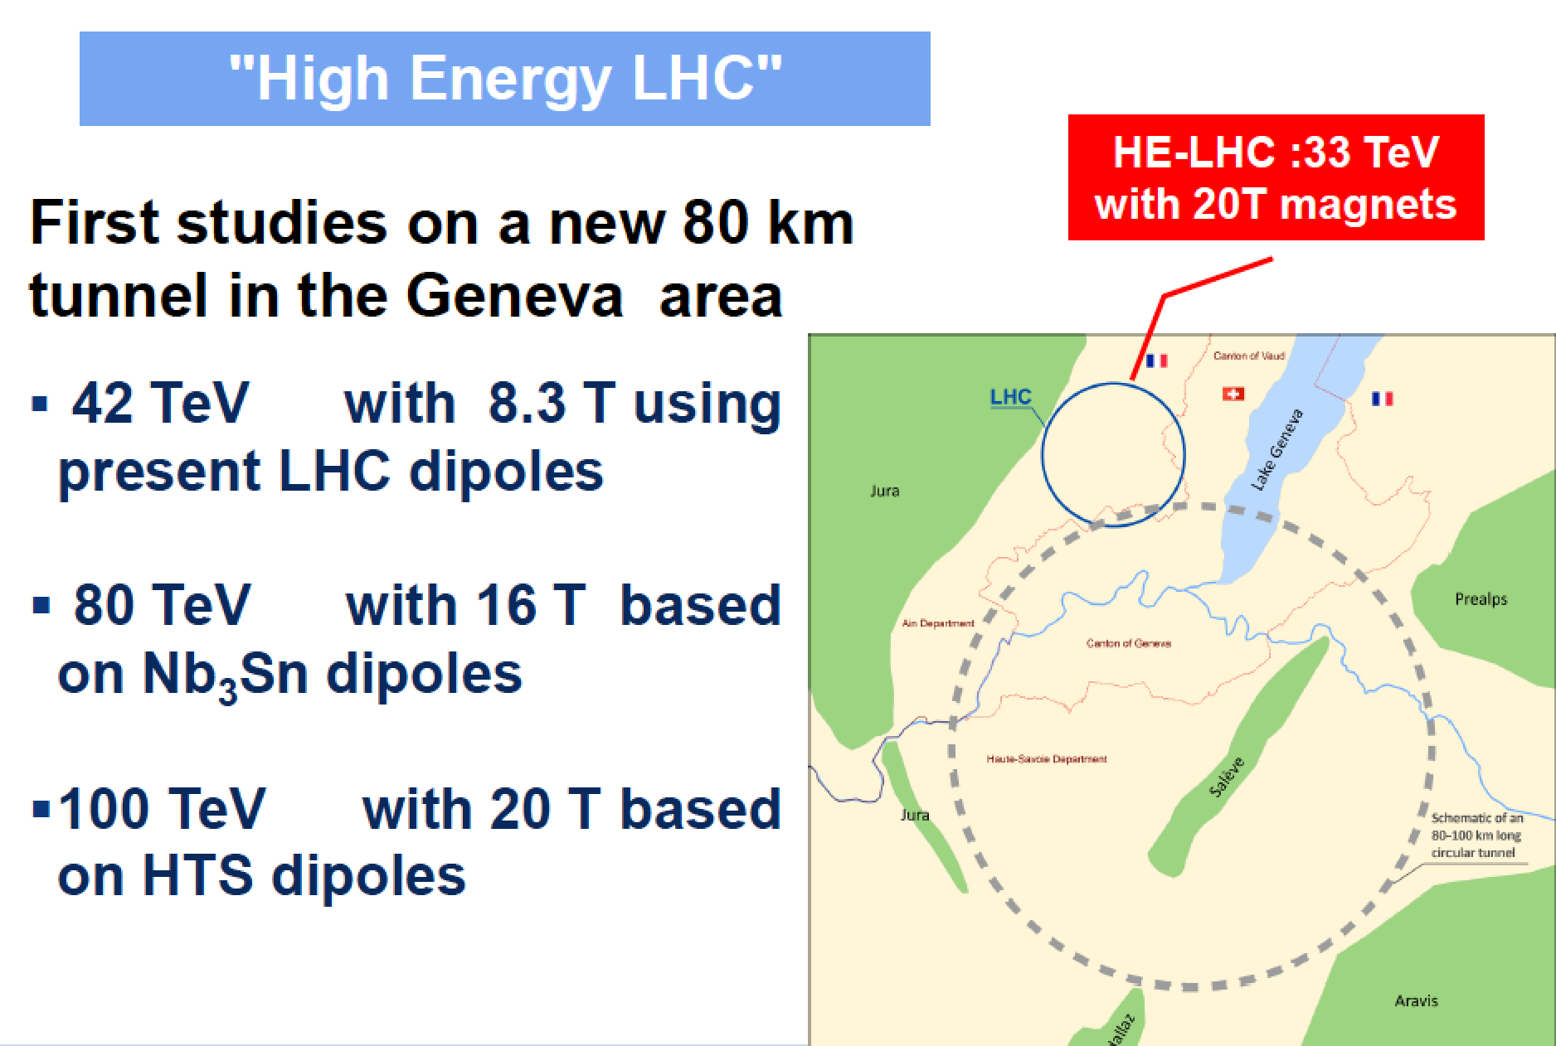
FCC-hh: a Proton-Proton Collider

Slide 13
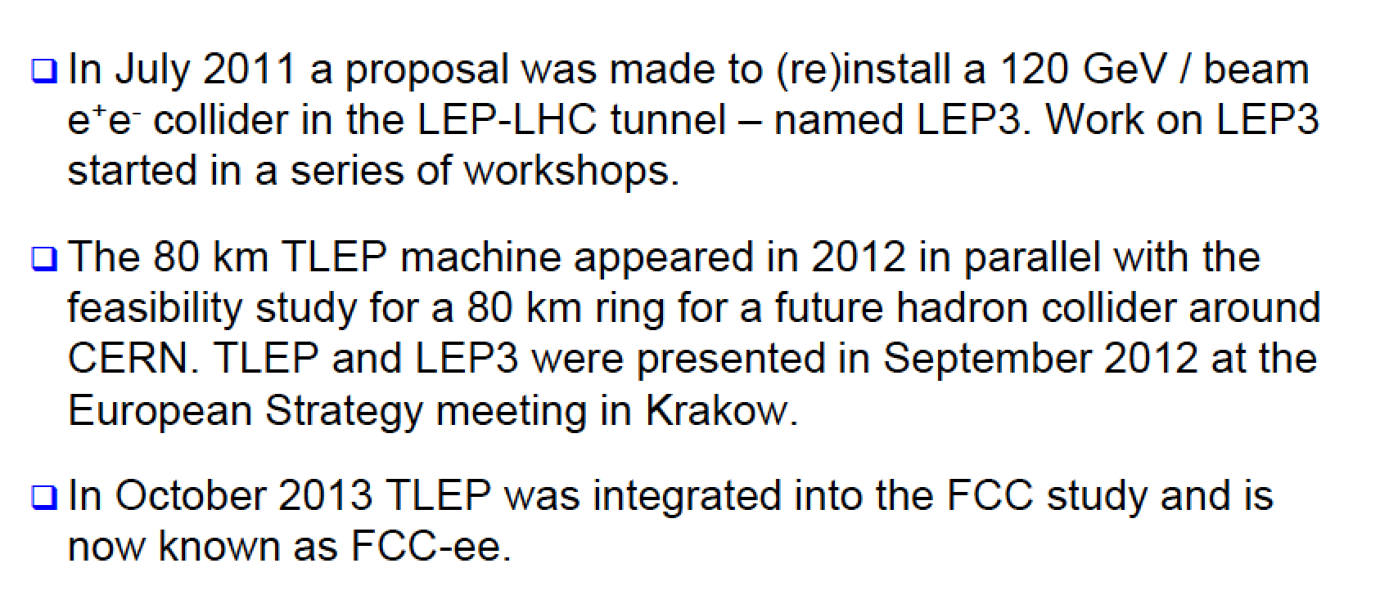
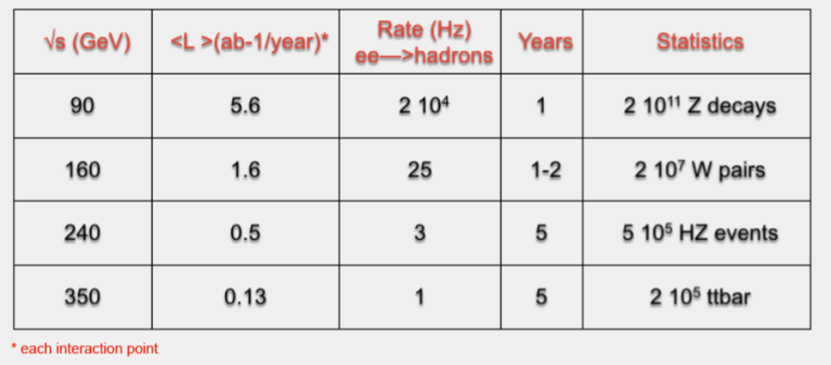
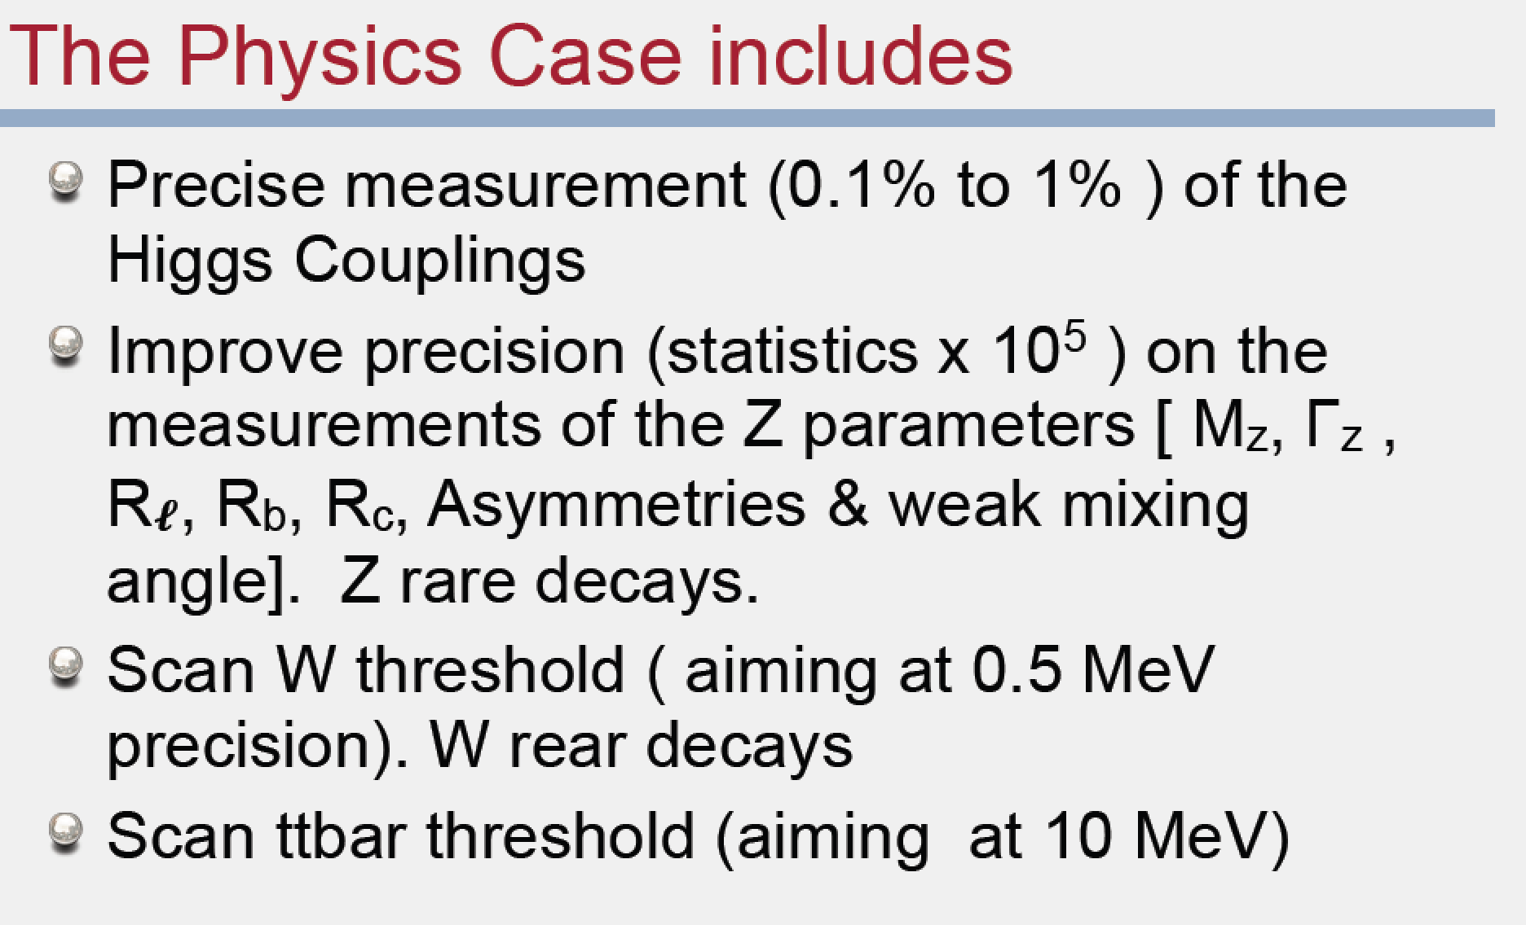
FCC-ee: the Electron-Positron Option
Circular e+e- collider
with √s energy in the
range of 90-350 GeV
Can serve 4 experiments
simultaneously!
Challenging but no
showstoppers!! (2 rings)
Energy loss/turn ~ 11 GeV
Tera-Z, Giga-W, Mega-H, Mega-top

Slide 14
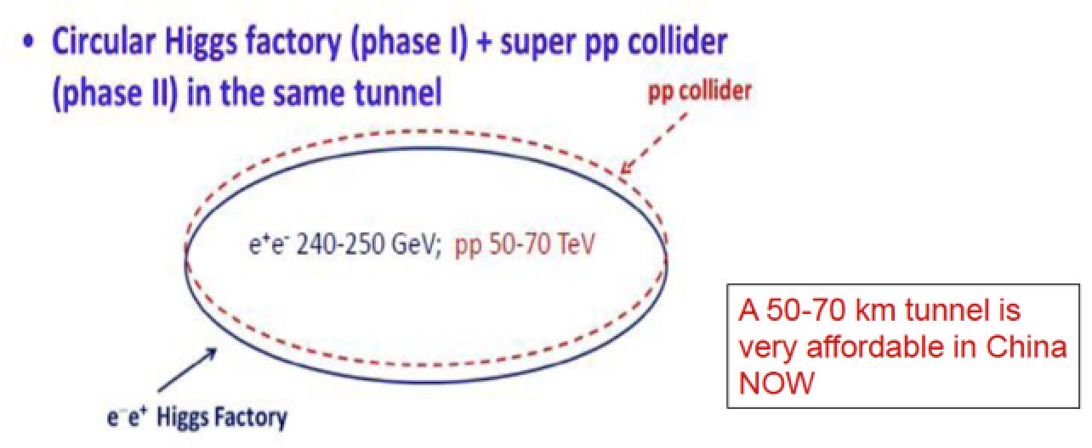
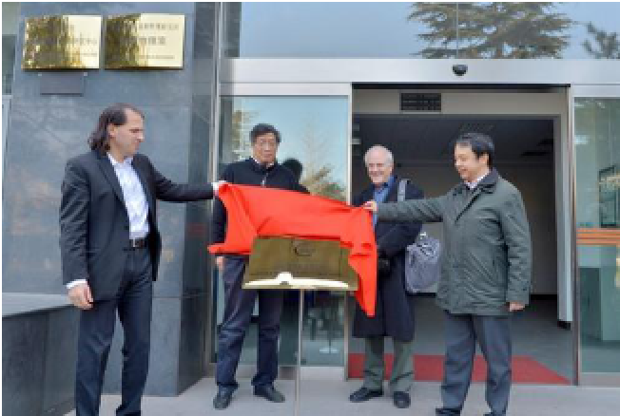
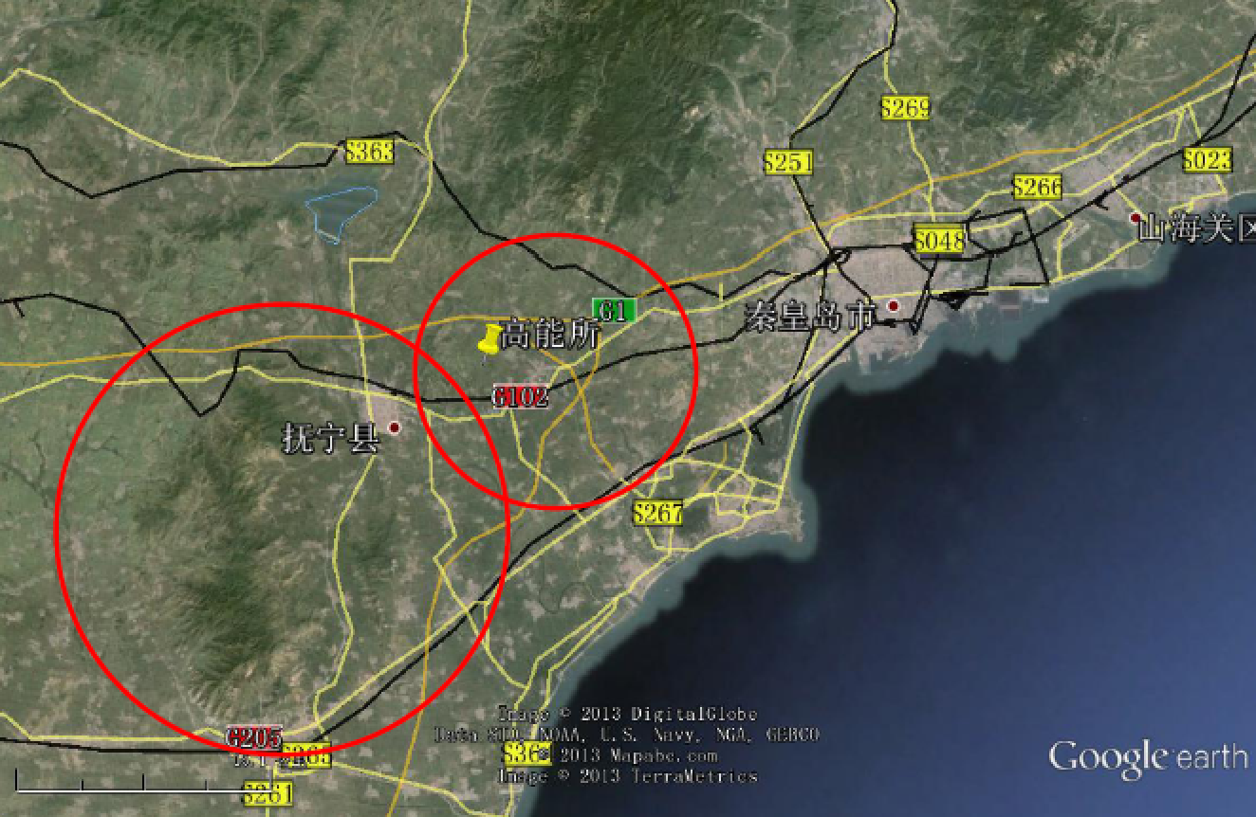
World Interest: in Particular in China…
China expressed an interest in
the construction of a new large
accelerator, first as an e+e-
Higgs factory and then as a
high energy pp machine.
Aim: design completed in 2020
Contribute to the world effort
Possible site: Qinhuangdao
(1 hr by train from Beijing)

Slide 15
Linear e+e- Colliders
Electron-positron machines for high precision and
possibly high energy (few TeV) …
Avoid Synchrotron radiation from a circular machine
Studies and R&D work on linear colliders started in
the ‘90’s and they have achieved a very high level
of maturity now…

Slide 16
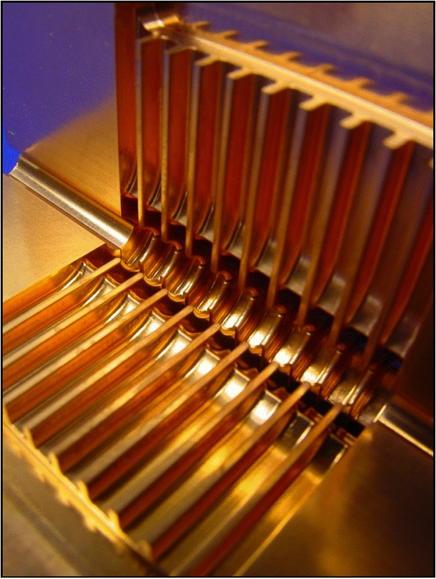
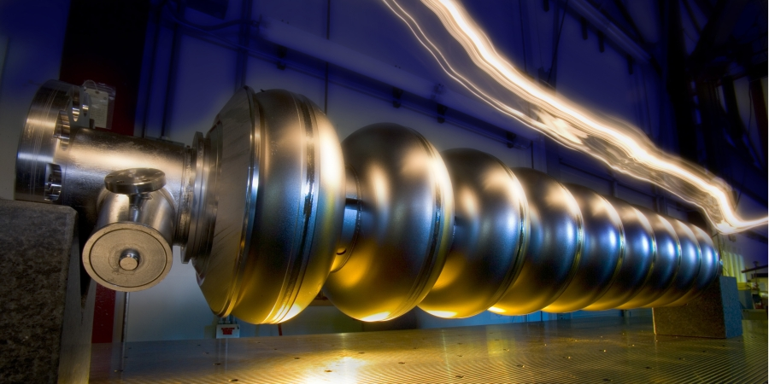
Linear e+e- Colliders: ILC and CLIC
CLIC
Linear e⁺e⁻ colliders
Luminosities: few 10³⁴ cm⁻²s⁻¹
ILC
Superconducting RF cavities (like XFEL)
Gradient 32 MV/m
√s ≤ 500 GeV (1 TeV upgrade option)
Focus on ≤ 500 GeV, physics studies
also for 1 TeV
2-beam acceleration scheme
at room temperature
Gradient 100 MV/m
√s up to 3 TeV
Physics + Detector studies
for 350 GeV - 3 TeV
The ILC is basically ready to be build now!

Slide 17
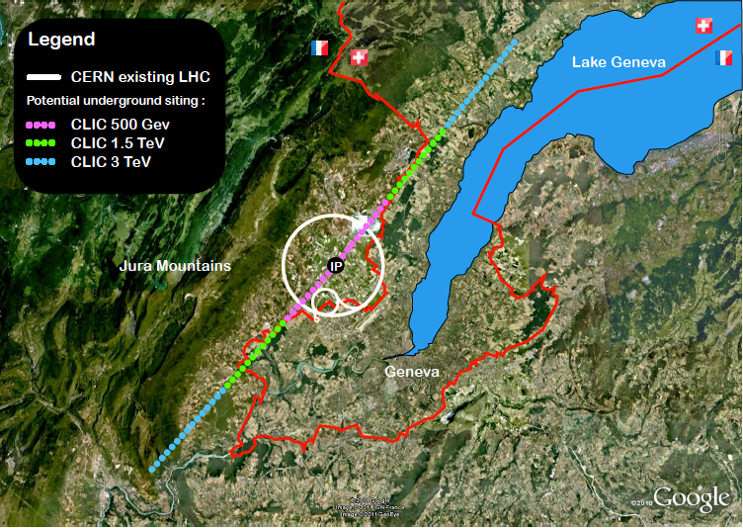
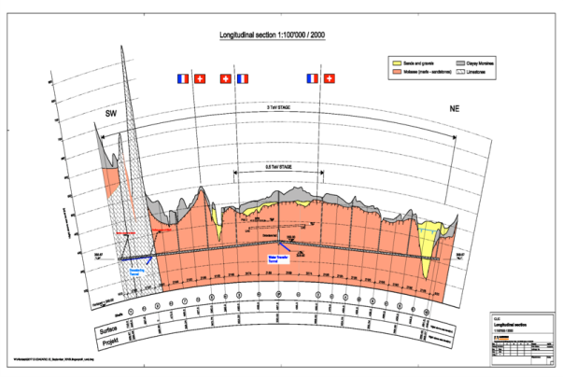
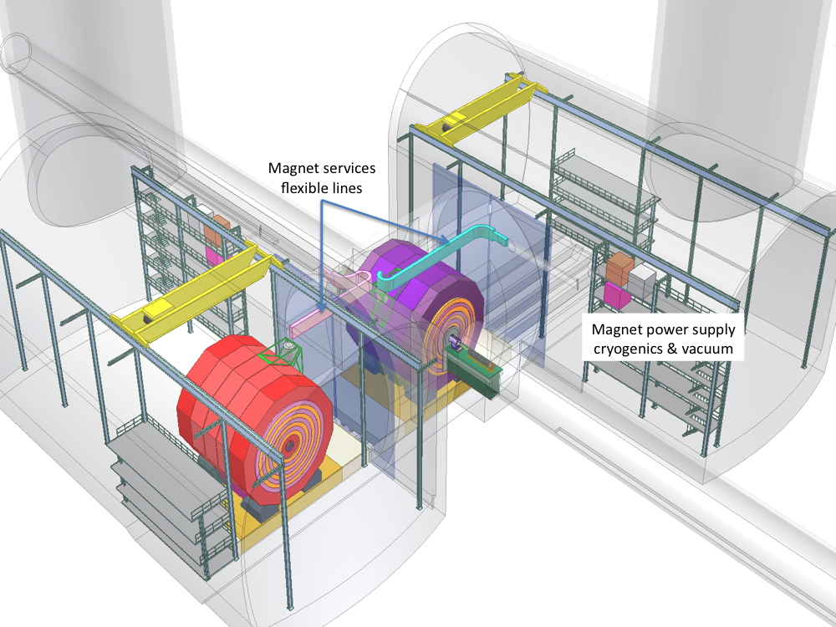
CLIC Layout @ CERN
Tunnel implementations (laser straight)
Central MDI & Interaction Region

Slide 18
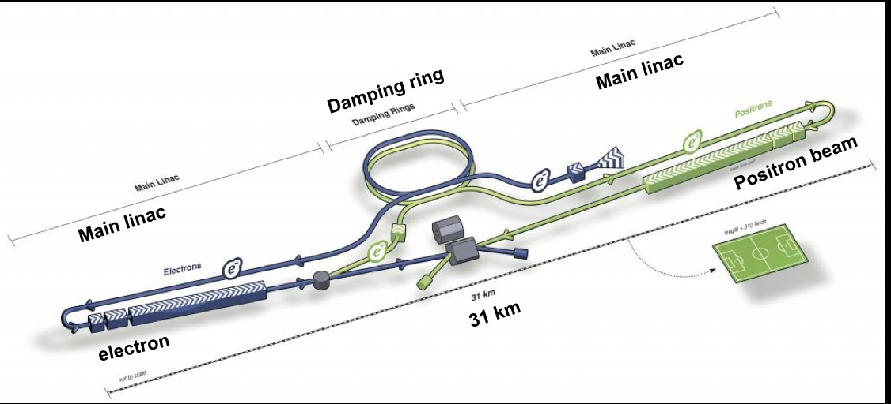

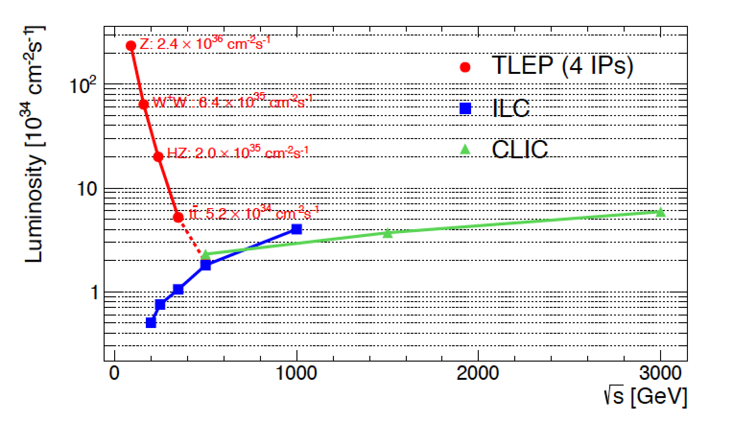
ILC Layout
Japan has expressed a strong interest to host this collider! Under discussion…
Comparison of different
e+e- colliders
Note: in 2013 ILC produced a
plan to double the luminosity
(not included in the figure)

Slide 19
The Physics at the Future Colliders
•Studies for linear colliders documented in TDRs since
~ 15 years, regularly updated
•HL-LHC studies started in 2012, ongoing
•FCC-ee studies started in 2012, ongoing
•FCC-hh and FCC-he studies started end of last year
Apart from LC studies, most of the future collider studies
are just at the beginning. (-> volunteers welcome!!)

Slide 20
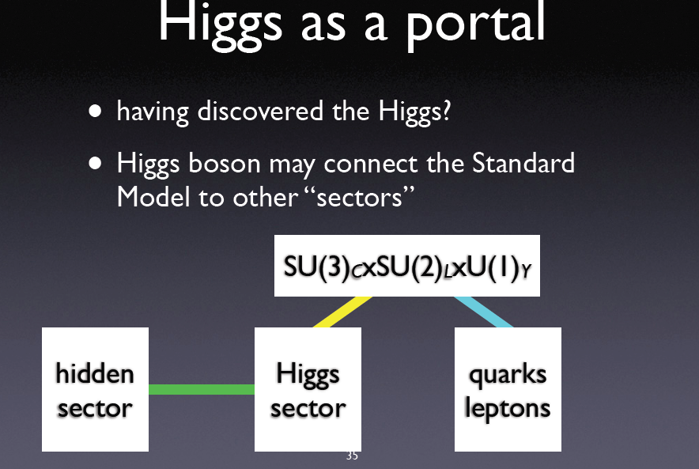
Next Questions to be Addressed
•Is it THE Standard Model Higgs or a messenger of New Physics ?
•How can we explain a Higgs mass ~ 126 GeV? What stabelizes
its mass? New Physics e.g. Supersymmetry?
•What explains the mass pattern of the particles we observe?
•What is Dark Matter and Dark energy?
•Neutrino masses and properties?
•Where is the antimatter in the Universe? How did it disappear??

Slide 21
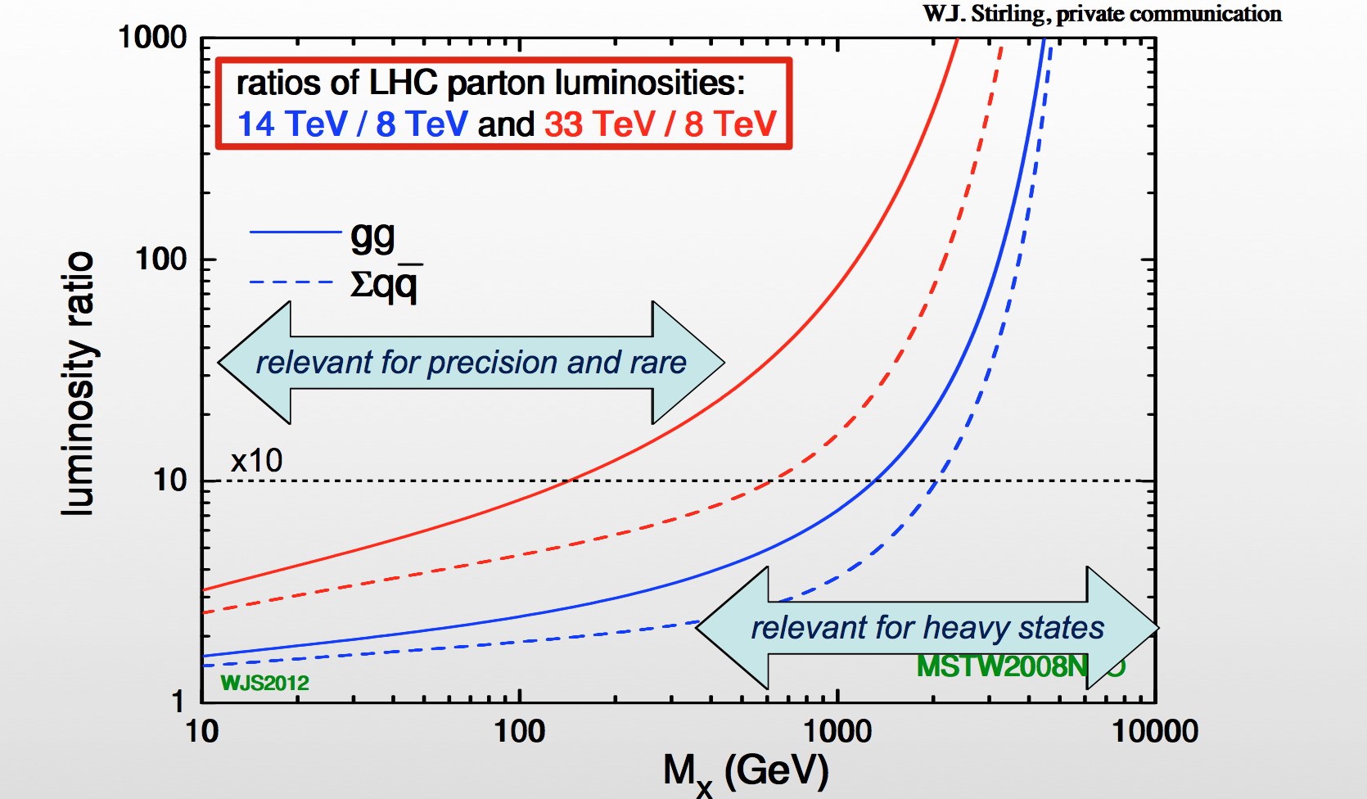
Physics Program: Key Topics
Properties of the new Higgs boson, precise determination of its characteristics
High mass reach for new particles and interactions
Precision measurements
Rare process
-> However, no “no-loose theorem” know, as yet.
•Higgs mass precisions
~ 100-200 MeV enough?
•Higgs self-coupling precision
Better than 20% needed?
•Higgs couplings? Few %? Better?
(J. Wells et al., arXiv:1305.6397)
Studies for future FCC options ongoing
Working group meetings every month

Slide 22
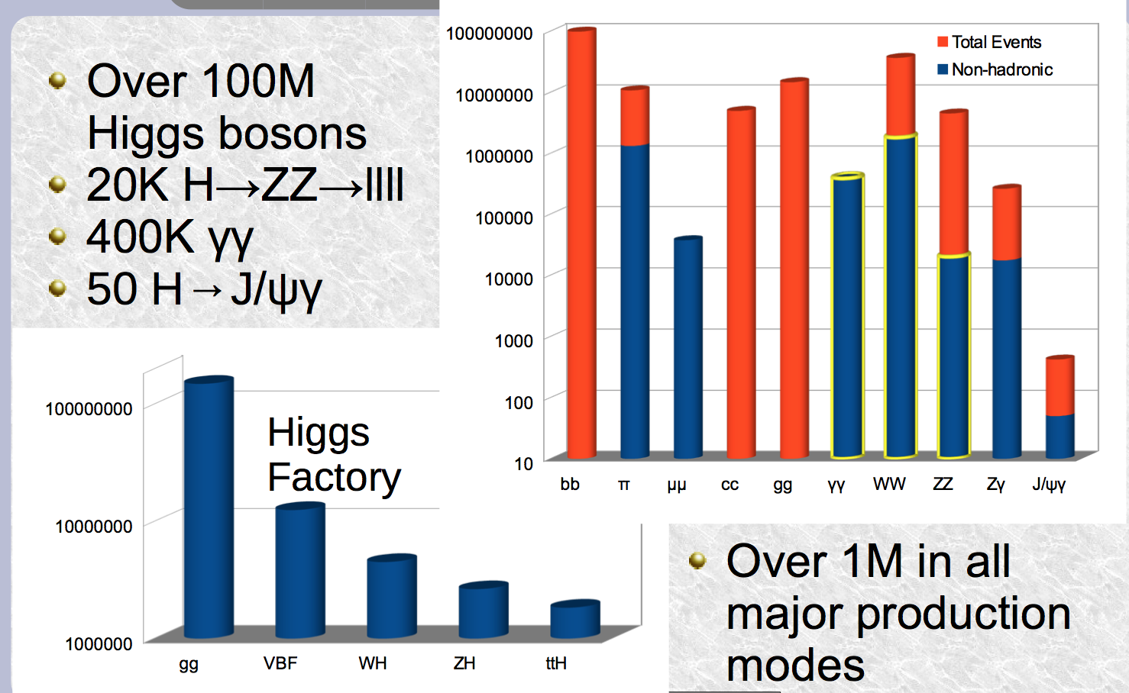
High Luminosity LHC
Number of Higgs Bosons produced with 3000 fb⁻¹

Slide 23
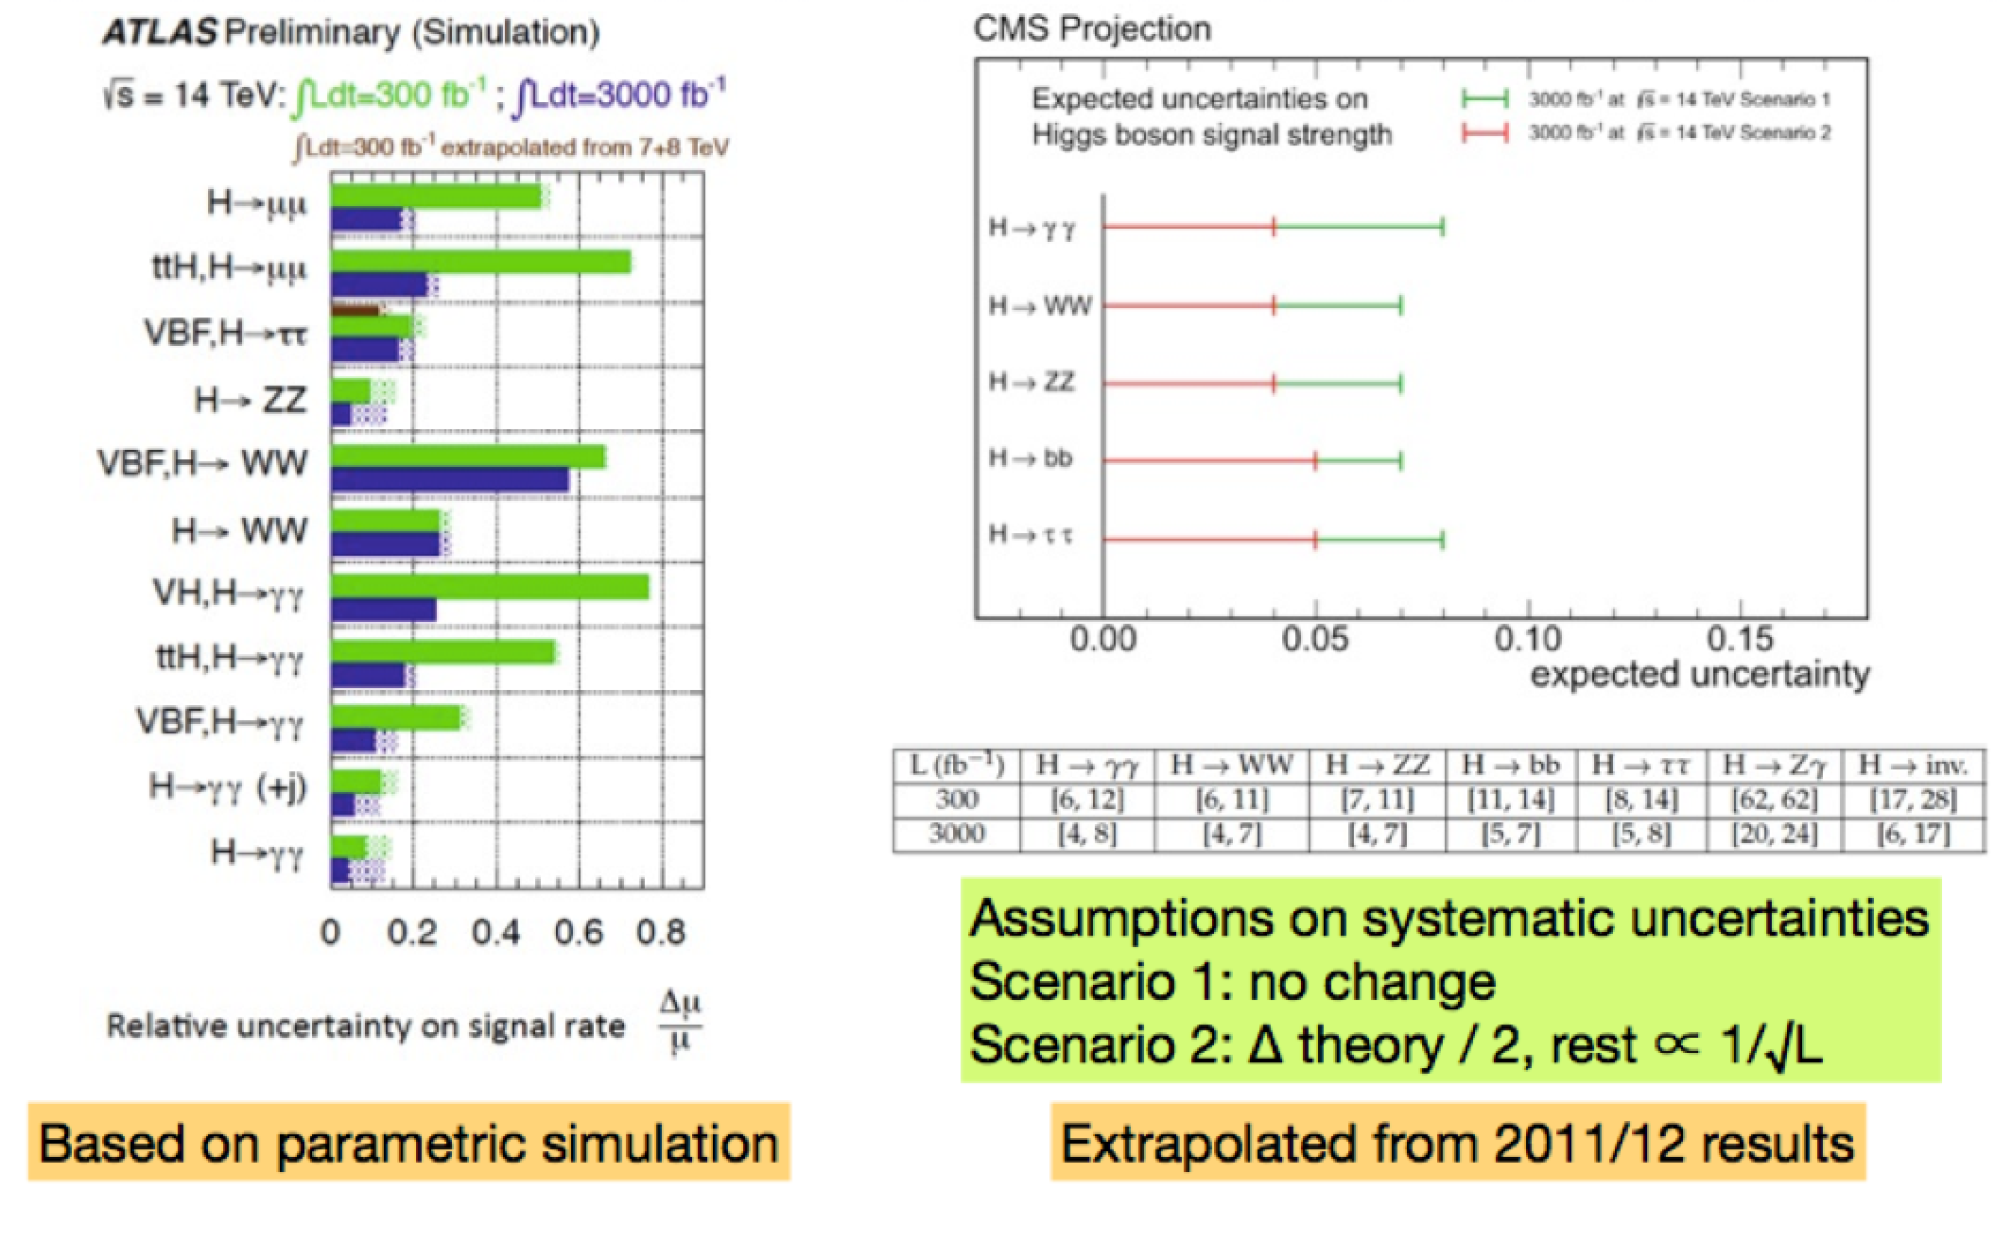
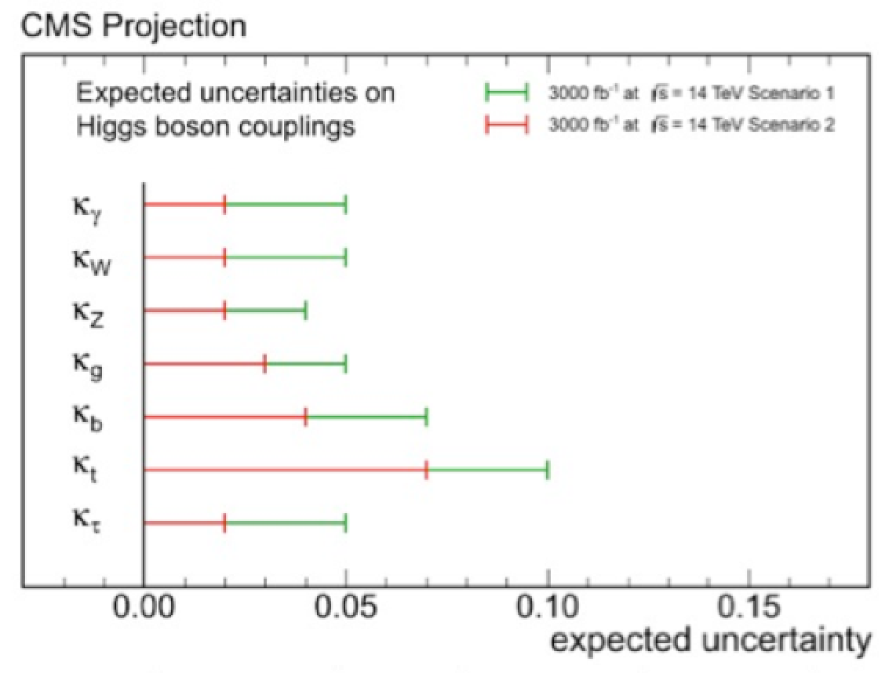
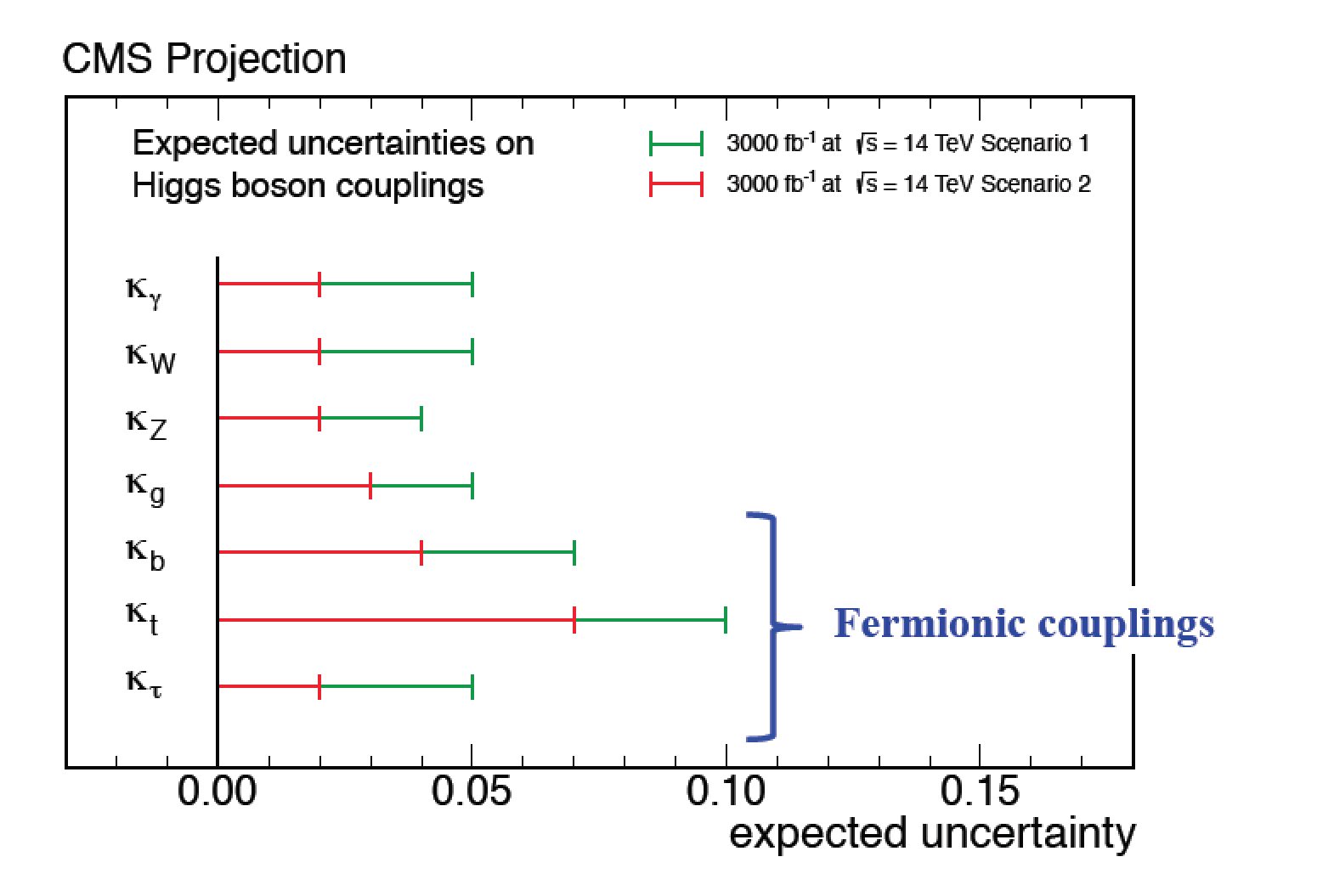
High Luminosity LHC Precision
Determine the Higgs couplings to a few % precision…

Slide 24
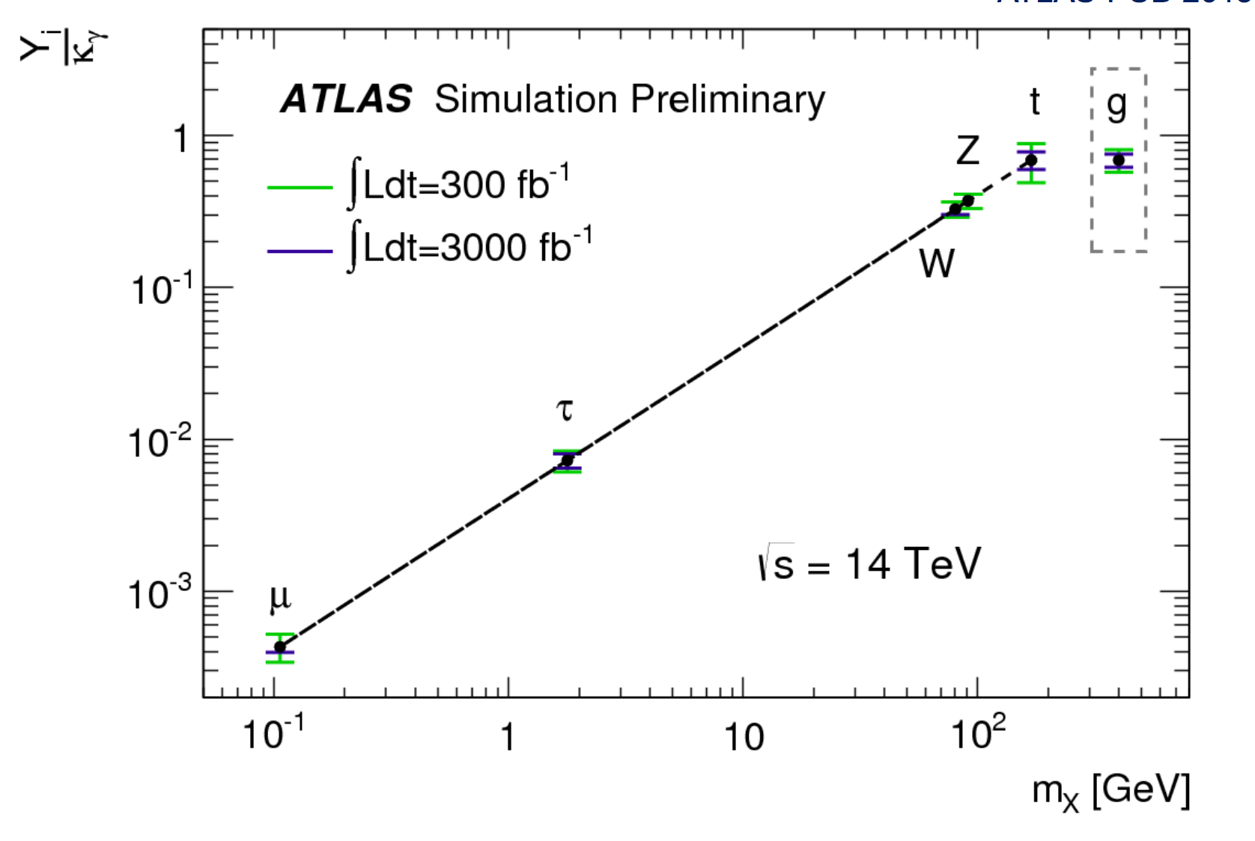
High Luminosity LHC Precision
Higgs couplings: ….
Determine the Higgs couplings to a few % precision…

Slide 25
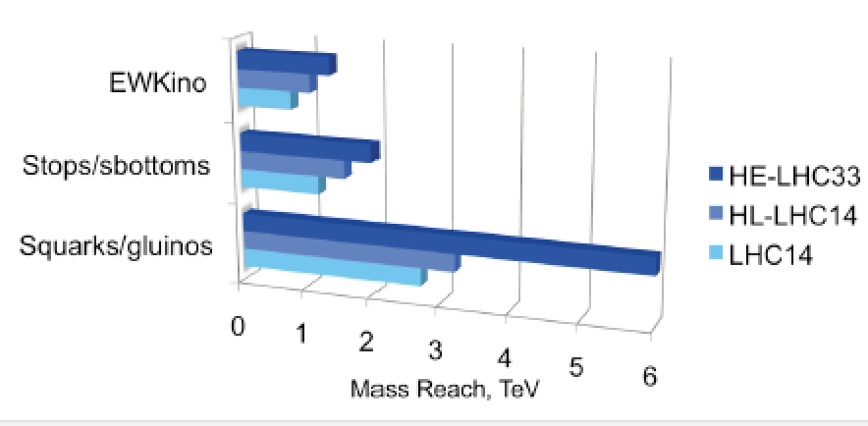
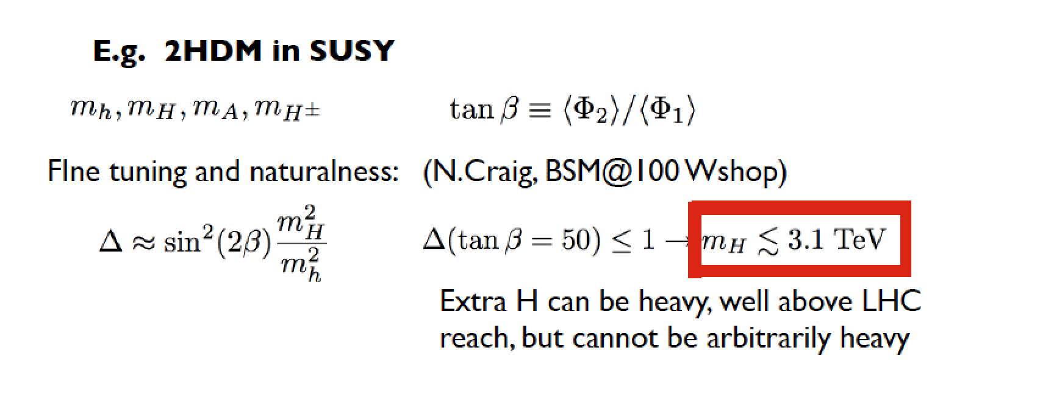
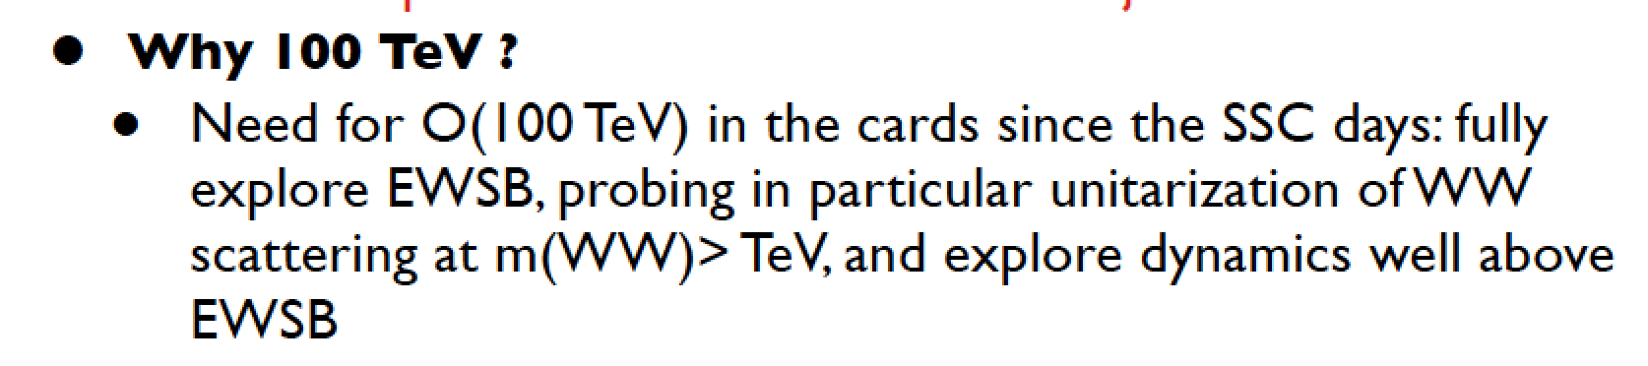
Searches for New Particles in pp
Searches for pair produced SUSY particles
FCC-hh (100 TeV)
-Reach sparticle masses
search up to about 20 TeV
for squarks of light quarks
and 6 TeV for stops
-Excited quarks searches
probe the structure of
quarks down to 4x10⁻²¹ m
-Discovery of resonances up
to masses of 40 TeV
Upper limit for higher Higgs
mass in 2HDM models?

Slide 26
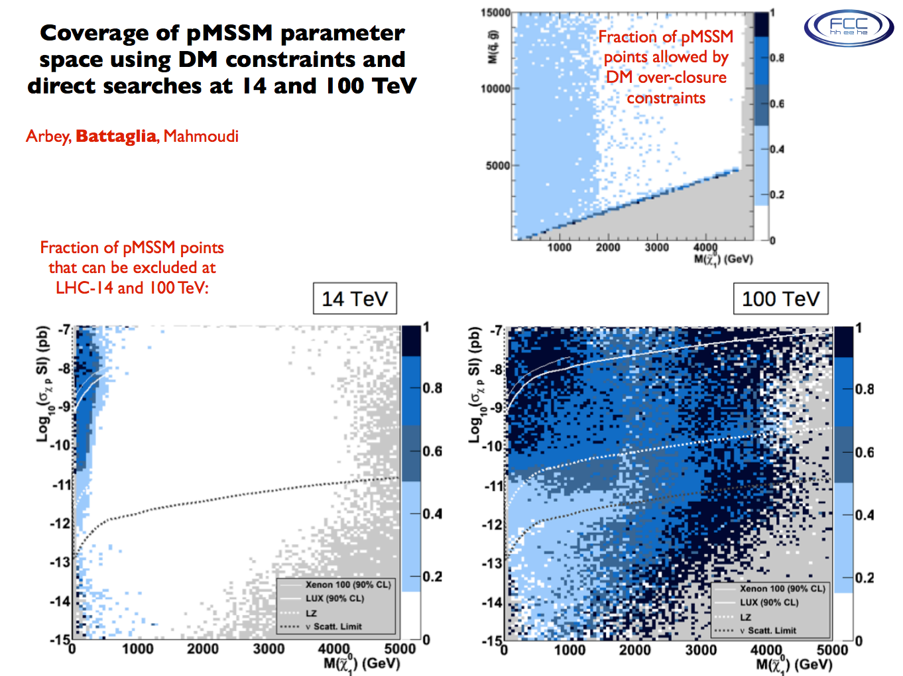
Dark Matter Coverage: pp @ 100 TeV

Slide 27
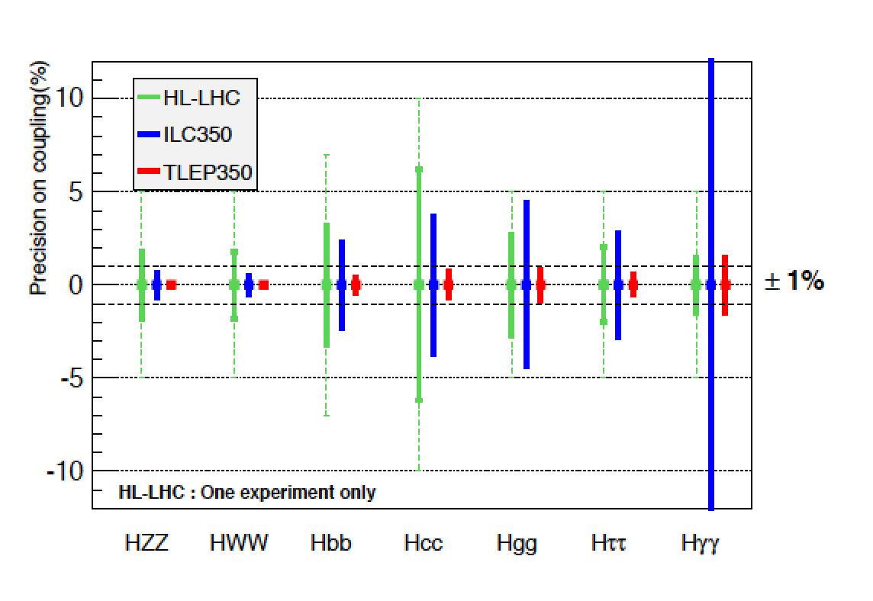
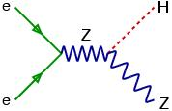
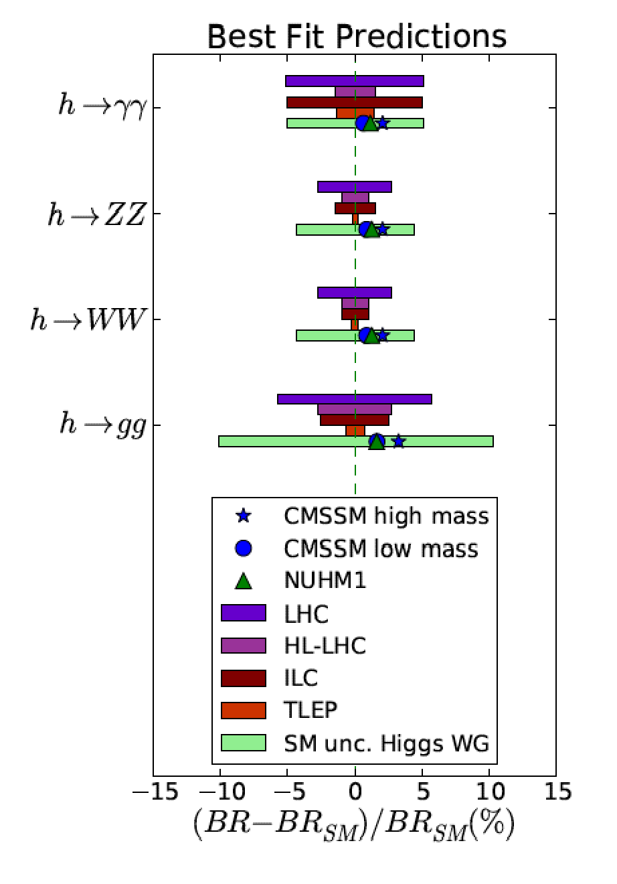
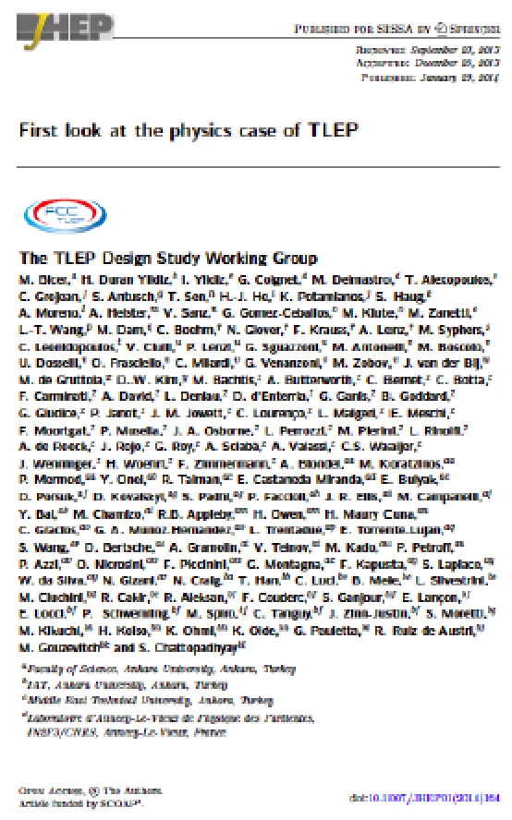
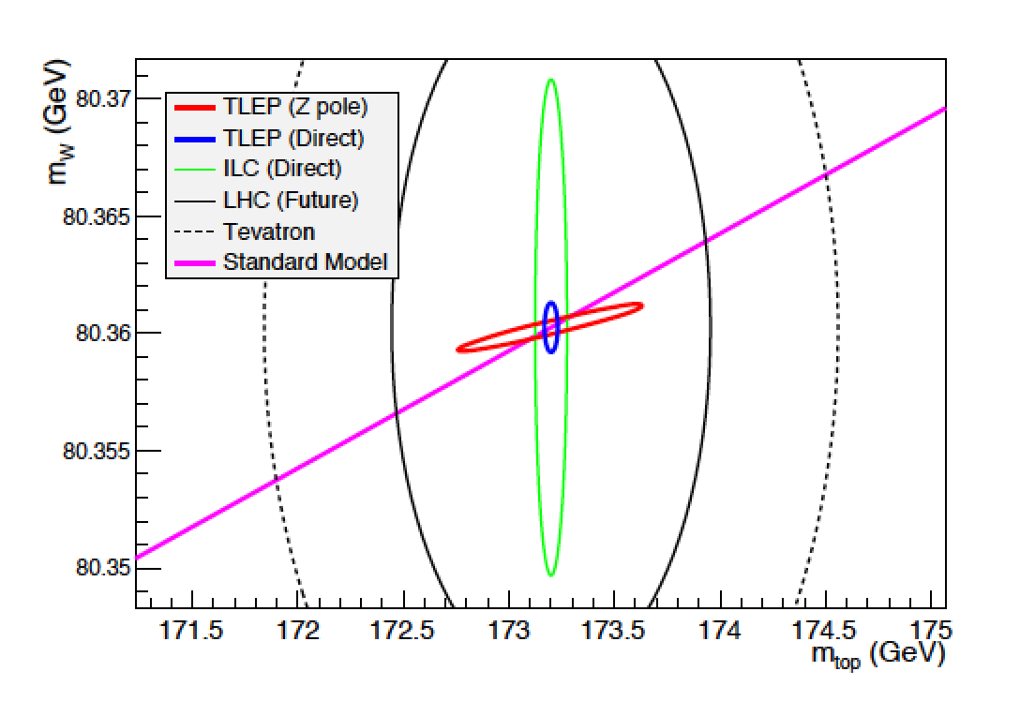
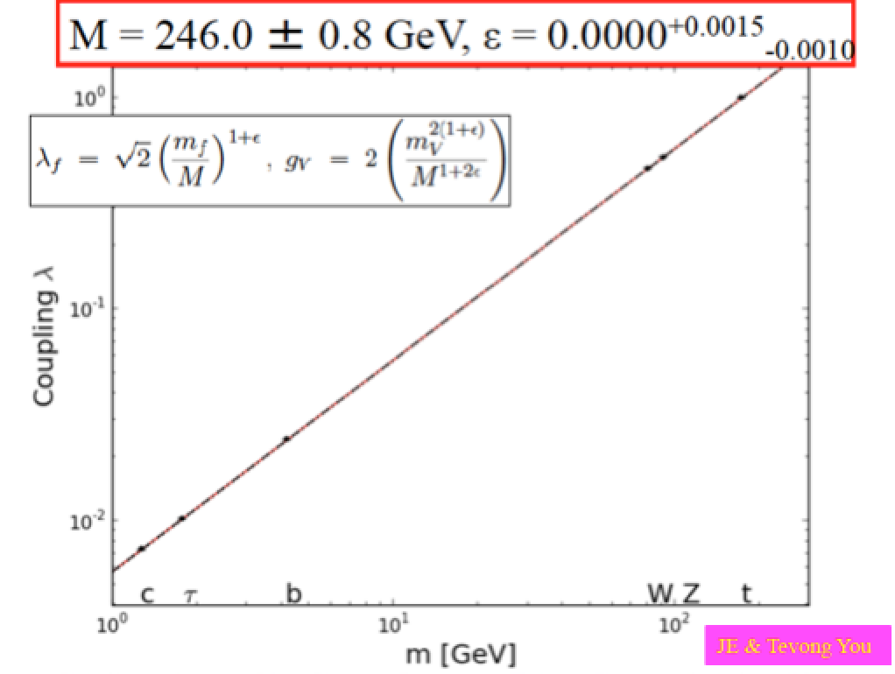
Physics at e+e- Colliders
Higgs Boson Couplings
Higgs Boson decays
arXiv1308.6176
ILC luminosity
upgrade not
included
Fit to all EWK precision measurements
Higgs couplings vs particle mass
FCC-ee delivers
very precise
measurements
~ invisible errors!

Slide 28
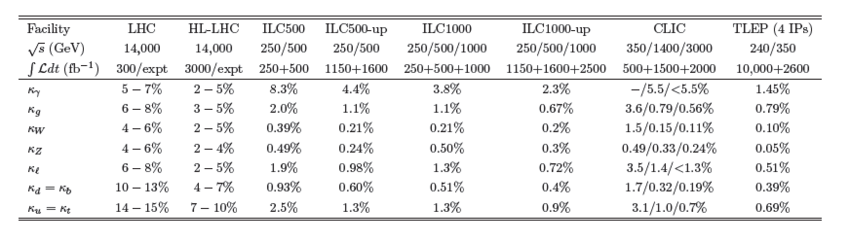
Physics at e+e- Colliders
Details: Precision on Higgs boson couplings
e+e- colliders can make very precise measurements!!

Slide 29
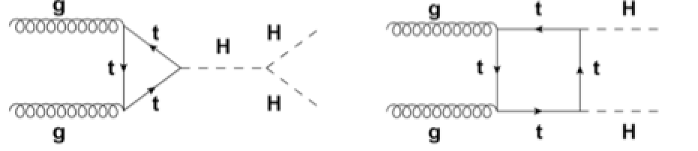
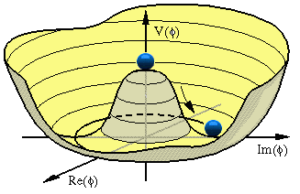
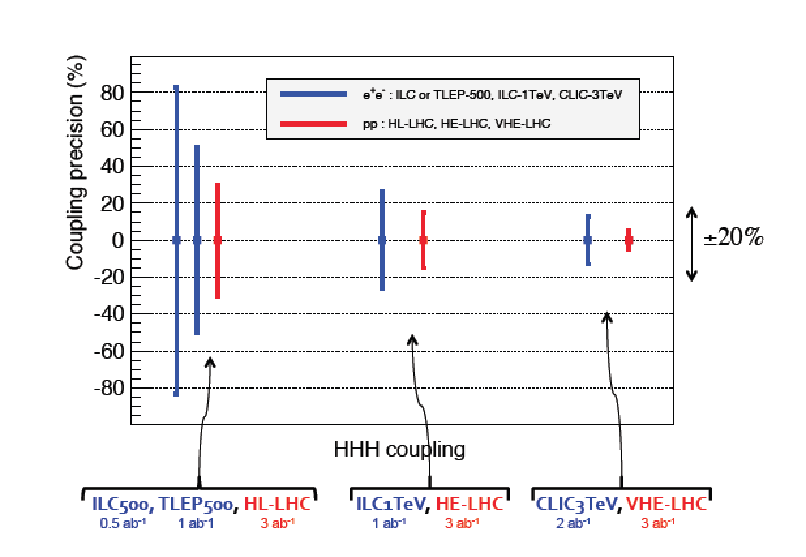
The Higgs Self Coupling!
A key measurement for our understanding of the Higgs field potential!
in pp
Difficult measurements!!:
Evaluation till ongoing
for HL-LHC sensitivity
e+e- machines with
sufficient energy and
FCC-hh can measure
this process

Slide 30
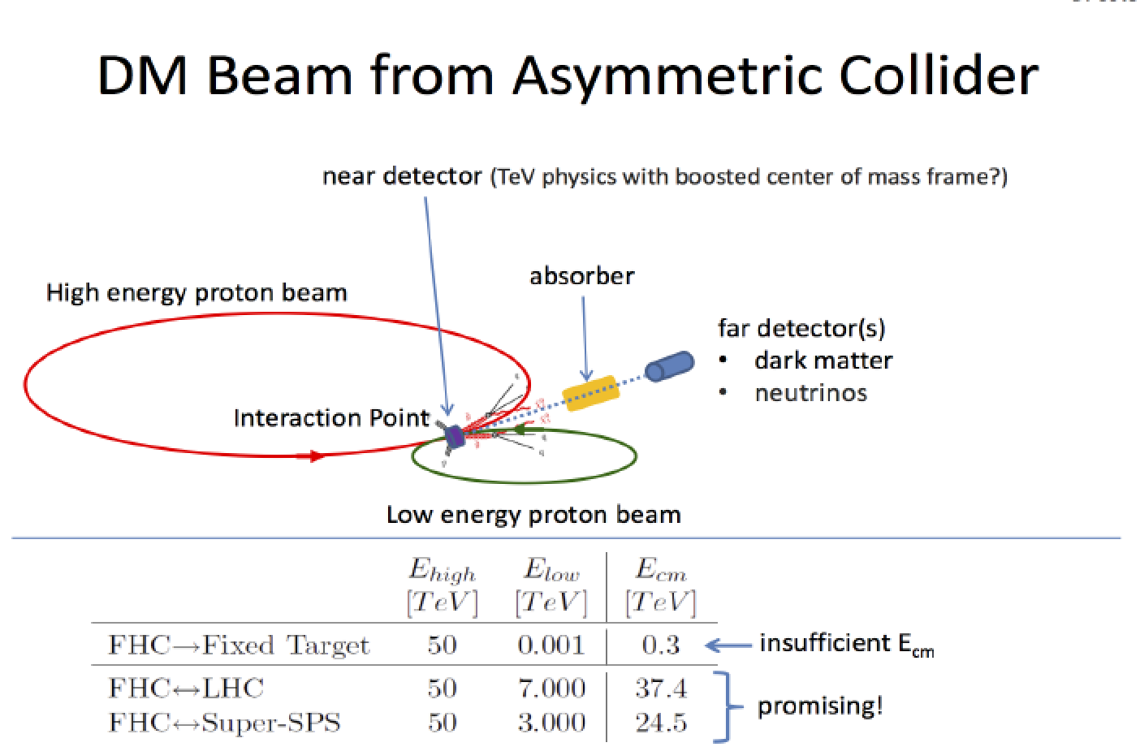
Room for Blue Sky Thinking!
Example: If we produce Dark Matter particles candidates, can we be
sure it is really DM? Check the interaction with matter in a detector!!
Long timescales: Time to explore new ideas!!

Slide 31
Conclusion
In 2012 we found a Higgs Boson at the LHC. Next LHC run @ 14 TeV will hopefully reveal even more.
The Higgs has started a new paradigm: Study the Higgs in detail. (HE-)LHC will be able to do a lot but very likely not everything.
e+e- Higgs factories are being discussed & studied
High energy pp colliders, eg at 100 TeV, will extend the reach for new particles and interactions
A large international effort is coming together on the study for the high energy frontier, FCCs and LCs
The path for new machines is long, and benefits for society (technology) will play an important role.

Slide 32
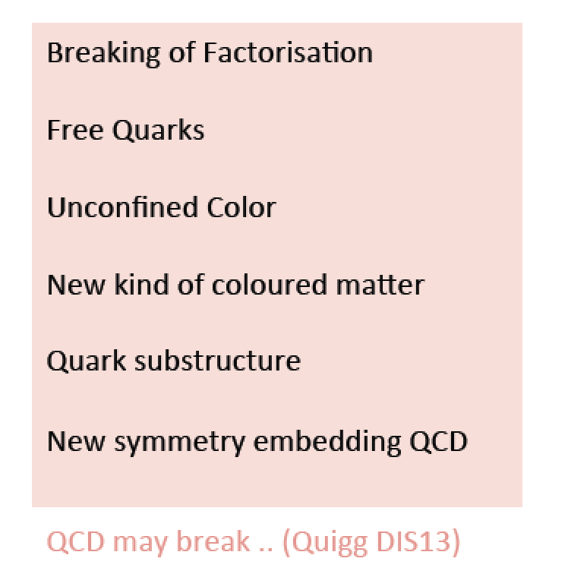
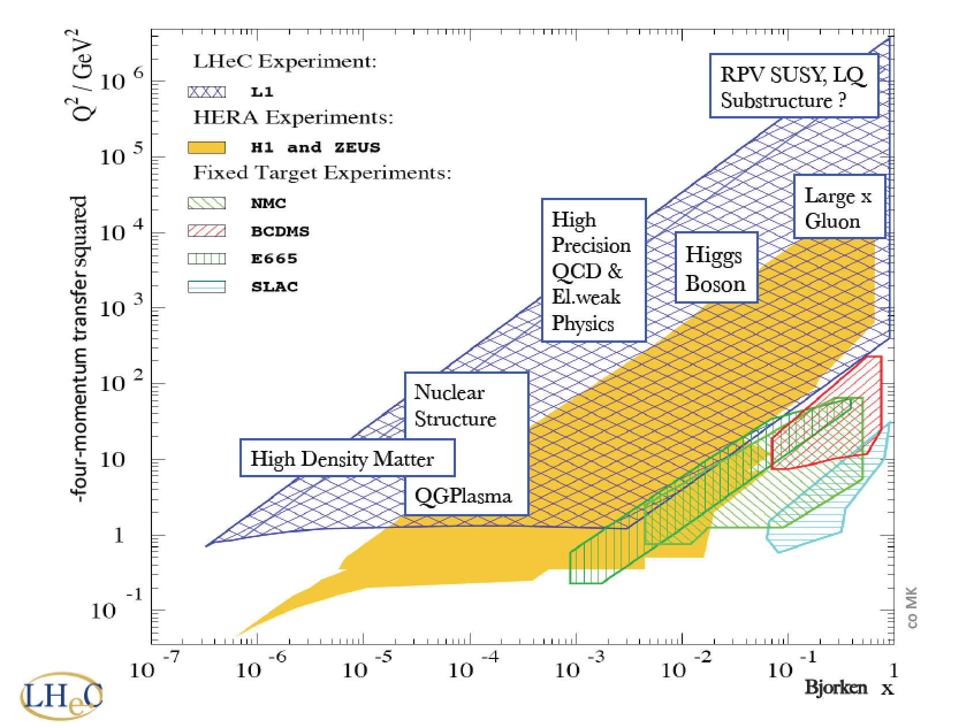

Electron-Proton Collider
Always a useful complement to a hadron collider
eg via measurement parton distribution functions
•Access to specific Higgs couplings
•Reach for new physics eg Leptoquarks, CIs…

Slide 33


FCC-he: the Electron-Proton Option
•Future possible hadron and lepton colliders will be excellent QCD explorers
•High luminosity (10³⁴-10³⁵) and/or energy lepton-hadron colliders
->Dedicated facilitie studies include the LHeC (Europe) and EIC (US) projects
and now FCC-he
ep: 60 GeV x 7 TeV
ep: 60-175 GeV x 50 TeV
Fcc
Use FCC-ee ring or
Energy Recovery Linac

Slide 34

FCC Schedule: First Step
Study reports requested for the next strategy meeting in 2018

Slide 35



Magnet Developments
Key Components: The superconducting magnets
A propos…
Tribute to
Kammerlingh Onnes
Groningen, (Leiden,
Delft) !!!
?
Break the wall with
High Temperature Superconductors!!

Slide 36


Slide 37





A Higgs…
We know already a lot on this Brand New Higgs Particle!!
Mass =
125.5 ±0.5 GeV
Width =
< 22 MeV
(95%CL)
Couplings are
within 20% of
the SM values
Spin =
0⁺ preferred
over 0⁻,1,2
Note: the LHC is a Higgs Factory: 1 Million Higgses already produced
15 Higgses/minute with present lumi.

Slide 38


A Higgs…
Stockholm Nobel Symposium
May 2013
But there there still a lot of questions…

Slide 39


Consequences for our Universe?
Precise measurements
of the top quark and
first measurements of the
Higgs mass:
Our Universe meta-stable ?
Will the Universe disappear
in a Big Slurp? (NBCNEWS.com)
New Physics inevitable?
But at which scale/energy?

