Slide 1

HESS J1640-465
An exceptionally luminous TeV γ-ray SNR
Stefan Ohm (DESY, Zeuthen)
Peter Eger (MPIK, Heidelberg)
On behalf of the H.E.S.S. collaboration

Slide 2
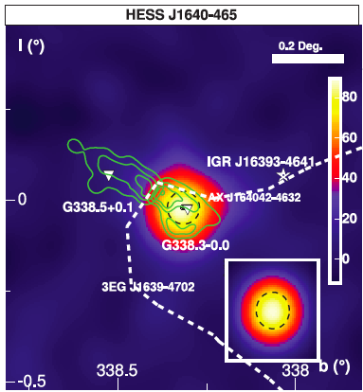
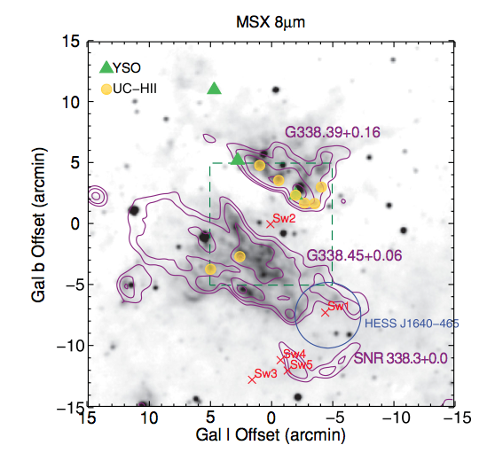
Introduction: HESS J1640-465
HESS
  Original discovery in 2006
  14σ in 14 hours of observations
  Compact (~2.7’), strong (~10% Crab) γ-ray emitter
  Γ = -2.40 ± 0.15
Environment
  In complex region (HII region, stellar cluster)
  Coincident with incomplete shell-type SNR
  No non-thermal emission reported at time of HESS discovery

Slide 3
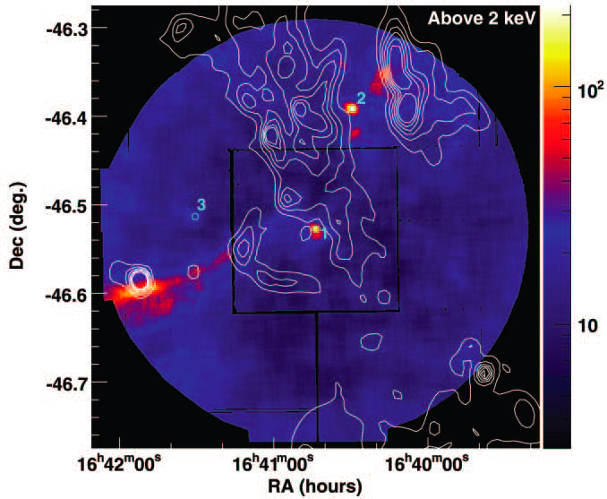
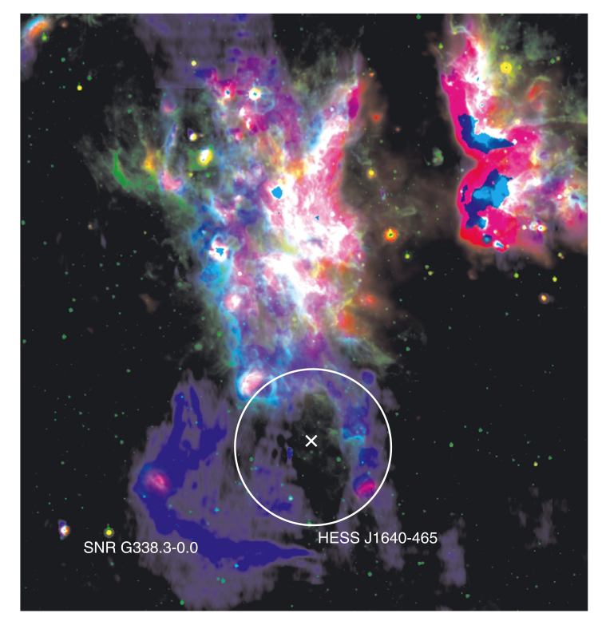
X-ray and radio follow-up observations
XMM -Newton
X-rays (Swift, XMM and Chandra)
  Detection of compact source + extended nebula
  No non-thermal X-ray emission from SNR shell
  Highly absorbed ➝ large distance
  Pulsar wind nebula interpretation of TeV signal
Swift (Landi et al. 2006)
XMM (Funk et al. 2007)
Chandra (Lemiere et al. 2009)
Radio (SGPS, GMRT, ATCA)
  Detection of non-thermal shell emission
  No non-thermal emission from PSR or PWN
  Absorption features of SNR throughout line-of-sight
  Distance estimate: 8 – 13 kpc
  ➝ Most luminous Galactic TeV γ-ray source
610 MHz (GMRT)
8μm (GLIMPSE)
24μm (MIPSGAL)
GMRT, ATCA (Castelletti et al. 2011)

Slide 4
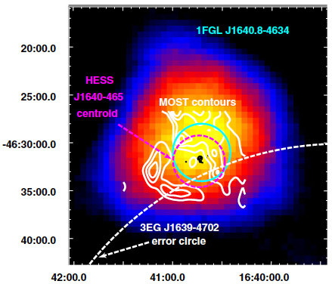
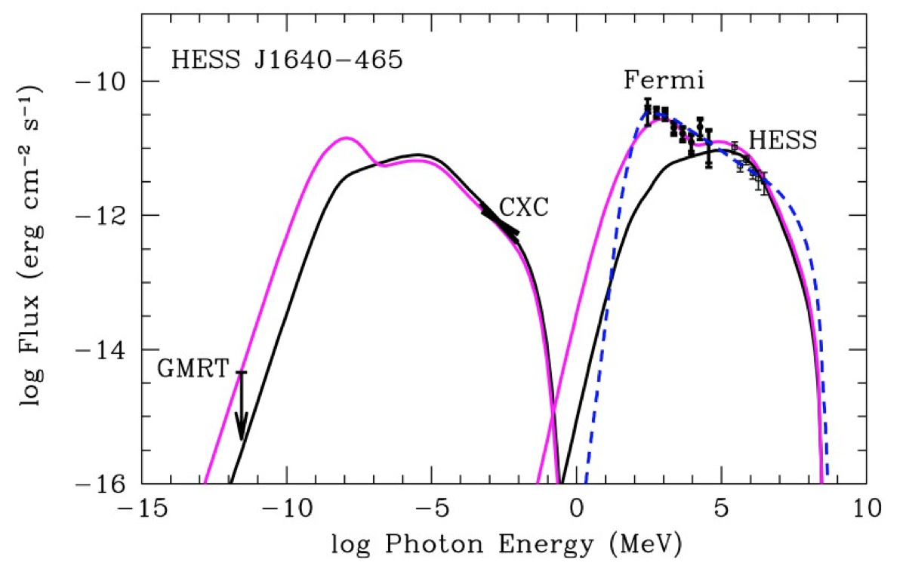
Fermi-LAT observations
Morphology
  Detection of luminous GeV source
  Coincident with HESS source
  Consistent with point source
Spectrum
  Spectral points between 200 MeV and 50 GeV
  Spectral index compatible with HESS (Γ = -2.3 ± 0.1)
Fermi-LAT (Slane et al. 2010)
Interpretation and modelling
  GeV + TeV spectrum interpreted as IC emission from PWN
  Smooth connection of Fermi and HESS spectrum requires additional low-energy relativistic Maxwellian component

Slide 5
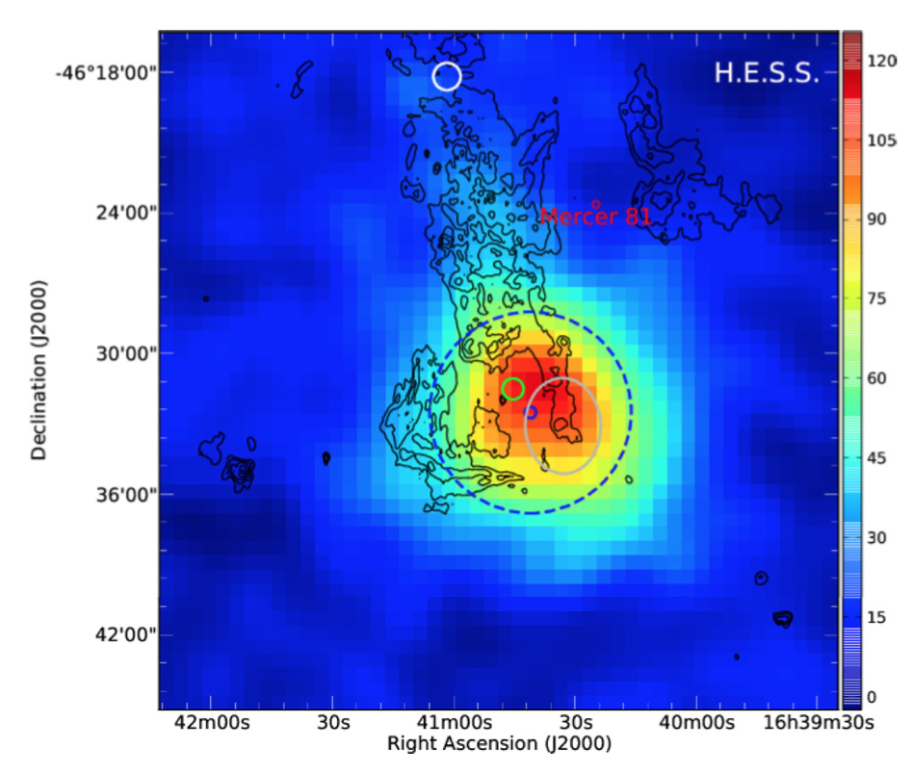
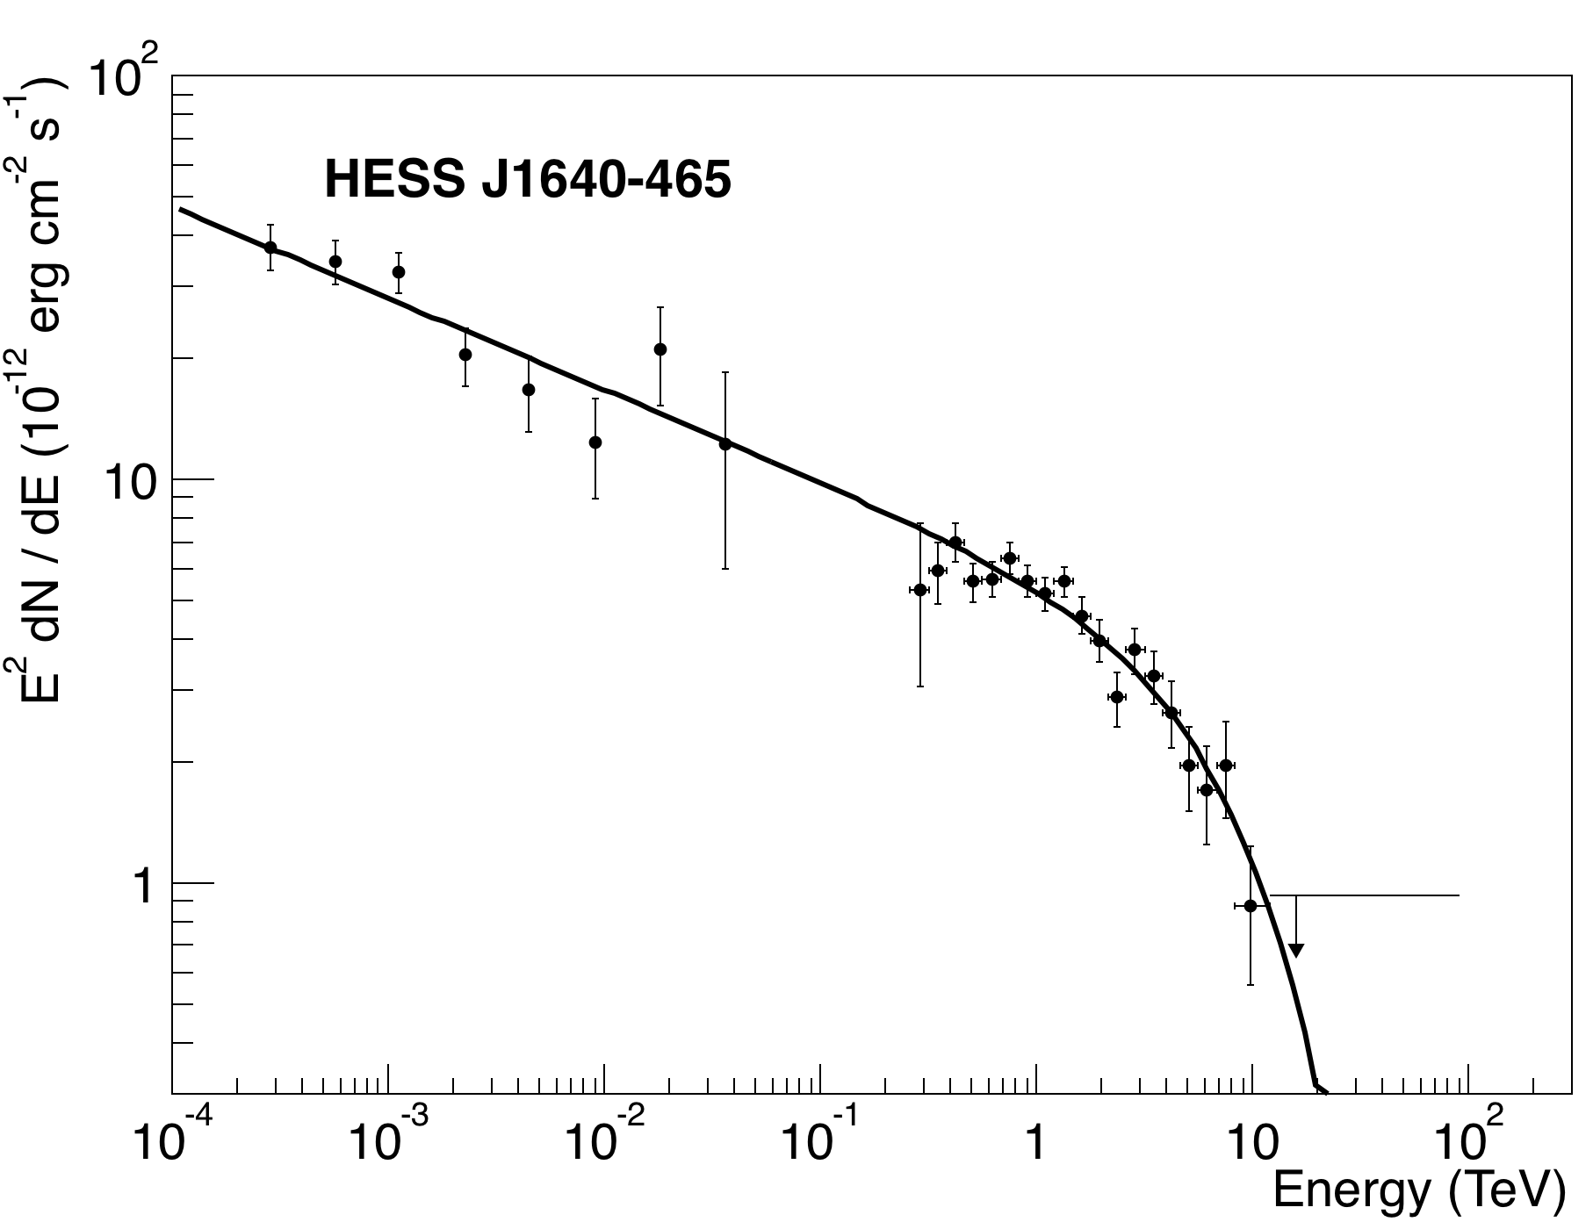
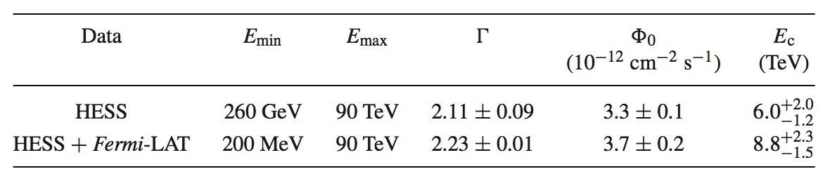
New HESS results
Data set
  Quadrupled data set (>60 hours of observations)
  More sensitive analysis methods (40σ, ~1800 γ-rays)
  ➝ detailed spectral and morphological studies possible
TeV spectrum
  Power-law has low probability p = 1%
  Exponential cut-off power-law (ECPL) fits data much better (fit probability p = 36%)
  At 10 kpc distance, luminosity L = 7.8 x 10³⁴ erg/s
GeV – TeV spectrum
  Simultaneous ECPL fit to Fermi and HESS spectrum gives consistent results ➝ no break required in γ-ray spectrum
HESS collaboration (2014)
Slane et al. (2010)

Slide 6
Discussion: Age and environment of G338.3-0.0
SNR evolution in wind-blown bubble
  Scenario that has also been invoked for RCW 86, Cygnus SNR, or RX J1713-3946
  Bubble size of 10 pc typical for 20 M⨀ mass O-type star (Chevalier, 1999)
  Lifetime of 7 Myrs, 2600 km/s, 10⁻⁷ M⨀ per year
  Lower age limit for wind material inside the bubble, the shock speed of 5000 – 10000 km/s of 1 – 2 kyr (Slane et al. estimate 5 – 8 kyrs)
  And free expansion until shock hits wall of swept up material
Density
  Large density required to explain γ-ray emission as hadronic
  Thermal radio: Castelletti et al. infer electron densities of 100 – 150 cm⁻³
  Thermal X-rays: not seen from the shell, detected in this source, but also not expected given the large distance, high absorption and possible evolution in wind-blown bubble
  HI: absorption gives upper limit on neutral gas density of ~600 cm⁻³
  No indication for molecular gas densities (n > 10⁴ cm⁻³)
  Measurements consistent with gas densities of ≥ 150 cm⁻³

Slide 7
Interpretation I: PWN scenario
PWN scenario
  Existence of point-like X-ray source + extended nebula (but no pulsations detected)
  Positional coincidence of X-ray PWN candidate, GeV source and HESS source
But…
  IC peak is seen for all TeV-emitting PWN, but not for this one
  Smooth power-law from hundreds of MeV to multi-TeV energies requires Γ_{e} ~ -3.4
  HESS spectrum also excludes the proposed low-energy relativistic Maxwellian
  TeV extension of all TeV emitting PWN is smaller than SNR shell, this one is larger
  No energy-dependent morphology seen in HESS data
  Scaled radio limit factor ~5 lower than model predictions
  ➝ PWN-only interpretation of GeV and TeV emission hard to realise
  ➝ different origin of Fermi and HESS emission is possible, but requires fine-tuning
Explore alternative scenario

Slide 8
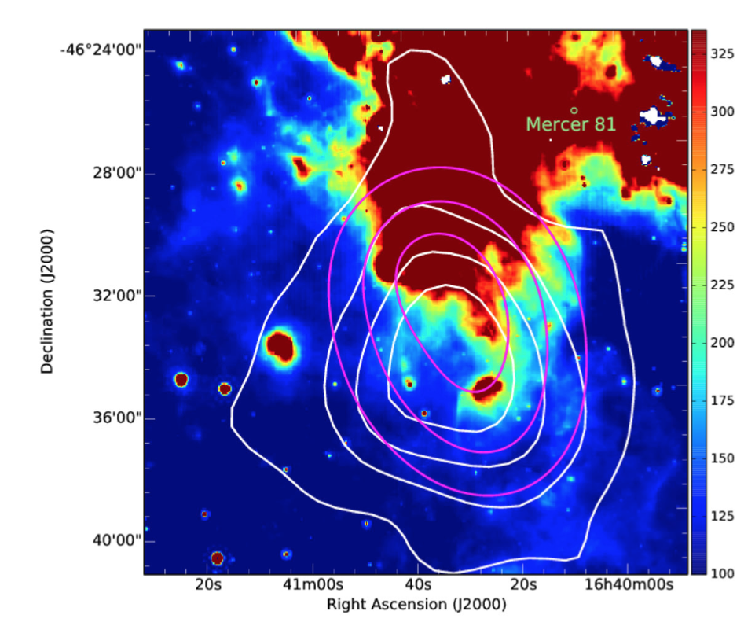
Interpretation II: SNR scenario
Supported by
  Positional coincidence of GeV and TeV source and north-western SNR shell
  Spectral and morphological similarity with other Galactic SNRs interacting with molecular clouds
Hadronic origin
  Efficient particle acceleration in low-density medium inside wind-blown bubble
  Requires large densities (interior of wind-bubble not sufficient)
  Target: a) dense wind shell, or b) dense and clumpy surrounding material
  cf. RX J1713-3946 (Zirakashvili & Aharonian, 2010)
  Higher IR flux from north-western shell consistent with TeV morphology
Color: 24μm (MIPS)
HESS contours
610 MHz, smeared with HESS PSF

Slide 9
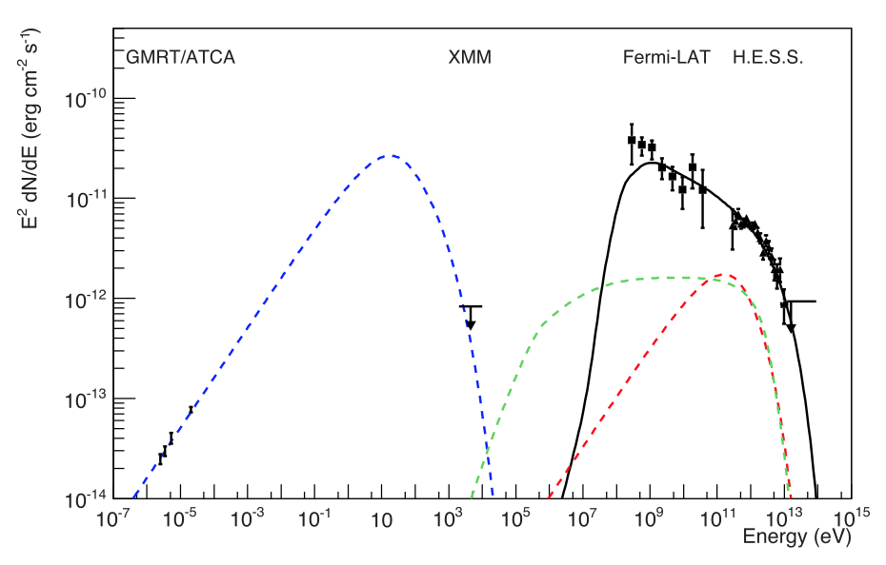
Interpretation II: SNR scenario
Modelling
  X-ray UL on non-thermal shell emission from archival XMM data
  Scale non-thermal radio flux from shell
  Apply time-dependent one-zone model
  Continuous injection of electrons and protons over assumed SNR age of 2.5 kyrs
Leptonic scenario
  Magnetic field and electrons spectral index from radio (B = 35μG, Γe = 2.0)
  Cut-off energy from XMM (E_{c,e} = 10 TeV)
  Predicted IC emission much lower than HESS data
  Larger e/p ratios and lower field help with the level of emission, but not with the shape
Hadronic scenario
  For n_{H} = 150 cm⁻³, 4 x 10⁵⁰ erg in protons required to explain γ-ray spectrum
  ➝ very efficient accelerator, and/or
  ➝ very energetic SN explosion

Slide 10
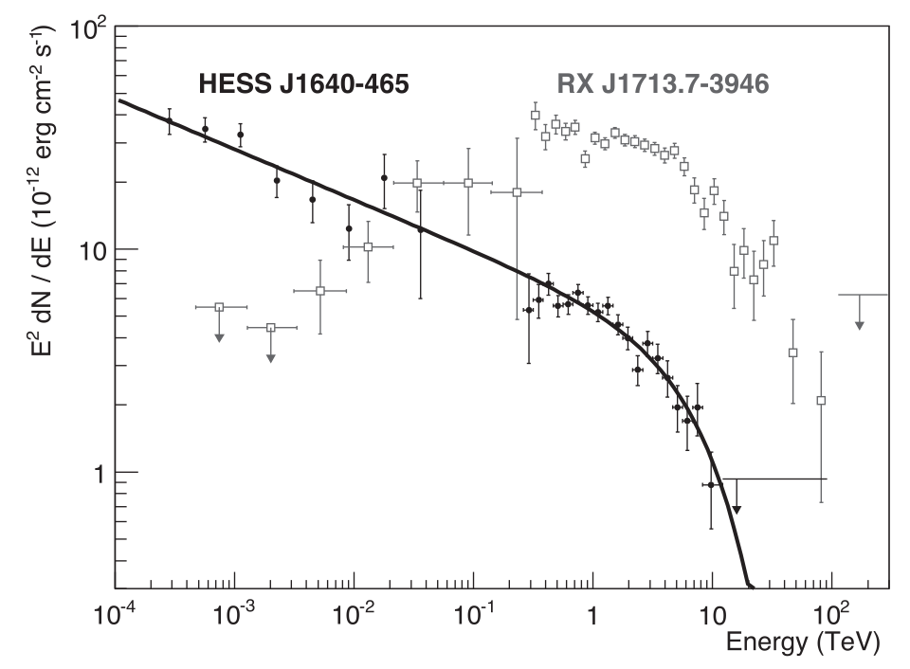
Interpretation III: Comparison with RX J1713-3946
Comparion
  Similar TeV spectra
  Different GeV spectra
Possible Explanation
  Diffusion of low-energy CRs into dense clumps in HESS J1640-465
  ‘Shielding’ of lower-energy CRs in RX J1713-3946?
  Different ages?
  Different diffusion properties?

Slide 11
Summary and Conclusion
HESS J1640-465 is the most luminous Galactic TeV source
TeV morphology
  significantly extended
  overlapping with SNR shell
  more extended than shell
GeV – TeV spectrum consistent with one featureless power-law over 6 orders of magnitude
PWNe interpretation challenging, but contribution to TeV spectrum not excluded
New HESS results + MWL data suggests dominant hadronic emission from SNR shell
  Morphology and spectrum well reproduced
  Requires high energy in CRs and high ambient densities

Slide 12
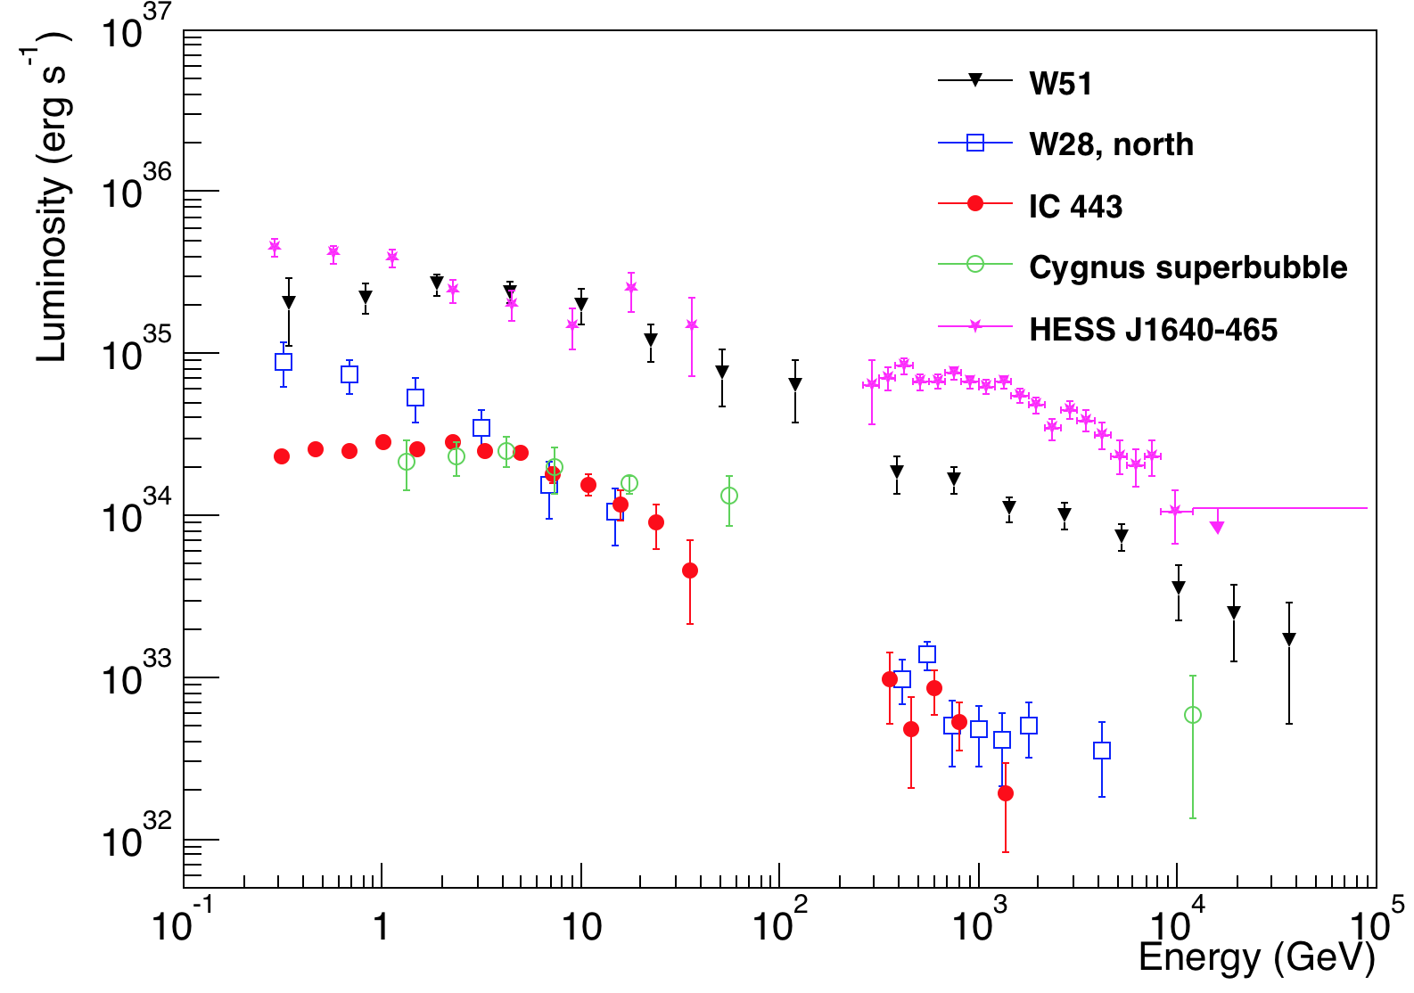
Comparison of HESS J1640 with other SNRs

Slide 13
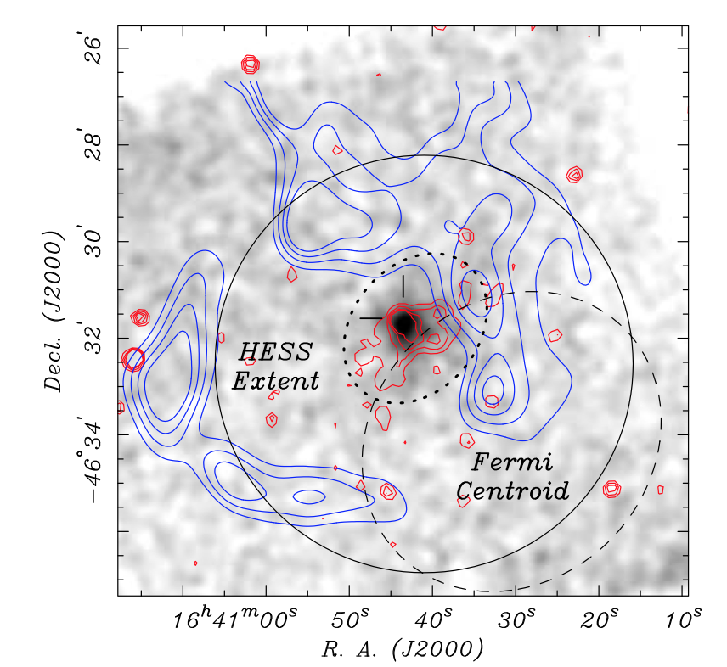
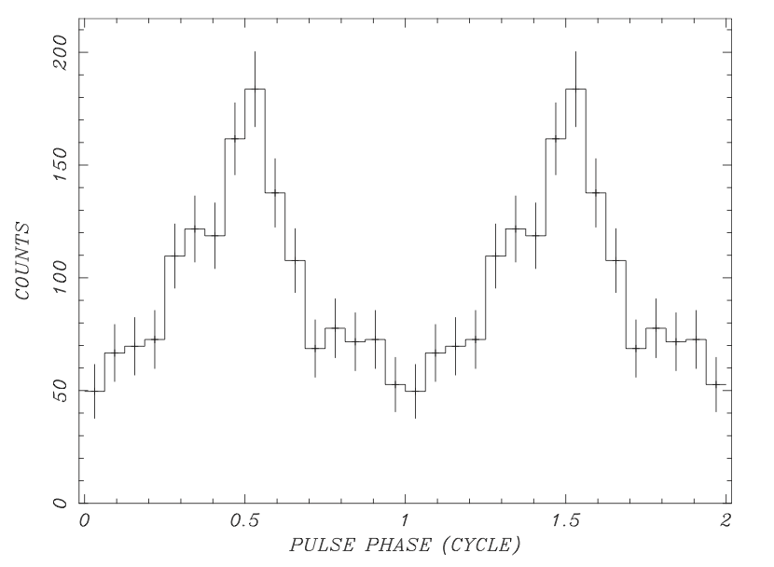
NuSTAR discovery of PSR in HESS J1640-465
Gotthelf et al. (2014) reported discovery of pulsation from PSR in HESS J1640-465
  Ė = 4.4 x 10 erg/s, τ_{c} = 3350 yrs, P = 206 ms
  With n = 2, >10 GeV spectrum can be described with PWN model for PSR birth period of P₀ = 15ms
Requires middle-aged PWN, 6% of current Ė to be converted into γ-rays
Spin-down power and age considerably smaller than in previous models
Authors argue that the Fermi spectrum below 10 GeV is likely not correct in HESS paper, but without presenting a reanalysis
Revised preliminary analysis of 5 years of Fermi-LAT data confirms significant emission below 10 GeV (as also presented in 2FGL)

