Slide 1

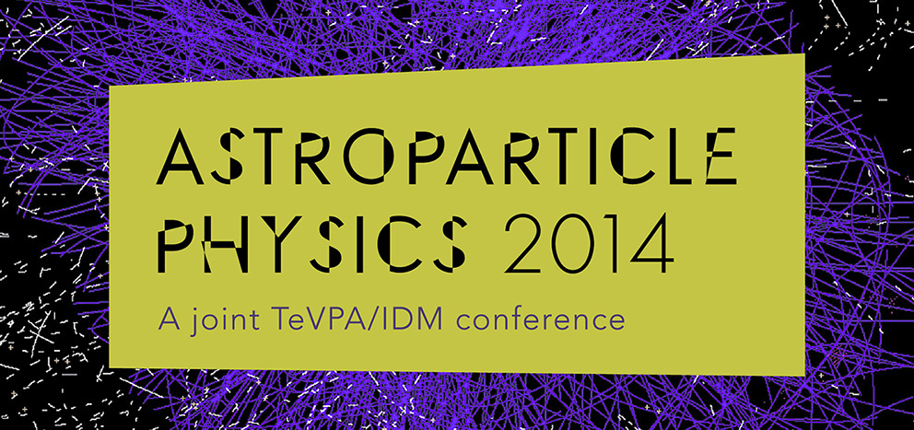

Explaining galactic structure and direct detection experiments with mirror dark matter
Robert Foot, CoEPP, University of Melbourne
June 26 2014

Slide 2
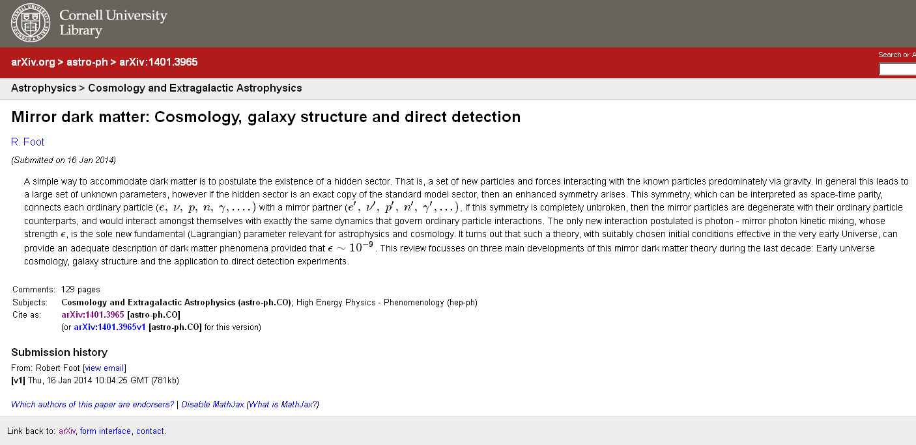
For further details see review:
See this review for detailed references to the literature

Slide 3
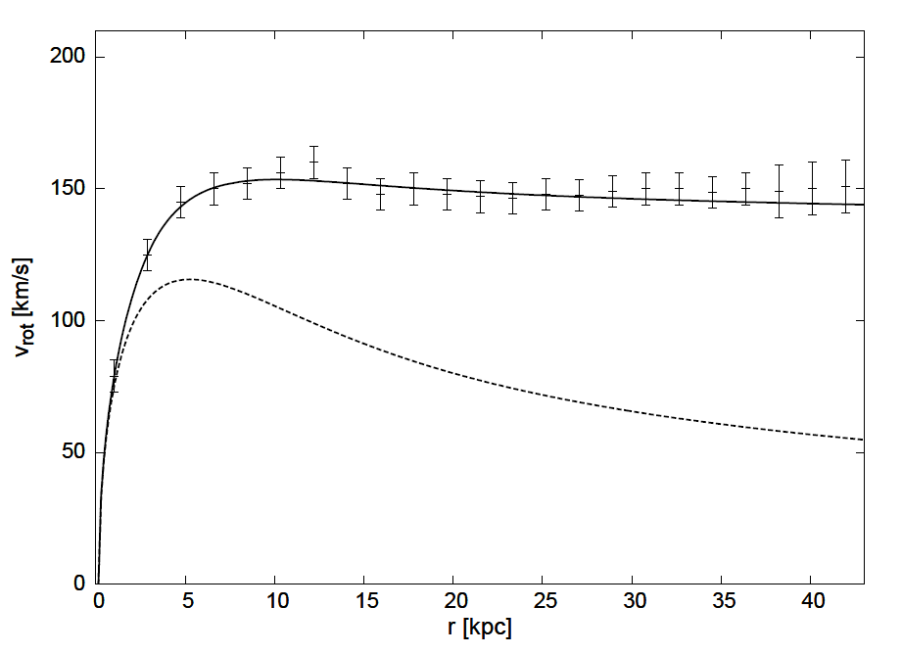
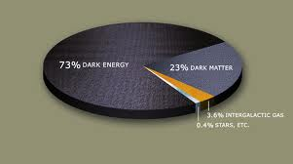
Evidence for non-baryonic dark matter
Rotation curves in spiral galaxies: E.g. NGC3198
Lambda-CDM Model
Suggests 23% of the Universe consists of non-baryonic dark matter

Slide 4

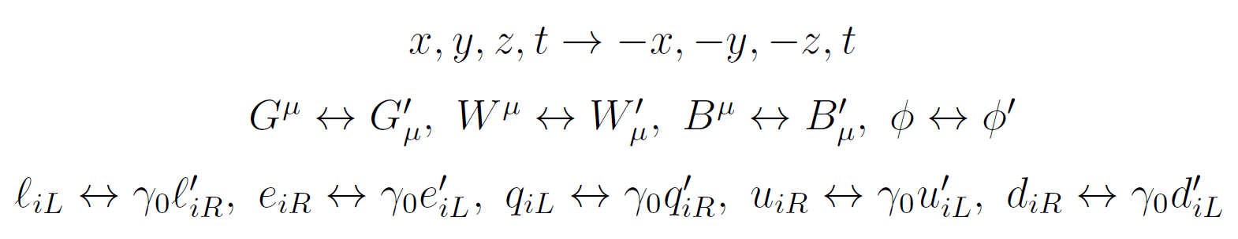
What is dark matter?
Dark matter might arise from a ‘hidden sector’:
Such a theory generally has accidental U(1) symmetries leading to massive stable fermions. Such a theory is also very poorly constrained by experiments.
An interesting special case is where is ‘isomorphic’ to the standard model:
There is a symmetry swapping each ordinary particle with its mirror partner. If we swap left and right chiral fields then this symmetry can be interpreted as space-time parity:

Slide 5
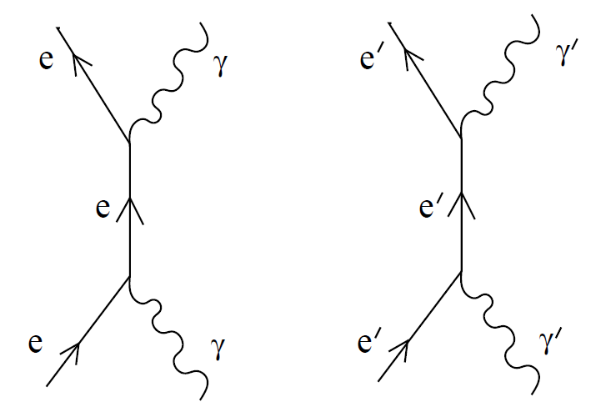

Mirror dark matter with kinetic mixing
Mirror dark matter has a rich structure: it is multi-component, self interacting and dissipative. Importantly there are no free parameters describing masses and self interactions of the mirror particles!
Exact symmetry implies:
m_{e’} = m_{e} , m_{p’} = m_{p ,} m_{γ’} = m_{γ} = 0 etc
and all cross-sections of mirror
particle self-interactions the same
as for ordinary particles.
Also, ordinary and dark matter almost decoupled from each other. Only gravity and photon-mirror photon kinetic mixing important for dark matter.
Kinetic mixing is theoretically free parameter, preserves all symmetries of the theory, and is renormalizable.

Slide 6
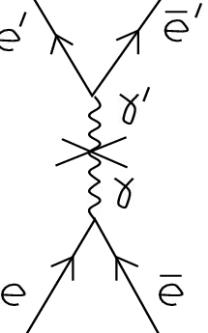
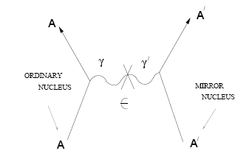

Kinetic Mixing
The physical effect of kinetic mixing is to induce tiny ordinary electric charges for mirror particles. This means that they can couple to ordinary photons:
Important for cosmology, supernova’s, Galactic structure,
if
Important for direct detection experiments, such as DAMA, CoGeNT etc if

Slide 7

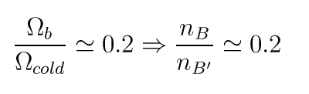
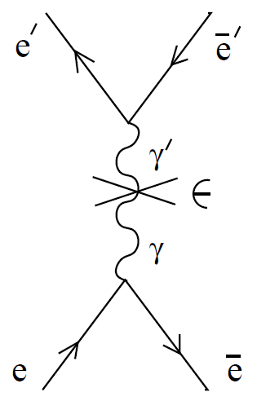
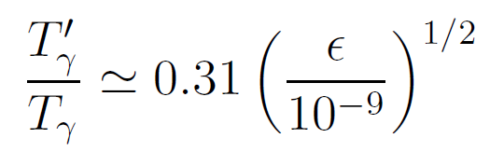
Early Universe cosmology
Consistent early Universe cosmology requires suitable initial conditions.
In addition to standard adiabatic (almost) scale invariant density perturbations, need:
(1) BBN/CMB
(2) CMB
But kinetic mixing interaction can produce entropy in mirror sector leading to non-negligible T’/T :
This means that at early times, mirror hydrogen was ionized. Mirror particles undergo acoustic oscillations prior to mirror hydrogen recombination.
Can suppress small scale structure if

Slide 8
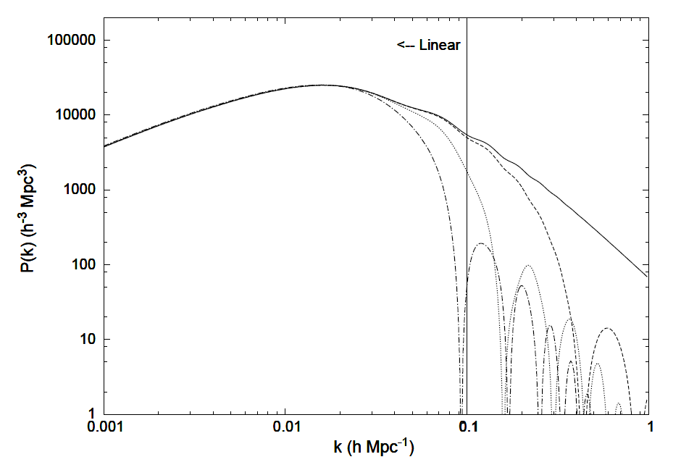
Implications of kinetic mixing for matter power spectrum
x= 0 equivalent to standard cold dark matter model
x= 0.7
x= 0.3
x= 0.5

Slide 9
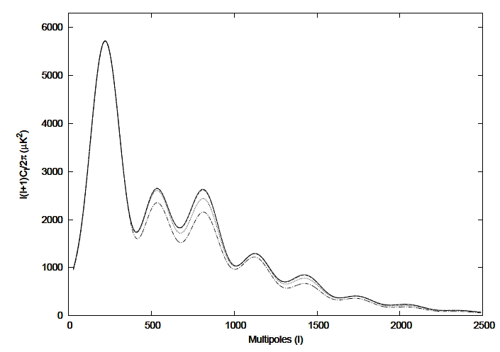
Implications of kinetic mixing for CMB
x= 0 equivalent to standard cold dark matter model
x= 0.5
x = 0.7
Current observations limit x = T'/T < 0.3-0.4.

Slide 10
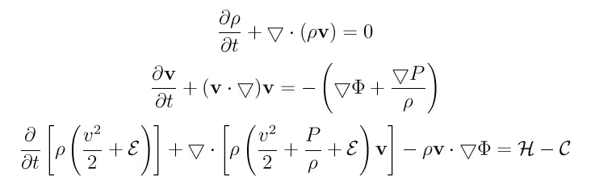
Galaxy structure
Mirror dark matter is collisional and dissipative.
Mirror particle halos of galaxies are composed of a plasma containing: e’, H’, He’, O’, Fe’ ….
This plasma can be modelled as a fluid, described by the Euler equations:
Halo heating supplied by Supernova generated γ’
Cooling due (mainly) to bremsstrahlung.

Slide 11
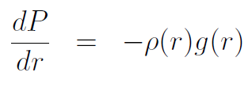
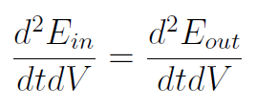
Spiral galaxies today
If system evolves to a static configuration then v=0 everywhere.
If this happens the equations reduce to two relatively simple equations, if spherical symmetry assumed:
Hydrostatic equilibrium
Energy balance equation: Heating=cooling
That is, we have two equations for two unknowns, the dark matter ρ(r), T(r) distributions.
Before we can solve these equations, need to identify the heat source.

Slide 12
Ordinary Supernova can supply required heat for the Halo
Supernova core temperature ~ 30 MeV.
In standard theory, core collapse energy (~310 ⁵³ ergs) is released in neutrinos.
If mirror sector exists with kinetic mixing: , then ~1/2 of the core collapse energy will instead be released into light mirror particles: e⁻’, e⁺’, γ’.
In the region around the supernova, this energy is ultimately converted into mirror photons.
Detailed energy spectrum is difficult to predict. If a substantial fraction of these photons (> ~ 10%) have energy less than ~30 keV, then they can provide a substantial heat source ~10⁴³ erg/s (for MW galaxy).

Slide 13





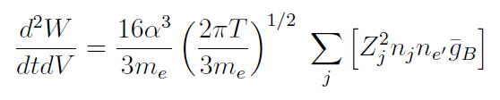
Dynamical halo model
Governed by a) heating b) cooling c) hydrostatic equilibrium
These two equations can be used to work out T(r) and ρ(r), given a known baryonic matter distribution and supernova rate
Supernova rate
Approximate E_{out} with thermal bremsstrahlung rate

Slide 14
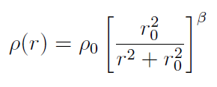
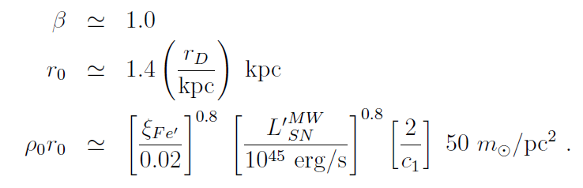
Spiral galaxies today
Numerically solve the equations for a `generic’ spiral galaxy of stellar mass m_{D} , disk scale length r_{D} .
Find that dark matter parameterized via:
gives solution to the hydrostatic equilibrium equilibrium and energy balance equation, iff:

Slide 15
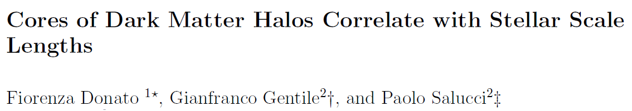
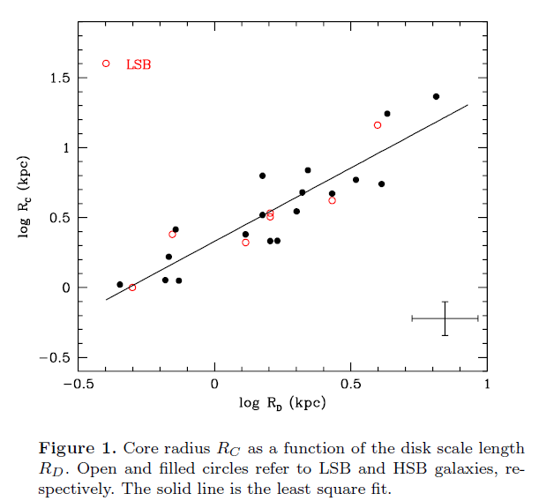

Slide 16
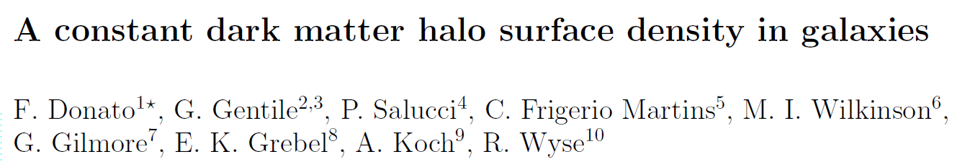
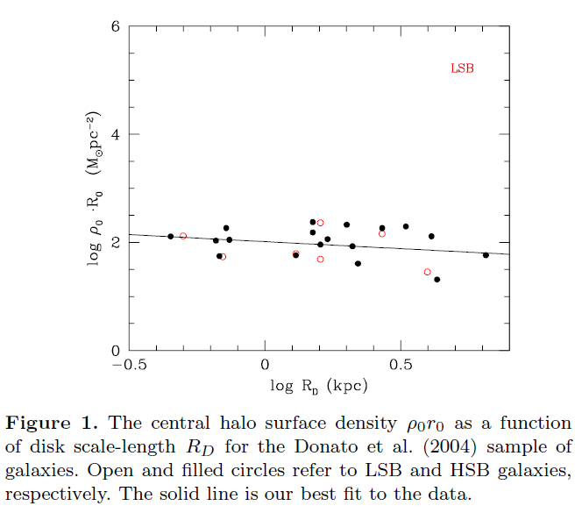
Constant halo surface density first discussed by Kormendy and Freeman – 2004 and further studied by Donato et al.

Slide 17
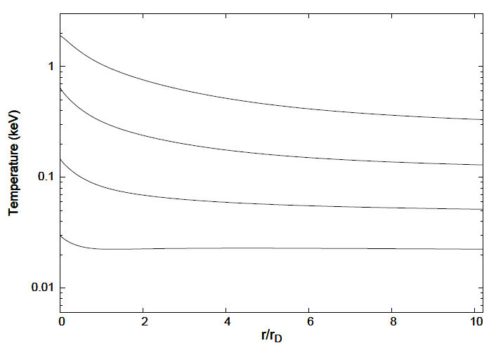
Spiral galaxies today – derived temperature profile

Slide 18
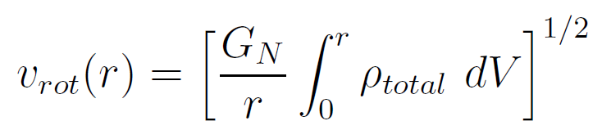
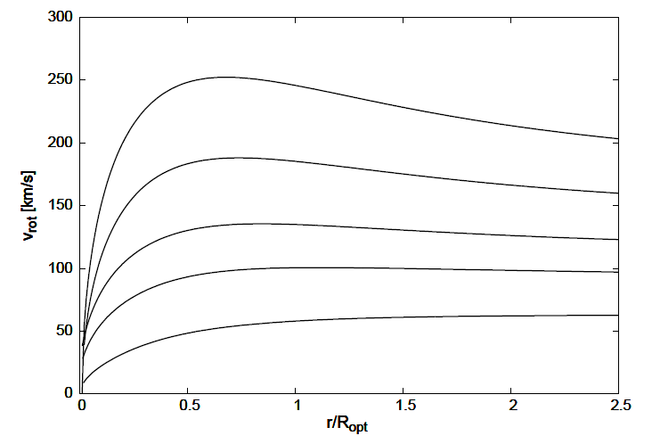
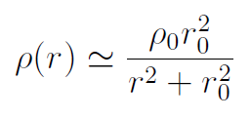
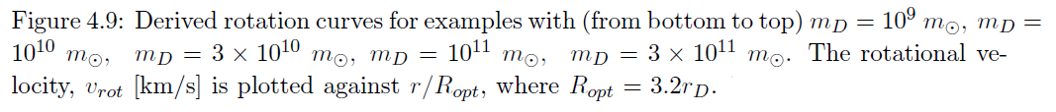
Spiral galaxies today derived rotation curves
ρ_{total} = ρ_{baryons} + ρ_{dark matter}

Slide 19
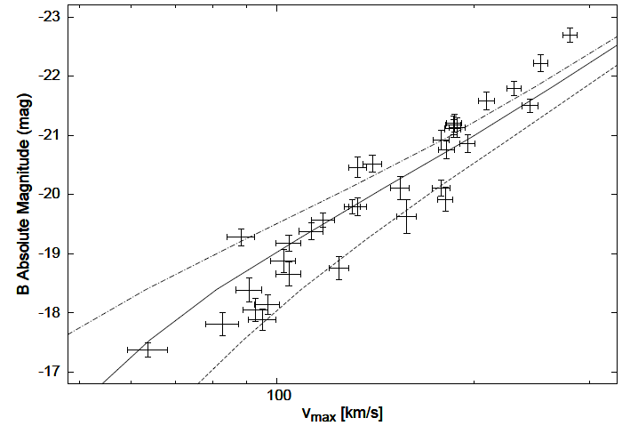
Spiral galaxies today – Tully Fisher relation
Data: Webster et al, 2008

Slide 20
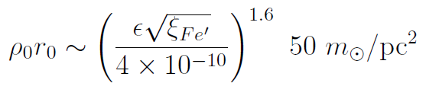

Spiral galaxies today
Derived mirror dark matter density profile:
Putting in epsilon dependence in last equation:

Slide 21



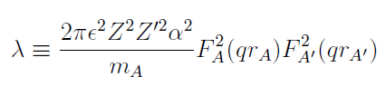

Mirror dark matter – direct detection
Rate depends on cross-section and halo distribution:
Halo distribution is Maxwellian with
The bottom line:

Slide 22





Mirror dark matter – direct detection
Mirror dark matter has 3 key features:
It is multi-component and light: H’, He’, O’, Fe’,…
Interacts via Rutherford scattering.
Halo velocity dispersion can be very narrow.
Mirror metal nuclei have masses and thus
This might help explain why higher threshold experiments do not see a signal.
Mean mass of particles in halo
Galactic rotation velocity

Slide 23
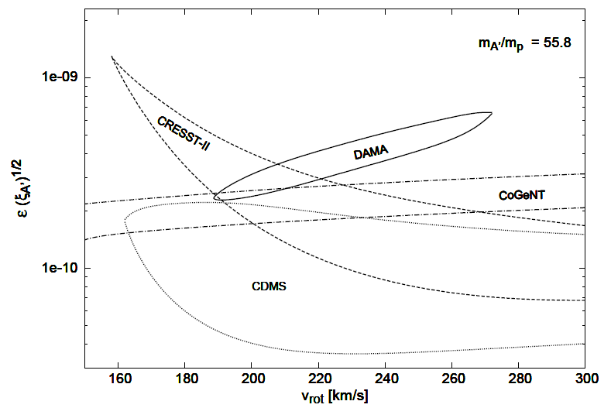
Mirror dark matter – direct detection

Slide 24
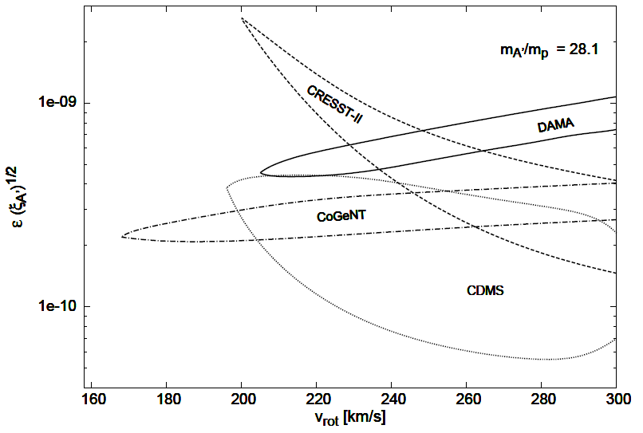
Mirror dark matter – direct detection

Slide 25
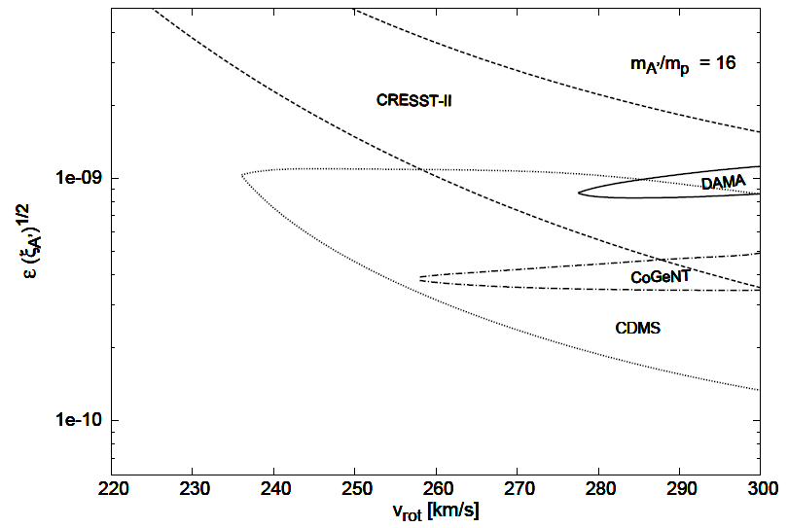
Mirror dark matter – direct detection

Slide 26
Mirror dark matter – direct detection

Slide 27
Conclusions
Evidence for non-baryonic dark matter from rotation curves in galaxies,
and precision cosmology.
Dissipative dark matter candidates are possible. Mirror dark matter
presents as a well motivated predictive example.
Such dark matter can explain the large scale structure of the Universe,
and recent work has found that it might also explain small scale structure
as well.
The DAMA experiment may have actually detected galactic dark matter!
Support from CoGeNT, CRESST-II and CDMS/Si !
Some tension with LUX and the low threshold superCDMS search.

