Slide 1
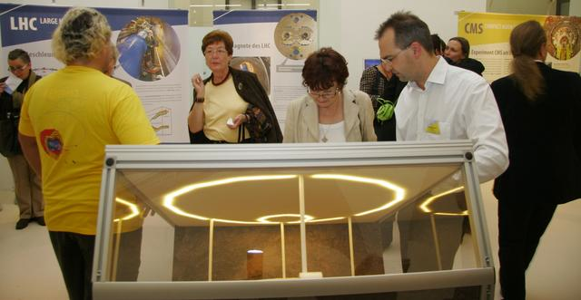
Panel: «Events»

Slide 2
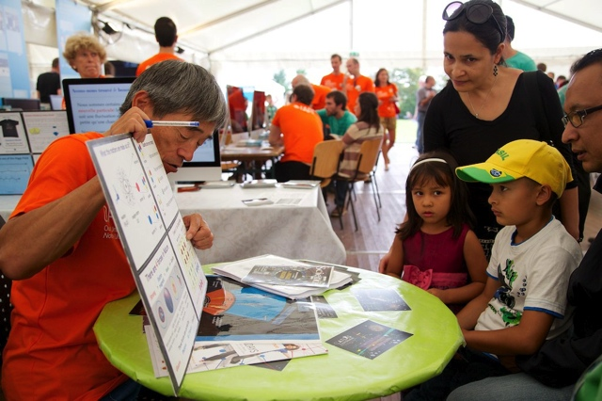

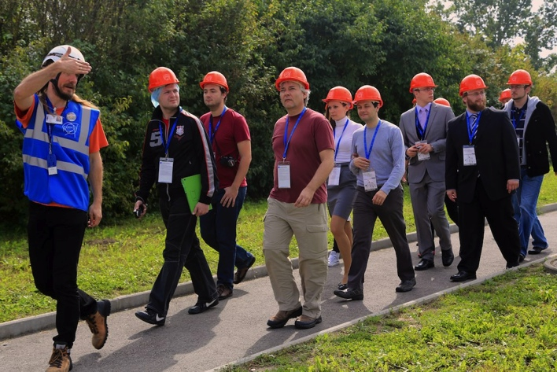
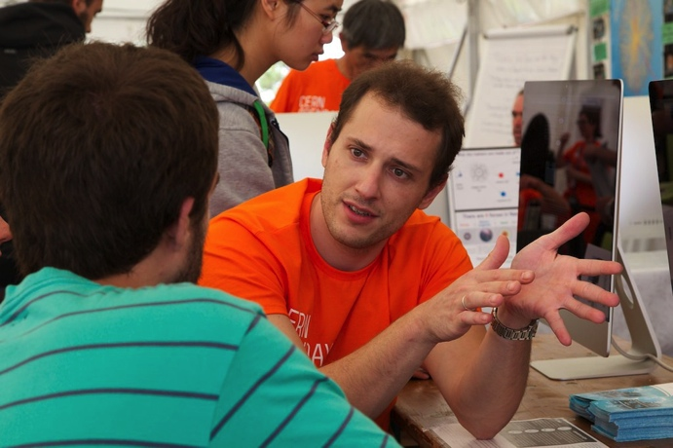
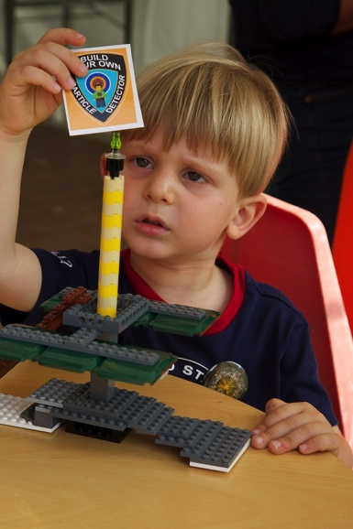
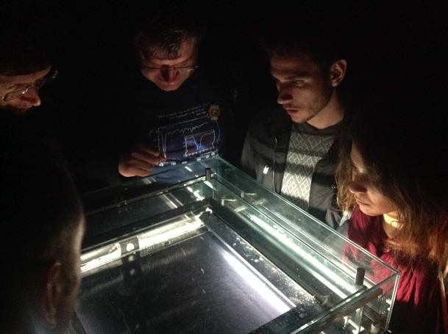
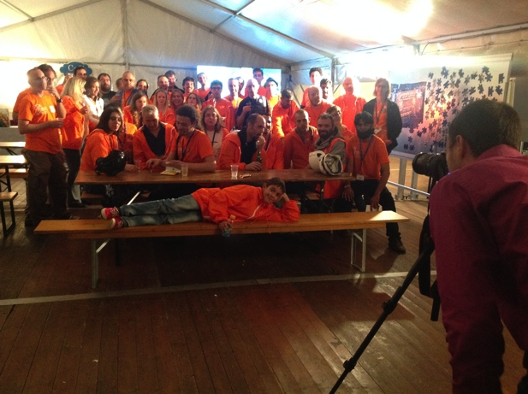
CERN Open Days
Saturday 28th September and Sunday 29th September from 09:00 to 20:00 (http://opendays2013.web.cern.ch)

Slide 3
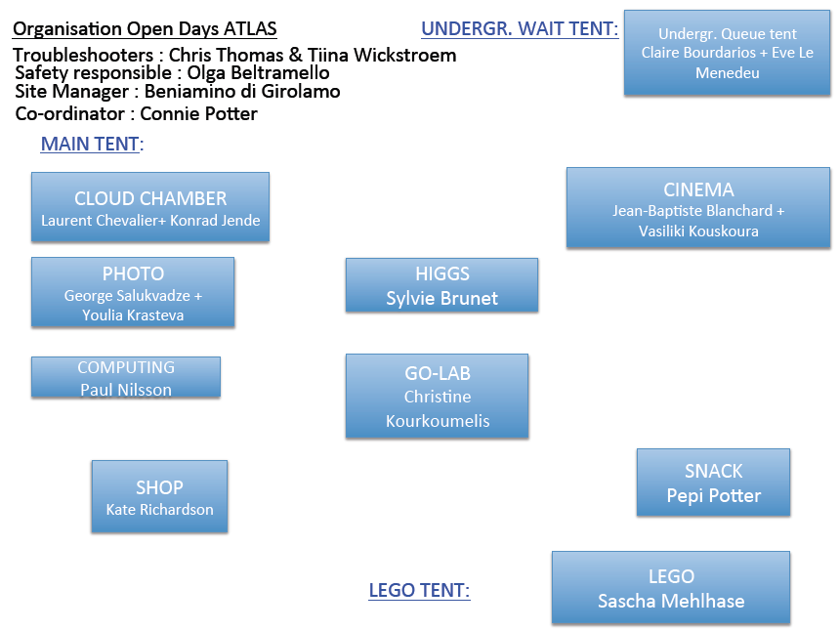
ATLAS Open Days
About 200 volunteers in ATLAS

Slide 4
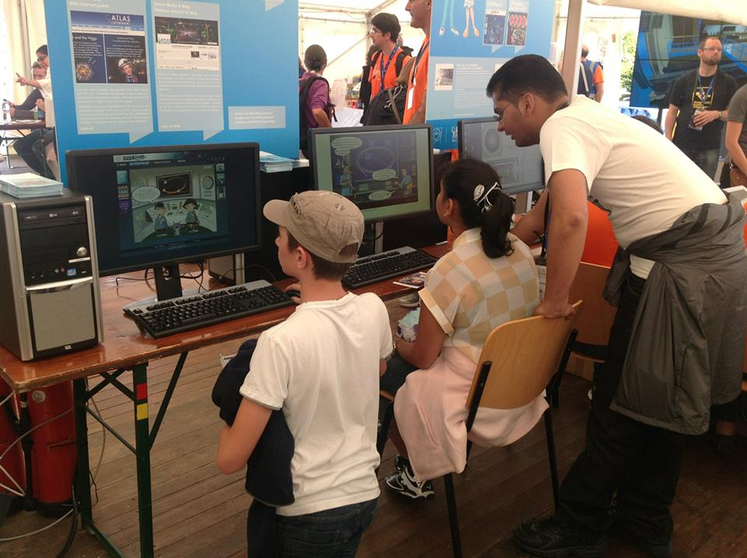
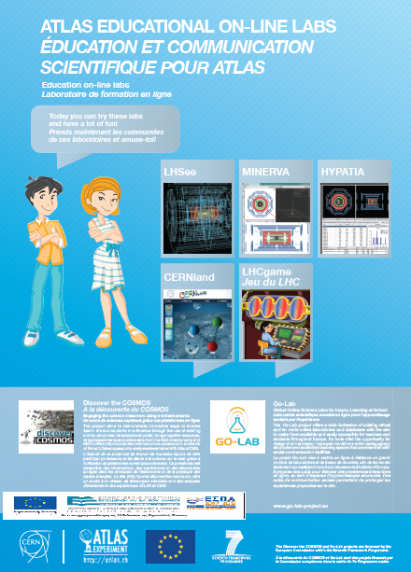
ATLAS Open Days
OPEN DAYS
September 28th-29th 2013
A crowd of about 3,000 visited the “Discover the COSMOS” and “Go-lab” stand in 24 hours and got a
demonstration of our resources
http://www.discoverthecosmos.eu/
http://www.go-lab-project.eu/

Slide 5
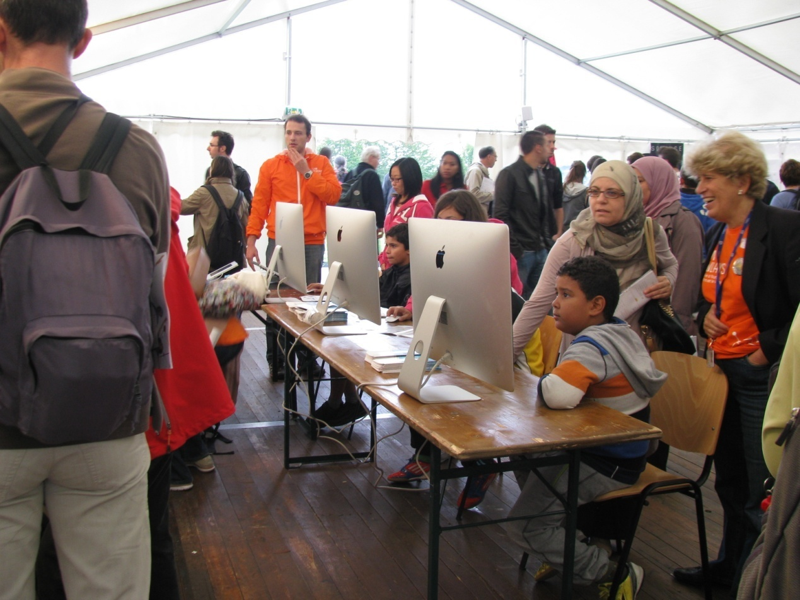
Six large screen PC’s and four ipad’s were set-up to run : MINERVA, HYPATIA, “Collisions”, LHC game and CERNland
ATLAS Open Days
IASA, CERN,
Birmingham, EPFL

Slide 6
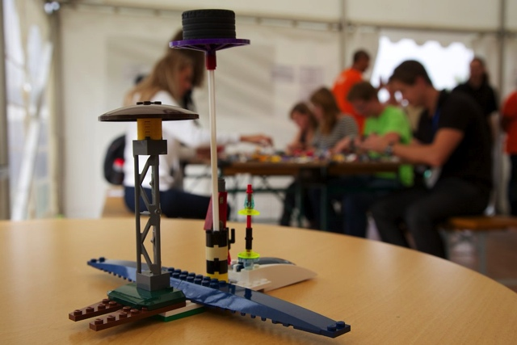
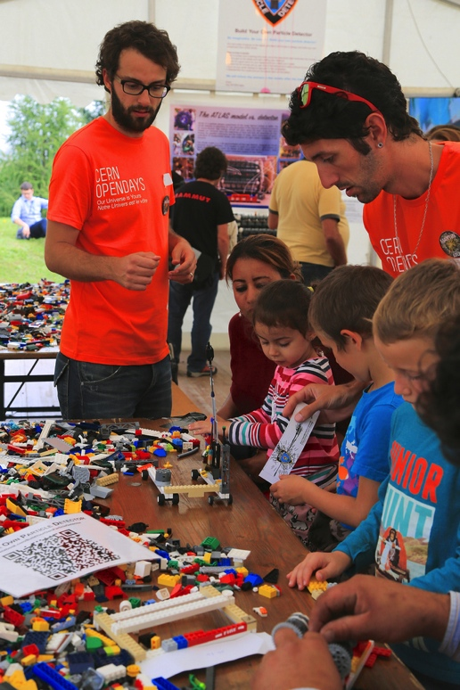
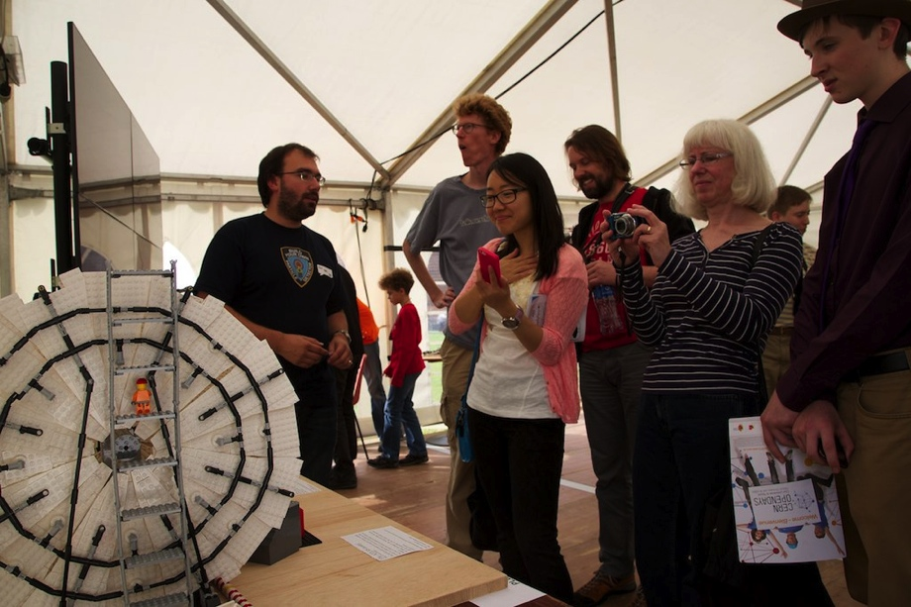
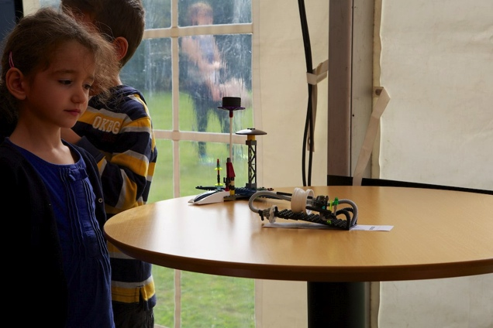
ATLAS LEGO Project
We plan to organize an event ala Masterclasses
where several students will assemble a full
model and record it in a video
http://build-your-own-particle-detector.org

Slide 7
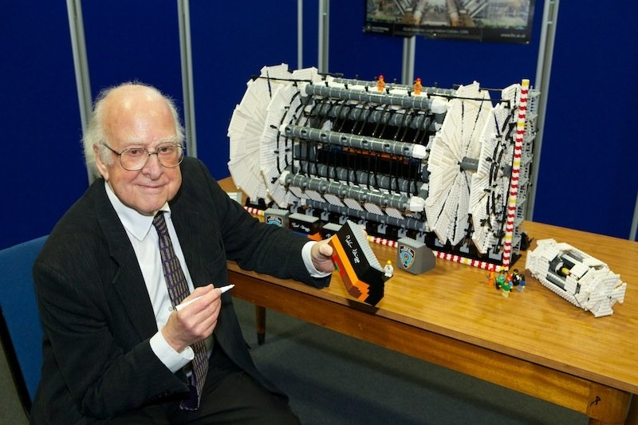
Peter Higgs signing the ATLAS model
@Manchester University

Slide 8


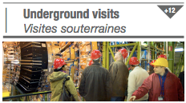
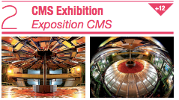
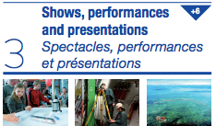
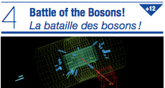
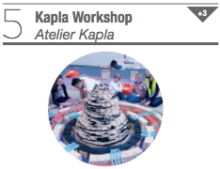
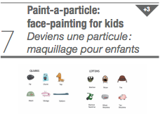
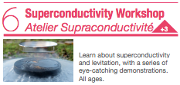

Slide 9
CERN Open Days 2013
CMS - Battle of the Bosons
Developed with Achintya Rao
From events on paper, visitors find:
    Z mass and Higgs mass – mass plot on wall
    W+ vs. W- using W scale
Leads to questions and discussions
Some visitors even helped facilitate

Slide 10
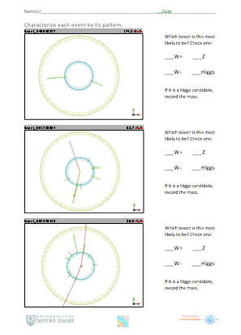
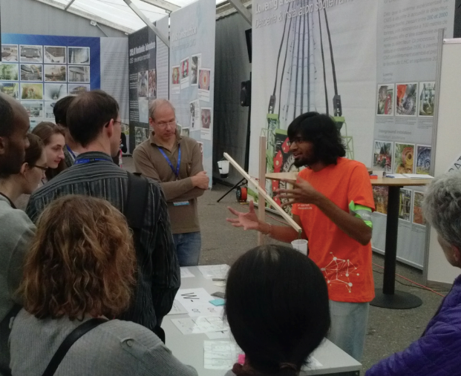
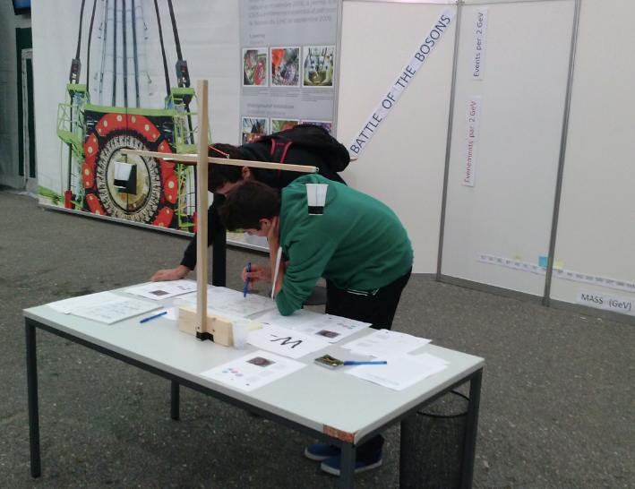
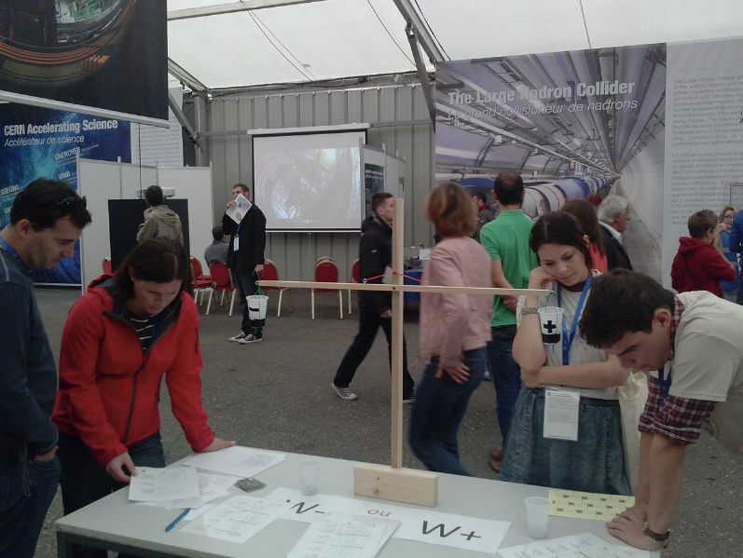
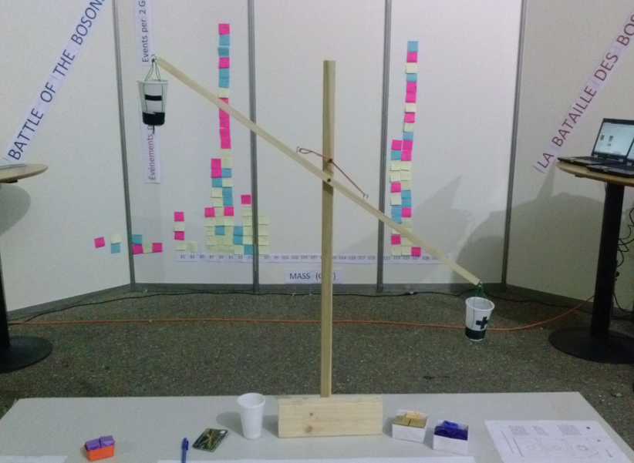
CERN Open Days 2013
CMS - Battle of the Bosons

Slide 11
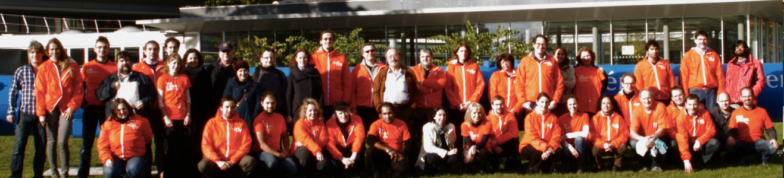
CERN Open Days 2013
CMS – Point 5 activities
About the people:
No. volunteers ~200
No. visitors underground in 2 days ~5500
Teams:
  Tech Coord & Comm
  CMS Collaboration, volunteers
Pictures: http://cds.cern.ch/record/1604231

Slide 12
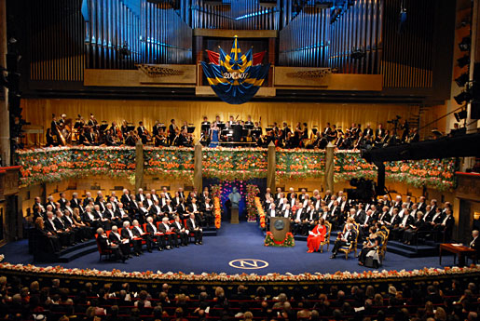
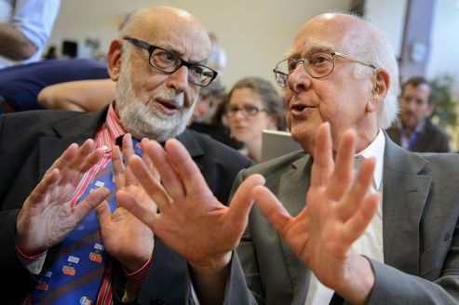
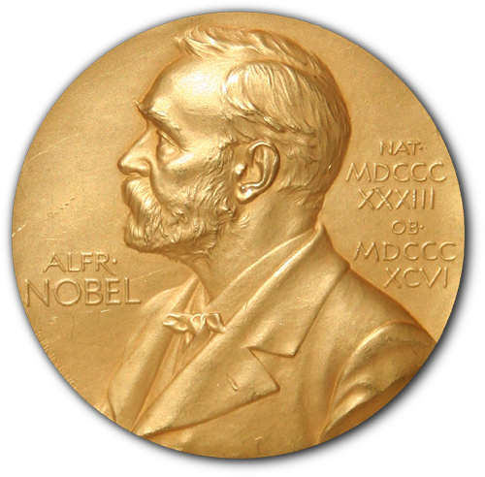
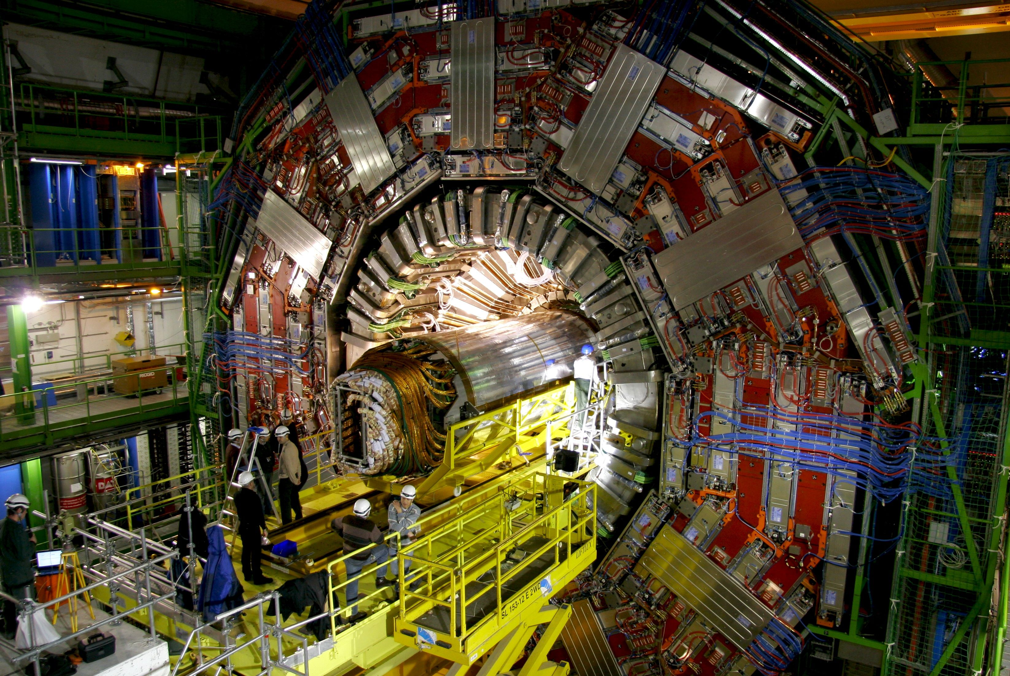
Panel: «Events»
Special events: Higgs Nobel prize 2013

Slide 13
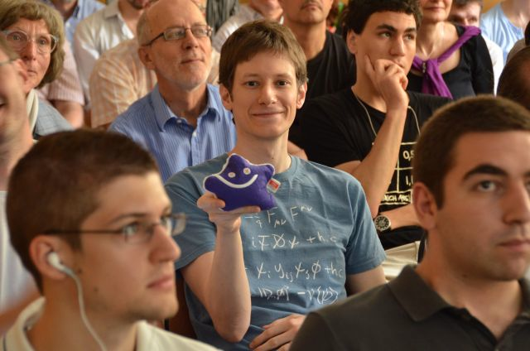
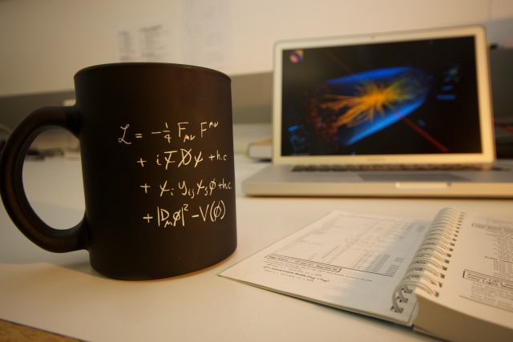
Higgs Nobel prize ceremony day
HEPHY Open Day
Location: High energy physics institute (HEPHY) in Vienna
Date: 10th Dec.2013, 11:00 h – 18:00 h
Presentations: „The Largest Accelerator of the World“ and „Discovery of the Higgs Boson“
Live guided CMS tour (Michi Hoch per helmet camera)
Guided tours showing the institute departments
Live stream of the Nobel Prize Award Ceremony
in Stockholm
Science Cafe „Ask the experts“

Slide 14
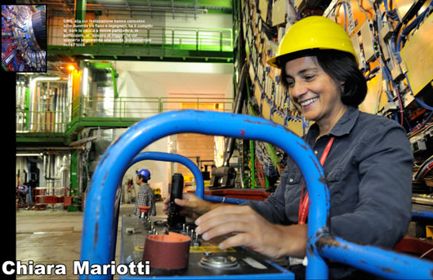
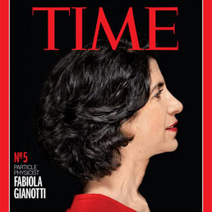
Higgs Lectures in Vienna
31st October 2013: Title „How we discovered the Higgs-Boson“ by Chiara Mariotti
HEPHY (Vienna) –Vienna University of Technology, ceremonial hall
25th November 2013: Title „The Higgs-Boson and our life” by Fabiola Gianotti
Smart Lecture at the CeMM (Research Center for Molecular Medicine) of the Austrian Academy of Science

Slide 15
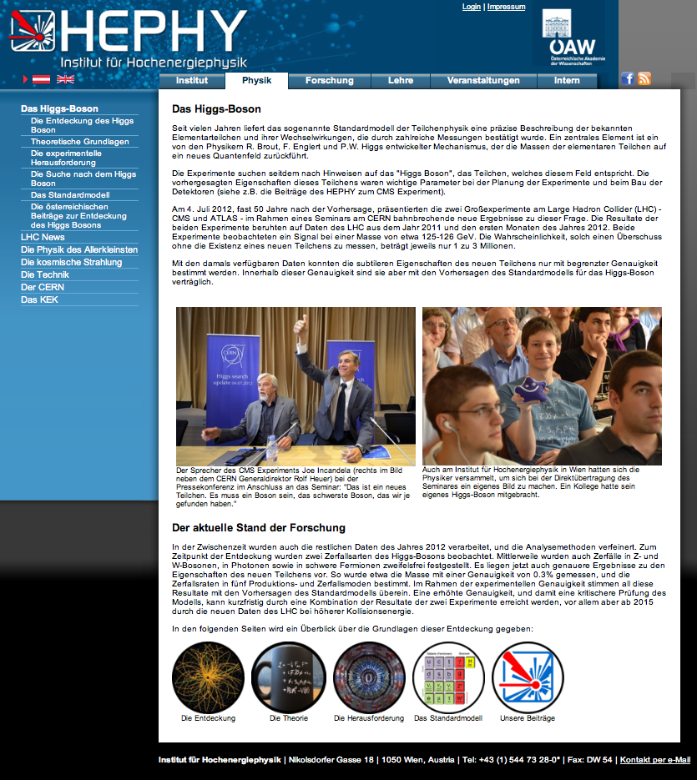
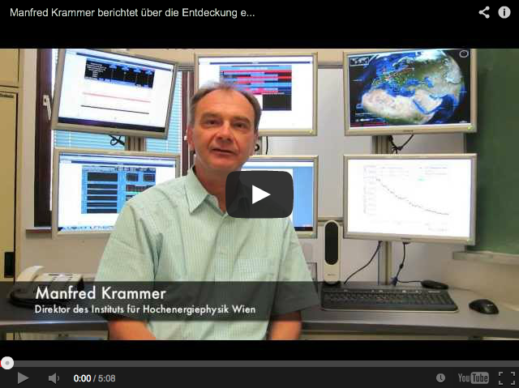
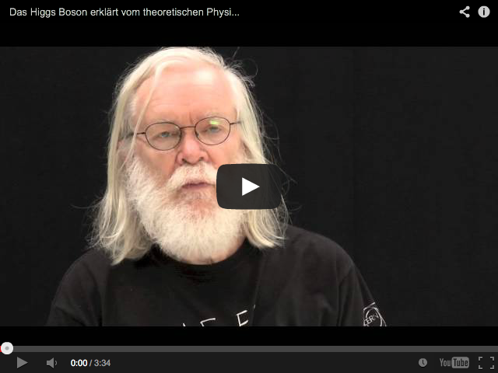
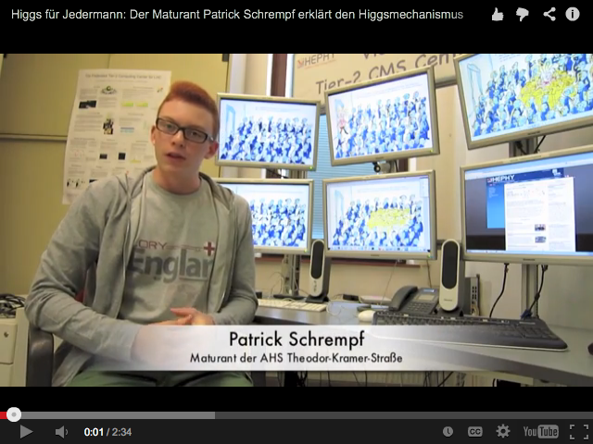
The Higgs Boson
HEPHY Higgs website
Informations about the Higgs incl. videos
Web-link:
higgs.hephy.at

Slide 16
ATLAS
Recent and Upcoming Events
LS1 : Underground Visits
LS1 : National Media Visits
17, 18 July 2013 : CERN @ Montreux Jazz Festival
27 Sep 2013 : Origin Night
27 Sep 2013 – 29 Sep 2013 : CERN Open Days
30 Sep 2013 : Bosons & More
08 Oct 2013 : Physics Nobel Prize Announcement
12 Nov 2013 : Science Museum, London LHC Exhibit Starts

Slide 17
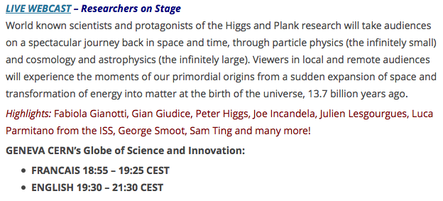
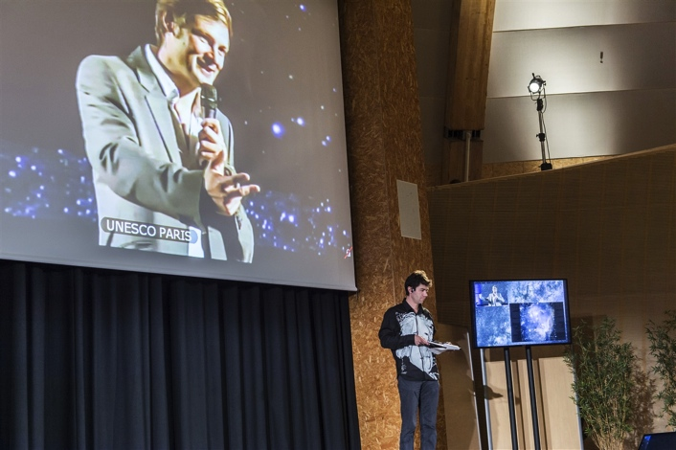
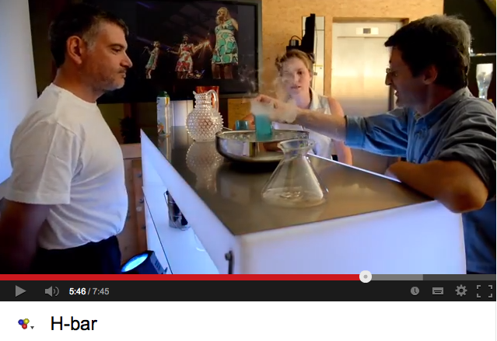
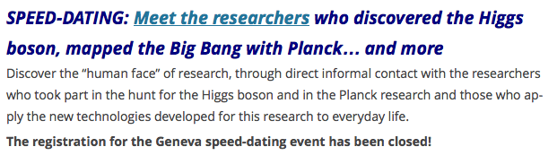
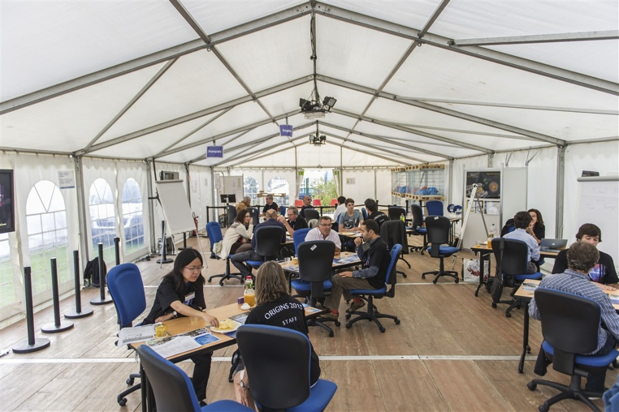
ATLAS Nuit d’Origins as part of the European researchers’ night
Origins Night (http://www.origins2013.eu)
  27th September 2013
  Speed Dating the Public (ATLAS Queue Tent, Globe, Microcosm)
  Show + Video Connection in Globe
  Participants: INAF, UNESCO, EU, ESA, ESO, INFN, CERN

Slide 18

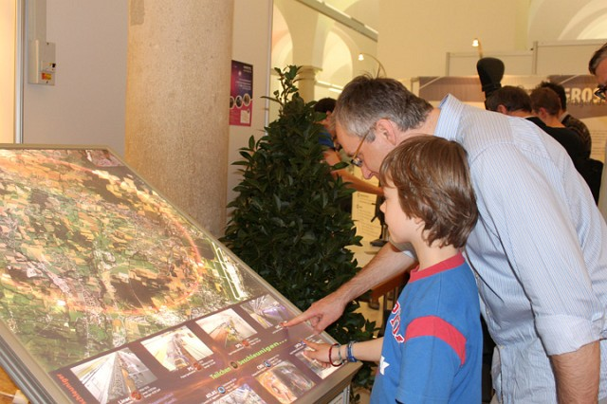
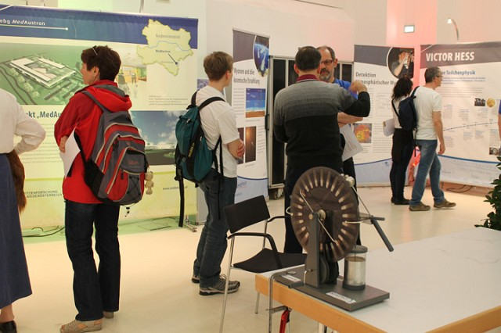
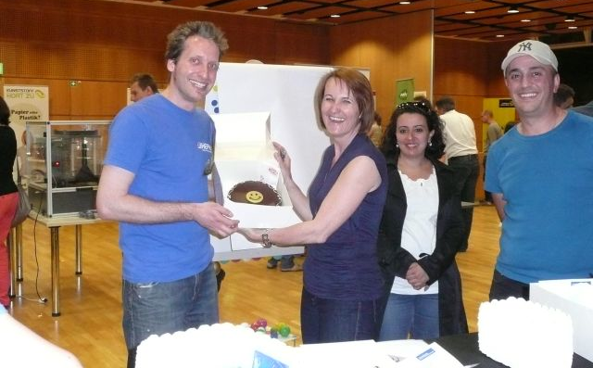
Long night of research in Austria
Date: 4. April 2014
Locations: in many Austrian cities, at universities, research centers and other institutes
HEPHY institute exhibition in Vienna: Austrian Academy of Science, hall of science
CERN DG Rolf Heuer is invited (60 years CERN celebration)
“60 years CERN” post stamp will be sold there (special post office!)

Slide 19
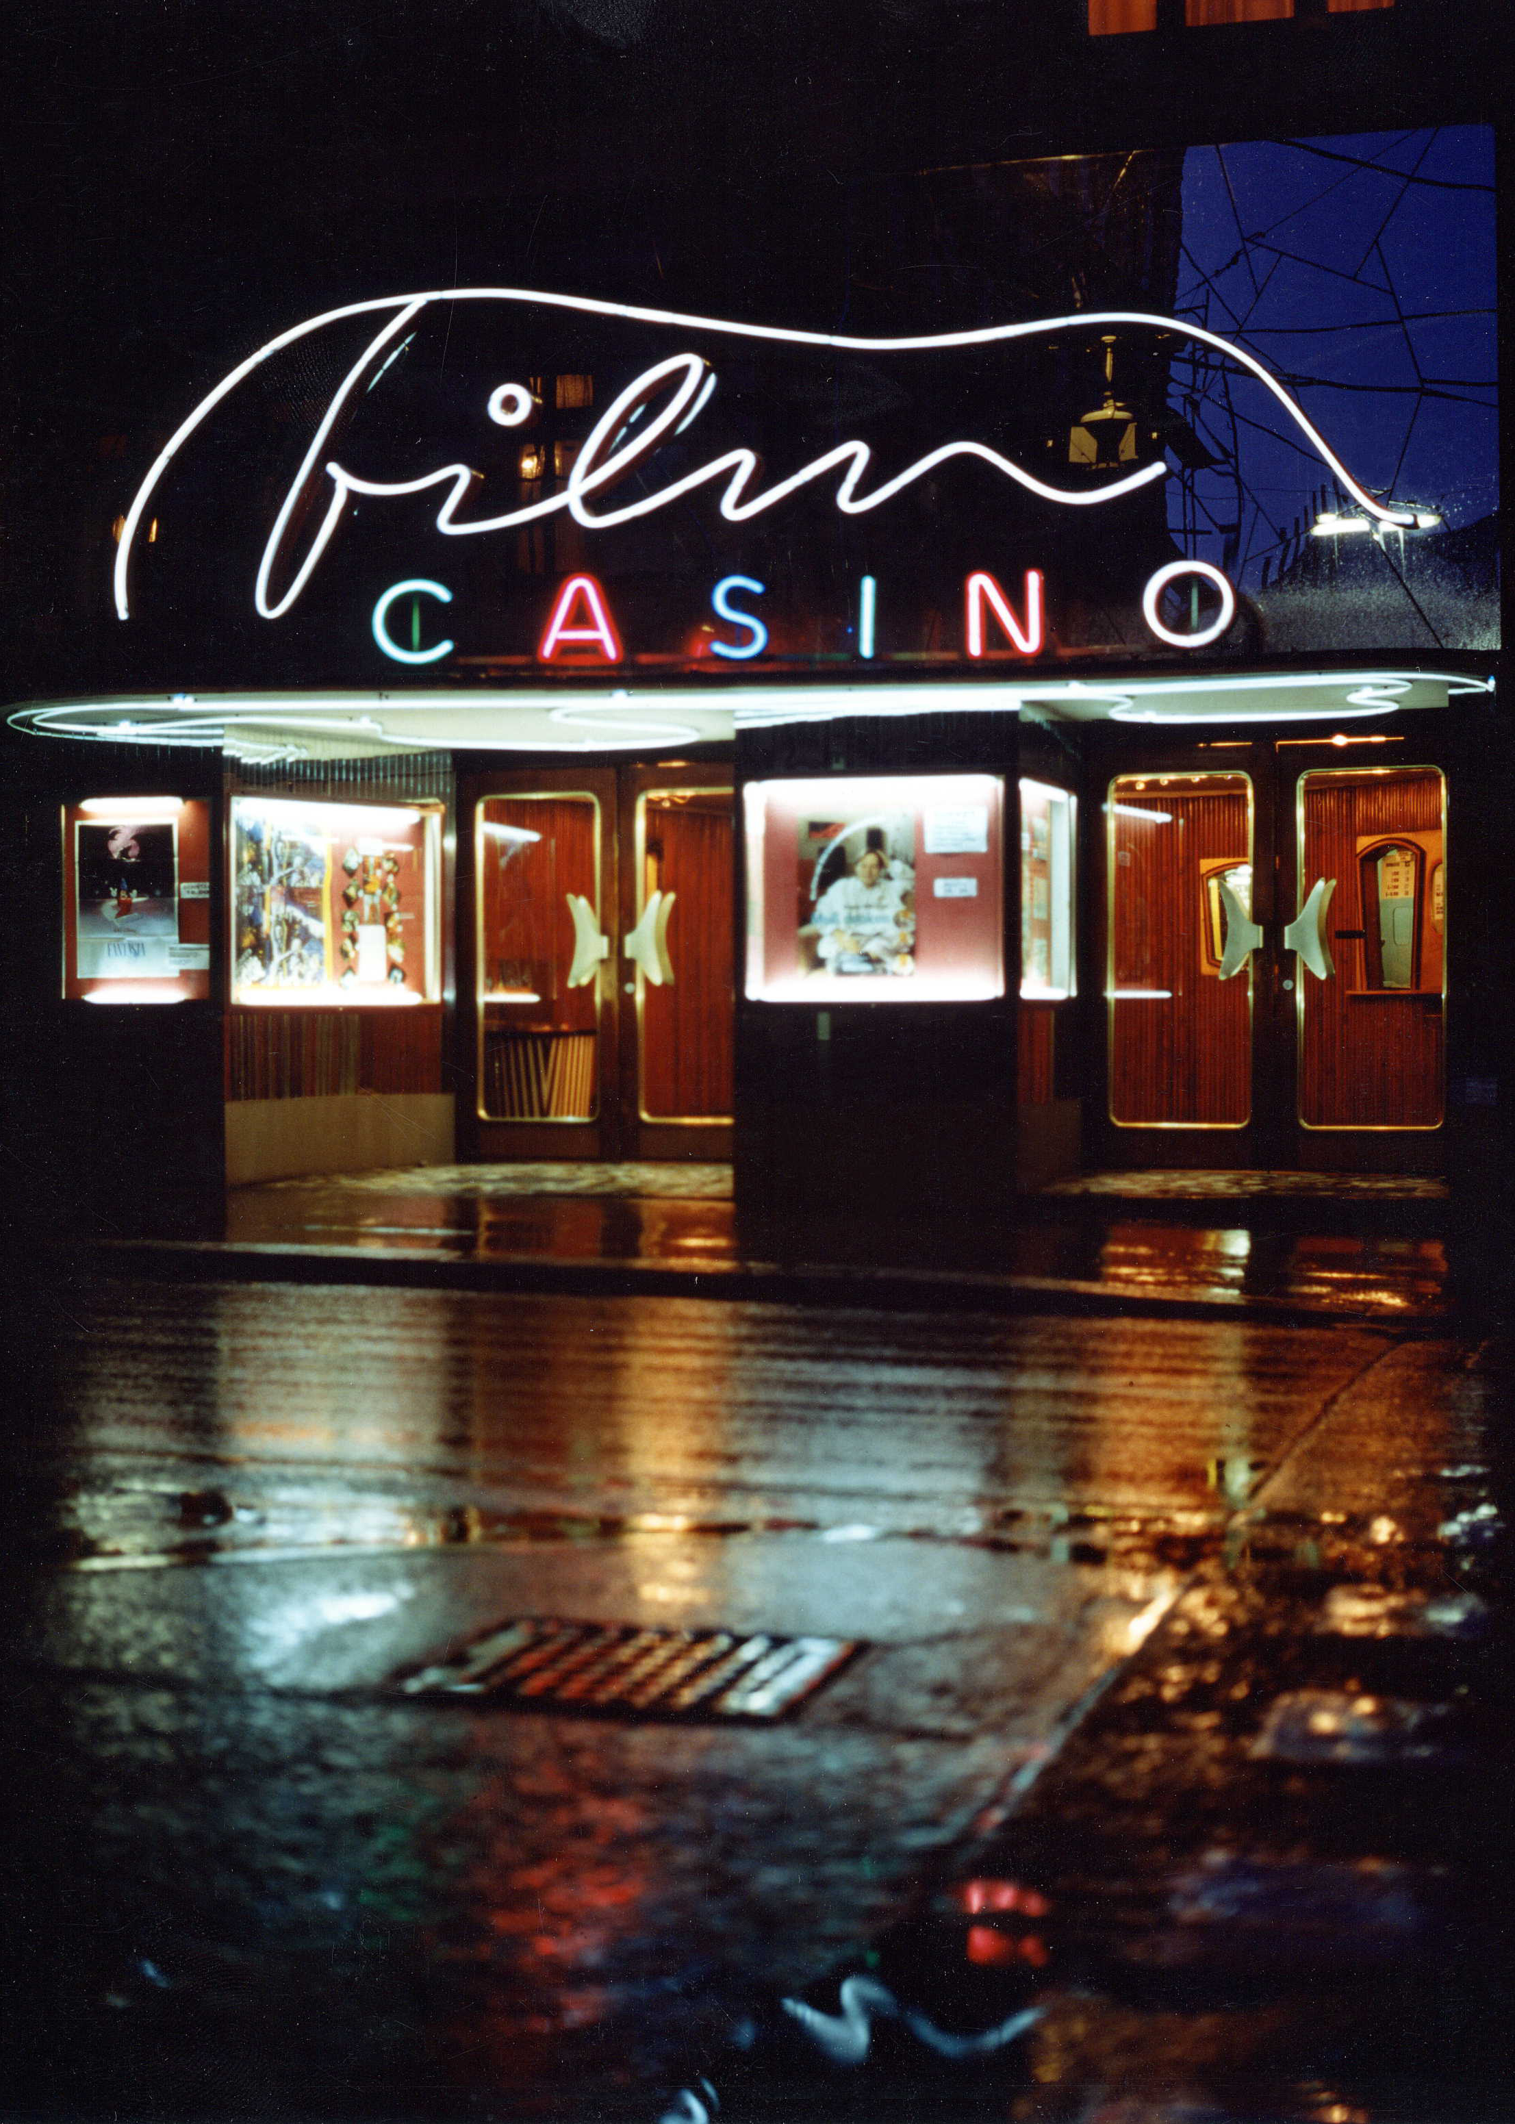
Film festival in Vienna
Particle physics film festival in the cinema “Filmcasino” in Vienna
We will show
  Documentations about particle physics
  Feature film with the topic particle physics or physics in general
  Presentations about particle physics and the Higgs boson

Slide 20


Discover the COSMOS International Conference
(Volos, Greece, August 2013)
4 Keynote Talks
Prof. Ton De Jong
University of Twente
Dr. Mick Storr
CERN
Prof. Carl Pennypacker
University of California @ Berkeley
Dr. Dan Karmgard*
University of Notre Dame
*QuarkNet Program Representative
($6.1 millions for training 500 high school teachers)
36 Presentations
8 Virtual Presentations
17 Posters (Poster Session)
Science Cafe
Quarknet speaker and EEE events were invited

Slide 21


Vilnius ICT 2013 Conference and Exhibition 6-8/11/2013

Slide 22

Panel: «Events»
Real and Virtual Visits

Slide 23
ATLAS Underground Visits
Evolution of Visit / Visitor Numbers
  Compiled by Lucie Loiseau
  Each sampling period about 3 months

Slide 24
ATLAS Underground Visits
2012
Mar-May 2013
Jun-Aug 2013
Evolution of VIP Visit Composition

Slide 25
ATLAS National Media Visits (full schedule; demands almost every day)
Date | Media
15-16 Apr | UK
23-24 Apr | Austria
07-08 May | Bulgary
14-15 May | France / Belgium
28-29 May | Czech
11-12 Jun | Danmark
17-18 Jun | USA
25-26 Jun | Greece
09-10 Jul | Hungary
17 Jul | Local Media
23-24 Jul | Germany
20-21 Aug | Sweden
03-04 Sep | Portugal
08-09 Oct | Italy
Date | Media
29-30 Oct | Netherlands & Belgium
05-06 Nov | Norway
19-20 Nov | Slovakia
26-27 Nov | Poland
03-04 Dec | Spain
17-18 Dec | Finland
14-15 Jan | Switzerland
28-29 Jan | Romania
11-12 Feb | Israel
25-26 Feb | Serbia
04-05 Mar | India
18-19 Mar | Japan
01-02 Apr | Russia
15-16 Apr | Turkey
http://press.web.cern.ch/press-viits-over-long-shutdown-lhc

Slide 26

ATLAS Virtual Visits
To be expanded to cavern visits using iPad’s
60 visits in 2013 and the year is not finished yet !!
http://cern.ch/atlas-virtual-visits

Slide 27

Panel: «Events»
Education and Masterclasses

Slide 28

The new EU projects
Go-Lab (Nov.2012-Nov.2016, 20 partners)
To build science laboratory IBSE
infrastructure for schools
“on line” labs (federation of labs)
http://www.go-lab-project.eu/
Inspiring Science Education (April 2013
+40mo,31 partners)
Get access to the tools to teach
Large pilots for schools continuation of “DtC”
in larger and wider scale
http://inspiring-science-education.eu/

Slide 29

CERN Council updated the European strategy for particle physics at the European Commission meeting
European Strategy meeting in Brussels 30th May 2013
“Discover the COSMOS” and “Go-lab” were one of the ten “talking” points presented as “on-line labs” to CERN council, ministers and EU officials
The Strategy report brochure distributed under chapter “society and skills” stated:

Slide 30
Educational -On-Line Labs
http://www.go-lab-project.eu/

Slide 31



The basic idea of the dedicated “Go-Lab” stand was to show to the public what the “events”->”results of high-energy particle collisions”, are and how they can “analyse”=”play around” with them
EDUCATIONAL ON-LINE LABs
In ATLAS we have the following tools:
HYPATIA
Collisions
MINERVA
Two versions
Phones+tablets

Slide 32





Local Masterclasses, e-Masterclasses
Masterclasses @schools
  20 schools all over Greece (Komotini to Crete)
    Students learn how actually science goes”
    Listen to lectures
    Follow a virtual visit to ATLAS control room
    Analyse events with the HYPATIA applet tool
e-Masterclasses
  Dutch (9) & Polish (43) students (Nov12)
    “Learn how actually science goes”
    Teachers’ role (e.g. HST12 participants)
    Targeting extended group visits
    Synergies with local-level MCs
    + CERN Hangouts (Polish students)
    + CERN Mini Expo (Santiago de Compostela)
…

Slide 33

May 2012-2013 more than 15 cities visited

Slide 34


Special Masterclass session
U.Bilow (TUD),M. Bugge(Oslo),S.Vourakis and C.Kourkoumelis (IASA)
talked about ATLAS MC
K.Cecire talked about
CMS MC
P. Di Nezza and M.A.Janik
talked about ALICE MC
Hands-on session during the poster session
http://indico.cern.ch/conferenceDisplay.py?confId=198153

Slide 35

“Go-Lab” and “Discover the COSMOS’ summer schools (Volos,Greece, August 2013)

Slide 36

Teacher training in the UK
Annual event for teachers
 | Sunday 21st | Monday 22nd | Tuesday 23rd | Wednesday 24th | Thursday 25th | Friday 26th
 |  |  |  | RAL
Lecture 1 10:00-11:00 |  | Ken Peach Rutherford Appleton Laboratory (10:30 Lecture) “Smashing Machines: What Accelerators Do For Me” | David Smith Brunel University “Space Physics” | C | Lee Thompson Sheffield University “Particle-AstroPhysics” | Julia Sedgbeer Imperical College “Neutrinos”
Lecture 2 11:30-12:30 |  | Bill Scott Rutherford Laboratory (11:45 Lecture) “Particles and Forces” | Glen Cowan Royal Holloway “Discovering the Particle of Nature” | E | Steve Watts Manchester University “Detecting elementary particles - finding mice in the kitchen” | David Evans Birmingham University ALICE
Lunch
Lecture 3 14:30-15:30 |  | Tour Of RAL | Jo Cole Brunel University “Top Quarks” | R | Phil Burrows Oxford University “Particle accelerators: making Higgs bosons, and much more!”
Lecture 4 16:00-17:00 | Reception 17:00 |  | Akram Khan Brunel University | N | Peter Hobson Brunel University “CMS”

Slide 37

ATLAS Book

Slide 38

LHC Pop-up Book

Slide 39
ATLAS – Near future activities
Continuous media visits
CERN “large” exhibition visits Greece
(Athens, Thessaloniki) next April
Public lectures
New scenaria with HYPATIA
Continuous mini-masterclasses and
e-masterclasses in schools in fall
Events at any given occasion…

