Slide 1


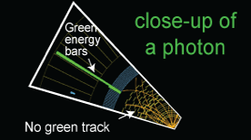

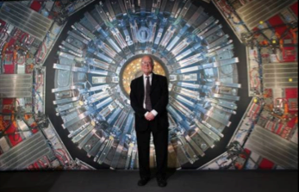

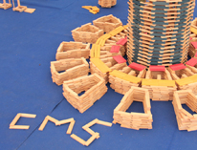
Panel: Exhibitions & Exhibits
Natascha, Uta/Michael, Marzena, Pedro, Pete, Marge

Slide 2
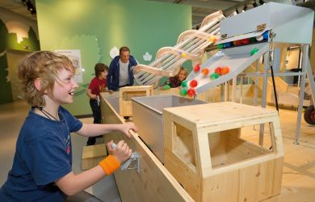
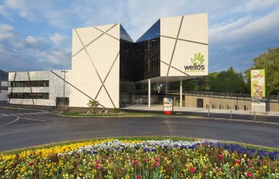
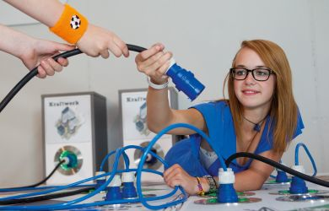
Austria
Austrian Special Exhibition in the Science Center Welios (Wels) –
Upper Austria
Cooperation between Welios (www.welios.at) and the Institute of High Energy Physics (HEPHY) in Vienna
Location: 300 m² hall for special exhibitions
Time: October 2014 – January 2015
Additional to the permanent exhibition
Showing an updated HEPHY traveling exhibition
More exhibits e.g. from DESY/weltmaschine.de, CERN, MedAUSTRON and CMS art work from Michi Hoch
Special program for school groups

Slide 3
Germany
2 exhibitions in Germany:
Bonn:
Bremen:

Slide 4
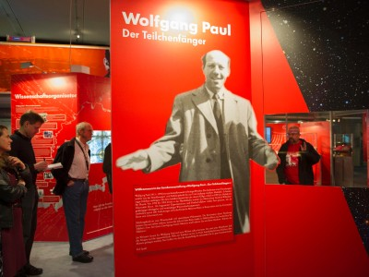
Deutsches Museum Bonn
13.11.2013 – 24.8.2014
Introduction to particle physics
Big Bang, radiation
Wolfgang Paul – life and work (Nobelprize in physics 1989)
+ Exhibition catalogue (270 p.)

Slide 5
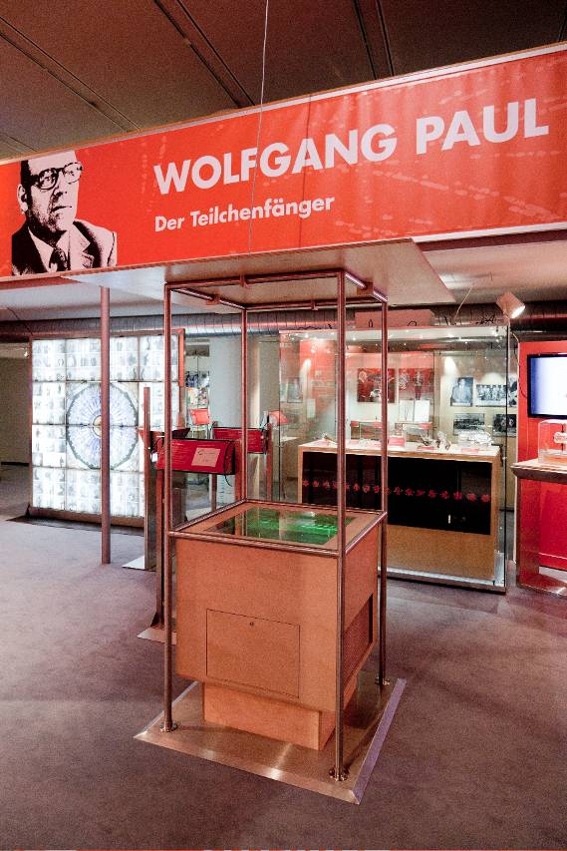
Exhibits:
Spark chamber
Cloud chamber (funded by Netzwerk Teilchenwelt)
Accelerator built by Wolfgang Paul
Ion trap
Original desk from his office
…

Slide 6
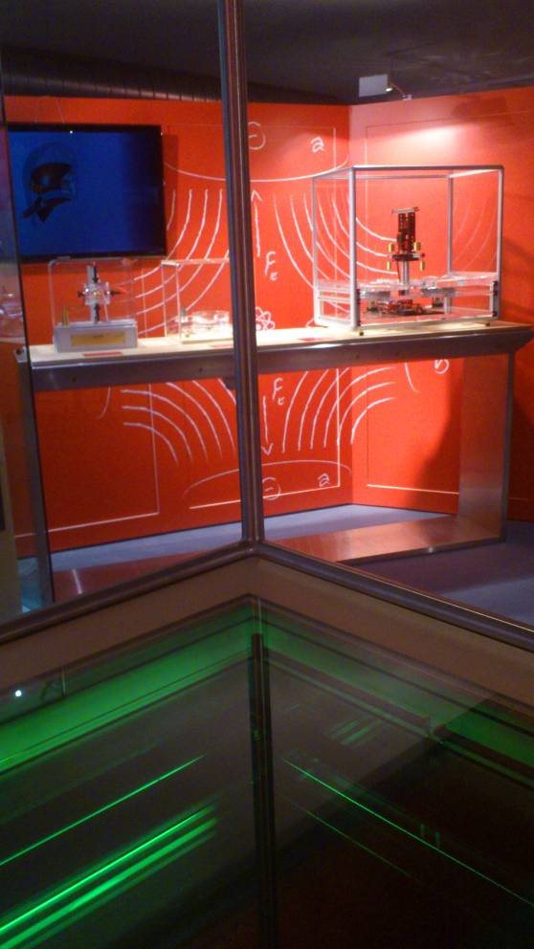
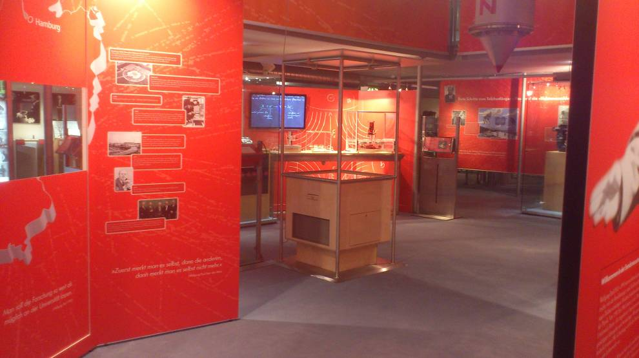

Slide 7

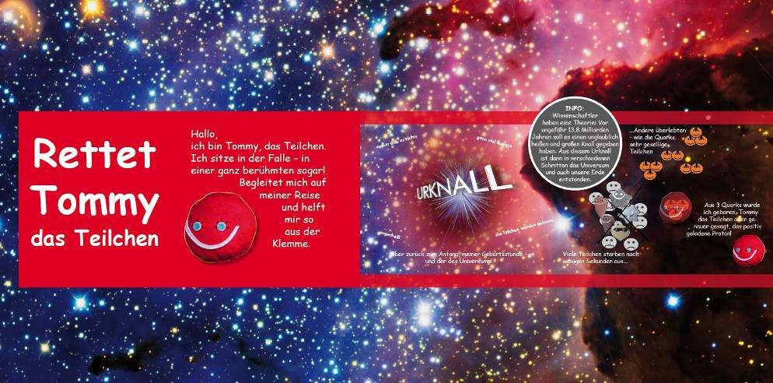
For children: Tommy the particle
tells about his birth and life
ends up in an ion trap

Slide 8
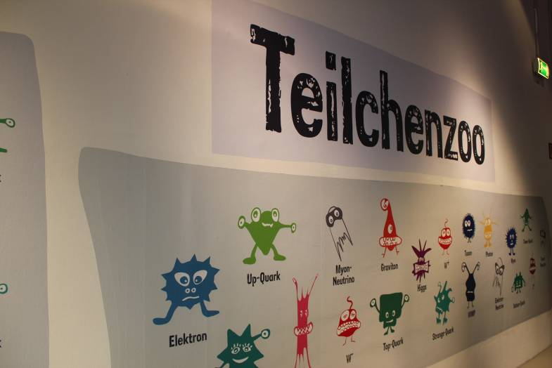

Universum Bremen (Science Center)
27.9.2013 – 30.6.2014
Designed as travelling exhibition
Concept: in cooperation with DESY Hamburg
Particles: visualized as characters, e.g. W⁺
properties (e.g. electric charge) tranferred to common attributes (optimist)
Start of the tour: machine „Teilch-o-mat“ - visitors find their matching particle by answering 10 questions

Slide 9
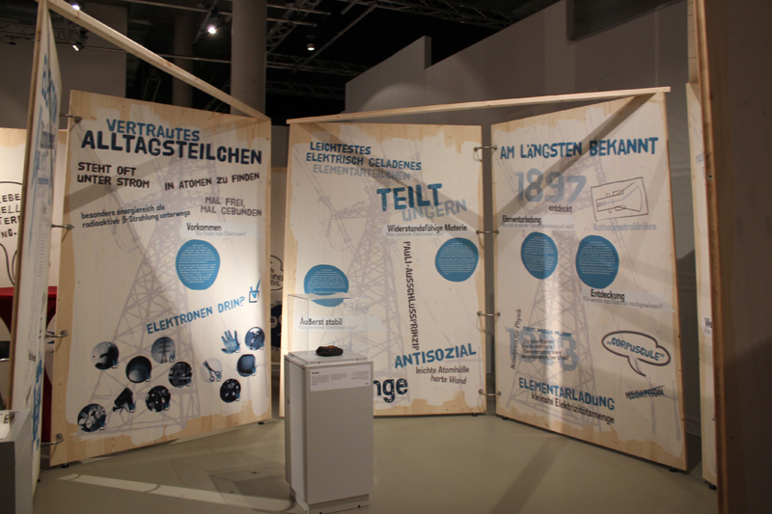
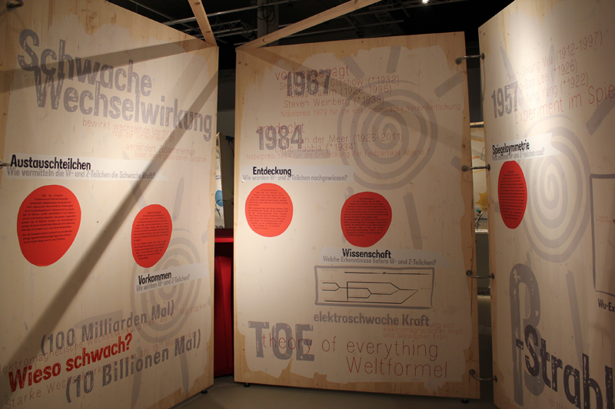
Particle profiles to learn about properties

Slide 10
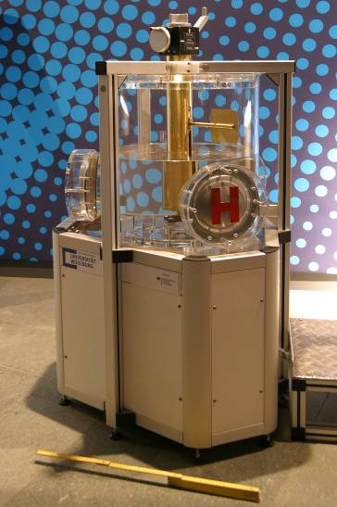
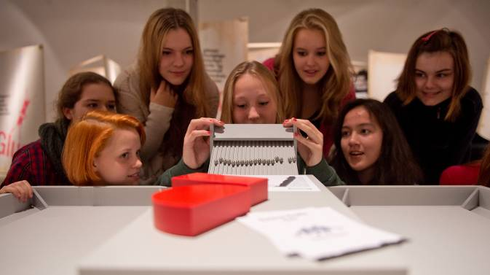
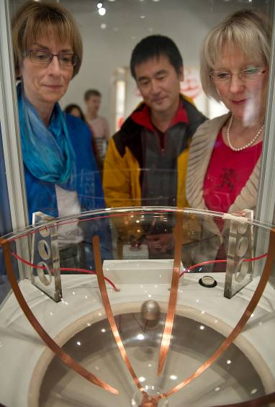
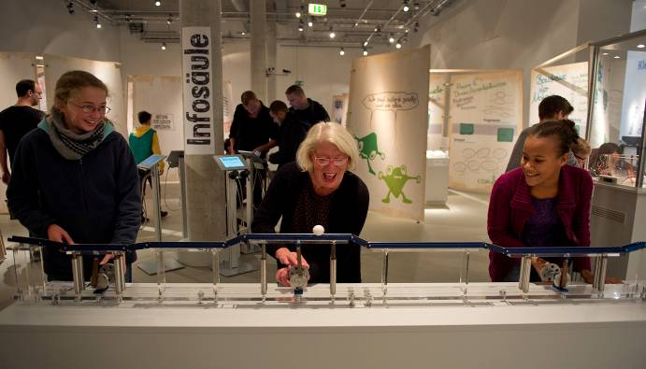
Higgs exhibit
particle accelerators
Plasma ball
Scattering experiment
…

Slide 11
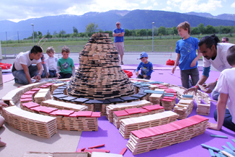
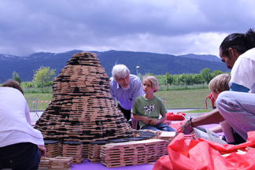
CERN

Slide 12
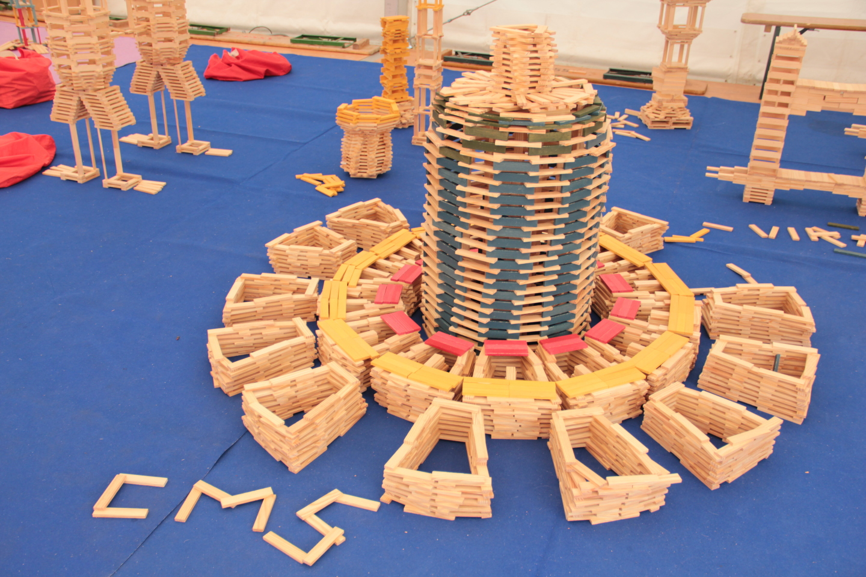
Kapla CMS
For ages 3 - 99
Took 3-4 hours
CERN Open Days
&
Passeport Big Bang

Slide 13

Portugal
Exhibition of
Historical Documents and Artifacts
with
Current Scientific Research
3 month exhibition
In a new venue – national library

Slide 14
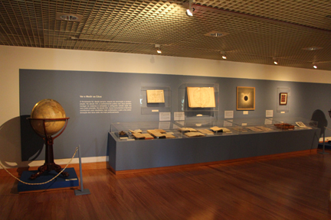
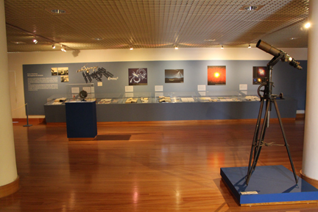
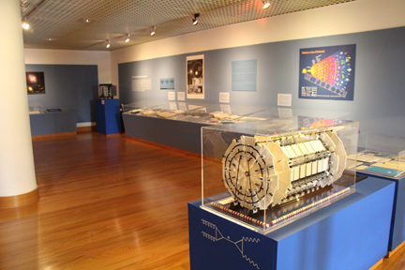

Slide 15
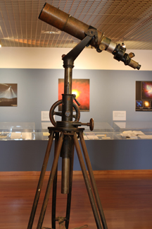
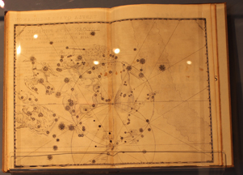

Slide 16
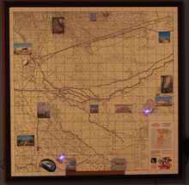
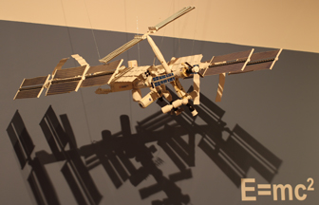

Slide 17
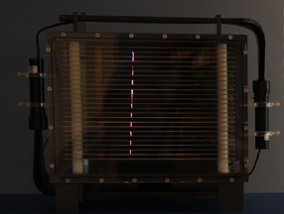
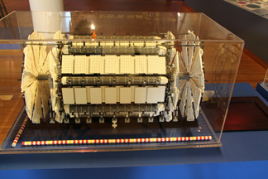

Slide 18
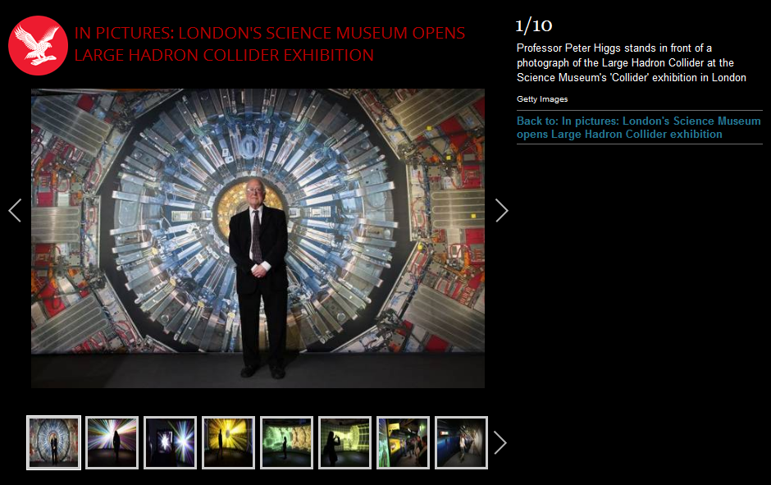
UK http://www.sciencemuseum.org.uk/visitmuseum/Plan_your_visit/exhibitions/collider.aspx
Exhibition starts this week for six months in London .
Followed by international tour

Slide 19
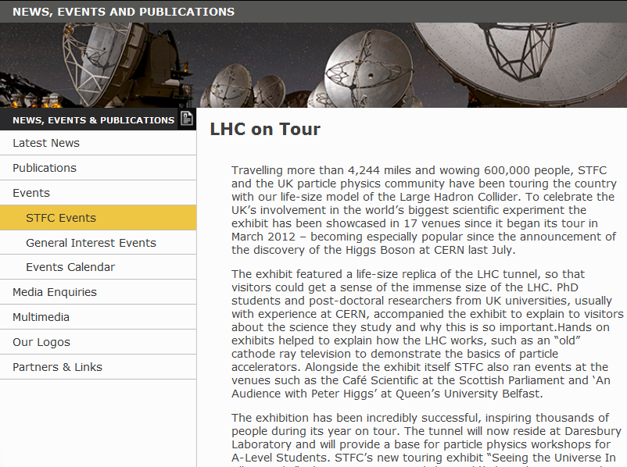
Exhibition starts this week for six months in London .
Followed by international tour
http://www.stfc.ac.uk/2658.aspx

Slide 20
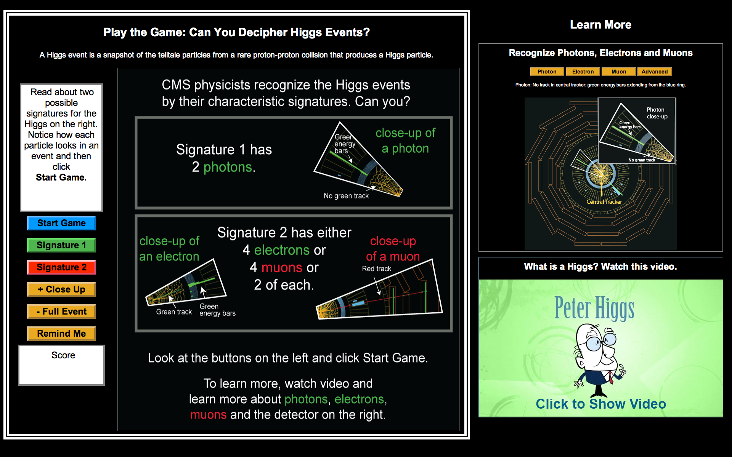
US

Slide 21
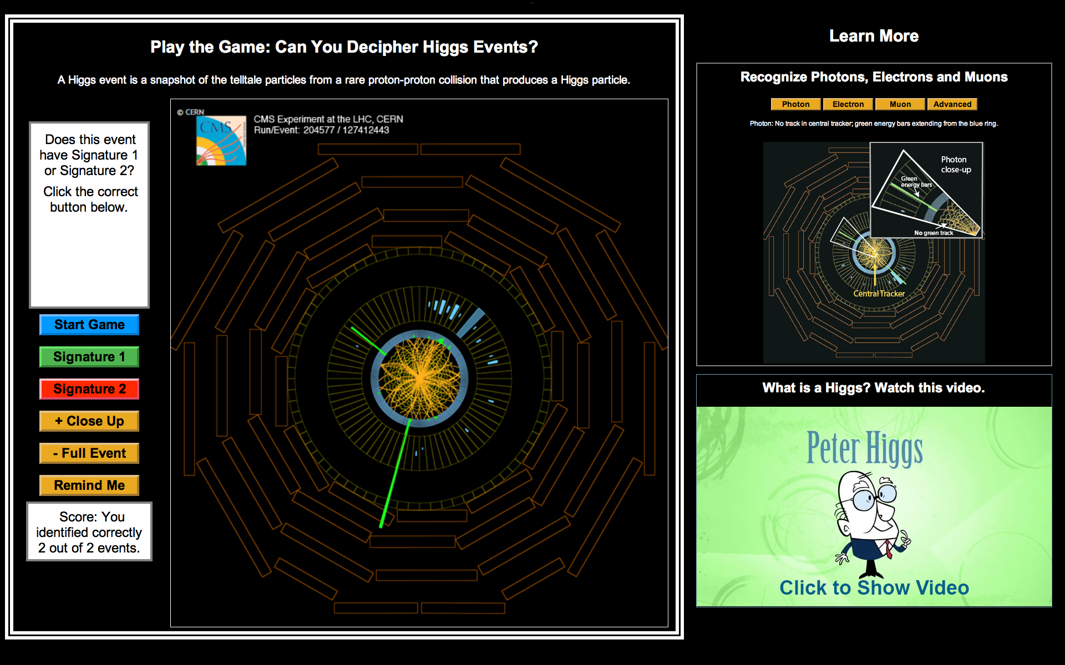
New Exhibit@Lederman Science Center
Online version: ed.fnal.gov/higgs

Slide 22
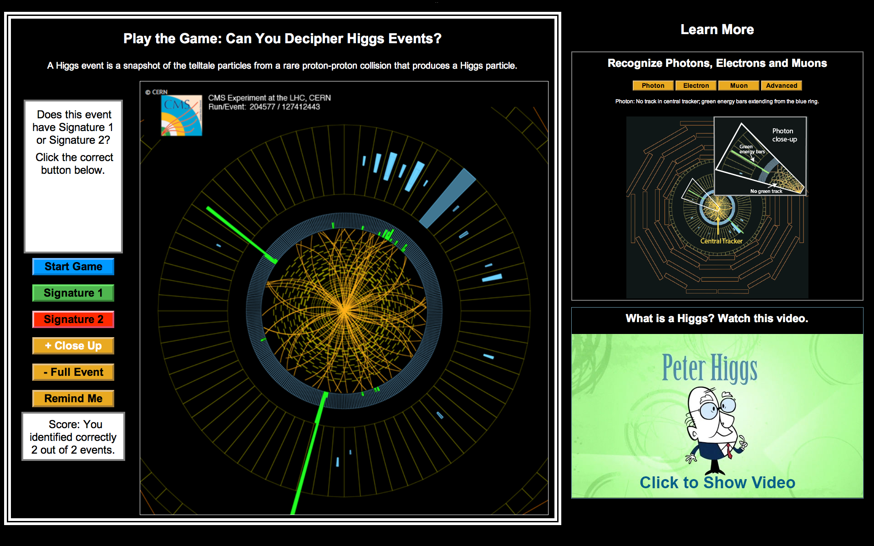
Close Up

Slide 23

New Neutrino Exhibit or Demo

