Slide 1
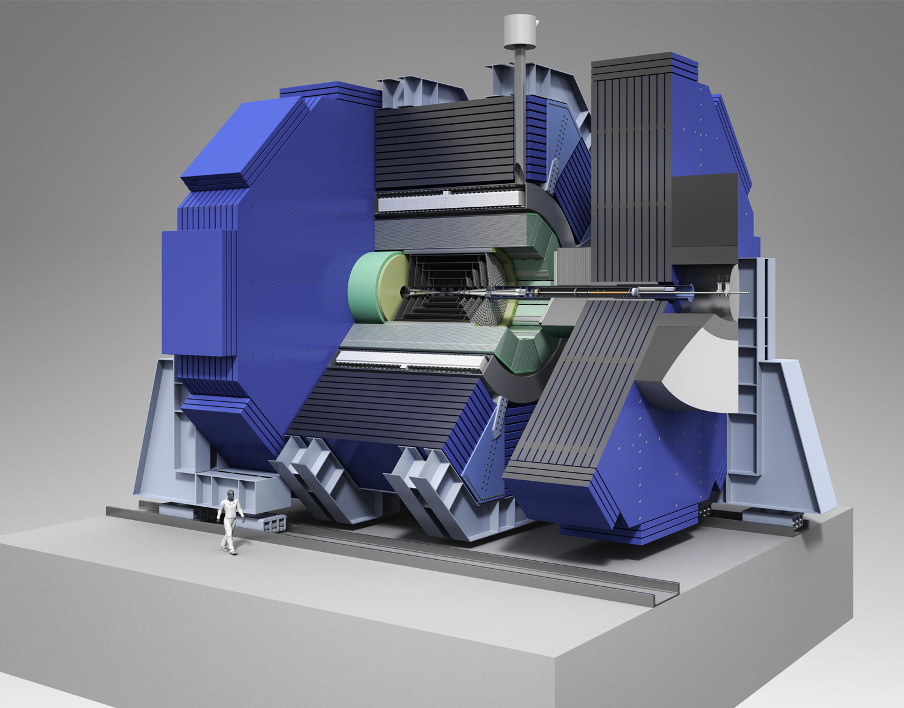
SiD
Status and Plans
Philip Burrows (Oxford)
Marcel Stanitzki (DESY)
29/November/2013

Slide 2
SiD Detector overview
SID Rationale
  A compact, cost-constrained detector designed to make
  precision measurements
  and be sensitive to a wide range of new phenomena
Design choices
  Compact design with 5 T field.
  Robust silicon vertexing and tracking system with excellent
  momentum resolution
  Time-stamping for single bunch crossings.
  Highly granular Calorimetry optimized for Particle Flow
  Iron flux return/muon identifier is part of the SiD self-shielding
  Detector is designed for rapid push-pull operation

Slide 3
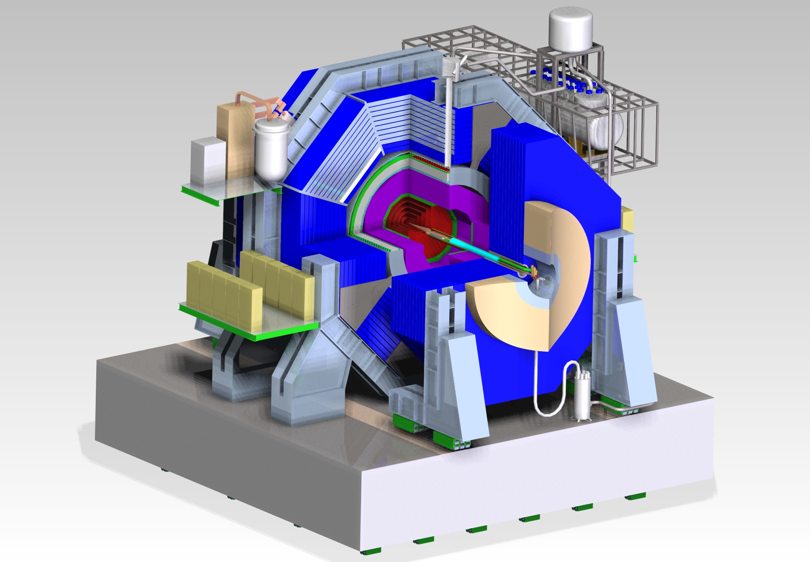
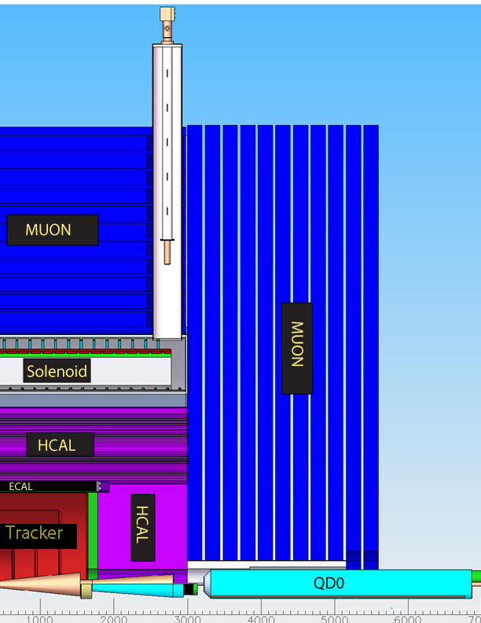
The DBD detector

Slide 4
SiD & the DBD
The DBD describes a baseline of SiD for the ILC
  Choices have been made for all subsystems besides
  the Vertex detector
  Options for various subsystems have been considered
  The detector is fully costed
The DBD is not a TDR
  Engineering effort not sufficient
  Not all R&D has been completed
In SiD's view the subsystem options offer
  Improved performance or lower cost
  Not as mature as the baseline choices yet

Slide 5
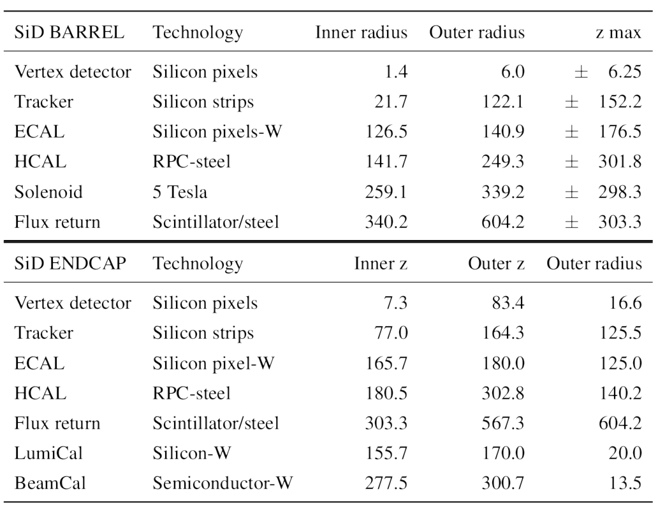
DBD Detector parameters

Slide 6
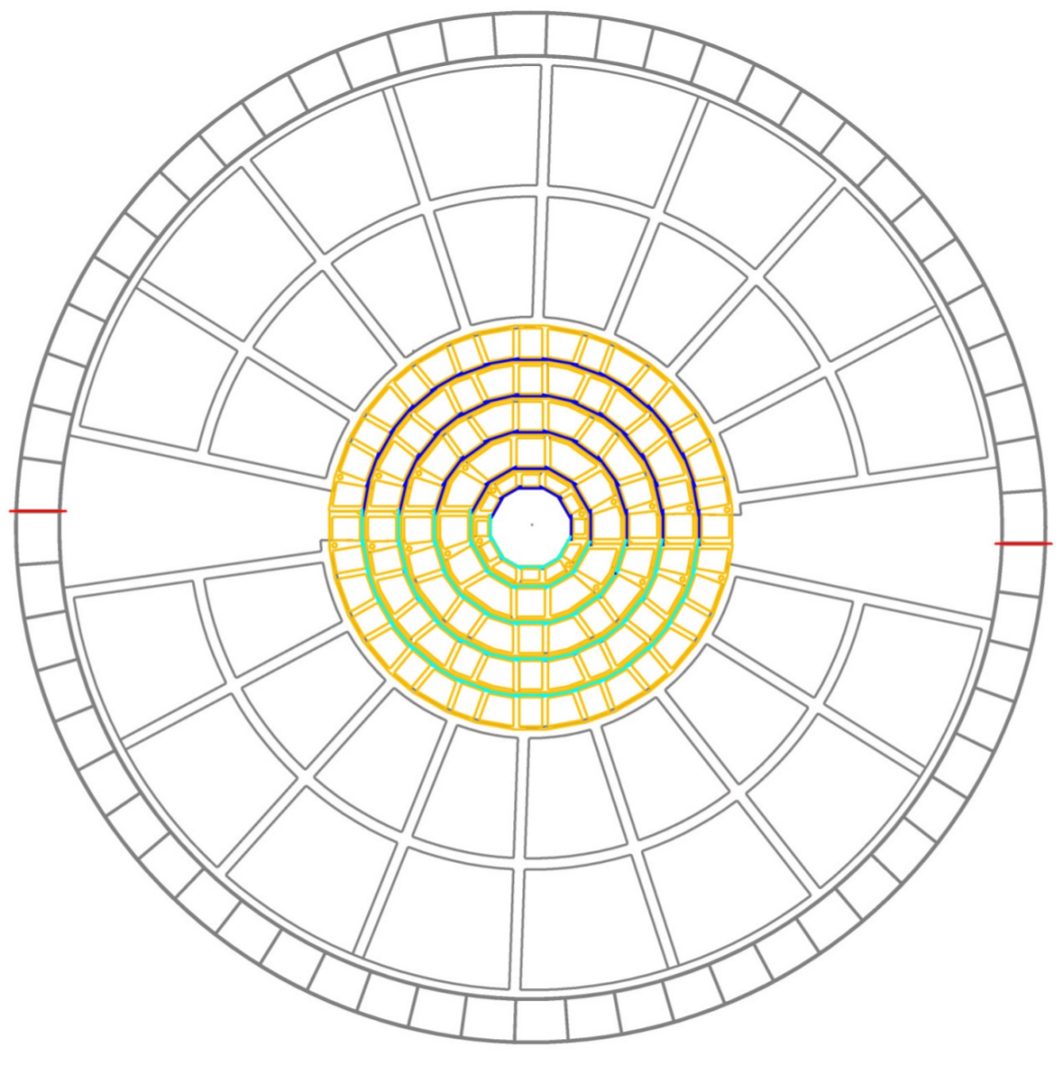
Vertex Detector
Many potential technology choices
  No baseline selected yet
Requirements
  <5 µm hit resolution
  ~ 0.1 % X0 per layer
  < 130 µW/mm2
  Single bunch timing resolution
Insertion of Vertex straightforward
  Allows to make late technology
  choice

Slide 7
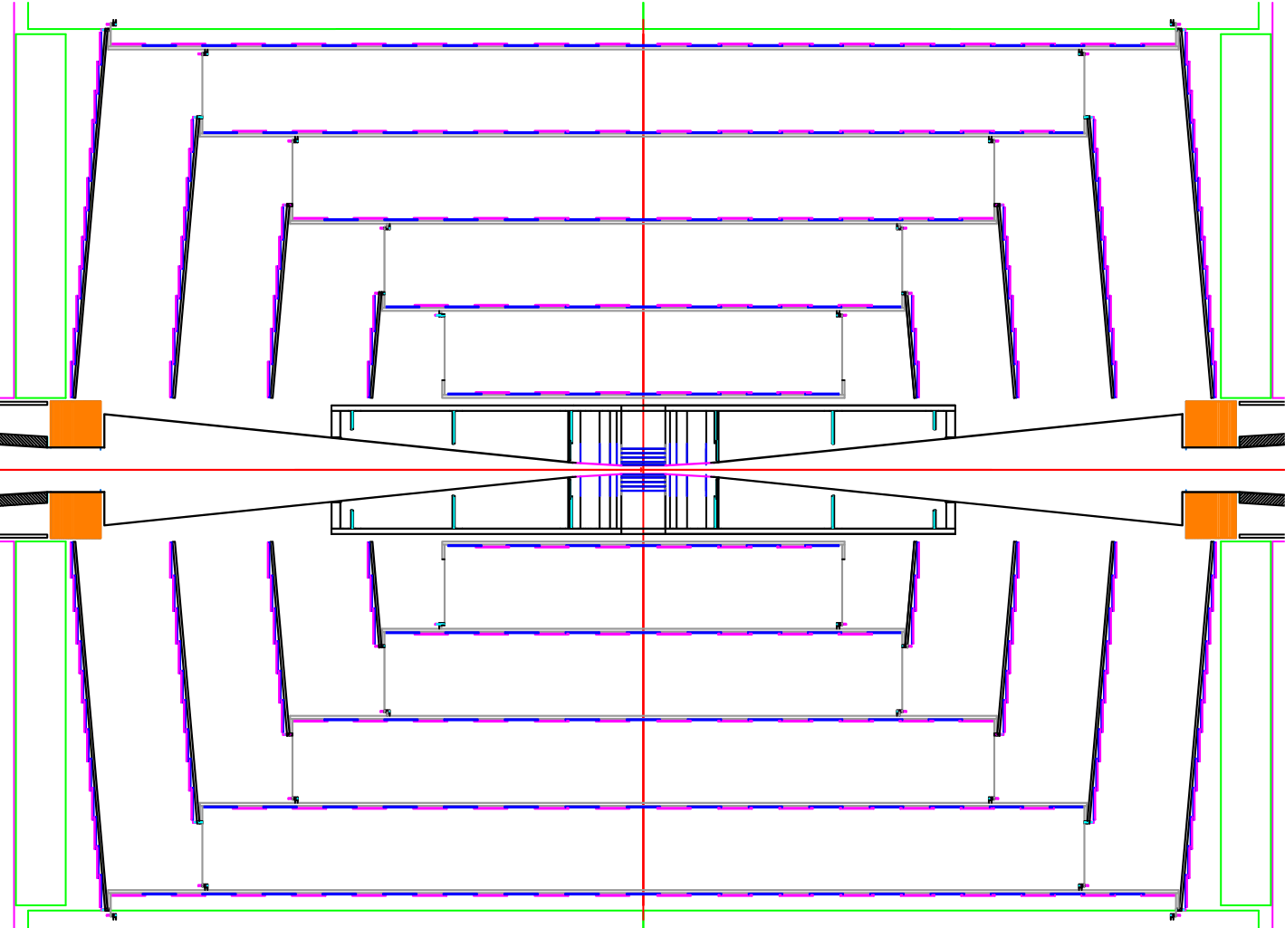
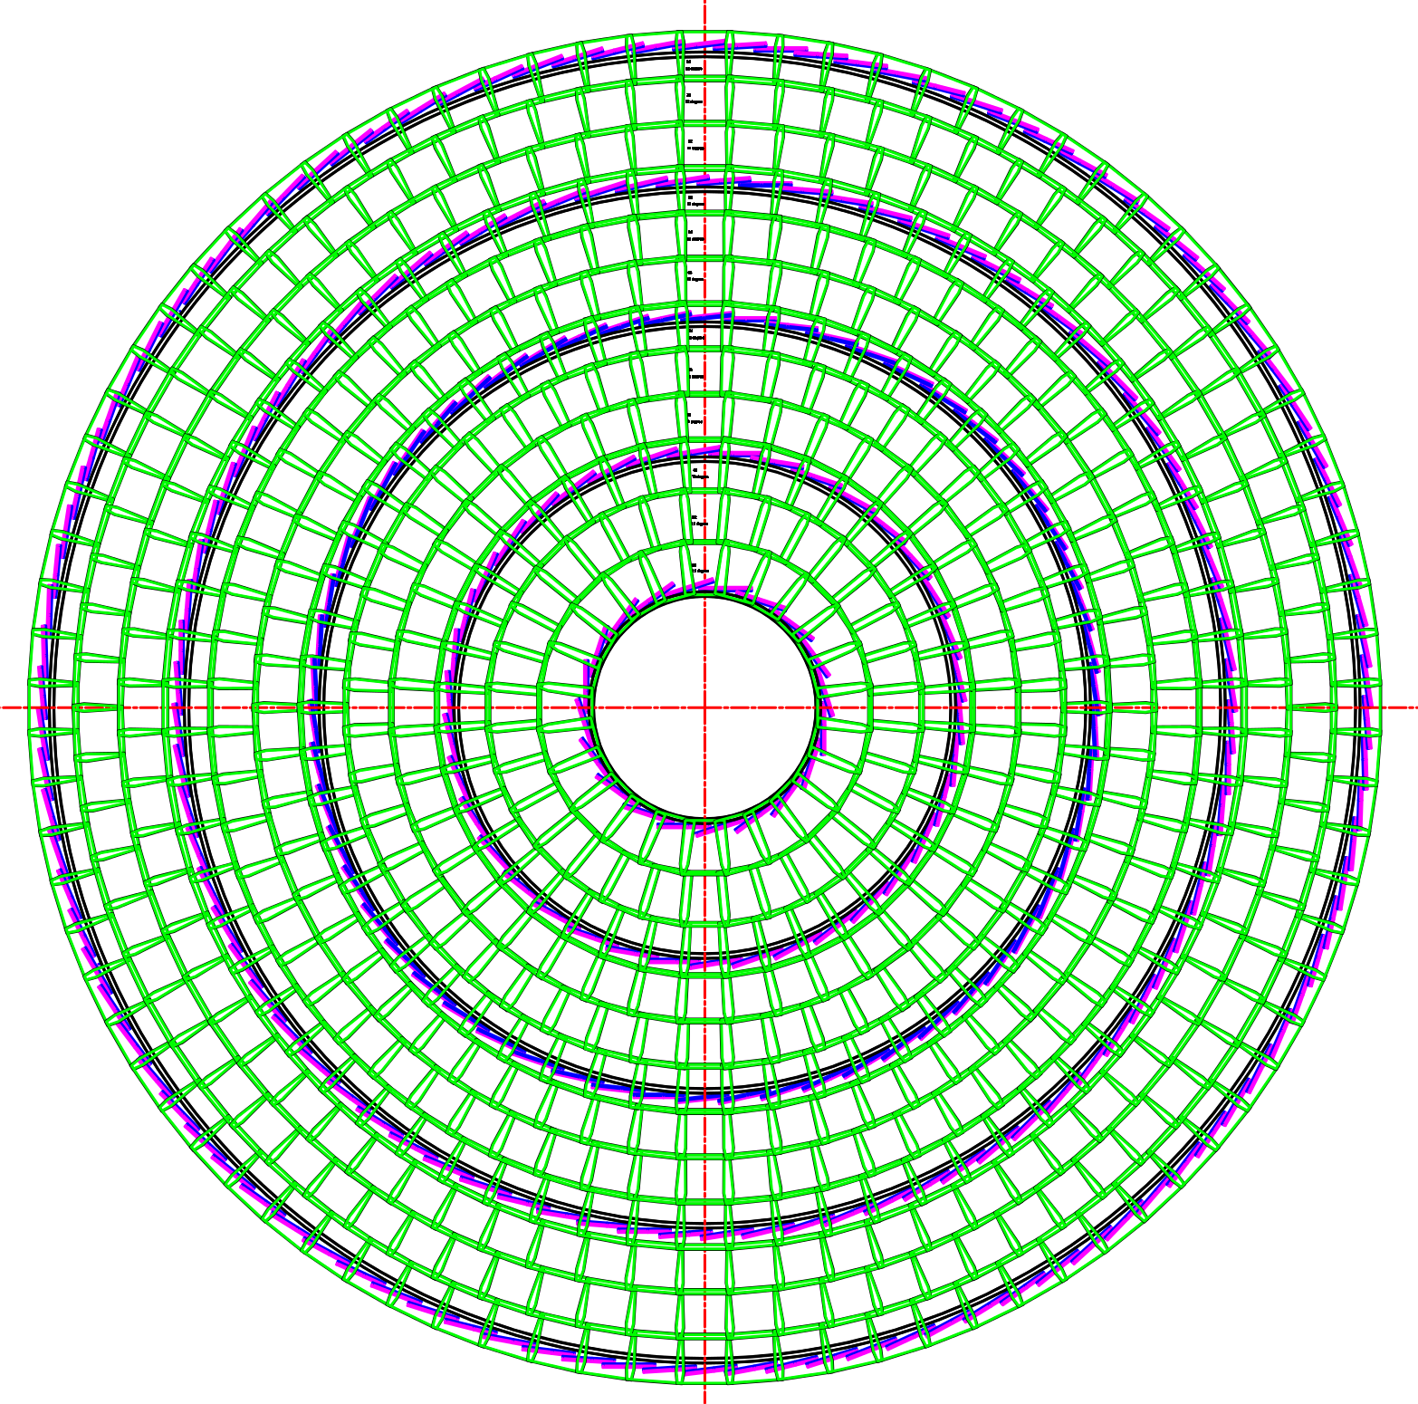
Silicon Strip Tracker
All silicon tracker
  Using silicon micro-strips
  Double metal layers
5 barrel layers and 4 disks
Cooling
  Gas-cooled
Material budget
  less than 20 % X0 in
  the active area
Baseline Readout using KPiX ASIC
  Bump-bonded directly
  to the modules

Slide 8
Calorimetry
SiD ECAL
  Tungsten absorber
  20+10 layers
  20 x 0.64 + 10 x 1.30 X0
Baseline Readout using
  5x5 mm2 silicon pads
SiD HCAL
  Steel Absorber
  40 layers
  4.5 Λi
Baseline readout
  1x1 cm2 RPCs
SiD has selected baseline choices for its Calorimeter
  Options are actively being considered
Lots of test beam activities (past, present and future)
  Parts of the program done as part of the CALICE effort

Slide 9
Calorimetry Tree
Subsystem
Absorber
Readout
Si-Pads
ECAL
Tungsten
MAPS
RPC
GEM
HCAL
Steel
Micromegas
SiPM
SiPM
Muons
Steel
RPC
Analog Readout
Baseline
Digital Readout
Option

Slide 10
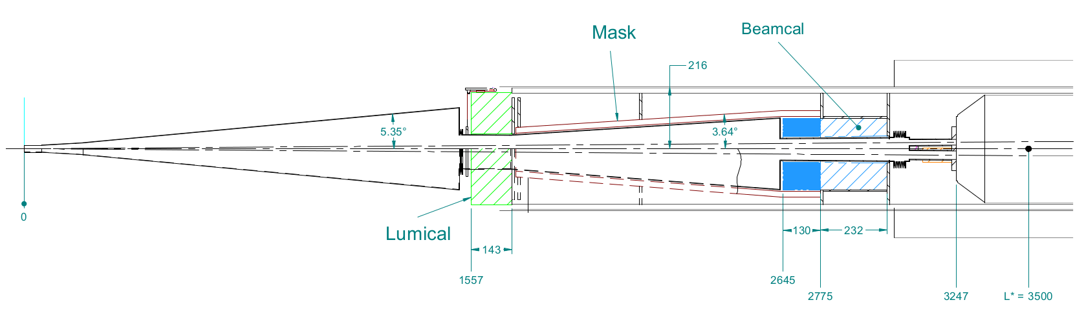
Forward Systems
SiD has two detectors in its forward region
  LumiCal and BeamCal
  SiD R&D is part of the worldwide FCAL effort.
  Close interactions with MDI group

Slide 11
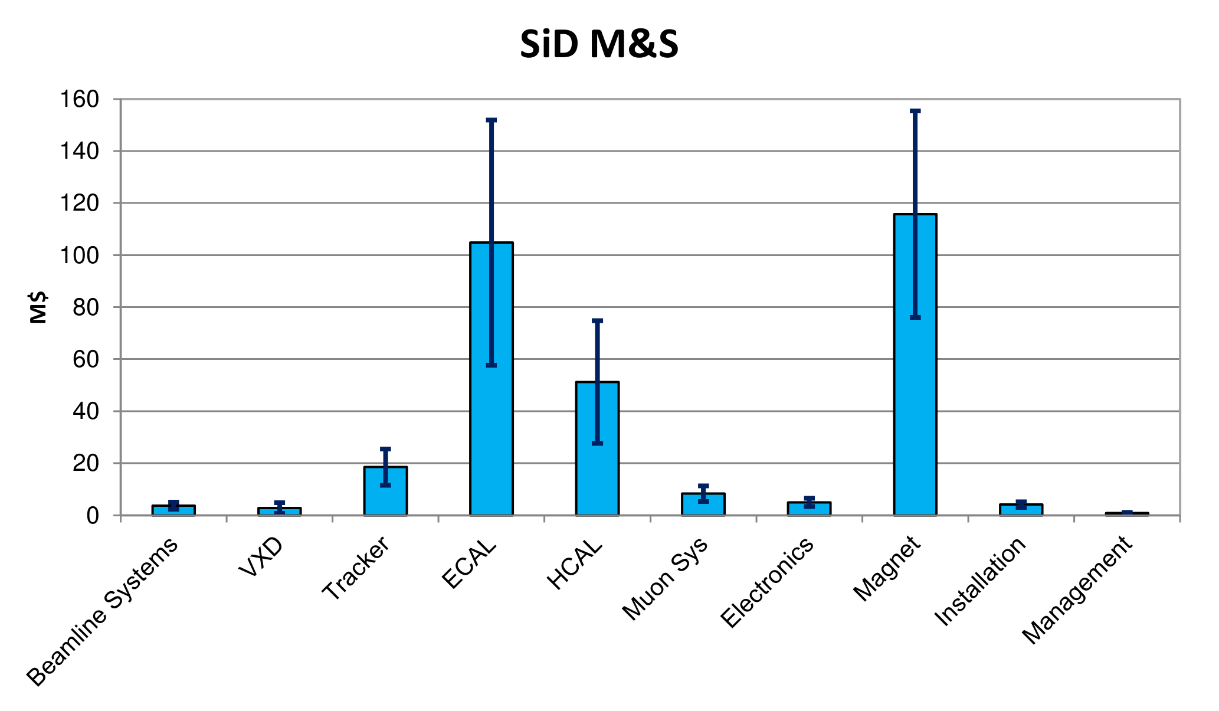
SiD Costing
  M&S : 315 M$
  Contingency: 127 M$
  Effort: 748 MY

Slide 12
SiD Consortium
As a next step towards project realization, we are going ahead with establishing the “SiD Consortium” as a precursor to a full collaboration.
SiD will remain open to all interested people and groups
  SiD is neither a closed nor exclusive club
Membership in SiD
  Representation in the Institute Board (IB)
  Actively take part in decisions
  Become an Author (once we start having SiD publications)
Both individuals and institutes can be members
How to become a member
  A letter to the Institute Board Chair
  Vote on membership by the IB
Notes:
12

Slide 13
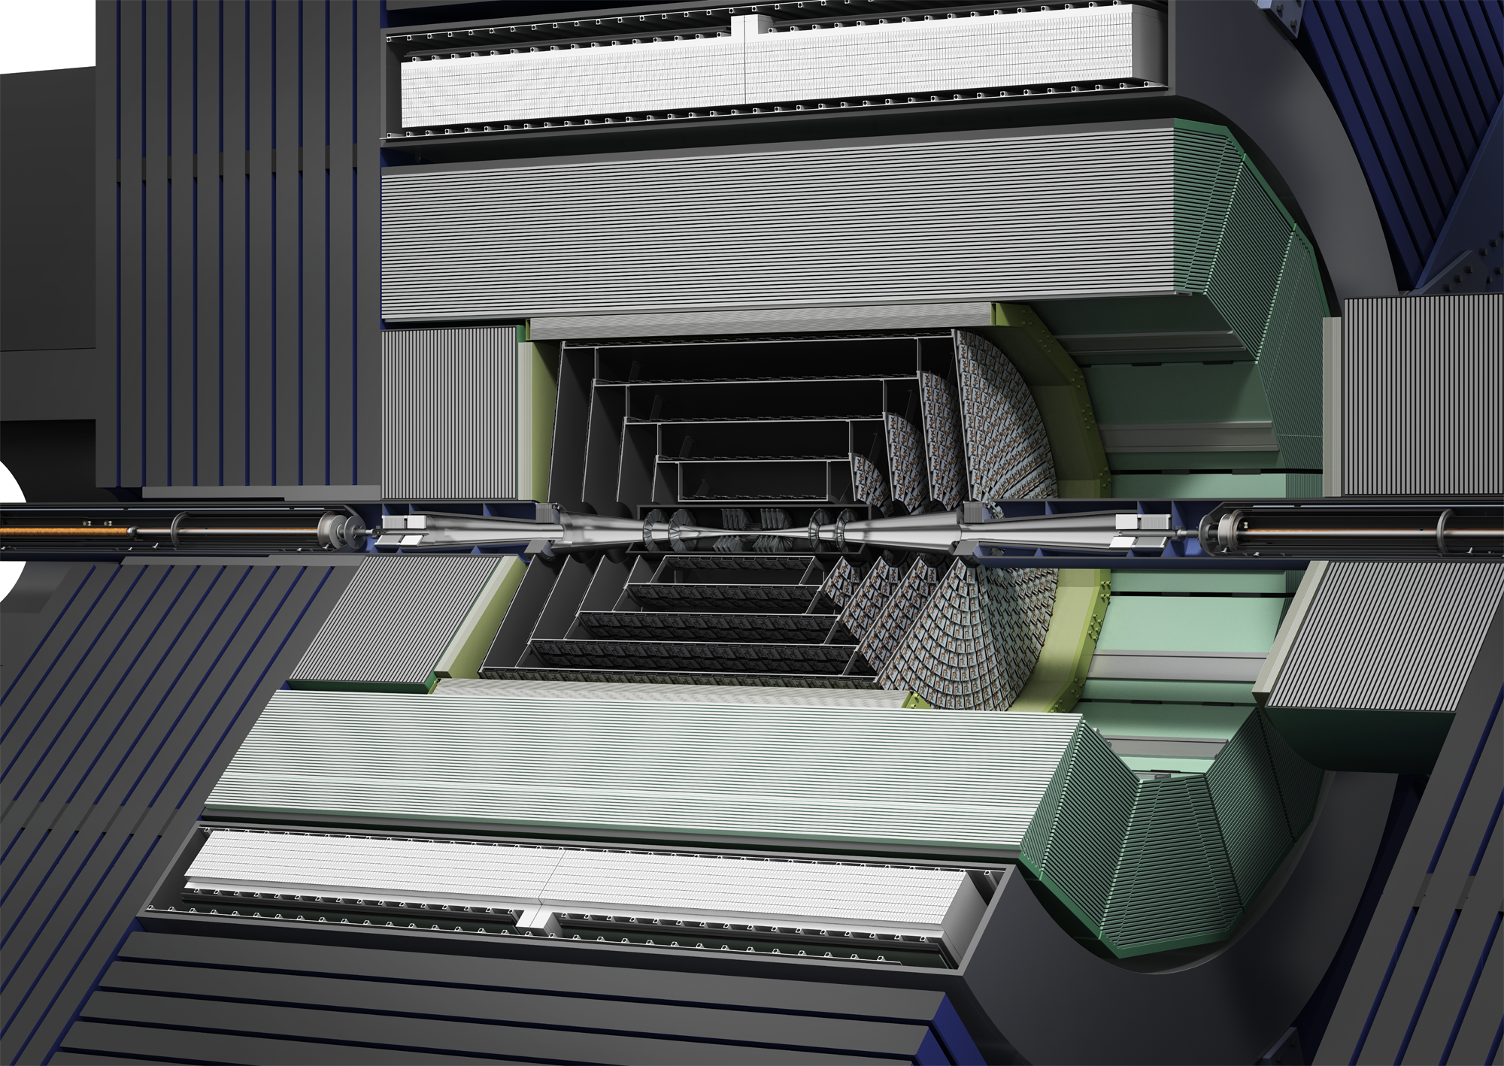
SiD Plans
LCC phase
2013-201X

Slide 14
Plans for the LCC phase
Goals
  SiD will be one of the two experiments at the ILC
  Deliver a full TDR once such a call has been made
LCC Phase
  2013-201X (a few years, till ILC becomes a project)
SiD has defined the following priorities for this
  Site-Specific Studies
  Detector Optimization studies
  Strengthen ILC Physics case
  Common Software Development
  Detector R&D
  Detailed Costing Study as preparation for the TDR

Slide 15
Site-Specific Studies
Japanese Site selection
  Kitakami selected in August 2013
Clear need for Site Specific studies for SiD
  Detector Hall
  Assembly schemes
  Horizontal access shafts
  Machine detector interface
Well suited for cooperation with the accelerator group
European ILC (Detector) Project Office
  Could provide engineering expertise for these studies

Slide 16
Detector Optimization
After the finalization of the DBD
  Ideal time to study SiD's choices
Geometry
  Aspect ratio, Calorimeter depth
Tracking
  Forward tracker will be reviewed
Preparing a potential technology down-select
  Detailed study of Scintillator and gaseous HCAL readout
  Benefits, performance gains
This will required some dedicated effort for SiD

Slide 17
Physics Benchmarks
DBD has already made a very clear physics case of the ILC
  That case remains strong
However new results from the 14 TeV LHC run
  Will require an update, particularly for the BSM studies
  This will need detailed studies and full simulations
  Important to consistent “physics message”
Ideally suited for a network effort
  Studies can be performed for both SiD & ILD
  Cooperation with Monte-Carlo Generator authors and
  phenomenologists
  Train students and postdocs

Slide 18
Common Software activites
This has been a great success so far
Many common tools have been used for the DBD, e.g.
  LCIO
  ILCDIRAC
  PandoraPFA
  Activities on MC generators
Clear case for strengthening common software development
Also provide support for current software
  Maintain investments already made
SiD continues to be very interested in common software
activities

Slide 19
Detector R&D
Some R&D will be SiD specific
  Dedicated R&D effort needs to be continued
Common themes that need addressing
  Power distribution and pulsing
  Cooling & services
  Readout (Optical links)
These themes need addressing when moving to
  “system-level” design
  Key part of a future TDR
  What could we learn from LHC Upgrades ?

Slide 20
R&D Infrastructures
Access to Testbeam facilities in Europe remains a
high priority for SiD
  Travel support is an essential component for this
SiD is also very interested in a high-field magnet testing facility
with a large bore
  To test detector components in a 5 T field
  To explore power-pulsing and power distribution
Clear use-case for such a facility
  Will be also useful for other detector communities

Slide 21
Summary
For the next phase of the ILC, SiD is planning for
  Expanding SiD globally
  completion of R&D
  Preparation of a real TDR
In order to achieve the goals of the LCC phase
  Significant increase in engineering resources (several FTE)
  Physics & optimization effort (~ 5 FTE)
  Common Software (1-2 FTE)
  Travel support for Test beams and conferences
R&D and R&D infrastructures
  Establishing common R&D themes for the system design
  Provide new test facilities

