Slide 1
BNL ERL and frequency choices
Ilan Ben-Zvi

Slide 2
In this presentation:
Introduction
The eRHIC ERL design
The R&D ERL
Frequency Choice
Summary

Slide 3
The ARDD of the Collider-Accelerator Department
The Accelerator R&D Division (ARDD) of C-AD engages in medium-term R&D related to the mission of ONP and provides expertise and support to short term accelerator R&D.
The ARDD is the site of a unique combination of expertise and facilities:
  Electron cooling of unique nature, such as the Coherent electron Cooling and bunched-beam electron cooling for cooling Low Energy RHIC.
  Superconducting RF for highly specialized applications such as high-current ERL, storage ring applications and SRF electron guns.
  Laser photocathodes, polarized and high QE non-polarized.
The ARDD has a HEP funded component (LARP, ATF, Muon Accelerator), which benefits the ONP program, e.g. crab cavities, and vice versa – the HEP program benefits from the capabilities within NP.
The expertise and intellectual interchange with HEP units greatly enhances the capabilities of the ARDD.

Slide 4
From the EICAC Report on Accelerator R&D Priorities
(C-AD is carrying out this research based on these recommendations)
eRHIC highest priority:
  High current (e.g. 50 mA) polarized electron gun
  Demonstration of high energy – high current ERL
  Beam-Beam simulations for EIC
  Polarized 3He production and acceleration
  Coherent electron cooling
eRHIC high priority:
  Compact loop magnets
  Development of eRHIC-type SRF cavities
eRHIC medium Priority:
  Crab cavities (funded by HEP in LARP group)
Complex
projects!

Slide 5
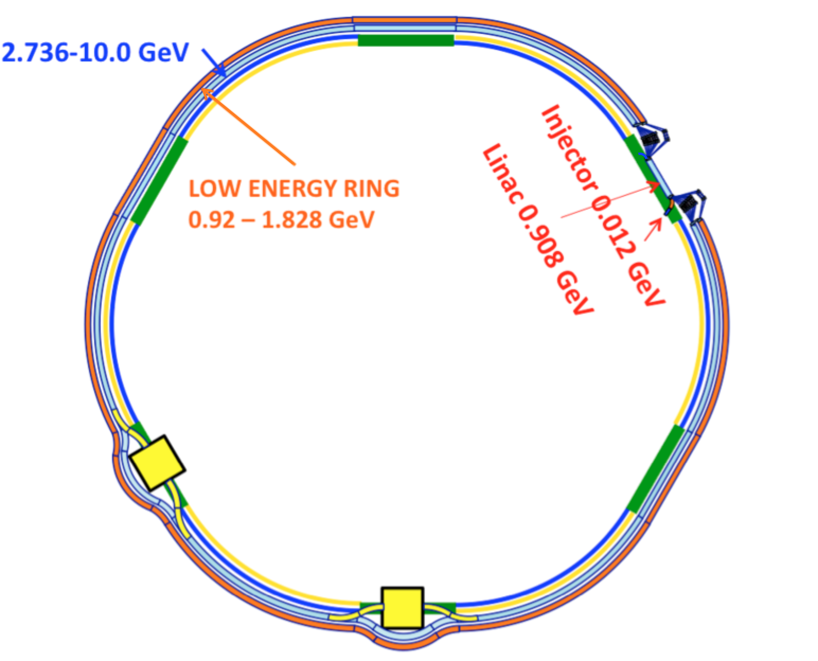
NS-FFAG eRHIC: Rapidly evolving!
11 turns
2 FFAG rings
50 mA
Current scheme, 10 GeV
Energy | 0.908 GeV
Beam current per pass | 50 mA
Bunch frequency | 9.38 MHz
Bunch length | 4 mm rms
RF frequency | 412.9 MHz
Linac length | 93 m
Number of cavities | 30
Filling factor | 0.59

Slide 6
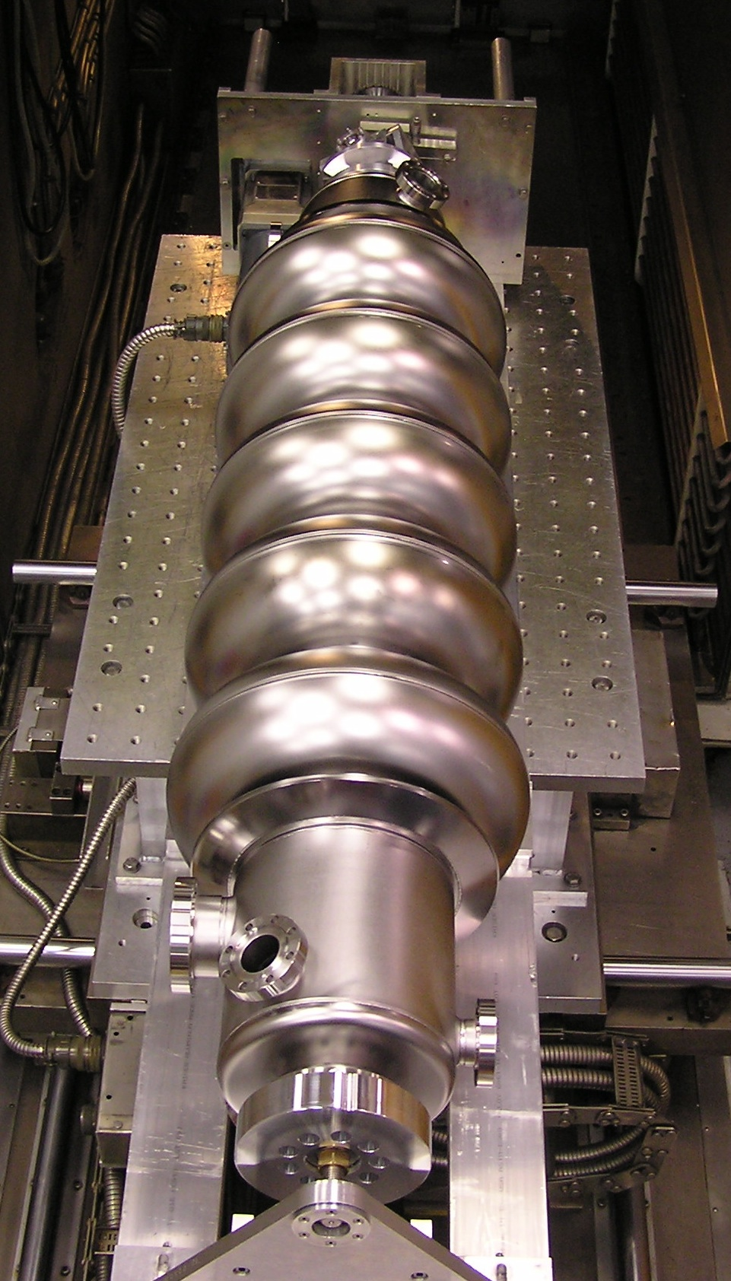
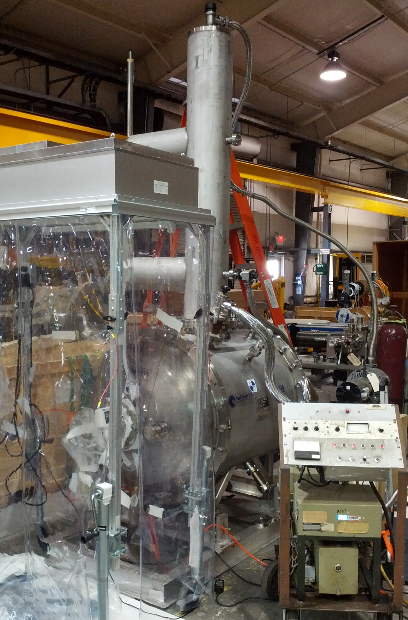
COHERENT ELECTRON COOLING
The CeC is a novel technique to cool stored ion beam which combines the best features of stochastic cooling and electron cooling. Such an effective cooling technique can be used to cool RHIC proton beams at full energy, and is a must for any version of EIC.
Competitive ONP R&D funding for CeC (M&S only, k$):
  FY11 FY12 FY13 FY14 FY15 FY16
  1488 1280 1410 1727 370 272

Slide 7
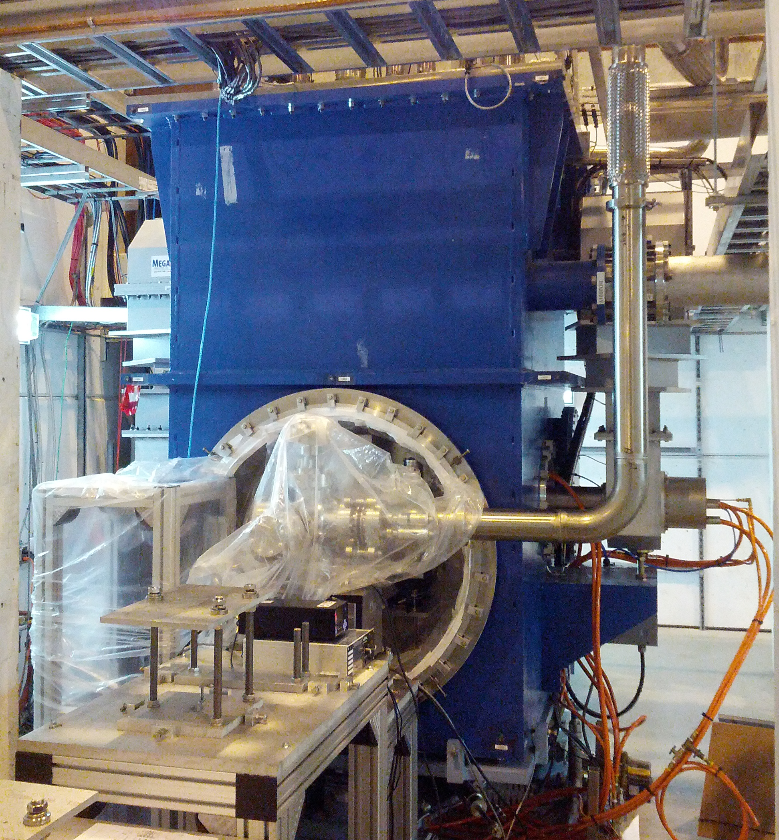
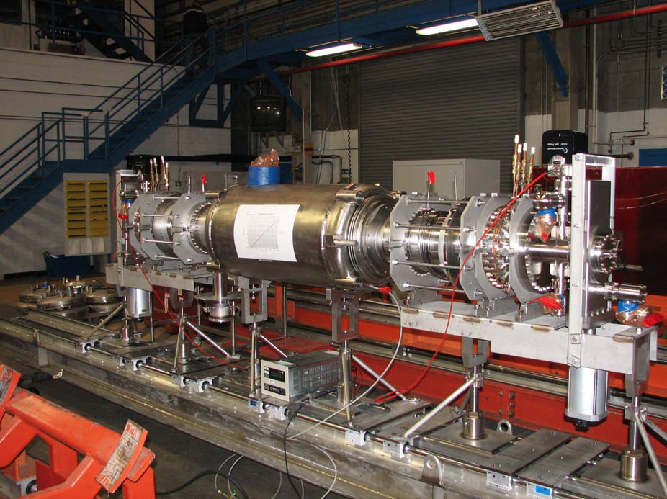
Energy Recovery Linac (ERL)
The R&D ERL is aimed at testing ERL issues for eRHIC and related projects, such as Coherent electron Cooling of RHIC. The current of 300 mA is required by eRHIC cavities.
The ERL incorporates originally developed state-of-the-art SRF laser-photocathode electron gun and a high-current, heavily damped acceleration cavity, the first such designed and built for ERL service.

Slide 8
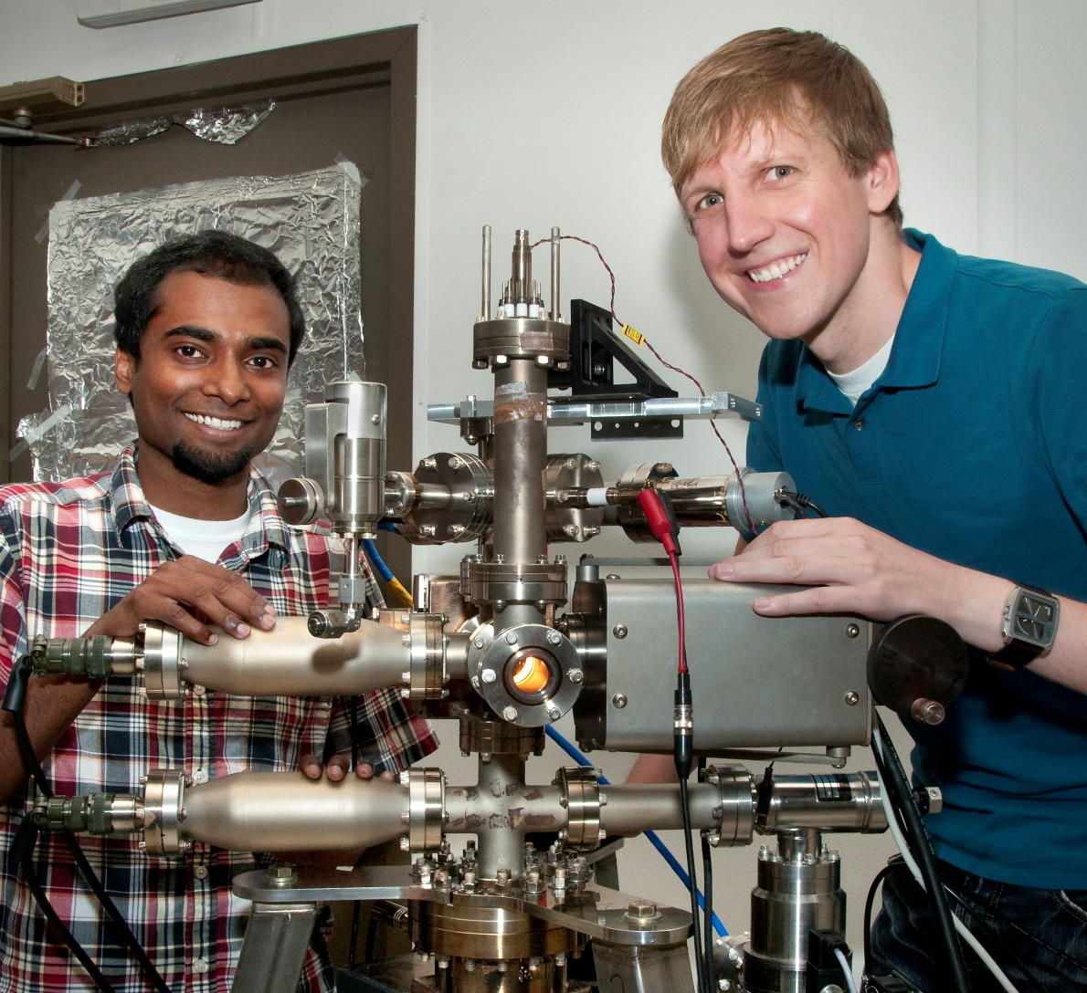
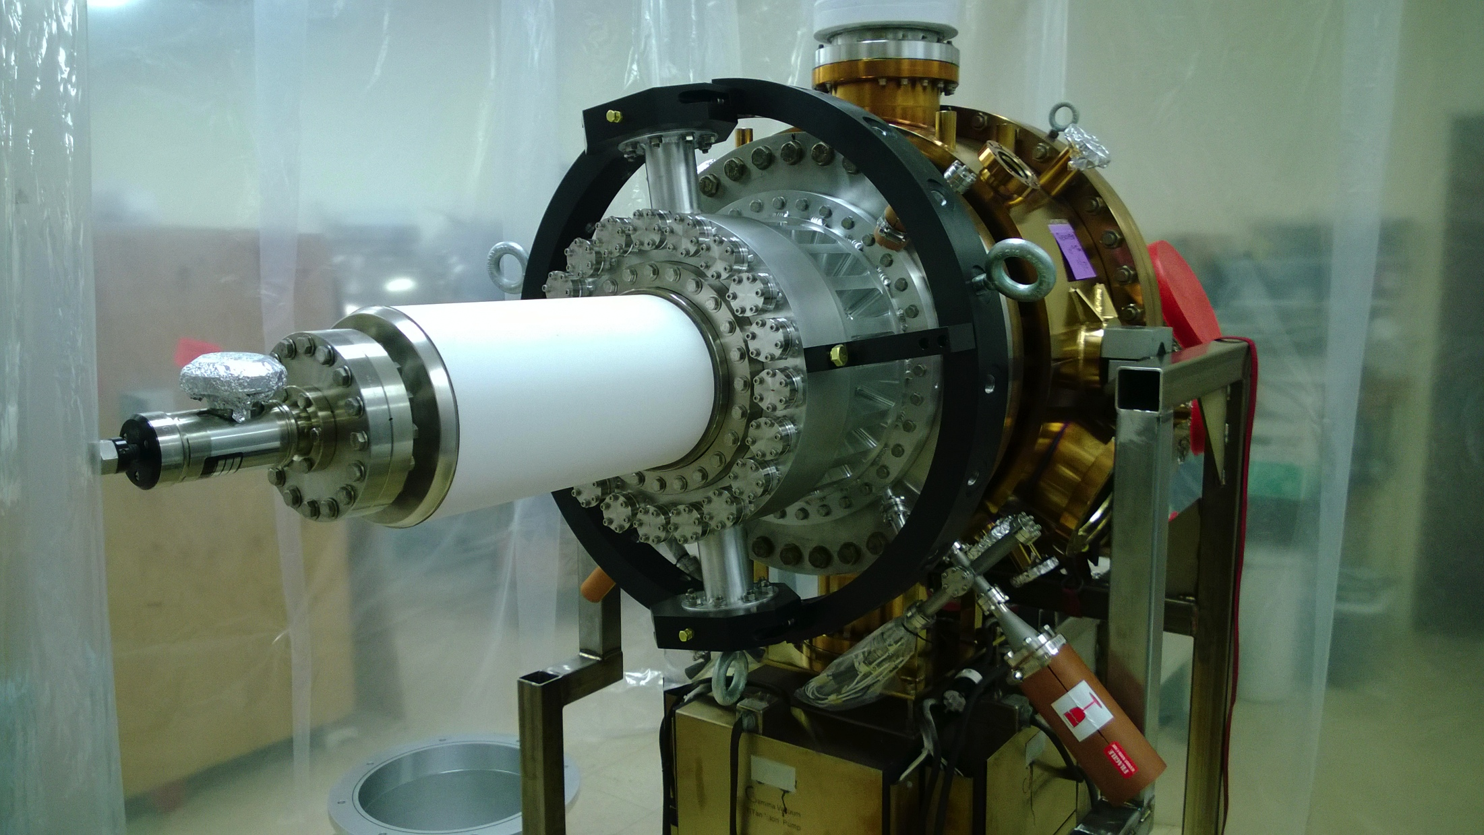
POLARIZED GUN
We are doing R&D, funded primarily by LDRD, to develop a high-current (50 mA), high-polarization electron gun for eRHIC.
The principle we are aiming to prove is funneling multiple independent beams from 20 cathodes.
External review was carried out in 2012.

Slide 9
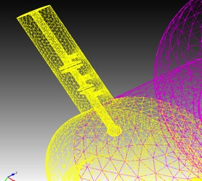
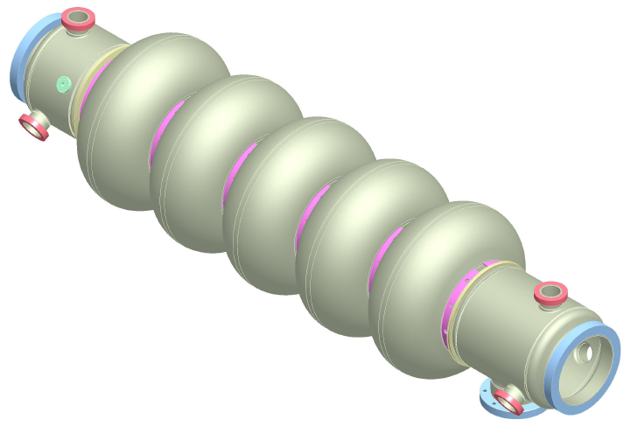
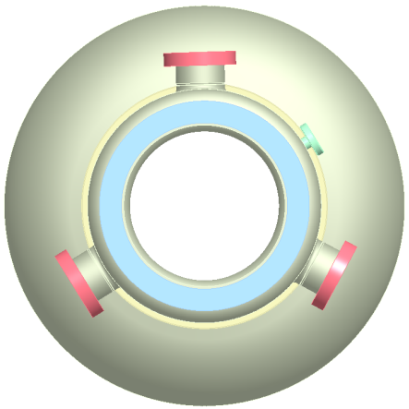
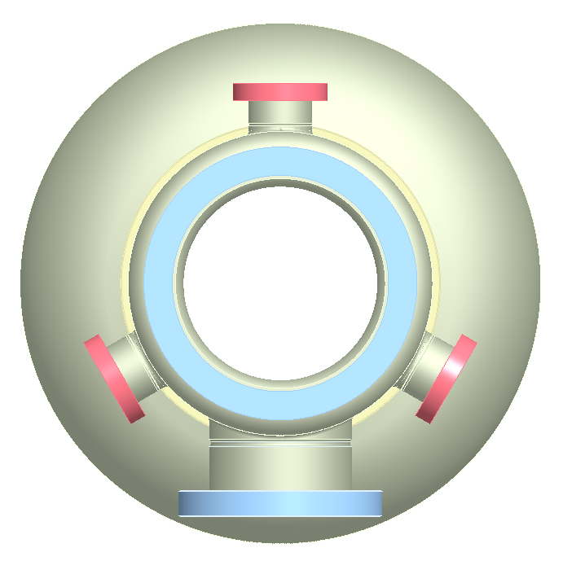
Superconducting RF cavity
HOM ports
FPC port
BNL3 cavity parameters
Frequency | 703.8 MHz
No. of cells | 5
Geometry factor | 283 Ohm
R/Q | 506.3 Ohm
E_{pk}/E_{acc} | 2.46
B_{pk}/E_{acc} | 4.26 mT/(MV/m)
Length | 1.58 m
Beam pipe radius | 0.11 m
A five-cell 703.8 MHz SRF cavity (BNL3) is optimized for high-current linac applications.
Reduced peak surface magnetic field -> reduced cryogenic load.
Three antenna-type couplers will be attached to a large diameter beam pipes at each end of the cavity and will provide strong HOM damping while maintaining good fill factor for the linac.

Slide 10
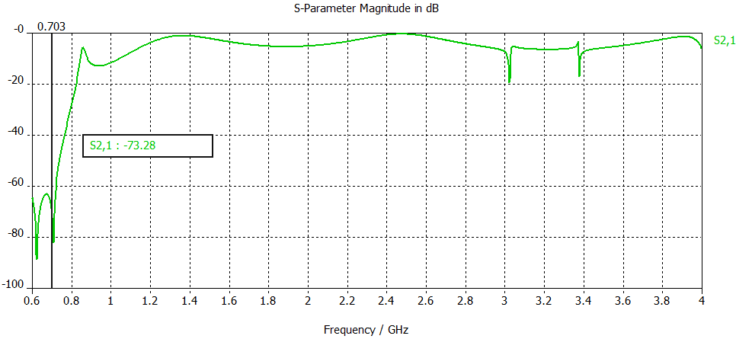
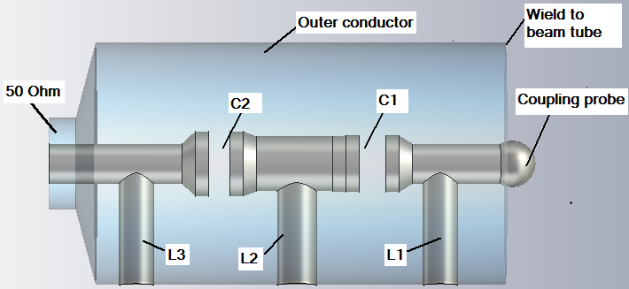
HOM damping
HOM high-pass filter
A two-stage high-pass filter rejects fundamental frequency, but allows propagation of HOMs toward an RF load.
1st HOM is at 0.82 GHz (for the 704 MHz cavity).
Total HOM power to extract is ~11 kW per cavity through 6 HOM dampers.

Slide 11
Frequency Choice Considerations
Bunch structure of eRHIC
Bunch length and energy spread
Beam breakup
SRF losses
RF power efficiency
Cost and complexity considerations
The considerations to be presented point towards a lower frequency ERL cavities, as will be shown in the following. The current choice is:
Cavity type | 5-cell elliptical
E_{acc} | 16.7 MV/m
Stored energy | 697 J
RF frequency | 412.9 MHz
Voltage gain per cavity | 30.3 MV
Cavity loss factor | 2.16 V/pC
Cavity Q₀ | 5x10¹⁰
Operating temperature | 1.9 K

Slide 12
Bunch structure and the frequency choice
To have uniform bunch pattern w/o large transients, the RF frequency has to be a multiple of the RHIC bunch repetition frequency (9.38 MHz) times twice the number of ERL passes (e.g. 11).
It can be 413 MHz.
By having all electron acceleration passes in the tunnel, we may have a ~0.95μS gap, enough to avoid ion accumulation and the fast ion instability.
The gap is also very useful to provide diagnostic electron bunches.
We are driven towards a lower frequency by a number of effects:
  BBU
  Energy spread due to RF wave curvature affecting polarization
  HOM power and energy spread due to cavity wake potential
  Energy spread due to other wake fields
  R₅₆ errors & path length errors affecting energy spread
The choice of 413 MHz provides satisfactory results.

Slide 13
Effect of transient voltage kick
When an electron bunch with charge q passes a cavity with a voltage V, it will remove (or add) an energy ΔU from the cavity, where
ΔU=qV=5.3(nC).30.3(MV)=0.162(J)
This corresponds to a transient voltage drop per cavity of
ΔV/V=0.5ΔU./U=1.1.10⁻⁴
The transient voltage step for 11 passes is then 1.2.10⁻³, in a highly repetitive pattern.
Note that the transient voltage fraction is proportional to f ²
The RHIC hadron beam has 111 of 120 filled RF buckets at ~9.38 MHz
The e-beam pattern has 111 full energy bunches, each circulating the long path going around the 3.8 km RHIC tunnel 22 times (11 acceleration and 11 deceleration passes).
Extra (non-colliding electron bunches) may be introduced in the gap to provide diagnostics.

Slide 14
Energy spread due to wake fields
Lower frequency allows us to increase the bunch length (RF curvature, always a limit).
This in turn reduces the various wake field effects.
Cavity wake and resistive wall are the dominant effects for eRHIC
Surface roughness is negligible for eRHIC.
CSR shielding is easier for longer bunches.
Cavity
Resistive Wall
Roughness
Thanks to A. Fedotov
CSR

Slide 15
Instability mechanism and threshold
Beam establishes a feedback that can become unstable. The threshold is approximately
1 accel.-1 decel., 2D
B
N accel.-N decel., 1D
x
E
I_{th} is inversely proportional to the HOM mode frequencies
Fewer HOMs (due to larger, fewer cavities) in linac.

Slide 16
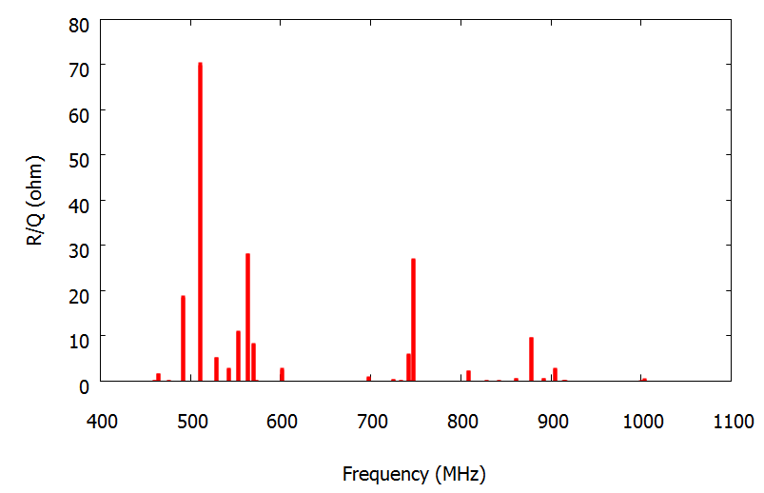
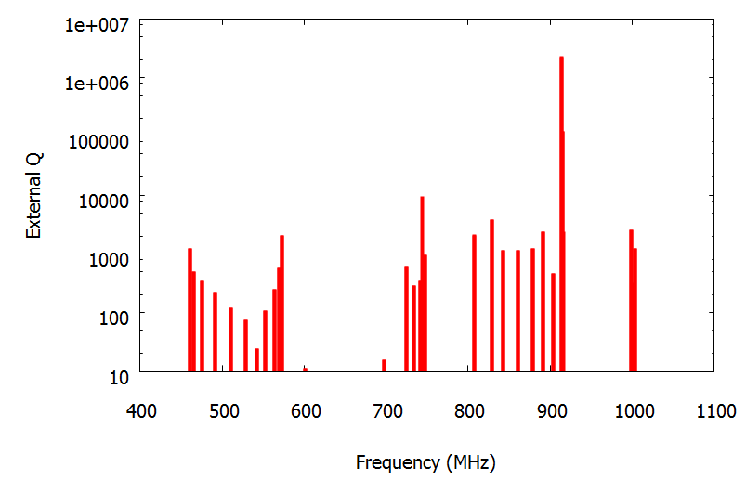
Multi-bunch BBU due to HOM of Cavities
11 passes ERL, 412.8 MHz
BBU threshold current are found by simulation with code written by E. Pozdeyev.
Even without HOM frequency variation, the threshold current, 106 mA, is more than a factor of 2 above the designed current, 50 mA.
With rms HOM frequency variation of 3.10⁻³, the BBU threshold current is 457 mA.
R/Q of HOM
Q_ext of HOM
Courtesy of Y. Hao and W. Xu

Slide 17
BCS resistance as a function of temperature
Operating
at a lower
frequency
can save
refrigeration
power!
n Ω
T(ºK)
Residual resistance: ~1 nΩ possible

Slide 18
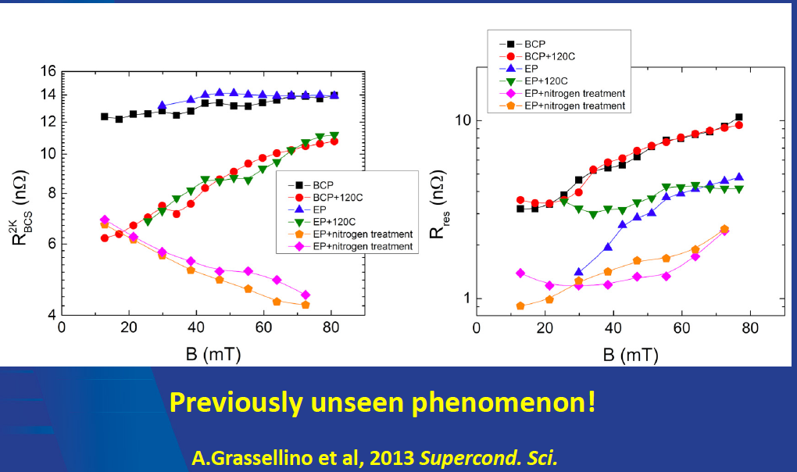
Systematic low residual resistivity achieved
1.3 GHz

Slide 19
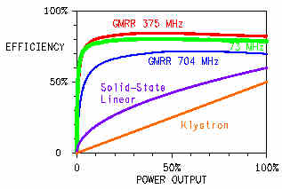
RF Power Efficiency
Class-F solid state amplifiers
More choices in transistor material at lower frequencies.
Efficiency increases with lower frequency.
RF power is required just for microphonics control.

Slide 20
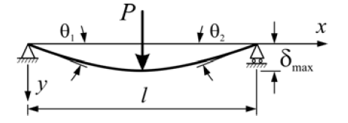

RF power for microphonics and size
Assume h~l, Δf/f=δ_{max}/l, f~1/l
(h is a transverse dimension of a bar)
Then the frequency deviation per unit force is proportional to
Δf~l ⁻³
The tuning power is given by
P_{rf}=2πUΔf and U~l³
Thus the RF power required for microphonics control should be independent of the cavity frequency.
However, with larger cavities we need fewer amplifiers!

Slide 21
Cost and complexity
The cost of the niobium material is a small
fraction of the linac cost, minimal effect on cost.
Complexity is reduced with lower frequency.
Fewer welds per voltage gain for a larger cavity.
ILC.
M. Harrison, P5
A. Favale, IPAC11

Slide 22
Summary
At the Accelerator R&D Division of C-AD we are pursuing the design and critical R&D for and ERL based eRHIC.
The eRHIC design is evolving rapidly, using innovative ideas such as a funneling polarized gun, SRF ERL, Coherent electron Cooling and various design features, the latest being the use of a NS-FFAG.
We made choices for the frequency of the ERL based on constraints given by the RHIC bunch structure and circumference as well as a general push towards the lowest plausible ERL frequency.
Some of the considerations leading to the choice of frequency were given above.

Slide 23
Thank you for your attention!

