Slide 1
JLab ERL,
802 MHZ cavity design, and Polarized Source
Andrew Hutton
Jefferson Lab

Slide 2
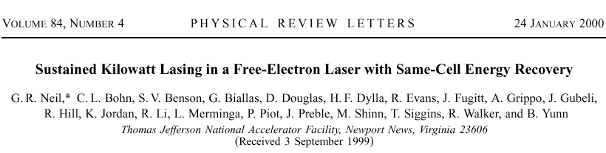
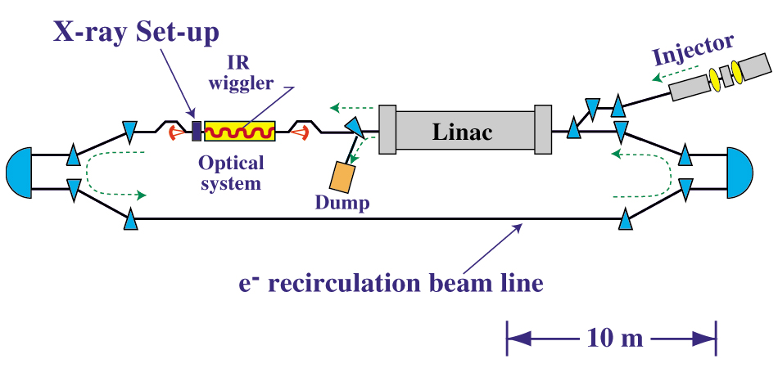
Jefferson Lab IR Demo Free-electron Laser
FEL Specifications
2 – 8 microns at > 1 kW average power
sub-picosecond pulse length
up to 75 MHz rep rate
3-40 keV sub picosecond x-rays

Slide 3

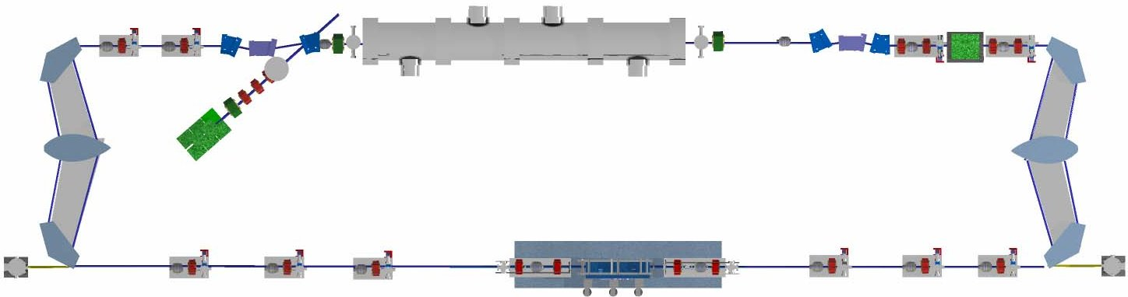

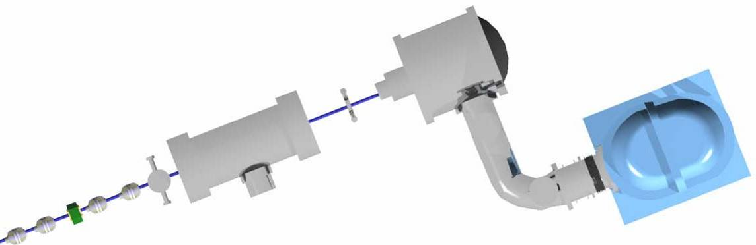



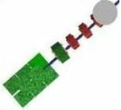
Free Electron Laser Operation in ERL
Niobium SRF Cavity with
Oscillating Electromagnetic Field
Electron Beam
Drive Laser
Cryomodule
Injector
Beam Stop
Gun
Light Output
Wiggler
Output Mirror
Total Reflector
Periodic Magnetic Field
Electron Beam

Slide 4
ENERGY RECOVERY WORKS
Required RF rises from 14.8 kW with beam off to 15.2 kW with energy recovery at 3.5 mA but rises to 35.7 kW with no recovery at 1.1 mA

Slide 5
Benefits of Energy Recovery

Slide 6
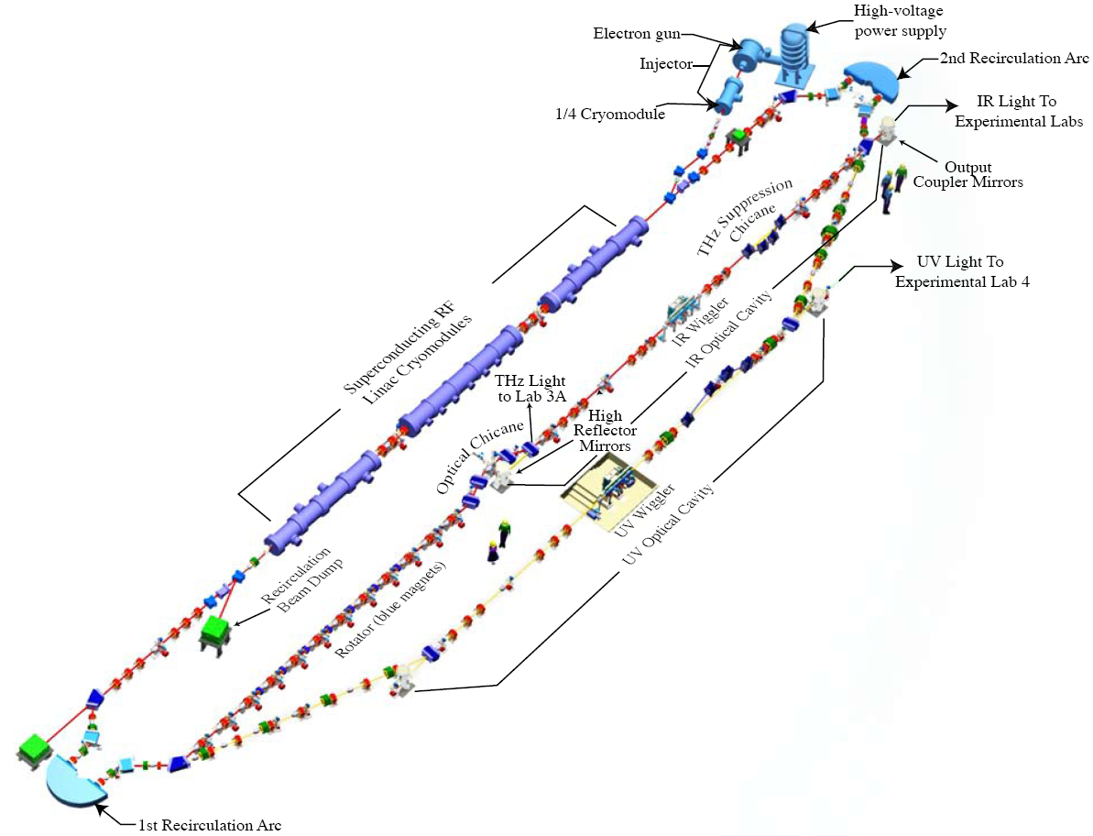
Existing JLab 4th Generation IR/UV Light Source
E = 120 MeV
135 pC pulses @ 75 MHz
(20 μJ/pulse in 250–700 nm UV-VIS
in commissioning)
120 μJ/pulse in 1-10 μm IR
1 μJ/pulse in THz
The first high current ERL
14 kW average power
Ultra-fast (150 fs)
Ultra-bright
(10²³ ph/sec/mm²/mrad²/0.1%BW)
UV harmonics exceed FLASH average brightness (10²¹ average, 10²⁷ peak ph/sec/mm²/mrad²/0.1%BW)

Slide 7
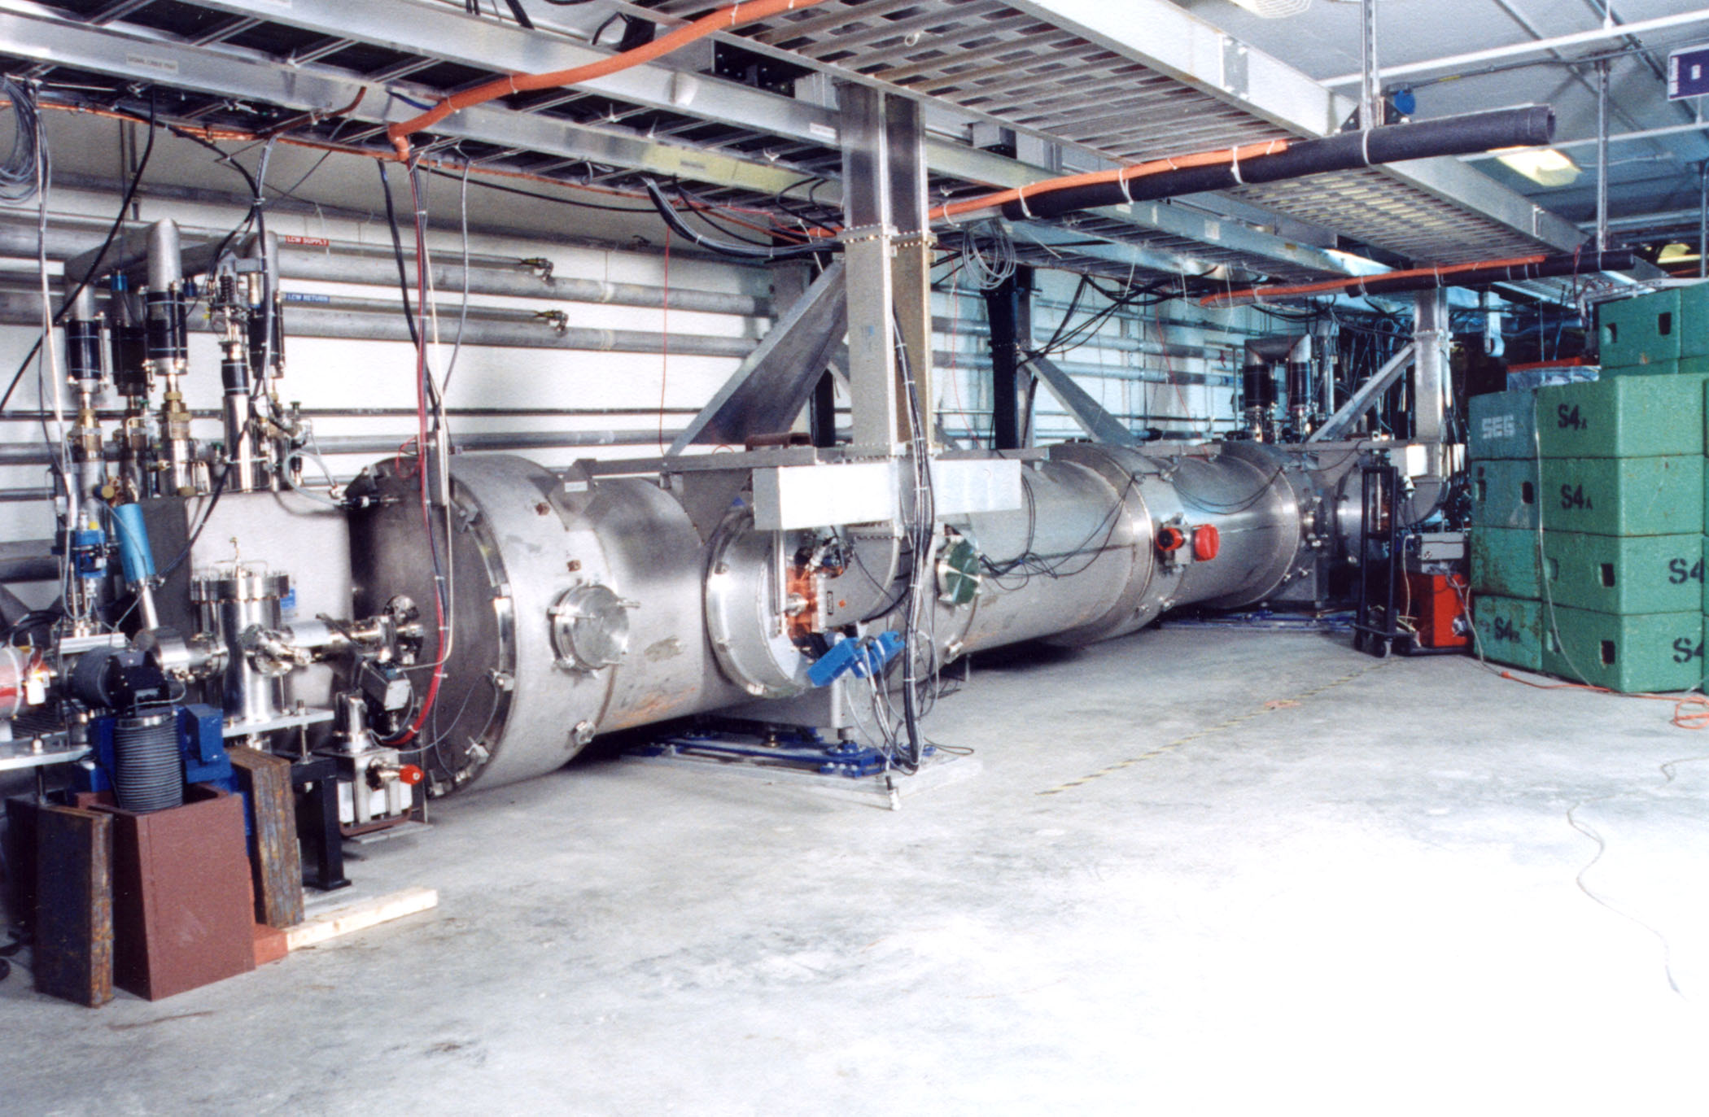
Jefferson Lab FEL Superconducting Linac

Slide 8
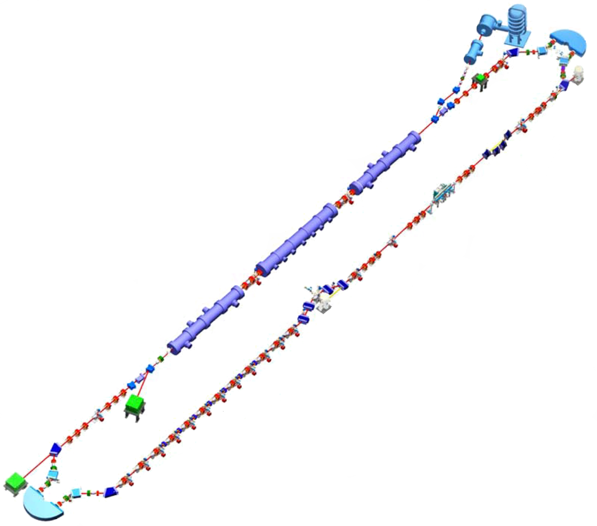
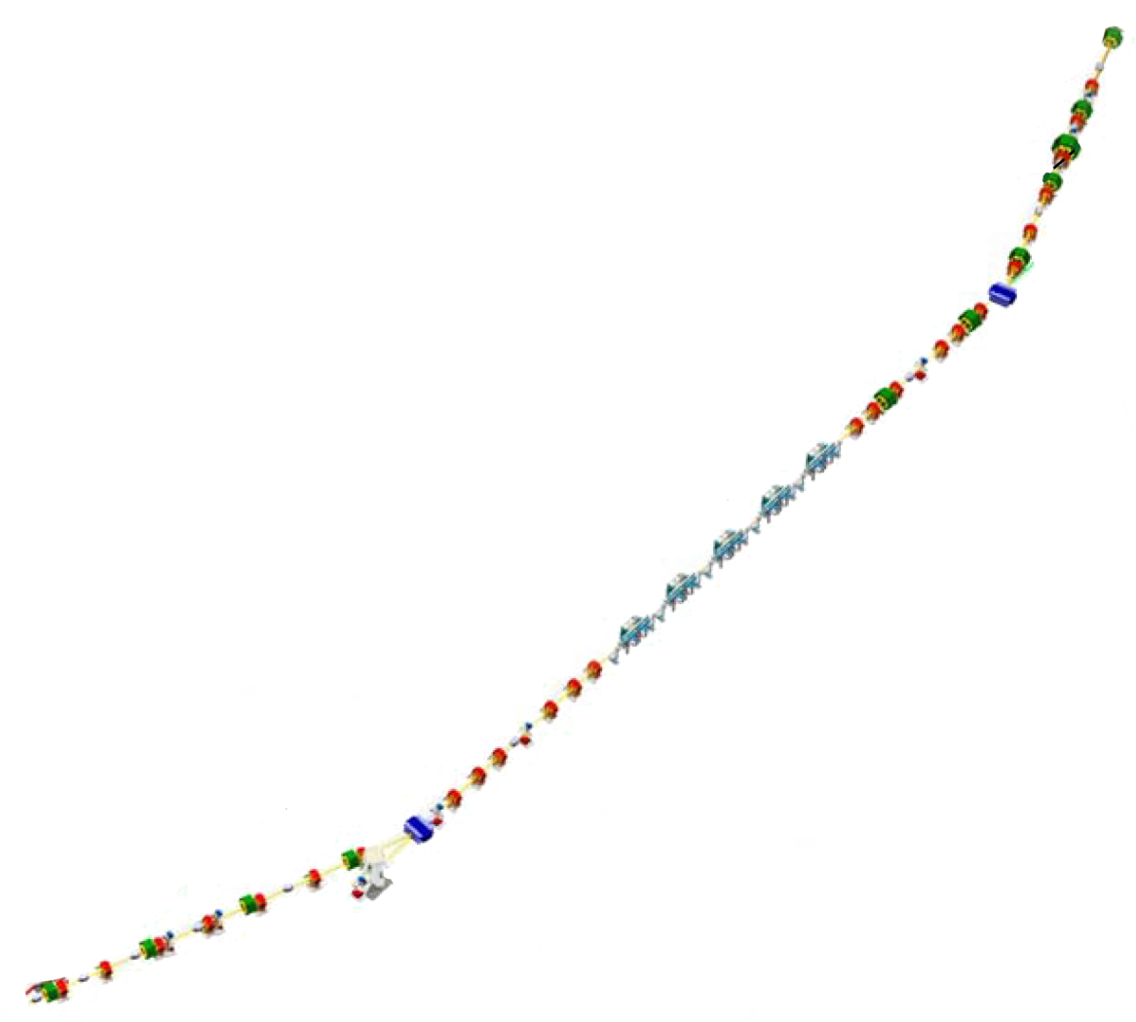
Longitudinal Matching Scenario
DC Gun
E
Requirements on phase space:
high peak current (short bunch) at FEL
  bunch length compression at wiggler
  using quads and sextupoles to adjust compactions
“small” energy spread at dump
  energy compress while energy recovering
  “short” RF wavelength/long bunch,
  large exhaust δp/p (~10%)
  get slope, curvature, and torsion right
  (quads, sextupoles, octupoles)
φ
E
IR Wiggler
φ
SRF Linac
E
Bunching Chicane
E
φ
E
φ
Dump
E
φ
φ

Slide 9
Higher Order Corrections
Without nonlinear corrections, phase space becomes distorted during deceleration
Curvature, torsion,… can be compensated by nonlinear adjustments
  differentially move phase space regions to match gradient required for energy compression
E
t
Required phase bite is cos⁻¹(1-ΔE_{FEL}/E); this is >25º at the RF fundamental for 10% exhaust energy spread, >30º for 15%
  typically need 3rd order corrections (octupoles)
  also need a few extra degrees for tails, phase errors & drifts, irreproducible & varying path lengths, etc, so that system operates reliably
In this context, harmonic RF very hard to use…

Slide 10
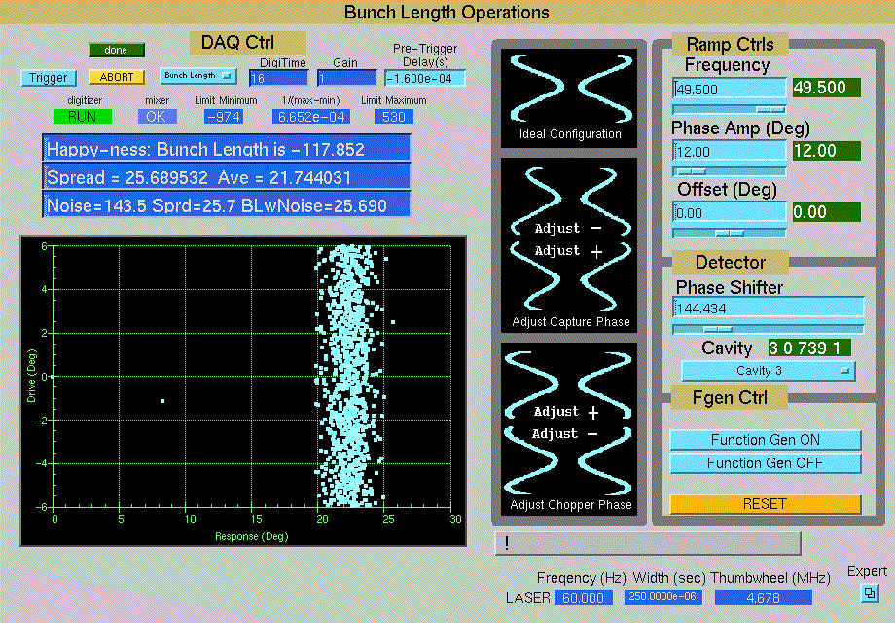
The M55 cavity system can map out phase response of any of the elements in the injector

Slide 11
Major R&D Efforts Around the World
Injector, injector, injector! No existing injector delivers required CW brightness. Many groups are working on this: LBNL, Cornell, Wisconsin, JLab, KEK, Daresbury, BNL, PKU…
Brightness preservation: Solutions to coherent synchrotron radiation (CSR) emittance degradation, longitudinal space charge (LSC) in pulse compression
Halo control essential for CW – non-Gaussian tails!!!
High order mode & beam breakup control in cavities
Wakefield and propagating mode damping
Handling sizeable (~ 20 kW! @ 100 mA) THz radiation in bends
Resistive wall heating in undulators
Reducing srf dynamic load to lower refrigerator costs; probably more important than increasing gradient
< 1μA local loss allowed
High HOM power lost at
srf temps?
100W/m at 4mA on JLab IR FEL

Slide 12
JLab FEL Accelerator Capabilities
 | Near Term Capability | Full Capability | Internal Target (Near Term)
 | external target | external target | internal target
E (MeV) | 80-320 | 80-610 | 80-165
P_{max} (kW) | 100 | 300 | 1650
I (mA) | 0.31-1.25 | 0.5/3.75 | 10
f_{bunch} (MHz) | 750/75 | 750/75 | 750/75
Q_{bunch} (pC) | 1.67-0.4/16.7-4 | 5-0.67/50-6.7 | 13.5/135
ε_{transverse} (mm-mrad) | ~1/~3 | ~2/~5 | ~3/~10
ε_{longitudinal} (keV-psec) | ~5/~15 | ~10/~25 | ~15/~50
Polarization | No | Up to 600 μA | No
 | 750 MHz drive laser; single F100 | 12 GeV RF drive; three F100s | 12 GeV RF drive; three F100s

Slide 13
High Dynamic Range Diagnostic Development is Essential
Four sorts of the unwanted beam (beam halo)
Fraction of the phase space distribution that is far away
from the core (due to the beam dynamics)
Low charge due to not well attenuated Cathode Laser (ERLs) – but real bunches that have proper timing for acceleration
Due to the Cathode Laser but not properly timed (scattered and reflected light)
Field emission: Gun (can be DC or RF), Accelerator itself (can be accelerated in both directions)
Evtushenko

Slide 14
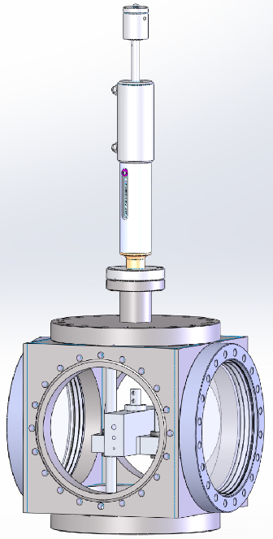
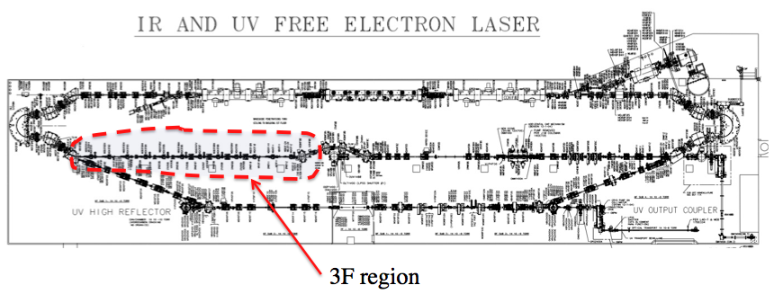
DarkLight Feasibility Test
Goal
Simulate high-power ERL operation with an internal gas-jet target controlling power deposition from beam loss and impedance/wake effects from both beam core and halo components through a 10 cm long small aperture (6, 4, or 2 mm diameter)
i.e., put > 400 kW through a coffee stirrer!
Target
Chamber
Stepper motor
Tube block
Designed and constructed by MIT-Bates R&E Center
in collaboration with JLab FEL staff
DarkLight Collaboration
Notes:
14

Slide 15
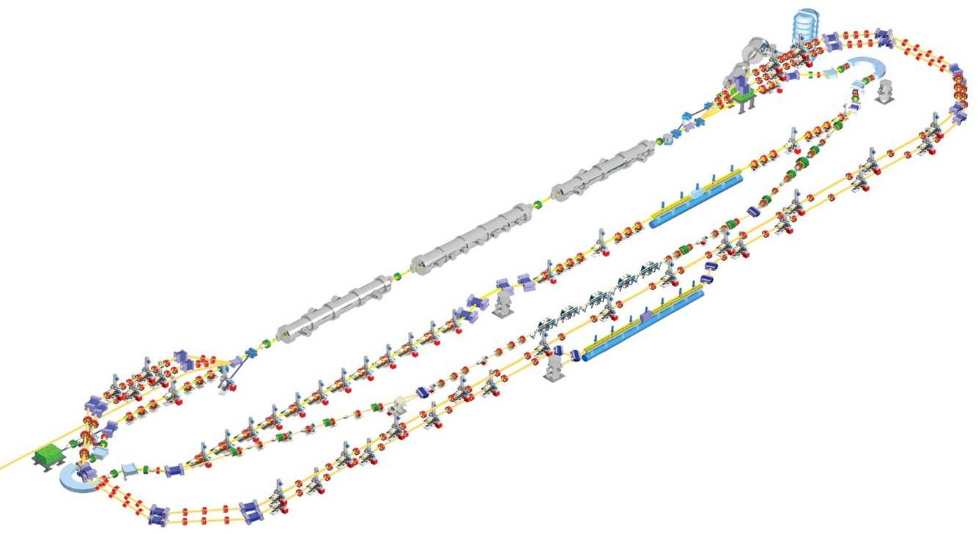
JLAMP FEL designed for unparalleled
average brightness of 10-100 eV photons
600 MeV, 2 pass acceleration
200 pC, 1 mm mrad injector
Up to 4.68 MHz CW repetition rate
Recirculation and energy recovery
10 nm fundamental output, 10 nm/H harmonic
50 fs-1000 fs near-Fourier-limited pulses
Baseline: seeded amplifier operation using HHG
HGHG amplifier + oscillator capability
THz Wiggler for synchronized pump/probe

Slide 16
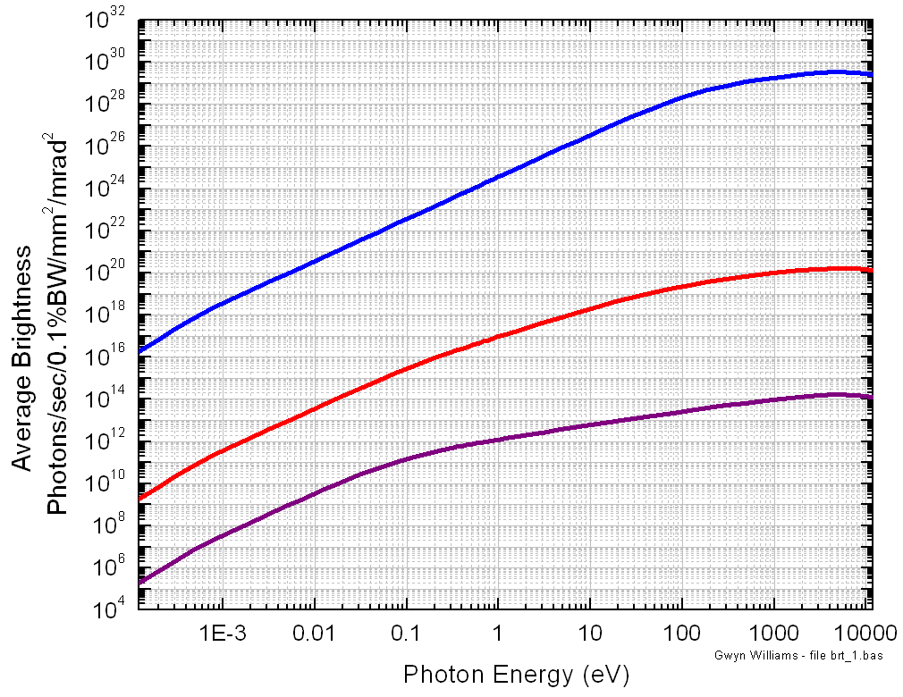
CW operation gives high average brightness in both fundamental and harmonics
NLS
JLAMP
XFEL
JLAB-UV FEL
JLAMP harm
LCLS
4th Gen
UV harm
FLASH
JLAB-THz
Infrared FELs
3rd Gen
2nd Gen

Slide 17
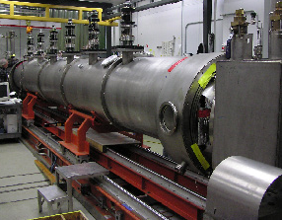
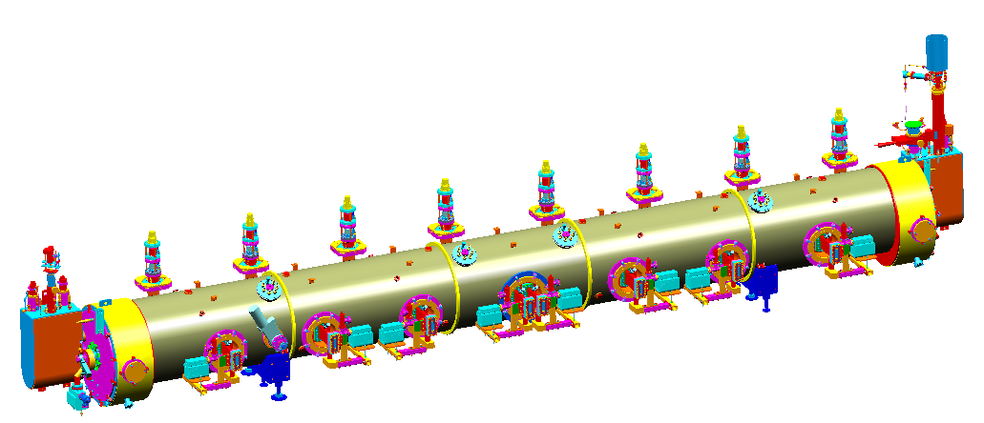
F100 Cryomodule
108 MV, 20 MV/m, 7-cell cavities
20 MV, 5 MV/m, 5-cell cavities
HOM Damping increased for FEL application
Meets all CERN ERL requirements except frequency
Upgrade made possible by advances in SRF

Slide 18
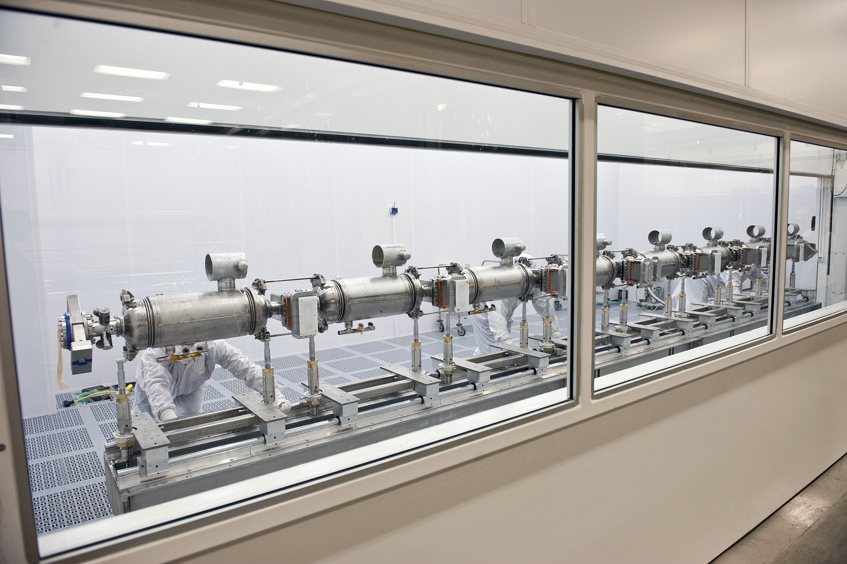
F100 Cavity String December 2013

Slide 19
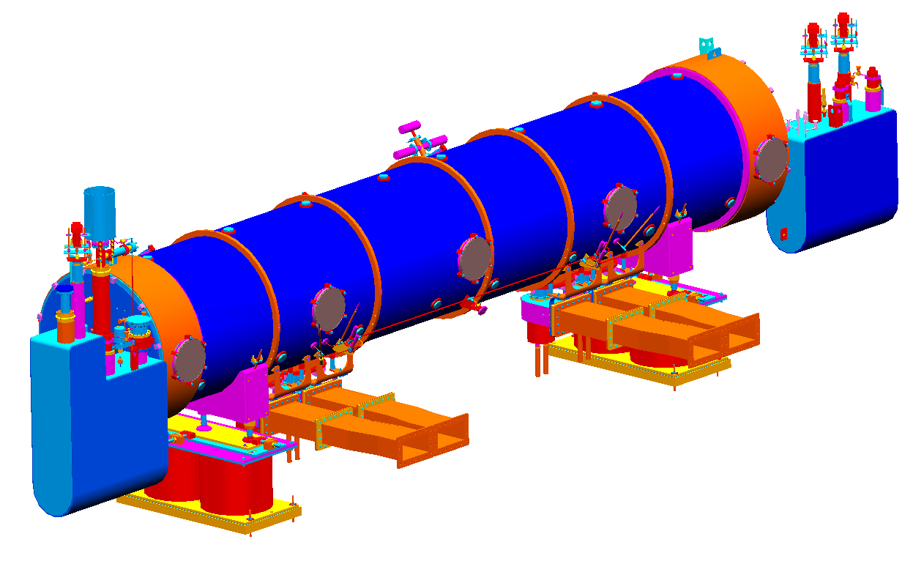
SRF Cryomodules for LHeC:
SNS-Style Conceptual Design
4 cavity SNS Style
E. Daly, J. Henry, A. Hutton, J. Preble and R. Rimmer
JLab Accelerator Division
20-JAN-2014

Slide 20
Proposal : SNS-Style Cryomodule
4 cavities per CM, 802.5 MHz
Based on SNS CM
  5-cell Low Loss Shape
  Coaxial Fundamental Power Coupler
  Single RF Window
  DESY-style HOM Couplers
  Cold Tuner Drive
Overall Length – 7.524 m
Beamline Length – 6.705 m
End Cans include integral heat exchanger for improved efficiency at 2K operations
Supply End Can
Scaled for β = 1
Return End Can
4X RF Power Coupler

Slide 21
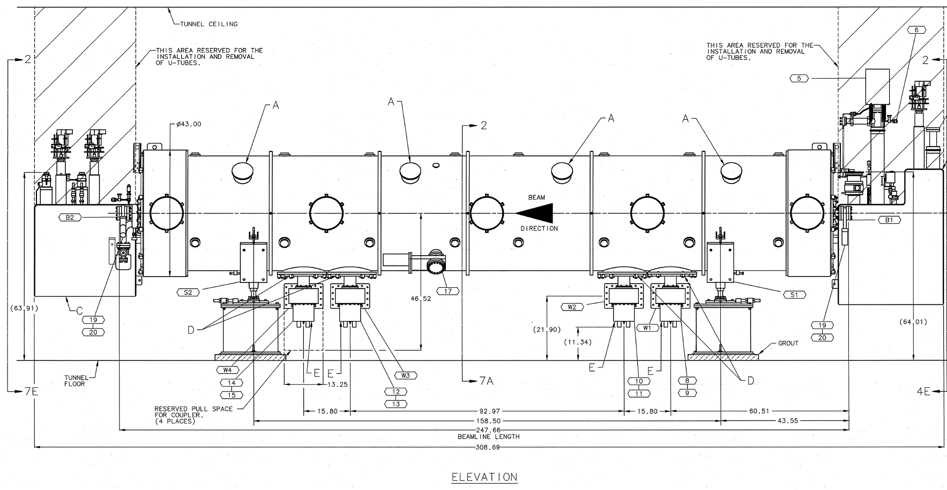
SNS High Beta Cryomodule

Slide 22
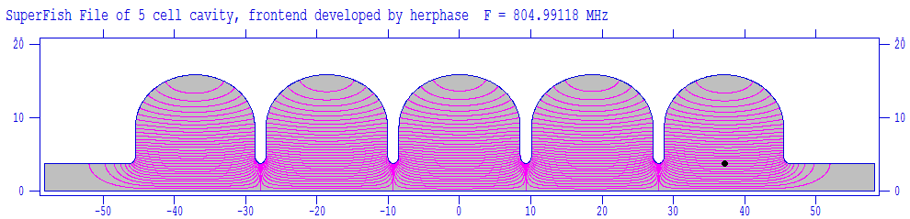
Example of Low-Loss Cavity Parameters (805 MHz) to be modified for 802.5 MHz
0 degree wall angle
Same shape for mid & end cell
Could use SNS cryomodule
N²/k~3000, better than JLab-LL
Assuming E_{a}=15MV/m, then E_{p}=36MV/m, B_{p}=50mT.
Assume Rres~10nΩ at 2K, so Q₀~2.0e10, P_{loss}~12.6W at 15MV/m
MP and HOM NOT investigated yet
Frequency [MHz] | 805
Cavity inner diameter [mm] | 316.7
Beam pipe diameter [mm] | 75.74
Cavity total length [mm] | 1165
Cavity active length [mm] | 925.2
Ep/Ea | 2.40
Bp/Ea [mT/(MV/m)] | 3.34
Geometry factor [Ω] | 288
Ra/Q [Ω] | 764
Ra*Rs (=G*Ra/Q) [Ω²] | 2.20 x 10⁵
Cell-to-cell coupling k | 0.84%

Slide 23
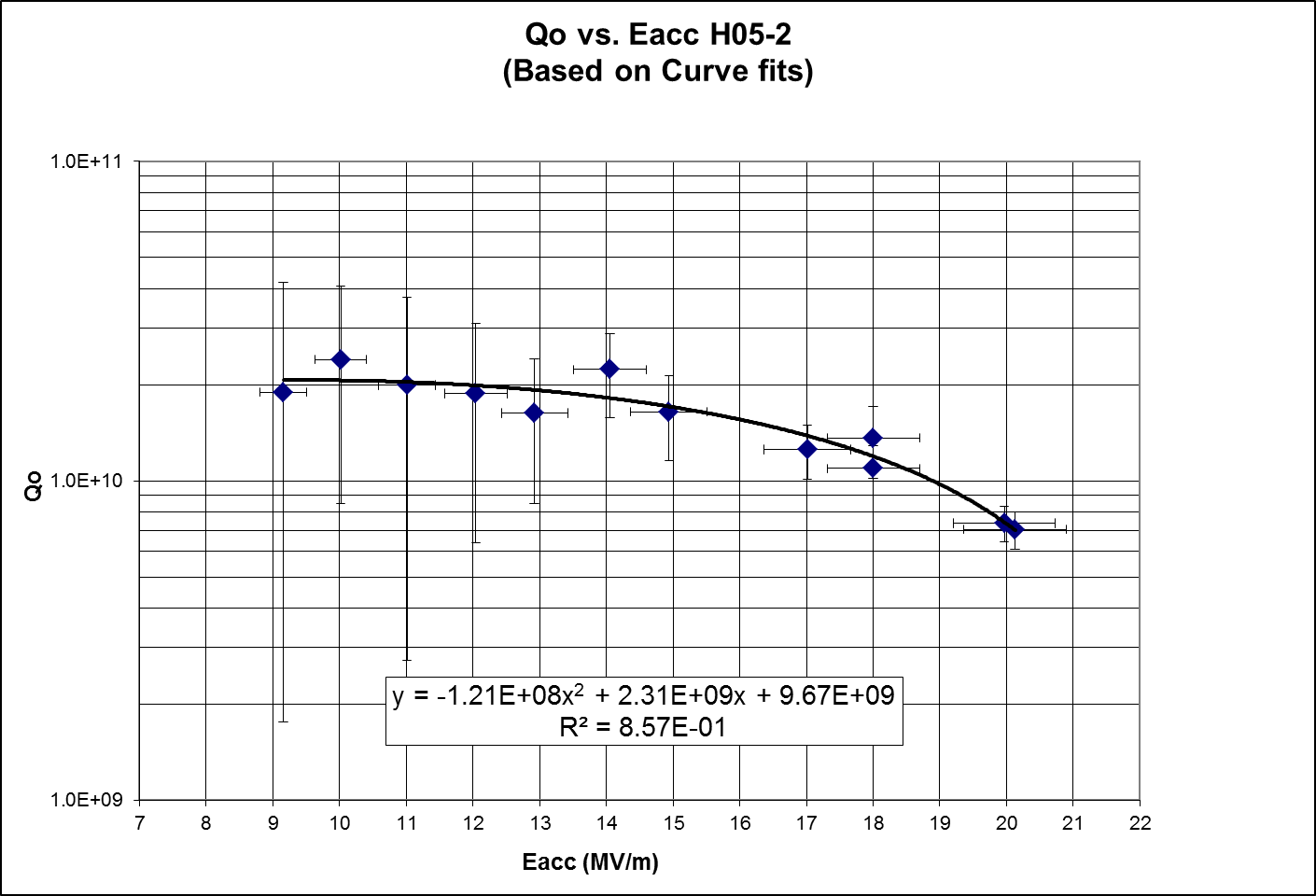
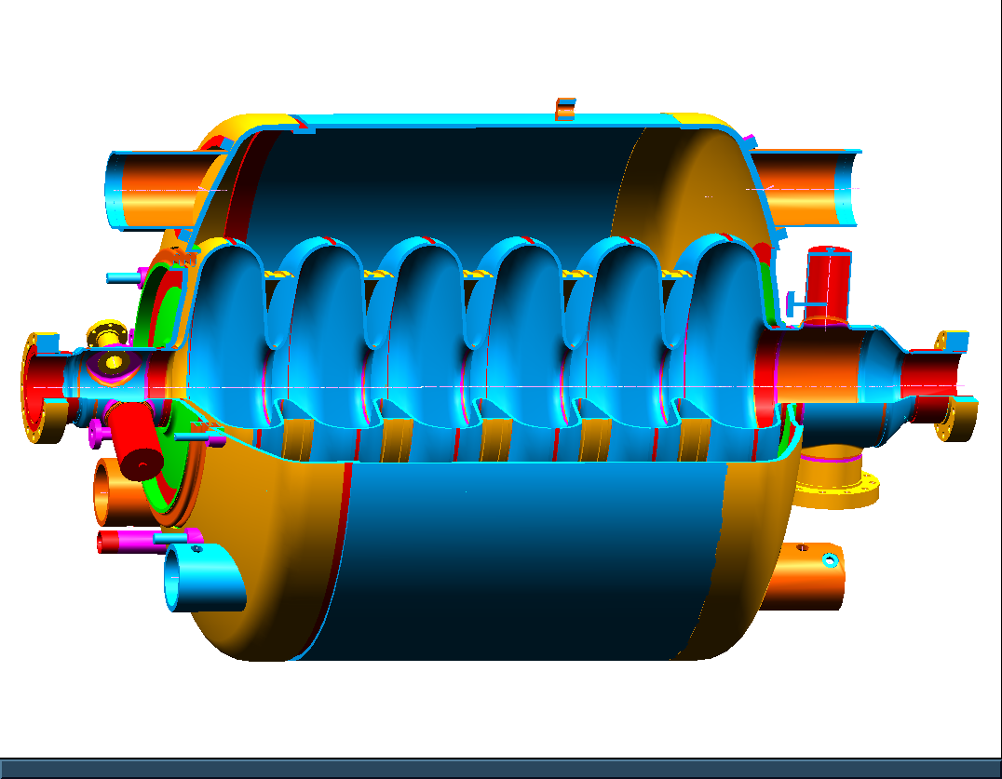
Measured Results for Production SNS High Beta Cavity
Average Q_{o} at 10 MV/m = 2.0E10
Dissipated Power = 8.4 Watts
Average Q_{o} at 15 MV/m = 1.64E10
Dissipated Power = 23.2 W
Field Probe
HOM Coupler
T = 2.0 K
Sample size = 7 Cavities
HOM Coupler
Fundamental Power Coupler
SNS-style CM : 4 cavities at 15 MV/m, 56 MV total
  Q_{o} = 1.64x10¹⁰ ~110 W per Cryomodule
  Q_{o} = 3.0x10¹⁰ ~ 60 W per Cryomodule

Slide 24
Performance/Design Maturity and Cost Considerations
Design maturity
  Cryostat design is complete, SNS cryostat and cryogenic connection is a “drop in” design
  Jefferson Lab has existing 750 MHz and 800 MHz cavity designs
    Needs HOM coupling design, detail SNS style coupler for this application
    Can use SNS coupler with minimal changes for CW operations (lower average power in this case, makes the design simpler)
Production
  Cryostat and power coupler costs from SNS production (2002) available
    Costs need to be corrected for small quantity production and escalation
  Jefferson Lab in-house cavity assembly to control schedule

Slide 25
Engineering and Design Effort
Table illustrates estimated labor effort for engineering design activities including analysis, design drawings, assembly drawing and technical specifications for a complete engineering design – “Ready for Production”
Design activities are split into three groups – cavity, helium vessel & tuner and cryostat
Assumes only incremental changes (scaling) from SNS Designs
PRELIMINARY costs to be confirmed upon scope agreement
Documentation generated is sufficient to support procurement and production for JLAB scope of work.
Option 2b represents one possible split of work
  JLAB collaborates with CERN on their scope while designing the cryostat components (vacuum vessel, thermal shield, magnetic shield, cryogenic piping, end cans, etc.)
  CERN designs cavity, helium vessel and tuner
Option | Design Team | Cavity Type | Cavity (weeks) | Helium Vessel & Tuner (weeks) | Cryostat (weeks) | Total (weeks)
2a | JLAB | SNS-Style | 43.5 | 13 | 71 | 127.5
2b | JLAB | SNS-Style | 4.35 | 1.3 | 71 | 76.65
 | CERN |  | 43.5 | 13 | 0 | 56.5

Slide 26
Conclusion
SNS-Style Cryomodule
  Design work is primarily the cavities
    Leverage CERN engineering resources
CERN participation in engineering and design welcome
MESA cryomodule could be prototype

Slide 27
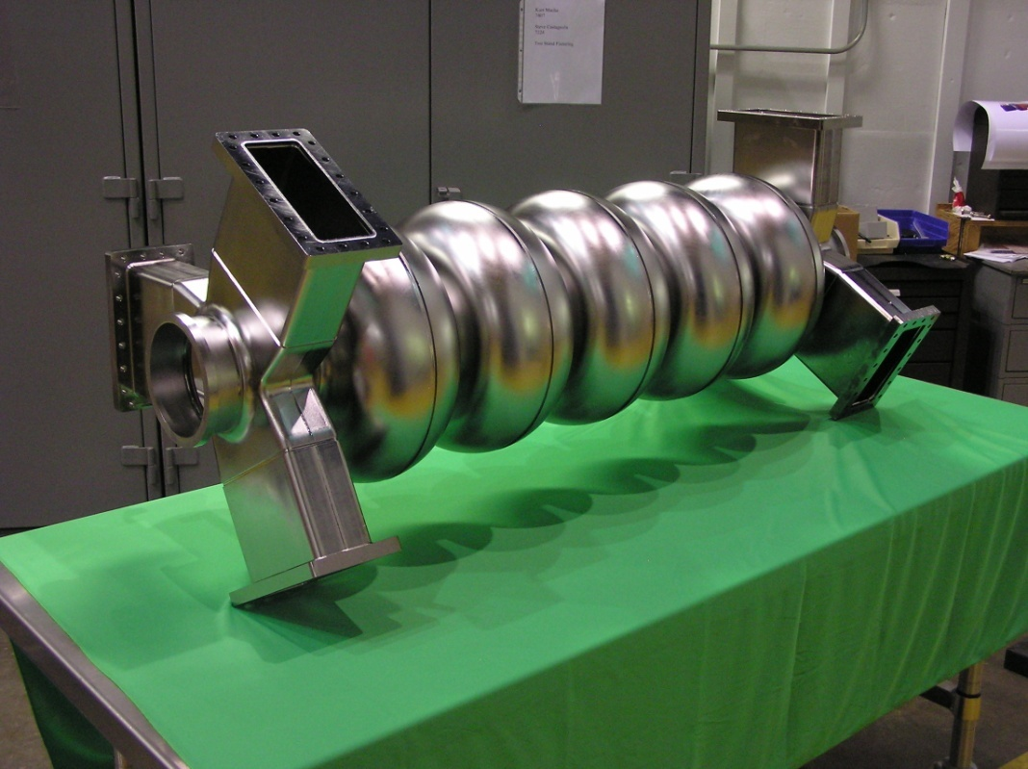
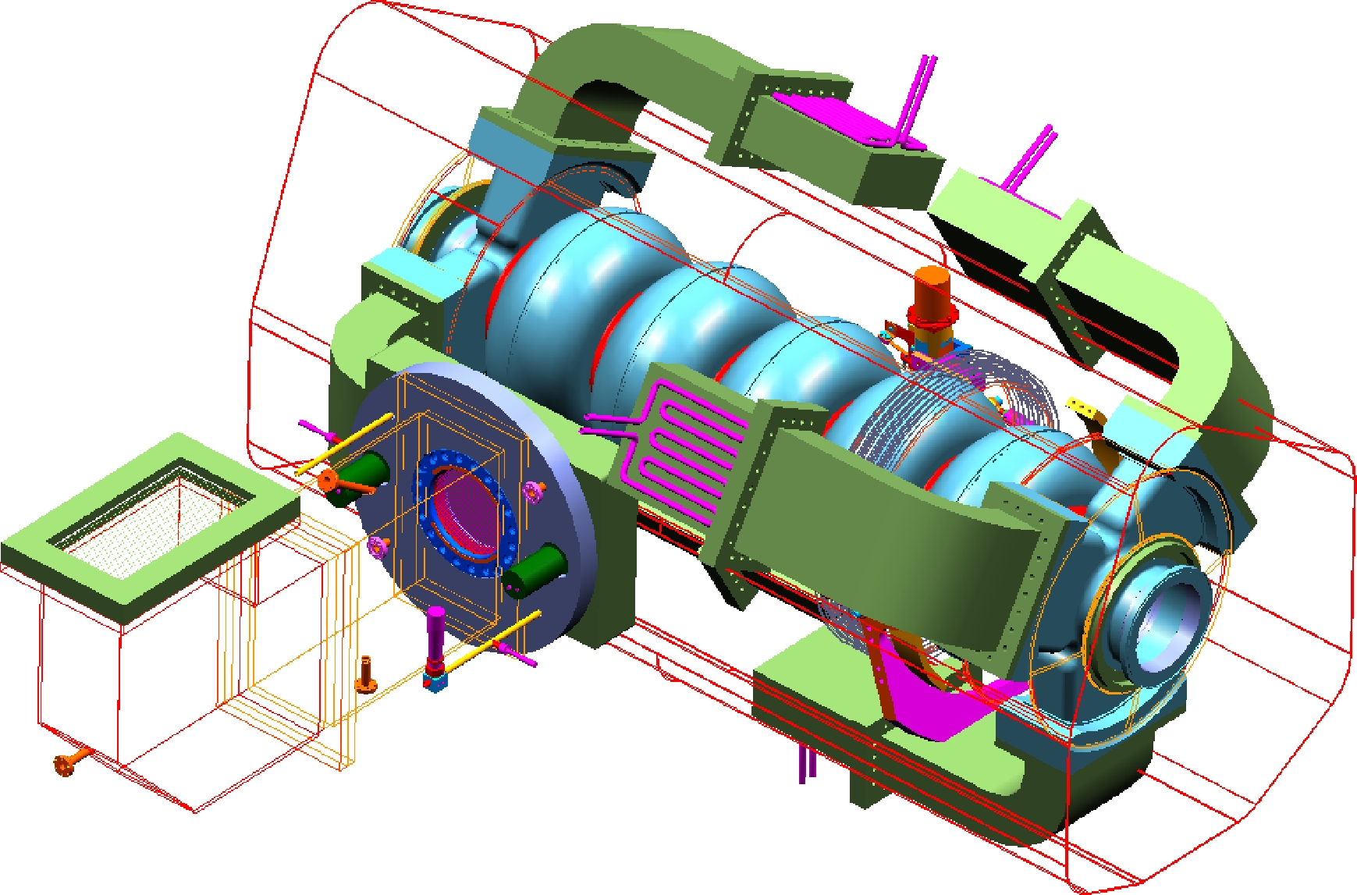
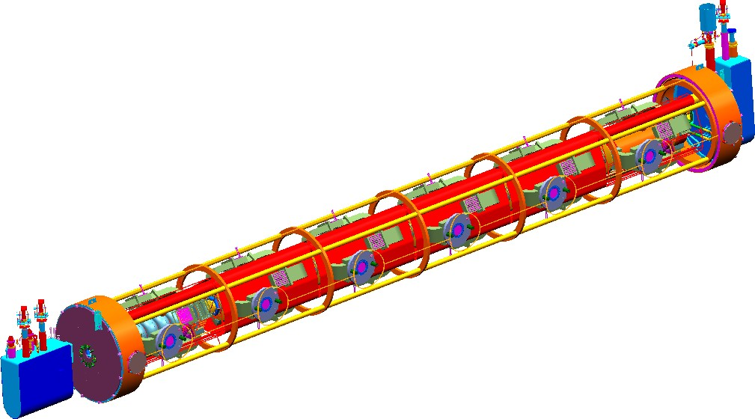
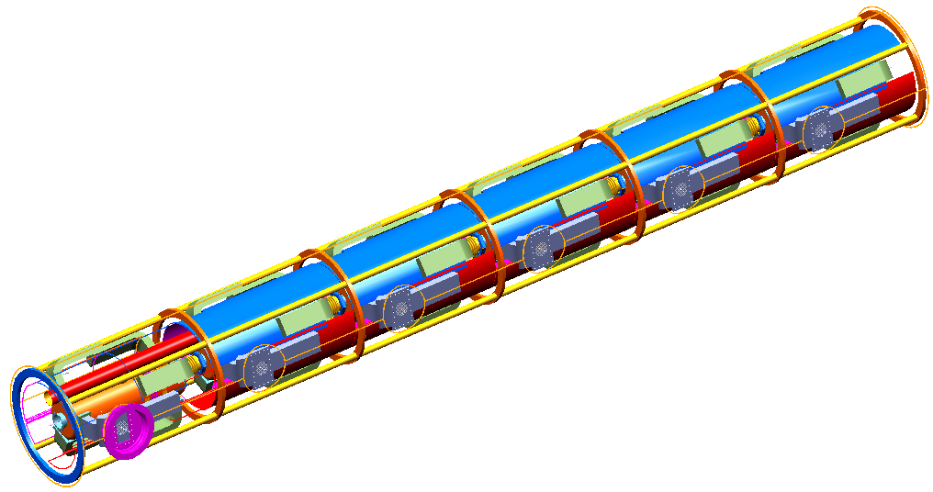
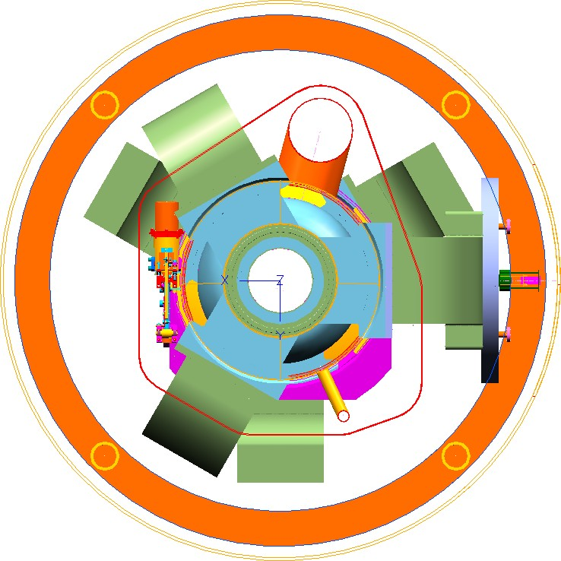
JLab 750 MHz FEL Cryomodule Concept
Spaceframe
~10 m
Thermal Shield
HOM Waveguides
Cavity / Helium Vessel / FPC / Warm Window
Top Hat Bellows
Returm Header
Tank diameter increased to accommodate HOM loads

Slide 28
Polarized Electron Gun

Slide 29
Source Parameter Comparison
Parameter | CEBAF | JLab/FEL | Nuclear Physics at Jlab FEL | Cornell ERL | LHeC | eRHIC | CLIC | ILC
Polarization | Yes | No | Yes | No | Yes | Yes | Yes | Yes
Number electrons/microbunch | 2.5 x 10⁶ | 8.3 x 10⁸ | 4.4 x 10⁶ | 4.8 x 10⁸ | 1 x 10⁹ | 2.2 x 10¹⁰ | 6 x 10⁹ | 3 x 10¹⁰
Number of microbunches | CW | CW | CW | CW | CW | CW | 312 | 3000
Width of microbunch | 50 ps | 35 ps | 35 ps | 2 ps | ~ 100 ps | ~ 100 ps | ~ 100 ps | ~ 1 ns
Time between microbunches | 2 ns | 13 ns | 0.67 ns | 0.77 ns | 25 ns | 71.4 ns | 0.5002 ns | 337 ns
Microbunch rep rate | 499 MHz | 75 MHz | 1497 MHz | 1300MHz | 40MHz | 14MHz | 1999 MHz | 3 MHz
Width of macropulse | - | - | - | - | - | - | 156 ns | 1 ms
Macropulse repetition rate | - | - | - | - | - | - | 50 Hz | 5 Hz
Charge per micropulse | 0.4 pC | 133 pC | 0.7 pC | 77 pC | 160 pC | 3.6 nC | 0.96 nC | 4.8 nC
Charge per macropulse | - | - | - | - | - | - | 300 nC | 14420 nC
Average current from gun | 200 uA | 10 mA | 1 mA | 100 mA | 6.5 mA | 50 mA | 15 uA | 72 uA
Average current in macropulse | - | - | - | - | - | - | 1.9 A | 0.0144 A
Duty Factor | 2.5 x 10⁻² | 2.6 x 10⁻³ | 5.2 x 10⁻² | 2.6 x 10⁻³ | 4 x 10⁻³ | 1.4 x 10⁻³ | 0.2 | 3x10⁻³
Peak current of micropulse | 8 mA | 3.8 A | 19 mA | 38.5 A | 1.6 A | 35.7 A | 9.6 A | 4.8 A
Current density* | 4 A/cm² | 19 A/cm² | 2 A/cm² | 500 A/cm² | 8 A/cm² | 182 A/cm² | 12 A/cm² | 6 A/cm²
Laser Spot Size* | 0.05 cm | 0.5 cm | 0.1 cm | 0.3 cm | 0.5 cm | 0.5 cm | 1 cm | 1 cm
* Loose estimates
Existing
Proposed
Challenges depend on specific beam requirements

Slide 30
Key Features of a Polarized Photogun
Vacuum
  Static Vacuum
  Dynamic Vacuum
High Voltage
  Eliminating field emission
Drive Laser
  Reliable, phase locked to machine
  Adequate Power, Wavelength Tunable?
Photocathode
  High Polarization, QE
  Long Lifetime

Slide 31
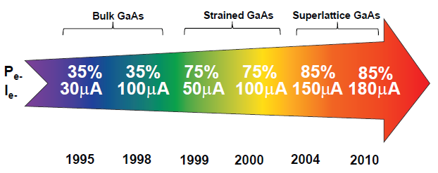
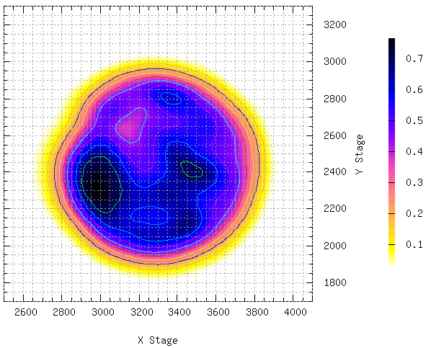
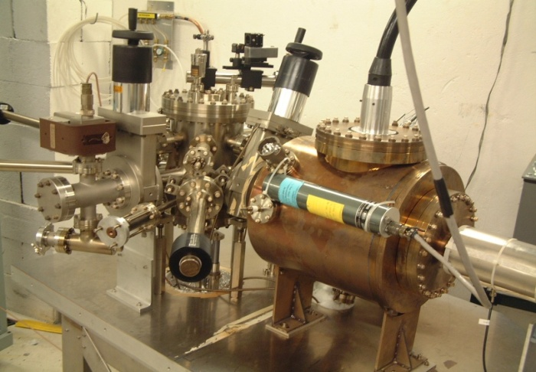
Jlab - ILC High Current Polarized Electron Source
Parameter | Value
Laser Rep Rate | 1500 MHz
Laser Pulselength | 50 ps
Laser Wavelength | 780 nm
Laser Spot Size | 350 µm FWHM
High-Pol Photocathode | SSL GaAs/GaAsP
Gun Voltage | 200 kV DC
CW Beam Current | 4 mA
Run Duration | 1.4 hr
Extracted Charge | 20 C
1/e Charge Lifetime | 85 C
Bunch charge | 2.7 pC
Peak current | 53 mA
Current density | 55 A/cm²
R. Suleiman et al., PAC’11, New York (NJ, USA), March 28 – April 1, 2011

Slide 32
How Long Can Gun Operate at 6.5 mA?
6.5 mA operation, 23 C/hr, 560 C/day.
Photocathode with 1% initial QE, 2W at 780nm and gun with 80 C charge lifetime
  Achieved at JLab during 4mA test
Need initial laser power ~ 1 W to produce 6.5mA
Should be able to operate at 6.5mA for 2 hours before running out of laser power.
Imagine a 10W laser and 1000 C charge lifetime. This provides 4 days of operation.
Message: high current polarized beam applications need photoguns with kilo-Coulomb charge lifetime

Slide 33
Summary
JLab has over 15 years experience in designing, constructing and operating high-power CW ERLs
  Facility under-utilized, available for ERL studies
JLab designed JLamp, a 600 MeV ERL-based light source
  Many similarities with CERN ERL Test Facility
JLab has over 25 years of experience with high-power SRF design, production and operation
  Built over 90 cryomodules, including 805 MHz SNS modules
  SNS Cryostat can be modified for CERN 802 MHz cavities
JLab has active polarized source development
We are ready to collaborate

