Slide 1
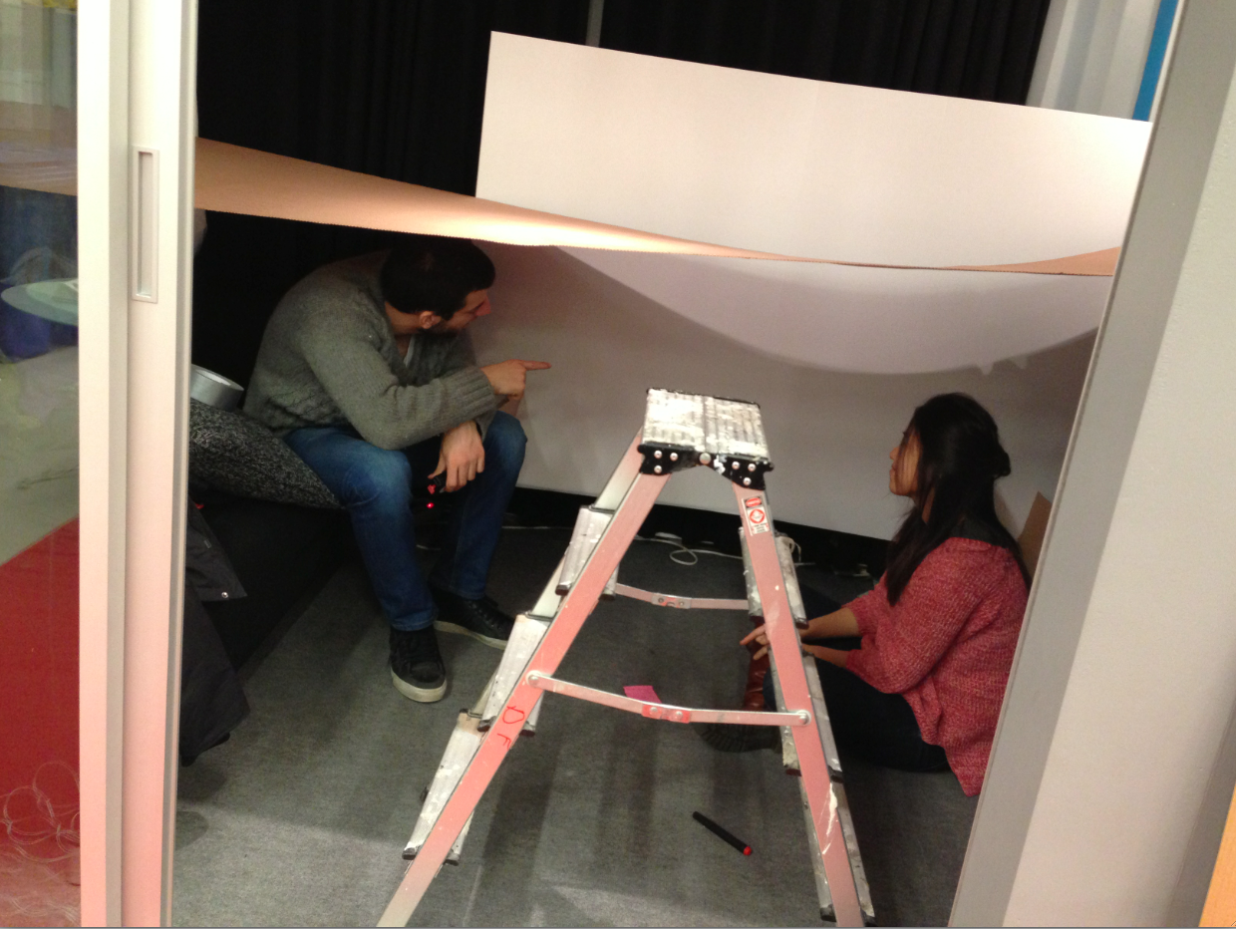
Experience for empathy

Slide 2
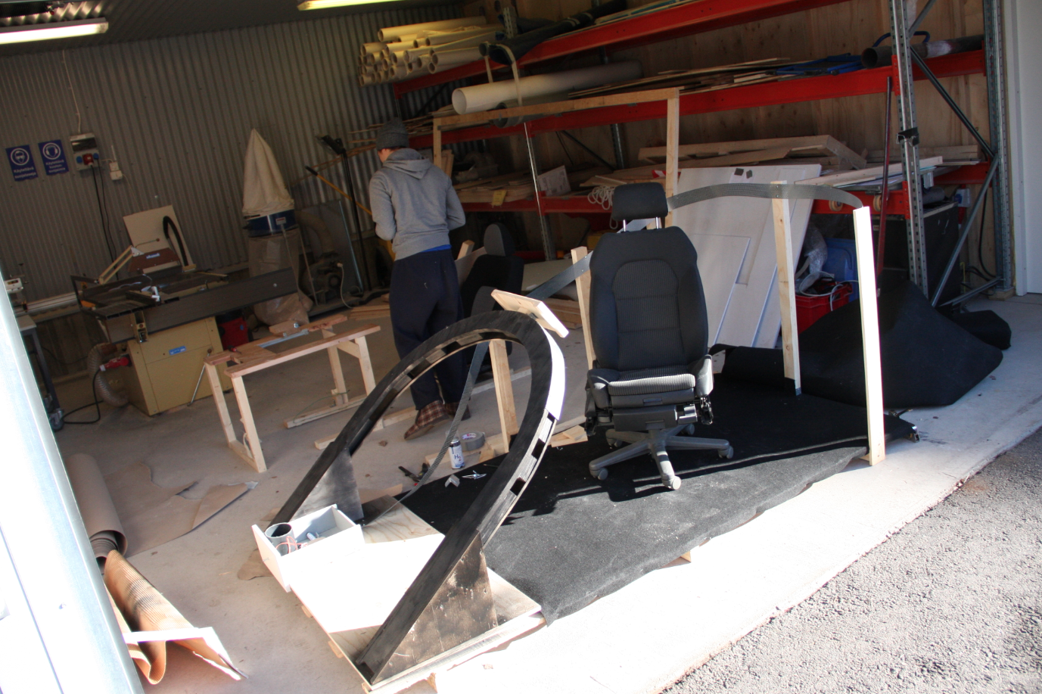
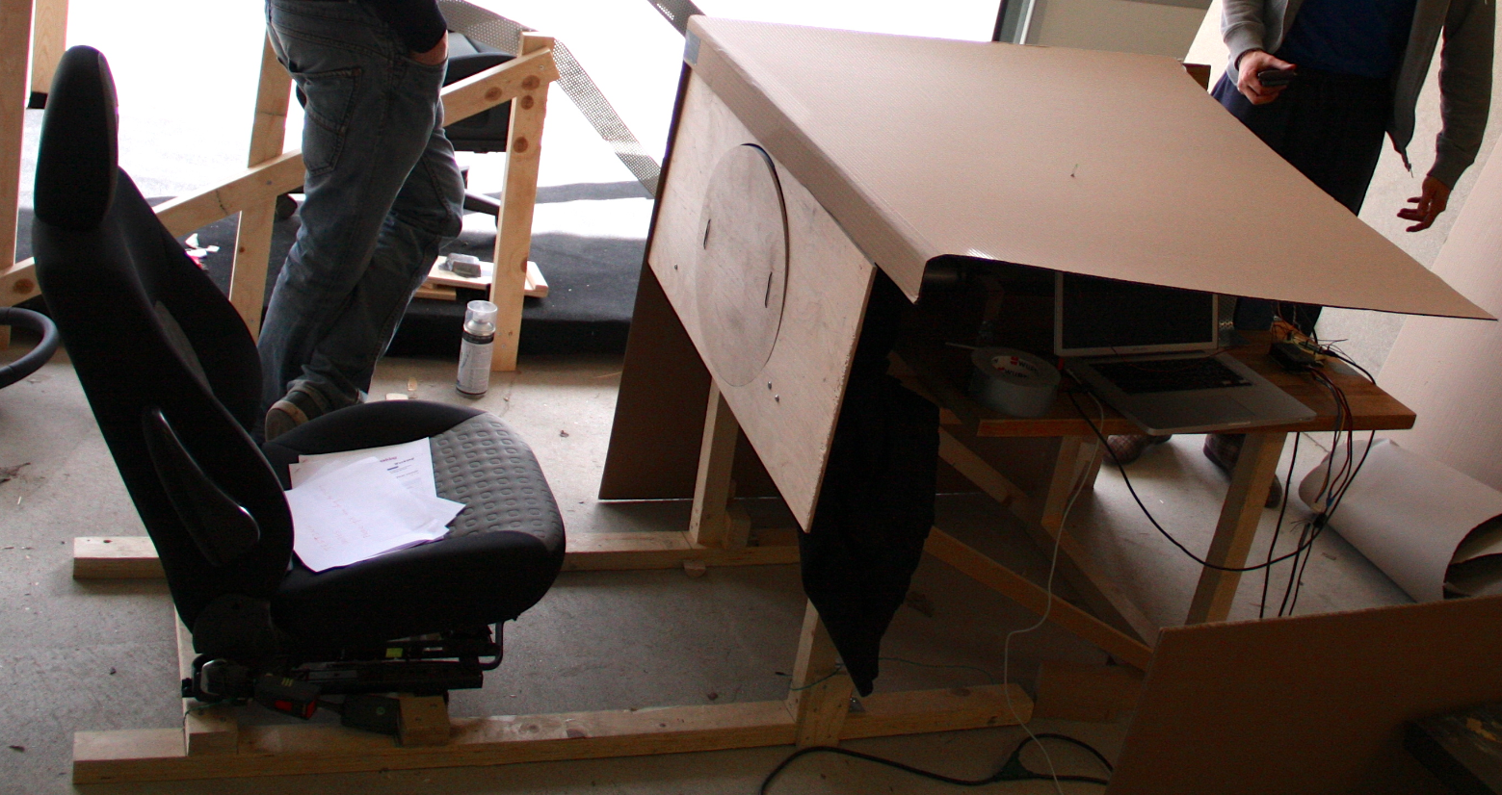
heikin rattikuvat
VS

Slide 3

Notes:
CERN

Slide 4
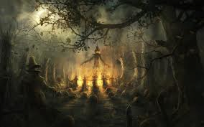
Mission: Trick or treat
Design a surprising and delightful (treat) or scary (trick) experience for CERN inhabitants.

Slide 5
Tricks
The key is surprise AND magic.
Be nice, don’t scare anyone to death!

Slide 6
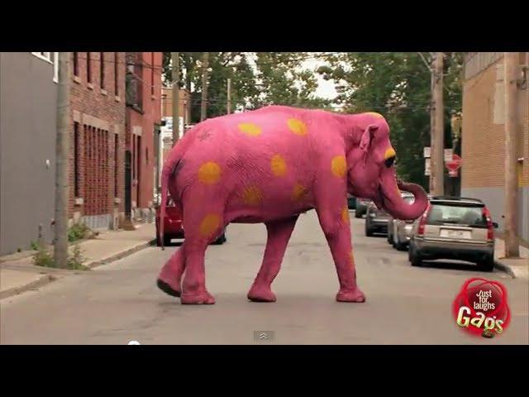
Tricks

Slide 7

Tricks
http://www.youtube.com/watch?v=EbAR1MV7NYY

Slide 8


Slide 9


Slide 10
Treats
Treats
The key is surprise AND delight!

Slide 11


Slide 12


Slide 13
Mission: Trick or treat
Design a surprising and delightful (treat) or scary (trick) experience for CERN inhabitants.
Document the experience with video
Metrics of success = Quality X Quantity of smiles or “screams”
Bonus: Embedding project topic into the trick/treat
Ready to present 17:30 and GET THE HECK OUT =)

Slide 14
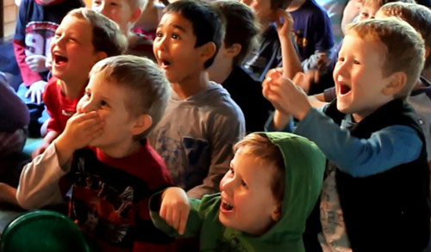
+/-
Experience
Design

