Slide 1
Get into the mood for
crazy

Slide 2
Good Ideas
Crazy Ideas

Slide 3
Good Ideas
Crazy Ideas

Slide 4

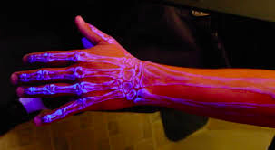
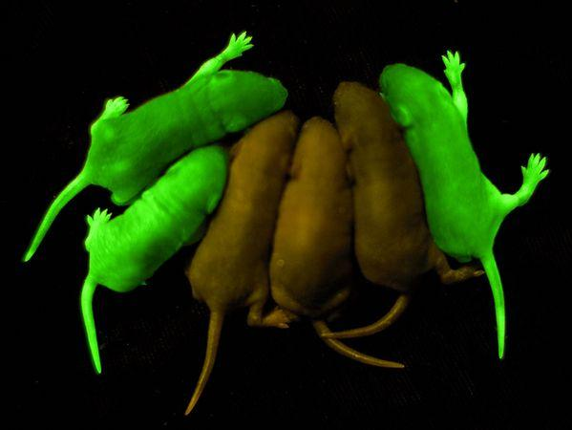
Good Ideas
Crazy Ideas

Slide 5
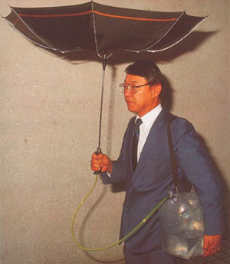
Step 1: Chindogu
Something that is not
unuseful

Slide 6
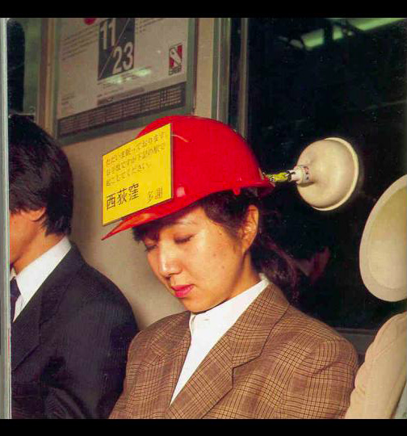


Slide 7
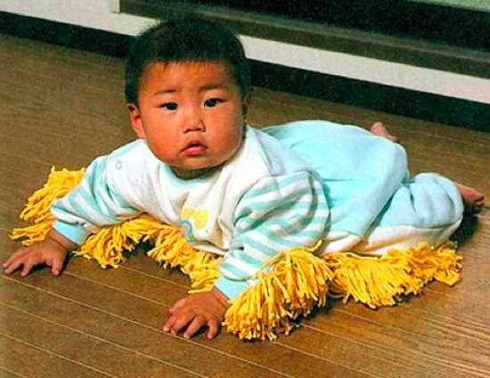

Slide 8
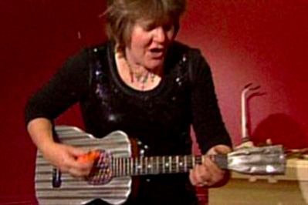
Step 1: Shindoku

Slide 9
Step 1: Chindogu
Create and build a Chindogu in teams of 3
different nationalities
different teams presented
Present tangibly in 30 minutes!

