Slide 1
PeterKucha
This might not make any sense

Slide 2
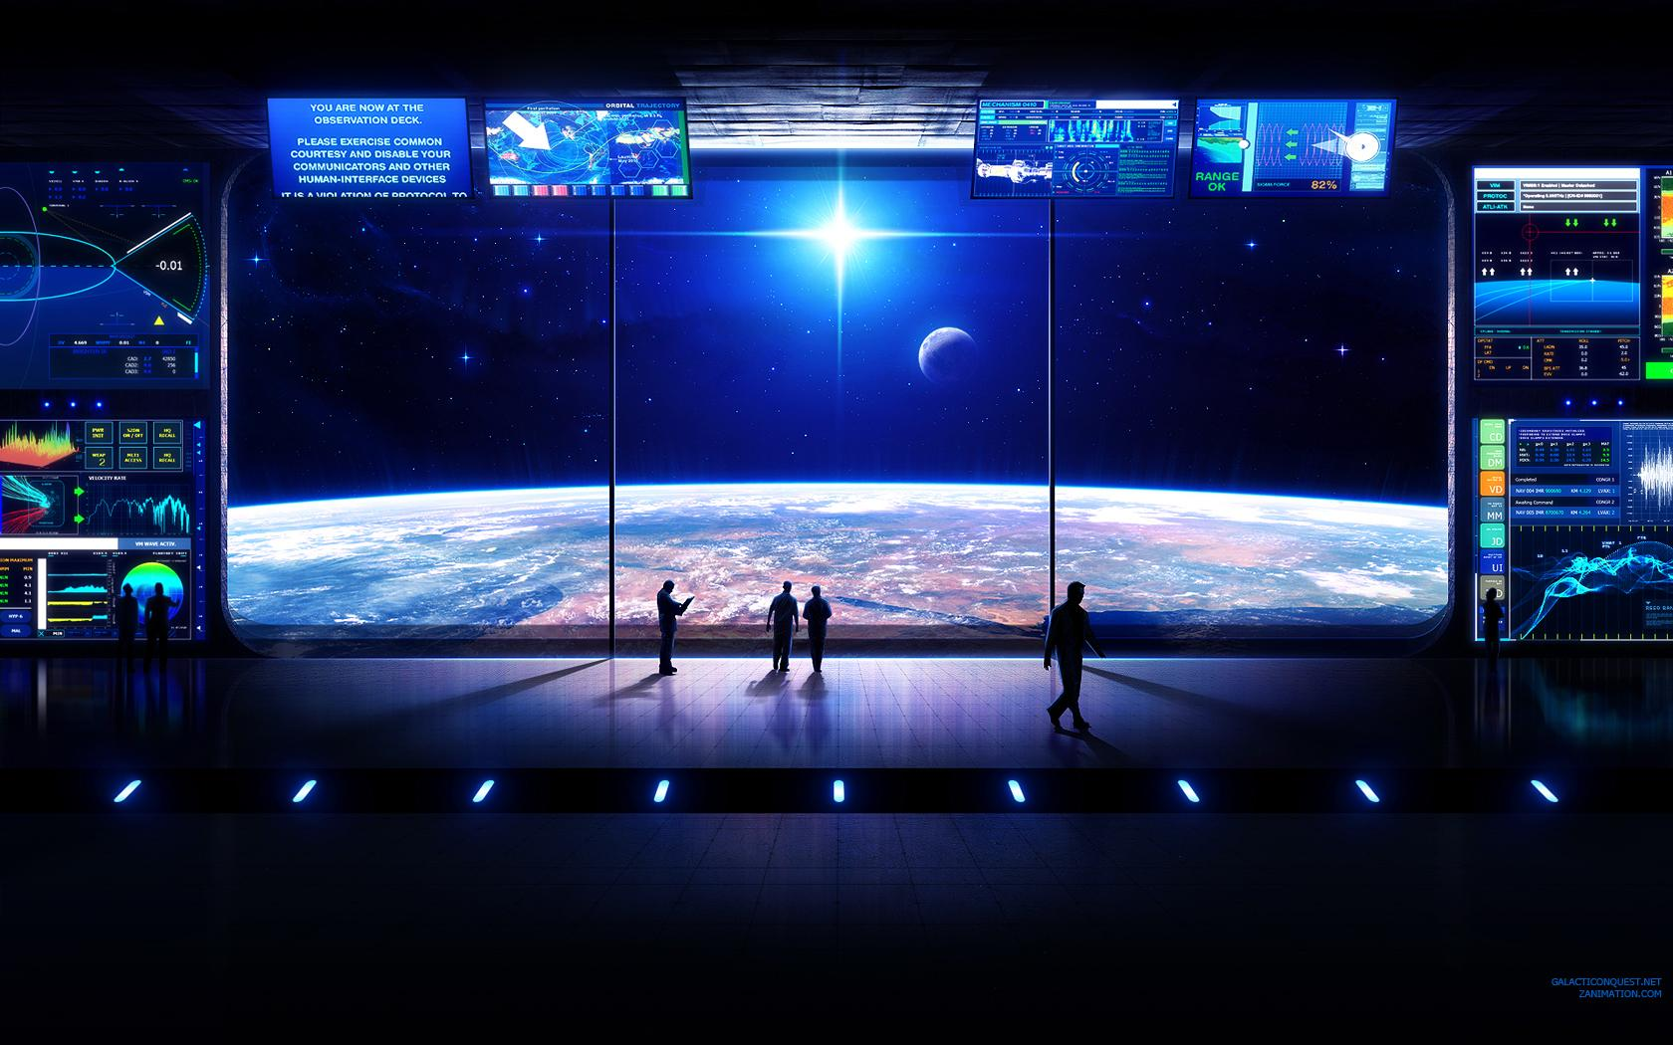
Notes:
I like to think big and I dream of future possibilities.

Slide 3
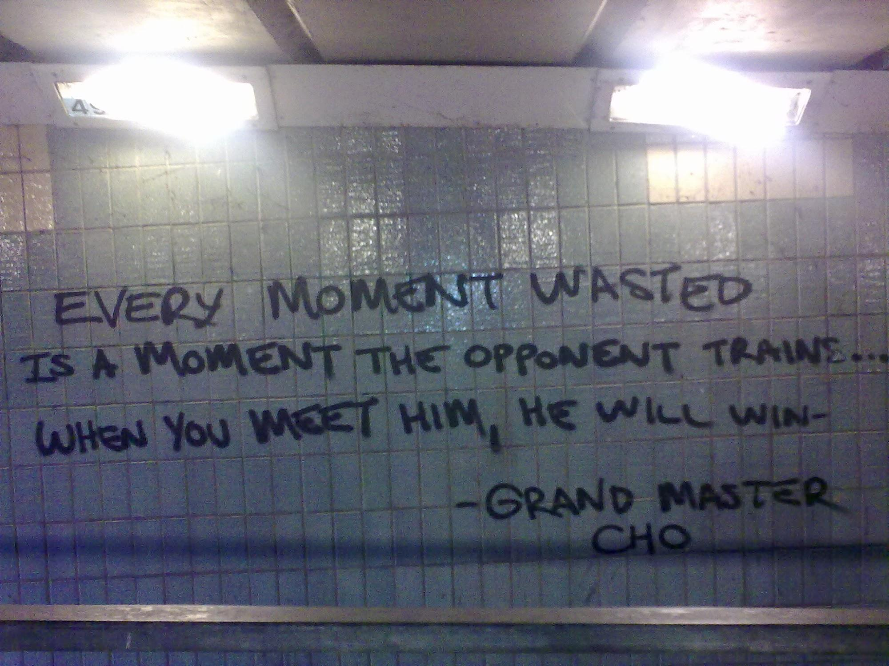
Notes:
It’s important have focus in life, I try to remind myself to have that.

Slide 4
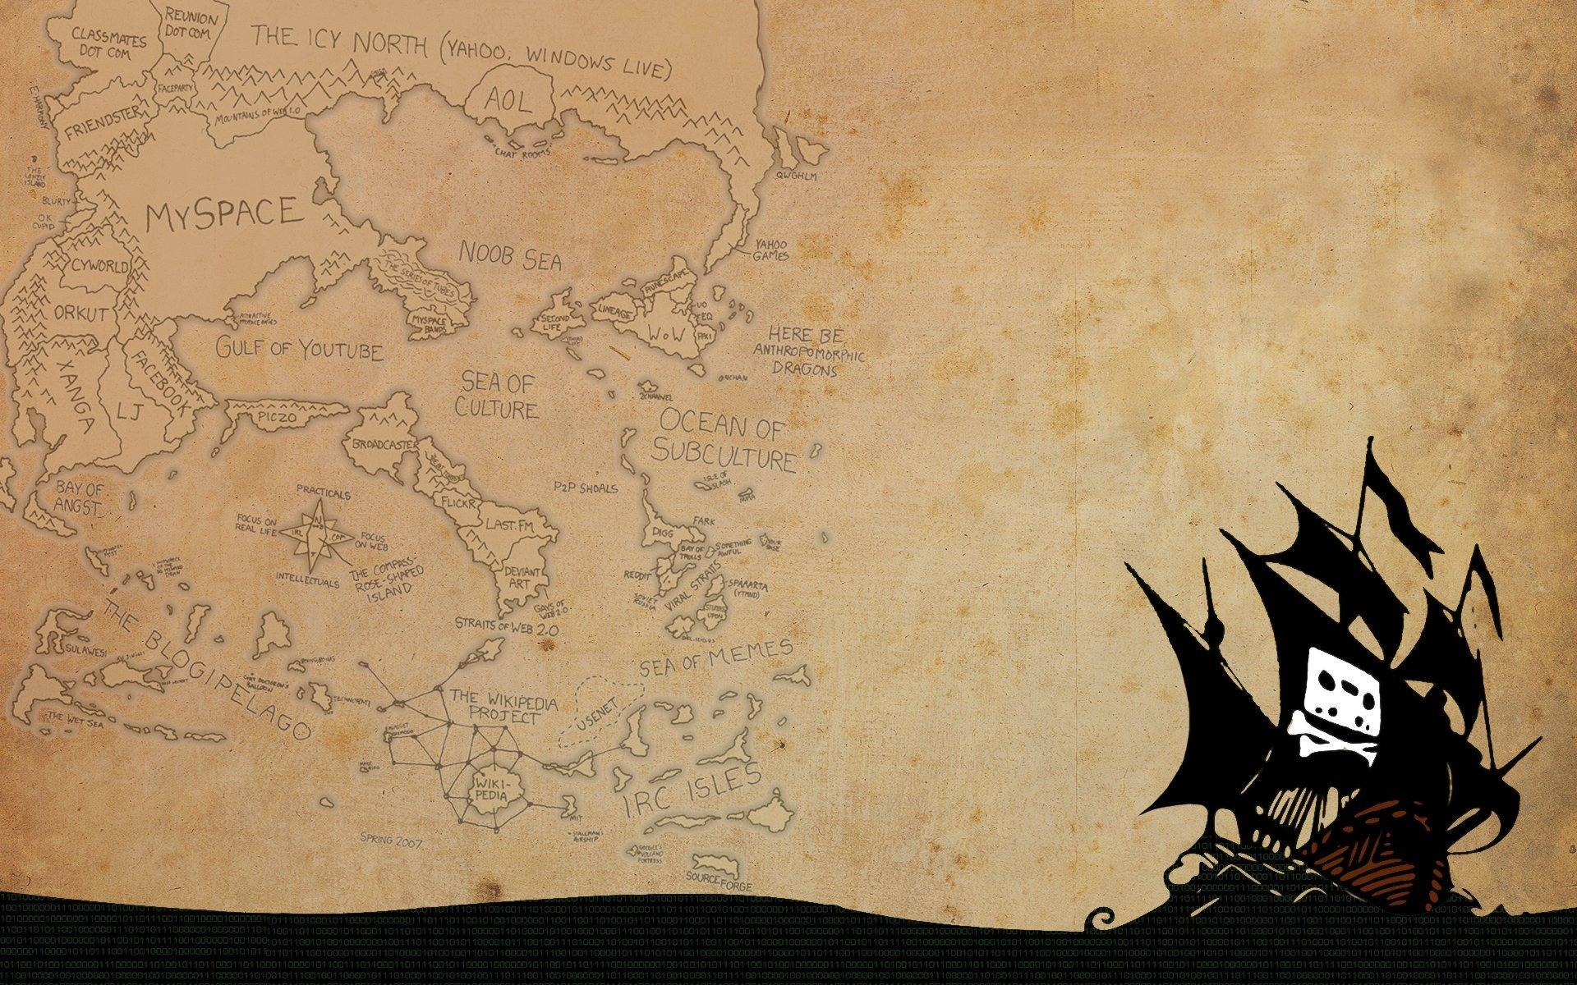
Notes:
I sail, in real life, but also on the digital seas of the interwebs.

Slide 5

Notes:
Communication is key and I am still learning a lot about it.

Slide 6

Notes:
Team is important, you can only go so far alone. Twice more awesome things can be done together.

Slide 7

Notes:
--

Slide 8

Notes:
I sometimes look for designers under my bed, but have recently started finding one inside myself.

Slide 9
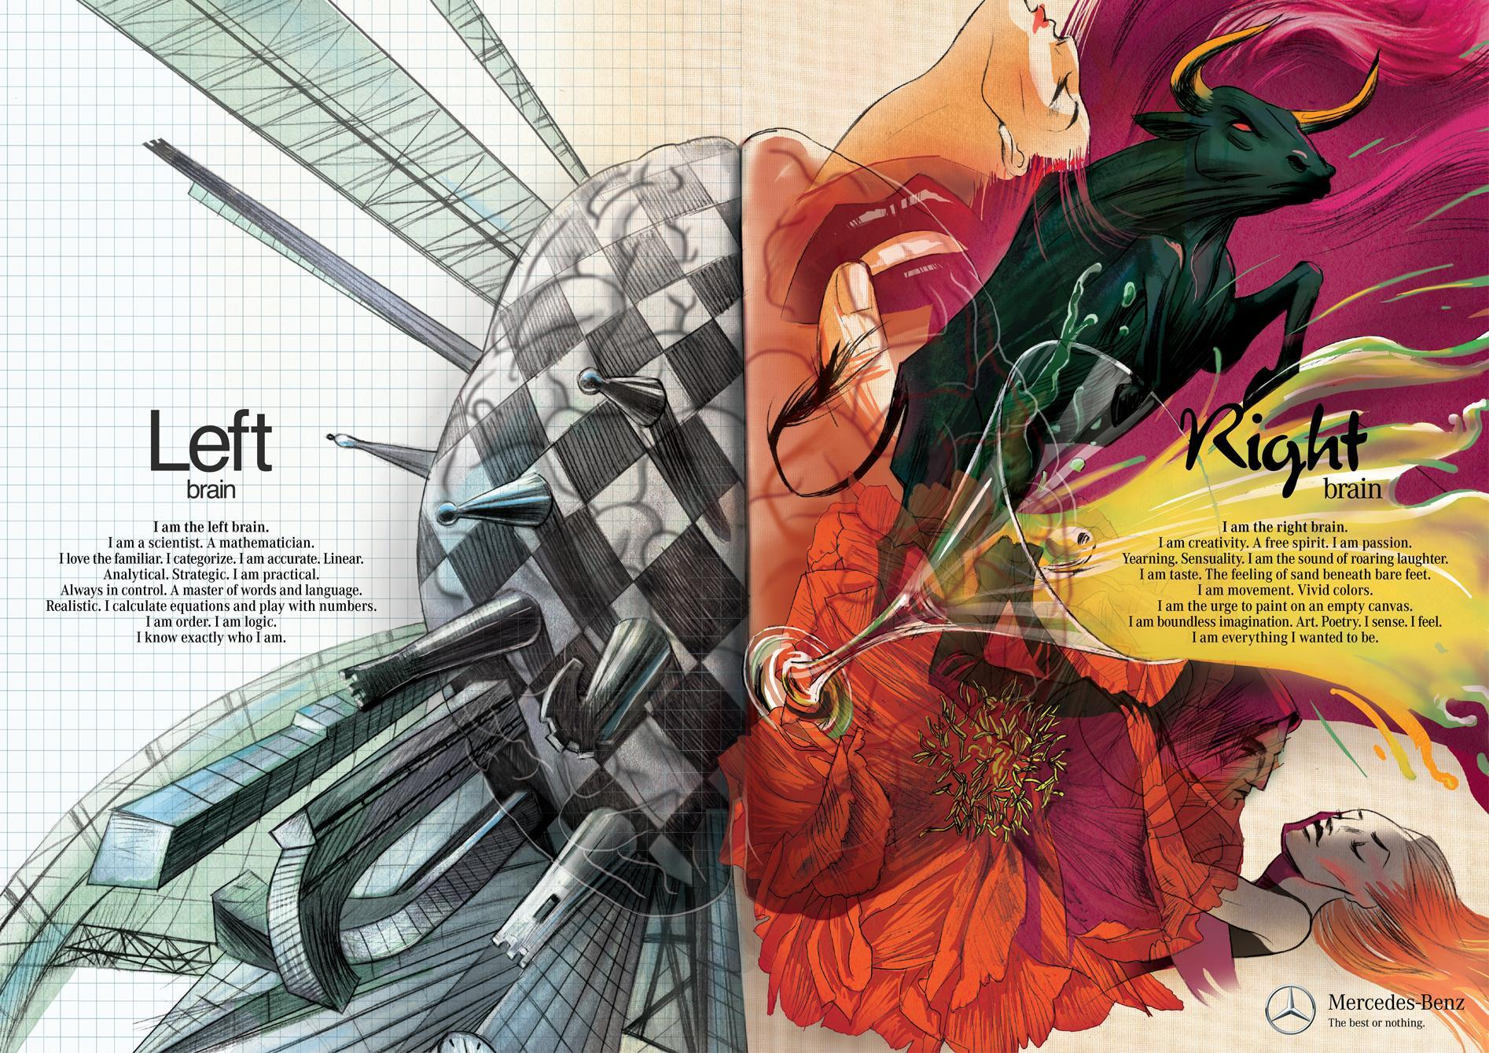
Notes:
I can be very analytical and very creative, but almost never at the same time. I do spend most of my time in the ends of the spectrum.

Slide 10

http://en.wikipedia.org/wiki/Sisu
Notes:
When the going gets tough, the tough get going. Anything can be done if you have some SISU. That wiki article is some of the most inspirational text I’ve read.

