Slide 1
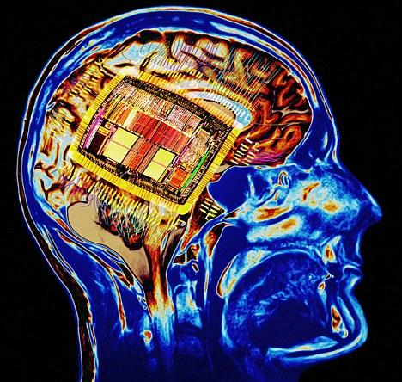
POWER CRUNCH

Slide 2
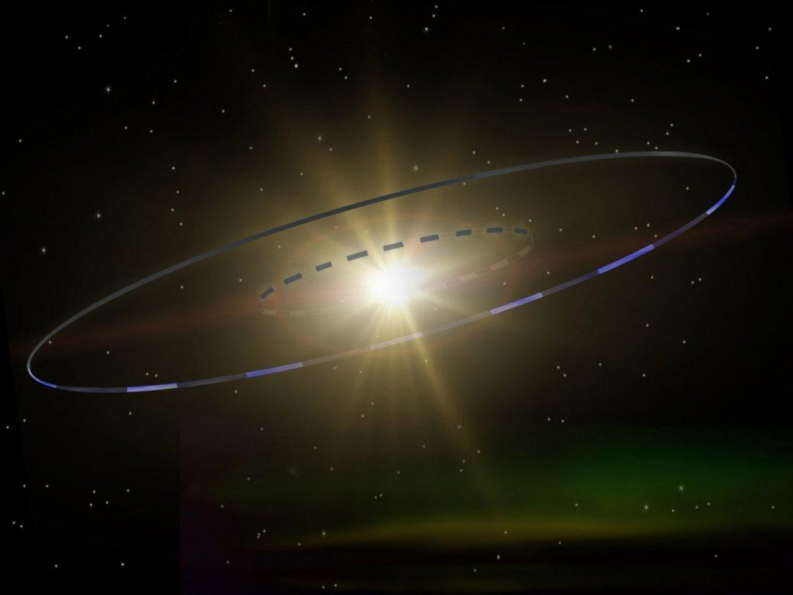
Introduction

Slide 3
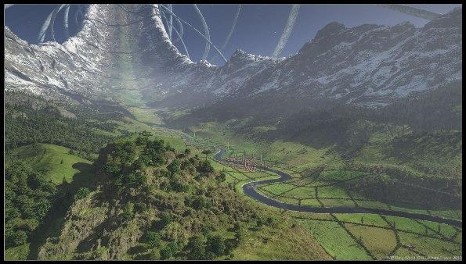

Slide 4
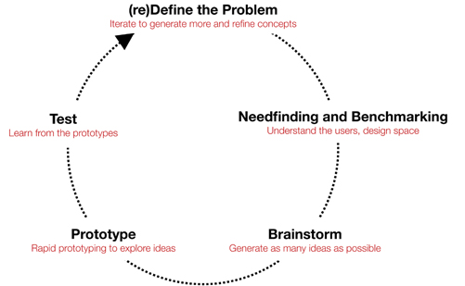

Slide 6

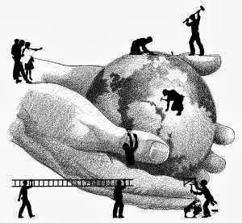
Mission I: Redefine the problem
Agree on terms and goals
Fix the pencap --------------------------- Fix the world

Slide 7
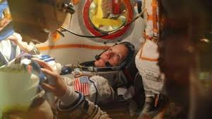
Redesign astronaut experience when waiting to be launched.

Slide 8
Redesign astronaut experience when waiting to be launched.
Improve the haptics of the seat to enforce the feeling of comfort and safety
Provide non-disruptive meaningful activities that eliminates the feeling of waiting
Provide the astronaut with superior sense of connection with the flight control to heighten sense of safety

Slide 9
Mission I: Redefine the problem
“Write your redefinition with 1 clear sentence on a flap paper - must be visible to all”

Slide 10


Slide 11
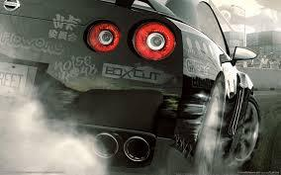
MISSION II: (needfinding) Dirty benchmarking
Needs - you might use assumptions - Fix it later/validate when testing
Benchmarking : “What means do people use now to satisfy the need you try to solve?”
Products….. yes AND business models, technologies, logistic channels, services, ways of working, processes….

Slide 12
Mission II: (Needfinding) dirty benchmarking
“Saturate the board with your discovered/assumed needs + benchmarks that relate to the redefined problem”

Slide 14
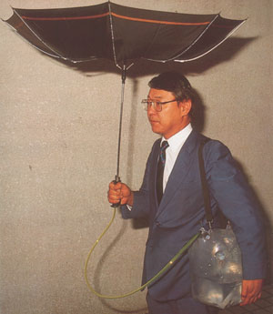

Mission III: Ideation
No bad ideas!
No wrong way to ideate!

Slide 15
Mission III: Ideation
“Write down at least 3 ideas and pin on board” (color: yellow)
Notes:
“Write down at least 3 ideas and pin on board” (color: yellow)

Slide 16
Mission III: Ideation
“Write down at least 3 ideas and pin on board” (color: yellow)
“Read others ideas and write and pin at least 3 YES-AND ideas next to them” (color pink)
Notes:
“Write down at least 3 ideas and pin on board” (color: yellow)

Slide 17
Mission III: Ideation
“Write down at least 3 ideas and pin on board” (color: yellow)
“Read others ideas and write and pin at least 3 YES-AND ideas next to them” (color pink)
“Freestyle!”
Notes:
“Write down at least 3 ideas and pin on board” (color: yellow)

Slide 19
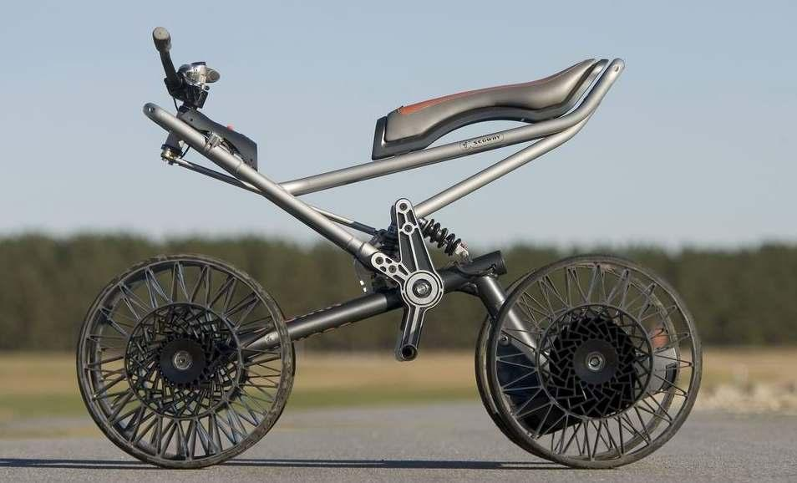
MISSION IV: Convergence and selection
Cluster into categories e.g. “What problem do the ideas cater for?”
axes you might use --- rich poor, young old, technological human
Draw 3 marks next to the most delicious and extravagant ideas to get an idea of what is interesting
(don’t get too abstract and greedy)

Slide 20
MISSION IV: Convergence and selection
“Select 1 idea you can’t wait to push forward”

Slide 22
Mission IV: Concept development
Idea vs. concept: More developed, less abstract, testable hypothesis with implications of execution
Idea: “Eating your bread crispy and nice” Concept: “A device that holds the bread and uses an iron construction to heat the surface of the bread.”
Notes:
“Write down at least 3 ideas and pin on board” (color: yellow)

Slide 23
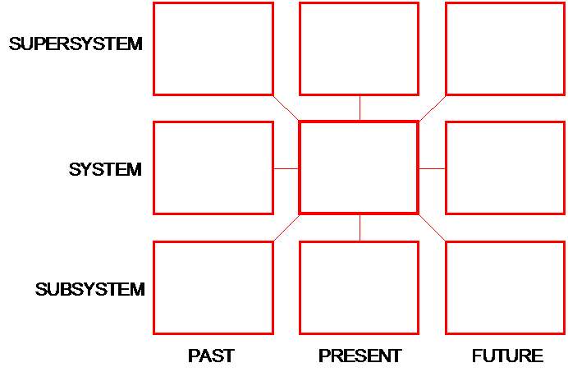
Notes:
“Write down at least 3 ideas and pin on board” (color: yellow)

Slide 24
Mission IV: Concept development
“Develop your idea into a concept. Visualize and present it.”
Notes:
“Write down at least 3 ideas and pin on board” (color: yellow)

Slide 25
Launch: Concept development
Difference between an idea and a concept (more developed, less abstract, testable hypothesis with implications of execution)
9 windows (think about the systemic level how your idea connects to the world and the surrounding environment --- think about the details, the materials and joints that make your idea… past ---- future)
Know what is critical: what makes your concept unique
Idea: “Eating your bread crispy and nice” Concept: “A device that holds the bread and uses an iron construction to heat the surface of the bread.”
“Present your concept”
Provide feedback capturing grid for presentations for memory support

Slide 26
Launch: Presentations

