Slide 1
Mission: Building and Testing

Slide 2
INSERTTO VIIDEO
Design Brief: Design a cabin for Autonomous car on year 2035

Slide 3
Prototyping
= getting ideas and explorations out of your head and into the physical world - can be anything that takes a physical form
- a role-playing activity, a space, an object, an interface, or even a storyboard
- The resolution is now rough and rapid
- Make something people can experience and interact with.
Notes:
Prototypes are learning tools - you only build them to test a hypothesis or increase your knowledge about your concept

Slide 4
Prototyping
- Start a conversation
- Empathy gaining
- Learn
- Exploration
- Testing
- Inspiration
- Solve disagreements
- Fail quickly and cheaply
- Manage the solution-building process

Slide 5
Form of shared thinking, internal and external communication, idea storage/reminder device
What does it mean???!

Slide 6
CYLINDER?
Form of shared thinking, internal and external communication, idea storage/reminder device

Slide 7
Different types?
- Technical prototypes
- communicational prototypes (how does it work e.g. act out with props.)
- experience prototype (user interacts)
- looks like -prototypes (no functionality, but look and feel)
- desirable prototype
*ADD your own* -> What do you want to learn?

Slide 8
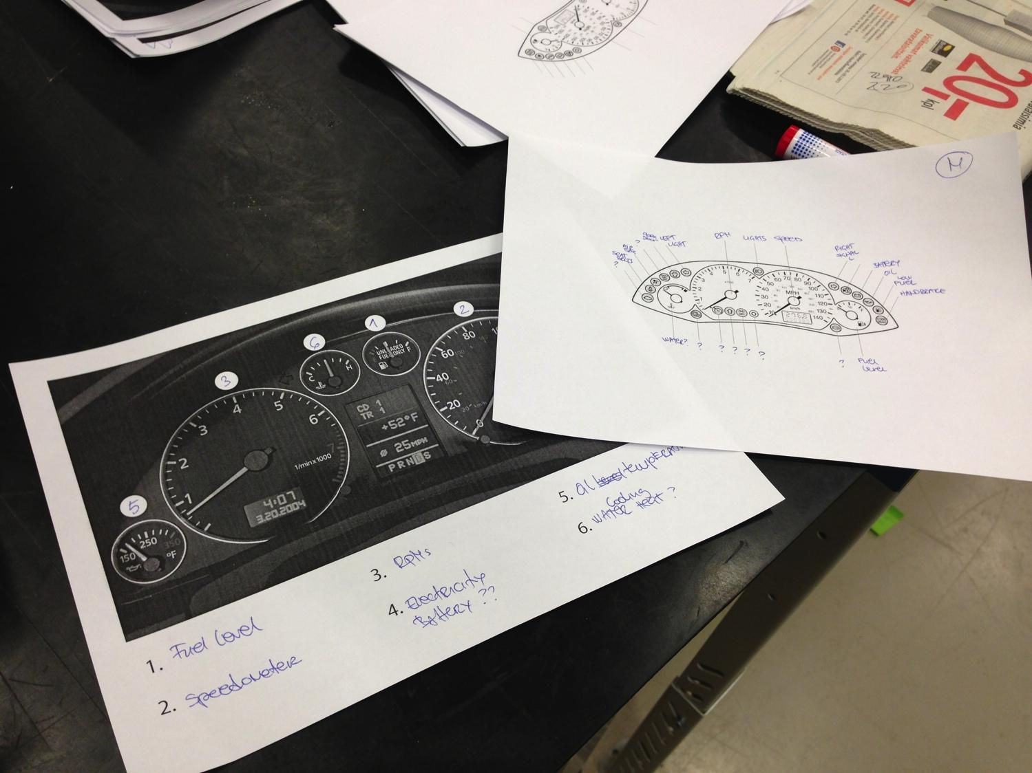
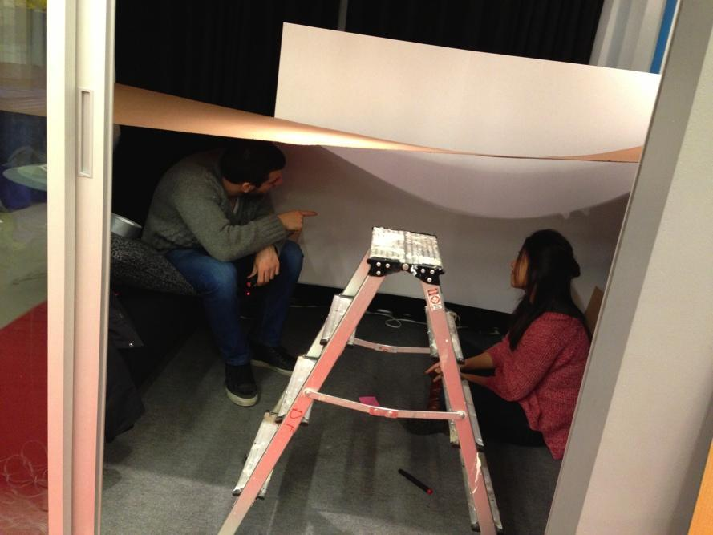
Communicational

Slide 9
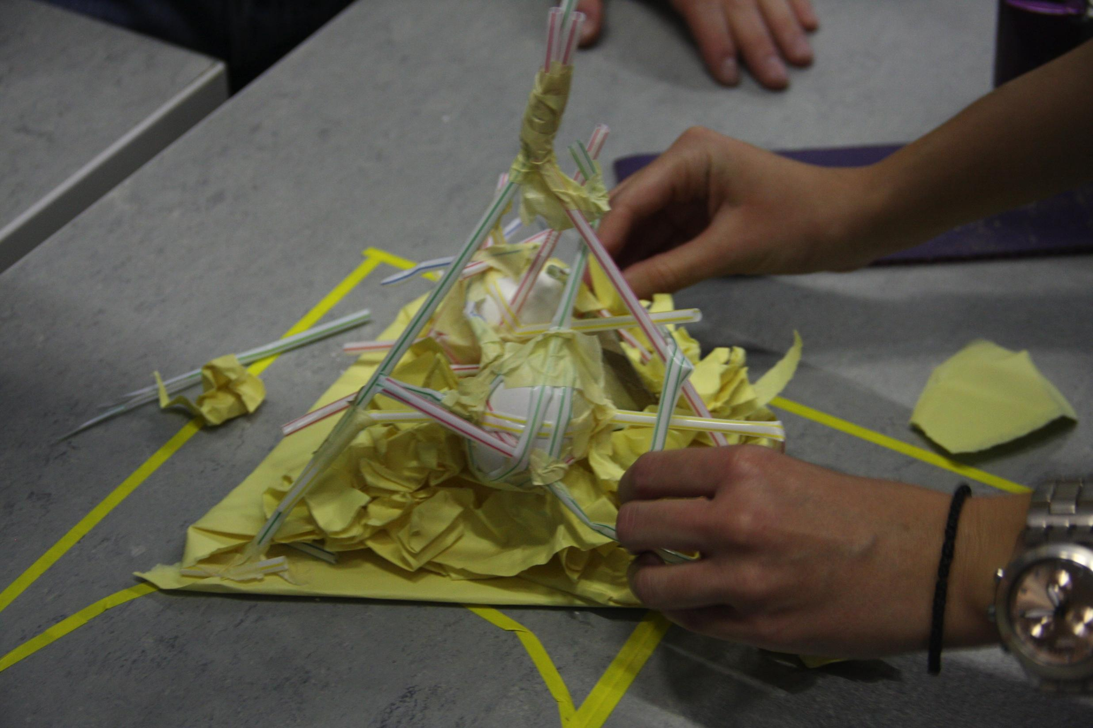
Technical prototypes

Slide 10

Technical prototypes

Slide 11
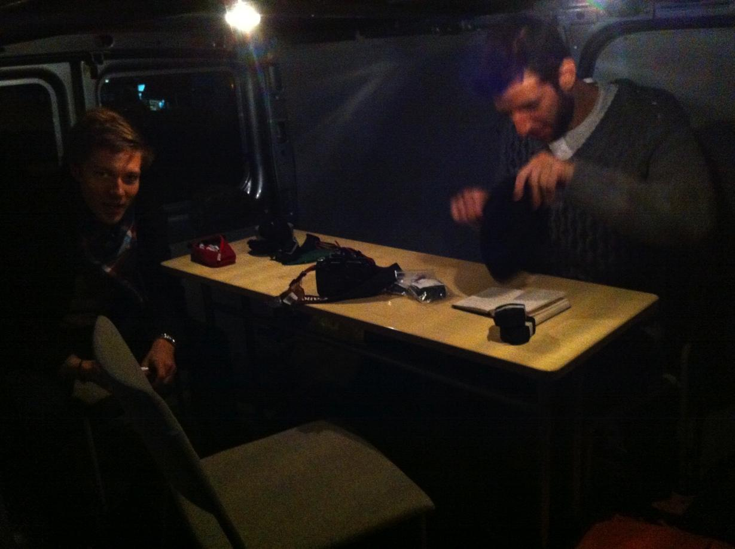
Experience

Slide 12
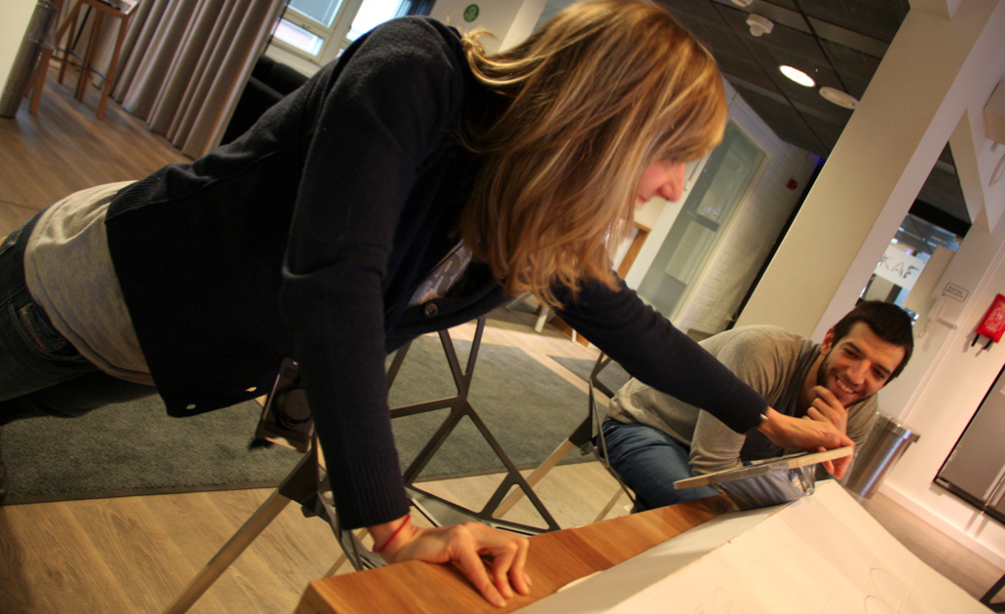
Experience

Slide 13
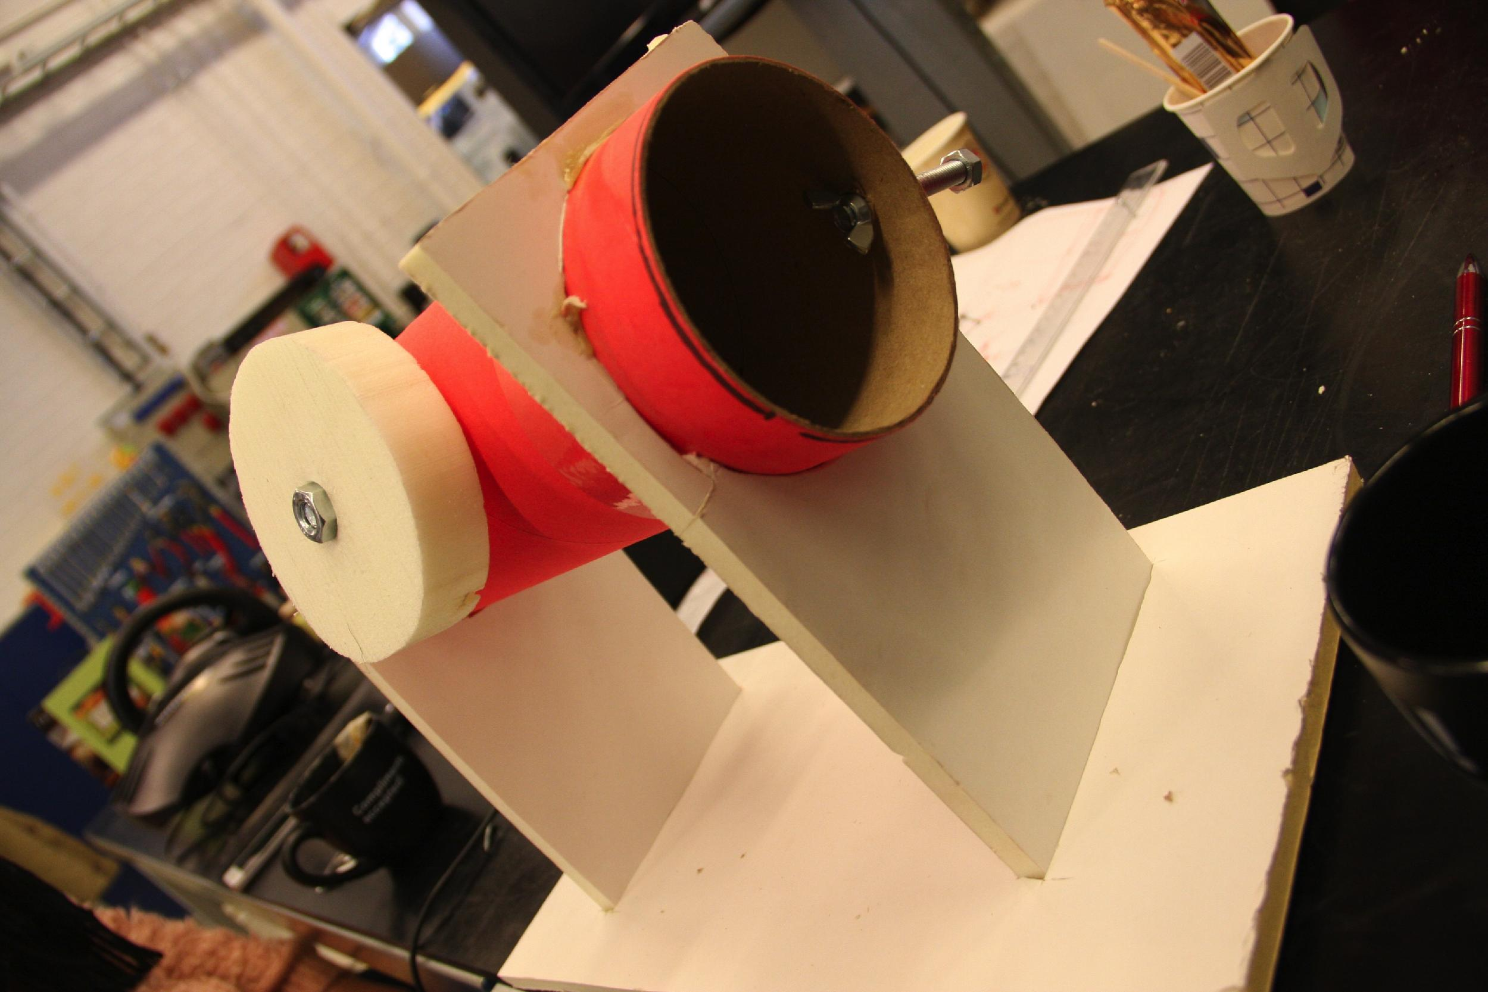
Resolution
Resolution (according to learning objectives and to resources)

Slide 14
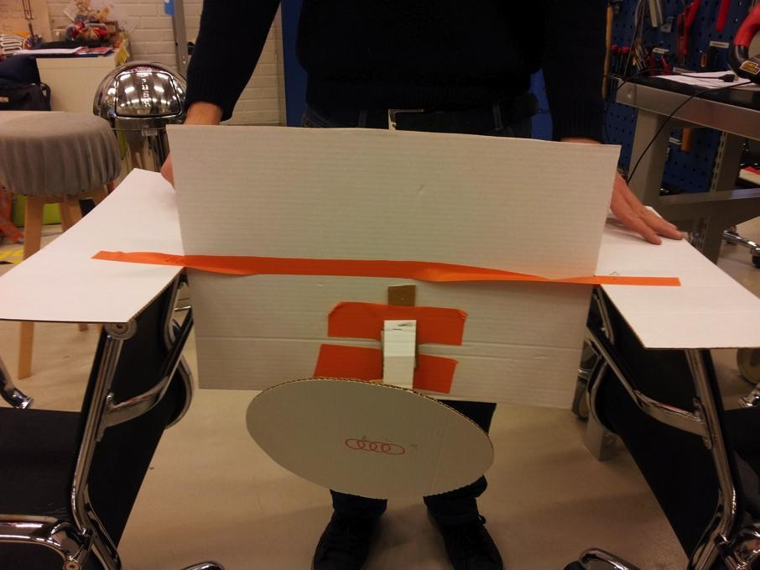
Resolution
Resolution (according to learning objectives and to resources)

Slide 15
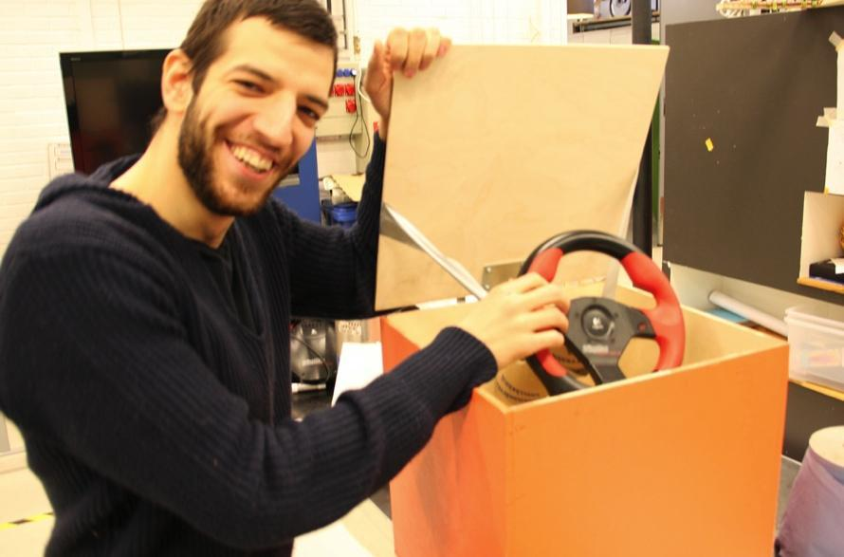
Resolution
Resolution (according to learning objectives and to resources)

Slide 16
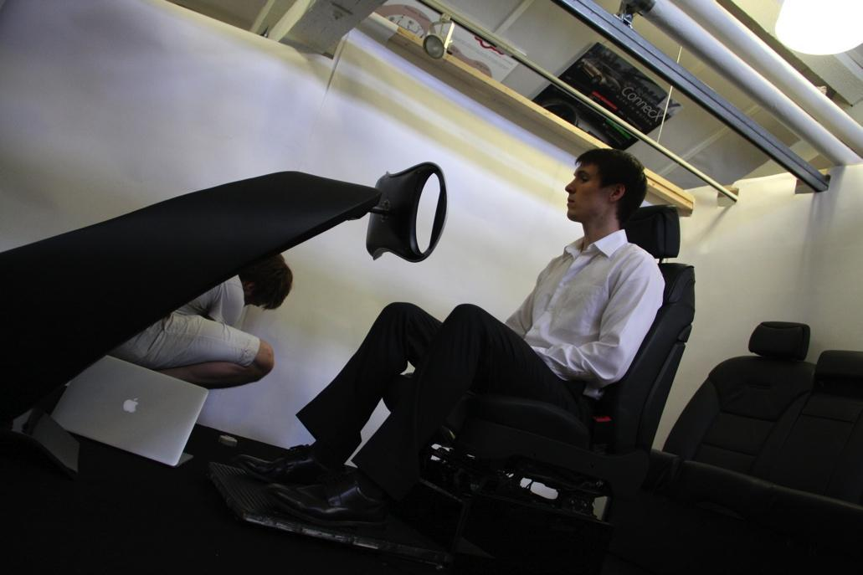
Resolution
Resolution (according to learning objectives and to resources)

Slide 17
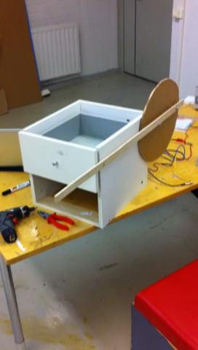
Iterating

Slide 18
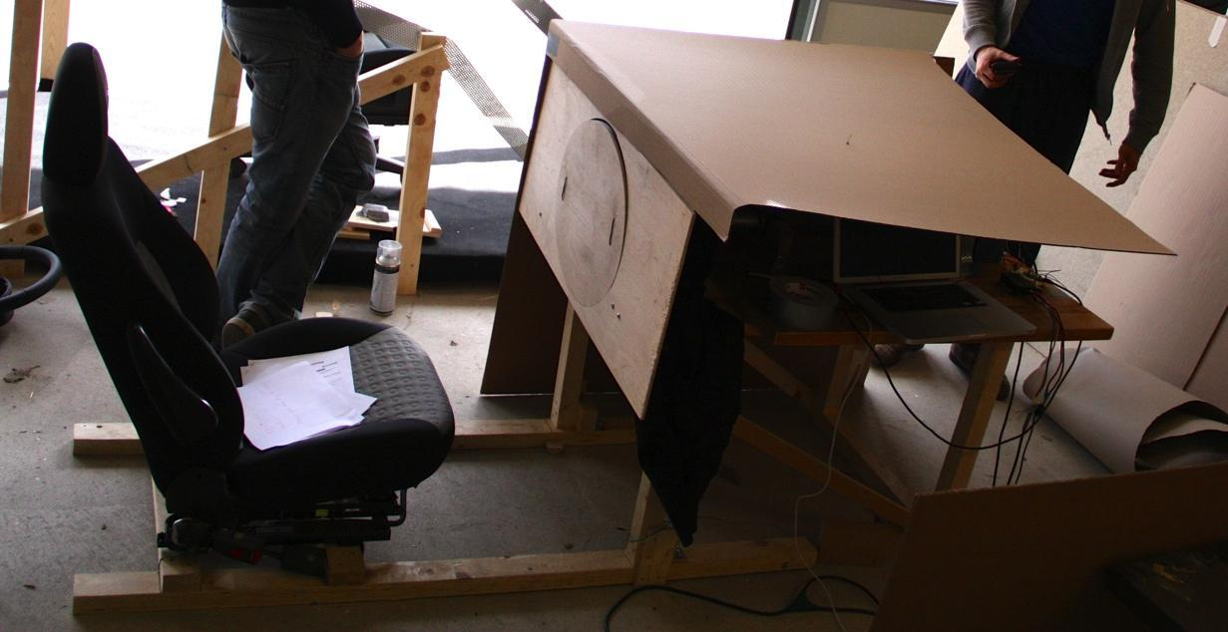
Iterating

Slide 19
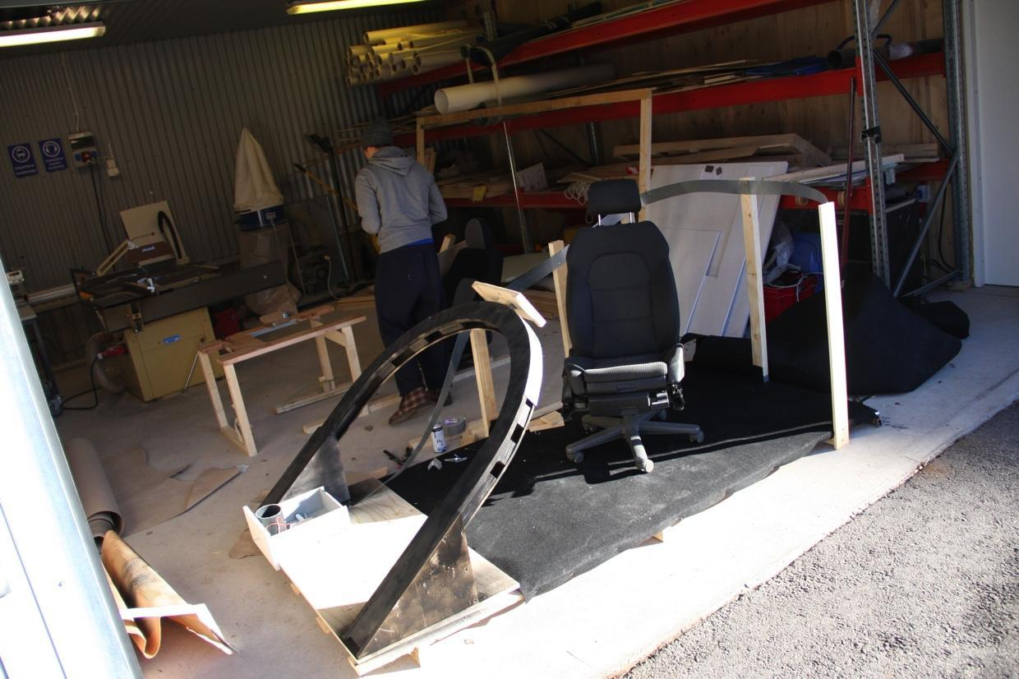
Iterating

Slide 20
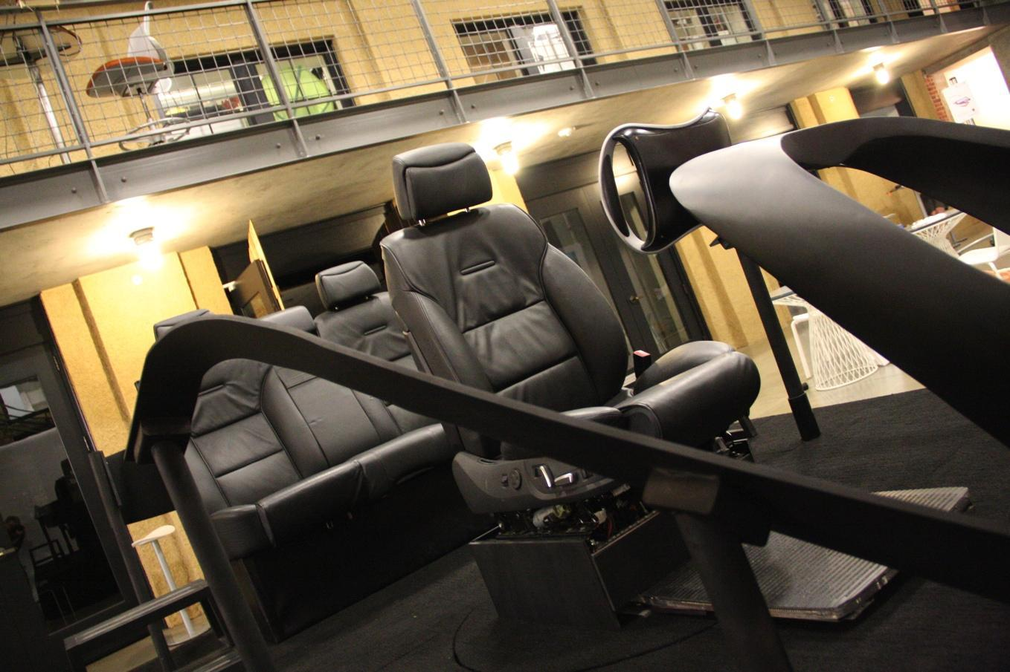
Iterating

Slide 21
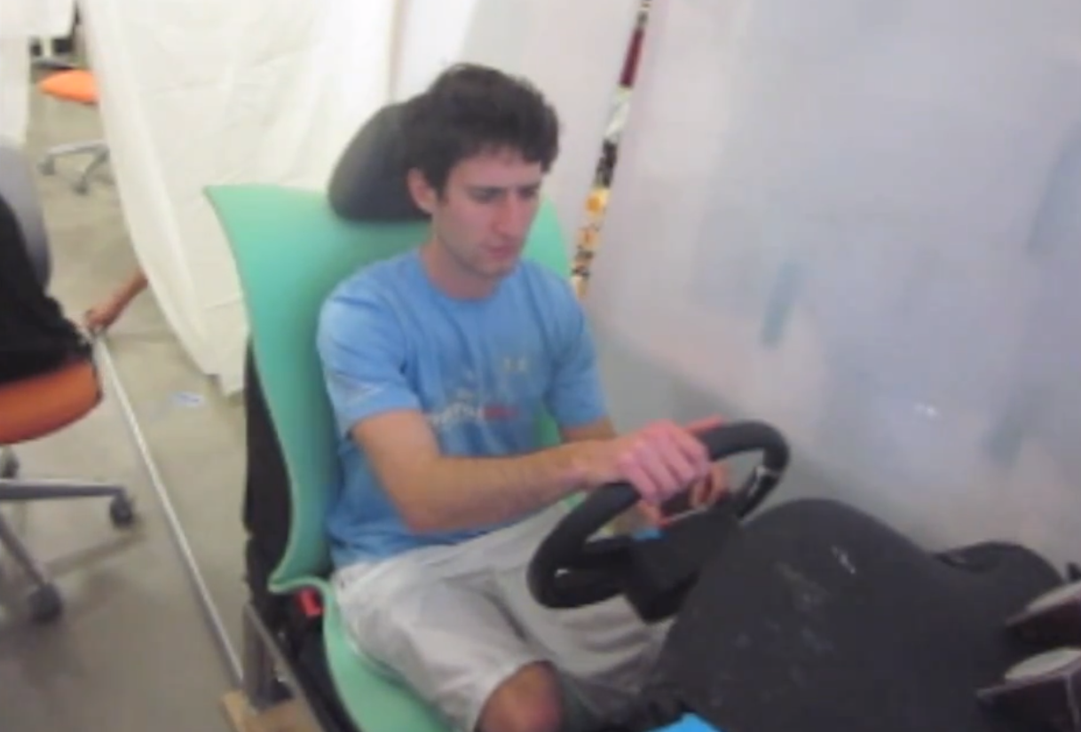
License to be creative
wizard of oz (fake A.I./functionality with people), smart phones give out light sounds, good vibrations..

Slide 22
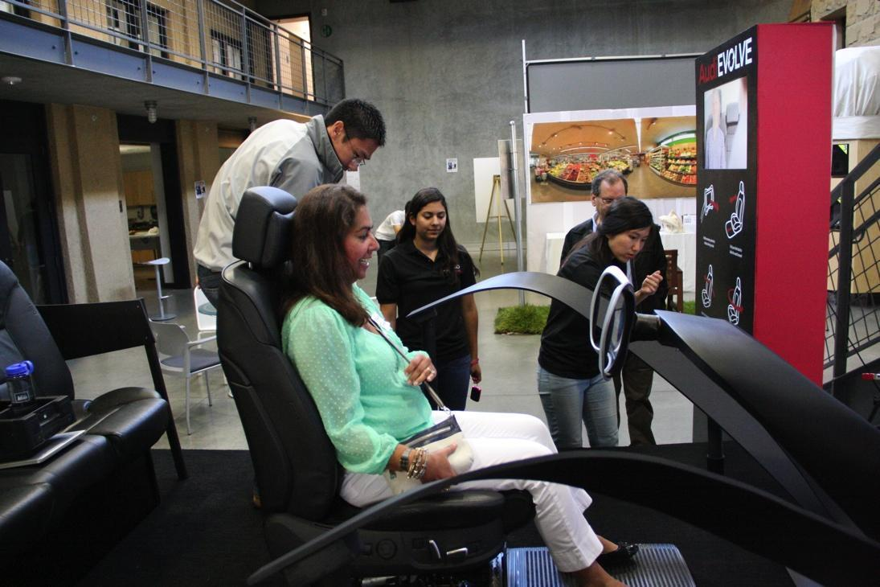
License to be creative

Slide 23
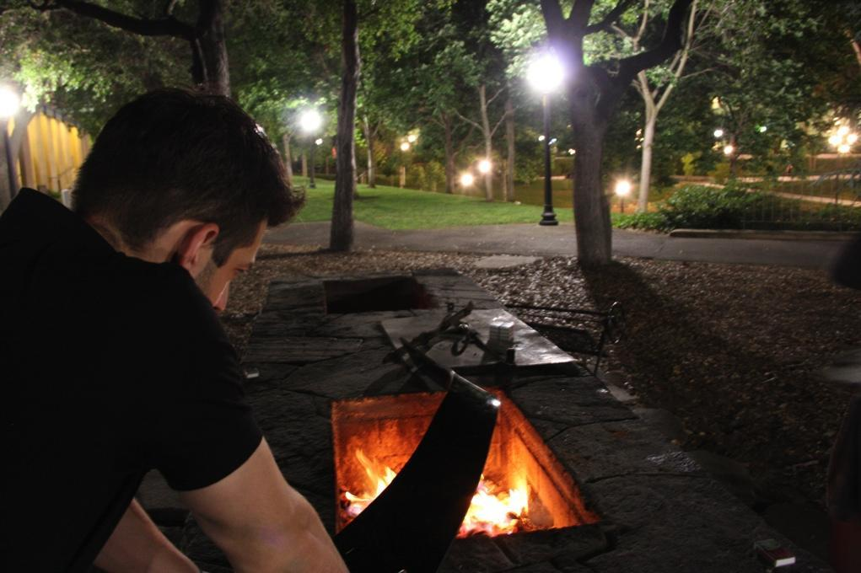
License to be creative

Slide 24
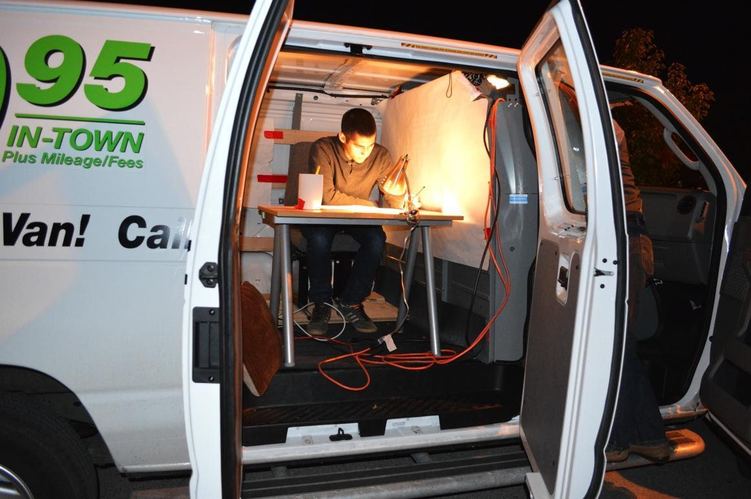
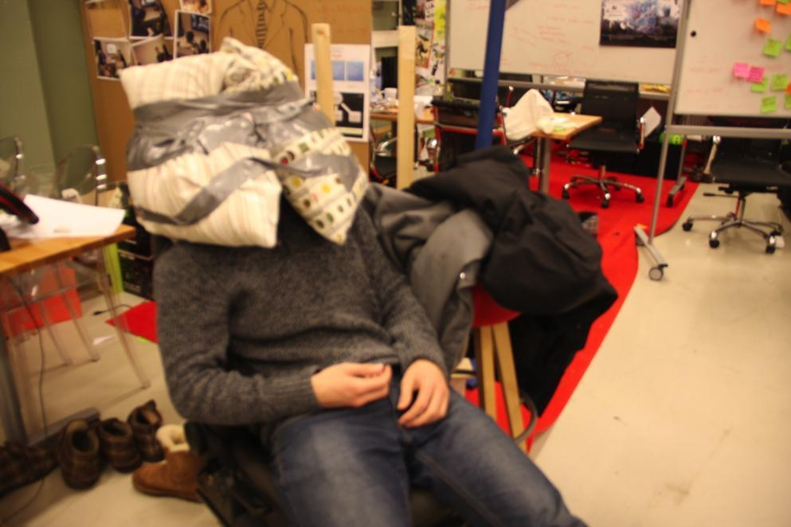
Testing

Slide 25
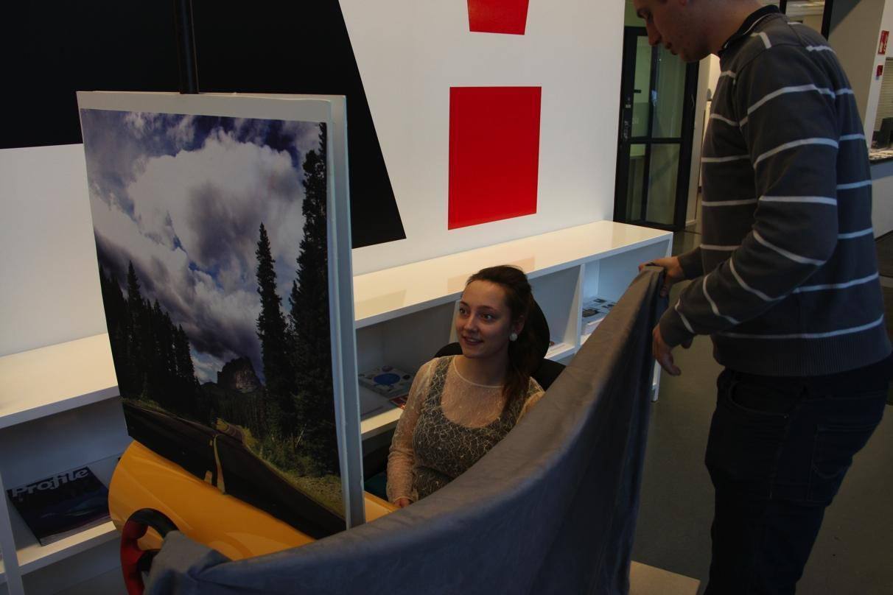
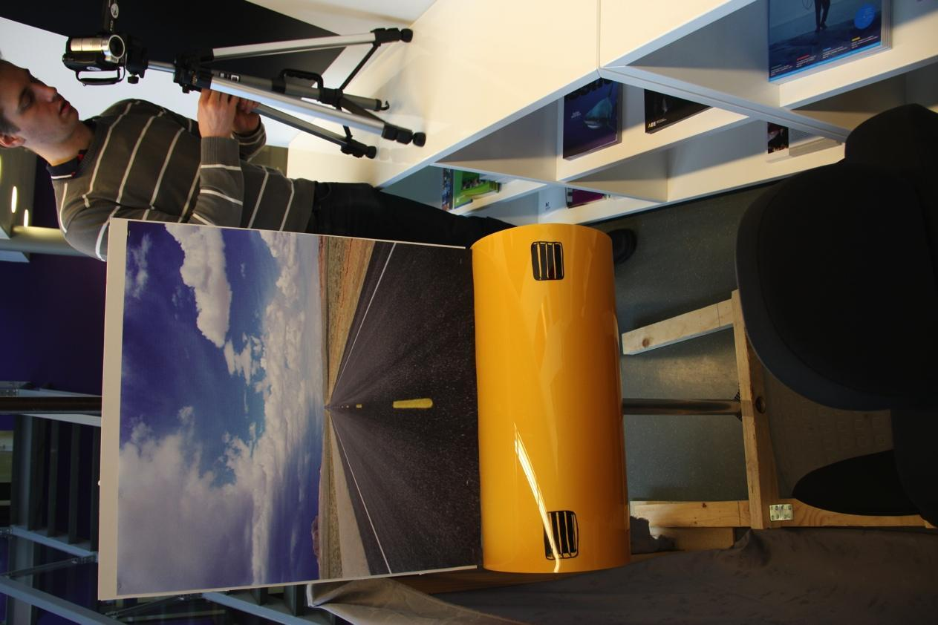
Testing

Slide 26
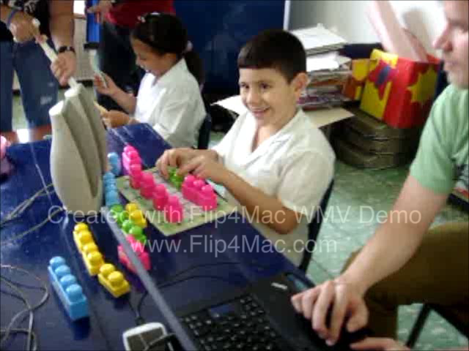
Testing – extreme users

Slide 27
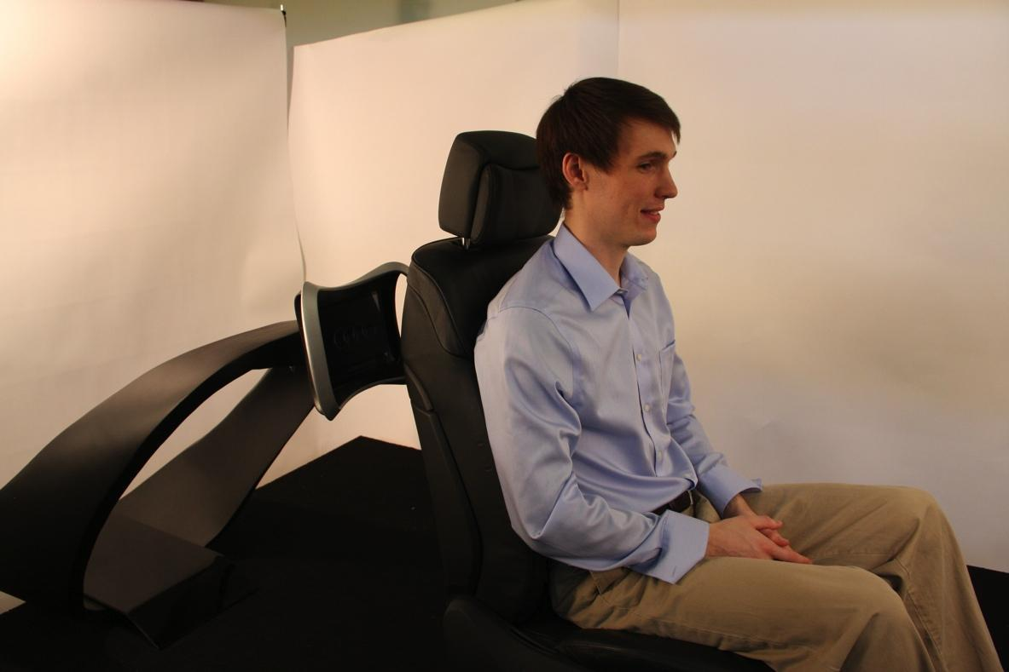
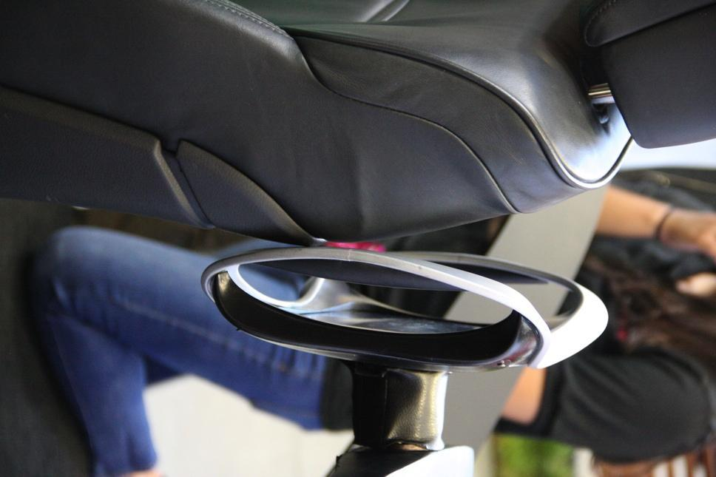
Prototyping
MOTTO: Failing is a good result, it saves a lot of time and energy.

Slide 28
You can prototype everything. You can prototype with anything.

Slide 29
MISSION
“Think about a critical aspect about your concept - write down your learning goal” – 5min
“Prototype and test - document results and learning experiences” – 90 min
-> Document your prototype with 30-90s video.
No spoken words. Audience is your Edusafe/TALENT researchers you meet later again.

