Slide 1
Luca Morini

Slide 2
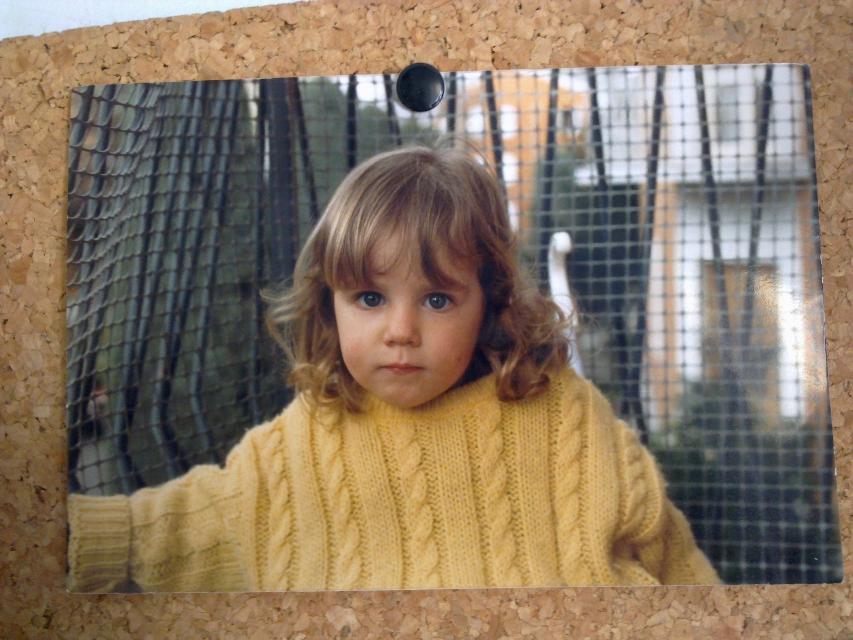
My story began on a cold February in 1986….
April ‘88

Slide 3
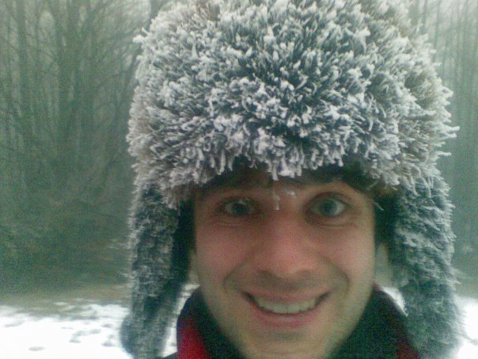
... and it seems that continued with the same weather…

Slide 4
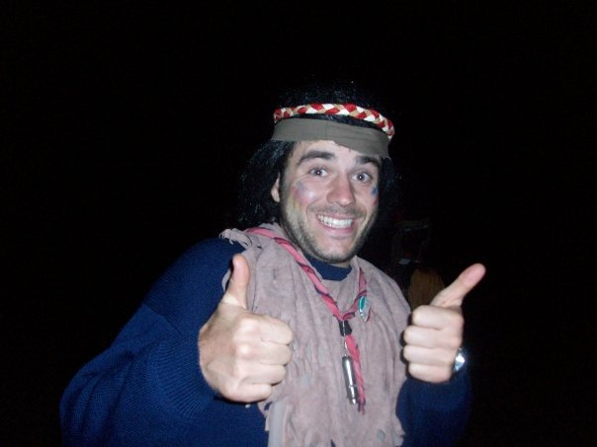
Scout camp - 2010

Slide 5
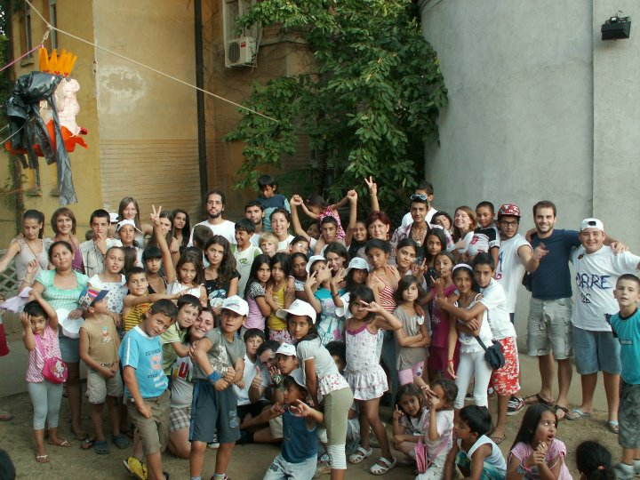
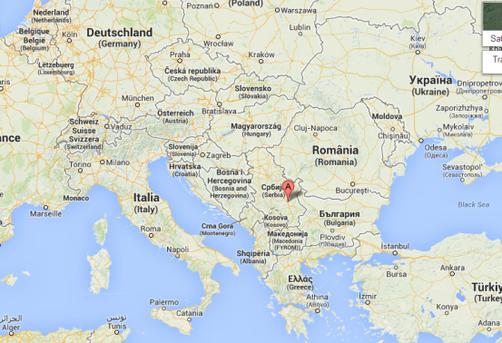
Aleksinac 2011 - Serbia

Slide 6
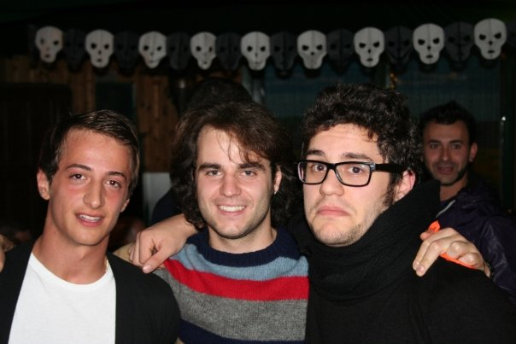
The best friends...
&
Passion
Determination

Slide 7
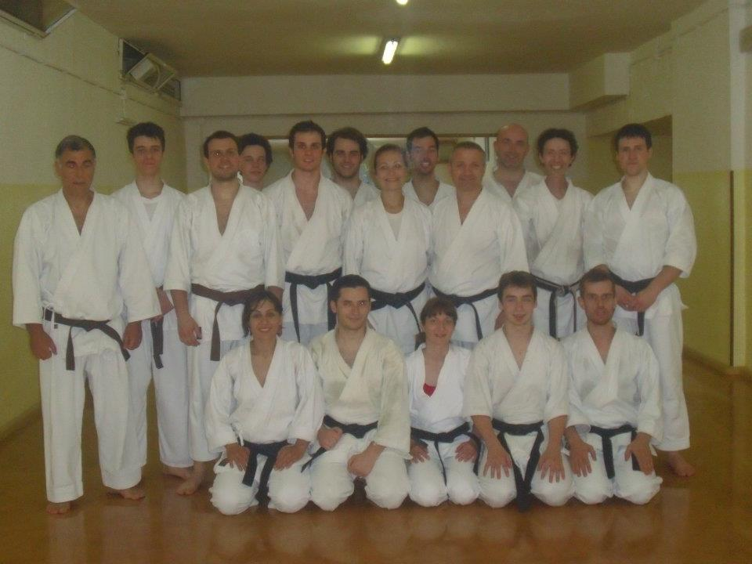
!

Slide 8
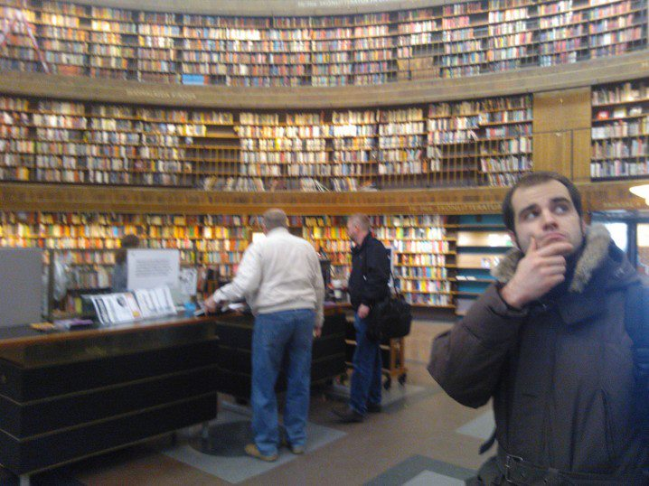
Stockholm Public Library

Slide 9
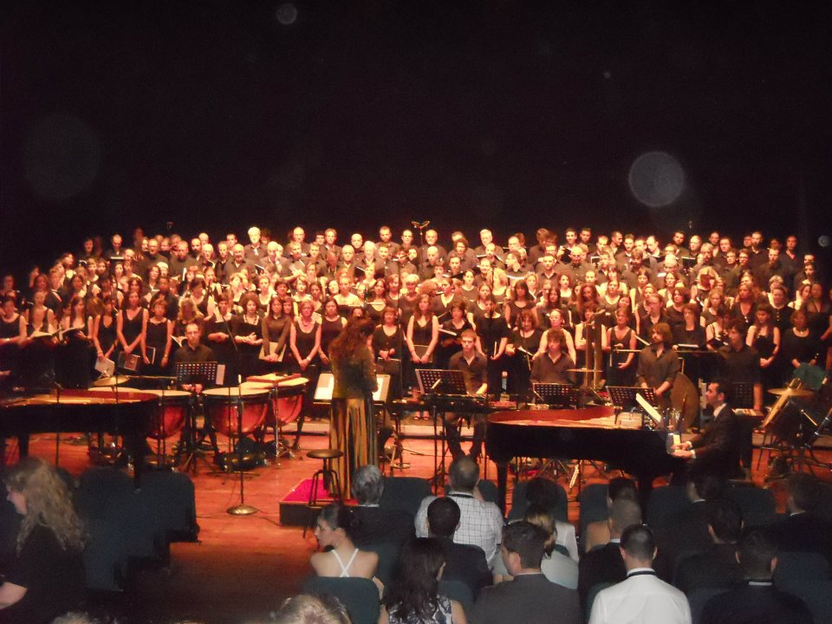
Carmina Burana Concert - Carl Orff
I was here

Slide 10
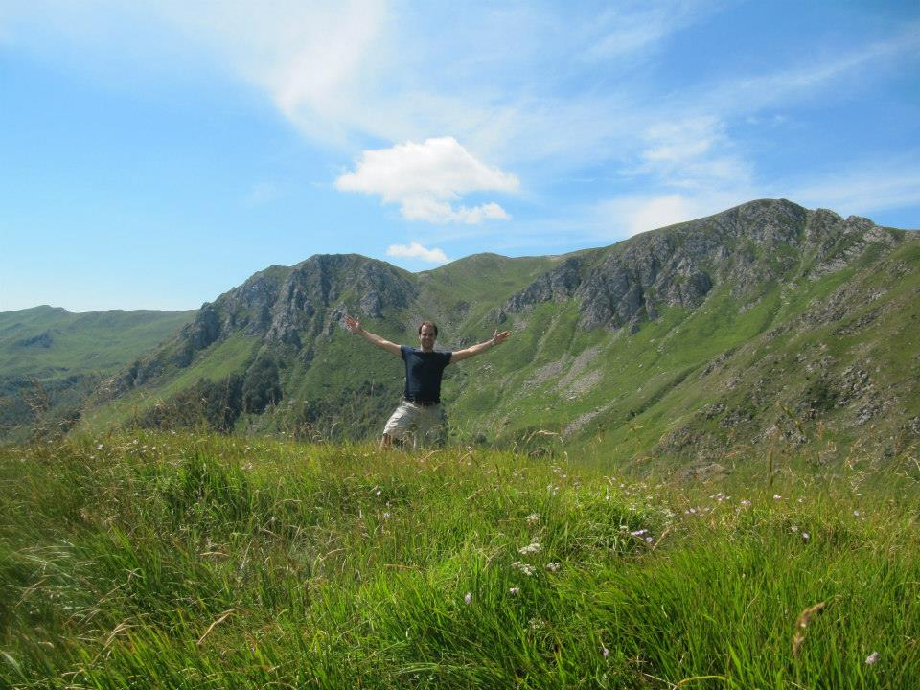
Decisions must be taken with courage, detachment, and sometimes with a certain amount of madness - the madness that does not destroy, but rather one that leads the human being to take the step beyond their limits. - P. Coelho

