Slide 1
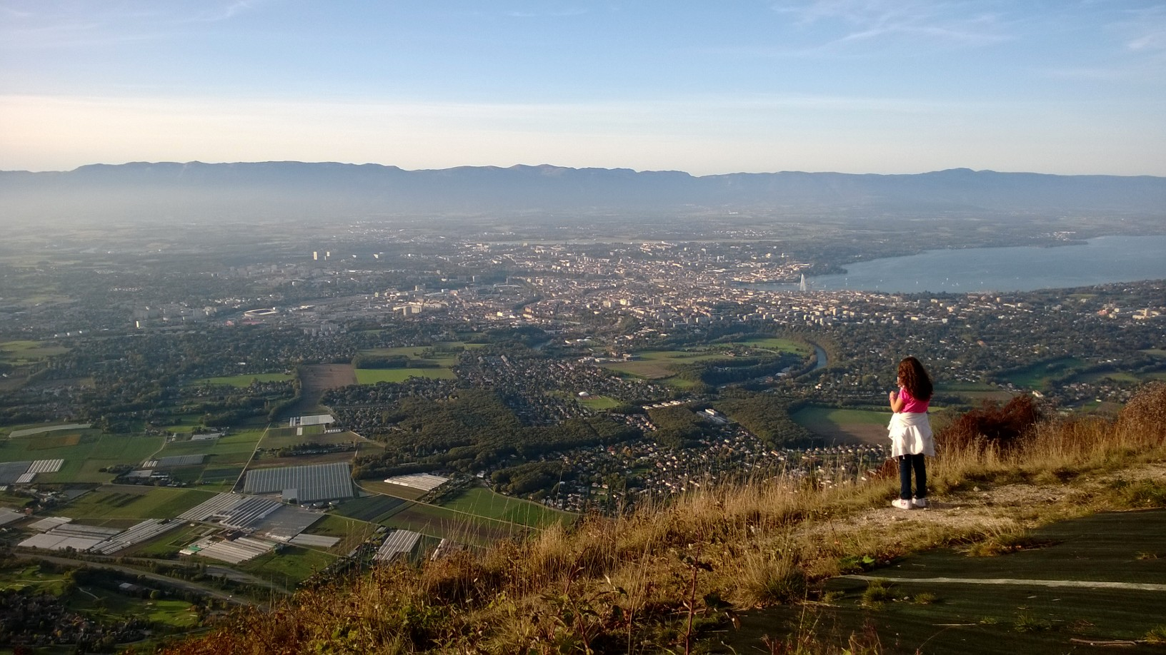
NEVER THOUGHT I WOULD I

Slide 2
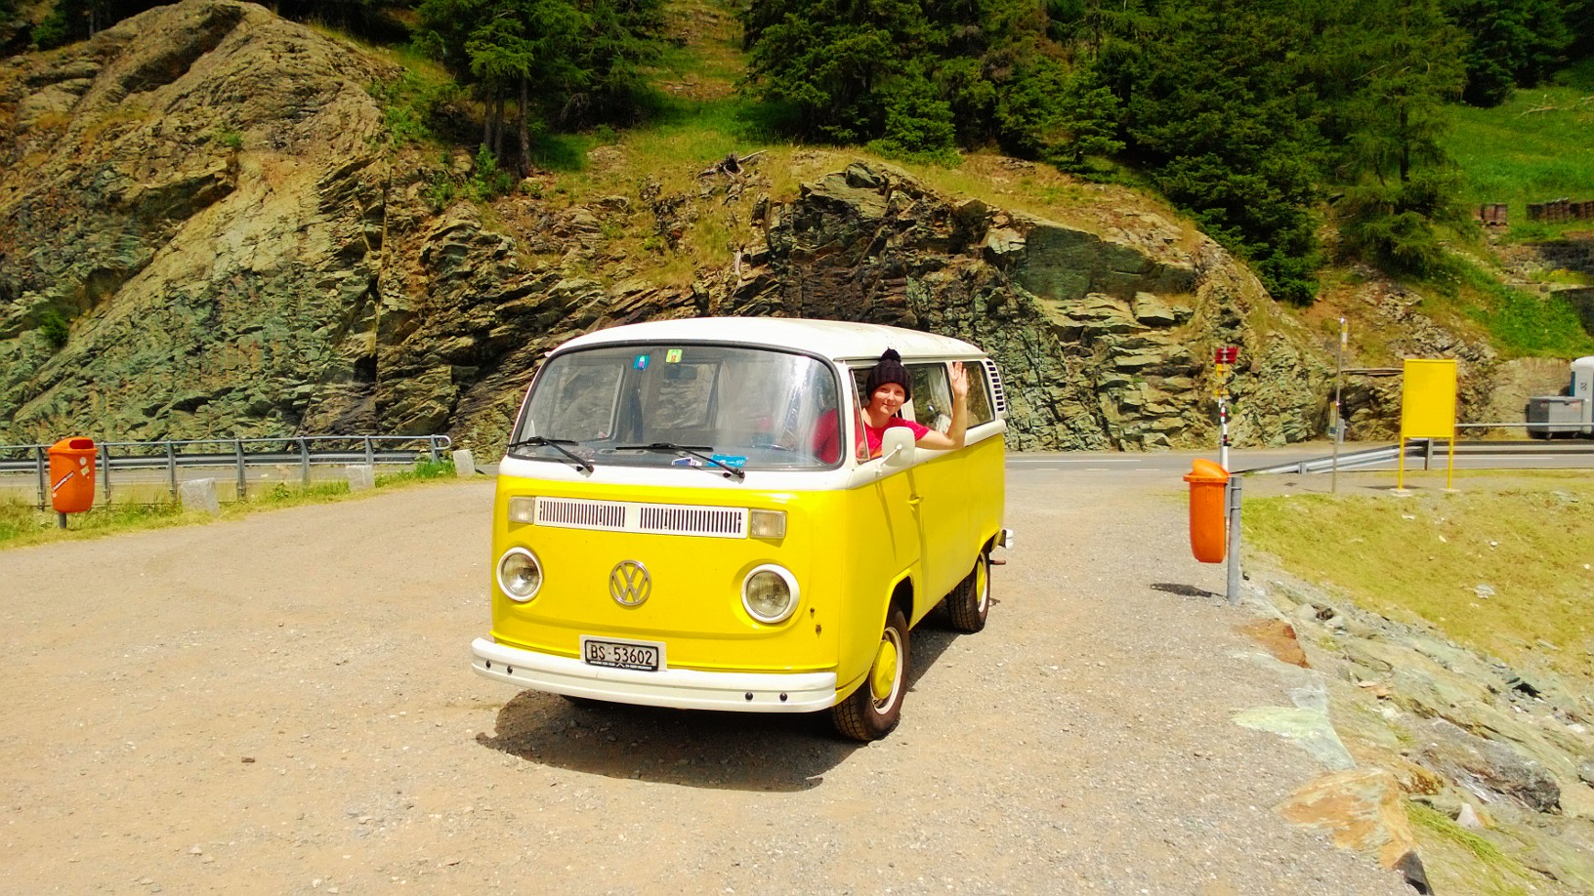
NEVER THOUGHT I WOULD II

Slide 3
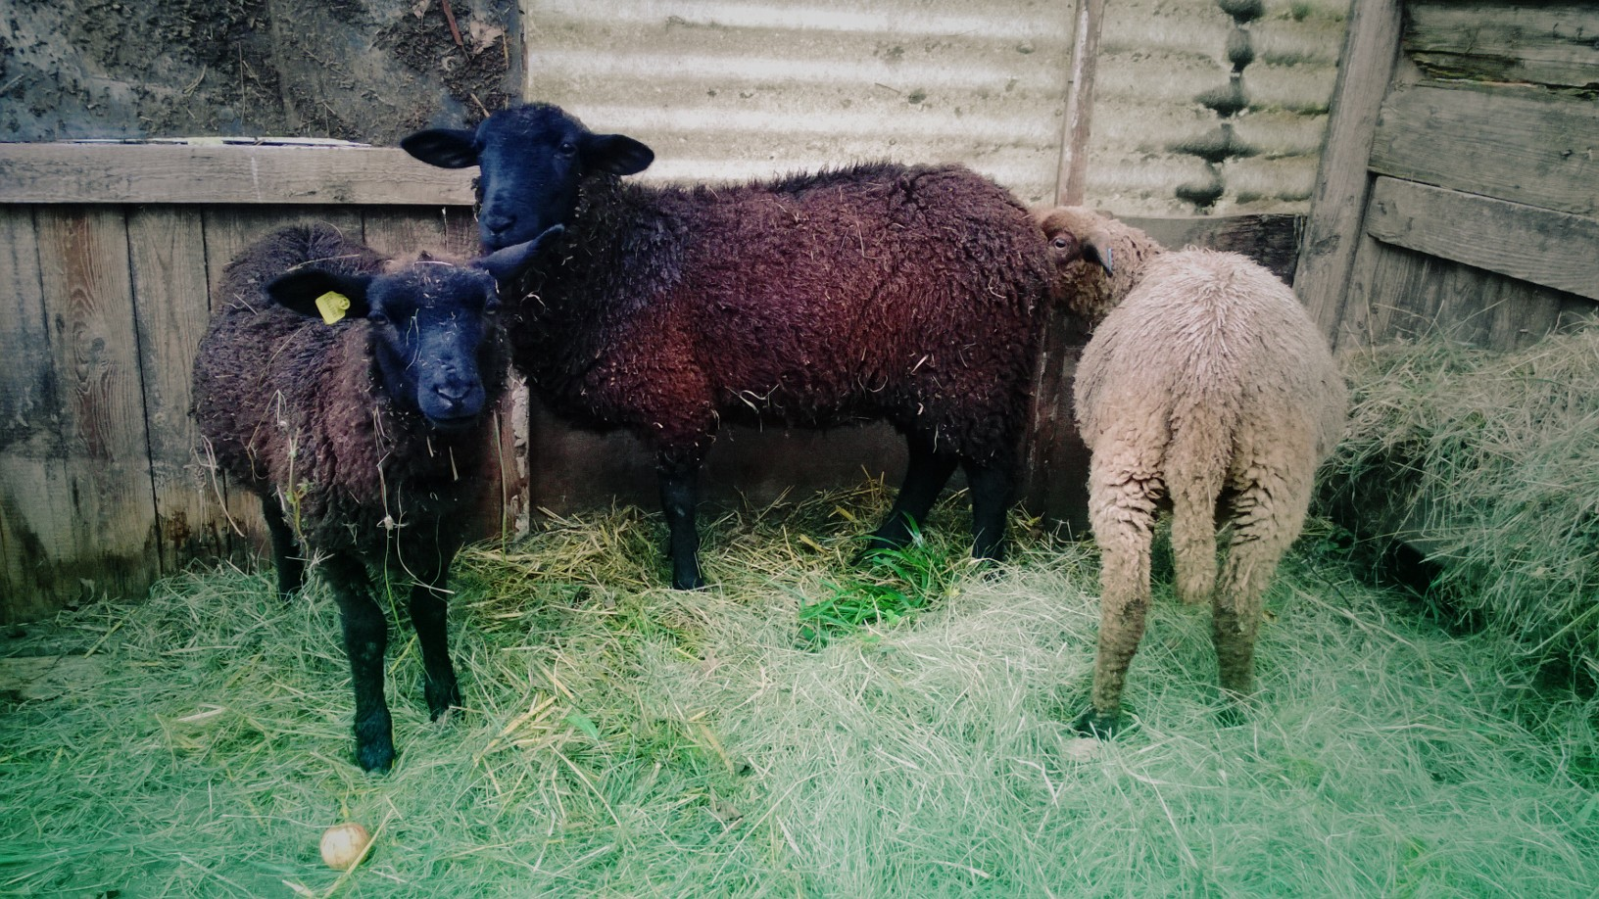
NEVER THOUGHT I WOULD III

Slide 4
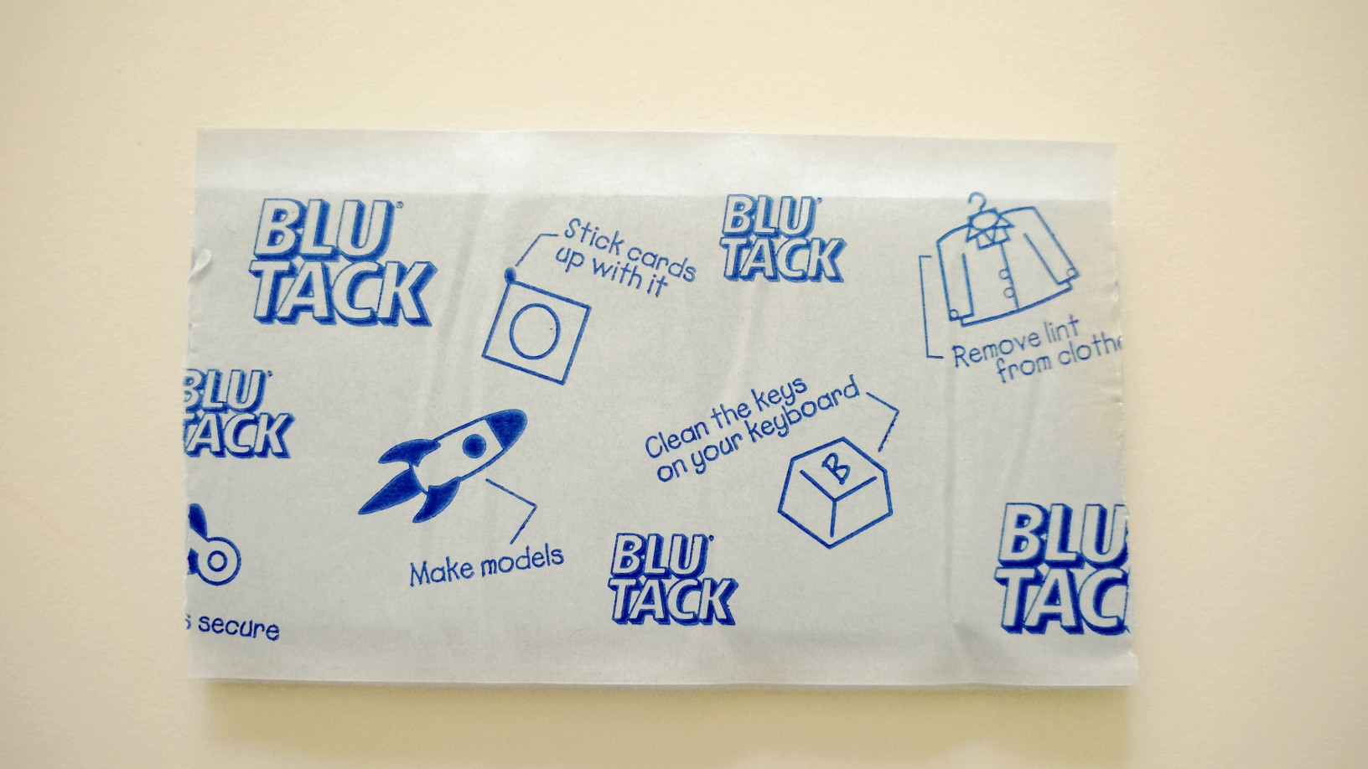
EXPERIMENTATION I

Slide 5
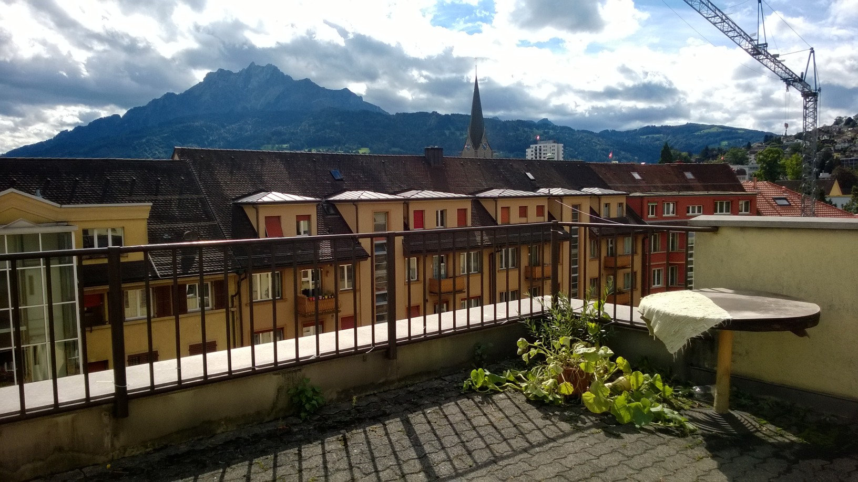
EXPERIMENTATION II

Slide 6
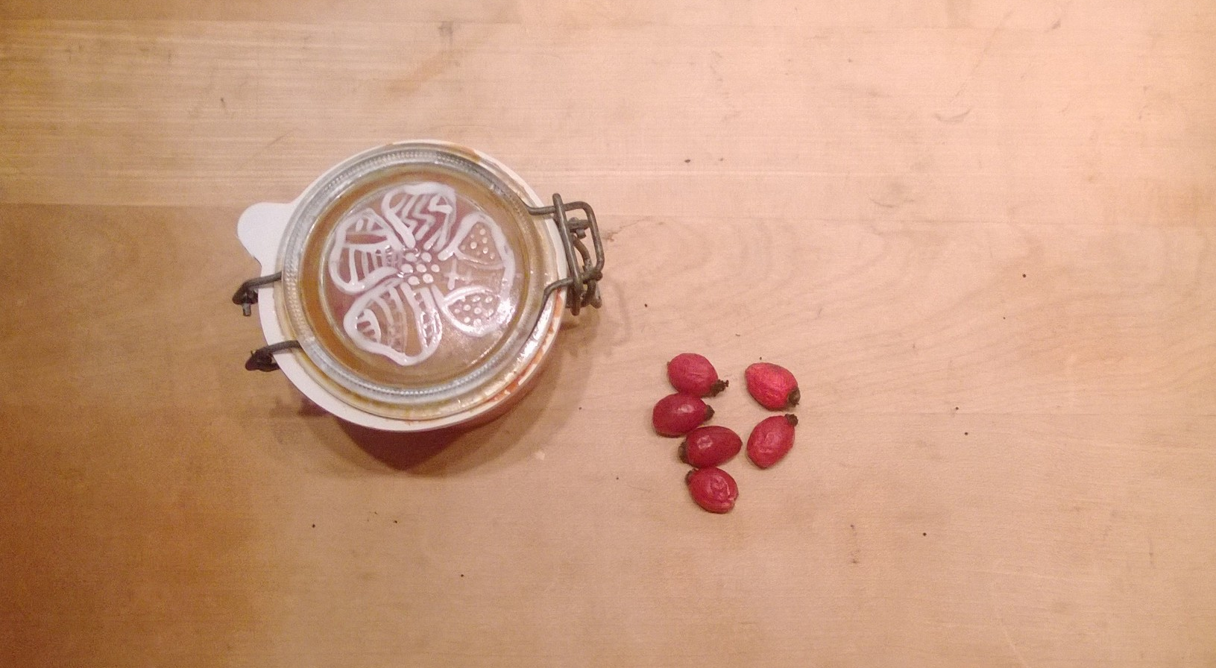
EXPERIMENTATION III

Slide 7
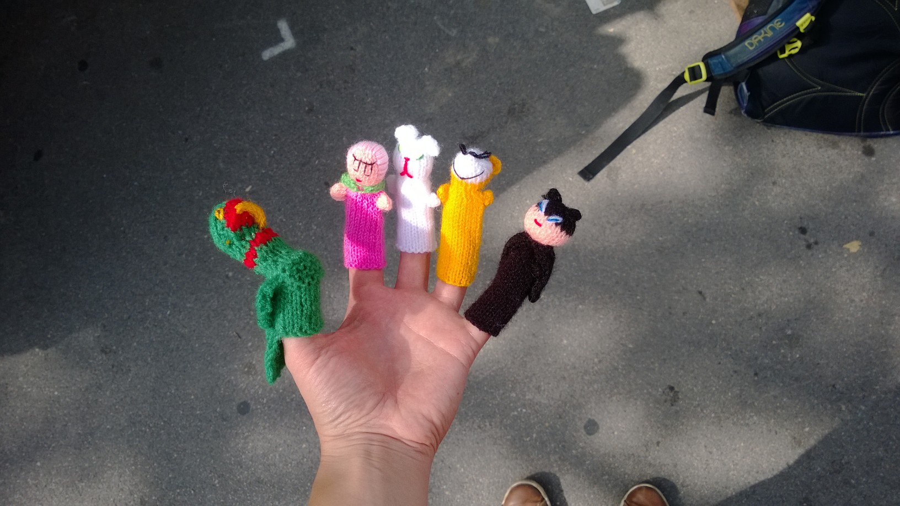
I LIKE I

Slide 8
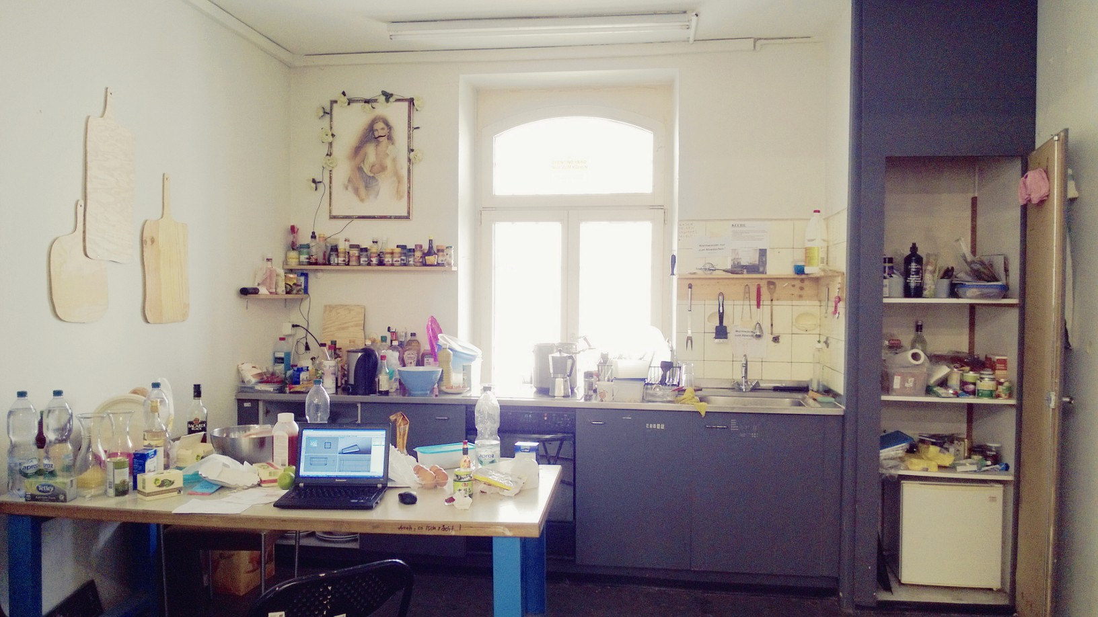
I LIKE II

Slide 9
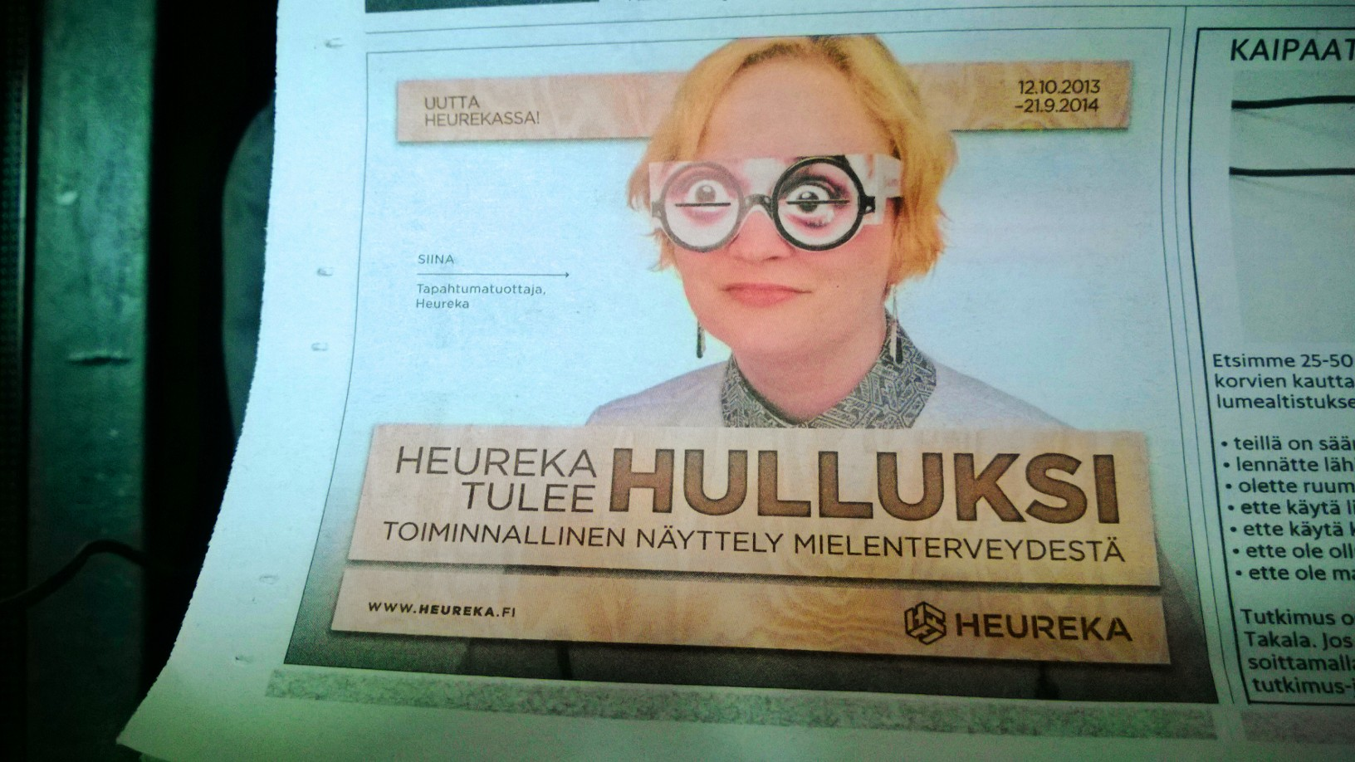
I LIKE III

