Slide 1
Next

Slide 2

CANDLE LIGHT phase - 28th Oct - 9th Dec
Our meetings and your presentations
15th Nov
  How: I-SGM (international small group meeting) presentation
  What expected:
    needs & stakeholders map
    service / methodology / technology benchmarking
  Support material: uploaded on drive on 8th Nov.
29th Nov
    How: I-SGM (international small group meeting) presentation
    What expected:
      presentation of prototypeS: tangible !! (e.g. product crunch exercise, exploratory)
      test planning: how are you going to test each of them?
9th Dec
  How: I-SGM (international small group meeting) presentation
  What expected:
    Test demos. Each prototype has to be tested at least with 4 different users in 2 different places
    Presentation second-iteration prototypes

Slide 3

BULB phase8th Dec – 31st Jan
Our beaten path
Divergent prototype: BLACK HOLE
Xmas
Convergent prototype
End of Jan: Present your “bulb” prototype

Slide 4

BIG BANG phase1st Feb – 7th March
final deliverables
7th March: big event in CERN

Slide 5
Go Public!
Weekly updates on what you have done and how you have done it. Be visual!
Set it up in teams, first updates by this Sunday. We can help you as much as needed!

Slide 6
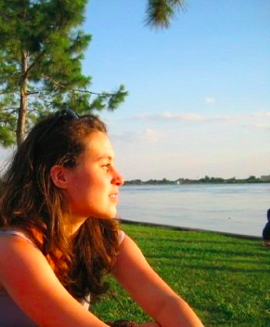
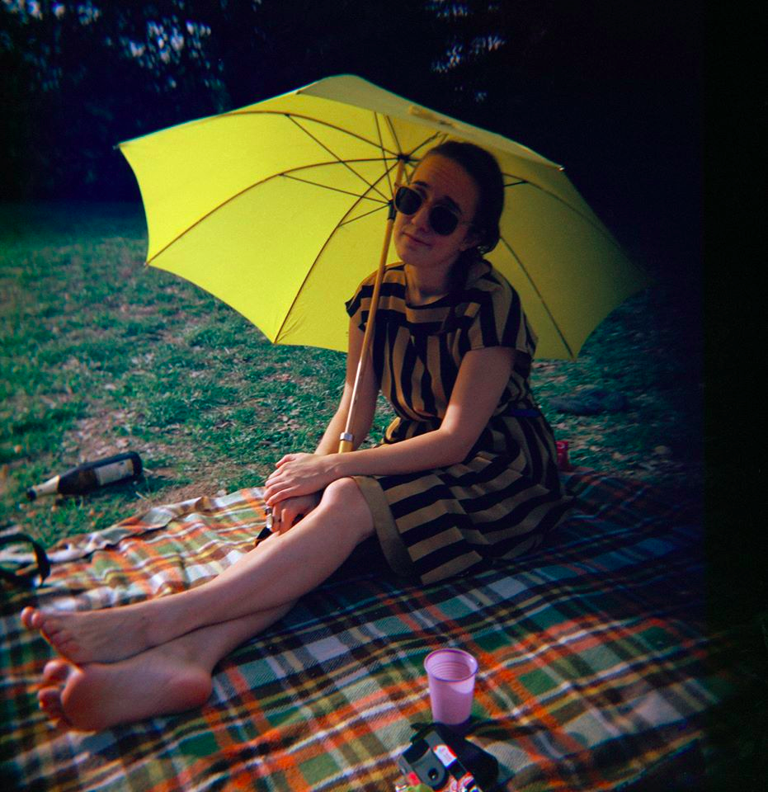
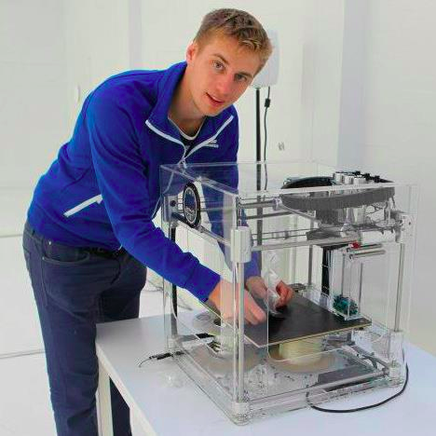
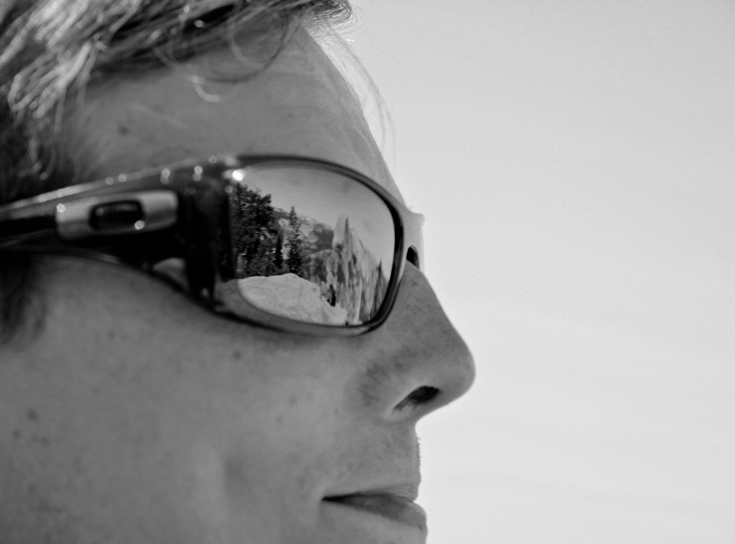
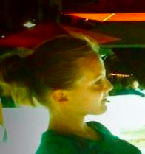
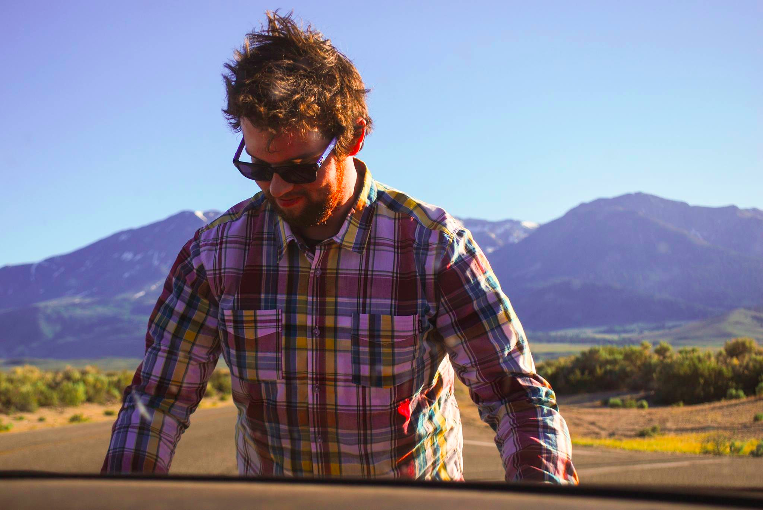
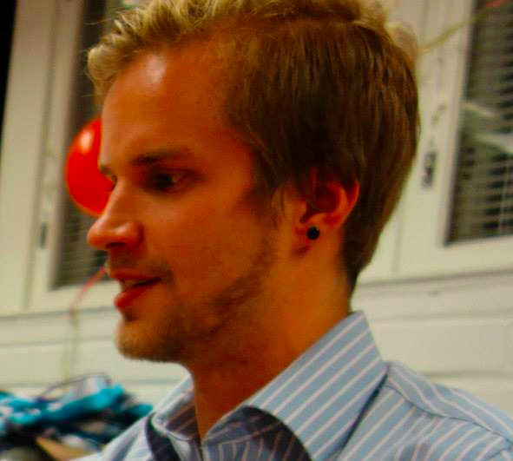
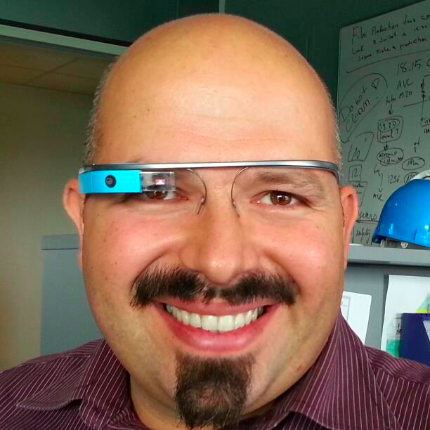
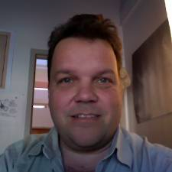
Clio
Valeria
Heikki
Harri
Tuuli
TAs, team coordination
IdeaLab shepherds
Online collaboration, tech, coding, videos...
The Universe
Joona
Justus
Matteo
Lauri

Slide 7
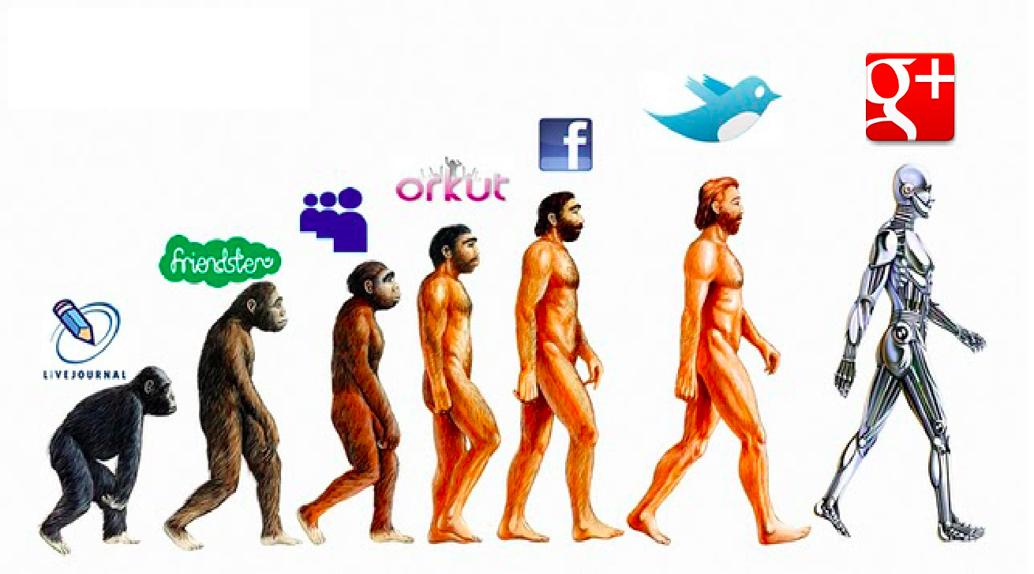
Email us, call us, add us on Google+ and hangouts
CBI @ CERN
https://plus.google.com/communities/112147821866612446180/

Slide 8
Valeria | Adani | Italian | TTeam | 39 380 302 4884 | valeria.adani@gmail.com skype: nenjiji
Clio | Dosi | Italian | TTeam | 39 328 573 6939 | clio.dosi@gmail.com skype: clio.dosi
Joona | Kurikka | Finnish | TTeam | 358 405926325 | joona.kurikka@aalto.fi
Justus | Reinikainen | Finnish | TTeam | 358 50 3847032 | justus.reinikainen@aalto.fi
Heikki | Sjöman | Finnish | TTeam | 358 503849719 | heikki.sjoman@aalto.fi
Harri | Toivonen | Finnish | TTeam | 41 76 487 6533 | harri.toivonen@cern.ch
Tuuli | Utriainen | Finnish | TTeam | 41 78 966 0358 | tuuli.utriainen@cern.ch
Matteo | Vignoli | Italian | TTeam | 39 328 83 11 503 | matteo.vignoli@unimore.it skype: vignolimatteo

