Slide 1
CBI Kick off week Fall 2013
Idealab@CERN
Sonia Fernández Pérez
TALENT ESR13 &WP5 CERN
PhD Student at Barcelona University
sonia.fernandez@cern.ch

Slide 2
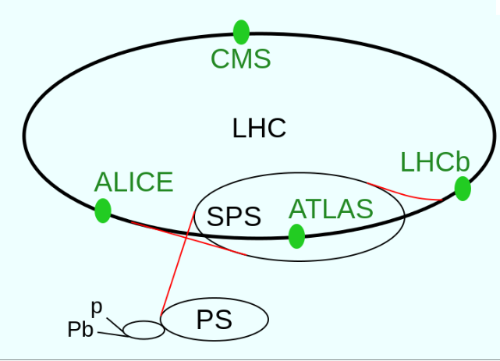
Large Hadron Collider (LHC)
2012 -> 8 TeV
2015 -> 14 TeV

Slide 3
ATLAS Detector & Sub detectors
Notes:
The Large Hadron collider is the largest circular accelerator, which makes collide proton beams. During the next years will interleave runs with shut down periods. The reason of that is to upgrade the detectors.
ATLAS is one of the four detectors at the LHC. As other particles detectors, ATLAS is composed by different sub detectors with a cylindrical shape around the collision point.
The ATLAS is mainly composed by:
The inner detector to reconstruct the particles trajectory and their momentum.
The calorimeters to measure the particles energy.
And by the Muon Spectrometer (to identify and to measure momentum of muons).
Going into the Inner detector, we can see it is composed by three sub detectors. We will focus on the Pixel one. The Pixel detector is the closest one to the collision point. Here the particle flux is higher and hard radiation technology is needed.
The ATLAS upgrade is taking place now consists on the installation of an extra layer between the beam pipe and the B-layer. The space needed to install this layer is coming from the change of the beam pipe by a new smaller one.
The 3D sensors under research here are going to be installed in this new layer, called Insertable B-layer or IBL.

Slide 4
Insertable B-Layer (IBL)
TALENT researchers are enrolled with the IBL project (DQ, cooling,
detectors..)
Development and Application of Silicon Pixel Detectors
3.2 cm -> more particle flux
8 TeV -> 14 TeV
Hardness radiation
Sensors Technologies
(Planar, 3D sensor)

Slide 5
How a Semiconductor Detector works
IONIZATION

Slide 6
CBI Kick off week Fall 2013
Idealab@CERN
Sonia Fernández Pérez
TALENT ESR13 &WP5 CERN
PhD Student at Barcelona University
sonia.fernandez@cern.ch

