Slide 1
TOF Das and preprocessor status

Slide 2
TOF DAs
Three DAQ-DAs implemented, deployed, validated, and tested:
  TOFda
  TOFnoiseda
  TOFpulserda
One “sort of” DCS-DA implemented, deployed, and tested.

Slide 3
TOF DAQ-DAs - I
TOFda
  Ready and validated in DAQ since April 2007
  Meant to run during PHYSICS runs
  Meant to run on monitoring machines at the end of run
  Meant to collect raw data from both TOF and T0
      → 2D histogram (TH2S)
      → Both Run-Level and cumulative histogram stored in FXS
    from which to compute calibration parameters
  Ran during the Feb cosmic exercise...
  ...but with no reliable calibration data
  Reading from DAQ Configuration DB may be added

Slide 4
TOF DAQ-DAs - II
TOFnoiseda
  Ready and validated in DAQ since December 2007
  Meant to run during NOISE runs
  Meant to run on LDCs
  Meant to collect raw data from TOF (12 DDL per LDC)
      → 1D histogram (TH1F)
      → output histogram stored in FXS
    to find TOF noisy channels
  Tested during the Feb cosmic exercise...
  ...but not really used: no NOISE runs were taken

Slide 5
TOF DAQ-DAs - III
TOFpulserda
  Ready and validated in DAQ since December 2007
  Meant to run during PULSER runs
  Meant to run on LDCs
  Meant to collect raw data from TOF (12 DDL per LDC)
      → 1D histogram (TH1S)
      → output histogram stored in FXS
    to find TOF dead channels
  Tested during the Feb cosmic exercise...
  ...but not really used: no PULSER runs were taken

Slide 6
TOF DCS-DA
More than a DA, it is a process that copies the TOF Front End Electronics (FEE) configuration in the DCS FXS → TofFeeMap
  Ready since end of March 2008
  Meant to run during PHYSICS/NOISE/PULSER runs
  Meant to provide a snapshot of the TOF configuration
  Not tested during the Feb cosmic exercise...
  ...but tested within the DCS infrascture, and validated by the SHUTTLE

Slide 7

TOF DCS DPs
Considerable reduction of the number of retrieved DP (well, considerable is probably not the proper way of saying.... ): from 10512 to 360 – only high voltages kept.
Still missing: implementation in reconstruction of the use of the information coming out of these → DPs processing output still kept in Reference folder; to be moved to OCDB.

Slide 8
TOF Preprocessor Members – I
AliTOFPreprocessor main functions:
  AliTOFPreprocessor::ProcessDCSDataPoints():
    processing of DCS DPs;
    called only in PHYSICS runs;
  AliTOFPreprocessor::ProcessOnlineDelays():
    processing of the TOFda output → TOF channel delays
    called only in PHYSICS runs;
    validity = [0, AliCDBRunRange::Infinity()]
  AliTOFPreprocessor::ProcessNoiseData():
    processing of the TOFnoiseda output → TOF noisy channels map
    called only in NOISE runs;
    updating existing OCDB entry;
    validity = [0, AliCDBRunRange::Infinity()]

Slide 9
TOF Preprocessor Members – II
AliTOFPreprocessor::ProcessPulserData():
  processing of the TOFpulserda output → TOF dead channels map
  called only in PULSER runs;
  updating existing OCDB entry;
  validity = [current run, AliCDB::Infinity]
AliTOFPreprocessor::ProcessFEEData():
  processing of the TofFeeMap (from DCS FXS);
  called every run:
    PHYSICS runs: preventing computation of delay for channels that are off
    PULSER/NOISE runs: preventing updating of channels that are off
  updating existing OCDB entry;
  validity = [0, AliCDBRunRange::Infinity()]

Slide 10
TOF Online Calibration - Reconstruction
Calibration constants calculated during PHYSICS runs, then applied in reconstruction till Offline Calibration takes over (see C. Zampolli’s talk at Oct 2007 Offline Week)
Waiting for offline calibration, TOF reconstruction always look for four OCDB objects (AliTOFClusterFinder::CalibrateRecPoints()):
  FEE status (AliTOFChannelOnlineStatus)
  Pulser status (AliTOFChannelOnlineStatus)
  Noise status (AliTOFChannelOnlineStatus)
  Channel Delay (AliTOFChannelOnline)

Slide 11
TOF Online Calibration – Planned Redesign
Merge into one single char the three status (FEE, Noise, Pulser), thanks to the access to the OCDB from the Shuttle;
Change the internal structure of the calibration status object being, for historical reason a TObjArray containing AliTOFChannelOnlineStatus, with a char member each should become an object (inheriting from TObject) containing an array of chars
  Loss of backward compatibility, But still TOF calibration objects from cosmics do not have any sense (no reasonable TOFs)
  Overload avoided.

Slide 12
TOF Offline Calibration
On-the-Flight offline calibration splitted into two steps:
  TTask (post-reconstruction process, running over ESDs):
    Filling a tree:
      one entry/TOF channel;
      Each entry being a 1D array with the necessary information to perform calibration: measured time of flight, time over threshold, expected times;
    Running at the EOR;
    Writing the tree into AliEn (as reference data) → don’t need CDB access
  Job/Macro:
    Chaining the trees so far created over many runs
    Running the calibration process
    Writing the calibration parameters on the CDB

Slide 13
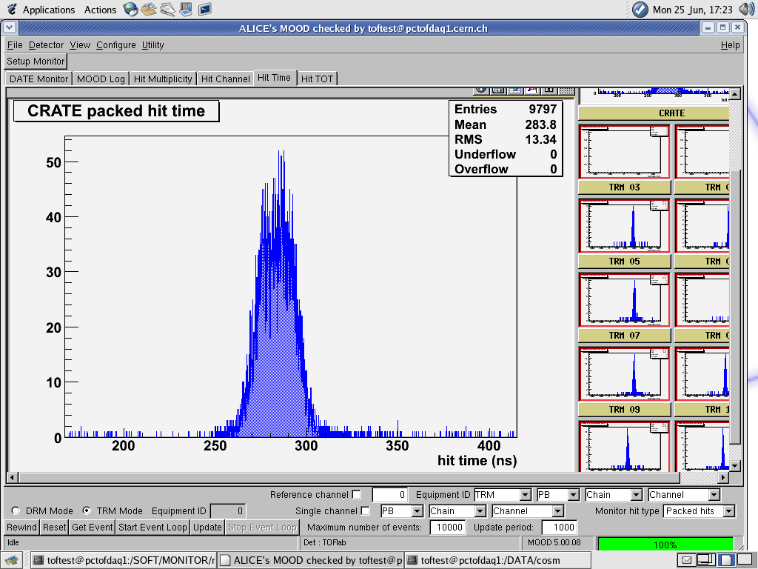
TOF Monitoring
Monitoring performed both with MOOD and AMORE (R. Preghenella).
MOOD snapshot

Slide 14
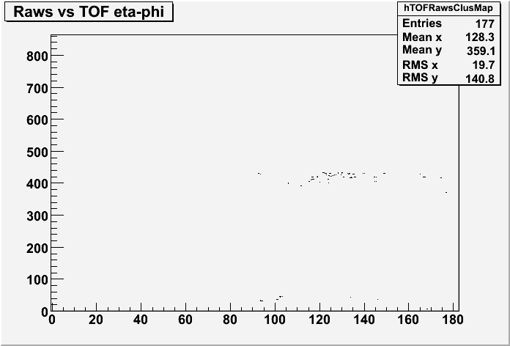
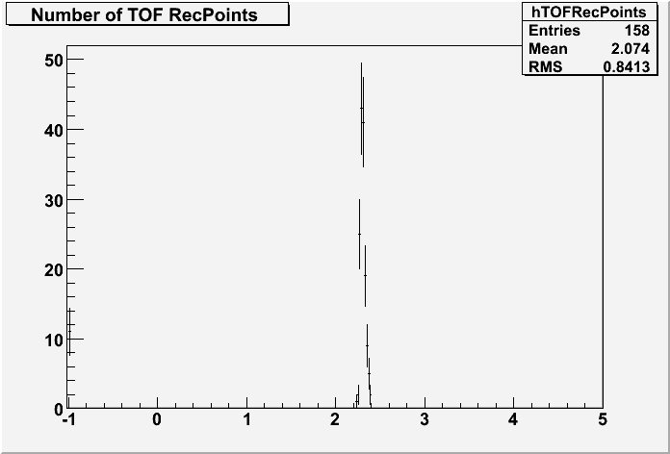
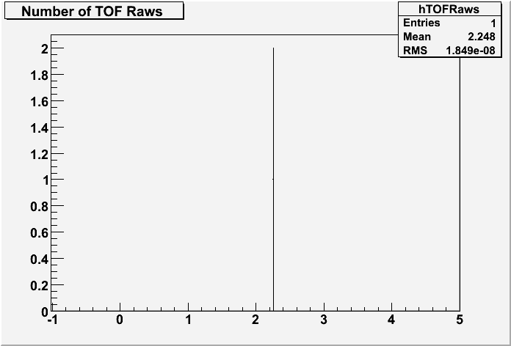
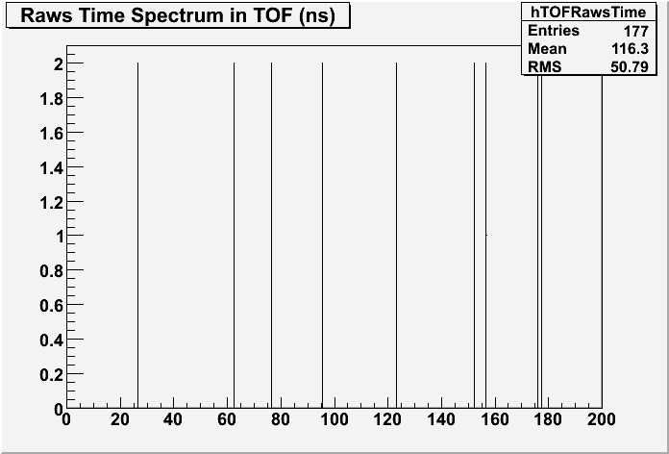
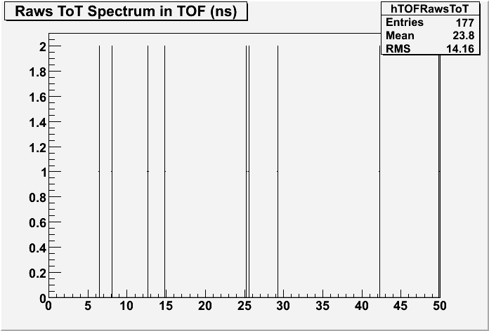
TOF QA histograms

Slide 15
TOF Online QA
Uses AMORE, integrated with the AliRoot TOF QA classes;
December problems with publication of “big” histogram solved;
Reference data not need so far, even if some check may be added when real data will come;

Slide 16
TOF Preprocessor & FDR – Conclusions
TOF Preprocessor ran successfully during the Feb/March ‘08 exercise;
Since data were not reliable for calibration, computing of delays was skipped:
    Dedicate flag introduced
      Artificial
      To be removed for real data taking
    If a “cosmic” beam type will be introduced in the DAQ logbook, then everything will be fine.
Integration with DAQ & DCS system fully achieved
Still some redisign is needed in view of the next data taking

