Slide 1
PHOS offline status report
Yuri Kharlov
ALICE offline week
7 April 2008

Slide 2
Steering the simulations
AliPHOSSimParam sets PHOS simulation parameters:
Float_t fLightYieldMean ; // Average number of
// photoelectrons per GeV
Float_t fIntrinsicAPDEfficiency; // APD efficiency including
// geometric coverage
Float_t fLightFactor ; // Average number of photons
// collected by APD per GeV
Float_t fAPDFactor ; // factor relating light
// yield and APD response
Float_t fAPDNoise; //RMS of APD noise
Float_t fEMCDigitThreshold ; //minimal energy to keep digit
Float_t fEMCADCchannel ; //width of ADC channel in GeV
Float_t fTOFa ; //constant term of TOF resolution
Float_t fTOFb ; //stochastic term of TOF resolut.

Slide 3
Geometry
No additional clearance is needed around alignable volumes:
Alignable volumes PSTR (strip units) are packed into 28x8 matrix which is embedded to the insulation foam PTII.
The sze of PTII is by 1 cm larger than the matrix of PSTR
Individual PSTR are misaligned according to a real survey data, therefore they are misaligned coherently which avoids overlaps
Alignable volumes PHOS (modules) are positioned inside ALIC with a gap between them, and with a gap between the PHOS modules and a PHOS cradle.

Slide 5

PSTR inside PTII
PTII
PSTR

Slide 6
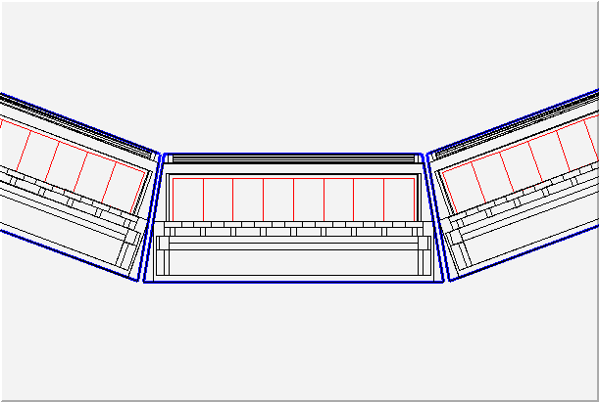
PHOS inside ALIC
gap

Slide 7
Raw data
Raw data as ALTRO samples with and without zero suppression is stored on MSS in a ROOT format
Raw reader in aliroot is fault-tolerant: good for offline processing, but not suitable for hardware diagnostics of corrupted data.
Raw data reader processes raw data in any of 3 formats: DDL, raw DATE and ROOT.
Decoders exist, tested and commissioned with simulated and real data from PHOS-1

Slide 8
On-line processing
Raw data from DDL is split to DAQ and HLT.
Detector Algorithms (DA) can be running in both DAQ and HLT environments. Algorithmic part and output are physically the same, but data reading and decoding are different.
DA, either DAQ or HLT, creates common root files with objects needed to calculate calibration parameters and bad channels map in preprocessor.
There is only one preprocessor for all DAs, independent on HLT/DAQ environment
HLT can run more sophisticated DA due to higher performance and data parallelization.

Slide 9
PHOS objects in OCDB
AliPHOSEmcCalibData
Float_t fADCchannelEmc[5][56][64]
Float_t fHighLowRatioEmc[5][56][64]
Float_t fTimeShiftEmc[5][56][64]
AliPHOSEmcBadChannelsMap
Bool_t fBadChannelEmc[5][56][64]
  Offline and HLT agreed to have Int_t instead of Bool_t for BCM.

Slide 10
Algorithmic part of DAs
The input to the DA is scalable:
  DAQ DQ: input is a full module (56x64x2)
  HLT DA: input is one RCU (28x32x2)
The input to the calibration DA is energy and time in the form: nX, nZ, Float_t e[nX][nZ][2], t[nX][nZ][2]
  the input energies are in ADC counts
  Input times are in sample
DA stores separate histograms for HG and LG per channel
Merging of HG and LG, conversion to energy and real time is done by the preprocessor.
The input to the bad channel map DA is quality parameter: nX, nZ, Float_t q[nX][nZ][2]

Slide 11
DA in implementation in DAQ and HLT
HLT or DAQ read and decode raw data. ALTRO samples are fit to give a digit energy, time and quality. These tasks are environment-dependent in DAQ and HLT.
Algorithmic part of DA, storing DA histograms, preprocessors are the responsibility of Offline project.

Slide 12
Commissioning of DA and preprocessor
DA was tested with real data read offline (from file).
Integration of DA with DAQ will be done in P2 (May)
Root files created by DA were submitted to the Shuttle commissioning team, where they were validated.
See Boris’ talk next.

Slide 13
Online monitoring
Fully implemented in HLT, extensively used in the PHOS lab during PHOS-1 commissioning in 2007.
Integration of the HLT monitoring with the ALICE monitoring:
  HLT passes ROOT objects to the DATE stream (TH, Tcanvas)
  AMORE receives raw data, selects HLT objects and displays them on online monitor
  Can AMORE read TObject?
Simple stand-alone monitoring will be done in AMORE framework.

Slide 14
Reconstruction
Reconstruction from raw data is validated with PHOS-1 commissioning real data
Reconstruction uses OCDB for calibration, bad channel map and alignment
Experience with raw data reconstruction in AliEn: 2 kfiles with 3 Mevents were successfully reconstructed, ESD were obtained and used for further analysis

Slide 15
Steering the reconstruction
AliPHOSRecoParam sets PHOS reconstruction parameters:
Float_t fClusteringThreshold;
Float_t fLocMaxCut;
Float_t fMinE;
Float_t fW0;
Float_t fSampleQualityCut;
Bool_t fSubtractPedestals; // kTRUE for non-ZS
Bool_t fUnfold;
Bool_t fOldRCUFormat; // kTRUE if RCU has old
// firmware (2006-2007)
TString fDecoderVersion ;

Slide 16
Event embedding: use case
Merging with raw data (Digits)
Merging with simulated data (SDigits)
void Sim(const Int_t nevents=1500,
const Int_t debLevel=0){
//Simulation MC event and merge with
//Digits from raw event.
AliPHOSSimParam * phosSimParam =
AliPHOSSimParam::GetInstance() ;
AliSimulation sim;
sim.SetMakeSDigits("PHOS") ;
sim.SetMakeDigits("PHOS") ;
sim.MergeWith("RAW/galice.root",1) ;
phosSimParam->SetStreamDigits(1) ;
sim.Run(nevents);
}
void Sim(const Int_t nevents=1500,
const Int_t debLevel=0){
//Simulation MC event and merge with
//SDigits from raw event.
AliPHOSSimParam * phosSimParam =
AliPHOSSimParam::GetInstance();
AliSimulation sim;
sim.SetMakeSDigits("PHOS");
sim.SetMakeDigits("PHOS");
sim.MergeWith("RAW/galice.root",1) ;
phosSimParam->SetStreamDigits(0) ;
sim.Run(nevents);
}
By default ALICE does not store Digits during official reconstruction, therefore for event embedding we will have to redo part of reconstruction ourselves

Slide 17
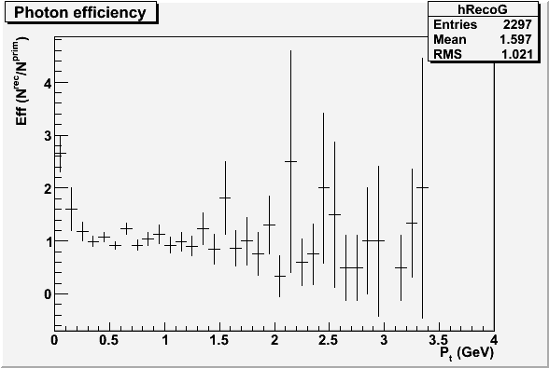
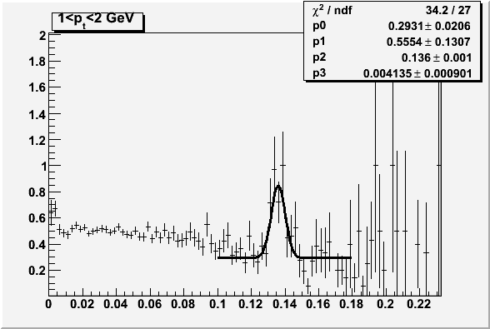
Event embedding in work
(code in trunk and release v4-11-Rev-04 – not yet in AliEn)
We embedded 2 π⁰/event/PHOS acceptance with HIJING pt spectrum into 2007 cosmic events and calculated single photon efficiency and constructed two-photon invariant mass
Embedded/primary ratio
Real/Mixed ratio
Single photon efficiency close to unit at p_{t}>300 MeV, while below there is a lot of noise from underlying event
π⁰ peak with width ~4 MeV is seen
at p_{t}>1 GeV

Slide 18
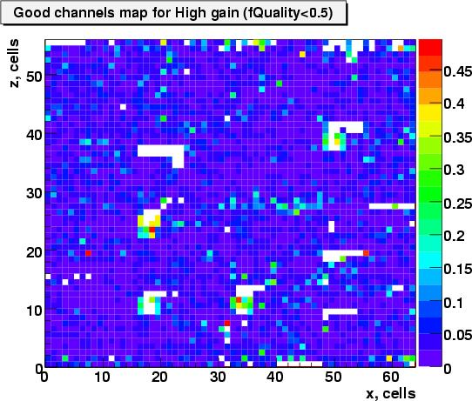
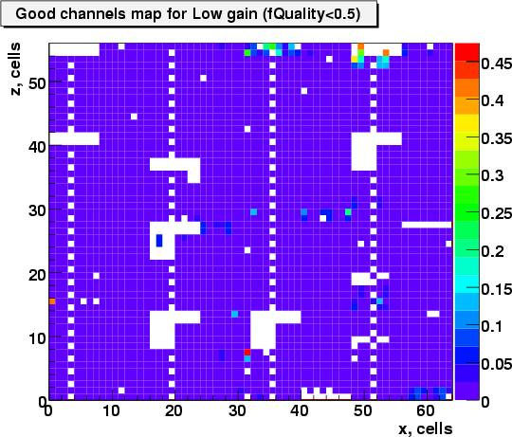
Good channels in LED run
Fit quality parameter is used to construct the bad channel map
BCM is stored in OCDB

Slide 19
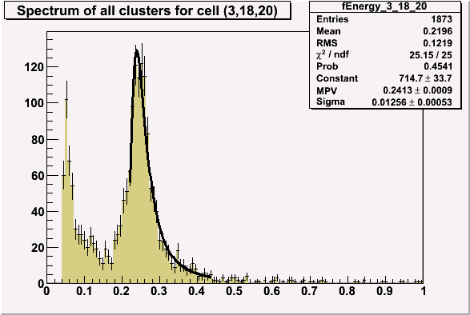
Reconstruction with bad channel map
BCM was built on the subset of Cosmic Run 8249 (Oct 2007)
All runs under the same run conditions (“apd 255”) were reconstructed by AliRoot
Clear MIP peaks (like this!) observed in all cells passed the good channel selection procedure
Absolute calibration factor is assumed as 5 MeV/ADC

Slide 20
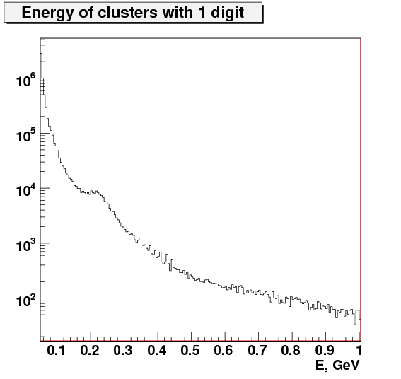
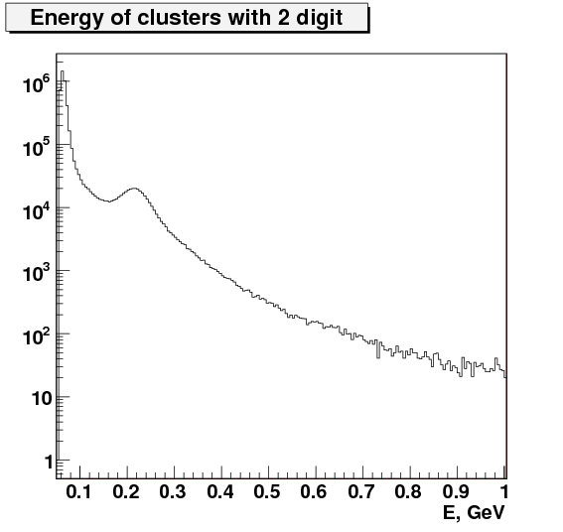
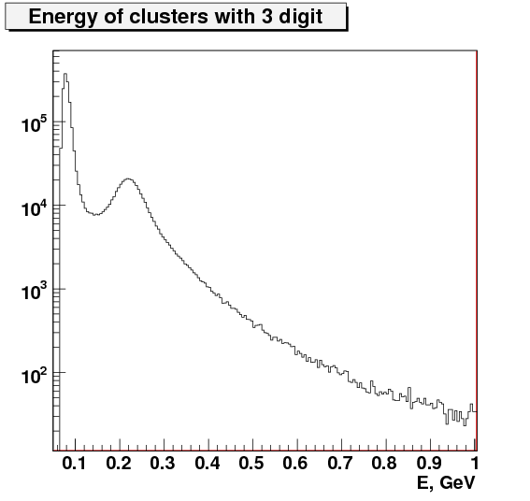
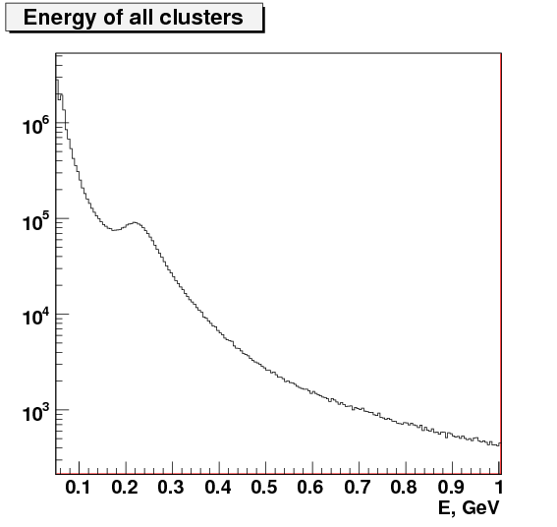
Amplitude spectra of all clusters in cosmic runs
MIP
MIP
MIP
MIP
Bad channel map and relative calibration is applied

Slide 21
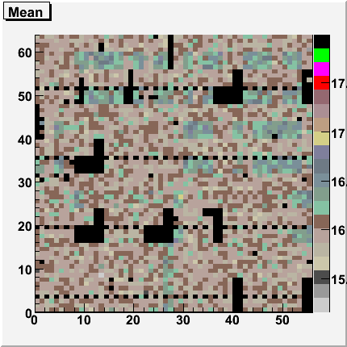
HG/LG ratio in LED run 2007
HG/LG ratio is stored in OCDB

Slide 22
PHOS data processing forum
Web-based forum is available at http://aliceinfo.cern.ch/static/phpBB3/
The aim of the forum is a rapid communications about current data processing status, new (even intermediate and preliminary) results, it provides an easy way to produce high-quality well-illustrated documentation.
Posted results are considered as prototypes of future analysis notes.
All PHOS users involving in the analysis are encouraged to join the forum.

