Slide 1
Update on ALICE Grid monitoring
costin.grigoras@cern.ch

Slide 2
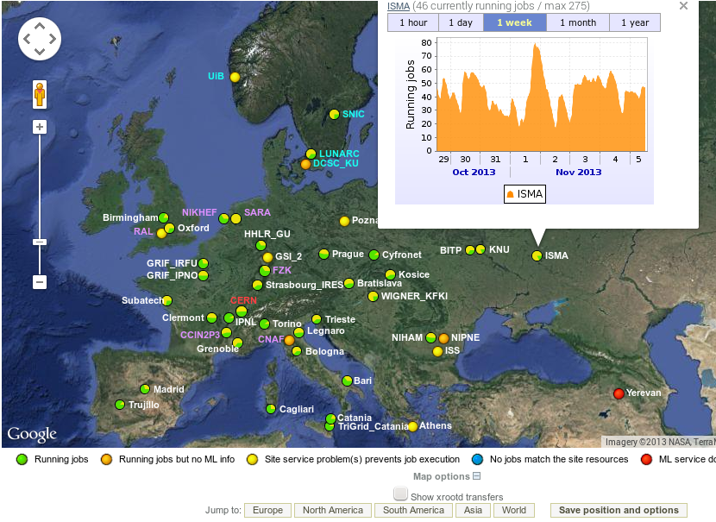
Updated map – Google Maps API v3

Slide 3
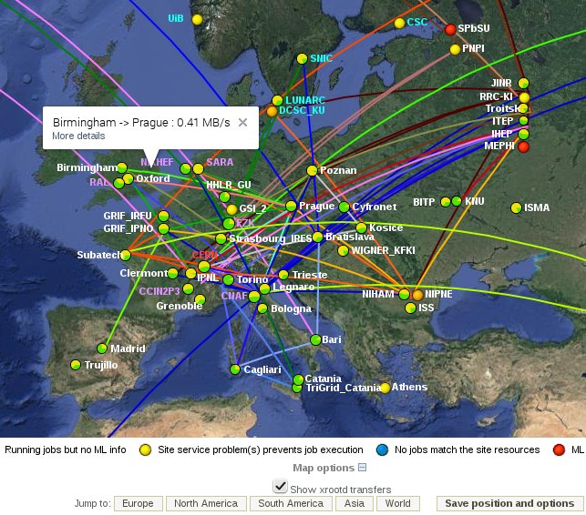
Updated map – real Xrootd traffic
Top 100 WAN connections at the moment
Source-based color coding
Traffic-dependent line width

Slide 4
Xrootd traffic aggregation
Filter on each VoBox aggregating local Xrootd on-close events (read and write) in:
  Client IPv4 C-classes
  Remote site (IP to site mapping done by the central services)
  LAN and WAN
  Total traffic
Also available are read and write operation frequencies
Data available in MonALISA under the XrdServers_Aggregation cluster
Not available for EOS yet

Slide 5
MonALISA – AliROOT Interface
Available in AliROOT as ANALYSIS/AliXMLParser.cxx
Requires ROOT >= 5-34/11 to read from URLs
Currently the following links implement it:
  Production details, eg:
  http://alimonitor.cern.ch/prod/jobs.jsp?t=4078&res_path=xml
  Run Condition Table:
  http://alimonitor.cern.ch/configuration/?res_path=xml
  SHUTTLE:
  http://alimonitor.cern.ch/shuttle.jsp?instance=PROD&time=10000&res_path=xml
  The REST interface of MonALISA:
  http://alimonitor.cern.ch/rest/CERN/MonaLisa/localhost/*?Accept=text/xml
Create the view you want in the web interface then
add the respective argument in the code

Slide 6
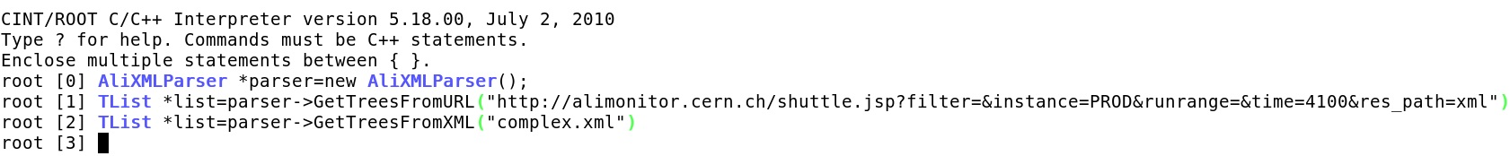
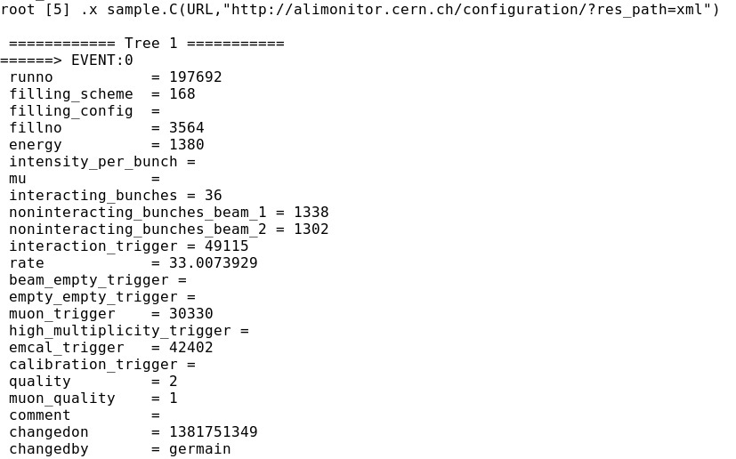
Usage
Thanks Harsh!

Slide 7
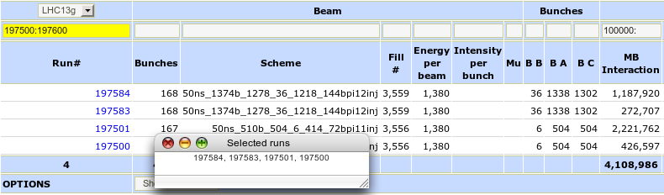
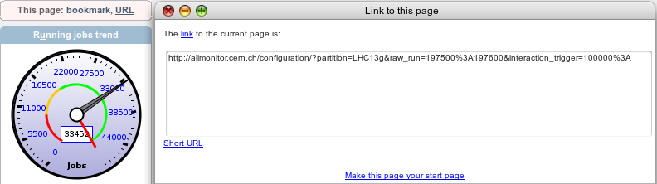
Using the web filters
You can use ranges, lists, exclude particular values…
  http://alimonitor.cern.ch/doc/index.jsp?page=configuration_index
Full link to page + options to send/bookmark:

Slide 8

Site Issues Dashboard
http://alimonitor.cern.ch/siteinfo/issues.jsp
Issues split in levels, last selected level as cookie
Added direct testing of individual Xrootd data servers
CVMFS status
IPv6, network buffers, efficiency…
  Only 3 sites have deployed IPv6 so far, kudos to Oksana for the complete deployment at BITP

