Slide 1
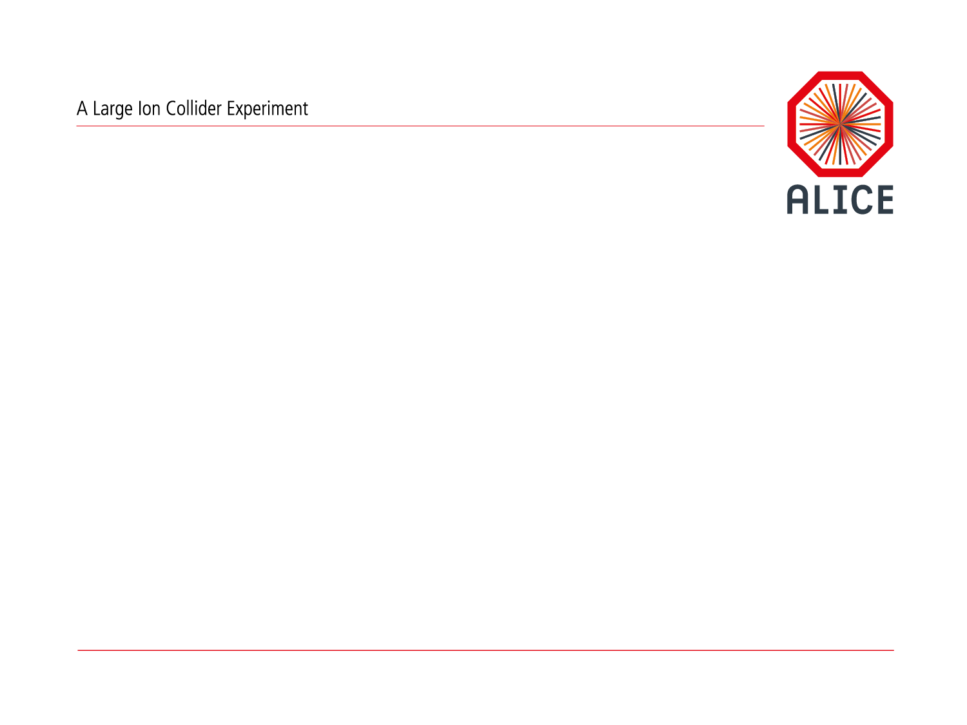
AliEn, Clouds and Supercomputers
Predrag Buncic

Slide 2

An alternative talk title…

Slide 3
AliEn@Grid
Highly Distributed infrastructure of ~100 computing centers, 50k cores
Distributed data, services and operation infrastructure
Not the easiest thing to master but we learned how to do it

Slide 4
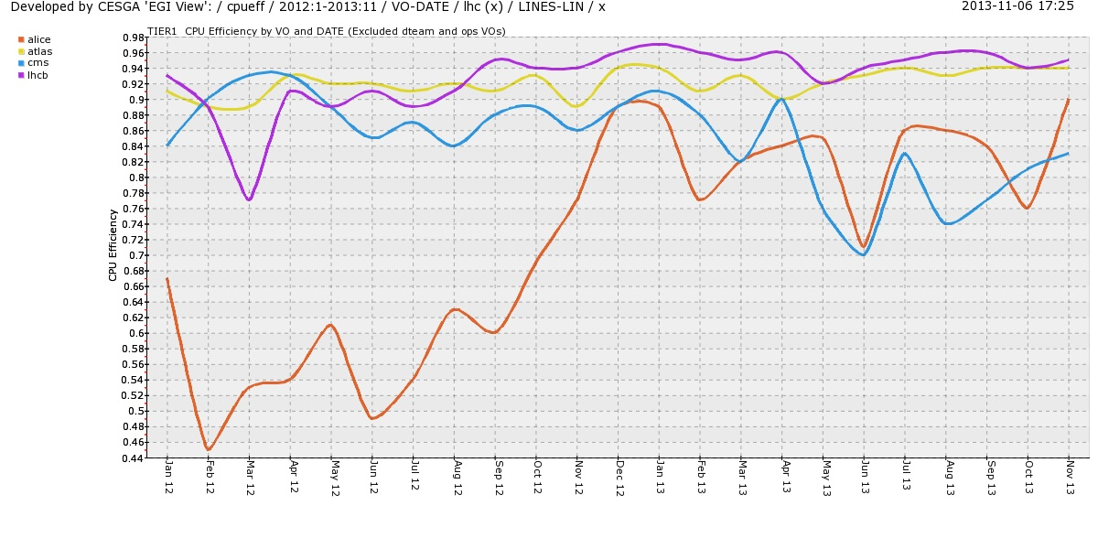
Job Efficiency
Well done, thank you! Can we still improve!

Slide 5
Why changes?
  The system currently fulfills all the needs of ALICE users for reconstruction, simulation and analysis
  We know how to operate it and system is tailored to our needs and requirements (that’s good)
  However, our needs will grow by x20 during Run3 (driven mostly by the simulation needs)
    …and even bigger will be needs of other experiments after LS3
  How should the Grid look to match those needs (and still be usable)?

Slide 6
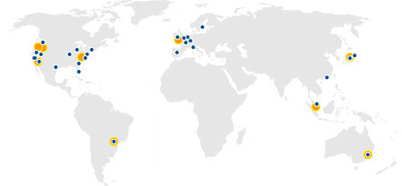
Meet the Cloud…
At present 9 large sites/zones (up to ~2M CPU cores/site, ~4M total)
About the size that will be needed for LHC data processing in Run3
500x more users, 10x more resources, 0.1x complexity
Optimized resource usage using virtualizations, IaaS model
Economy of scale

Slide 7
The bad part…
  The Cloud is not End-to-End system
    It allows us to build one (or reuse one of the existing solutions suitable for given scale)
  We can re-build our Grid on top of Cloud
    Preserving investment and user interfaces
    Have to do the development and maintenance of our own middleware
  Data management is already a big problem and is bound to become much bigger
    Cloud does not come with out of the box solutions for data management that would be appropriate for our problem

Slide 8




ALICE@Run4
Private CERN
Cloud
Analysis
Reconstruction
Custodial Data Store
AliEn
CAF
On
Demand
AliEn
HLT
DAQ
O₂
Online-Offline
Facility
T1/T2/T3
AliEn
CAF
On
Demand
Simulation
AliEn
Analysis
Simulation
Data Cache
Vision
Public Cloud(s)

Slide 9

From Grid to Cloud(s)
In order to reduce complexity national or regional T1/T2 centers could transform themselves into Cloud regions
  Providing IaaS and reliable data services with very good network between the sites, dedicated links to T0

Slide 10
Reducing the complexity
  This would allow us to reduce complexity
    Deal with handful of clouds/regions instead of individual sites
  Each cloud/region would provide reliable data management and sufficient processing capability
    What gets created in a given cloud, stays in it and gets analyzed there
  This could dramatically simplify scheduling and high level data management

Slide 11
Simulation
  Even with efficient use of Clouds and our own O2 facility we might be still short of resources for simulation
    Need to be able to use all possible sources of CPU cycles

Slide 12
Simulation strategy
Migrate from G3 to G4
  G3 is not supported
  G4 is x2 slower for ALICE use case
Need to work with G4 experts on performance
Expect to profit from future G4 developments
  Multithreaded G4, G4 on GPU…
Must work on fast (parameterized) simulation
  Basic support exists in the current framework
Make more use of embedding, event mixing…
In spite of all this we might fall short of resources

Slide 13
Top 500
  The good news is that we have access to #2 and #6 supercomputers from Top 500

Slide 14

Lots of CPU, no internet, minimal OS
Compute
Node
Compute
Node
ssh
Login
Node
qsub
Service
Node
arun
Compute
Node
Login
Node
Service
Node
Compute
Node
CVMFS
Squid
Squid
$ [titan-batch6][12:12:09][/tmp/work/atj/cvmfs_install/bin]$ aprun ./parrot_run -t/tmp/scratch /cvmfs/alice.cern.ch/bin/alienv setenv AliRoot -c aliroot -b
*******************************************
* W E L C O M E to R O O T *
* Version 5.34/08 31 May 2013 *
* You are welcome to visit our Web site
* http://root.cern.ch *
* *
*******************************************
ROOT 5.34/08 (v5-34-08@v5-34-08, Jun 11 2013, 10:26:13 on linuxx8664gcc)
CINT/ROOT C/C++ Interpreter version 5.18.00, July 2, 2010
Type ? for help. Commands must be C++ statements.
Enclose multiple statements between { }.
2+2
(const int)4
Thanks to CMS parrot (from cctools) extended
to allow access to CVMFS
(some restrictions apply)
Adam Simpson, ORNL

Slide 15
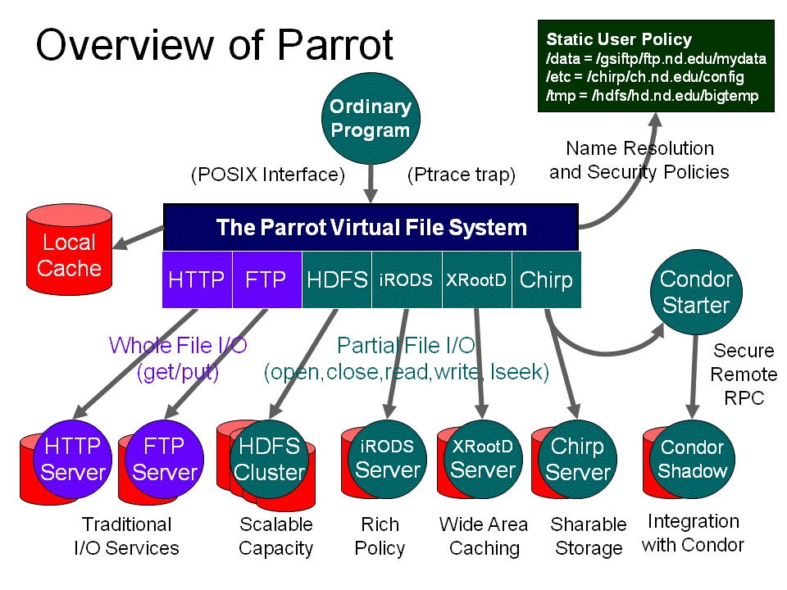
Parrot is a transparent user-level virtual filesystem that allows any ordinary program to be attached to many different remote storage systems, including HDFS, iRODS, Chirp, and FTP
+ CVMFS

Slide 16
Interfacing with PanDA (Plan B)
Tactical
SE
Job
Agent
AliEn
CE

Slide 17
Conclusions
Run3+ will impose much higher computing requirements
  100x more events to handle
Simply scaling the current Grid won’t work
  We need to reduce the complexity
Regional clouds may be an answer
  We are not abandoning the grid
  “Our grid on the cloud” model
In order to complement these resource we might have to tap into flagship HPC installations
  Not exactly grid friendly environment, needs some work(arounds)
Looking for synergies and collaboration with other experiments and IT
  Transition to clouds, CVMFS, location aware service, edge/proxy services, data management, release validation, monitoring, pilot jobs, distributed analysis, use of opportunistic resources, volunteer computing…

