Slide 1
Improving the analysis performance
Andrei Gheata
ALICE offline week
7 Nov 2013

Slide 2
Performance ingredients
Maximize efficiency: CPU/IO
  Useful CPU cycles: deserialization is I/O accounted for as CPU
Minimize time to complete a given analysis
Maximize throughput
  N_{events}/second/core for local data access

Slide 3
1. CPU/IO

Slide 4
More CPU cycles
Maximize CPU = organized analysis trains
  At least one CPU intensive wagon gives others a free ride…
  Many times possible in organized mode (LEGO), not the case for user distributed analysis
Maximize participation in LEGO
LEGO/USER

Slide 5
Faster I/O
Fragmented I/O introduces overheads
  ~N_{I/O_req}*latency
  Killer in case of WAN file access
  (see old lessons)
Tree caching reduces fragmentation
  Overheads still present for WAN access! Sharing WAN bandwidth does not scale as good as LAN at all sites.
latency
latency
latency
latency
latency
latency
latency
TREE CACHING
latency
latency

Slide 6
Maximizing local file access
By smart file distribution and “basketizing” (splitting) per job - done
  Locality is a feature by design
  Algorithm fixed now after longstanding splitting issues
  Some local file access may timeout, or jobs intentionally sent to free slots with non-local access
Data migration?
  Based on popularity services? Not terribly useful without a working forecast service…
  Integrated with the job scheduling system?
By using data prefetching
  At low level (ROOT) – “copy during run” – to be tested at large scale
  At workload management level (smart prefetching on proxies)?

Slide 7
TFilePrefetch
Separate thread reading ahead data blocks
First testing round found a bug
  The fix made it to ROOT v5-34-11 (not yet used in production)
  To be tested with LEGO trains soon
AliAnalysisManager::SetAsyncReading()
  Job reading from CNAF with 70% efficiency becomes 82% !
  Forward file opening not implemented -> non-smooth transitions between files
Reading thread
File1
File2
block1
block2
block3
block4
block5
block6
block7
Processing thread

Slide 8
Speeding-up deserialization
“The event complexity highly contributes to DS time…”
  …for the same amount of bytes read
  Deserialization itself + ReadFromTree()
  Remains to be measured
Ongoing work: flattening AliAODEvent to 2 levels
  Event + tracks, vertices, cascades, V0’s, …
  TFile::MakeFile, TFile::MakeClass as base for refactoring
  Read event from AOD into new structure + write to new file
  Compare reading speeds in the 2 cases
For the future: new “thinned” AOD format serving 80% of analysis
  The train model calls for “general” data -> contradicts with reducing size
  To investigate: SOA for tracks, vertices, V0’s, …

Slide 9
Minimizing time to complete analysis

Slide 10
Improving tails…
Assess acceptable statistics loss cutting the tail
Jobs in the queue not finding free slots where data is
  Currently the site requirements are being released and jobs land on some free slot and access (almost) all files remotely -> efficiency price
  One can also play with raising the priority for the tail jobs
Prefetching jobs file lists on data proxies near free slots
  Triggered by low watermark on remaining jobs or high watermark on waiting time
  Change job requirements to match the data proxy
  Better than local job file prefetching because can be done while jobs are waiting
Just ideas to open the discussion…
  Implementation would require a data transfer service and xrootd-based proxy caching
  Can bring the efficiency up, but also reduce the time to finish the jobs

Slide 11
Possible approaches
Job slots
Is there such thing as “free slots?
SITE B
Dispatched jobs
SE
Job slots
Job slots
SITE C
SITE A
F4,F5,F6
SE
SE
Transfer service
trigger
F1,F2,F3
F1,F2,F3, SITE A
Job slots
Big gun to kill a fly ? (the tail is ~5%). Alternative: no copy but relaxing requirements based on geographic proximity
Waiting jobs
OR C
F4,F5,F6, SITE B
SITE D
OR C
F7,F8,F9, SITE D
SE
OR C
F7,F8,F9

Slide 12
Throughput/core

Slide 13
Prerequisites
Achieving micro parallelism
  Vectors, instructions pipelining, ILP
  Some performed by HW and compilers, other require explicit intervention
Working on “parallel” data (i.e. vector-like)
  Redesign of data structures AND algorithms
  Data and code locality enforced at framework level, algorithm optimizations at user level
Make use of coprocessors (GPGPU, Xeon Phi, …)
  Require parallelism besides vectorization (including at I/O level)
“Decent” CPU usage
  CPU bound tasks

Slide 14
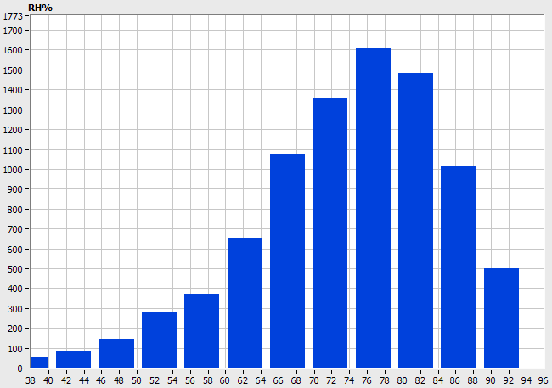
Does it worth?
Nice exercise by Magnus Mager reshaping a three-prong vertexing analysis
  Re-formatting input data and keeping minimal info, feeding threads from a circular data buffer, some AVX vectorization, custom histogramming
  500 MB/s processed from SSD
Analysis threads
Reader thread
Circular
buffer
Result
Merging

Slide 15
Micro-parallelism path
Data structures re-engineering: shrink and flatten, use SOA and alignment techniques runtime
Concurrency in data management: reading, dispatching to workers
Define work unit: e.g. vector of tracks, provide API with vector signatures
Concurrent processing: thread safe user code, usage of vectorization, kernels

Slide 16
Conclusions
Analysis performance has multiple dimensions, we are addressing few
Data management policy require improvements to extra reduce time to analysis completion while staying efficient
File prefetching expected to bring efficiency up with extra 10%
A long path in future towards micro-parallelism in analysis

