Slide 1
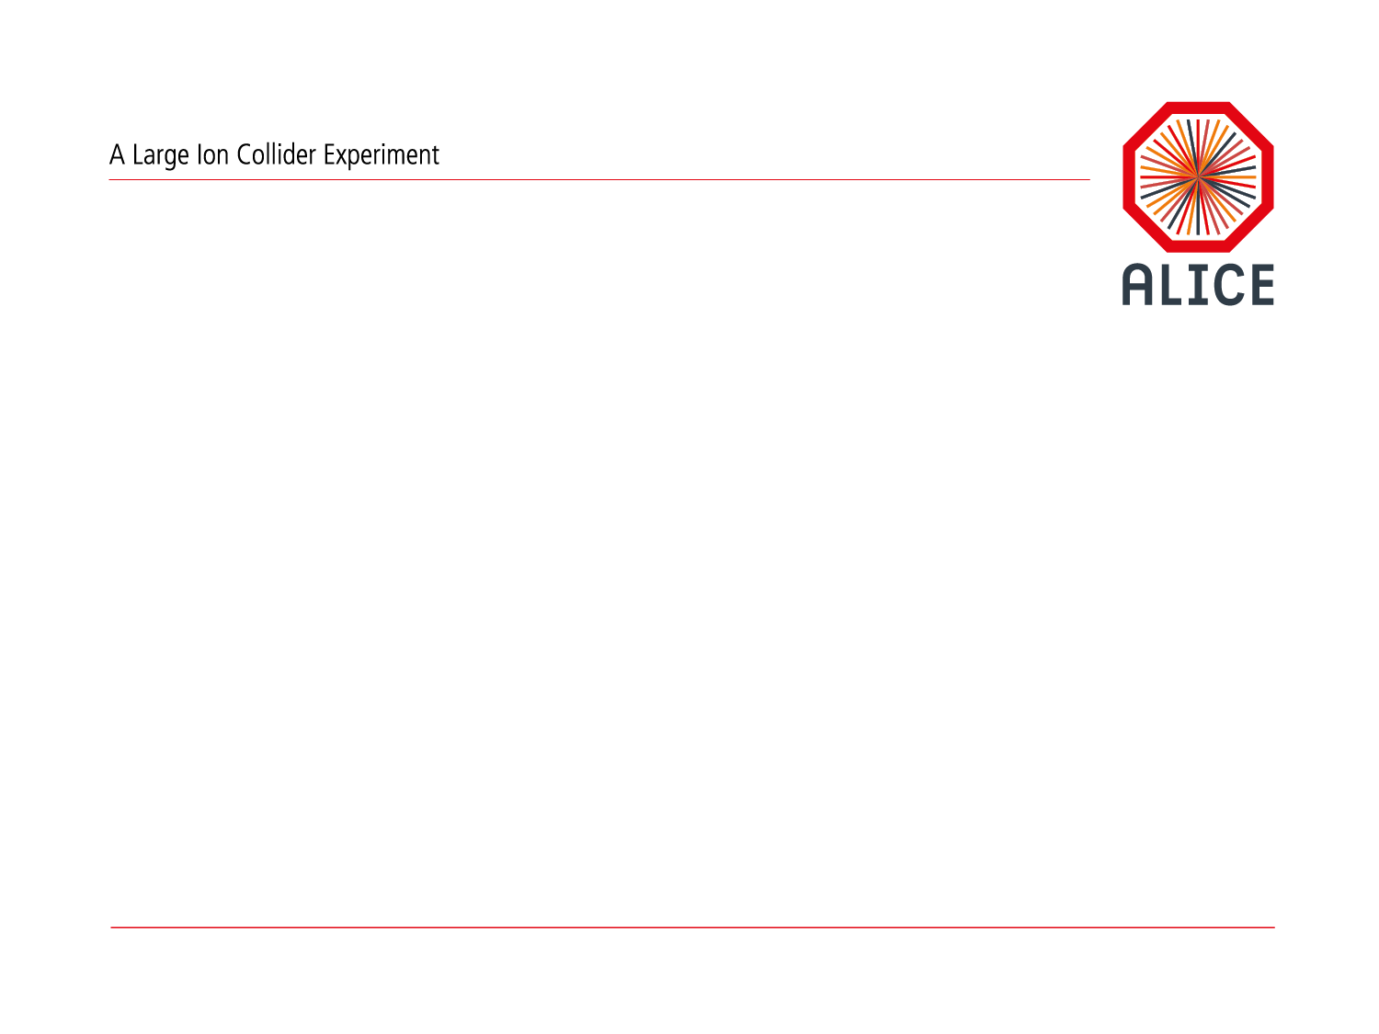
Introduction
Predrag Buncic

Slide 2
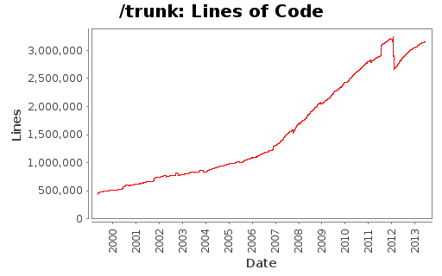
AliRoot
  ALICE Software Framework (written in C++)
    15 years old and still growing
  Built on top of ROOT (and using all ROOT features)
  Supports our basic use cases
    Simulation
    Reconstruction
    Analysis
  But also
    calibration, alignment, visualization, QA…
    HLT reconstruction (different from offline)
  3M SLOC, 180+ contributors

Slide 3
Need for changes
  We must adapt to changing environment and new technologies
    ROOT 6, C++11
    Multi and many cores
    GPUs
  We must improve the performance
    New algorithms
    Memory issues
    I/O is critical, needs a fresh look on data model
  We must converge to use the same framework in Online and Offline environment

Slide 4
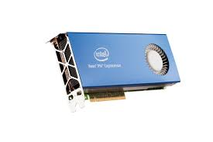
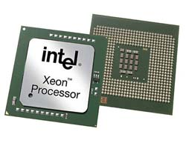
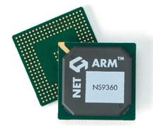
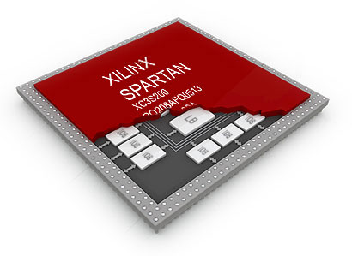
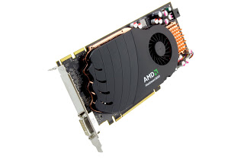
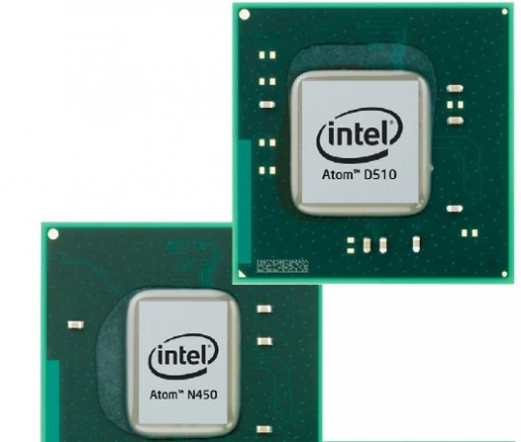
Heterogeneous Platforms?
  Using specialized hardware we could gain performance and save power
    At the expense of having to program and operate in heterogeneous computing environment

Slide 5
Single process framework

Slide 6
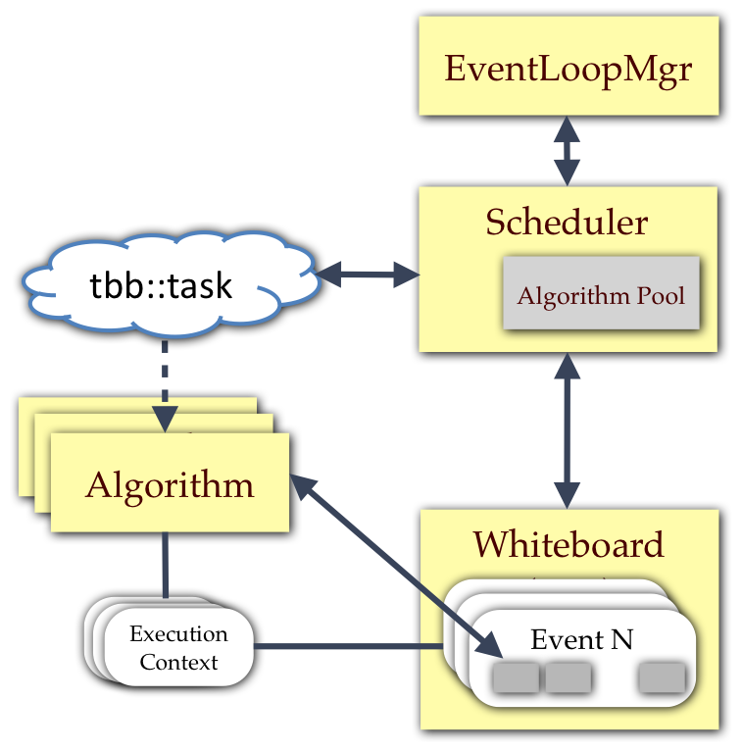
Multithreaded concurrency framework?

Slide 7


Or distributed multiprocess concurrency framework?
Analysis
Clusters
Simulation
Tracking
Analysis
(?)
PID
ESD
AOD

Slide 8
Timeline
Evolution of current framework
Based on Root 5.x
Improved algorithms and procedures
AliRoot 5.x
New modern framework
Based on Root 6.x, C++11
Optimized for I/O
FPGA, GPU, MIC…
AliRoot 6.x
Run 1
LS1
Run 2
LS2
Run 3
LS3
Run 4
C. Zampolli - Open Forum pA
8
2010
2011
2012
2013
2014
2015
2016
2017
2018
2019
2020
2021
2022
2023
2024-26

