Slide 1
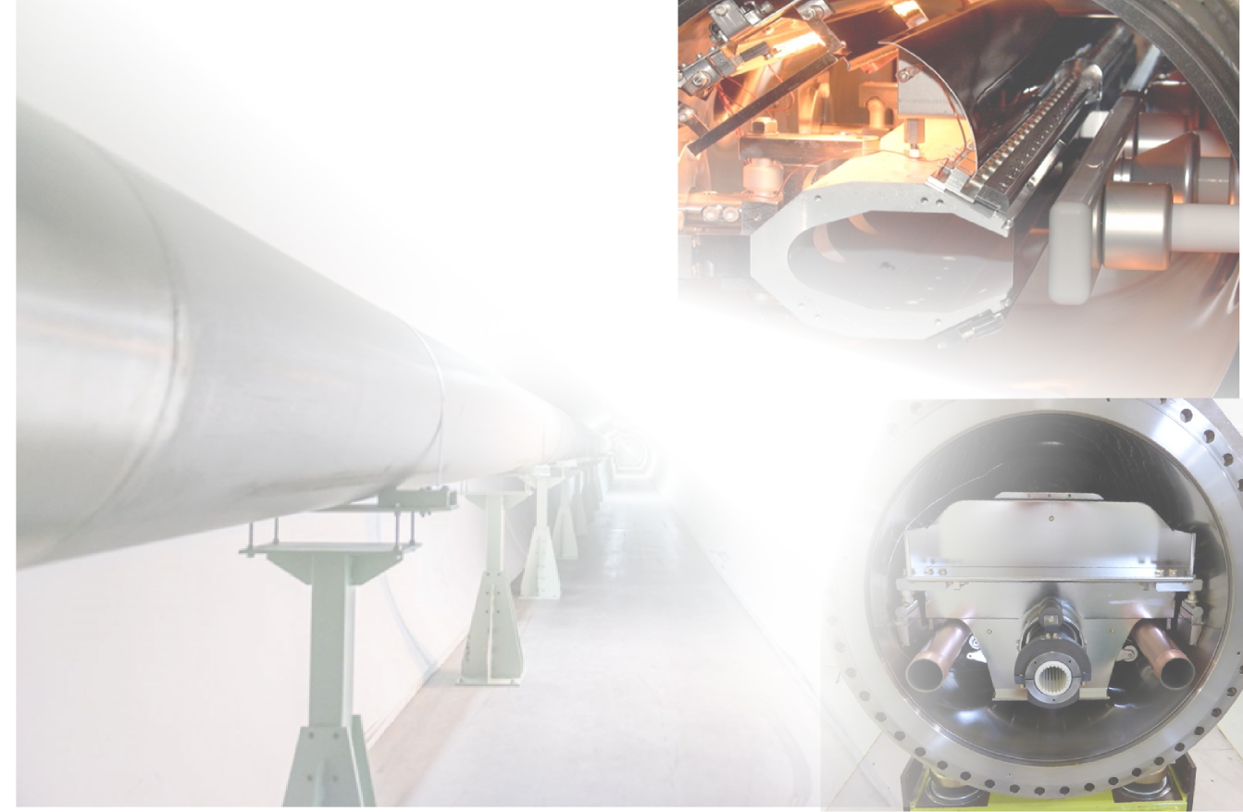
Injection and extraction
Wolfgang Bartmann
CERN
(based on lectures by Brennan Goddard)

Slide 2
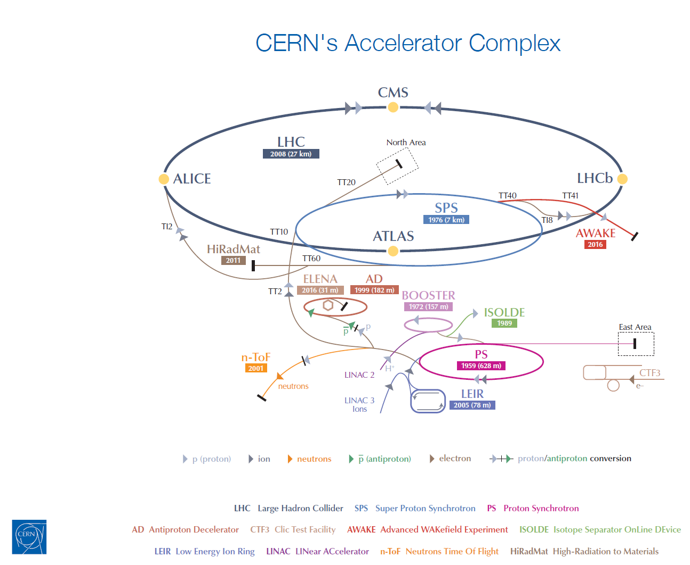
Injection, extraction and transfer
An accelerator has limited dynamic range.
Chain of stages needed to reach high energy
Periodic re-filling of storage rings, like LHC
Beam transfer (into, out of, and between machines) is necessary.

Slide 3
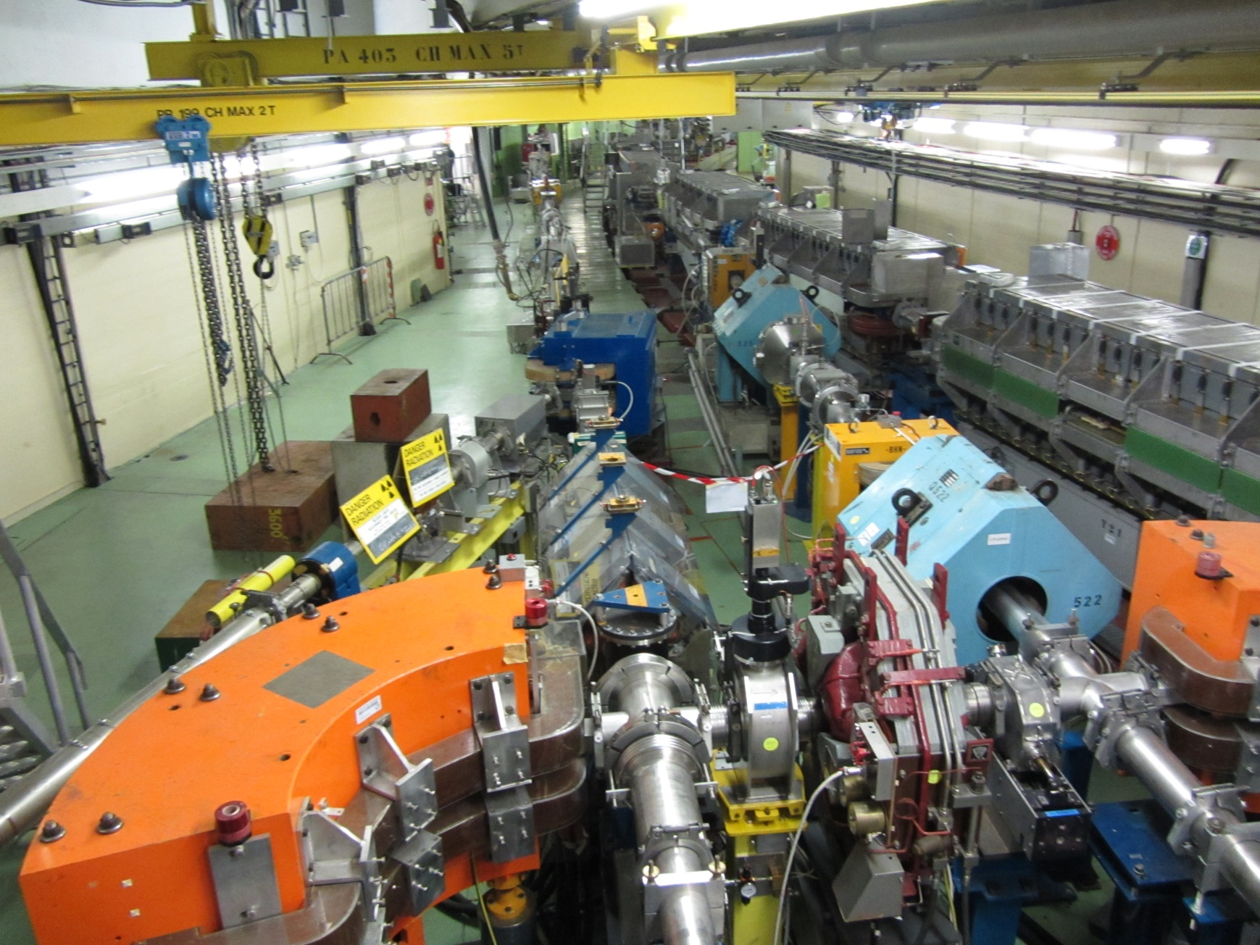
Injection, extraction and transfer

Slide 4
Injection, extraction and transfer
Kickers and septa
Normalised phase space
Injection methods
  Single-turn hadron injection
  Injection errors, filamentation and blow-up
  Multi-turn hadron injection
  Charge-exchange H- injection
  Lepton injection
Extraction methods
  Single-turn (fast) extraction
  Non-resonant multi-turn extraction
  Resonant multi-turn (slow) extraction

Slide 5
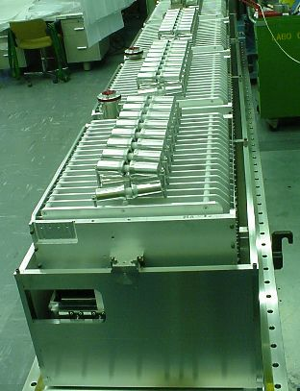
Kicker magnet
Pulsed magnet with very fast rise time
(100ns – few μs)
w
Ferrite
g
B
I
B = μ₀I / g
L = μ₀wl / g (magnet length l)
dI/dt = V/L
Typically 3 kA in 1 μs rise time

Slide 6
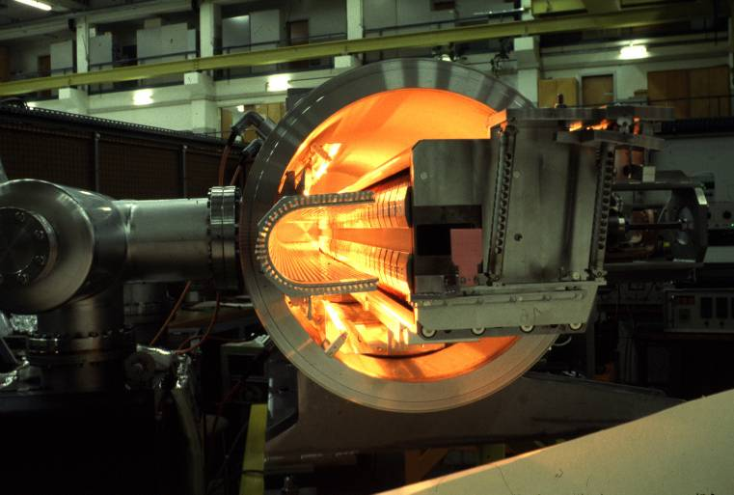
Magnetic septum
Pulsed or DC magnet with thin (2-20mm)
septum between zero field and high field region
Septum coil
I
B_{o} = μ₀I / g
Typically Ι 5-25 kA
Yoke

Slide 7
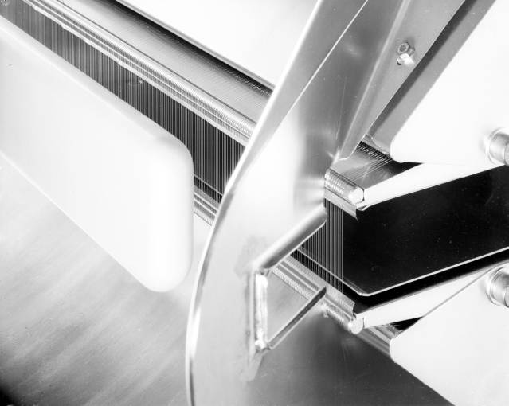
Electrostatic septum
DC electrostatic device with very thin (~0.1mm)
septum between zero field and high field region
High voltage
electrode
Hollow earth
electrode
Hollow earth
electrode
g
Septum wires
E₀
E=0
Thin wire or
foil (~0.1 mm)
E = V / g
Typically V = 200 kV
E = 100 kV/cm
High Voltage
Electrode

Slide 8

Normalised phase space
Real phase space
Normalised phase space
x’
⇒
x
Area = πε
Area = πε

Slide 9
Normalised phase space
Transform real transverse coordinates x, x’ by

Slide 10
Single-turn injection – same plane
Injected beam
‘boxcar’ stacking
intensity
injected
beam
Septum magnet
kicker field
t
Circulating beam
Kicker magnet
F-quad
D-quad
Septum deflects the beam onto the closed orbit at the centre of the kicker
Kicker compensates for the remaining angle
Septum and kicker either side of D quad to minimise kicker strength

Slide 11
Single-turn injection
Normalised phase space at centre of idealised septum
Large deflection by septum
θ septum

Slide 12
Single-turn injection
π/2 phase advance to kicker location

Slide 13
Single-turn injection
Normalised phase space at centre of idealised kicker
Kicker deflection places beam on central orbit
θ kicker

Slide 14
Injection oscillations
For imperfect injection the beam oscillates around the central orbit. 1
kicker θ error

Slide 15
Injection oscillations
For imperfect injection the beam oscillates around the central orbit. 2

Slide 16
Injection oscillations
For imperfect injection the beam oscillates around the central orbit. 3

Slide 17
Injection oscillations
For imperfect injection the beam oscillates around the central orbit. 4

Slide 18
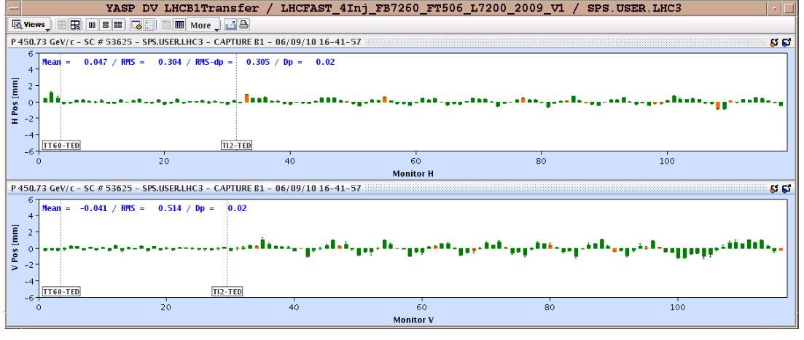
Injection oscillations
Betatron oscillations with respect to the Closed Orbit
Horizontal
Vertical
Transfer line
LHC (first turn)

Slide 19
Injection errors
Measured
Displacements
δ_{1,2}
Angle errors
Δθ_{s,k}
kicker
septum
δ₁
Δθ_{s,}
Δθ_{k,}
phase μ
δ₂
∼π/2
∼π/2
∼π/2
bpm1
bpm2
δ₁ = Δθ_{s} √(β_{s}β₁) sin (μ₁ – μ_{s}) + Δθ_{k} √(β_{k}β₁) sin (μ₁ – μ_{k})
≈ Δθ_{k} √(β_{k}β₁)
δ₂ = Δθ_{s} √(β_{s}β₂) sin (μ₂ – μ_{s}) + Δθ_{k} √(β_{k}β₂) sin (μ₂ – μ_{k})
≈ -Δθ_{s} √(β_{s}β₂)

Slide 20
Filamentation
Non-linear effects (e.g. magnetic field multipoles ) present which introduce amplitude dependent effects into particle motion.
Over many turns, a phase-space oscillation is transformed into an emittance increase.
So any residual transverse oscillation will lead to an emittance blow-up through filamentation
  “Transverse damper” systems used to damp injection oscillations - bunch position measured by a pick-up, which is linked to a kicker

Slide 21
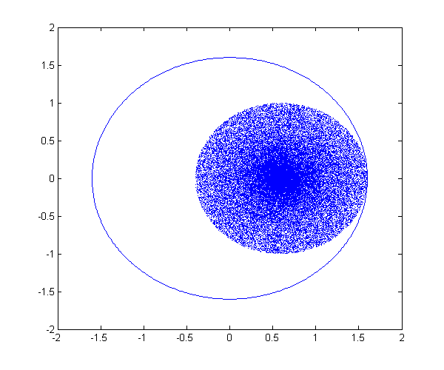
Filamentation

Slide 22
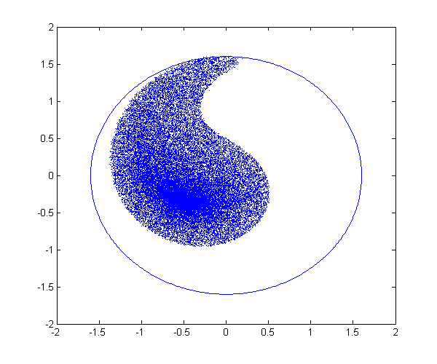
Filamentation

Slide 23
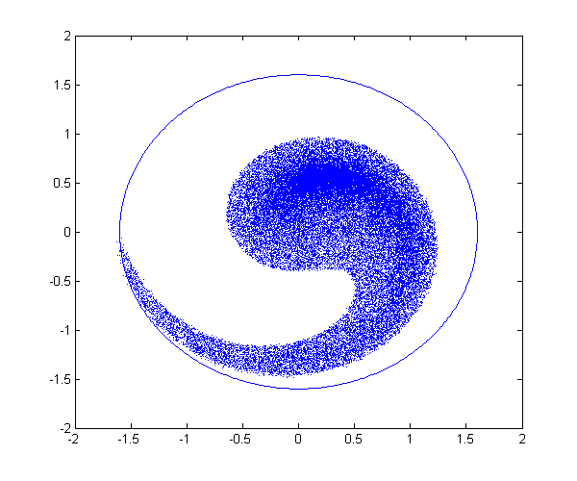
Filamentation

Slide 24
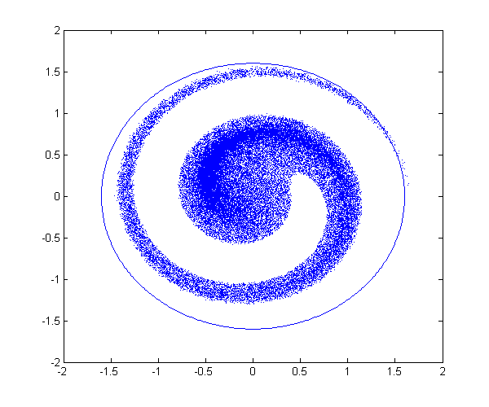
Filamentation

Slide 25
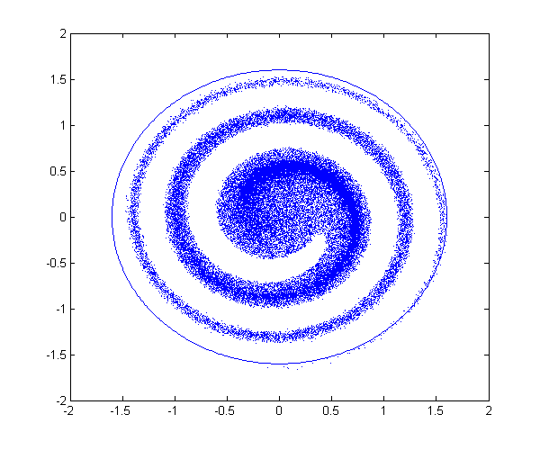
Filamentation

Slide 26
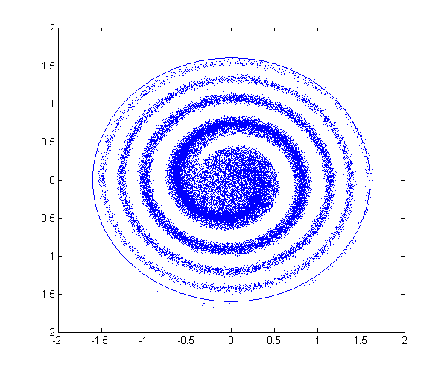
Filamentation

Slide 27
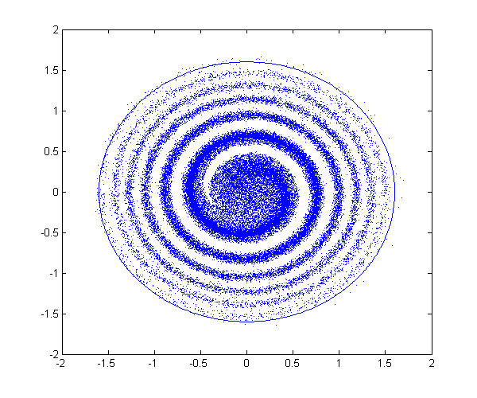
Filamentation

Slide 28
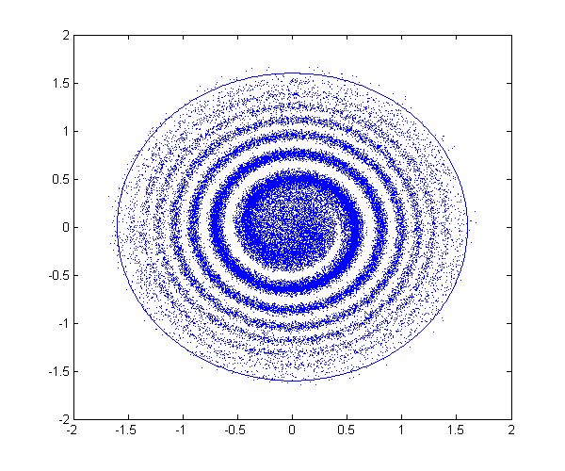
Filamentation

Slide 29
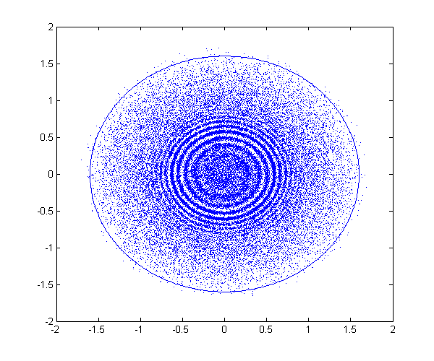
Filamentation

Slide 30
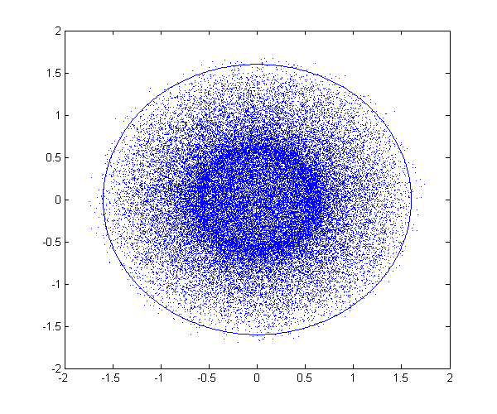
Filamentation

Slide 31
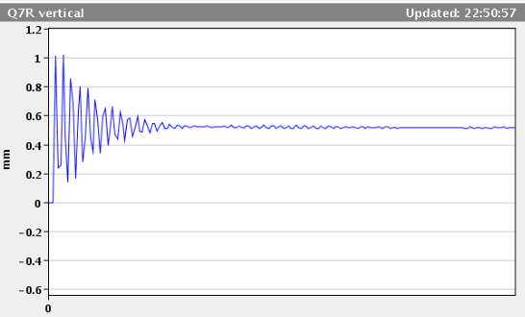
Damping of injection oscillations
Residual transverse oscillations lead to an emittance blow-up through filamentation
“Transverse damper” systems used to damp injection oscillations - bunch position measured by a pick-up, which is linked to a kicker
Damper measures offset of bunch on one turn, then kicks the bunch on a subsequent turn to reduce the oscillation amplitude
Injection oscillation

Slide 32
Optical Mismatch at Injection
Can also have an emittance blow-up through optical mismatch
Individual particles oscillate with conserved CS invariant:
a_{x} = γ x² + 2α xx’ + β x’²
Mismatched injected beam
x’
x
Matched phase-space ellipse

Slide 33
Optical Mismatch at Injection
Filamentation fills larger ellipse with same shape as matched ellipse
Turn 0
Time
Turn N
x’
x

Slide 34
Multi-turn injection
For hadrons the beam density at injection can be limited either by space charge effects or by the injector capacity
If we cannot increase charge density, we can sometimes fill the horizontal phase space to increase overall injected intensity.
  Condition that the acceptance of receiving machine is larger than the delivered beam emittance

Slide 35
Multi-turn injection for hadrons
Septum magnet
Varying amplitude bump
Closed orbit bumpers
No kicker
Bump amplitude decreases and inject a new bunch at each turn
Phase-space “painting”

Slide 36
Multi-turn injection for hadrons
Example: CERN PSB injection, fractional tune Qh = 0.25
  Beam rotates π/2 per turn in phase space
Turn 1
On each turn inject a new batch and reduce the bump amplitude
Septum

Slide 37
Multi-turn injection for hadrons
Turn 2

Slide 38
Multi-turn injection for hadrons
Turn 3

Slide 39
Multi-turn injection for hadrons
Turn 4

Slide 40
Multi-turn injection for hadrons
Turn 5

Slide 41
Multi-turn injection for hadrons
Turn 6

Slide 42
Multi-turn injection for hadrons
Turn 7

Slide 43
Multi-turn injection for hadrons
Turn 8

Slide 44
Multi-turn injection for hadrons
Turn 9

Slide 45
Multi-turn injection for hadrons
Turn 10

Slide 46
Multi-turn injection for hadrons
Turn 11

Slide 47
Multi-turn injection for hadrons
Turn 12

Slide 48
Multi-turn injection for hadrons
Turn 13

Slide 49
Multi-turn injection for hadrons
Turn 14

Slide 50
Multi-turn injection for hadrons
Phase space has been “painted”
Turn 15
In reality filamentation occurs to produce a quasi-uniform beam

Slide 51
Injection mismatch
For multiturn injection over n turns, injected beam ellipse is deliberately mismatched to circulating beam ellipse to reduce losses
√ε_{r}

Slide 52
Charge exchange H- injection
Multiturn injection is essential to accumulate high intensity
Disadvantages inherent in using an injection septum
  Width of several mm reduces aperture
  Beam losses from circulating beam hitting septum
  Limits number of injected turns to 10-20
Charge-exchange injection provides elegant alternative
  Possible to “cheat” Liouville’s theorem, which says that emittance is conserved….
  Convert H⁻ to p⁺ using a thin stripping foil, allowing injection into the same phase space area

Slide 53
Charge exchange H- injection
Start of injection process
H- beam
Stripping foil
H-
H₀
p+
Circulating p+
Displace orbit
Injection chicane dipoles

Slide 54
Charge exchange H- injection
End of injection process
H- beam
Stripping foil
H-
H₀
p+
Circulating p+
Injection chicane

Slide 55
Charge exchange H- injection
Paint uniform transverse phase space density by modifying closed orbit bump and steering injected beam
Foil thickness calculated to double-strip most ions (>99%)
  50 MeV - 50 μg.cm-2
  800 MeV - 200 μg.cm-2 (~1μm of C!)
Carbon foils generally used – very fragile
Injection chicane reduced or switched off after injection, to avoid excessive foil heating and beam blow up

Slide 56
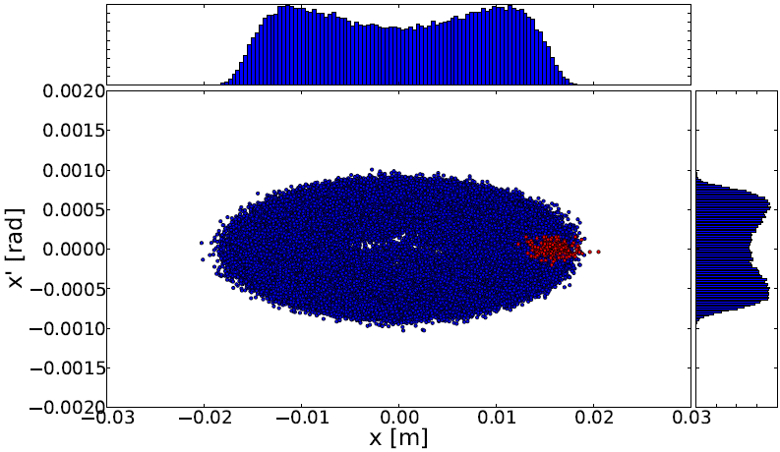
“Overinjection”
Multiturn injection of hadrons
Charge exchange injection
Septum → cannot inject on already occupied phase space area
NO Septum needed → overinject on already occupied phase space area

Slide 57
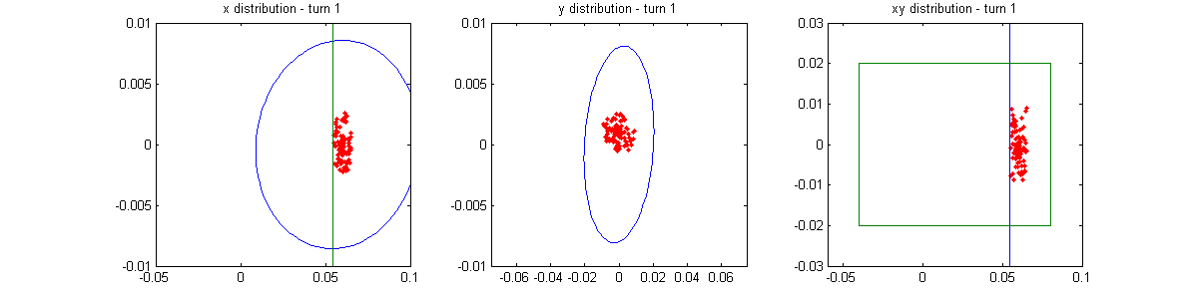
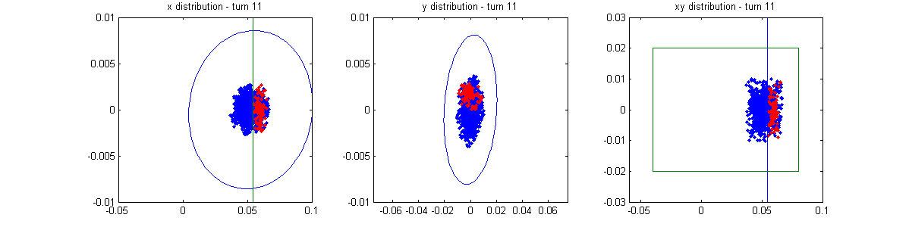
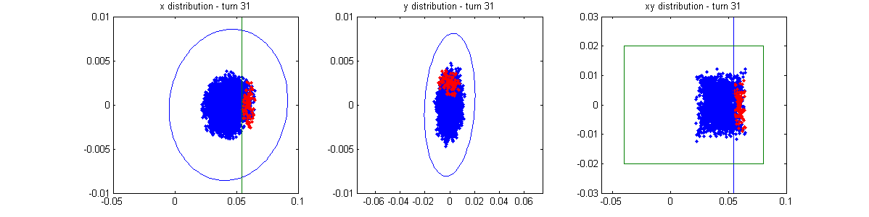
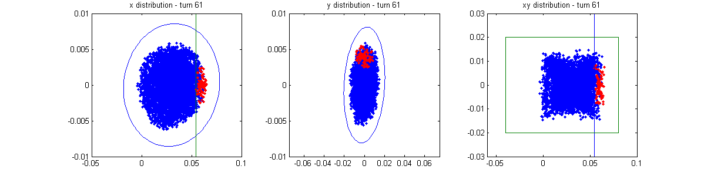
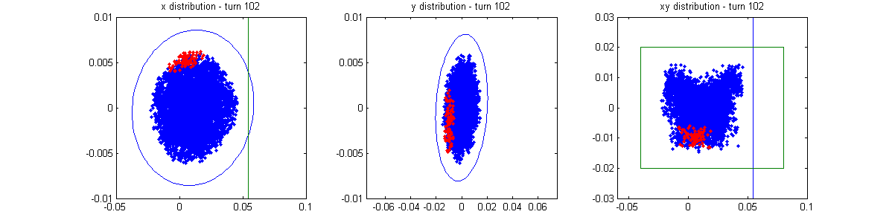
H- injection - painting
x’ vs x
y’ vs y
y vs x
Time
Note injection into same phase space area as circulating beam
~100 turns

Slide 58
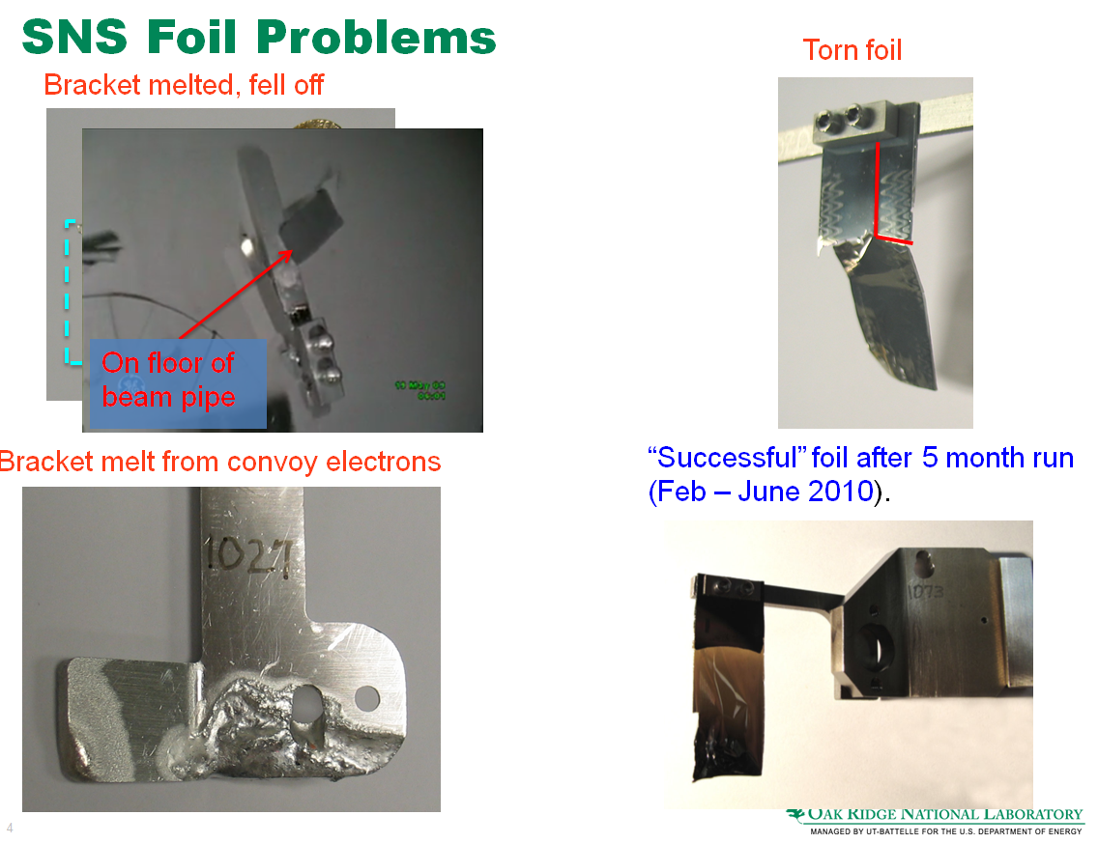
Problems with foils
Foil damage
Present machines on the high beam power frontier are approaching the limits of foils
Sarah Cousineau, Laser stripping WS, Fermilab, 26-27 Sept-2013

Slide 59
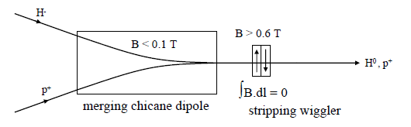
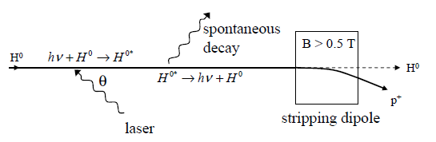
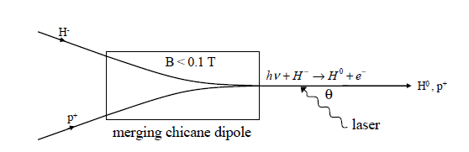
Problems with foils
Beam loss and radiation
  Beam loss due to foil scattering (foil is highest loss point in SNS accelerator complex)
Emittance growth due to foil scattering
  Relevant for multi-purpose machines
Laser stripping avoids a mechanical interaction with the beam
Neutralisation (H- → H0)
Stripping (H0 →p+)

Slide 60
H- injection with laser stripping
Wiggler or laser for neutralisation
Laser for excitation
Dedicated design of stripping chicane magnet
H- beam
H-
H₀
p+
Circulating p+
Injection chicane

Slide 61
Laser stripping concept: H⁻ to H⁰
Either Lorentz-stripping in a wiggler magnet…
or Photo-dissociation

Slide 62
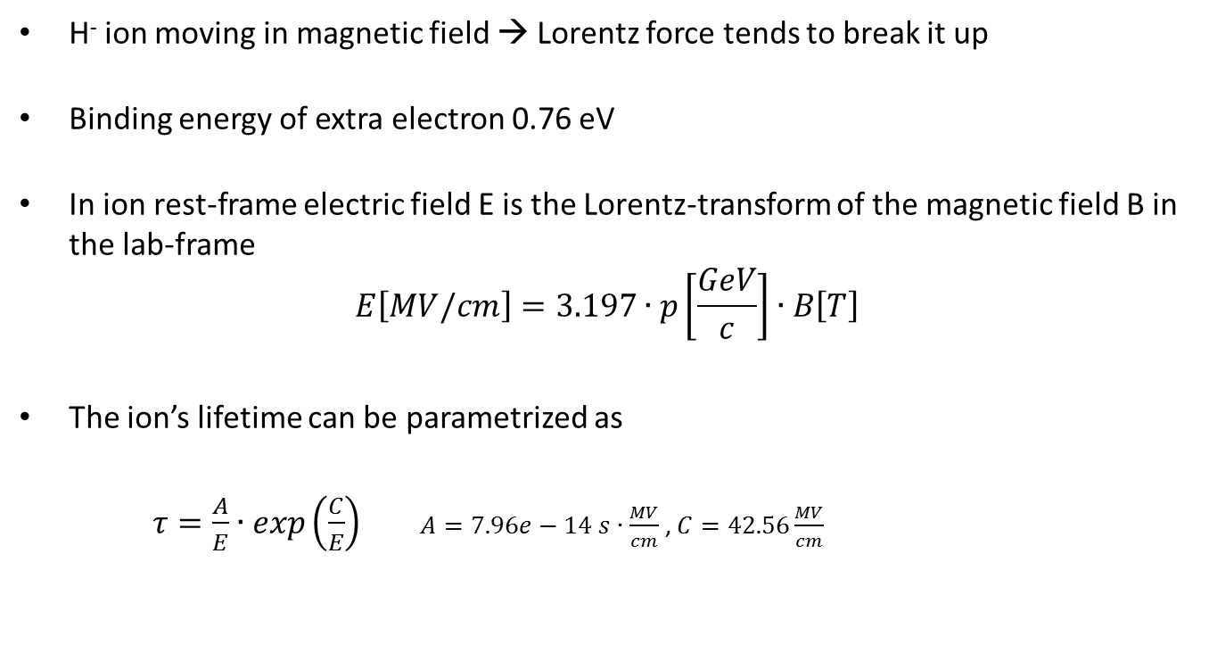
Lorentz stripping
H⁻ ion moving in magnetic field → Lorentz force tends to break it up
Binding energy of extra electron 0.76 eV
In ion rest-frame electric field E is the Lorentz-transform of the magnetic field B in the lab-frame
$$E\left[MV/cm\right]=3.197∙p\left[\frac{GeV}{c}\right]∙B\left[T\right]$$
The ion’s lifetime can be parametrized as
$τ=\frac{A}{E}∙exp\left(\frac{C}{E}\right)$ $A=7.96e−14 s∙\frac{MV}{cm}$ , $C=42.56\frac{MV}{cm}$

Slide 63
H⁰ --> p⁺ stripping divergent laser beam
Scheme developed and tested at SNS
(Danilov et al.):
Resonant excitation of ground-state H⁰ in field free region
Stripping of excited electron in magnetic field
Large spread of effective resonance frequencies →divergent beam
H⁻
Divergent laser light

Slide 64
Lepton injection
Single-turn injection can be used as for hadrons; however, lepton motion is strongly damped (different with respect to proton or ion injection).
  Synchrotron radiation
Can use transverse or longitudinal damping:
  Transverse - Betatron accumulation
  Longitudinal - Synchrotron accumulation

Slide 65
Betatron lepton injection
Septum magnet
Closed orbit bumpers or kickers
Beam is injected with an angle with respect to the closed orbit
Injected beam performs damped betatron oscillations about the closed orbit

Slide 66
Betatron lepton injection
Injected bunch performs damped betatron oscillations
In LEP at 20 GeV, the damping time was about 6’000 turns (0.6 seconds)

Slide 67
Synchrotron lepton injection
Inject an off-momentum beam
p = p₀ + Δp
Septum magnet
Injected beam
p = p₀
x_{s}
Bumped circulating beam
x_{s} = D_{x ·} Δp/p₀
Closed orbit bumpers or kickers
Beam injected parallel to circulating beam, onto dispersion orbit of a particle having the same momentum offset Δp/p
Injected beam makes damped synchrotron oscillations at Q_{s} but does not perform betatron oscillations

Slide 68
Synchrotron lepton injection
Double batch injection possible….
RF bucket
Injection 2 (turn N + Q_{s}/2)
Stored beam
Injection 1 (turn N)
E
Φ
Longitudinal damping time in LEP was ~ 3’000 turns (2 x faster than transverse)

Slide 69
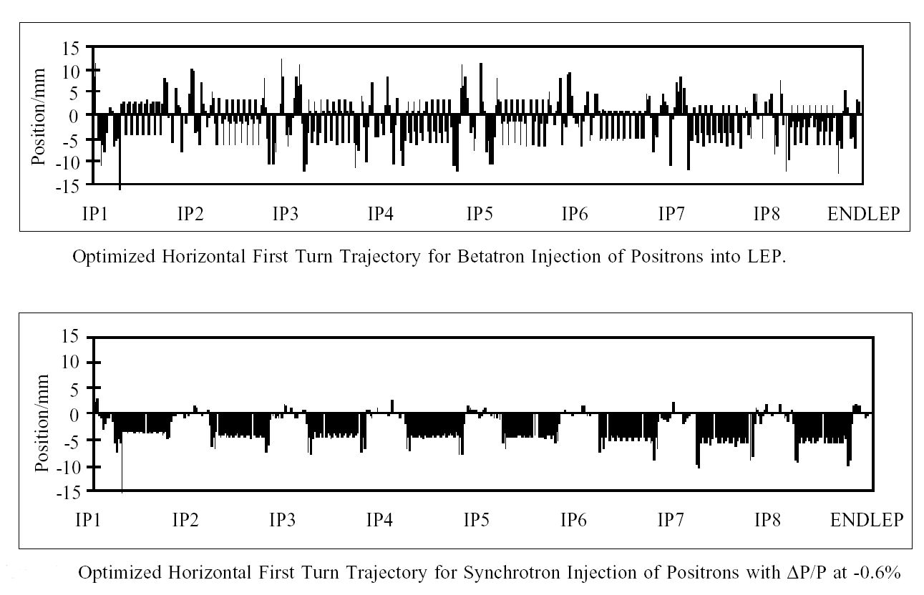
Synchrotron lepton injection in LEP
Synchrotron Injection in LEP gave improved background for LEP experiments due to
small orbit offsets in zero dispersion straight sections

Slide 70
Injection - summary
Several different techniques
  Single-turn injection for hadrons
    Boxcar stacking: transfer between machines in accelerator chain
    Angle / position errors ⇒ injection oscillations
    Optics errors ⇒ betatron mismatch oscillations
    Oscillations ⇒ filamentation ⇒ emittance increase
  Multi-turn injection for hadrons
    Phase space painting to increase intensity
    H- injection allows injection into same phase space area
  Lepton injection: take advantage of damping
    Less concerned about injection precision and matching

Slide 71
Extraction
Different extraction techniques exist, depending on requirements
  Fast extraction: ≤1 turn
  Non-resonant multi-turn extraction: few turns
  Resonant multi-turn extraction: many thousands of turns
  Resonant low-loss multi-turn extraction: few turns
Usually higher energy than injection ⇒ stronger elements (∫B.dl)
  At high energies many kicker and septum modules may be required
  To reduce kicker and septum strength, beam can be moved near to septum by closed orbit bump

Slide 72
Fast single turn extraction
    Whole beam kicked into septum gap and extracted.
Septum magnet
Kicker magnet
Closed orbit bumpers
Kicker deflects the entire beam into the septum in a single turn
Septum deflects the beam entire into the transfer line
Most efficient (lowest deflection angles required) for p/2 phase advance between kicker and septum

Slide 73
Fast single turn extraction
For transfer of beams between accelerators in an injector chain.
For secondary particle production (e.g. neutrinos)
Septum deflection may be in the other plane to the kicker deflection.
Losses from transverse scraping or from particles in extraction gap
Particles in SPS extraction kicker rise- and fall-time gaps

Slide 74
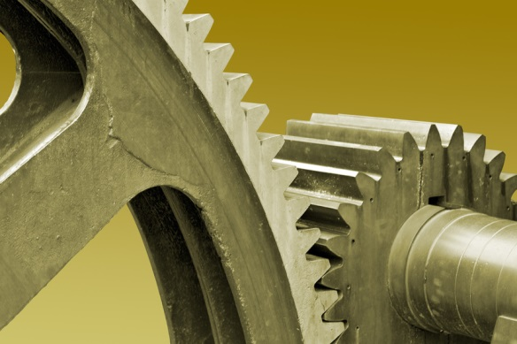
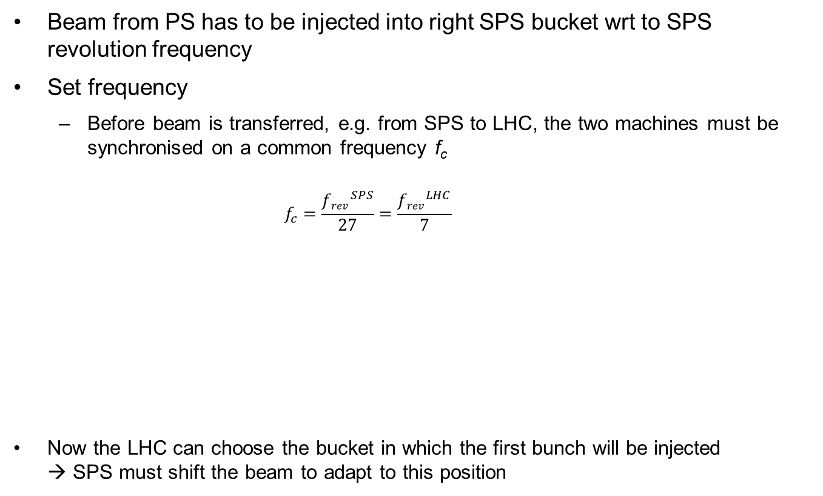

Synchronisation I
Beam from PS has to be injected into right SPS bucket wrt to SPS revolution frequency
Set frequency
  Before beam is transferred, e.g. from SPS to LHC, the two machines must be synchronised on a common frequency f_{c}
    $$f_{c}=\frac{{frev}_{}^{SPS}}{27}=\frac{{frev}_{}^{LHC}}{7}$$
  Now the LHC can choose the bucket in which the first bunch will be injected
  → SPS must shift the beam to adapt to this position
$${frev}_{}^{SPS, LHC}$$
f_{c}

Slide 75
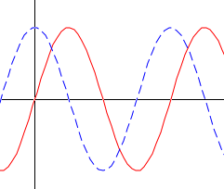
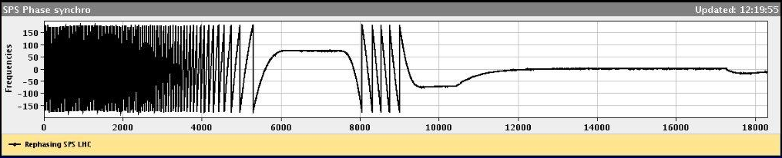


Synchronisation II
“Coarse” rephasing
  Shift the beam in the SPS to reach wanted LHC bucket
  To do so the particles will run for a short period on an average radius which is different from the central orbit (“radial steering”)
  Matching of common frequency f_{c} with SPS revolution frequency (TDC)
“Fine” rephasing – phase matching
  Correct the position within the bucket
  Matching of ${fRF}_{}^{LHC}$ and ${fRF}_{}^{SPS}$ (phase lock loop)
ΔΦ(${2·fRF}_{}^{SPS}$, ${fRF}_{}^{LHC}$) vs turn
Constant frequency offset
Fine rephasing
Set frequency
Coarse rephasing
Extraction

Slide 76
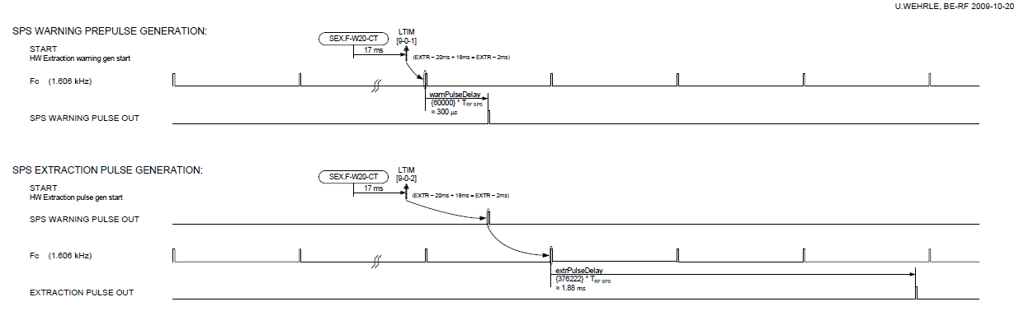
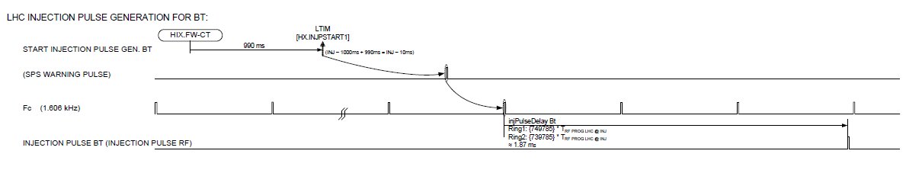
Synchronisation III
Triggering the SPS extraction and LHC injection kickers
  Timing event: has only 1ms resolution; serves as prepulse;
  With f_{c} calculate exact timing of kicker pulse for SPS and LHC
Arm counter
Generate warning pulse which goes to SPS and LHC
Calculate RF periods for SPS extraction and LHC injection kicker pulse

Slide 77
Multi-turn extraction
Some filling schemes require a beam to be injected in several turns to a larger machine…
And very commonly Fixed Target physics experiments and medical accelerators often need a quasi-continuous flux of particles…
Multi-turn extraction…
  Non-Resonant multi-turn ejection (few turns) for filling e.g. PS to SPS at CERN for high intensity proton beams (>2.5 10¹³ protons)
  Resonant extraction (ms to hours) for experiments

Slide 78
Non-resonant multi-turn extraction
    Beam bumped to septum; part of beam ‘shaved’ off each turn.
Extracted beam
Septum
Bumped circulating beam
Fast closed orbit bumpers
Fast bumper deflects the whole beam onto the septum
Beam extracted in a few turns, with the machine tune rotating the beam
Intrinsically a high-loss process – thin septum essential

Slide 79
Non-resonant multi-turn extraction
Example system: CERN PS to SPS Fixed-Target ‘continuous transfer’.
  Accelerate beam in PS to 14 GeV/c
  Empty PS machine (2.1 μs long) in 5 turns into SPS
  Do it again
  Fill SPS machine (23 μs long)
  Quasi-continuous beam in SPS (2 x 1 μs gaps)
  Total intensity per PS extraction ≈ 3 × 10¹³ p+
  Total intensity in SPS ≈ 5 × 10¹³ p+

Slide 80
Non-resonant multi-turn extraction
CERN PS to SPS: 5-turn continuous transfer
Q_{h} = 0.25
septum
2
5
1
3
4
Bump vs. turn
1 2 3 4 5

Slide 81
Non-resonant multi-turn extraction
CERN PS to SPS: 5-turn continuous transfer – 5th turn
Q_{h} = 0.25
5
Bump vs. turn
1 2 3 4 5

Slide 82
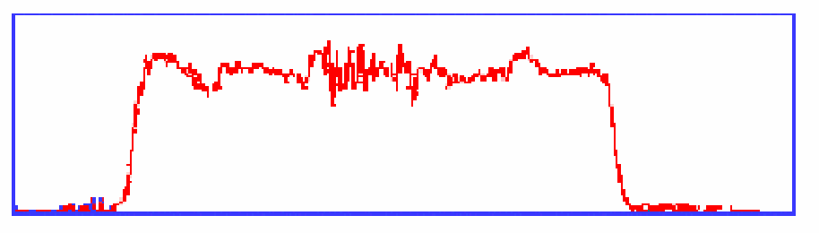
Non-resonant multi-turn extraction
CERN PS to SPS: 5-turn continuous transfer
  Losses impose thin (ES) septum… second septum needed
  Still about 15 % of beam lost in PS-SPS CT
  Difficult to get equal intensities per turn
  Different trajectories for each turn
  Different emittances for each turn
I
1
2
3
4
5
1
2
3
4
5

Slide 83
Resonant multi-turn extraction
    Non-linear fields excite resonances which
    drive the beam slowly across the septum
Extracted beam
Septum
Bumped circulating beam -
particles moved across
Septum by resonance
Closed orbit bumpers
Slow bumpers move the beam near the septum
Tune adjusted close to n^{th} order betatron resonance
Multipole magnets excited to define stable area in phase space, size depends on ΔQ = Q - Q_{r}

Slide 84
Resonant multi-turn extraction
3rd order resonances
  Sextupole fields distort the circular normalised phase space particle trajectories.
  Stable area defined, delimited by unstable Fixed Points.
  Sextupoles families arranged to produce suitable phase space orientation of the stable triangle at thin electrostatic septum
  Stable area can be reduced by increasing the sextupole strength, or (easier) by approaching machine tune Q_{h} to resonant 1/3 integer tune
  Reducing ΔQ with main machine quadrupoles can be augmented with a ‘servo’ quadrupole, which can modulate ΔQ in a servo loop, acting on a measurement of the spill intensity
R_{fp}

Slide 85
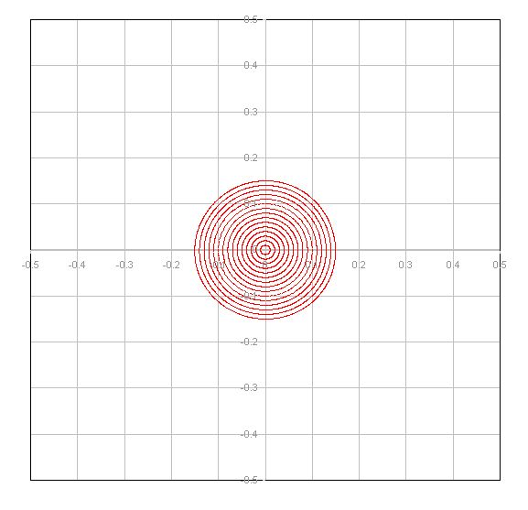
Third-order resonant extraction
Septum wire
Particles distributed on emittance contours
ΔQ large – no phase space distortion

Slide 86
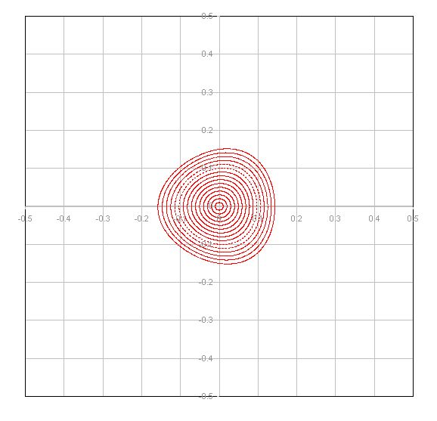
Third-order resonant extraction
Septum wire
Dedicated sextupole magnets produce a triangular stable area in phase space
ΔQ decreasing – phase space distortion for largest amplitudes

Slide 87
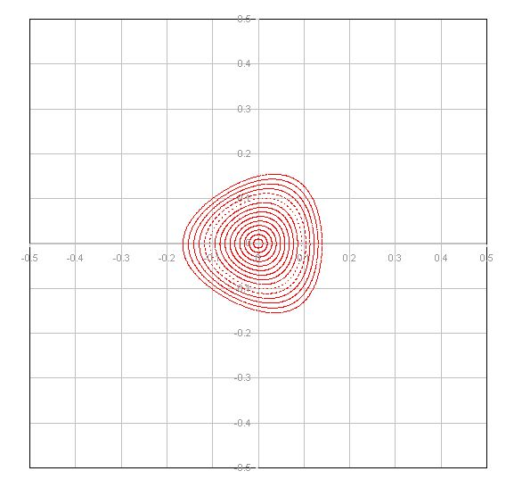
Third-order resonant extraction
Septum wire

Slide 88
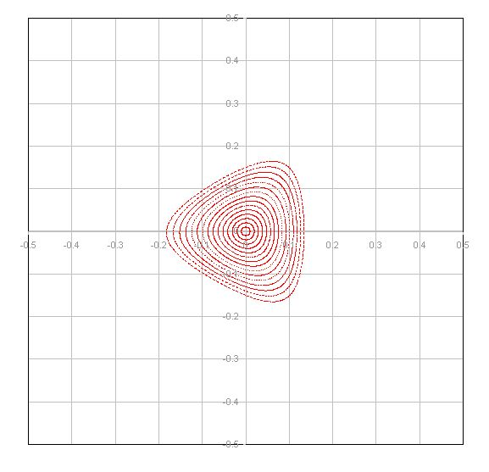
Third-order resonant extraction
Septum wire

Slide 89
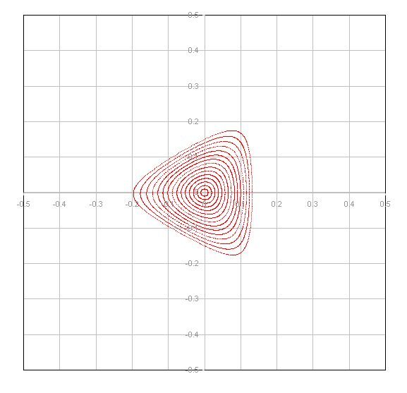
Third-order resonant extraction
Septum wire

Slide 90
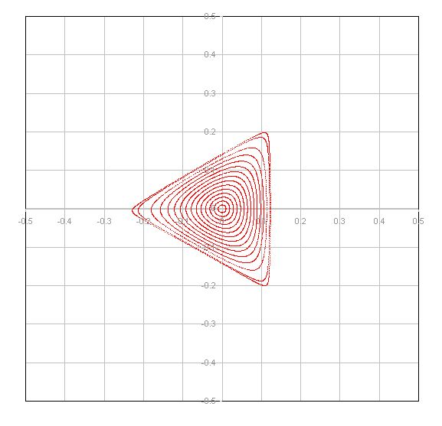
Third-order resonant extraction
Septum wire
DQ small enough that largest amplitude particles are close to the separatrices
Fixed points locations discernable at extremities of phase space triangle

Slide 91
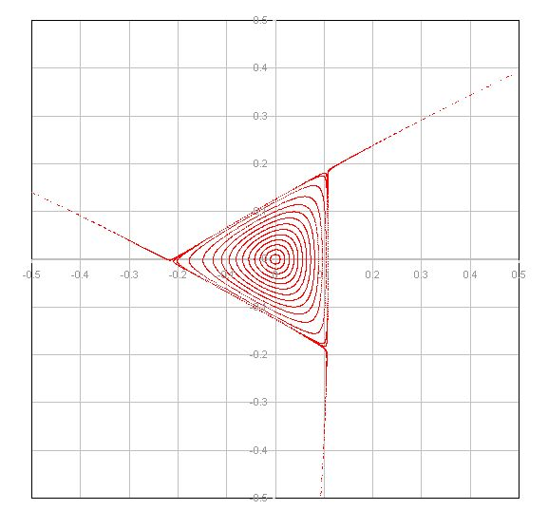
Third-order resonant extraction
Septum wire
ΔQ now small enough that largest amplitude particles are unstable
Unstable particles follow separatrix branches as they increase in amplitude

Slide 92
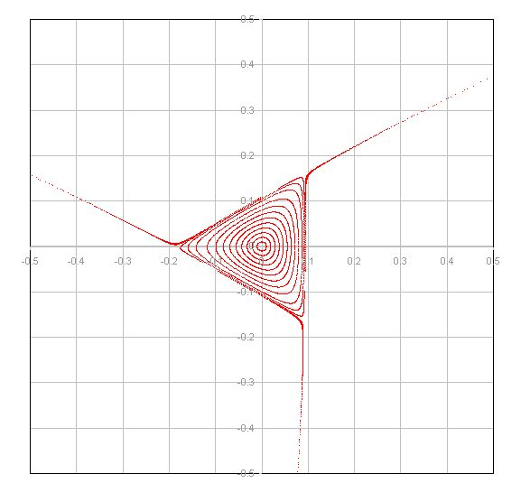
Third-order resonant extraction
Septum wire
Stable phase area shrinks as ΔQ gets smaller

Slide 93
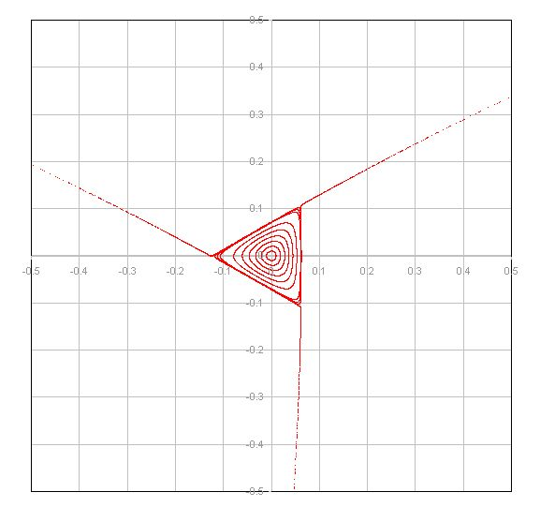
Third-order resonant extraction
Septum wire
Separatrix position in phase space shifts as the stable area shrinks

Slide 94
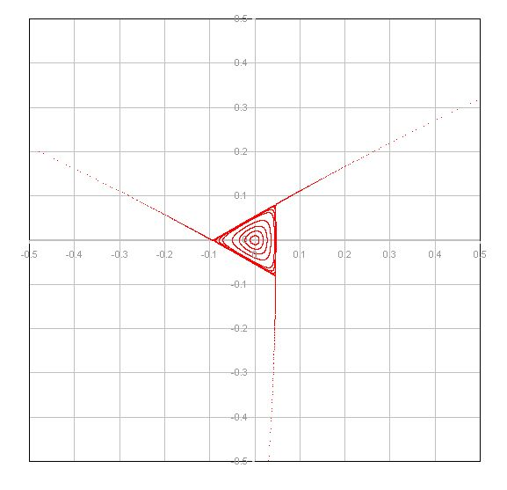
Third-order resonant extraction
Septum wire
As the stable area shrinks, the beam intensity drops since particles are being continuously extracted

Slide 95
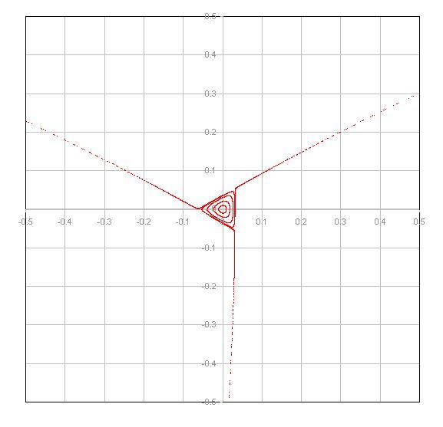
Third-order resonant extraction
Septum wire

Slide 96
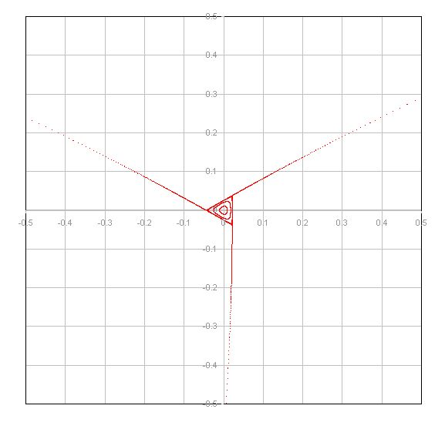
Third-order resonant extraction
Septum wire

Slide 97

Third-order resonant extraction
Septum wire

Slide 98

Third-order resonant extraction
Septum wire
As ΔQ approaches zero, the particles with very small amplitude are extracted

Slide 99
Third-order resonant extraction
Example – SPS slow extraction at 450 GeV/c.
~3 x 10¹³ p+ extracted in a 2-4 second long spill (~200,000 turns)
Intensity vs time:
~10⁸ p+ extracted per turn

Slide 100
Second-order resonant extraction
An extraction can also be made over a few hundred turns
2nd and 4th order resonances
  Octupole fields distort the regular phase space particle trajectories
  Stable area defined, delimited by two unstable Fixed Points
  Beam tune brought across a 2nd order resonance (Q→0.5)
  Particle amplitudes quickly grow and beam is extracted in a few hundred turns

Slide 101

Resonant extraction separatrices
3rd order resonant extraction
2nd order resonant extraction
Amplitude growth for 2nd order resonance much faster than 3rd – shorter spill
Used where intense pulses are required on target – e.g. neutrino production

Slide 102
Resonant low-loss multi-turn extraction
Adiabatic capture of beam in stable “islands”
  Use non-linear fields (sextupoles and octupoles) to create islands of stability in phase space
  A slow (adiabatic) tune variation to cross a resonance and to drive particles into the islands (capture)
  Variation of field strengths to separate the islands in phase space
Several big advantages
  Losses reduced virtually to zero (no particles at the septum)
  Phase space matching improved with respect to existing non-resonant multi-turn extraction - all ‘beamlets’ have same emittance and optical parameters

Slide 103

Resonant low-loss multi-turn extraction
Unperturbed beam
Increasing non-linear fields
Beam captured in stable islands
Islands separated and beam bumped across septum – extracted in 5 turns
Q_{h} = 0.25
Bump vs. turn
1 2 3 4 5
Courtesy M. Giovannozzi
Septum wire

Slide 104
Extraction - summary
Several different techniques:
  Single-turn fast extraction:
    for Boxcar stacking (transfer between machines in accelerator chain), beam abort
  Non-resonant multi-turn extraction
    slice beam into equal parts for transfer between machine over a few turns.
  Resonant multi-turn extraction
    create stable area in phase space ⇒ slowly drive particles into resonance ⇒ long spill over many thousand turns.
  Resonant low-loss multi-turn extraction
    create stable islands in phase space: slice off over a few turns.
Thank you for your attention

