Slide 1

RF Systems II
Erk Jensen, CERN BE-RF
Introduction to Accelerator Physics, Prague, Czech Republic, 31 Aug – 12 Sept 2014

Slide 2
Accelerating gap

Slide 3
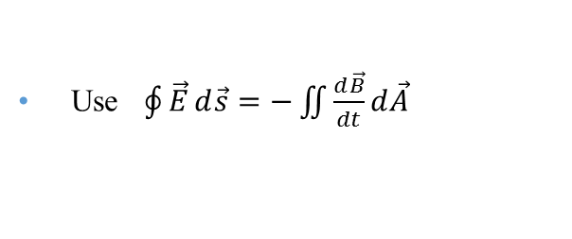
Accelerating Gap
We want a voltage across the gap!
It cannot be DC, since we want the beam tube on ground potential.
Use $\oint{\vec{E}}d\vec{s}=−\iint{\frac{d\vec{B}}{dt}}d\vec{A}$
The “shield” imposes a
  upper limit of the voltage pulse duration or – equivalently –
  a lower limit to the usable frequency.
The limit can be extended with a material which acts as “open circuit”!
Materials typically used:
  ferrites (depending on f-range)
  magnetic alloys (MA) like Metglas®, Finemet®, Vitrovac®…
resonantly driven with RF (ferrite loaded cavities) – or with pulses (induction cell).
gap voltage

Slide 4
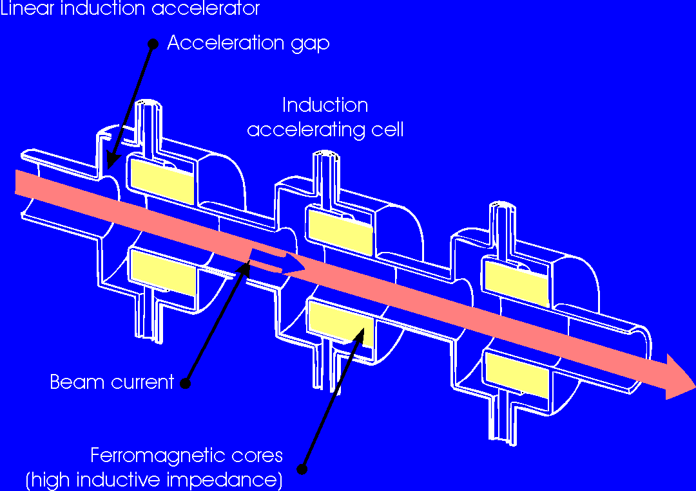
Linear induction accelerator
compare: transformer, secondary = beam
Acc. voltage during B ramp.

Slide 5
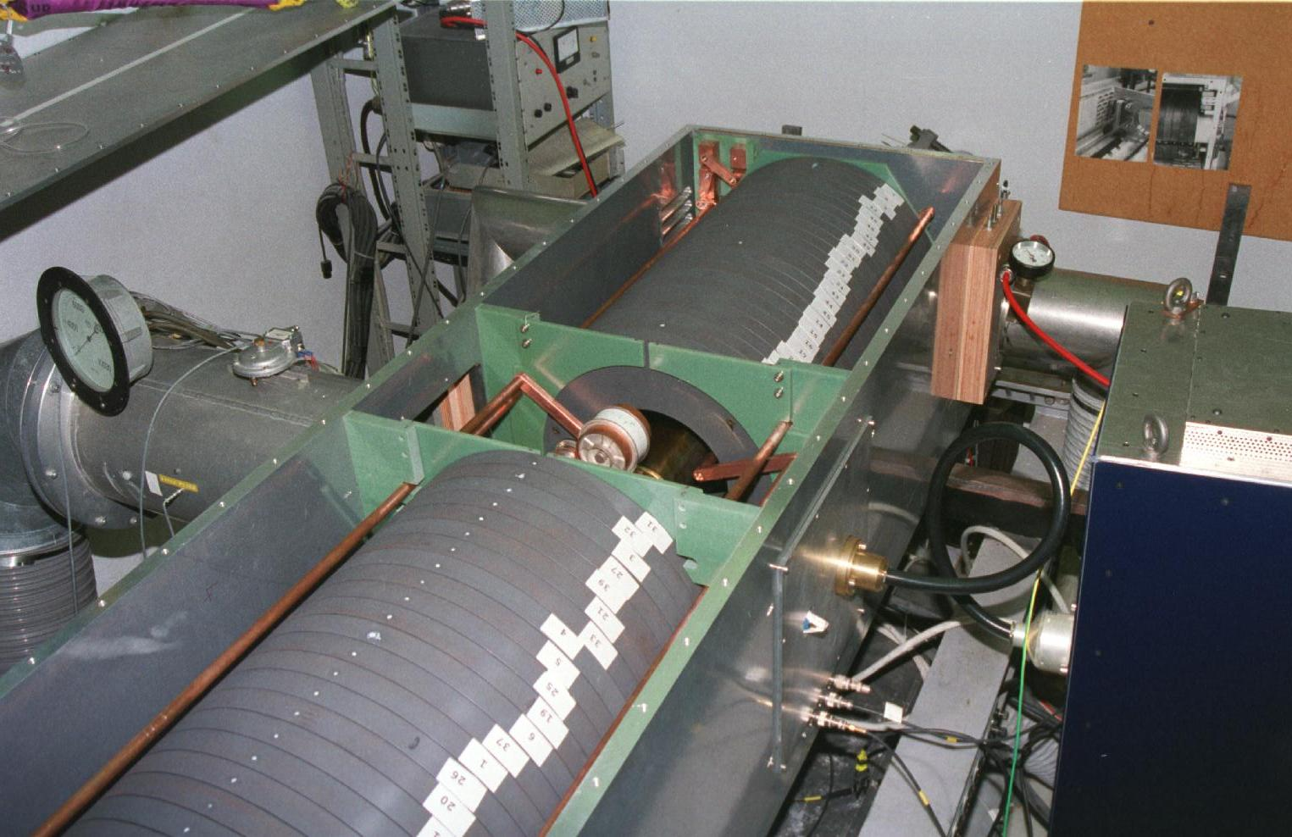
Ferrite cavity
PS Booster, ‘98
0.6 – 1.8 MHz,
< 10 kV gap
NiZn ferrites

Slide 6
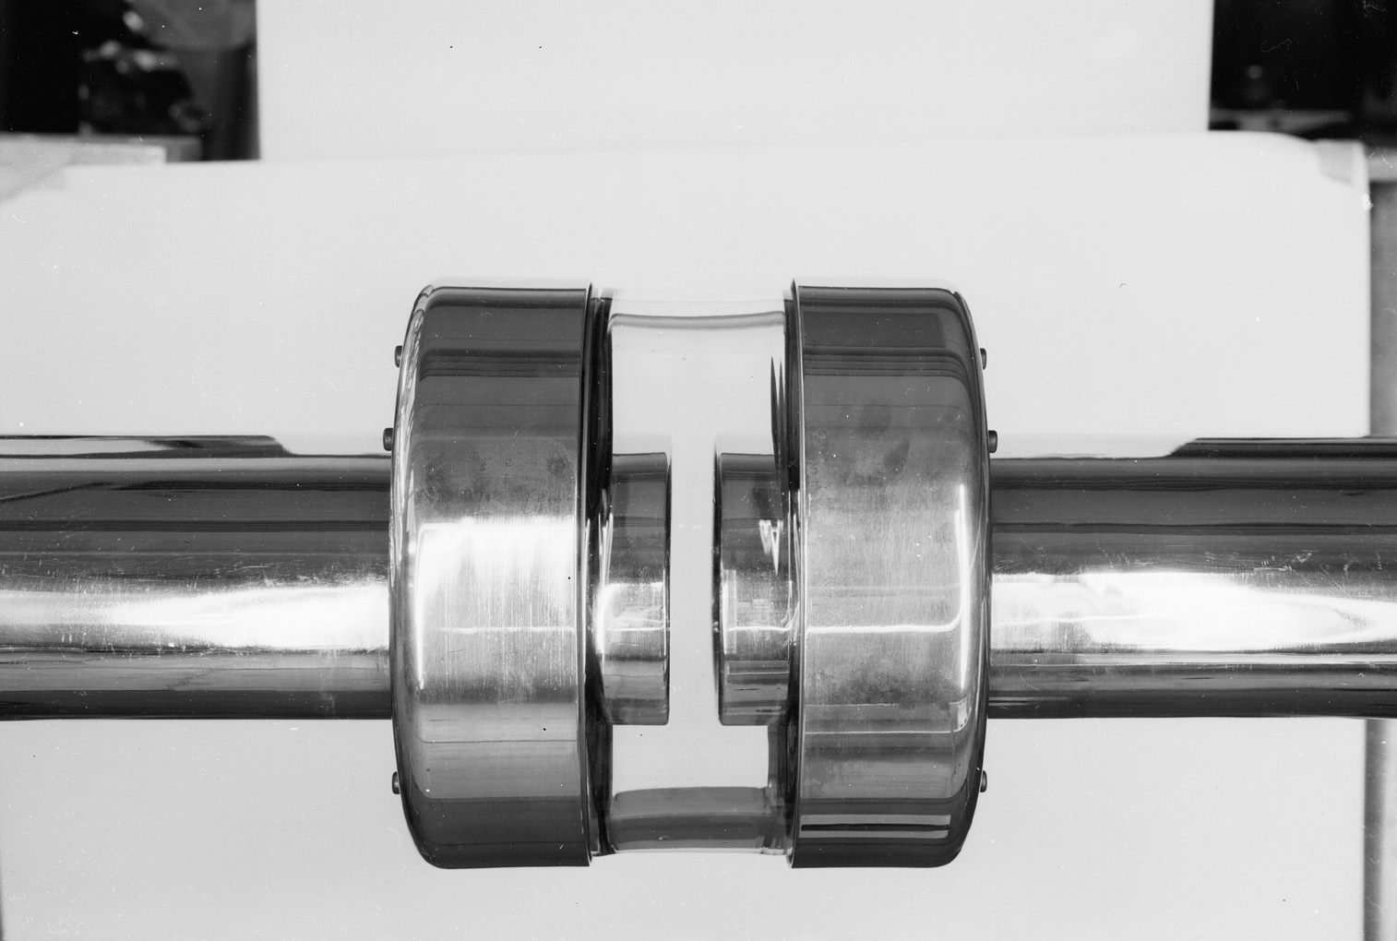
Gap of PS cavity (prototype)

Slide 7
Characterizing a cavity

Slide 8
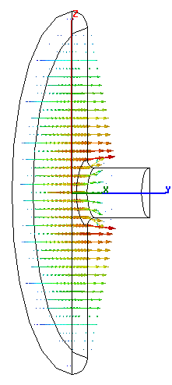
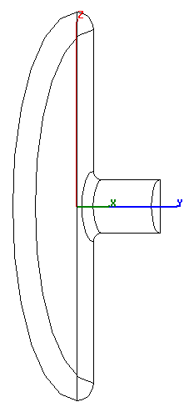
Reminder: The pillbox cavity
TM₀₁₀-mode
(only 1/4 shown)
electric field
magnetic field

Slide 9

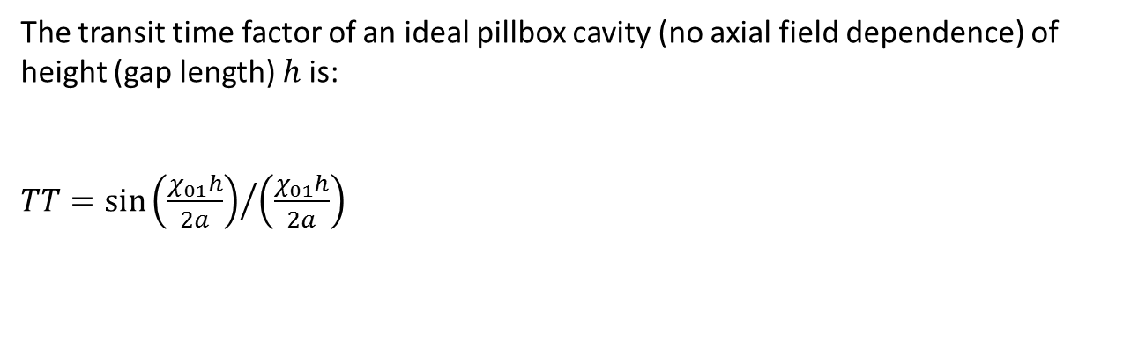
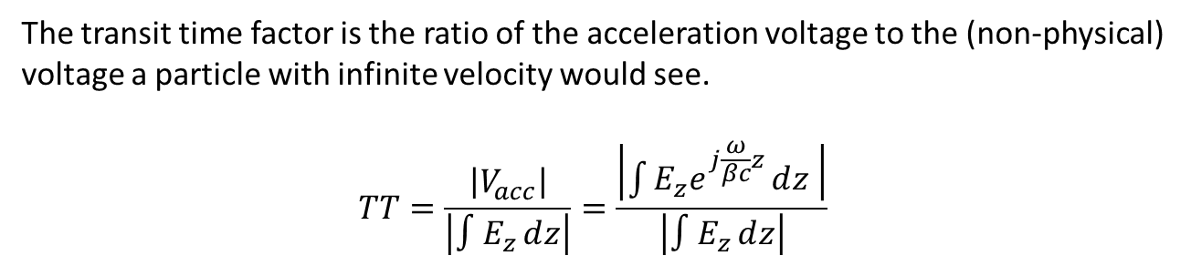

Transit time factor
The transit time factor is the ratio of the acceleration voltage to the (non-physical) voltage a particle with infinite velocity would see.
$$TT=\frac{\left|V_{acc}\right|}{\left|∫E_{z}ⅆz\right|}=\frac{\left|\int{\left.E_{z}ⅇ^{ⅉ\frac{ω}{βc}z}ⅆz\right. }\right|}{\left|∫E_{z}ⅆz\right|}$$
The transit time factor of an ideal pillbox cavity (no axial field dependence) of height (gap length) $h$ is:
$TT=\sin{{\left(\frac{χ_{01}h}{2a}\right)}/{\left(\frac{χ_{01}h}{2a}\right)}}$
Field rotates by 360° during particle passage.
$$TT$$
$$\frac{h}{λ}$$

Slide 10

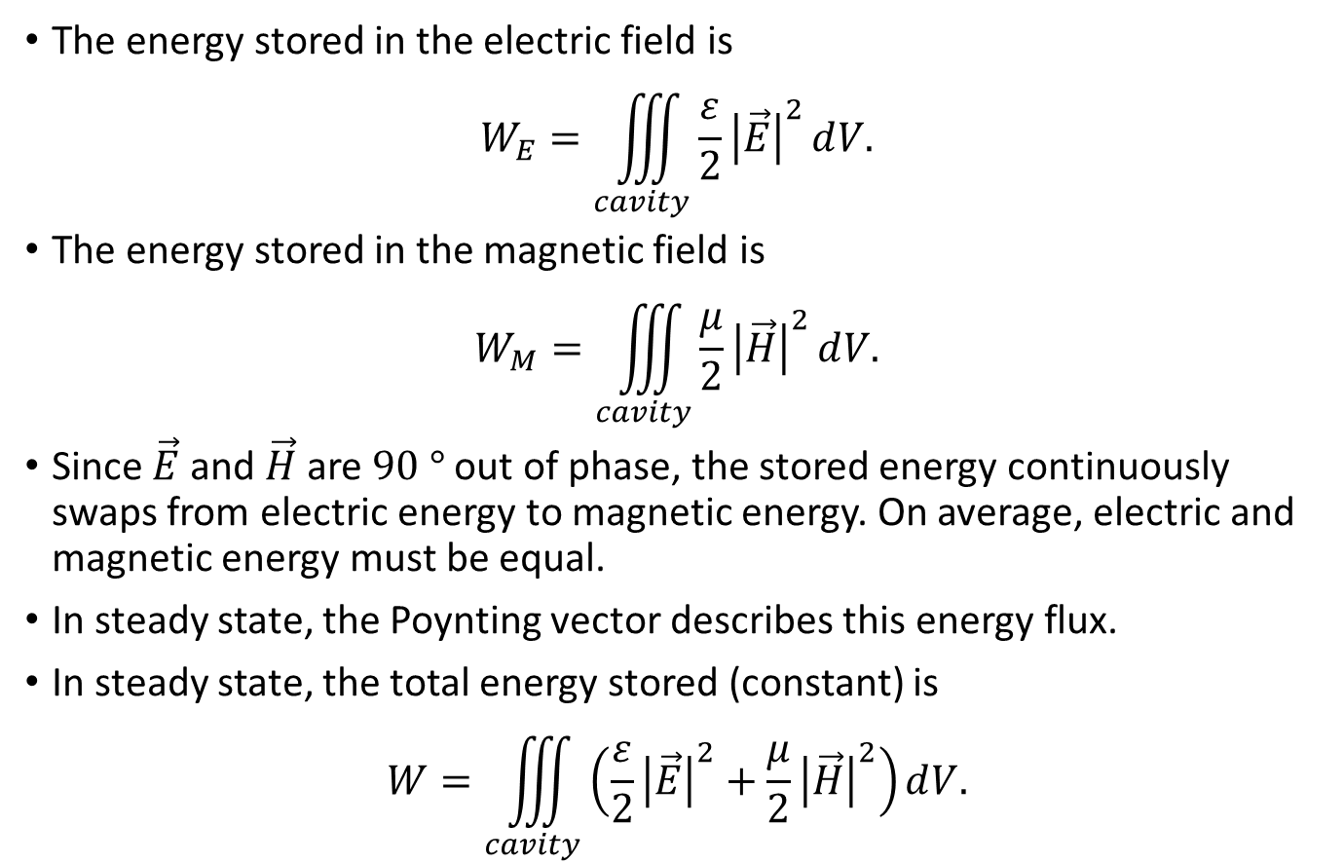



Stored energy
The energy stored in the electric field is
$$W_{E}=\iiint_{cavity}{\frac{ε}{2}{\left|\vec{E}\right|}^{2}ⅆV.}$$
The energy stored in the magnetic field is
$$W_{M}=\iiint_{cavity}{\frac{μ}{2}{\left|\vec{H}\right|}^{2}ⅆV.}$$
Since $\vec{E}$ and $\vec{H}$ are $90 °$ out of phase, the stored energy continuously swaps from electric energy to magnetic energy. On average, electric and magnetic energy must be equal.
In steady state, the Poynting vector describes this energy flux.
In steady state, the total energy stored (constant) is
$$W=\iiint_{cavity}{\left(\frac{ε}{2}{\left|\vec{E}\right|}^{2}+\frac{μ}{2}{\left|\vec{H}\right|}^{2}\right)ⅆV.}$$
$$W_{E}$$
$$\vec{E}$$
$$W_{M}$$
$$\vec{H}$$

Slide 11
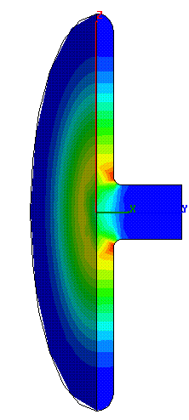

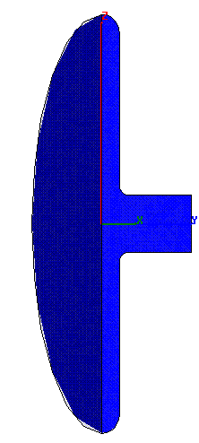
Stored energy and Poynting vector
electric field energy
Poynting vector
magnetic field energy

Slide 12
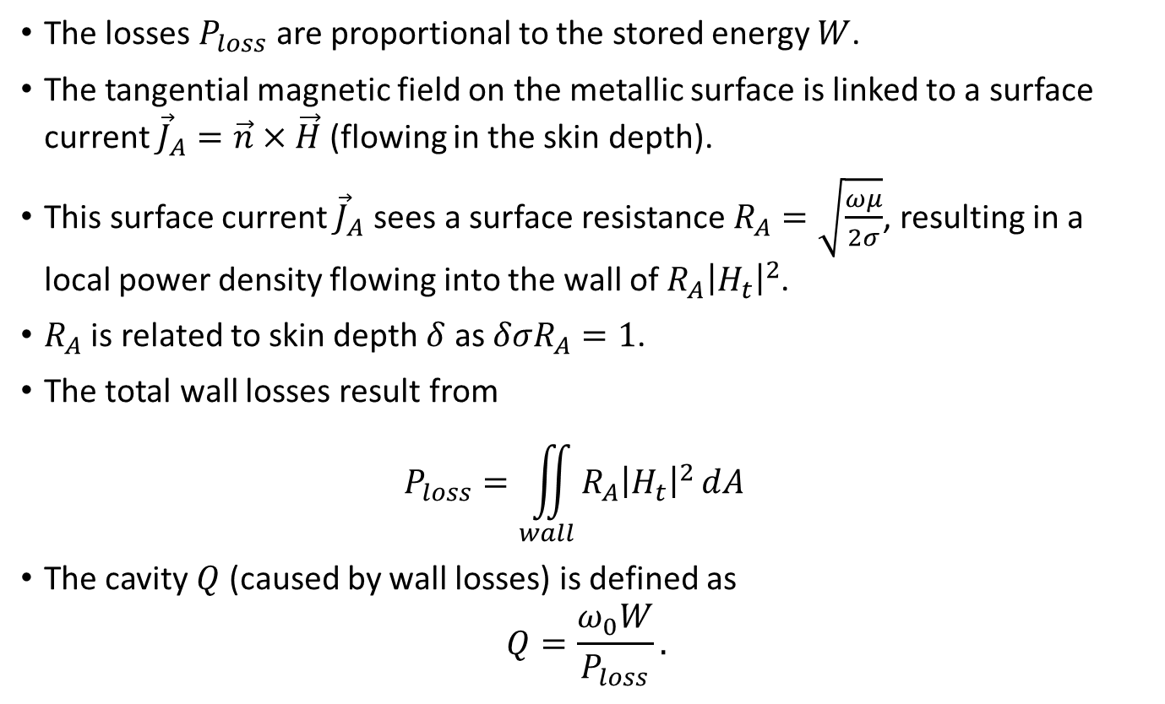
Wall losses (valid for good conductor)
The losses $P_{loss}$ are proportional to the stored energy $W$.
The tangential magnetic field on the metallic surface is linked to a surface current ${\vec{J}}_{A}=\vec{n}×\vec{H}$ (flowing in the skin depth).
This surface current ${\vec{J}}_{A}$ sees a surface resistance $R_{A}=\sqrt{\frac{ωμ}{2σ}}$, resulting in a local power density flowing into the wall of $R_{A}{\left|H_{t}\right|}^{2}$.
$R_{A}$ is related to skin depth $δ$ as $δσR_{A}=1$.
The total wall losses result from
$P_{loss}=\iint_{wall}{R_{A}{\left|H_{t}\right|}^{2}ⅆA}$
The cavity $Q$ (caused by wall losses) is defined as
$Q=\frac{ω_{0}W}{P_{loss}}.$

Slide 13






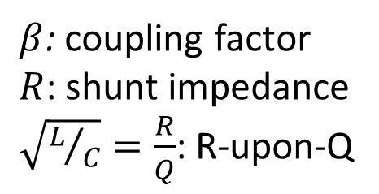

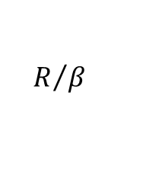
Cavity resonator – equivalent circuit
Simplification: single mode
$$I_{G}$$
$$V_{gap}$$
$$I_{B}$$
$$P$$
Generator
Z
Beam
$$R/β$$
$$C$$
$$L$$
$$R$$
$β$: coupling factor
$R$: shunt impedance
$\sqrt{L/C}=\frac{R}{Q}$: R-upon-Q
Cavity
We have used this before when explaining the “fast feedback”

Slide 14
Resonance

Slide 15
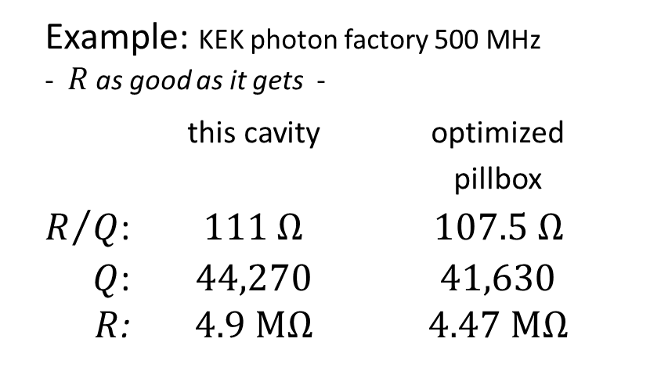
Reentrant cavity
Nose cones increase the transit time factor, round outer shape minimizes losses.
Example: KEK photon factory 500 MHz - $R$ as good as it gets -
this cavity optimized
pillbox
$R/Q$: $111 Ω$ $107.5 Ω$
$Q$: $44,270$ $41,630$
$R$: $4.9 \text{MΩ}$ $4.47 \text{MΩ}$
nose cone

Slide 16
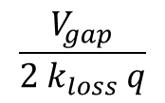
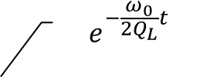
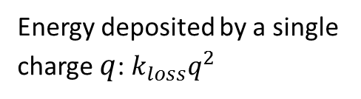
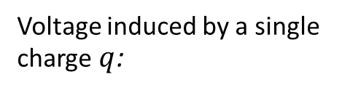

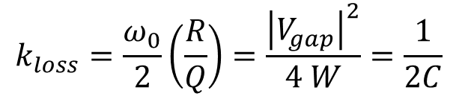
Loss factor
Impedance seen by the beam
I_{B}
V (induced)
$$k_{loss}=\frac{ω_{0}}{2}\left(\frac{R}{Q}\right)=\frac{{\left|V_{gap}\right|}^{2}}{4 W}=\frac{1}{2C}$$
Beam
Energy deposited by a single charge $q$: $k_{loss}q^{2}$
R/β
C
L
R
L=R/(Qω₀)
C=Q/(Rω₀)
Cavity
Voltage induced by a single charge $q$:
$$ⅇ^{−\frac{ω_{0}}{2Q_{L}}t}$$
$$\frac{V_{gap}}{2 k_{loss} q}$$
$$f_{0}t$$

Slide 17
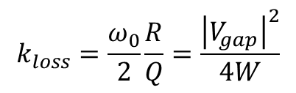



Summary: relations V_{gap}, W, P_{loss}
$$V_{gap}$$
gap voltage
𝑉_𝑔𝑎𝑝
gap voltage
$$P_{loss}$$
wall losses
𝑃_𝑙𝑜𝑠𝑠
wall losses
$$W$$
Energy stored
𝑊
Energy stored
$$\frac{R}{Q}=\frac{{\left|V_{gap}\right|}^{2}}{2ω_{0}W}$$
$$R=\frac{{\left|V_{gap}\right|}^{2}}{2P_{loss}}$$
$$k_{loss}=\frac{ω_{0}}{2}\frac{R}{Q}=\frac{{\left|V_{gap}\right|}^{2}}{4W}$$
$$Q=\frac{ω_{0}W}{P_{loss}}$$

Slide 18
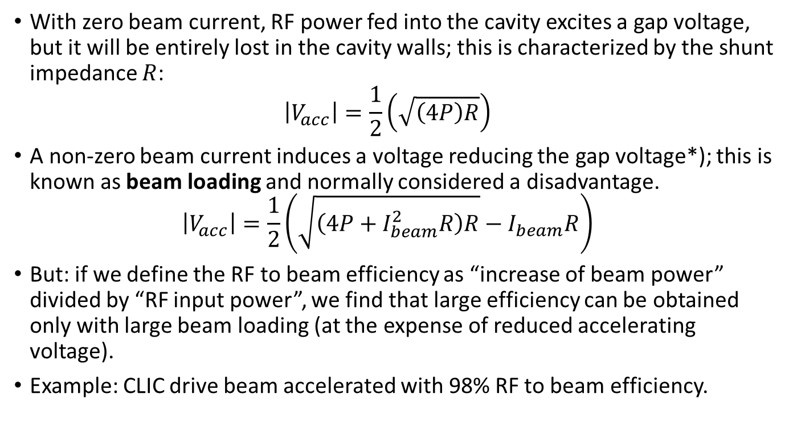
Let’s talk about RF → beam efficiency!
With zero beam current, RF power fed into the cavity excites a gap voltage, but it will be entirely lost in the cavity walls; this is characterized by the shunt impedance $R$:
$\left|V_{acc}\right|=\frac{1}{2}\left(\sqrt{\left(4P\right)R}\right)$
A non-zero beam current induces a voltage reducing the gap voltage*); this is known as beam loading and normally considered a disadvantage.
$\left|V_{acc}\right|=\frac{1}{2}\left(\sqrt{\left(4P+I_{beam}^{2}R\right)R}−I_{beam}R\right)$
But: if we define the RF to beam efficiency as “increase of beam power” divided by “RF input power”, we find that large efficiency can be obtained only with large beam loading (at the expense of reduced accelerating voltage).
Example: CLIC drive beam accelerated with 98% RF to beam efficiency.
*) for an accelerated beam! For a decelerated beam the voltage is increased

Slide 19
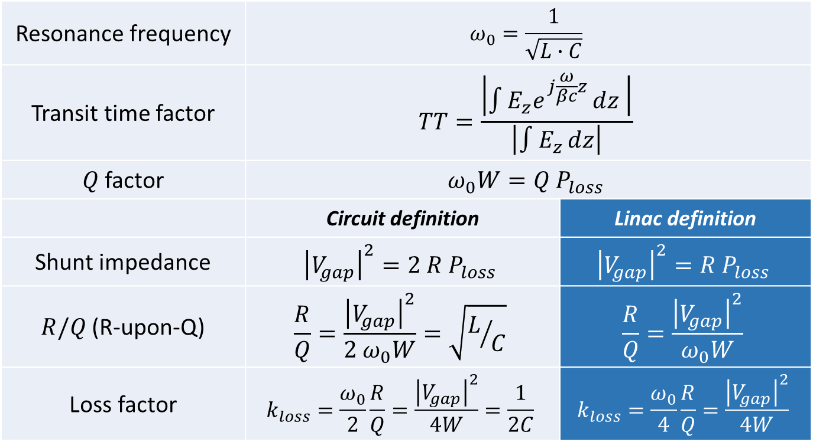
Cavity parameters
Resonance frequency | $$ω_{0}=\frac{1}{\sqrt{L∙C}}$$
Transit time factor | $$TT=\frac{\left|\int{\left.E_{z}ⅇ^{ⅉ\frac{ω}{βc}z}ⅆz\right. }\right|}{\left|∫E_{z}ⅆz\right|}$$
$Q$ factor | $$ω_{0}W=Q P_{loss}$$
 | Circuit definition | Linac definition
Shunt impedance | $${\left|V_{gap}\right|}^{2}=2 R{ P}_{loss}$$ | $${\left|V_{gap}\right|}^{2}=R{ P}_{loss}$$
$R/Q$ (R-upon-Q) | $$\frac{R}{Q}=\frac{{\left|V_{gap}\right|}^{2}}{2 ω_{0}W}=\sqrt{L/C}$$ | $$\frac{R}{Q}=\frac{{\left|V_{gap}\right|}^{2}}{ω_{0}W}$$
Loss factor | $$k_{loss}=\frac{ω_{0}}{2}\frac{R}{Q}=\frac{{\left|V_{gap}\right|}^{2}}{4W}=\frac{1}{2C}$$ | $$k_{loss}=\frac{ω_{0}}{4}\frac{R}{Q}=\frac{{\left|V_{gap}\right|}^{2}}{4W}$$

Slide 20
Higher order modes (HOM’s)
external dampers
R₁, Q₁,ω₁
R₂, Q₂,ω₂
R₃, Q₃,ω₃
...
...
n₁
n₂
n₃
I_{B}

Slide 21
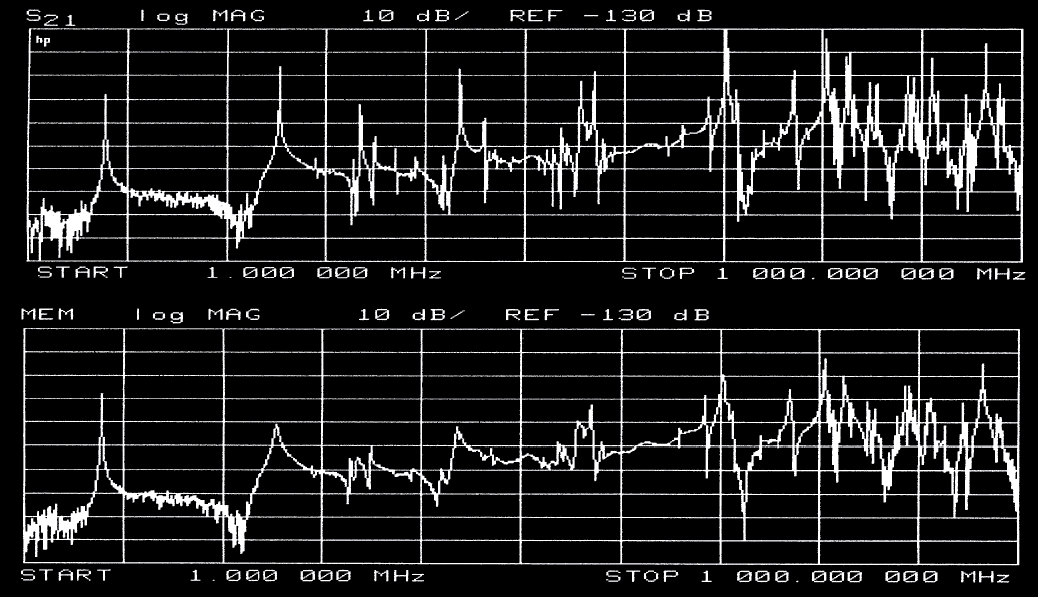
HOM (measured spectrum)
without dampers
with dampers

Slide 22
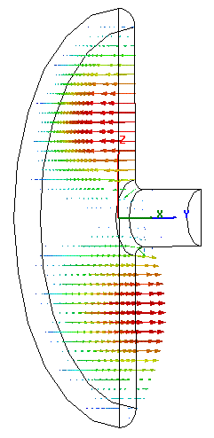
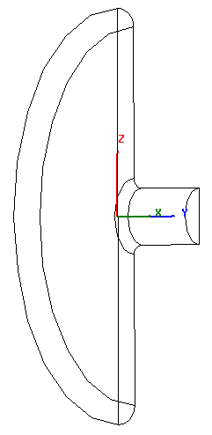
Dipole mode in a pillbox
TM₁₁₀-mode
(only 1/4 shown)
electric field
magnetic field

Slide 23
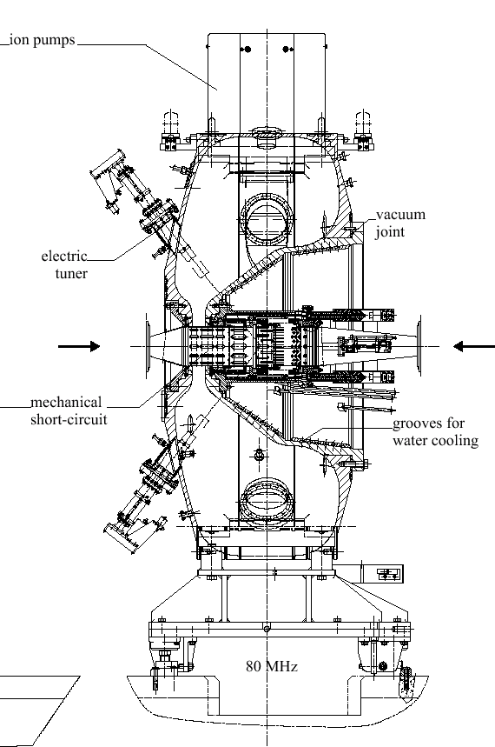
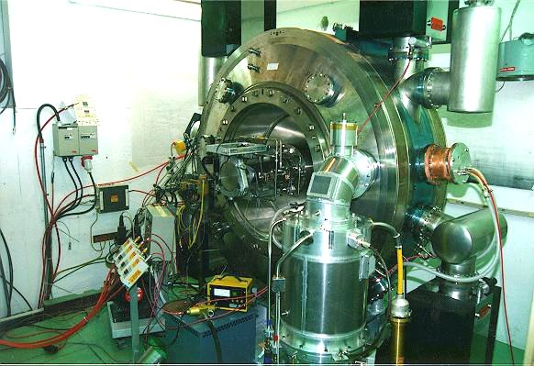
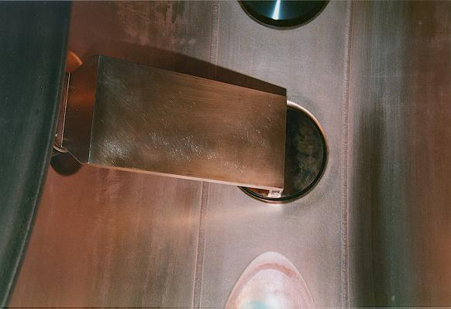
CERN/PS 80 MHz cavity (for LHC)
inductive (loop) coupling,
low self-inductance

Slide 24
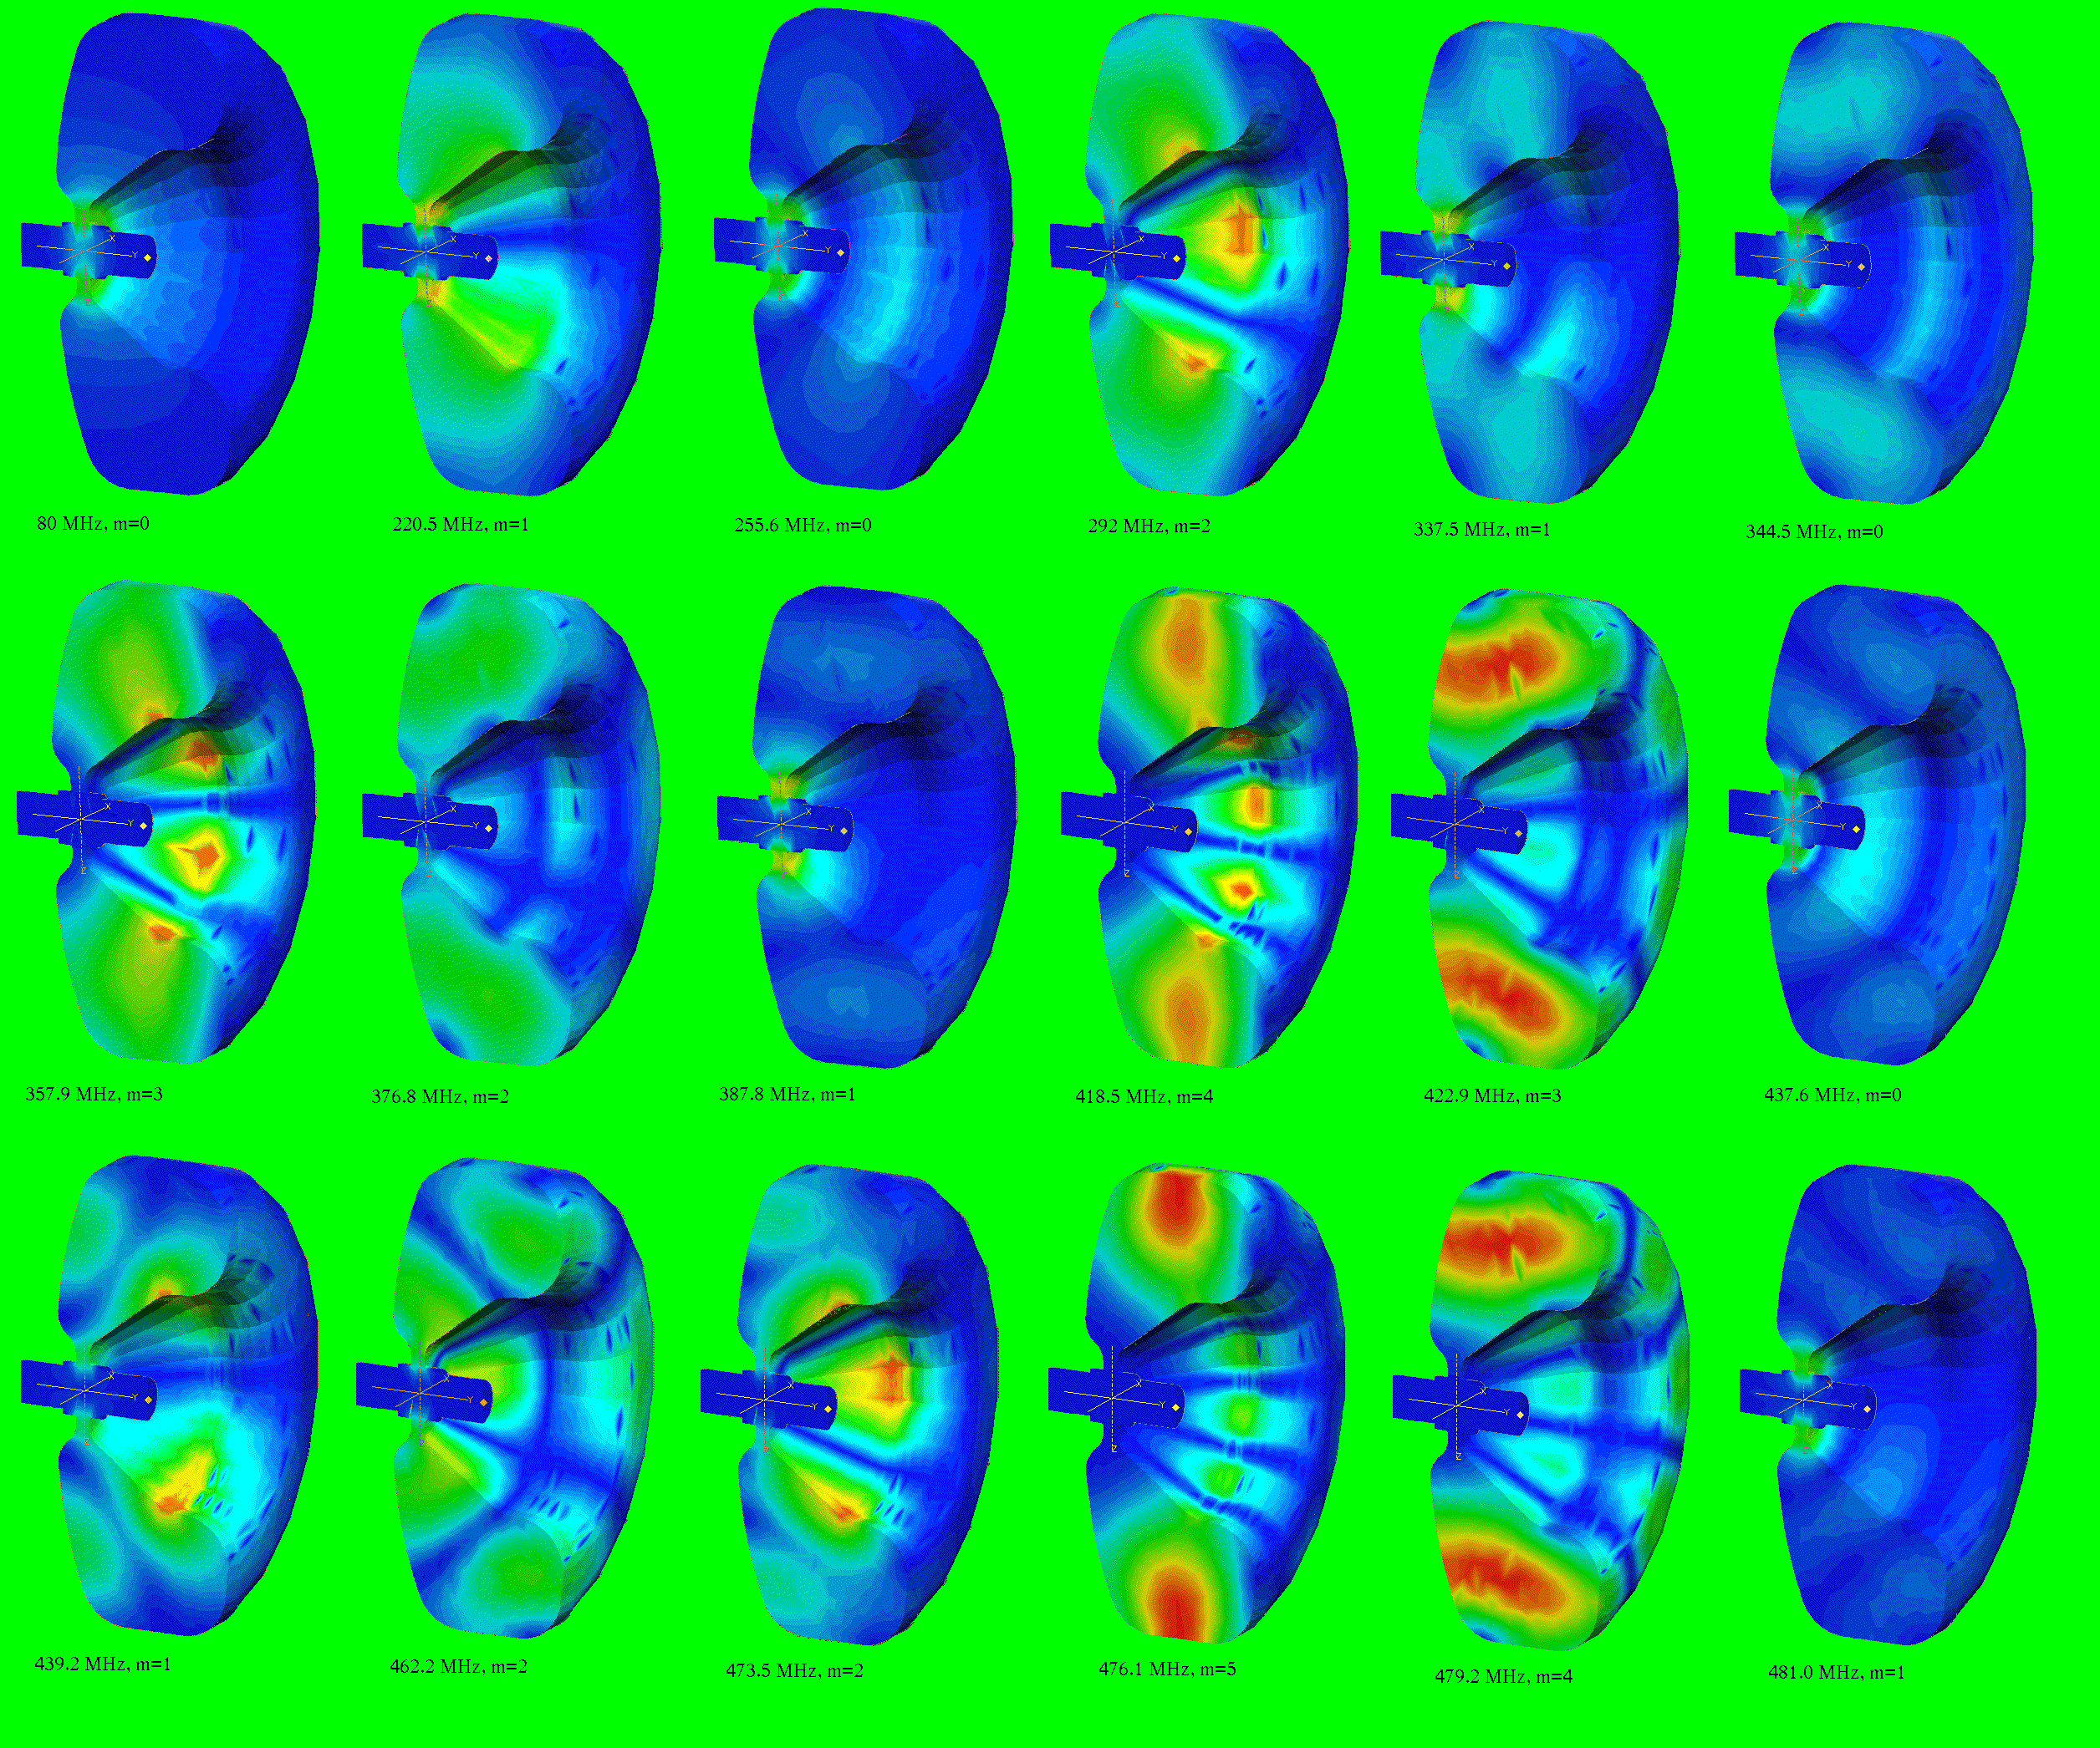
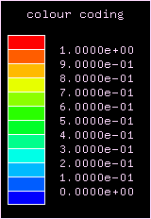

HOM’s
Example shown:
CERN/PS 80 MHz cavity
Colour coding: $\left|\vec{E}\right|$

Slide 25
More examples of cavities

Slide 26
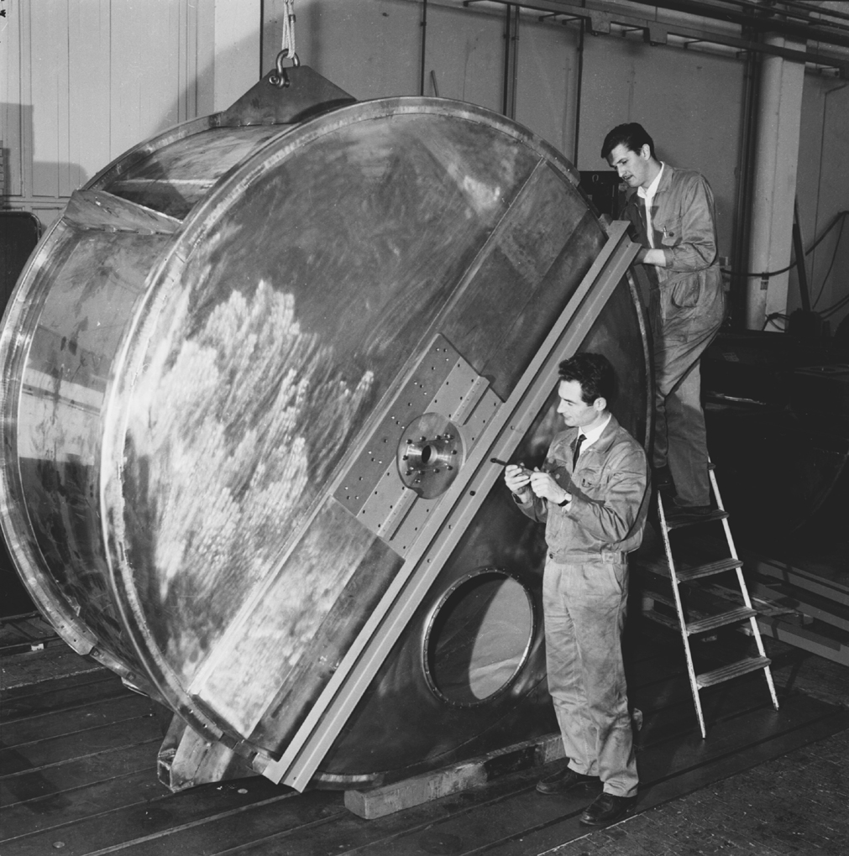
PS 19 MHz cavity (prototype, photo: 1966)

Slide 27
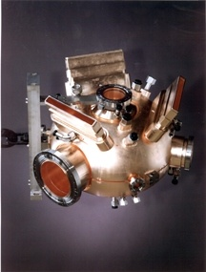
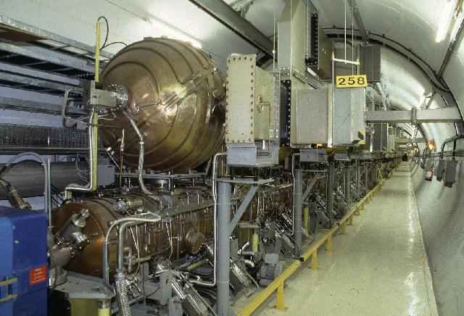
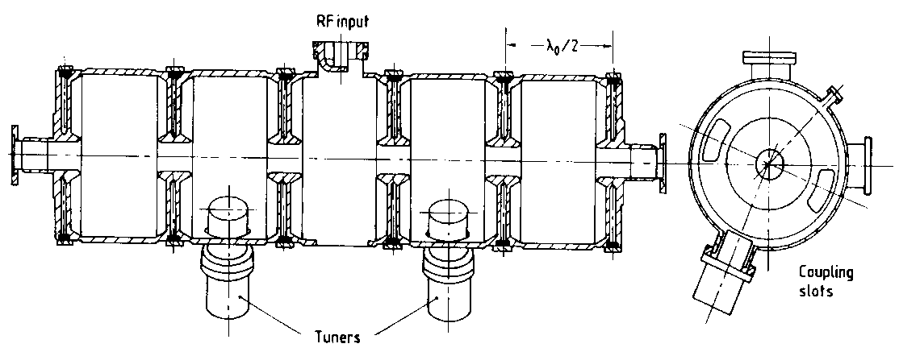
Examples of cavities
PEP II cavity
476 MHz, single cell,
1 MV gap with 150 kW,
strong HOM damping,
LEP normal-conducting Cu RF cavities,
352 MHz. 5 cell standing wave +
spherical cavity for energy storage, 3 MV

Slide 28
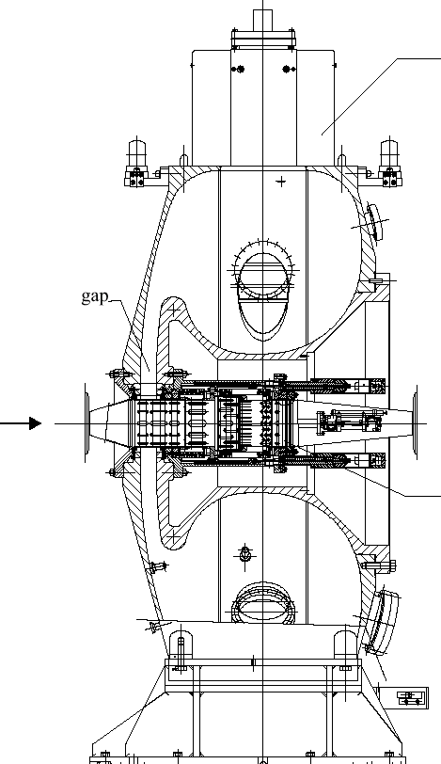
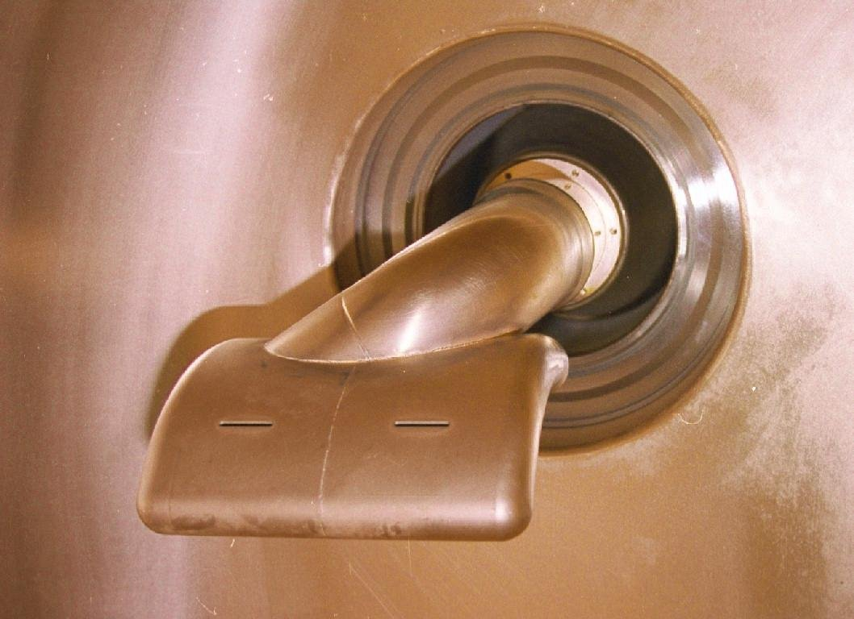
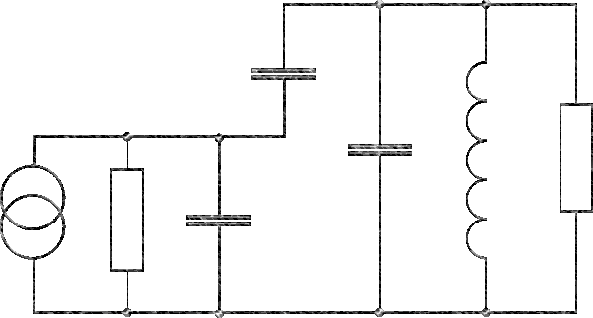
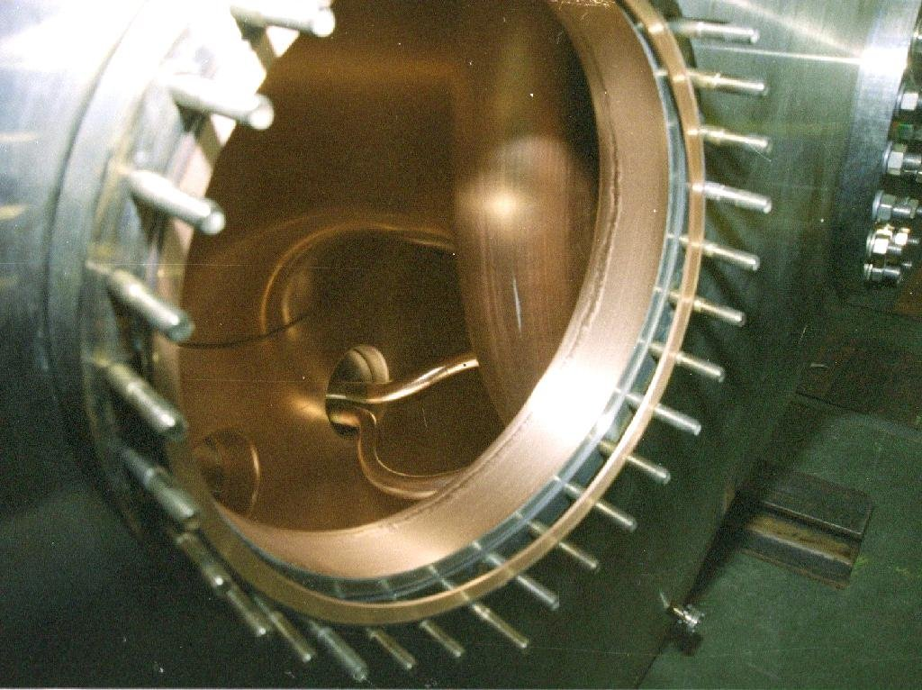

CERN/PS 40 MHz cavity (for LHC)
Example for capacitive coupling
Coupling $C$
cavity

Slide 29
Many gaps

Slide 30
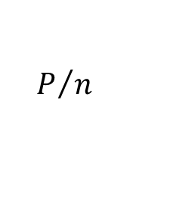
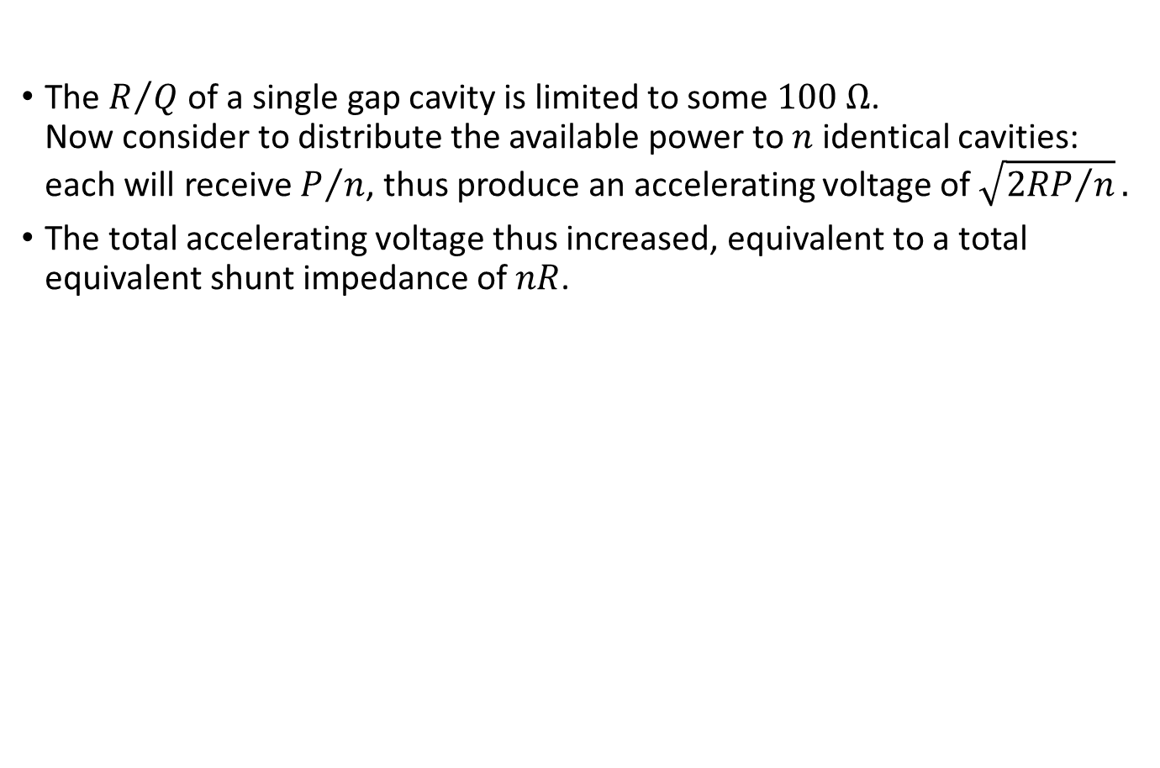
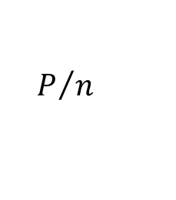
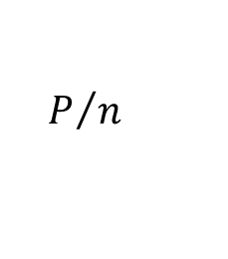
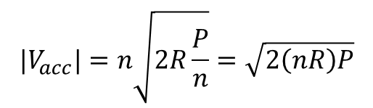
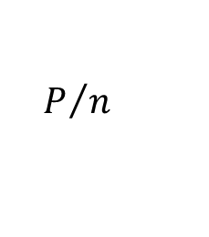
What do you gain with many gaps?
The $R/Q$of a single gap cavity is limited to some $100 \text{Ω}$.
Now consider to distribute the available power to $n$ identical cavities: each will receive $P/n$, thus produce an accelerating voltage of $\sqrt{{2RP}/n}.$
The total accelerating voltage thus increased, equivalent to a total equivalent shunt impedance of $nR$.
$$P/n$$
$$P/n$$
$$P/n$$
$$P/n$$
$${|V}_{acc}|=n\sqrt{2R\frac{P}{n}}=\sqrt{2\left(nR\right)P}$$
1
2
3
n

Slide 31
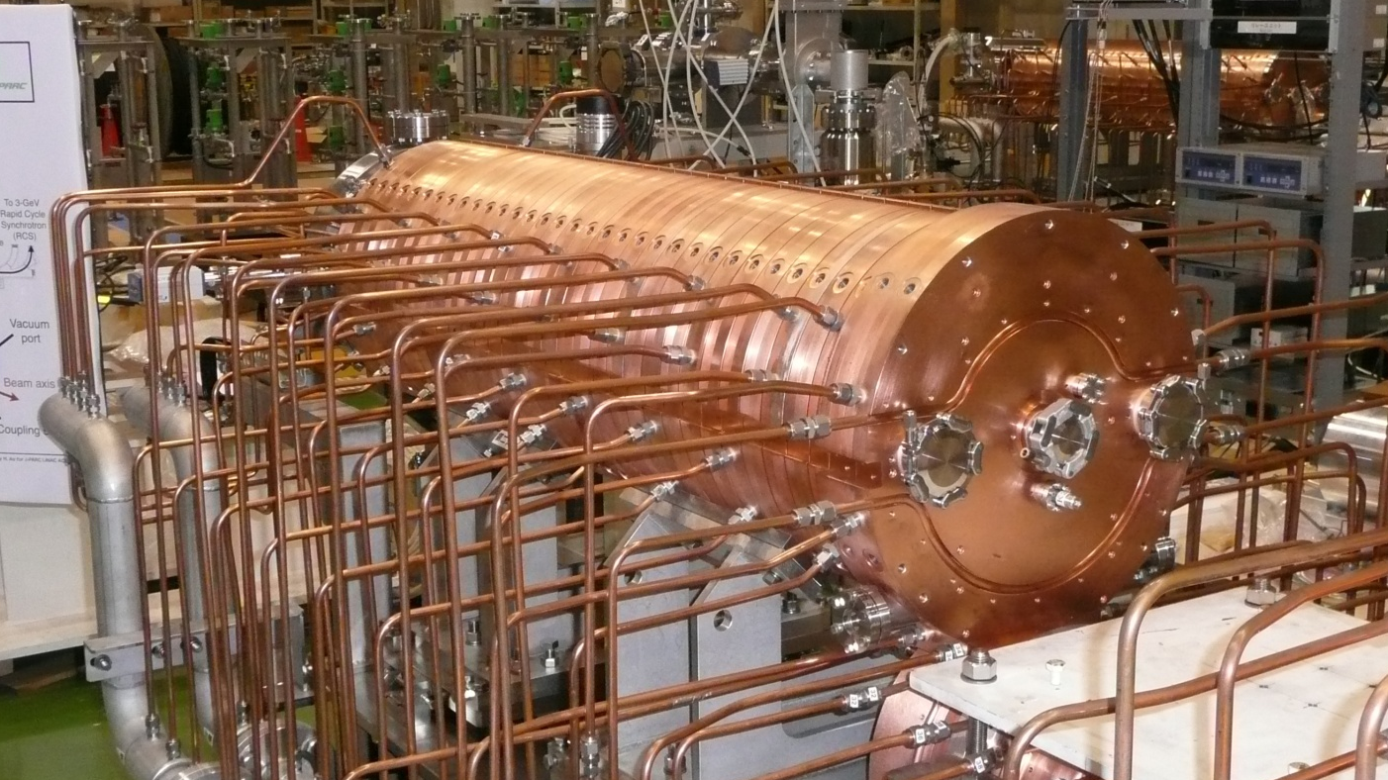
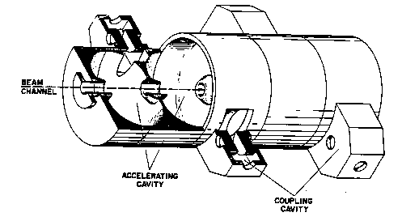


Standing wave multi-cell cavity
Instead of distributing the power from the amplifier, one might as well couple the cavities, such that the power automatically distributes, or have a cavity with many gaps (e.g. drift tube linac).
Coupled cavity accelerating structure (example: side coupled)
“Standard” superconducting cavities are
standing-wave, multi-cell cavities with a phase
shift of $π$ between cells (cell length $λ/2$)

Slide 32
Travelling wave structures

Slide 33

















Brillouin diagram
Travelling wave structure
$$π$$
$$\frac{ω}{c}L$$
$${2π}/3$$
$$2π$$
speed of light line, $ω=β/c$
$$π/2$$
$$π$$
synchronous
$$π/2$$
$$0$$
$$0$$
$$π/2$$
$$βL$$
$$π$$

Slide 34




Travelling wave cavities
CLIC “T18”, 12 GHz
CLIC “HDS”, 12 GHz
“Shintake” structure, 5.7 GHz, see next page

Slide 35

Disc loaded structure with strong HOM damping
“choke mode cavity” (“Shintake” structure)
Dimensions in mm

Slide 36

CERN SPS 200 MHz TW cavity

Slide 37
Superconducting RF

Slide 38




RF Superconductivity
Different from DC, at RF the resistance $R$ is not exactly zero, but just very small – the resulting $Q_{0}$ thus is not infinite, but very large.
It is well described by BCS (Bardeen-Cooper-Schrieffer)
Theory: $R_{BCS}∝\frac{ω^{2}}{T}\exp\left(−1.76 \frac{T_{c}}{T}\right)$
Surface resistance $R=R_{BCS}+R_{res}$.
Good values for $Q_{0}$ are some ${10}^{10}$.
Typical performance plot of a SC cavity:
1.3 GHz
The wall losses are small, but since they occur at low temperature, they are “expensive” to cool! ($1000{\text{W}}/{\text{W}}$ at $1.8 \text{K}$!)
Most used superconductor for RF applications is Nb.

Slide 39


“Elliptical” multi-cell cavities
The elliptical shape was found as
optimum compromise between
  maximum gradient ($E_{acc}/E_{surf}$)
  suppression of multipactor
  mode purity
  machinability
Operated in $π$-mode, i.e. cell length
is exactly ${βλ}/2$.
It has become de facto standard,
used for ions and leptons! E.g.:
  ILC/X-FEL: 1.3 GHz, 9-cell cavity
  SNS (805 MHz)
  SPL/ESS (704 MHz)
  LHC (400 MHz, single cell)
D. Proch: SRF1993 ^{*)}
*): accelconf.web.cern.ch/accelconf/SRF93/papers/srf93g01.pdf‎

Slide 40



TESLA/ILC/X-FEL SC cavities, 1.3 GHz
25 -35 MV/m

Slide 41

LEP Superconducting cavities
10.2 MV/ per cavity

Slide 42
Nb coating techniques
Sputtering Nb on Cu
  Advantages:
    Due to the high cost of Nb, this can reduce cost!
    The Cu substrate increases the mechanical & thermal stability (quench resistance).
  Technology initially developed at CERN (Benvenuti, LEP, 1980); experts today at JLAB, Legnaro, Saclay, Sheffield & CERN
  Technique used today for ALPI (LNL), Soleil, LHC & HIE-Isolde
  Today, the max. fields are still smaller than for bulk Nb – is this an intrinsic limitation? An interesting field of R&D!
    Can this technique be extended to new materials? (NbTiN, V₃Si, Nb₃Sn, HTS?)
“Energetic Condensation”- HiPIMS
  Gas phase deposition of Nb with additional kinetic energy to slow ions.
Cathodic Arc Deposition
…

Slide 43




LHC SC RF, 4 cavity module, 400 MHz
installed in LHC IP4, 2 MV/cavity
LHC spare module stored in CERN’s SM18

Slide 44
Energy Recovery Linac
How to reach “power grid → beam” efficiencies above 100%

Slide 45
Recovering the energy from the beam – the concept
Energy
Energy
Energy
accelerating phase
decelerating phase
beam
RF Power in
RF Power out
One could use a waveguide and reuse the RF power!
Energy
accelerating phase
Energy
decelerating phase
Energy
beam
waveguide for power feedback
(Smaller) RF Power in

Slide 46

A word about CLIC
In the CLIC scheme, 90% of the
drive beam power is recovered
(to produce the RF power for the main beam)
http://clic-study.org/accelerator/CLIC-inaNutshell.php

Slide 47
The CLIC power source idea
to main beam
Short RF Pulses
P_{A} = P₀ × N
τ_{A} = τ₀ / N
f_{A} = f₀ × N
extracted from
recombined drive beam
Long RF Pulses
P₀ , f₀ , τ₀
to accelerate the drive beam
here:
combination
factor 2
98% RF → beam
90% beam → RF
beam manipulation
long bunch train, moderate current, 1 GHz
short bunch train with 12 x current, 12 GHz

Slide 48



Recirculating Linac
One could use the same accelerating structure more than once!
CEBAF (Continuous Electron Beam Accelerator Facility) at JLAB, Newport News, VA, USA has been using this scheme successfully for many years.

Slide 49
Recirculating Linac compared to linac and synchrotron
Linac
Accelerating Structure used for 1 passage
Only single pass instabilities
Recirculating Linac
Accelerating Structure used for some (2-10) passages
Concerning instabilities, a good compromise
Synchrotron
Accelerator Structure used many times
Instabilities develop over many turns (coupled bunch, mode coupling
Periodic lattice
Return arcs different for different energies
Less efficient
L. Merminga ‘07: In a storage ring, electrons are stored for hours in an equilibrium state, whereas in an ERL it is the
energy of the electrons that is stored. The electrons themselves spend little time in the accelerator (from ~1 to 10’s of μs) thus never reach equilibrium. As a result, in common with linacs, the 6-dimensional phase space in ERLs is largely determined by the electron source properties by design. On the other hand, in common with storage rings, ERLs have high current carrying capability enabled by the energy recovery process, thus promising high efficiencies.
http://accelconf.web.cern.ch/AccelConf/p07/PAPERS/MOYKI03.PDF

Slide 50

Energy Recovery Linac:
Combine “Energy recovery” and “recirculating”
accelerating phase
Energy
Energy
low energy beam
from injector
decelerating phase
low energy
beam to dump
x (IP)
beam
RF Power in
N.B.: With bunches in both the
accelerating and decelerating phase in the
accelerator, the net beam loading is zero!
The beam provides (most of) its own power!
… like a perpetual motion machine
total return arc length: $\left(n+\frac{1}{2}\right)\frac{β c}{f}$

Slide 51

LHeC ERL-TF (300 MeV) − Layout
This model and animation by Alex Bogacz, Jefferson Lab
ΔE = 75 MeV
5 MeV
ΔE = 75 MeV
5 MeV
ΔE = 75 MeV
ΔE = 75 MeV
ΔC = λ/2
ΔC = λ/2
5 MeV
5 MeV
Two passes ‘up’ + Two passes ‘down’

Slide 52
RF power sources

Slide 53
RF power sources

Slide 54



Example SSPA, 1 kW
$\left(0.2 ÷50\right) \text{MHz}$, 1 kW solid state amplifier for LEIR
M. Paoluzzi
$\left(0.2 ÷10\right) \text{MHz}$, 1 kW SSPA for MedAustron
Notes:
This photograph shows a look inside a solid state power amplifier consisting of nine modules. At the top, there is the nine way power splitter, the blue ferrite cores at the bottom up part of the eight individual 28 V power supplies. The output power combiner is placed underneath the circuit board and not visible here.
Each individual module delivers 120 W of RF and frequency range of 200 kHz to 50 MHz. The MRF151G can deliver up to 300 W up to 175 MHz, but the special challenge of this particular design was the large instantaneous bandwidth. The amplifier fits into a 19 inch rack.
This amplifier is used at CERN as a driver amplifier in the LEIR RF chain. For KEK's J-Parc facility, six of these amplifiers will be combined to a 6 kW amplifier.

Slide 55



Soleil/ESRF Booster SSPA, 150 kW, 352 MHz
Taken from J. Jacob, CWRF 2014
Initially developed by SOLEIL
Transfer of technology to ELTA / AREVA
Pair of push-pull transistors
x 128
x 2
650 W RF module
6th generation LDMOSFET (BLF 578 / NXP), V_{ds} = 50 V
Efficiency: 68 to 70 %
75 kW Coaxial combiner tree
with λ/4 transformers
150 kW, 352.2 MHz Solid State Amplifiers for the ESRF booster (7 in operation)
Efficiency: > 57 % at nominal power
Notes:
I think the most advanced solid state power amplifier today is the 352 MHz system for the French synchrotron Soleil. It consists of 147 indivitual 330 W modules and has been tested up to 47 kW in CW. In a future stage they plan to combine 4 of these towers for a total output power of 190 kW. Stay tuned!

Slide 56



Tetrodes
4CX250B
(Eimac/CPI),
< 500 MHz, 600 W
(Anode removed)
RS 1084 CJ (ex Siemens, now Thales),
< 30 MHz, 75 kW
YL1520 (ex Philips, now Richardson),
< 260 MHz, 25 kW
Notes:
The high-power tetrode is a vacuum tube with four electrodes. In RF tubes, the electrodes are arranged coaxially, with the cathode in the centre and the anode at the outside where it is more easily cooled. Depending on the cathode material, it is typically operated at around 1000° C, and this temperature has to be well controlled to obtain a good lifetime of the tube. By a varying control grid voltage, the cathode to anode current can be modulated; with a sufficiently negative grid voltage, the anode current will be zero. The screen grid serves to minimise the influence of the anode potential variation on the input circuit between control grid and cathode.
High-power tetrodes are cooled by forced air, demineralised water or vapour. In a carefully designed amplifier and under good operating conditions lifetimes of between 5000 and 50,000 hours can be obtained.

Slide 57


High power tetrode amplifier
CERN Linac3: 100 MHz, 350 kW
50 kW Driver: TH345, Final: RS 2054 SK
CERN PS: 13-20 MHz, 30 kW
Driver: solid state 400 W, Final: RS 1084 CJSC
Notes:
These two photographs show some practical realisations of high-power tetrode amplifiers. On the left, easy one of two 100 MHz amplifiers for CERN's heavy ion linac, producing 350 kW. The final amplifier tube on the left is water cooled, the 50 kW driver on the right air cooled.
The photograph on the right shows the practical realisation of the 30 kW amplifier 13 to 20 MHz. In the foreground, one can see part of the neutralisation circuit, compensating the internal anode to grid capacitance, on the right part of the LC output circuit is visible.

Slide 58

Klystron principle
Notes:
An upper frequency limit for high-power tetrodes (or generally grid tubes) results from the finite time of flight of electrons between cathode, grid and anode. This time of flight must remain small compared to the RF period, otherwise the principal of amplification of a grid tube fails.
This brings us to the realm of microwave tubes, which make use of the time of flight of electrons for their amplification principle. The simplest microwave tube is probably the klystron, the principle of which is explained in this diagram. The electrons are emitted from a thermionic cathode and accelerated by DC voltage (typically a few hundred kV). This voltage gives them their initial velocity which is presented as the inverse slope of the trajectories in the z-t-diagram. This DC current passes through a first RF cavity, which modulates the velocity of the electrons. It follows a drift space, in which the velocity modulation will become a density modulation (cf. to what you learned about longitudinal beam dynamics). This density modulation will induce an RF voltage in the output cavity. Loading this cavity will decelerate the electrons and thus extract RF power. To guide the particles through the drift space, there are either solenoids around the klystron to produce a longitudinal magnetic guiding field, or periodic permanent magnet (PPM) focusing can be applied.
For highly efficient operation, the bunches through the output cavity should be as small as possible. This is obtained by using additional cavities between the input and the output cavity, some of which even resonant at harmonics of the operation frequency. These additional cavities are indicated in blue on the top of the simulation output.
For large beam currents, space charge forces will counteract the bunching process, again an effect which decreases the overall efficiency. The quantity which describes how much beam current will flow for a given DC voltage is the so-called perveance (I V^{-3/2}). For high efficiency operation, the perveance should be small. This can either be obtained with very high DC voltages or with so-called multi-beam klystrons (MBKs) which promise efficiencies in excess of 70%.
There exists on the market are vacuum tube which may be considered as a hybrid between a grid tube and a klystron, the so-called IOT (Inductive Output Tube) or klystrode. It uses a grid above the cathode to modulate the beam current, but it has an output cavity like a klystron. Even though commercially available IOTs perform only slightly better than grid tubes, they have a potential for use in future accelerators since most UHV TV transmitters use IOTs today.
Other microwave tubes which are less important for accelerators but could be considered are the travelling wave tube (TWT) and the cross field amplifier (CFA).

Slide 59


Klystrons
CERN CTF3 (LIL):
3 GHz, 45 MW,
4.5 μs, 50 Hz, η 45 %
CERN LHC:
400 MHz, 300 kW,
CW, η 62 %

Slide 60
Some examples
Some Power RF systems at CERN

Slide 61



Finemet® based wide-band cavity
        Finemet exhibits wideband response
5-gap finemet cavity
C_{P} mostly depends on geometry and drives the high frequency response. The capacitive effect is enhanced by the final stage output capacitance.
  R_{P} and L_{P} drive
  the low frequency response. They and are mostly dependent on Finemet® Characteristics.
6-gap finemet cavity for MedAustron
Prototype system installed in ring 4 of CERN PSB
Mauro PAOLUZZI (CERN)

Slide 62






CERN PS RF Systems
10 MHz system, h=7…21
13/20 MHz system, h=28/42
40 MHz system, h=84
80 MHz system, h=168
200 MHz system

Slide 63



SPS 200 MHz RF system
4 TW cavities
“Siemens”:
4 x 550 kW (28 tetrode amplifiers)
“Philips”:
4 x 550 kW (72 tetrode amplifiers)

Slide 64




LHC 400 MHz High-Power RF System
Notes:
Talk about modules = RF unit

Slide 65
End of RF Systems II
Thank you for your attention!

