Slide 1
Accelerator Magnets
Neil Marks,
STFC- ASTeC / U. of Liverpool,
Daresbury Laboratory,
Warrington WA4 4AD,
U.K.
Tel: (44) (0)1925 603191
Fax: (44) (0)1925 603192
n.marks@stfc.ac.uk

Slide 2
Contents
Theory
Maxwell's 2 magneto-static equations;
With no currents or steel present:
Solutions in two dimensions with scalar potential (no currents);
Cylindrical harmonic in two dimensions (trigonometric formulation);
Field lines and potential for dipole, quadrupole, sextupole;
Introduction of steel:
Ideal pole shapes for dipole, quad and sextupole;
Field harmonics-symmetry constraints and significance;
Significance and use of contours of constant vector potential;

Slide 3
Contents (cont.)
Three dimensional issues:
Termination of magnet ends and pole sides;
The ‘Rogowski roll-off’
Introduction of currents:
Ampere-turns in dipole, quad and sextupole;
Coil design;
Coil economic optimisation-capital/running costs;
Practical Issues:
Backleg and coil geometry- 'C', 'H' and 'window frame' designs;
FEA techniques - Modern codes- OPERA 2D and 3D;
Judgement of magnet suitability in design.

Slide 4
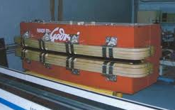
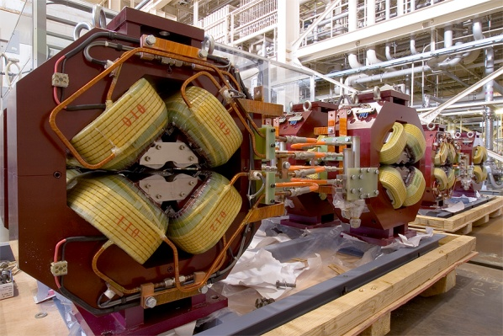
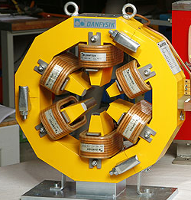
Magnets - introduction
Dipoles to bend the beam:
Quadrupoles to focus it:
Sextupoles to correct chromaticity:
We shall establish a formal approach to describing these magnets.

Slide 5
No currents, no steel:
Maxwell’s equations: ∇.B = 0 ;
∇ ∧ H = j ;
Then we can put: B = - ∇φ
So that: ∇²φ = 0 (Laplace's equation).
Taking the two dimensional case (ie constant in the z direction) and solving for cylindrical coordinates (r,θ):
φ = (E+F θ)(G+H ln r) + Σ_{n=1}∞ (J_{n} r ^{n} cos nθ +K_{n} r ^{n} sin nθ
+L_{n} r ^{-n} cos n θ + M_{n} r ^{-n} sin n θ )

Slide 6
In practical situations:
The scalar potential simplifies to:
φ = Σ_{n} (J_{n} r ^{n} cos nθ +K_{n} r ^{n} sin nθ),
with n integral and J_{n},K_{n} a function of geometry.
Giving components of flux density:
B_{r} = - Σ_{n} (n J_{n} r ^{n-1} cos nθ +nK_{n} r ^{n-1} sin nθ)
B_{θ} = - Σ_{n} (-n J_{n} r ^{n-1} sin nθ +nK_{n} r ^{n-1} cos nθ)
Then to convert to Cartesian coordinates:
x = r cos θ; y = r sin θ;
and B_{x} = - ∂φ/∂x; B_{y} = - ∂φ/∂y

Slide 7
Significance
This is an infinite series of cylindrical harmonics; they define the allowed distributions of B in 2 dimensions in the absence of currents within the domain of (r,θ).
Distributions not given by above are not physically realisable.
Coefficients J_{n}, K_{n} are determined by geometry (remote iron boundaries and current sources).
Note that this formulation can be expressed in terms of complex fields and potentials.

Slide 8
Dipole field n=1:
Cylindrical: Cartesian:
φ =J₁ r cos θ +K₁ r sin θ. φ =J₁ x +K₁ y
B_{r} = J₁ cos θ + K₁ sin θ; B_{x} = -J₁
B_{θ} = -J₁ sin θ + K₁ os θ; B_{y} = -K₁
So, J₁ = 0 gives vertical dipole field:
K₁ =0 gives horizontal dipole field.

Slide 9
Quadrupole field n=2:
Cylindrical: Cartesian:
φ = J₂ r 2 cos 2θ +K₂ r 2 sin 2θ; φ = J₂ (x² - y²)+2K₂ xy
B_{r} = 2 J₂ r cos 2θ +2K₂ r sin 2θ; B_{x} = -2 (J₂ x +K₂ y)
B_{θ} = -2J₂ r sin 2θ +2K₂ r cos 2θ; B_{y} = -2 (-J₂ y +K₂ x)
J₂ = 0 gives 'normal' or ‘upright’ quadrupole field.
Line of constant
scalar potential
K₂ = 0 gives 'skew' quad fields (above rotated by π/4).
Lines of flux density

Slide 10
Sextupole field n=3:
Cylindrical; Cartesian:
φ = J₃ r³ cos 3θ +K₃ r³ sin 3θ; φ = J₃ (x³-3y²x)+K₃(3yx²-y³)
B_{r} = 3 J₃r² cos 3θ +3K₃r² sin 3θ; B_{x} = -3{J₃ (x²-y²)+2K₃yx}
B_{θ}= -3J₃ r² sin 3θ+3K₃ r² cos 3θ; B_{y} = -3{-2 J₃ xy +K₃(x²-y²)}
-C
-C
J₃ = 0 giving ‘upright‘ sextupole field.
+C
+C
+C
+C
Line of constant scalar potential
-C
-C
-C
-C
Lines of flux density
+C
+C

Slide 11
Variation of B_{y} on x axis (upright fields).
B_{y}
Dipole;
constant field:
x
B_{y}
Quadrupole;
linear field
Sextupole:
quadratic variation:
x
B_{y} = G_{Q} x;
G_{Q} is quadrupole gradient (T/m).
B_{y}
B_{y} = G_{S} x²;
G_{S} is sextupole gradient (T/m²).
x

Slide 12
Alternative notation:
(used in most lattice programs)
magnet strengths are specified by the value of k_{n};
(normalised to the beam rigidity);
order n of k is different to the 'standard' notation:
dipole is n = 0;
quad is n = 1; etc.
k has units:
k₀ (dipole) m⁻¹;
k₁ (quadrupole) m⁻²; etc.

Slide 13
Introducing iron yokes and poles.
What is the ideal pole shape?
Flux is normal to a ferromagnetic surface with infinite μ:
curl H = 0
therefore ∫ H.ds = 0;
in steel H = 0;
therefore parallel H air = 0
therefore B is normal to surface.
μ = ∞
μ = 1
Flux is normal to lines of scalar potential, (B = - ∇φ);
So the lines of scalar potential are the ideal pole shapes!
(but these are infinitely long!)

Slide 14
Equations of ideal poles
Equations for Ideal (infinite) poles;
(J_{n} = 0) for ‘upright’ (ie not skew) fields:
Dipole:
y= ± g/2;
(g is inter-pole gap).
Quadrupole:
xy= ±R²/2;
Sextupole:
3x²y - y³ = ±R³;
R
R is the ‘inscribed radius’ of a multipole magnet.

Slide 15
‘Pole-tip’ Field
The radial field at pole centre of a multipole magnet:
B_{PT} = G_{N} R^{(n-1)} ;
Quadrupole: B_{PT} = G_{Q} R; sextupole: B_{PT} = G_{S} R²; etc;
Has it any significance?
- a quadrupole R = 50 mm; G_{Q} = 20 T/m; B_{PT} = 1.0 T;
i) Beam line – round beam r = 40 mm;
pole extends to x = 65 mm; B_{y}(65,0) = 1.3 T; OK ☺ ;
ii) Synchrotron source – beam ± 50 mm horiz.; ± 10 mm vertical;
pole extends to x = 80 mm; By (80,0)= 1.6 T; perhaps OK ???😐 ;
iii) FFAG – beam ± 65 mm horiz.; ± 8 mm vertical;
Pole extends to x = 105 mm; By (105, 0) = 2.1 T ☹☹☹.

Slide 16
Combined function magnets
'Combined Function Magnets' - often dipole and quadrupole field combined (but see later slide):
A quadrupole magnet with
physical centre shifted from
magnetic centre.
Characterised by 'field index' n,
+ve or -ve depending
on direction of gradient;
do not confuse with harmonic n!
ρ is radius of curvature of the beam;
B_{o} is central dipole field

Slide 17
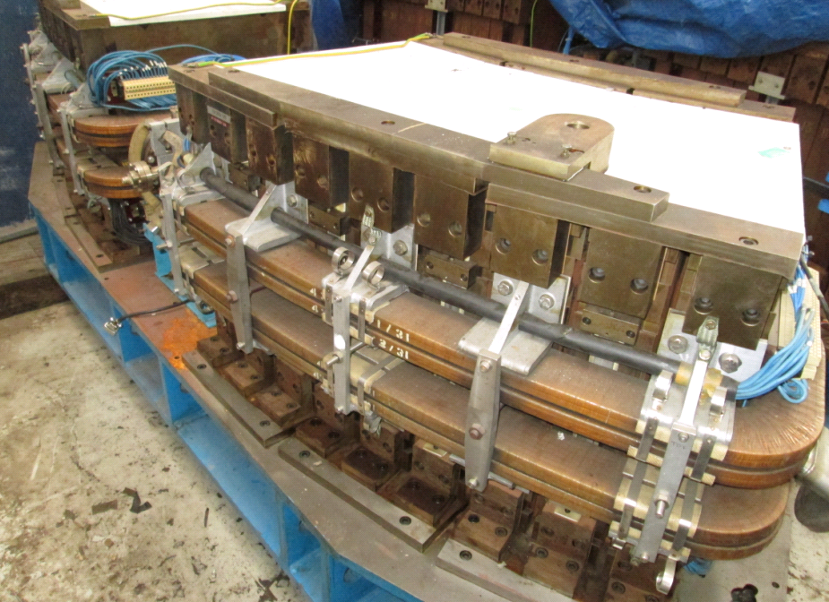
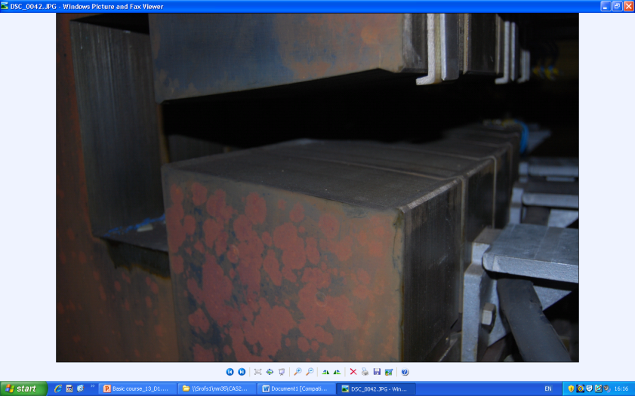
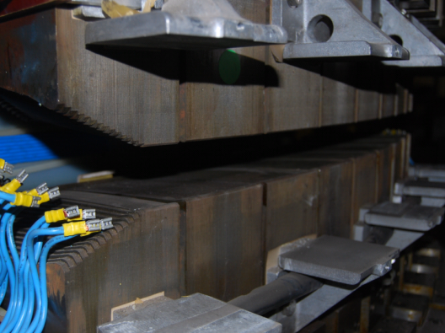
Typical combined dipole/quadrupole
SRS Booster c.f. dipole
‘F’ type -ve n
‘D’ type +ve n.

Slide 18
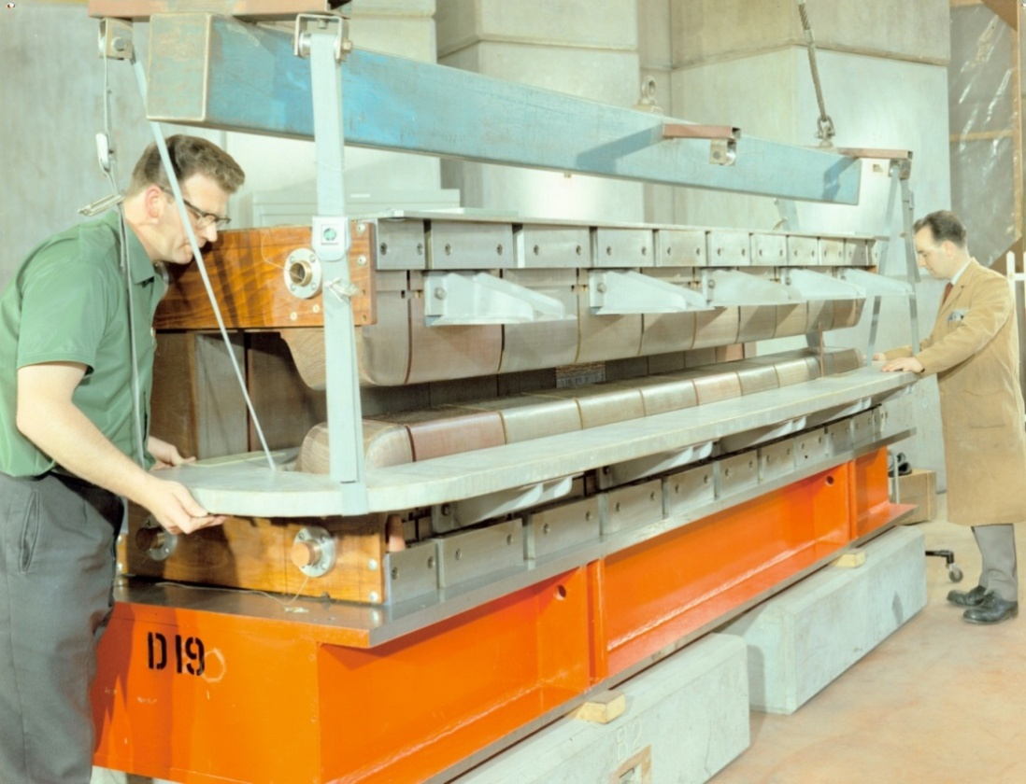

NINA Combined function magnets

Slide 19
Pole for a combined dipole and quad.

Slide 20
Other combined function magnets:
dipole, quadrupole and sextupole;
dipole & sextupole (for chromaticity control);
dipole, skew quad, sextupole, octupole;
Generated by
pole shapes given by sum of correct scalar potentials
- amplitudes built into pole geometry – not variable!
OR:
multiple coils mounted on the yoke
- amplitudes independently varied by coil currents.

Slide 21
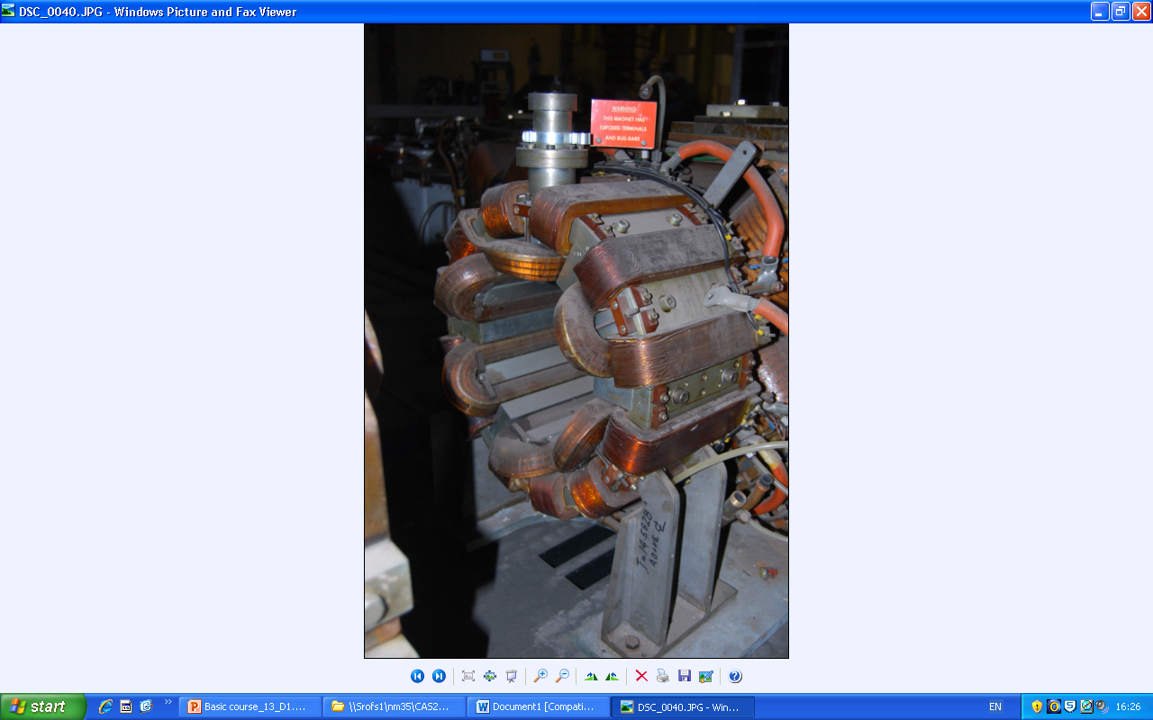
The SRS multipole magnet.
Could develop:
vertical dipole
horizontal dipole;
upright quad;
skew quad;
sextupole;
octupole;
others.

Slide 22
The practical pole in 2D
Practically, poles are finite, introducing errors;
these appear as higher harmonics which degrade the field distribution.
However, the iron geometries have certain symmetries that restrict the nature of these errors.
Dipole:
Quadrupole:

Slide 23
Possible symmetries.
Lines of symmetry:
Dipole: Quad
Pole orientation y = 0; x = 0; y = 0
determines whether pole
is upright or skew.
Additional symmetry x = 0; y = ± x
imposed by pole edges.
The additional constraints imposed by the symmetrical pole edges limits the values of n that have non zero coefficients

Slide 24
Dipole symmetries
Type Symmetry Constraint
Pole orientation φ(θ) = -φ(-θ) all J_{n} = 0;
Pole edges φ(θ) = φ(π -θ) K_{n} non-zero only for:
n = 1, 3, 5, etc;
+φ
+φ
+φ
-φ
So, for a fully symmetric dipole, only 6, 10, 14 etc pole errors can be present.

Slide 25
Quadrupole symmetries
Type Symmetry Constraint
Pole orientation φ(θ) = -φ( -θ) All J_{n} = 0;
φ(θ) = -φ(π -θ) K_{n} = 0 all odd n;
Pole edges φ(θ) = φ(π/2 -θ) K_{n} non-zero only for:
n = 2, 6, 10, etc;
So, a fully symmetric quadrupole, only 12, 20, 28 etc pole errors can be present.

Slide 26
Sextupole symmetries.
Type Symmetry Constraint
Pole orientation φ(θ) = -φ( -θ) All J_{n} = 0;
φ(θ) = -φ(2π/3 - θ) K_{n} = 0 for all n φ(θ) = -φ(4π/3 - θ) not multiples of 3;
Pole edges φ(θ) = φ(π/3 - θ) K_{n} non-zero only for: n = 3, 9, 15, etc.
So, a fully symmetric sextupole, only 18, 30, 42 etc pole errors can be present.

Slide 27
Summary
For perfectly symmetric magnets, the ‘allowed’ error fields are fully defined by the symmetry of scalar potential φ and the trigonometry:
Dipole:
Quadrupole:
+ φ
+ φ
- φ
+ φ
+ φ
- φ
- φ
Dipole: only dipole, sextupole,
10 pole etc can be present
Sextupole: only sextupole, 18, 30, 42 pole, etc. can be present
Quadrupole: only quadrupole, 12 pole, 20 pole etc can be present

Slide 28
Vector potential in 2 D
We have: B = curl A (A is vector potential);
and div A = 0
Expanding: B = curl A =
(∂A_{z}/ ∂y - ∂A_{y}/ ∂z) i + (∂A_{x}/ ∂z - ∂A_{z}/ ∂x) j + (∂A_{y}/ ∂x - ∂A_{x}/ ∂y) k;
where i, j, k, are unit vectors in x, y, z.
In 2 dimensions B_{z} = 0; ∂ / ∂z = 0;
So A_{x} = A_{y} = 0;
and B = (∂A_{z}/ ∂y ) i - (∂A_{z}/ ∂x) j
A is in the z direction, normal to the 2 D problem.
Note: div B = ∂²A_{z}/(∂x ∂y) - ∂²A_{z}/(∂x ∂y) = 0;

Slide 29
Total flux between two points ∝ ΔA
In a two dimensional problem the magnetic flux between two points is proportional to the difference between the vector potentials at those points.
B
Φ ∝ (A₂ - A₁)
A1
A2
Φ
Proof on next slide.

Slide 30
Proof:
Consider a rectangular closed path, length λ in z direction at (x₁,y₁) and (x₂,y₂); apply Stokes’ theorem:
B
Φ = ∫ ∫ B.dS = ∫ ∫ ( curl A).dS = ∫ A.ds
But A is exclusively in the z direction, and is constant in this direction.
So:
∫ A.ds = λ { A(x₁,y₁) - A(x₂,y₂)};
A
dS
λ
z
ds
y
x
(x₁, y₁)
(x₂, y₂)
Φ = λ { A(x₁,y₁) - A(x₂,y₂)};

Slide 31
Contours of constant A
Therefore:
i) Contours of constant vector potential in 2D give a graphical representation of lines of flux.
ii) These are used in 2D FEA analysis to obtain a graphical image of flux distribution.
iii) The total flux cutting the coil allows the calculation of the inductive voltage per turn in an ac magnet:
V = - d Φ/dt;
iv) For a sine wave oscillation frequency ω:
V_{peak} = ω (Φ/2)

Slide 32
In 3D – pole ends (also pole sides).
Fringe flux will be present at pole ends so beam deflection continues beyond magnet end:
z
B₀
B_{y}
The magnet’s strength is given by ∫ By (z) dz along the magnet , the integration including the fringe field at each end;
The ‘magnetic length’ is defined as (1/B₀)(∫ By (z) dz ) over the same integration path, where B₀ is the field at the azimuthal centre.

Slide 33
End Fields and Geometry.
At high(ish) fields it is necessary to terminate the pole (transverse OR longitudinal) in a controlled way:;
to prevent saturation in a sharp corner (see diagram);
to maintain length constant with x, y;
to define the length (strength) or preserve quality;
to prevent flux entering normal
to lamination (ac).
Longitudinally, the end of the magnet is therefore
'chamfered' to give increasing gap
(or inscribed radius) and lower fields as the end is approached.

Slide 34
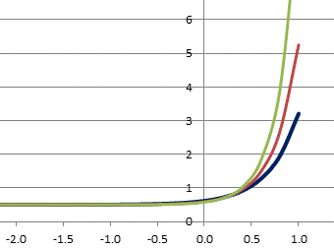
Classical end or side solution
The 'Rogowski' roll-off: Equation:
y = g/2 +(g/πα) [exp (απx/g)-1];
g/2 is dipole half gap;
y = 0 is centre line of gap;
α ( ̴ 1); parameter to control
the roll off;
α = 1.5
α = 1.25
α = 1.0
With α = 1, this profile provides the maximum rate of increase in gap with a monotonic decrease in flux density at the surface;
For a high B_{y} magnet this avoids any additional induced non-linearity

Slide 35
Introduction of currents
Now for j ≠ 0 ∇ ∧ H = j ;
To expand, use Stoke’s Theorum:
for any vector V and a closed curve s :
∫V.ds =∫∫ curl V.dS
Apply this to: curl H = j ;
then in a magnetic circuit:
∫ H.ds = N I;
N I (Ampere-turns) is total current cutting S

Slide 36
Excitation current in a dipole
B is approx constant round the loop made up of λ and g, (but see below);
But in iron, μ>>1,
and H_{iron} = H_{air} /μ ;
So
B_{air} = μ₀ NI / (g + λ/μ);
g, and λ/μ are the 'reluctance' of the gap and iron.
Approximation ignoring iron reluctance (λ/μ << g ):
NI = B g /μ₀

Slide 37
Excitation current in quad & sextupole
For quadrupoles and sextupoles, the required excitation can be calculated by considering fields and gap at large x. For example: Quadrupole:
Pole equation: xy = R² /2
On x axes B_{Y} = G_{Q}x;
where G_{Q} is gradient (T/m).
At large x (to give vertical lines of B):
N I = (G_{Q}x) ( R² /2x)/μ₀
N I = G_{Q} R² /2 μ₀ (per pole).
The same method for a
Sextupole,
( coefficient G_{S},), gives:
N I = G_{S} R³/3μ₀ (per pole)

Slide 38
General solution-magnets order n
In air (remote currents! ), B = μ₀ H B = - ∇φ
Integrating over a limited path
(not circular) in air: N I = (φ₁ – φ₂)/μ_{o}
φ₁, φ₂ are the scalar potentials at two points in air.
Define φ = 0 at magnet centre;
then potential at the pole is:
μ_{o} NI
Apply the general equations for magnetic
field harmonic order n for non-skew
magnets (all Jn = 0) giving:
N I = (1/n) (1/μ₀) {B_{r}/R ^{(n-1)}} R ^{n}
Where:
NI is excitation per pole;
R is the inscribed radius (or half gap in a dipole);
term in brackets {} is magnet gradient G_{N} in T/m ^{(n-1)}.
φ = μ₀ NI
φ = 0

Slide 39
Coil geometry
Standard design is rectangular copper (or aluminium) conductor, with cooling water tube. Insulation is glass cloth and epoxy resin.
Amp-turns (NI) are determined, but total copper area (A_{copper}) and number of turns (N) are two degrees of freedom and need to be decided.
Current density:
j = NI/A_{copper}
Optimum j determined from economic criteria.

Slide 40
Current density - optimisation
Advantages of low j:
lower power loss – power bill is decreased;
lower power loss – power converter size is decreased;
less heat dissipated into magnet tunnel.
Advantages of high j:
smaller coils;
lower capital cost;
smaller magnets.
Chosen value of j is an
optimisation of magnet
capital against power costs.
total
capital
running

Slide 41
Number of turns per coil-N
The value of number of turns (N) is chosen to match power supply and interconnection impedances.
Factors determining choice of N:
Large N (low current) Small N (high current)
Small, neat terminals. Large, bulky terminals
Thin interconnections-hence low Thick, expensive connections.
cost and flexible.
More insulation layers in coil, High percentage of copper in
hence larger coil volume and coil volume. More efficient use
increased assembly costs. of space available
High voltage power supply High current power supply.
-safety problems. -greater losses.

Slide 42
Examples-turns & current
From the Diamond 3 GeV synchrotron source:
Dipole:
N (per magnet): 40;
I max 1500 A;
Volts (circuit): 500 V.
Quadrupole:
N (per pole) 54;
I max 200 A;
Volts (per magnet): 25 V.
Sextupole:
N (per pole) 48;
I max 100 A;
Volts (per magnet) 25 V.

Slide 43
Magnet geometry
Dipoles can be ‘C core’ ‘H core’ or ‘Window frame’
''C' Core:
Advantages:
Easy access;
Classic design;
Disadvantages:
Pole shims needed;
Asymmetric (small);
Less rigid;
The ‘shim’ is a small, additional piece of ferro-magnetic material added on each side of the two poles – it compensates for the finite cut-off of the pole, and is optimised to reduce the 6, 10, 14...... pole error harmonics.

Slide 44
Flux in the gap.
Flux in the yoke includes the gap flux and stray flux, which extends (approx) one gap width on either side of the gap.
Thus, to calculate total flux in the back-leg of magnet
length λ:
Φ =B_{gap} (b + 2g) λ.
Width of backleg is chosen to limit B_{yoke} and hence maintain high μ.

Slide 45
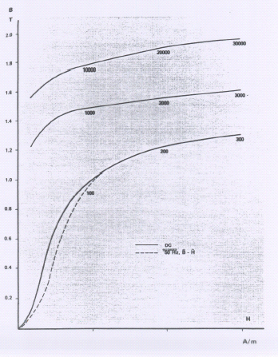
Steel- B/H curves
-for typical silicon steel laminations
Note:
the relative permeability is the gradient of these curves;
the lower gradient close to the origin - lower permeability;
the permeability is maximum at between 0.4 and 0.6 T.

Slide 46
Typical ‘C’ cored Dipole
Cross section of the Diamond storage ring dipole.

Slide 47
H core and window-frame magnets
''Window Frame'
Advantages:
High quality field;
No pole shim;
Symmetric & rigid;
Disadvantages:
Major access problems;
Insulation thickness
‘H core’:
Advantages:
Symmetric;
More rigid;
Disadvantages:
Still needs shims;
Access problems.

Slide 48
Window frame dipole
Providing the conductor is continuous to the steel ‘window frame’ surfaces (impossible because coil must be electrically insulated), and the steel has infinite μ, this magnet generates perfect dipole field.
Providing current density J is uniform in conductor:
H is uniform and vertical up outer face of conductor;
H is uniform, vertical and with same value in the middle of the gap;
→ perfect dipole field.
J
H

Slide 49
Practical window frame dipole.
Insulation added to coil:
B increases close to coil insulation surface
B decrease close to coil insulation surface
best compromise

Slide 50
Open-sided Quadrupole
‘Diamond’ storage ring quadrupole.
The yoke support pieces in the horizontal plane need to provide space for beam-lines and are not ferro-magnetic.
Error harmonics include n = 4 (octupole) a finite permeability error.

Slide 51
Typical pole designs
To compensate for the non-infinite pole, shims are added at the pole edges. The area and shape of the shims determine the amplitude of error harmonics which will be present.
Dipole:
Quadrupole:
The designer optimises the pole by ‘predicting’ the field resulting from a given pole geometry and then adjusting it to give the required quality.
When high fields are present,
chamfer angles must be small, and tapering of poles may be necessary

Slide 52
Pole-end correction.
As the gap is increased, the size (area) of the shim is increased, to give some control of the field quality at the lower field. This is far from perfect!
Transverse adjustment at end of dipole
Transverse adjustment at end of quadrupole

Slide 53
Assessing pole design
A first assessment can be made by just examining B_{y}(x) within the required ‘good field’ region.
Note that the expansion of B_{y}(x) _{y = 0} is a Taylor series: B_{y}(x) = _{∑n =1} ∞ {b_{n} x ^{(n-1)}}
= b₁ + b₂x + b₃x² + ………
dipole quad sextupole
Also note:
∂ B_{y}(x) /∂ x = b₂ + 2 b₃x + ……..
So quad gradient G ≡ b₂ = ∂ B_{y}(x) /∂ x in a quad
But sext. gradient G_{s} ≡ b₃ = ½ ∂² B_{y}(x) /∂ x² in a sext.
So coefficients are not equal to differentials for n = 3 etc.

Slide 54
Is it ‘fit for purpose’?
A simple judgement of field quality is given by plotting:
Dipole: {B_{y} (x) - B_{y} (0)}/B_{Y} (0) (ΔB(x)/B(0))
Quad: dB_{y} (x)/dx (Δg(x)/g(0))
6poles: d²B_{y}(x)/dx² (Δg₂(x)/g₂(0))
‘Typical’ acceptable variation inside ‘good field’ region:
ΔB(x)/B(0) ≤ 0.01%
Δg(x)/g(0) ≤ 0.1%
Δg₂(x)/g₂(0) ≤ 1.0%

Slide 55
Design computer codes.
Computer codes are now used; eg the Vector Fields codes -‘OPERA 2D’ and 3D.
These have:
  finite elements with variable triangular mesh;
  multiple iterations to simulate steel non-linearity;
  extensive pre and post processors;
  compatibility with many platforms and P.C. o.s.
Technique is iterative:
  calculate flux generated by a defined geometry;
  adjust the geometry until required distribution is achieved.

Slide 56
Design Procedures –OPERA 2D
Pre-processor:
The model is set-up in 2D using a GUI (graphics user’s interface) to define ‘regions’:
  steel regions;
  coils (including current density);
  a ‘background’ region which defines the physical extent of the model;
  the symmetry constraints on the boundaries;
  the permeability for the steel (or use the pre-programmed curve);
  mesh is generated and data saved.

Slide 57
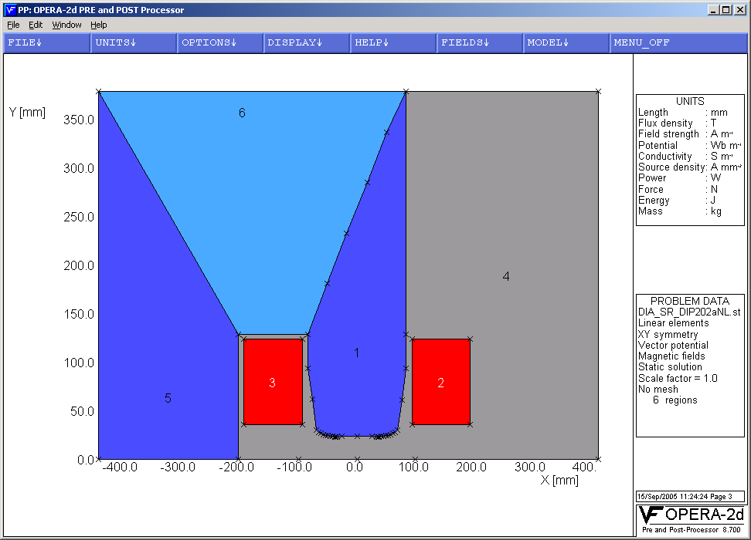
Model of Diamond storage ring dipole

Slide 58
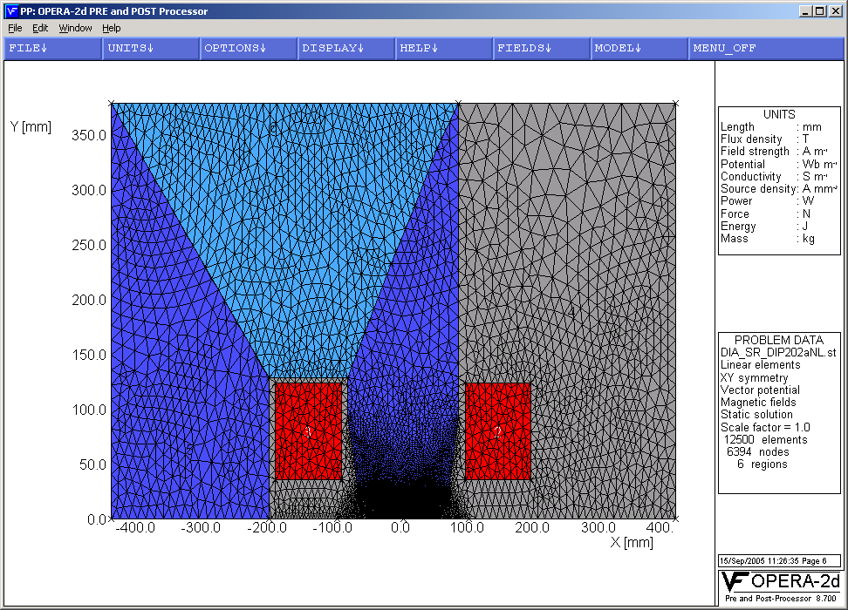
With mesh added

Slide 59
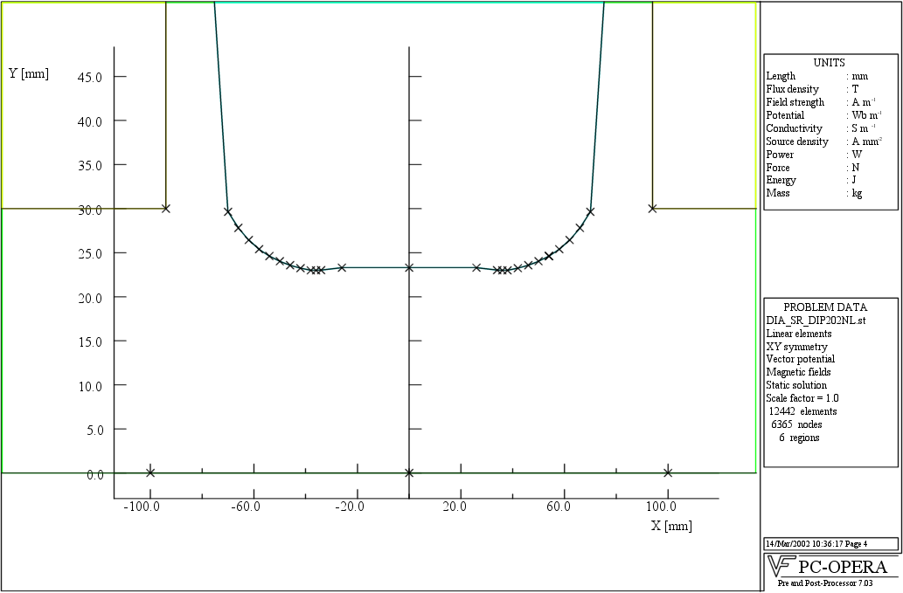
Close-up of pole region.
Pole profile, showing shim and Rogowski side roll-off for Diamond 1.4 T dipole.:

Slide 60
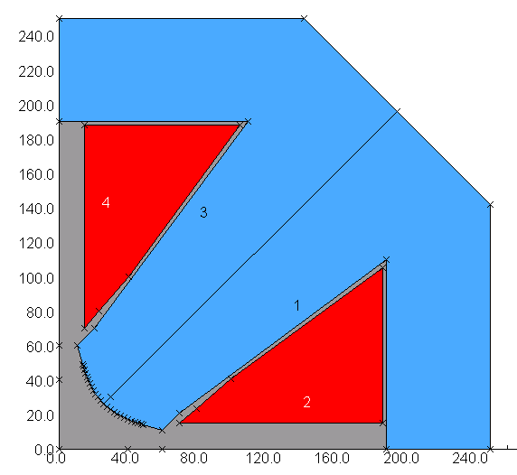
Diamond quadrupole: a simplified model
Note – one eighth of
Quadrupole could be used with opposite symmetries defined on horizontal and y = x axis.
But I have often experienced discontinuities at the origin with such1/8 ^{th} geometry.

Slide 61
Calculation of end effects using 2D codes
FEA model in longitudinal plane, with correct end geometry (including coil), but 'idealised' return yoke:
This will establish the end distribution; a numerical integration will give the 'B' length.
Provided dBY/dz is not too large, single 'slices' in the transverse plane can be used to calculated the radial distribution as the gap increases. Again, numerical integration will give ∫ B.dl as a function of x.
This technique is less satisfactory with a quadrupole, but end effects are less critical with a quad.

Slide 62
Calculation.
Data Processor:
either:
  linear - which uses a predefined constant permeability for a single calculation, or
  non-linear - which is iterative with steel permeability set according to B in steel calculated on previous iteration.

Slide 63
Data Display – OPERA 2D
Post-processor:
uses pre-processor model for many options for displaying field amplitude and quality:
  field lines;
  graphs;
  contours;
  gradients;
  harmonics (from a Fourier analysis around a pre-defined circle).

Slide 64
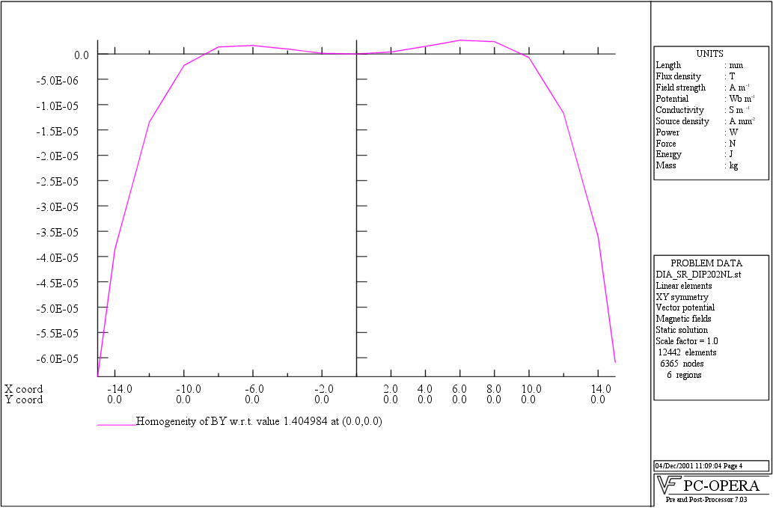
2 D Dipole field homogeneity on x axis
Diamond s.r. dipole: ΔB/B = {By(x)- B(0,0)}/B(0,0);
typically ± 1:10⁴ within the ‘good field region’ of -12mm ≤ x ≤ +12 mm..

Slide 65
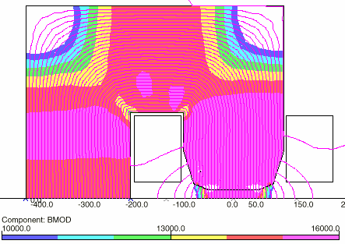
2 D Flux density distribution in a dipole

Slide 66
2 D Dipole field homogeneity in gap
Transverse (x,y) plane in Diamond s.r. dipole;
contours are ±0.01%
required good field region:

Slide 67
Harmonics indicate magnet quality
The amplitude and phase of the integrated harmonic components in a magnet provide an assessment:
  when accelerator physicists are calculating beam behaviour in a lattice;
  when designs are judged for suitability;
  when the manufactured magnet is measured;
  to judge acceptability of a manufactured magnet.
Measurement of a magnet after manufacture will be discussed in the section on measurements.

Slide 68
End geometries - dipole
Simpler geometries can be used in some cases.
The Diamond dipoles have a Rogawski roll-off at the ends (as well as Rogawski roll-offs at each side of the pole).
See photographs to follow.
This give small negative sextupole field in the ends which will be compensated by adjustments of the strengths in adjacent sextupole magnets – this is possible because each sextupole will have its own individual power supply.

Slide 69
OPERA 3D model of Diamond dipole.

Slide 70
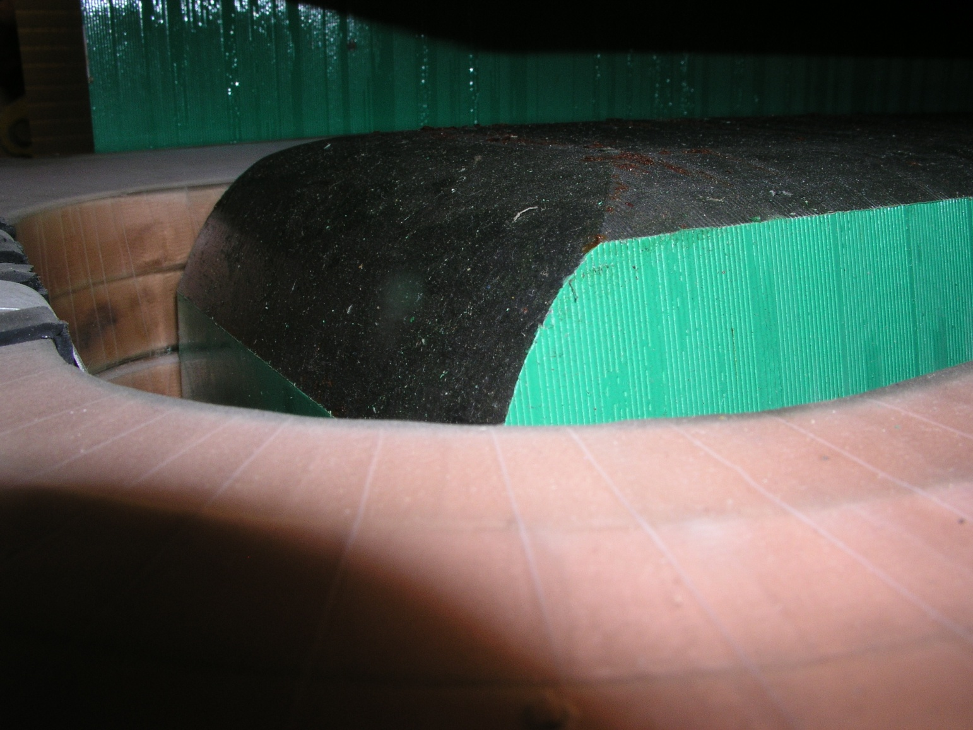
Diamond dipole poles

Slide 71
2 D Assessment of quadrupole gradient quality
Diamond WM quadrupole:
graph is percentage variation in dBy/dx vs x at different values of y.
Gradient quality is to be ± 0.1 % or better to x = 36 mm.

Slide 72
End chamfering - Diamond ‘W’ quad
Tosca results -different depths 45° end chamfers on Δg/g₀ integrated through magnet and end fringe field (0.4 m long WM quad).
Thanks to Chris Bailey (DLS) who performed this working using OPERA 3D.

Slide 73
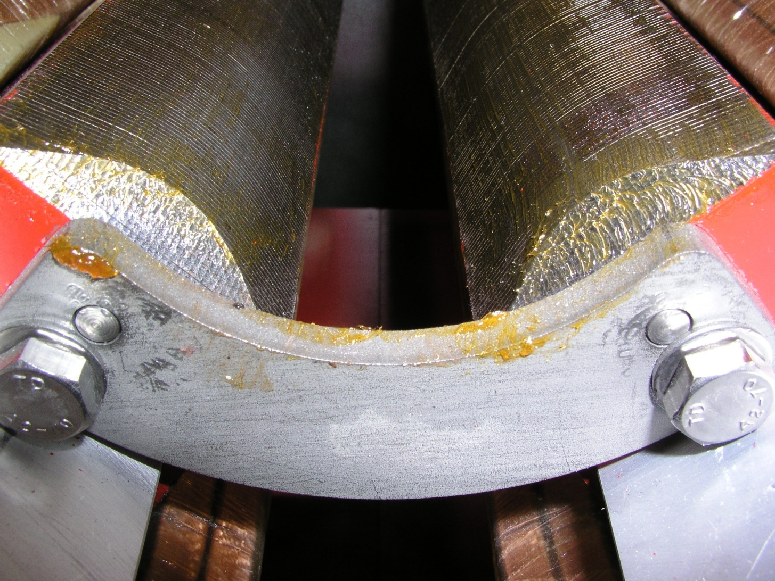
Simplified end geometries - quadrupole
Diamond quadrupoles have an angular cut at the end; depth and angle were adjusted using 3D codes to give optimum integrated gradient.

Slide 74
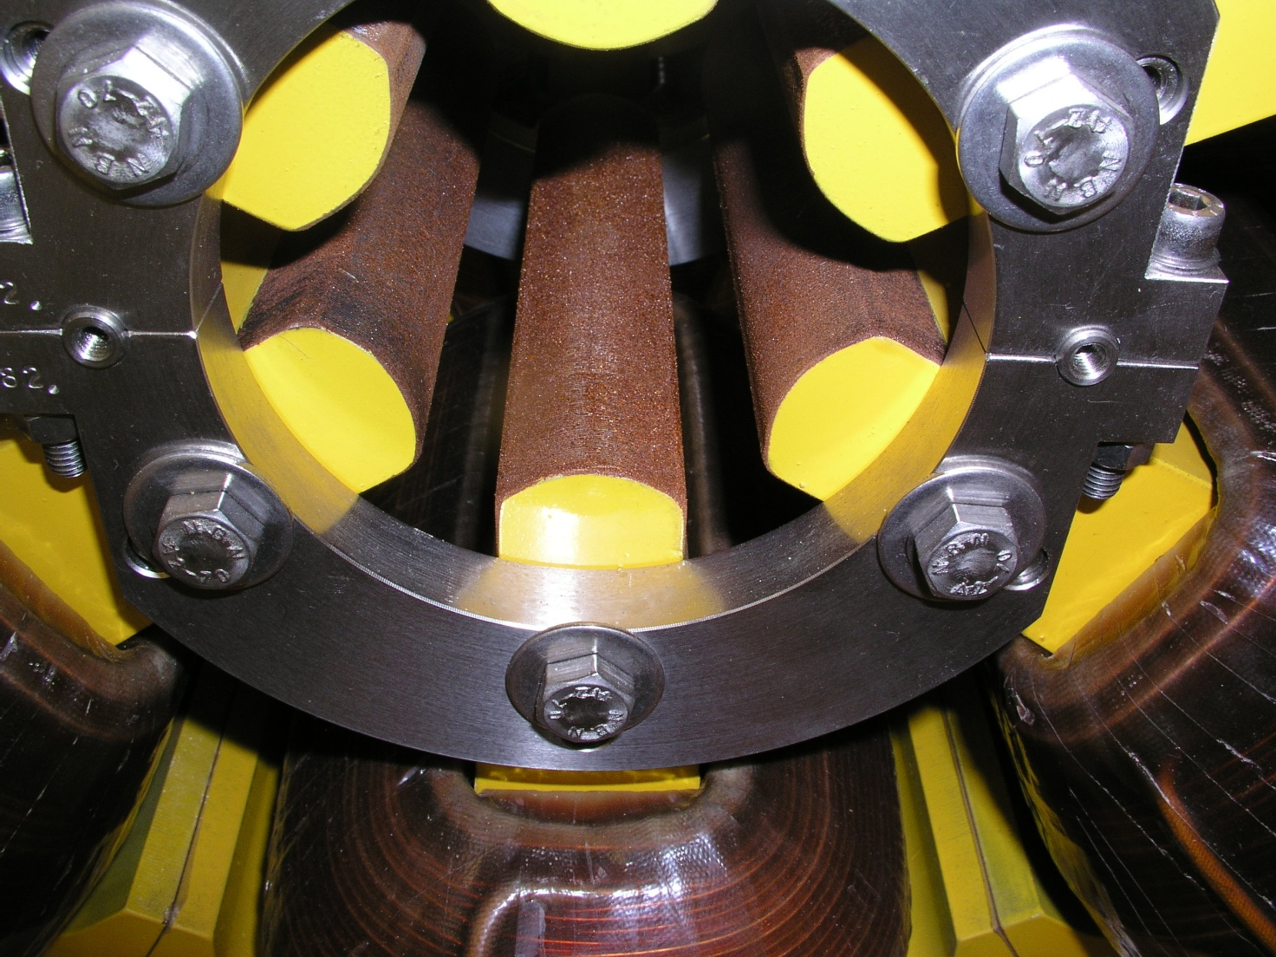
Sextupole ends
It is not usually necessary to chamfer sextupole ends (in a d.c. magnet). Diamond sextupole end:

Slide 75
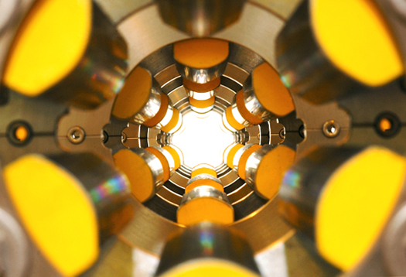
‘Artistic’ Diamond Sextupoles

