Slide 1
Instrumentation for
CERN experiments at Helsinki Detector Laboratory

Slide 2
Outline
MISSION
INFRASTRUCTURE
INSTRUMENTATION FOR CERN
SUMMARY
Particle Physics Day 30.10.2015
Eija Tuominen / Detector Laboratory

Slide 3
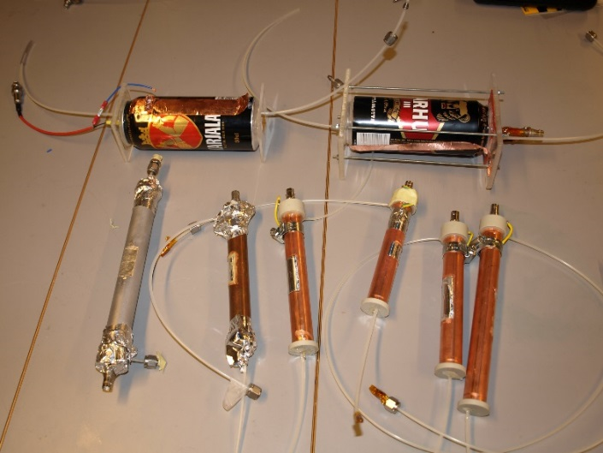
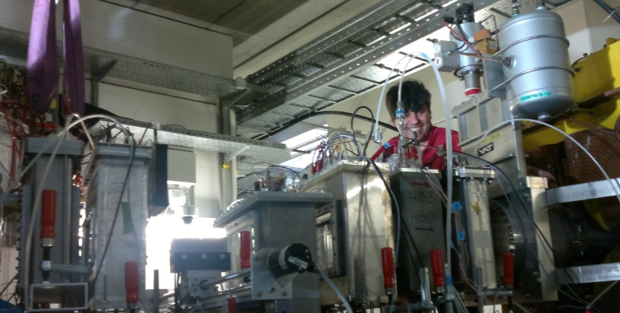
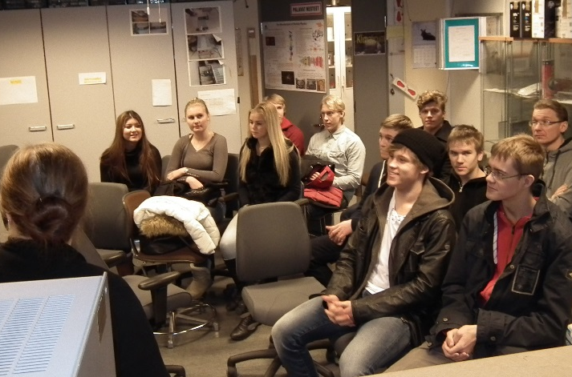
Mission
Helsinki Detector Laboratory, joint effort by HIP and UH/Physics:
- supports the instrumentation of particle and nuclear physics;
- supports the education of physics and instrumentation;
- participates in R&D projects with external funding.
Support to UH research projects and education.
Participation in the instrumentation is a pre-requisite to access CERN & FAIR experiments and their measurement data to produce new physics.
29.10.2015

Slide 4
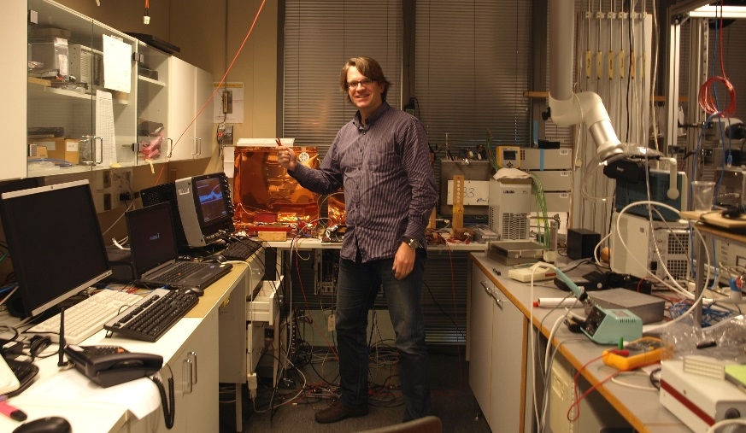
Infrastructure
Two laboratories and three clean rooms;
Equipment for Research & Development, assembly, testing and quality assurance of semiconductor and gas-filled detectors;
Personnel with extensive know-how about detectors and instrumentation.
Particle Physics Day 30.10.2015
Eija Tuominen / Detector Laboratory

Slide 5
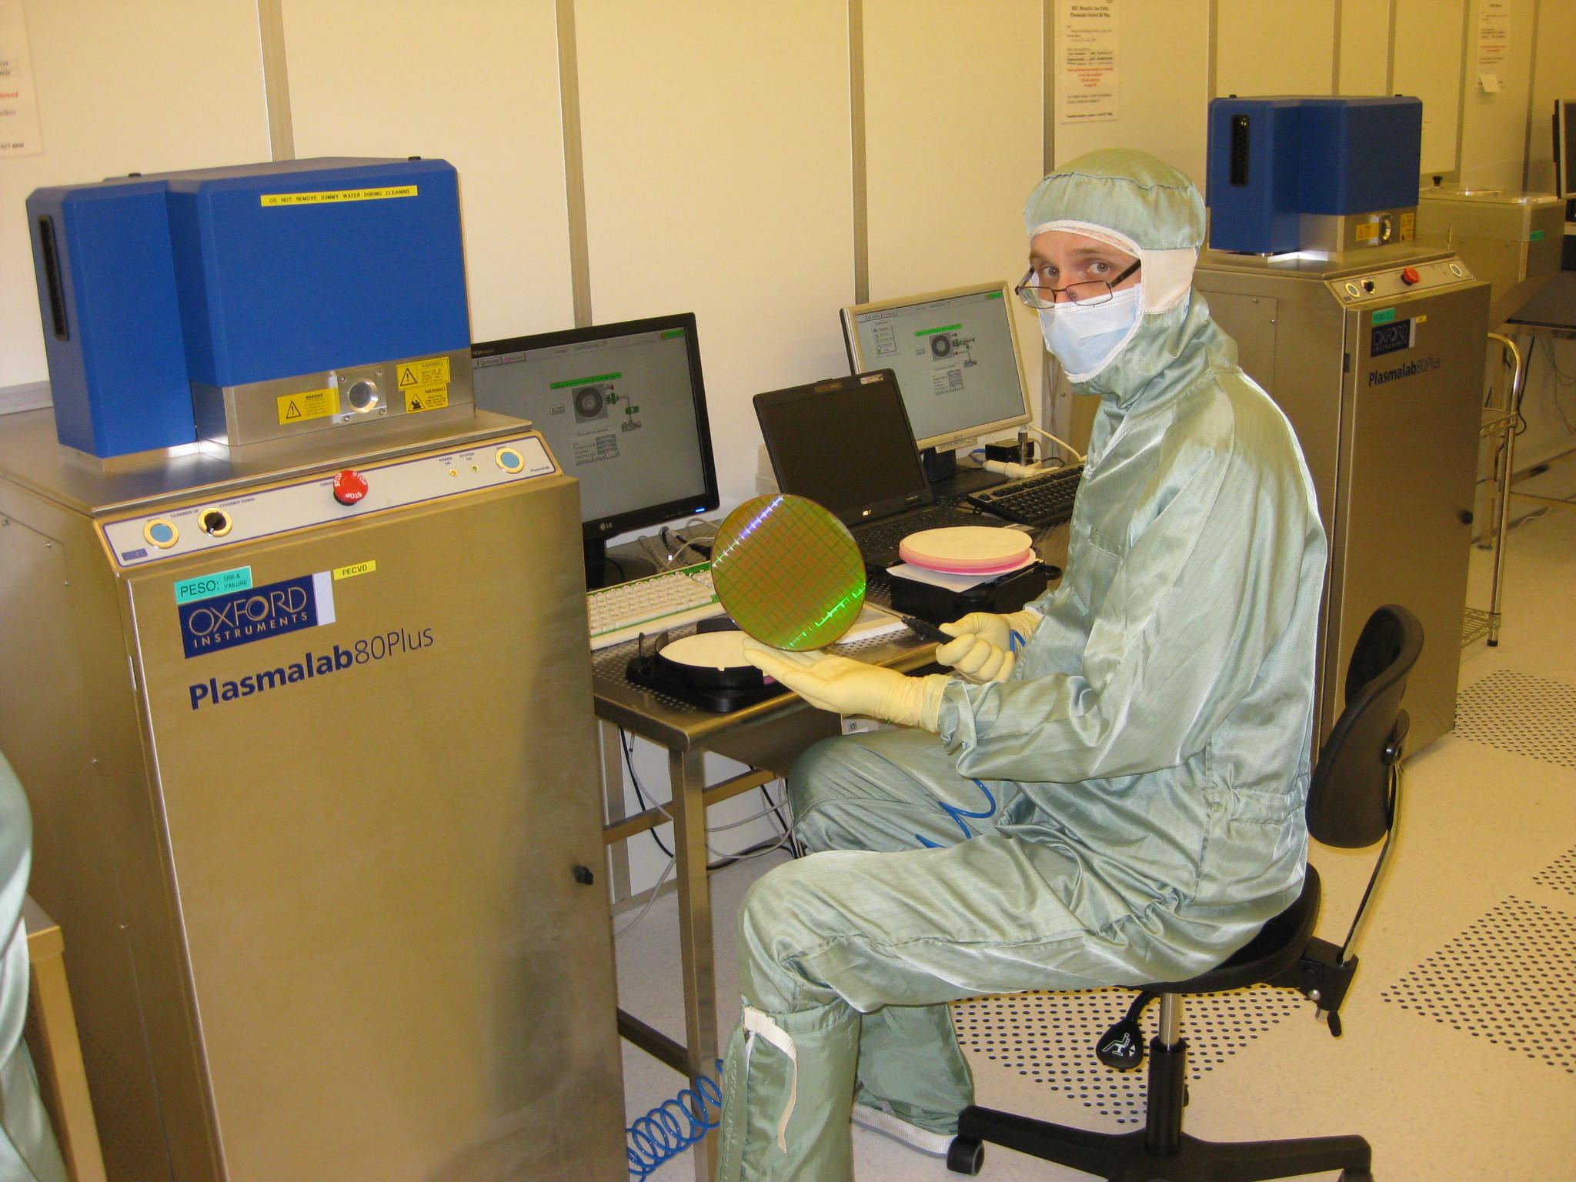
Instrumentation for
CMS Tracker Upgrade
Manufacture and quality assurance of 250 silicon pixel detector modules for CMS Tracker Phase 1 Upgrade;
R&D for Phase 2 Upgrade, with Aalto Micronova, UH/Phys, UH/Chem.
Particle Physics Day 30.10.2015
Eija Tuominen / Detector Laboratory

Slide 6
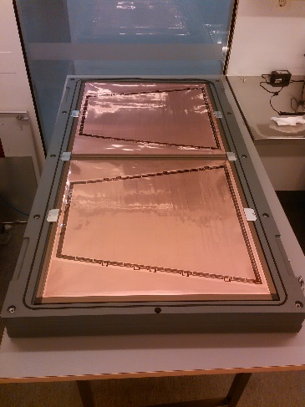
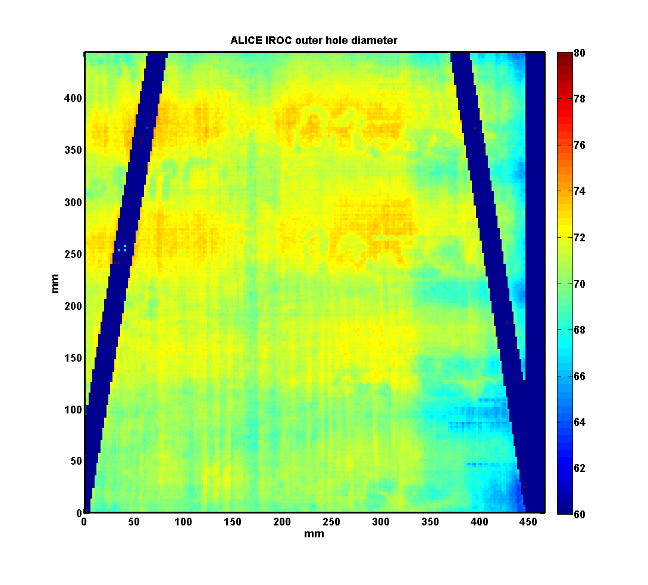
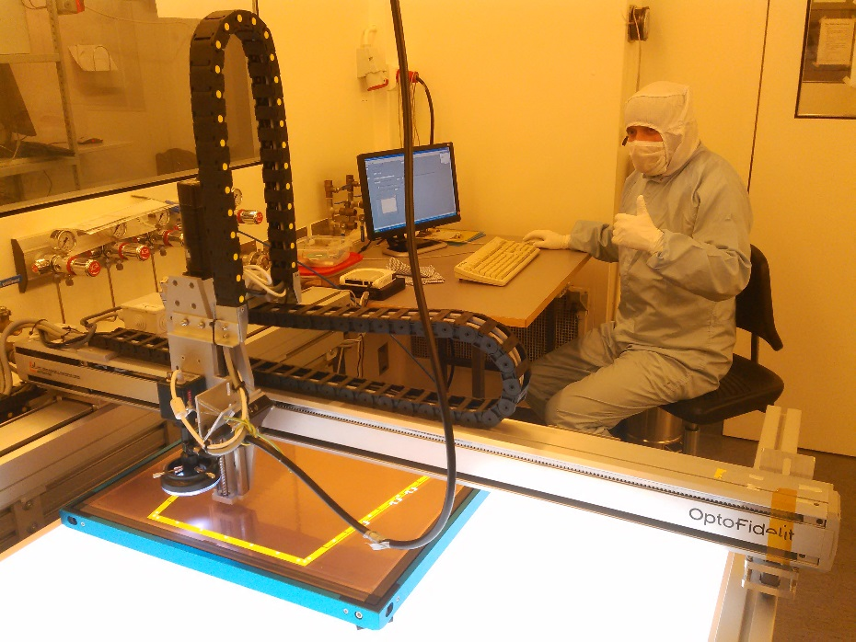
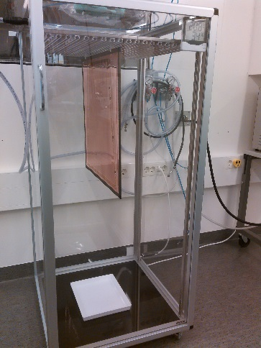
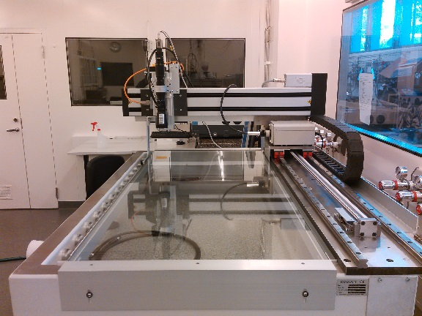
Instrumentation for
ALICE Upgrade
Quality assurance of ~400 large-size GEM (Gas Electron Multiplier) foils for ALICE Phase 1 Upgrade by optical scanning and leakage current measurements;
Close cooperation with the University of Jyväskylä.
Particle Physics Day 2015
Eija Tuominen

Slide 7
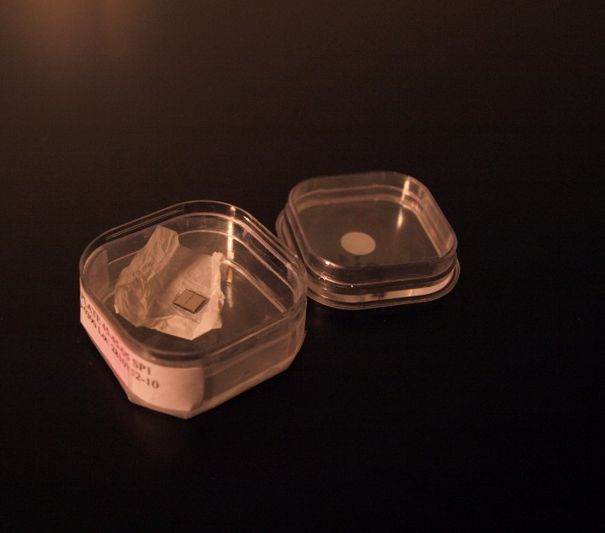
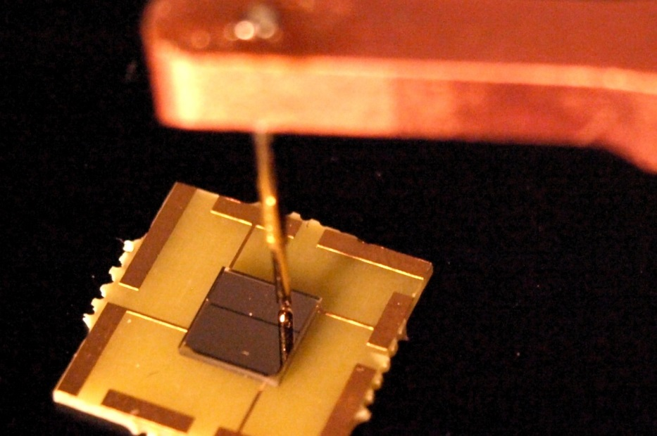
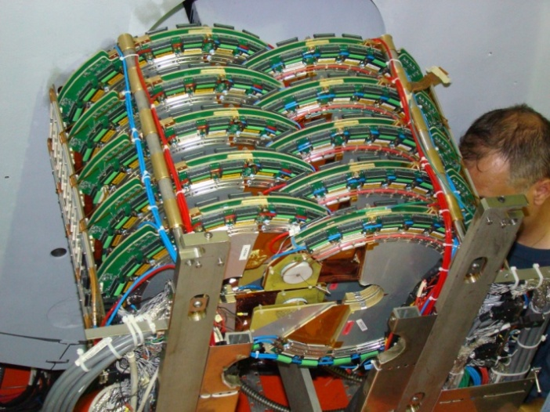
Instrumentation for
TOTEM Upgrade
Quality assurance of diamond timing detectors for the Roman Pots of the TOTEM Phase 1 Upgrade;
Maintenance of the previously manufactured 40 GEM detectors for TOTEM T2 telescope.
Particle Physics Day 30.10.2015
Eija Tuominen / Detector Laboratory

Slide 8
Summary
We do: research, education and societal interaction;
We offer: premises, equipment and know-how;
More info: research coordinator Doc. Eija Tuominen.
Particle Physics Day 30.10.2015
Eija Tuominen / Detector Laboratory

