Slide 1
Quality Control and Quality Assurance for PCB production
Fabian Kuger
on behalf of the MAMMA Collaboration
Julius-Maximilians Universität Würzburg, Germany
November 5th 2013 - MicroMegas General Meeting - CERN

Slide 2
Outline
Philosophy of QC/QA
QC/QA steps during PCB production
Proposal on QC setups
    PCB + readout strips
    resistive foils
    glued PCB + foil
    finished PCB incl. pillar structure
Open questions (Summary)

Slide 3
Philosophy of QC/QA
Conduct QC tests as fine-meshed as possible
- QC should be done after many steps during PCB production
→ all parts should be qualified before further processing, especially before shipping to another company
Shifting QC as close to industries as possible
- QC should be done at the industries whenever possible
→ requires exportable setups
- QC should be done by industry employees
→ requires automatized setups & strict criteria
Maintaining QC pressure on the industries
→ retest qualified products before delivery whenever we like

Slide 4
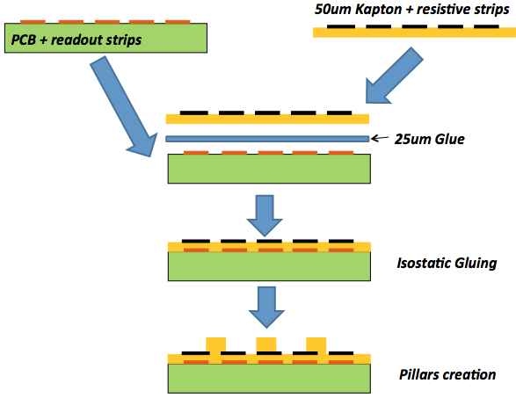
QC/QA Steps during PCB production
QC 1: PCB + readout
board thickness
strips conductivity
strips pattern, pitch, length & width
QC 2: resistive foil
resistivity
HV stability
strips pattern, pitch, length & width
QC 3: PCB + foil
board thickness
strips alignment
HV stability
(resistivity changes)
QC 4: finished PCB
missing pillars
pillar height
HV instable spots
from: Rui de Oliveira: ‘Situation with industries’, RD51 collaboration Meeting, 16-18.10. 2013 - CERN

Slide 5
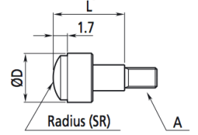
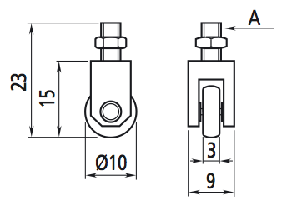
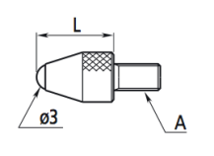
Proposal on QC setups
QC 1: PCB + readout
board thickness
strips conductivity
strips pattern, pitch, length & width
Raw material parameters:
  - Thickness of FR4 500 ± 50μm (industrial standard)
  → lower deviation of 5% maybe possible
  - Copper thickness quiet accurate 18μm, variation negligible
Mean thickness control by weight:
- easily accurate < %-level, possible fast rejection criterion
Local thickness measurement (automated test):
  - 2D Gantry system scanning PCB (sucked on flat desk) with
  a length gauge → Accuracy on < 5μm-level
- 2 different approaches:
Open questions/tasks
- Preselecting by
weigh necessary or
even sufficient?
- Local /area wide scan
practicable and
affordable?
- Rejection criteria to be discussed / defined (depending on panel construction technique)
Scanning lines with a punctual sensor:
Area wide scan with a ‘wheel-like’ sensor:
220 cm
↯
50 cm

Slide 6
Proposal on QC setups
QC 1: PCB + readout
board thickness
strips conductivity
strips pattern, pitch, length & width
Proving conductivity (record resistance) of each strip
Tagging shortcuts between neighboring strips
connector
setup sketch
(not to scale)
Side view
readout
bar-connector
(or zebra connector,
if applicable)
bar- connector
rubber
libs
pin connector
Bottom view
≳ 50 cm
PCB + strips
1024 pins
≳ 220 cm
Longitudinal cut
Desk with sucking system and alignment pins

Slide 7
Proposal on QC setups
QC 1: PCB + readout
board thickness
strips conductivity
strips pattern, pitch, length & width
Optical evaluation of the mask-PCB agreement
  (human based QC)
  PCB normal mask ‘strips only’
  PCB inverted mask ‘ FR4 only’
Alternative: Taking high resolution image + digital pattern recognition program
(PC based QC)
Strips defect:
too narrow /
broken
+
→
Non-linearity
of the strips
Open questions/tasks
- Human or PC based
measurement?
- Distinct criteria to be
defined!
+
→
Strip defect:
too wide /
shorted

Slide 8
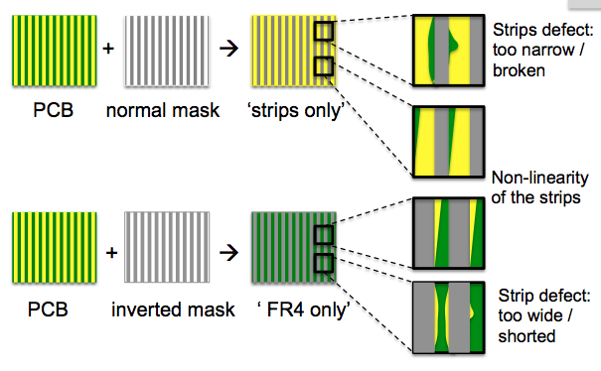
Proposal on QC setups
QC 2: resistive foil
resistivity
HV stability
strips pattern, pitch, length & width
Optical evaluation of the mask-PCB agreement
  (human based QC)
Alternative: Taking high resolution image
+ digital pattern recognition program (PC based QC)
Same possibilities as proposed for PCB inspection
Open questions/tasks
- Human or PC based
measurement?
- Do we care about
single/ local defects
in the pattern?
→ Rejection criteria to
be defined.

Slide 9
Proposal on QC setups
QC 2: resistive foil
resistivity
HV stability
strips pattern, pitch, length & width
Resistivity & HV stability QC (automated test)
- Combined setup to minimize installation time
- Sequential steps for resistivity measurement and HV - QA
connector 1 /
HV supply
Ω
Kapton foil + resistive strips
( ≳ 2200 x ≳ 50 cm )
HV
Open questions/tasks
- Limits on resistivity
variation?
- Requirements on HV
stability?
→ Rejection criteria to
be defined.
alignment pins
isolating desk incl. metallic surface
+ sucking system
2D gantry system +
measuring sensor
(connector 2)

Slide 10
Proposal on QC setups
QC 3: PCB + foil
board thickness
strips alignment
HV stability
(resistivity changes)
Gluing process might lead to:
  - Long-scale thickness fluctuations
  → Severity? (depending on panel construction technique)
  - Local surface defects (‘pits’ or ‘bumps’)
  - ‘pits’ should cause no trouble → no need for sensitive QC
  - ‘bumps’ could lead to localized sparking → QC necessary
  Checking ‘by-hand’ (human based)
  - Human hand is a very sensitive tool
  Objective test criteria (Quantity and Severity)
  ‘Storing test results’
  Or: Automated area wide scan (as for PCB) (PC based)
Open questions/tasks
- Decision on method
- Definition of rejection
criteria

Slide 11
Proposal on QC setups
QC 3: PCB + foil
board thickness
strips alignment
HV stability
(resistivity changes)
Test on strip alignment with mask
  - same alignment holes on PCB and resistive foils
  attaching PCB mask over the cured PCB + foil yields
  disalignment between resistive pattern & strips
  Retest HV stability
  - enclosed dirt could pierce trough the kapton foils
  Repeat resistivity measurement
  - heat and pressure may influence the resistive layer
  → has to be studied in advance, maybe not necessary
  for each single PCB
  → Setup as proposed for resistive foil QC
Open questions/tasks
- Criteria on alignment
to be defined.
- Requirements on HV
stability?
- Study influence of
gluing / curing process

Slide 12
Proposal on QC setups
QC 4: finished PCB
missing pillars
pillar height
HV stability
Influence of missing / broken pillars
  - a single missing pillar seems barely to influence the MM
  - but: region or pattern of missing pillars will
  → ‘Threshold’ of missing pillars is not really known
  Visual & tactile test on missing pillars (human based)
  - Hand & eyes are very sensitive tools
  - Missing pillars are easy to identify
  ‘Storing test results’
  Or: Automated surface scan (similar as for PCB)
  (PC based)
  Difficult to ensure ‘damage free’ measurement
  Or: Trust on capacity measurement
  - As soon as missing pillars influence the mesh position,
  this should be visible in the capacity measurement …
Open questions/tasks
- Study the influence of
missing pillars
- Decide if / how to
identify missing pillars
→ Define rejection
criteria

Slide 13
Proposal on QC setups
QC 4: finished PCB
missing pillars
pillar height
HV stability
Pillar height by capacity measurement
  - Capacity is very sensitive to height deviation
  - Attaching a segmented anode on the pillars
  (segmented PCB or foil, applied similar to a floating mesh)
  Capacity mapping → ‘mean’ pillar height map
  Stretching of PCB / foil not jet tested
Same Setup can be used to identify HV instable spots
  If dust filaments are partly encapsulated in the pillars they
  can act as a current bridge
→ Localization allows systematic cleaning
  Setup requires clean environment
Longitudinal cut
Top view
(patterned PCB / foil)
stretched PCB / Foil + copper pattern
finished PCB
Open questions/tasks
Study on operability
Decision on layout / size of segments
→ Define rejection
criteria

Slide 14
Summary / Open Questions
QC/QA plans for PCB production are in progress,
proposals to address all QC items are under discussion.
Technical realization of these proposals will be driven forward.
To conclude on QC/QA plans open questions have to be discussed and answered:
  Final decisions on production have to be taken before finalization of QC/QA plans.
  QC-testing proposals / alternatives should be discussed and agreed on.
  Technical details of proposed setups have to be fixed.
  Requirements for QC tests (alignment holes, connections etc.) must be included in PCB and resistive pattern layouts.
  Rejection criteria in every step of PCB production have to be defined.

Slide 15
Thank you for your attention!
Questions, comments and remarks are highly welcome.

