Slide 1
MM mechanical prototype
Work progress at CERN

Slide 2
Purpose
Demonstrate feasibility
Setup of basic infrastructure
Gain experience with
  Materials
  Construction/assembly ideas/schemes
  Procedures
  Precision (panel planarity, parallelism of skins, …)
Produce objects that can be measured

Slide 3
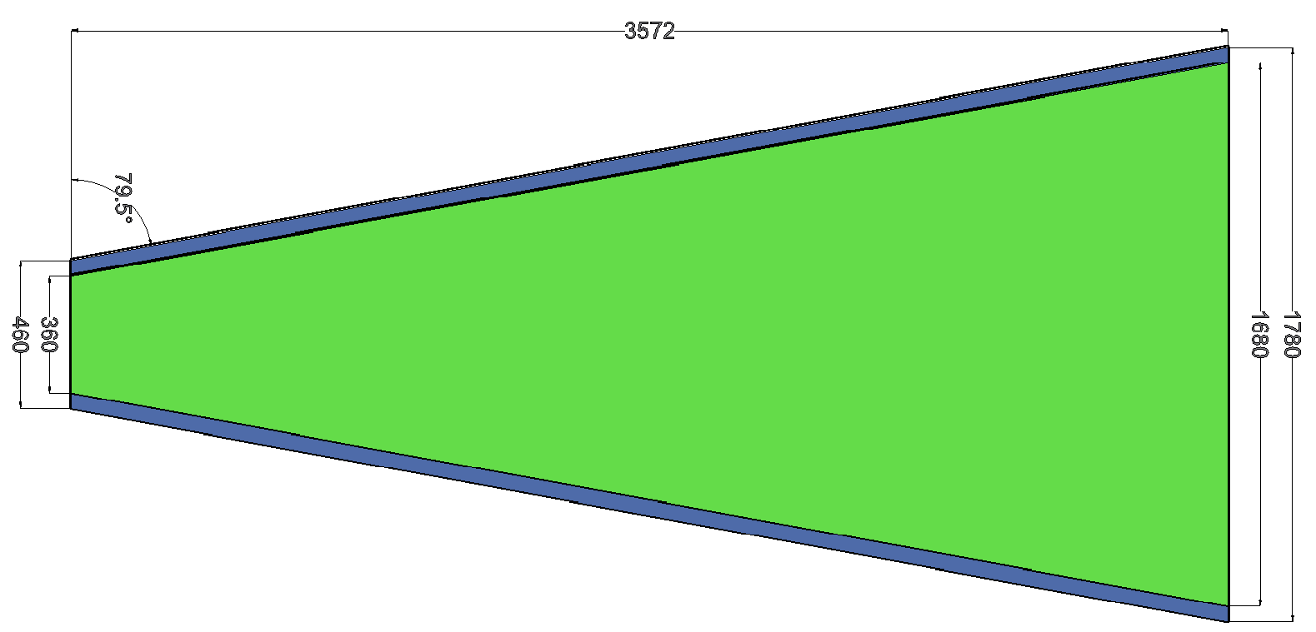
CERN mechanical prototype (1)
Full-wedge small sector quadruplet
  Eta and stereo doublets
Drift gap – 5 mm
Total thickness ~80 mm
Support frame (spacer)

Slide 4
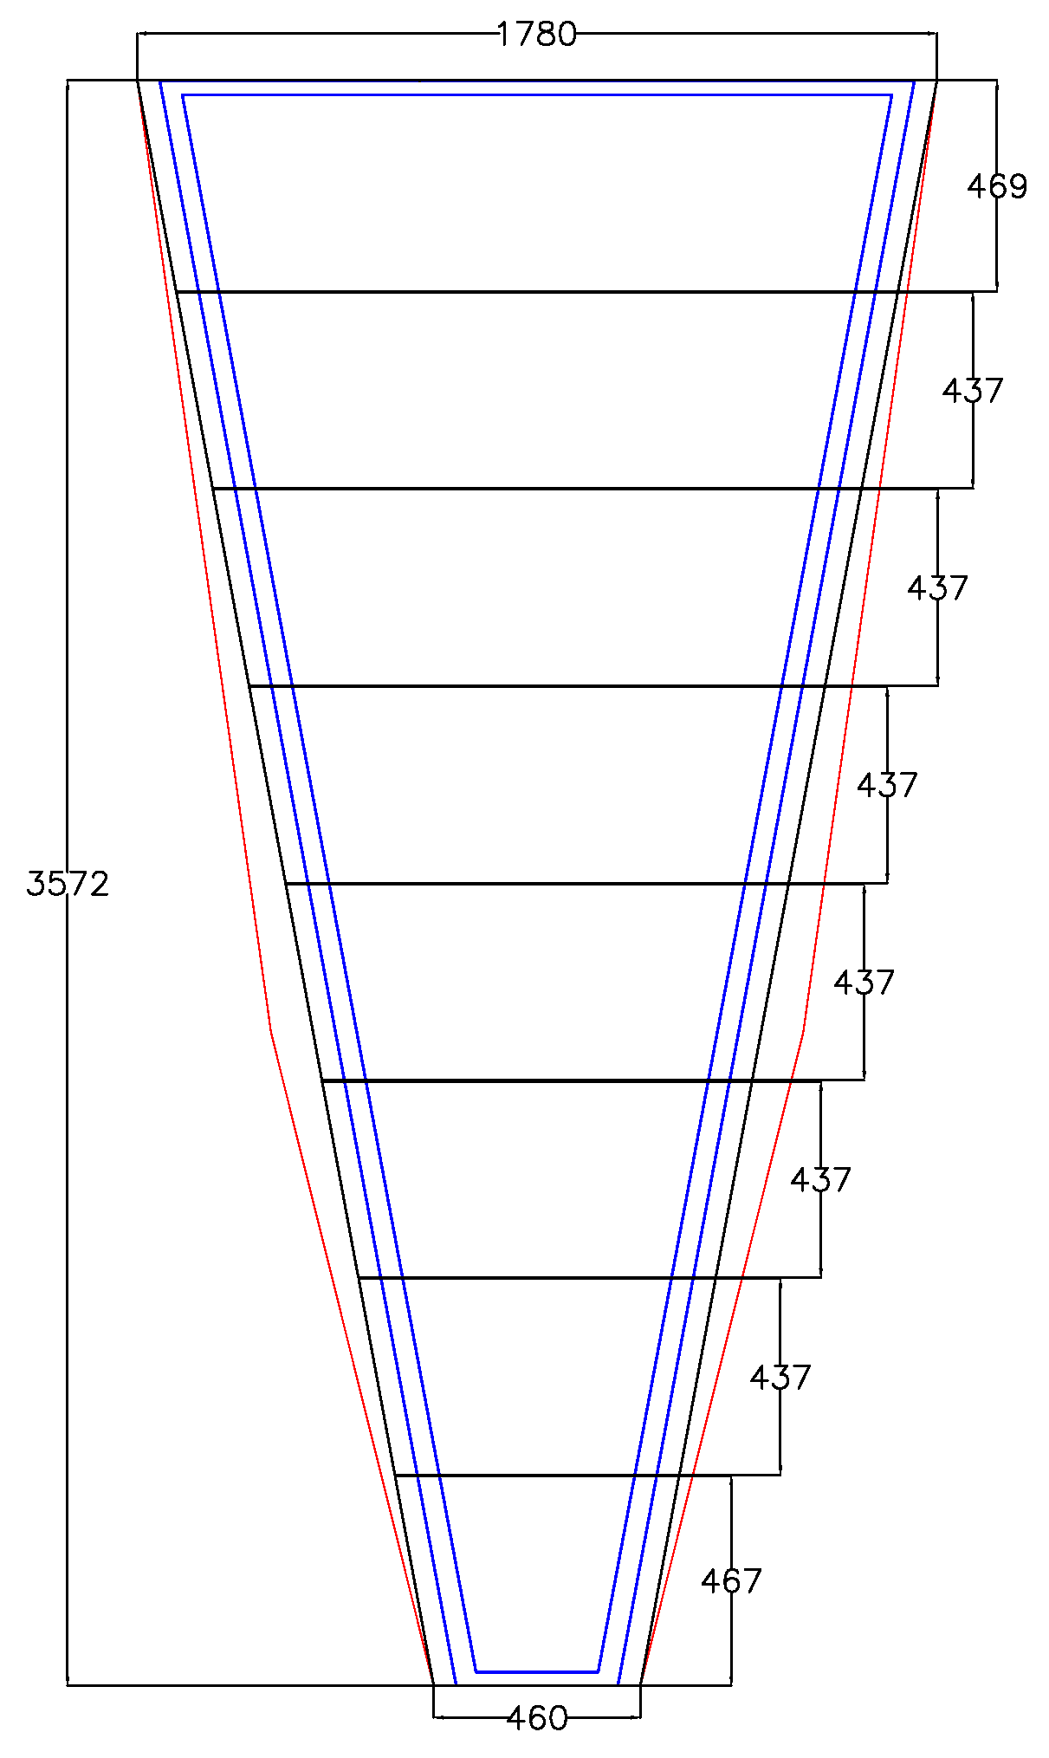
CERN mechanical prototype (2)
All panels of equal thickness ~12 mm
  Frame of standard 10 mm Al profiles
  0.4 mm plastic mesh
  9.5 mm foam panel
  Skins – 0.5 mm FR4 segmented
  into the 8 parts
  Glue – Araldite 2011
  – Araldite AY 103-1 + HY 991
  – Scotch-Weld DP490

Slide 5
Assembling site
We get new space at Bld. 153-R-030
Iron table 4 x 2.5 m²
Flatness ≤ 20μm

Slide 6
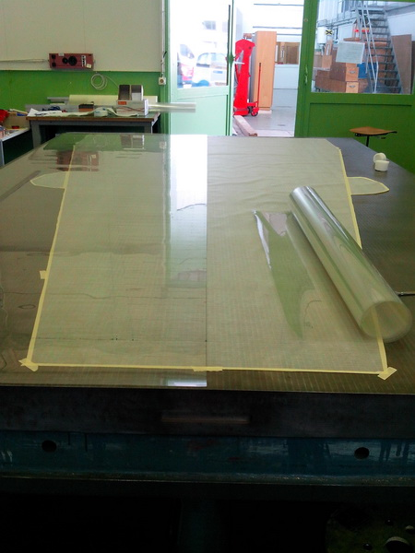
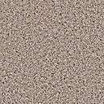
Vacuum table
On the table was placed
thin plastic mesh for
pressure distribution
Mesh was covered by
175 μm Mylar foil
with the holes
Vacuum

Slide 7
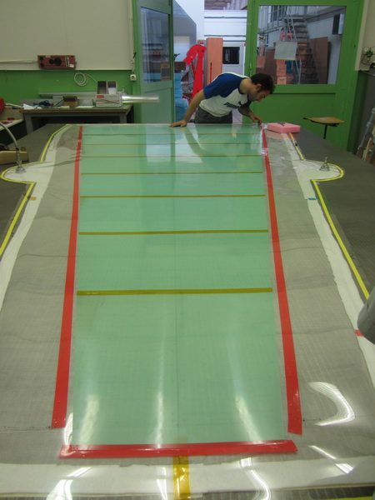
Vacuum table
On the Mylar was placed 8 pieces of FR4 skin joined by 60 μm Kapton scotch
Skins were sealed with the tape along the perimeter and sucked to the table

Slide 8
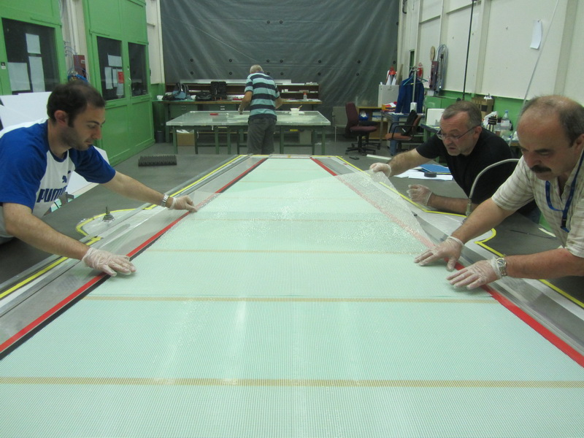
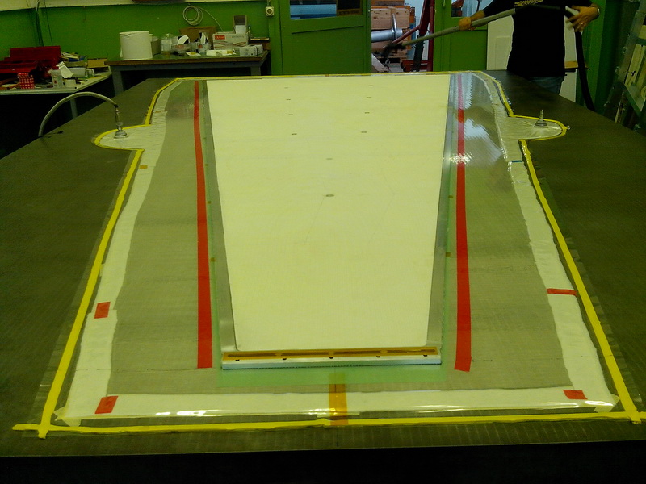
Gluing (1)
Step 1 – 400 μm plastic mesh was glued on the skin
Step 2 – Aluminum frame and foam panels were placed and glued on the mesh

Slide 9
Gluing (2)
Second skin was placed and sucked on the table
Glue was distributed on the surface
Plastic mesh was wetted by glue and placed on the skin
Prepared “half panel” picked up with the stiff-back structure and placed on the mesh
Calibrated shims were placed under the stiff-back

Slide 10

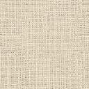

Gluing (3)
Using Stiff-back frame
Clarinet gas
Vacuum
Vacuum
Vacuum
Rohacell honeycomb
Skin (G10)
Glue
Precision shim

Slide 11
First experience (1)
All 5 full-wedge size panels (2 read-out and 3 drift) were glued using different glues and scheme:
The planarity of the panels seems good (visually)
– to be measured on the laser interferometer
  Araldite AY103 + HY991 seems more comfortable
  When use Scotch-weld DP490 glue no need of the plastic mesh
Some problems with the gluing
  Some regions where mesh is not glued to the skin,
  needed injection of the fluid glue

Slide 12
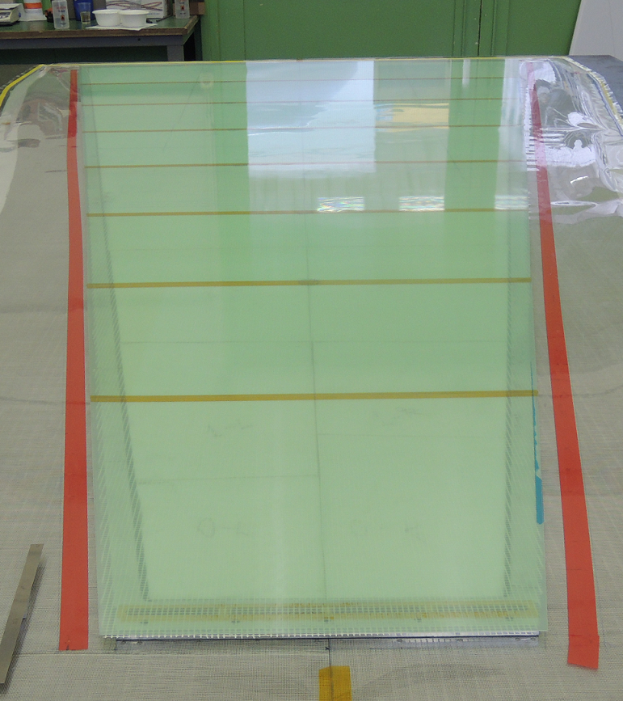
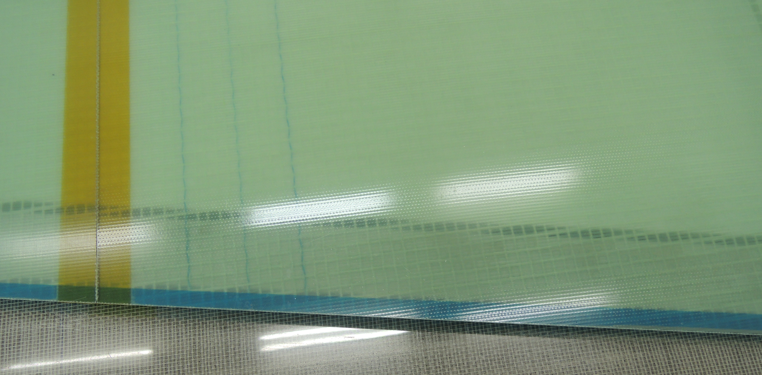
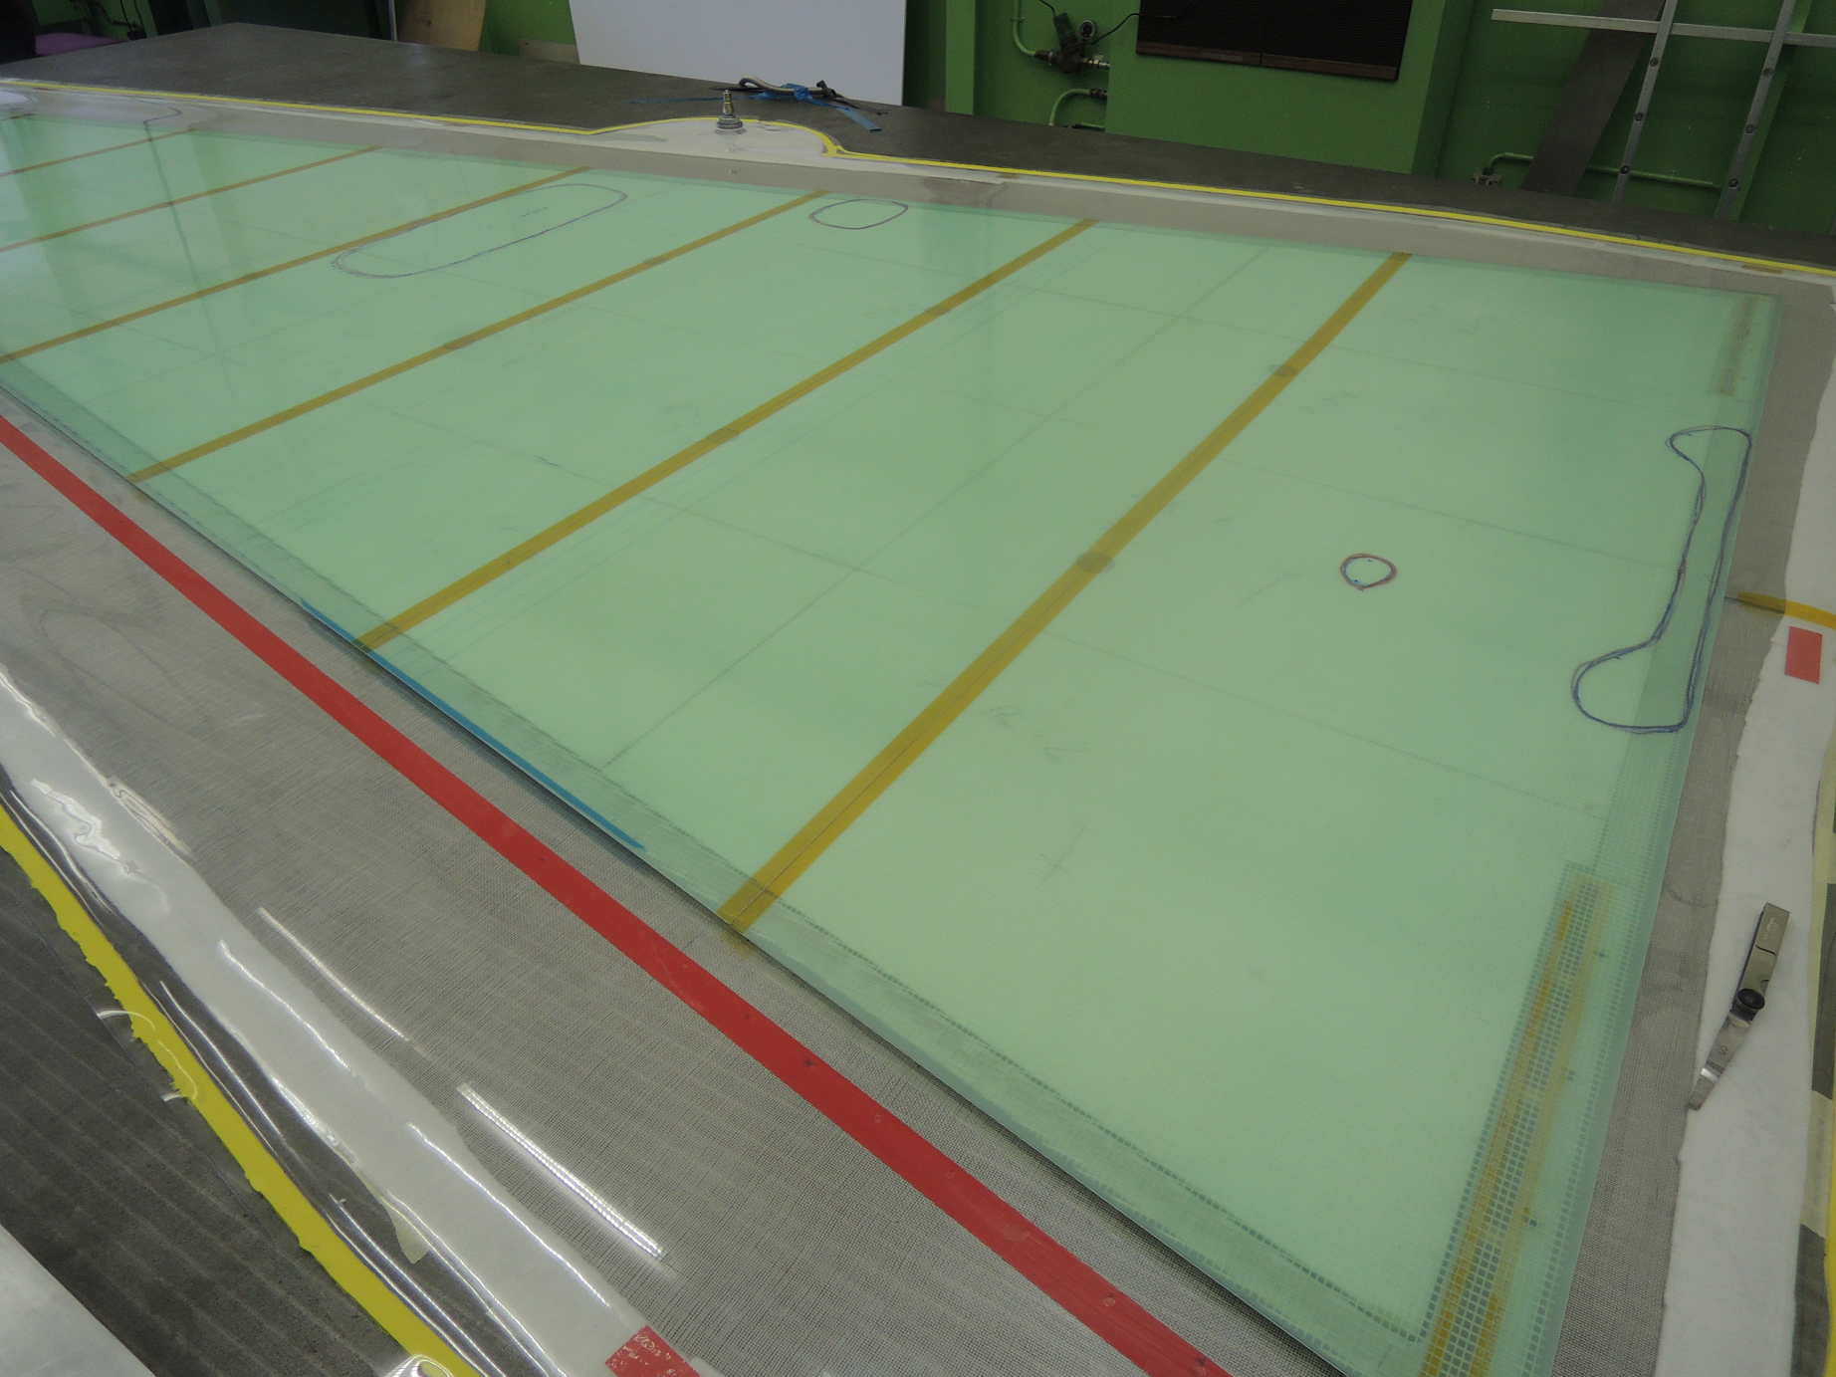
First experience (2)
Inner structure
Full panel view
Problematic regions

Slide 13
Panel sag measurements (1)
To measure the sag of the panels, they were places on two ends
The measurements were done for each panel separately with and without additional weight (2.7 kg)
Same measurements were done also for the combination of 2, 3, 4 and 5 panels assembled together

Slide 14
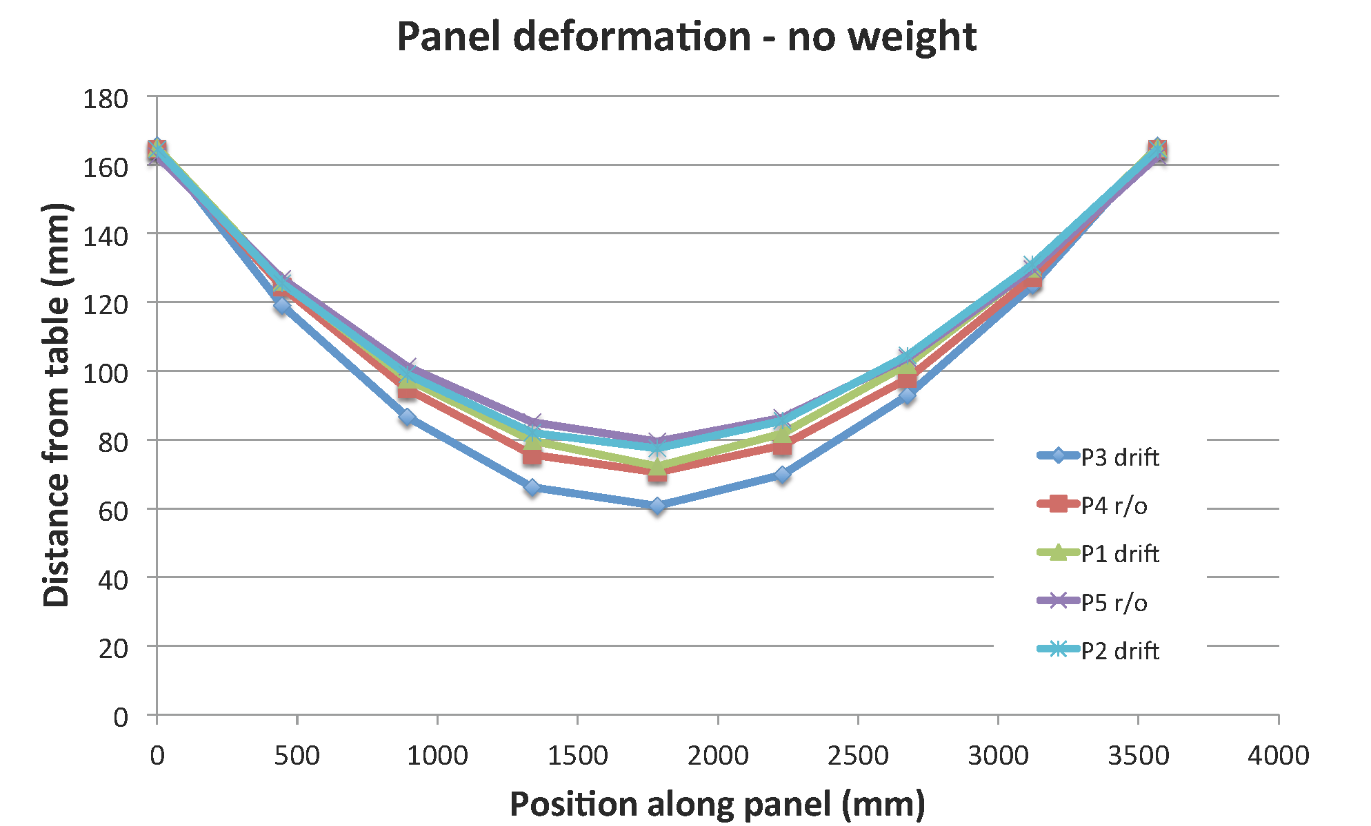
Panel sag measurements (2)

Slide 15
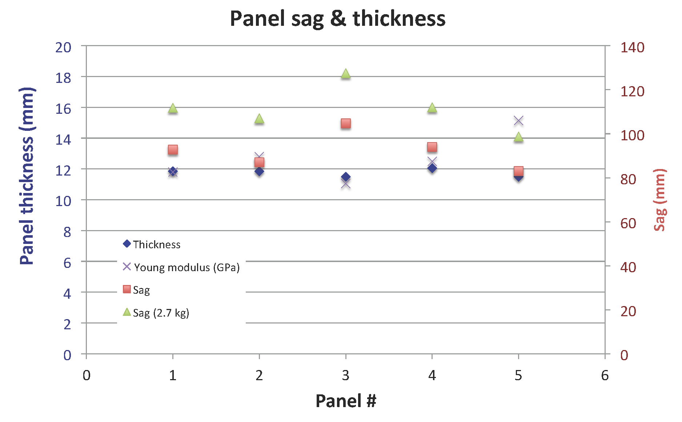
Panel sag measurements (3)

Slide 16
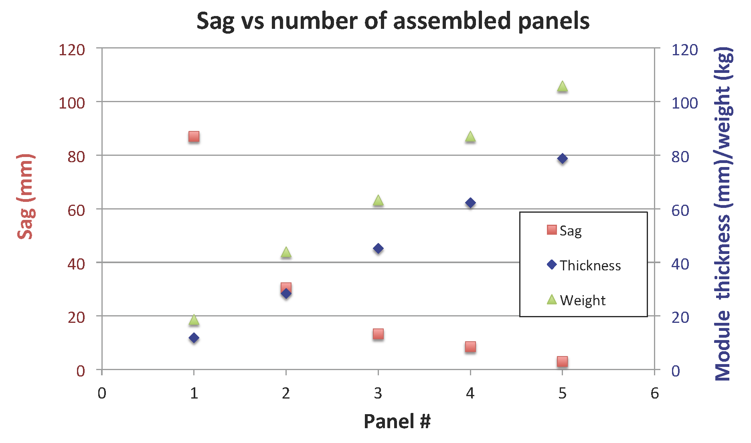
Panel sag measurements (4)

Slide 17
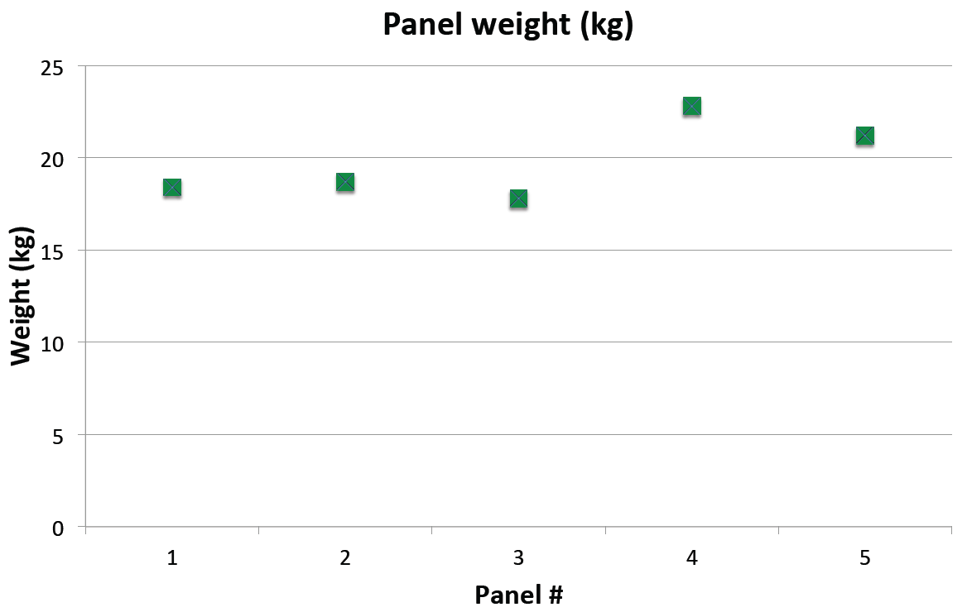
Weight of the panels

Slide 18
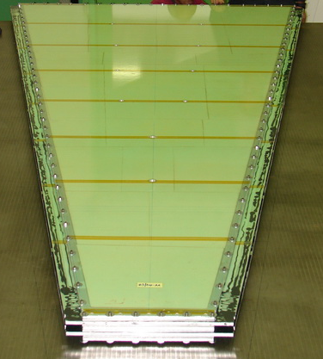
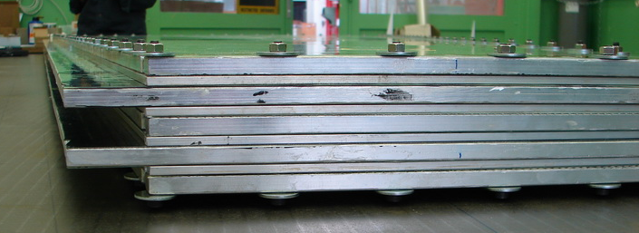
Prototype assembling
The panel weight varies between 18 and 22 kg
The weight of the assembled prototype including the spacer bars and assembling screws and nuts (100 pairs) –107 kg

Slide 19
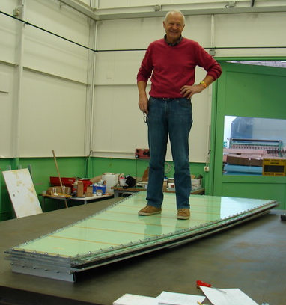
Prototype test
After applying of “extra weight” of 82.1 kg the sag of the assembled prototype increased by 3 mm
Sag came back to the previous value when extra weight has been removed

Slide 20
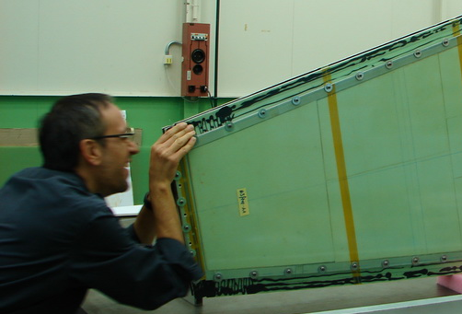
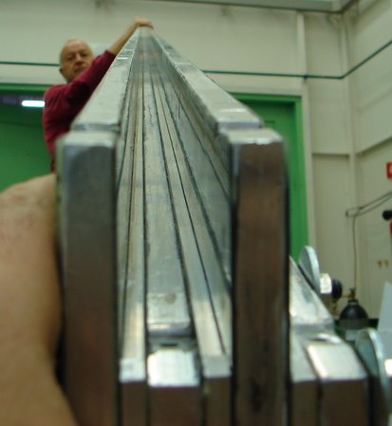
Prototype test
Visual inspection shows rather good planarity, to be measured with more precise devises.

Slide 21
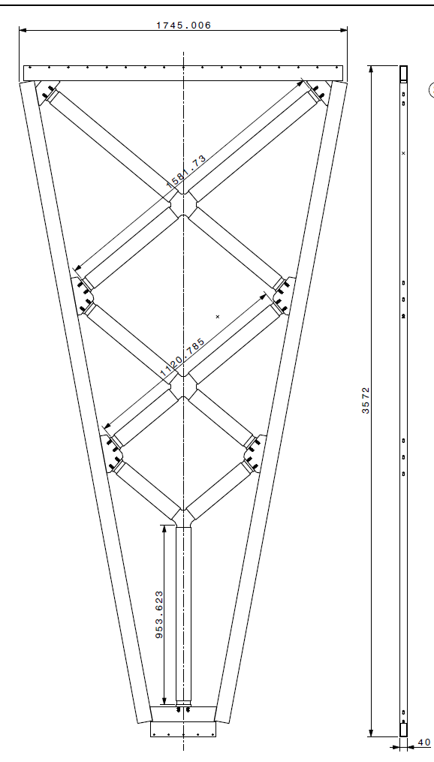
Next step – spacer frame
The spacer frame has been designed and simulated (G. Spigo & M. Ciapetti)
Frame under contraction (Naples, CERN)
From other side of the spacer will be added the dummy wedge with equal weight
To be assembled and tested with prototype in the different orientation for the mechanical deformation, ect…

Slide 22
Collaborative effort
CERN, Dubna, Lecce …
Drawings and calculations: Lecce and CERN
Infrastructure and tooling: CERN
Technical work: CERN, Dubna, Lecce, Naples
+ 3 summer students (2 physicist + 1 engineer)

