Slide 1



Energy Deposition Results in: Decay Tube Window & Shutter
1st AWAKE Performance Meeting 28.10.2013 Athanasios.Manousos@cern.ch, Vasilis.vlachoudis@cern.ch

Slide 2
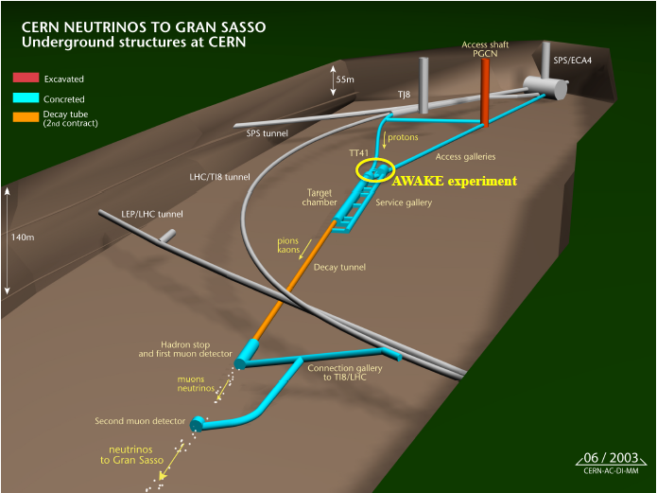
Introduction

Slide 3
Simulation Setup Beam & Materials
Beam Parameters
Energy : 400 GeV
Intensity : 3.5*10¹¹ p⁺ (Ultimate: 3.5 10¹¹)
1 sigma : 6mm at the window
Frequency: 0.14Hz
Center of beam is at center of window
Divergence → 30urad
Materials
Tube Window: Titanium Grade 2
Shutter: Iron

Slide 4
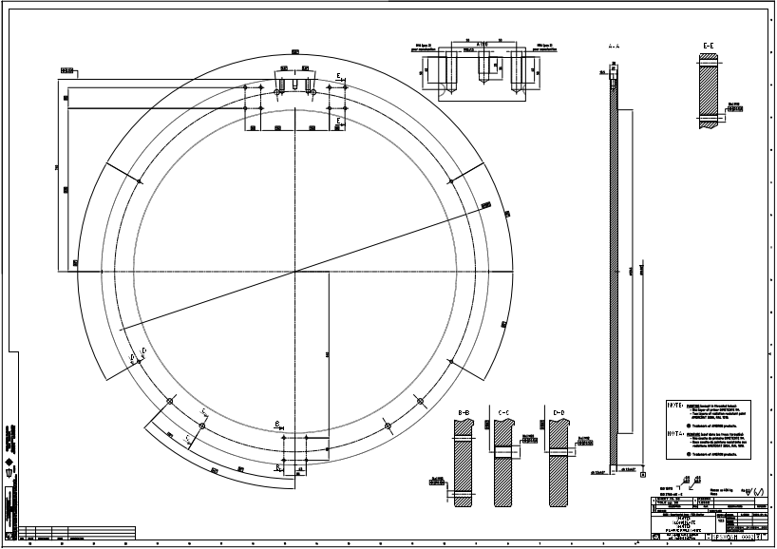
Simulation Setup Geometry Layouts
Tube Window
Shutter

Slide 5
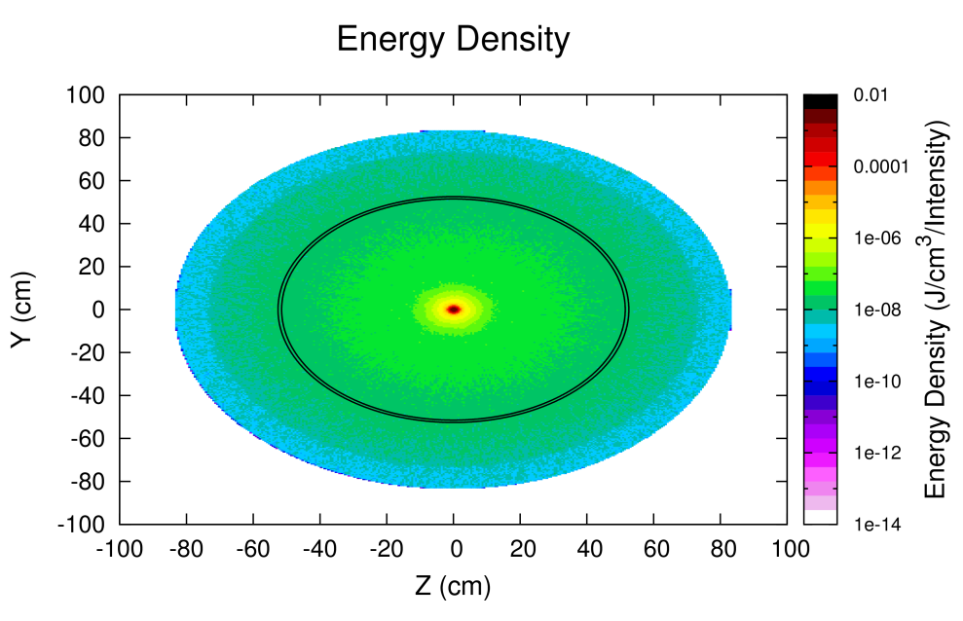
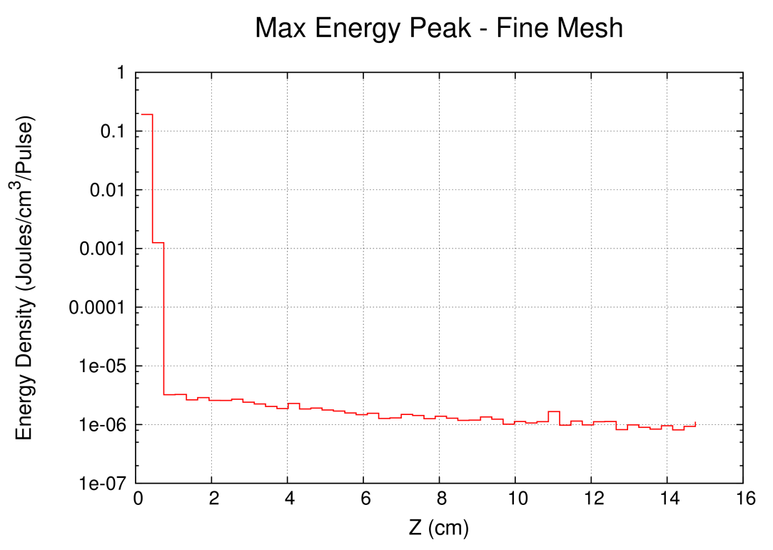
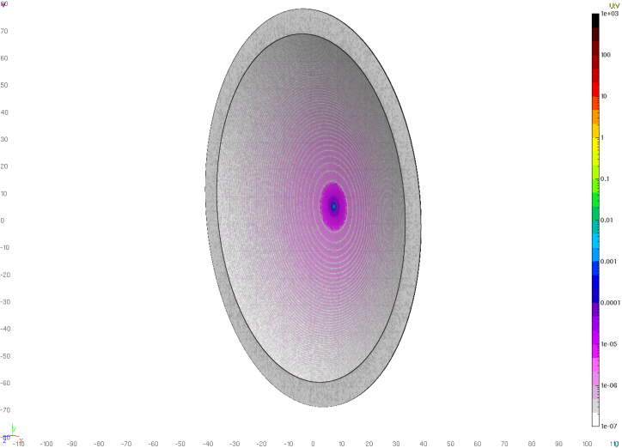
FLUKA: Energy Deposition Calculations Decay Tube Window
Max Energy Deposited: ~ 0.2 Joules/cm³/Pulse

Slide 6
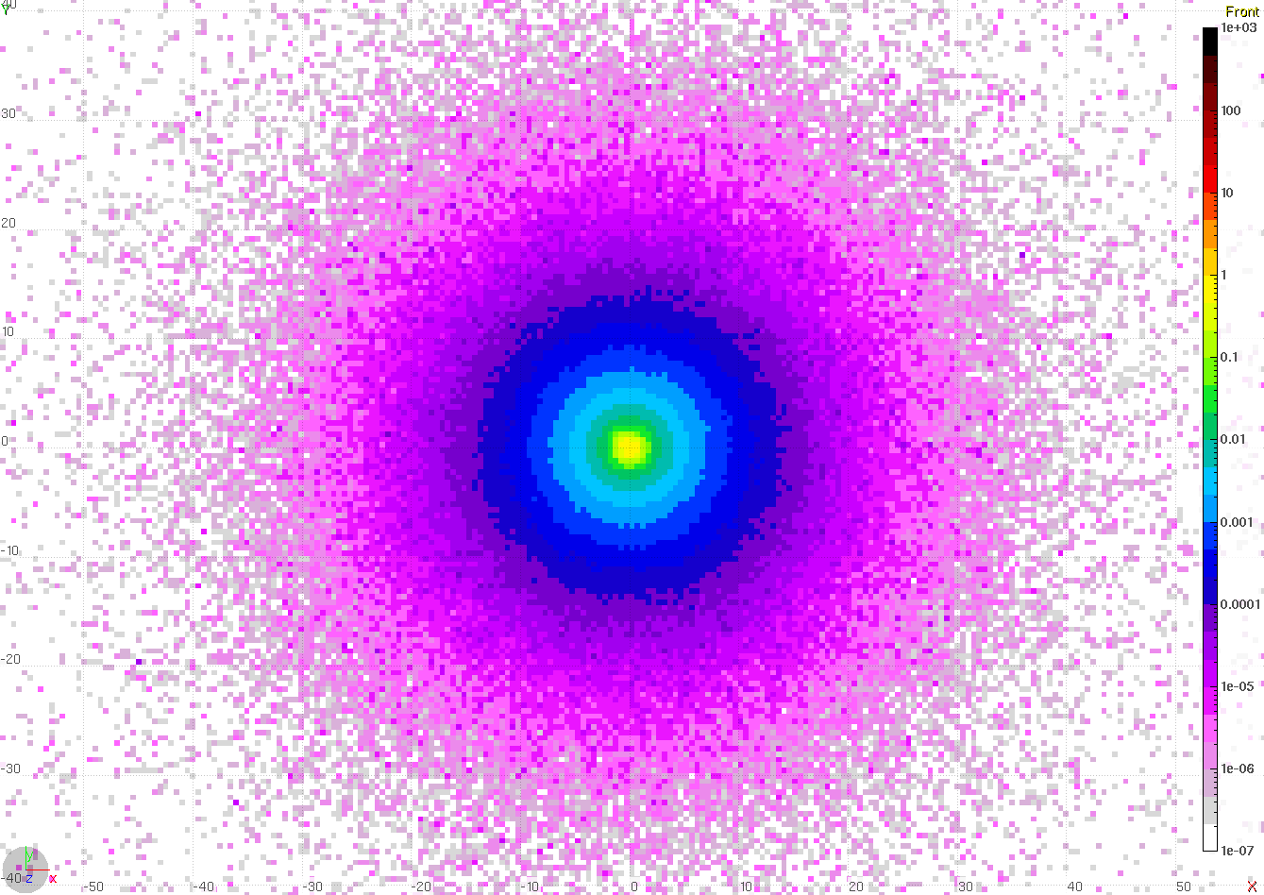
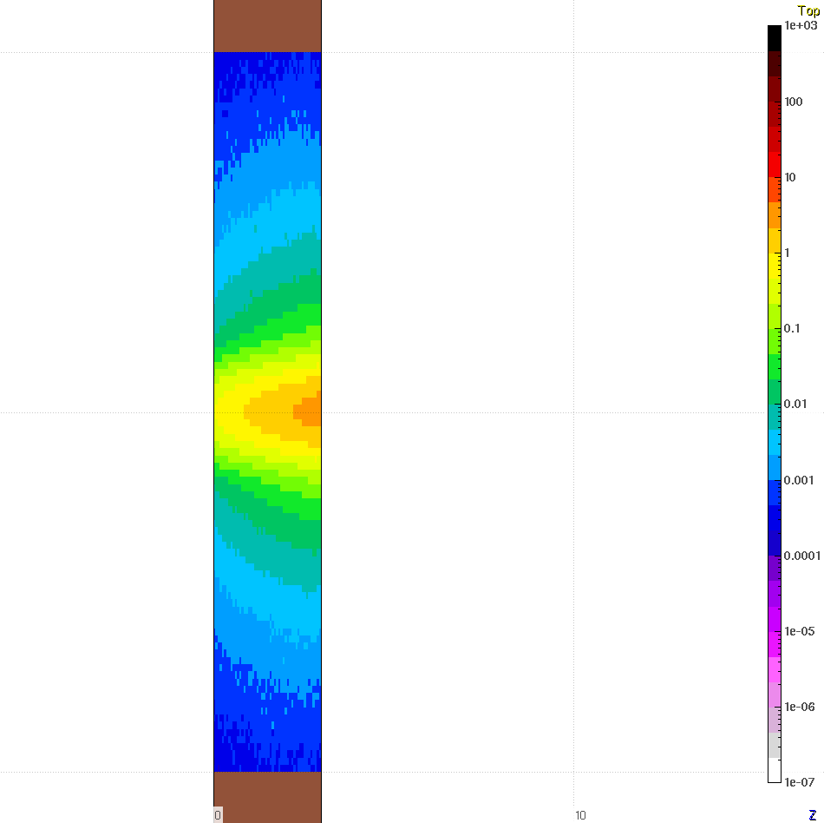
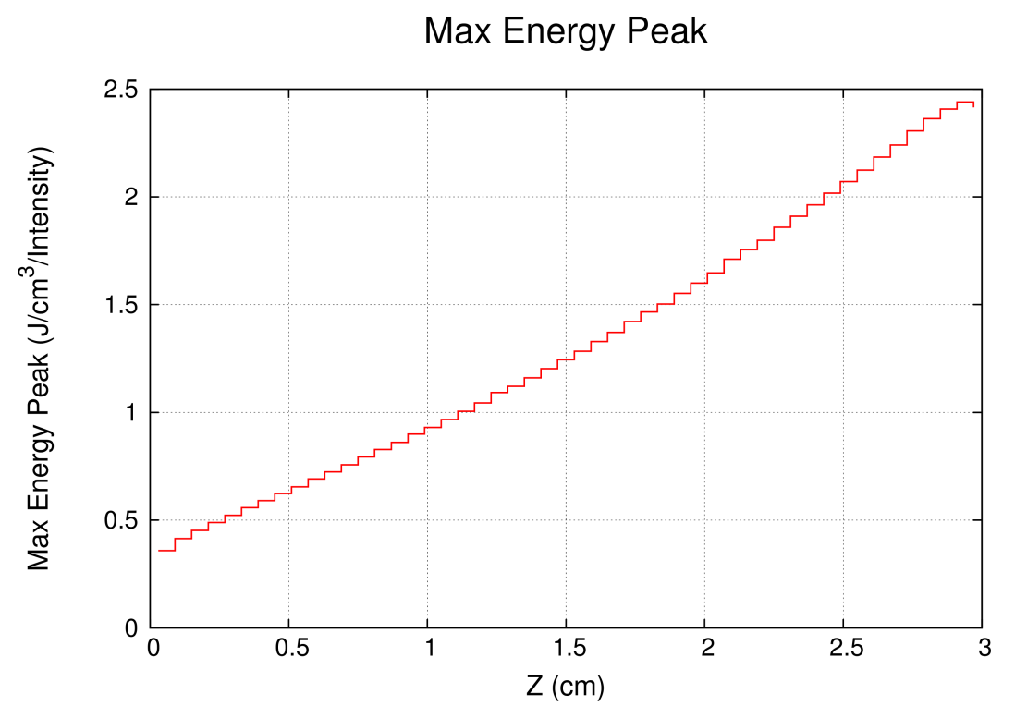
FLUKA: Energy Deposition Calculations Shutter
Max Energy Deposited: ~ 2.5 Joules/cm³/Pulse

Slide 7
Summary
Maximum Energy Deposited:
~ 0.2 Joules/cm³/Pulse on Window
~ 2.5 Joules/cm³/Pulse on Shutter
Both presented simulations are accepted.
Questions ??

Slide 8
Backup Slides
Material Definition:
TG2:
Material | Mass Fraction %
Carbon | 0.1
Iron | 0.3
Hydrogen | 0.015
Nitrogen | 0.03
Oxygen | 0.25
Titanium | 99.2

