Slide 1
AWAKE: D2E for Alexey beam properties
Silvia Cipiccia, Eduard Feldbaumer, Helmut Vincke
DGS/RP

Slide 2
Outline:
Alexey’s simulations output
Preliminary D2E results for different scenarios:
  3 mm radius 6 m long steel cylinder
  10 mm radius 6 m long steel cylinder
  10 mm radius 9 m long steel cylinder
  15 mm radius 9 m long steel cylinder
  4 cm diameter new plasma cell
    3 mm radius 6 m long steel cylinder
    10 mm radius 6 m long steel cylinder
    15 mm radius 6 m long steel cylinder
Alexey’s simulations output for compressed beam

Slide 3
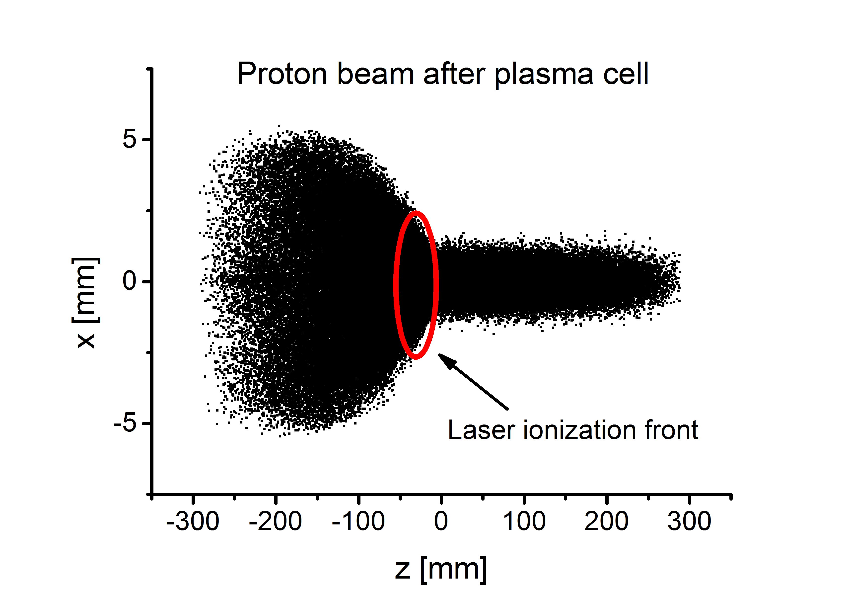
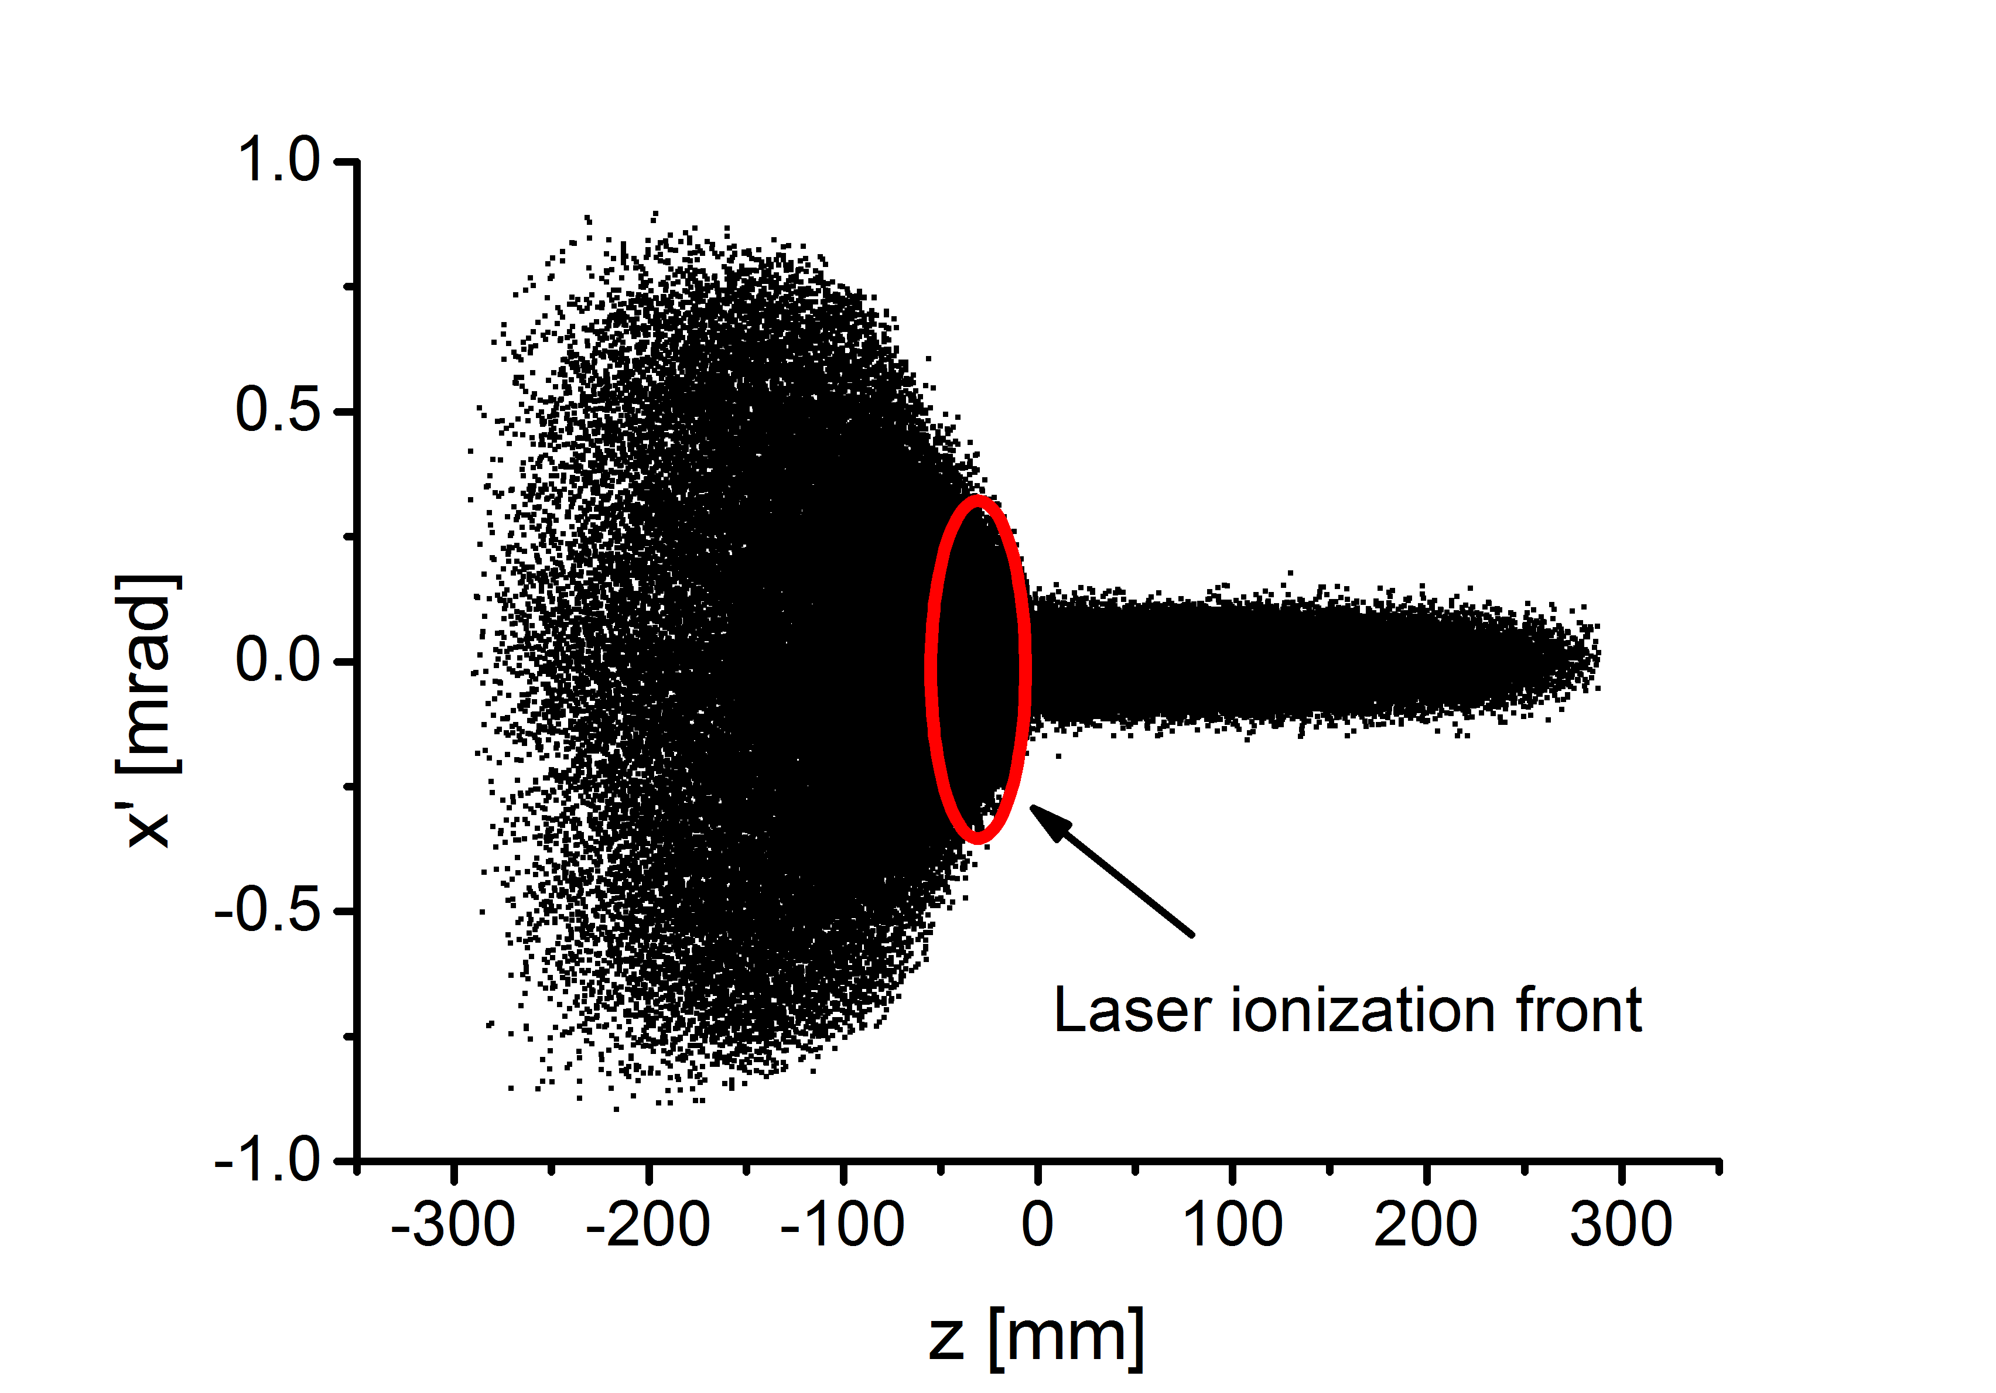
Alexey’s simulations output
Proton beam in plasma undergoes SMI->increasing in beam divergence
Alexey’s data

Slide 4
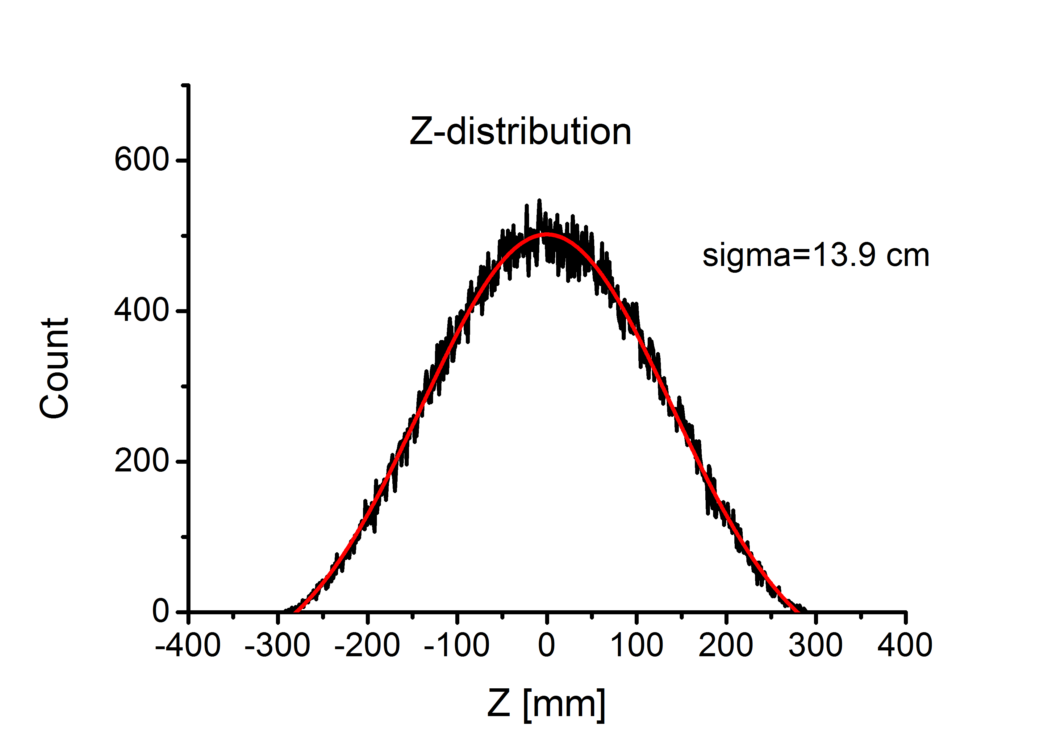
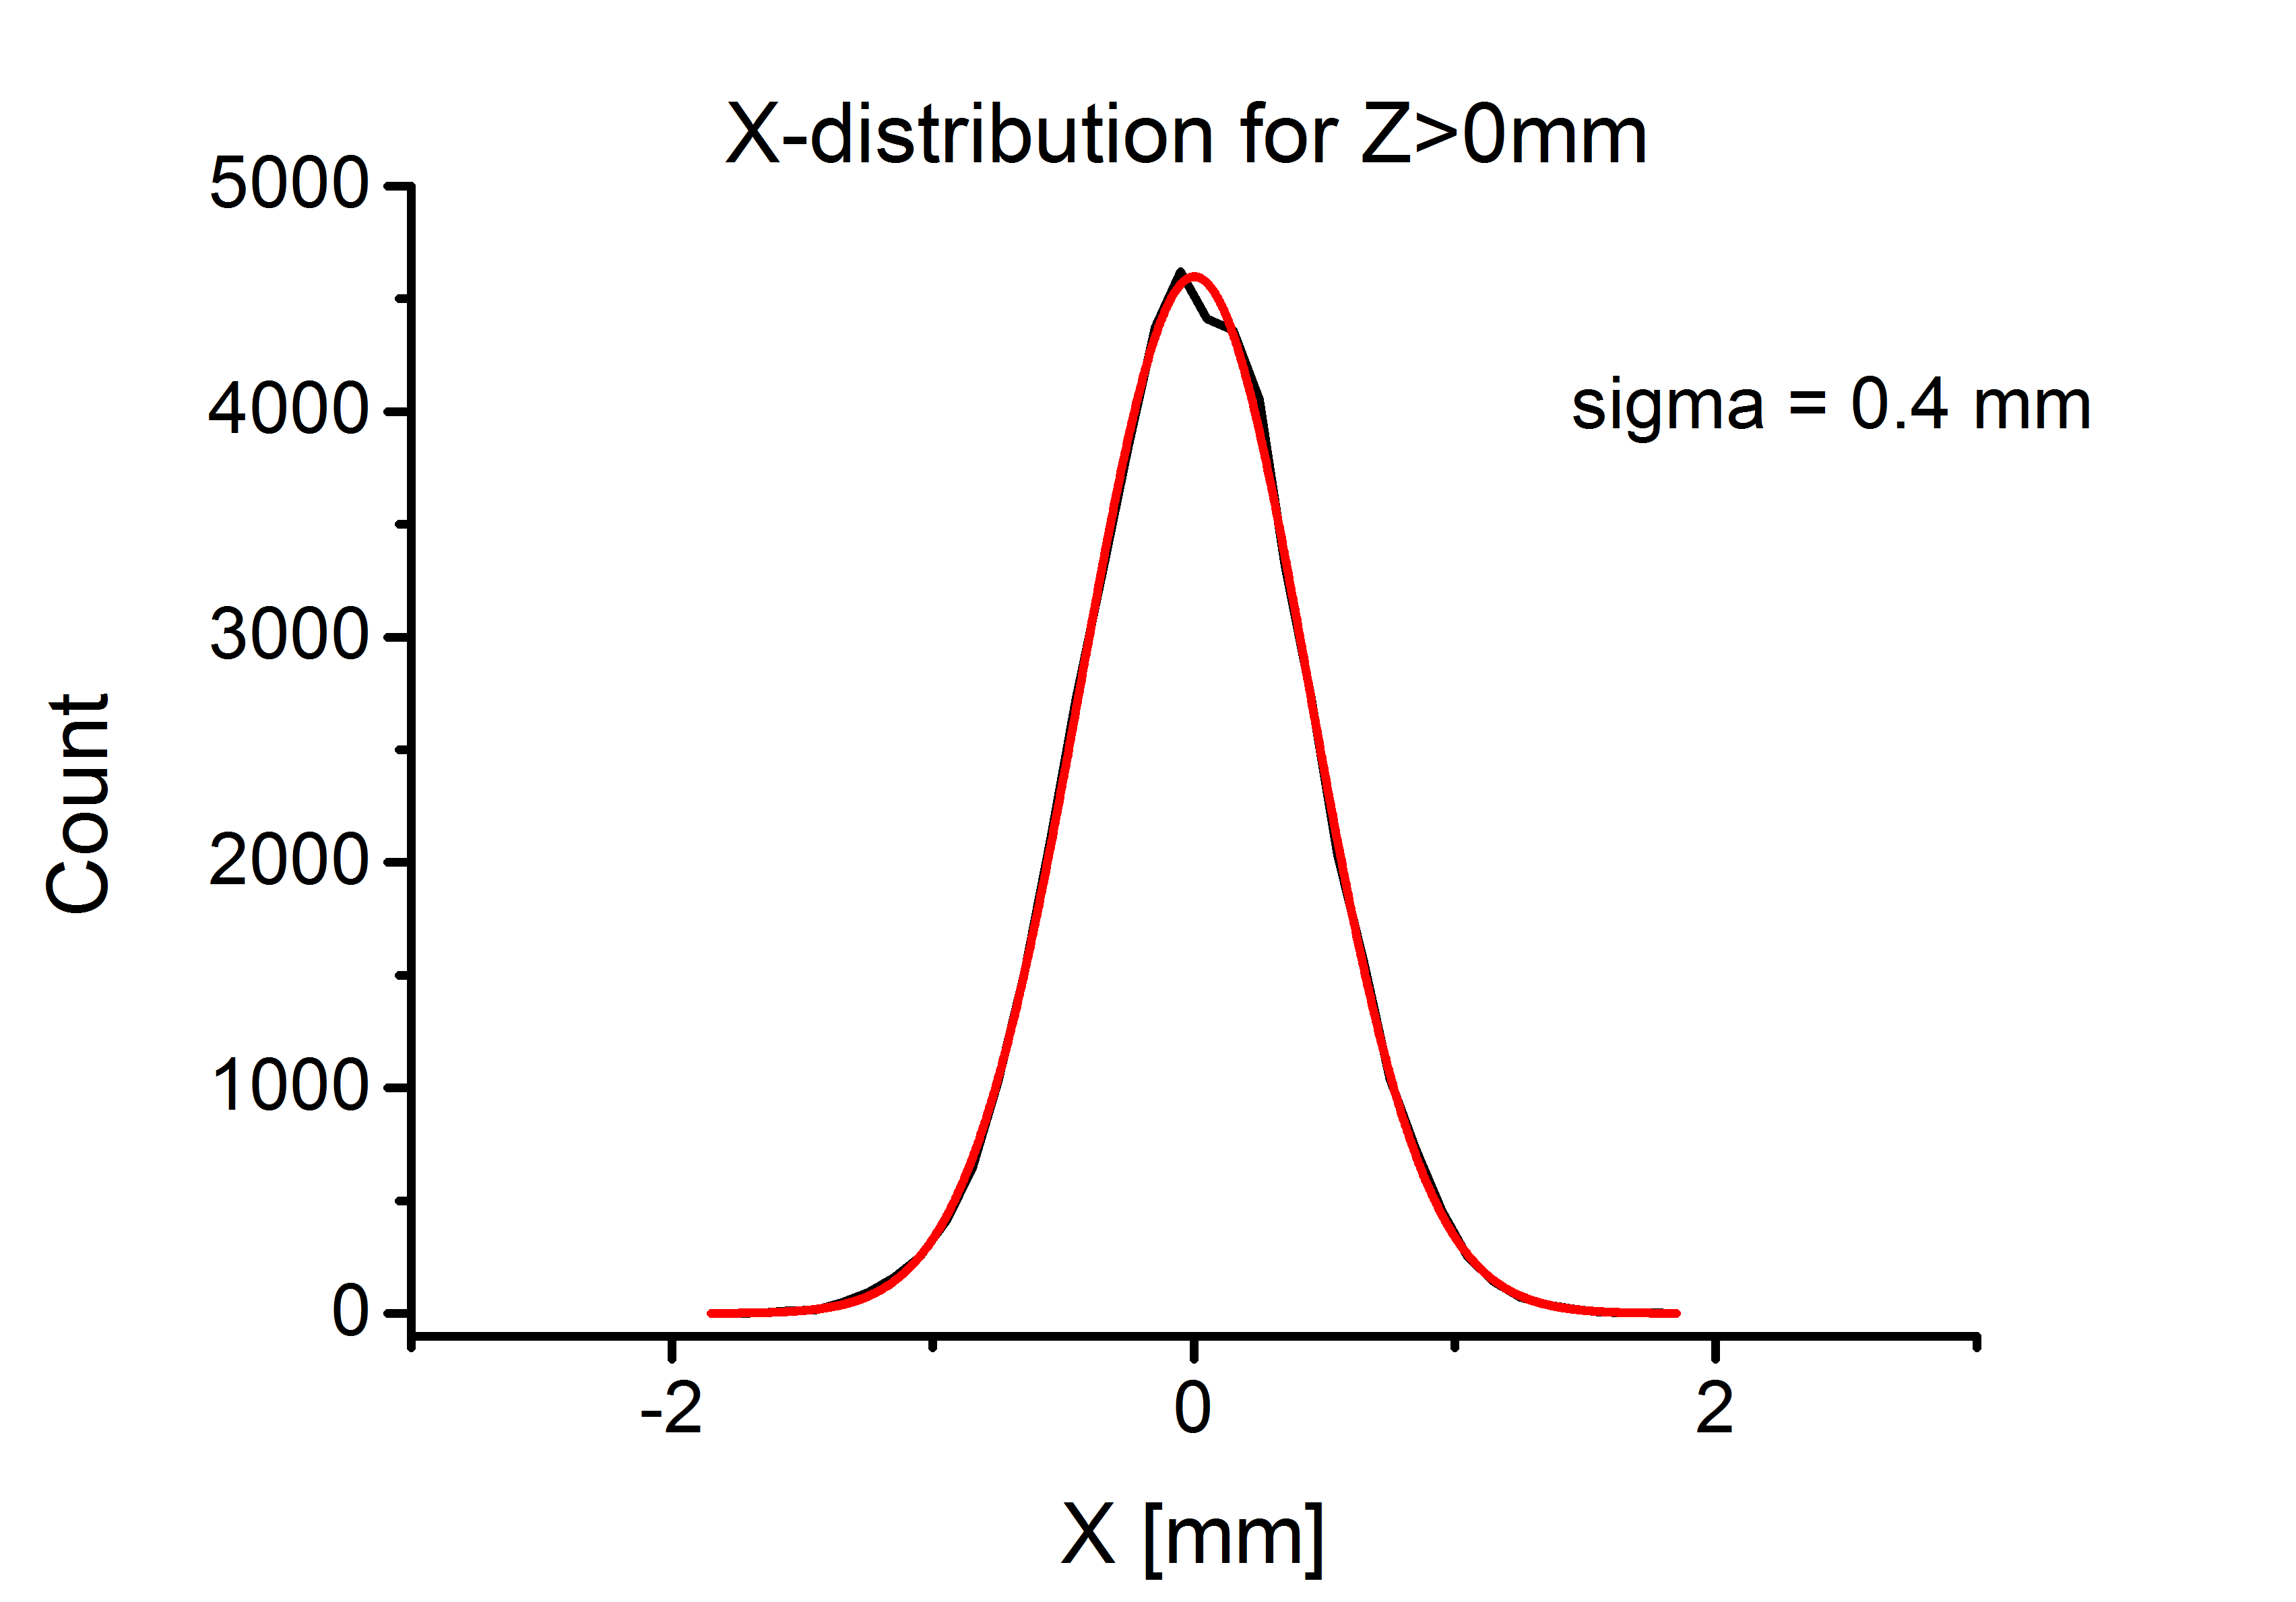
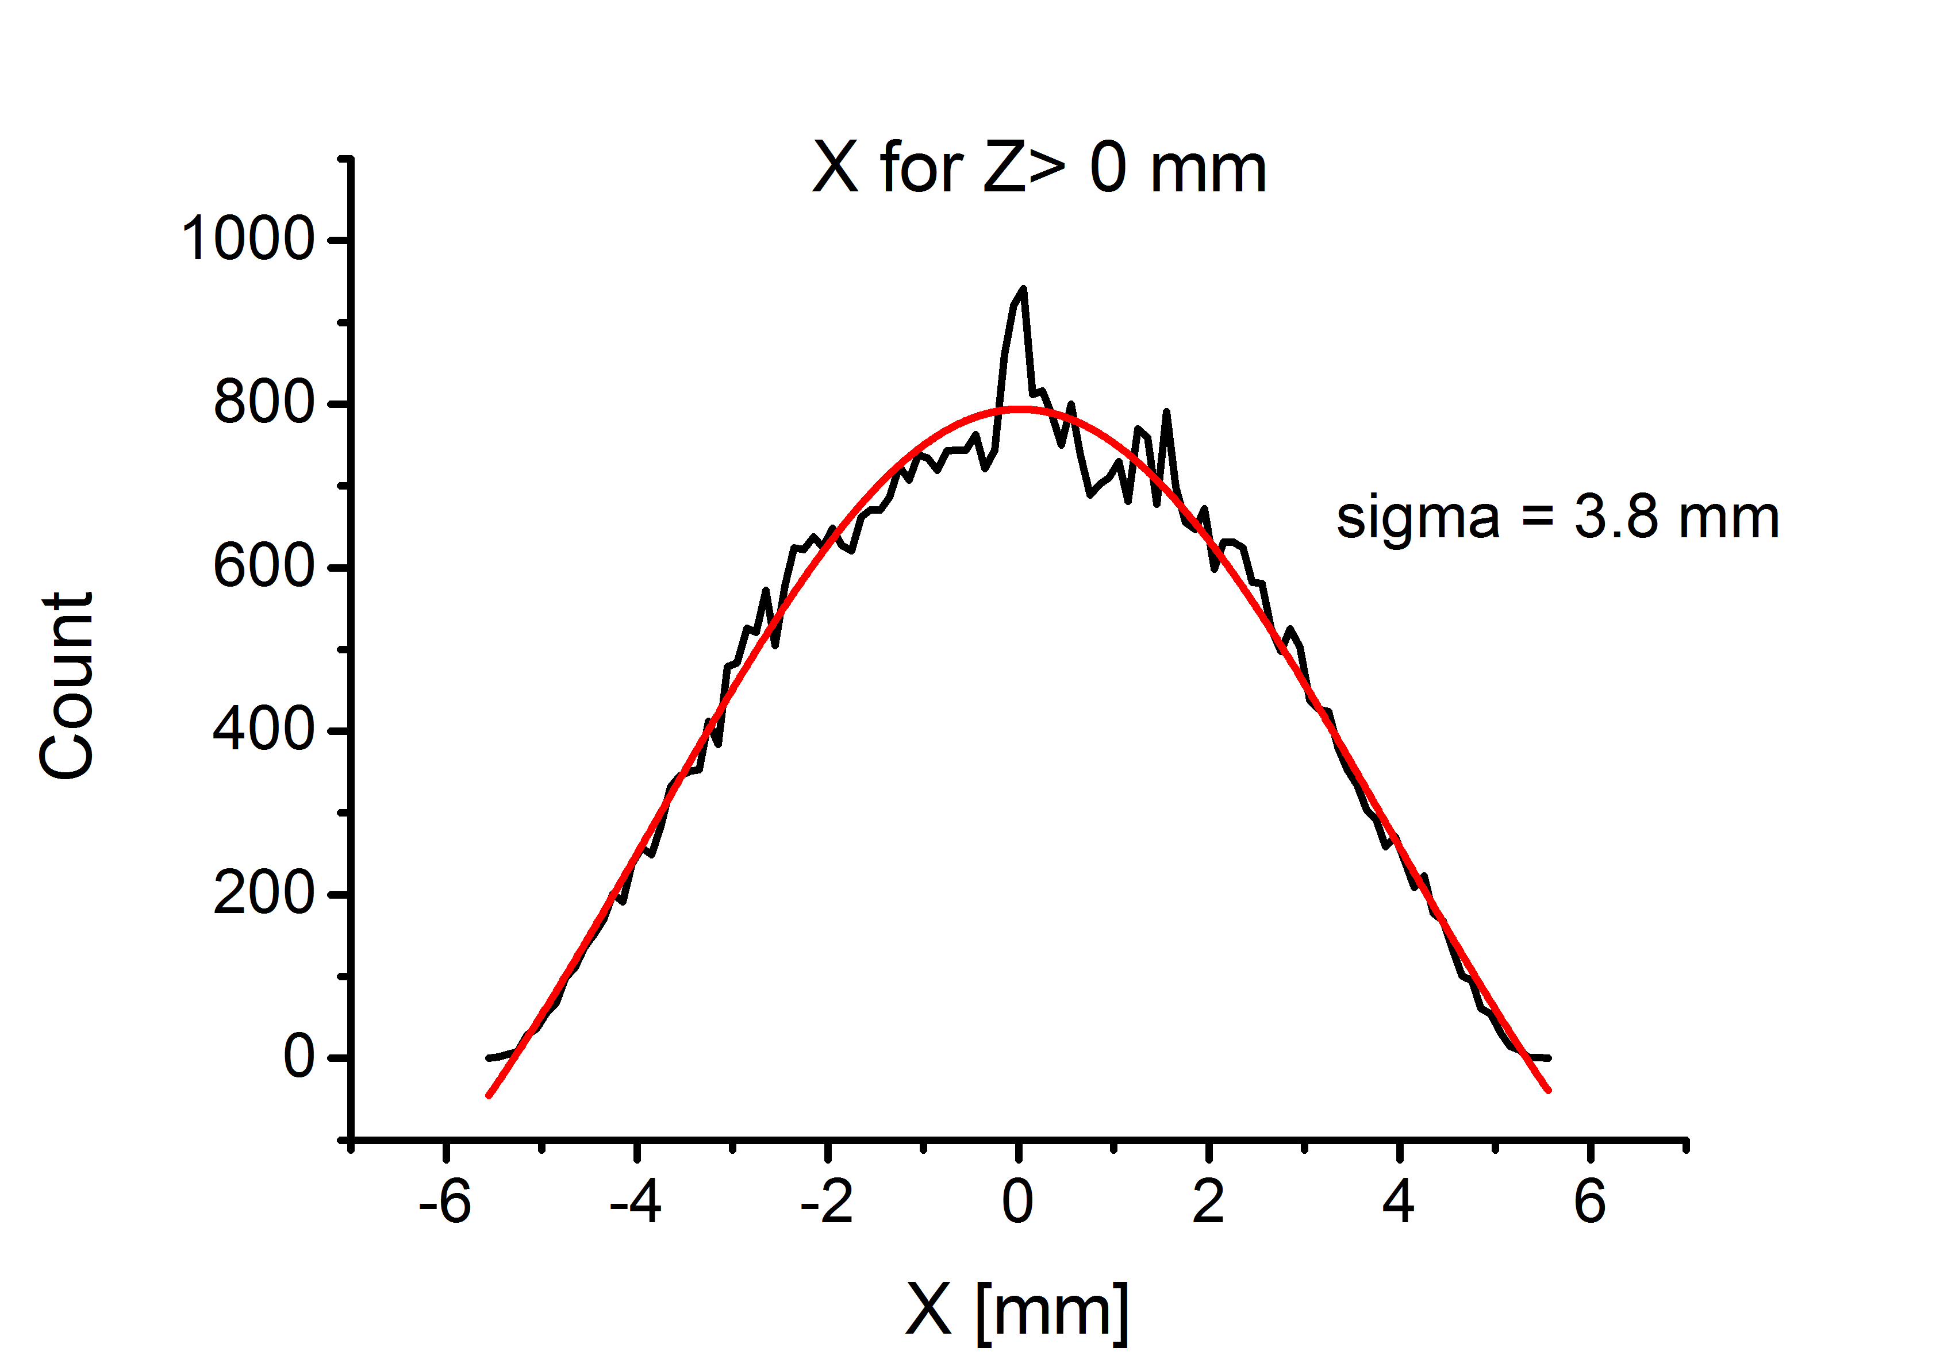
Alexey’s simulations output
In front of the laser
Behind the laser

Slide 5
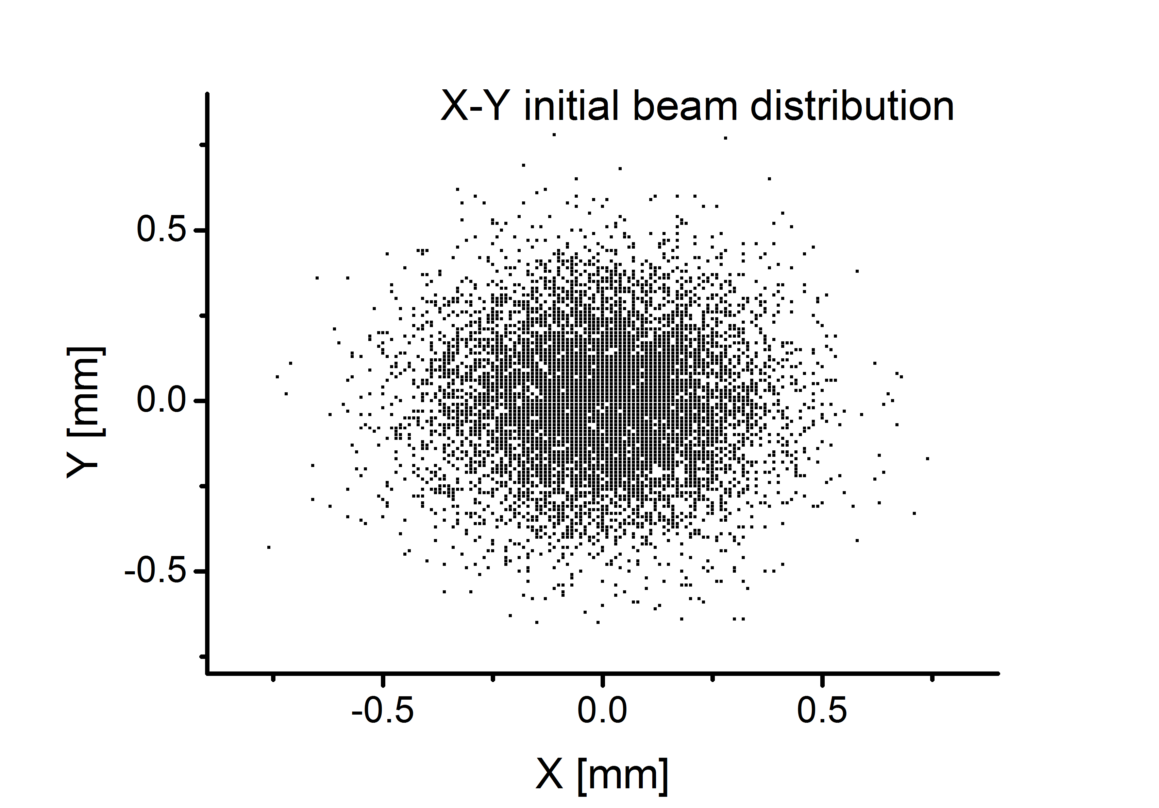
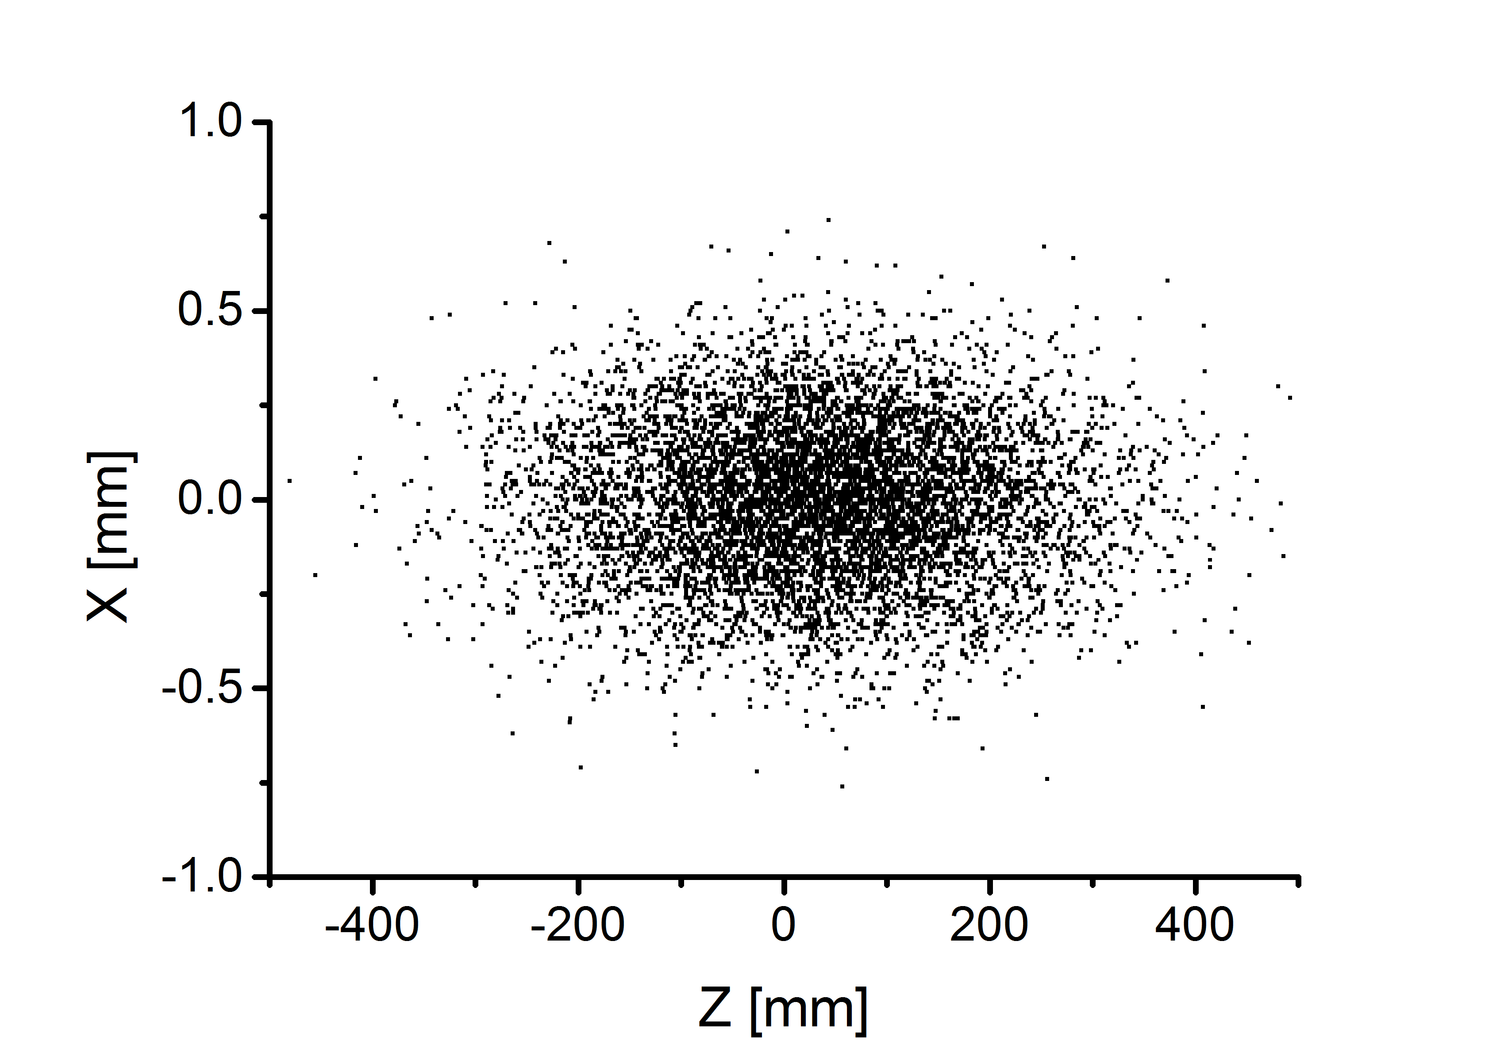
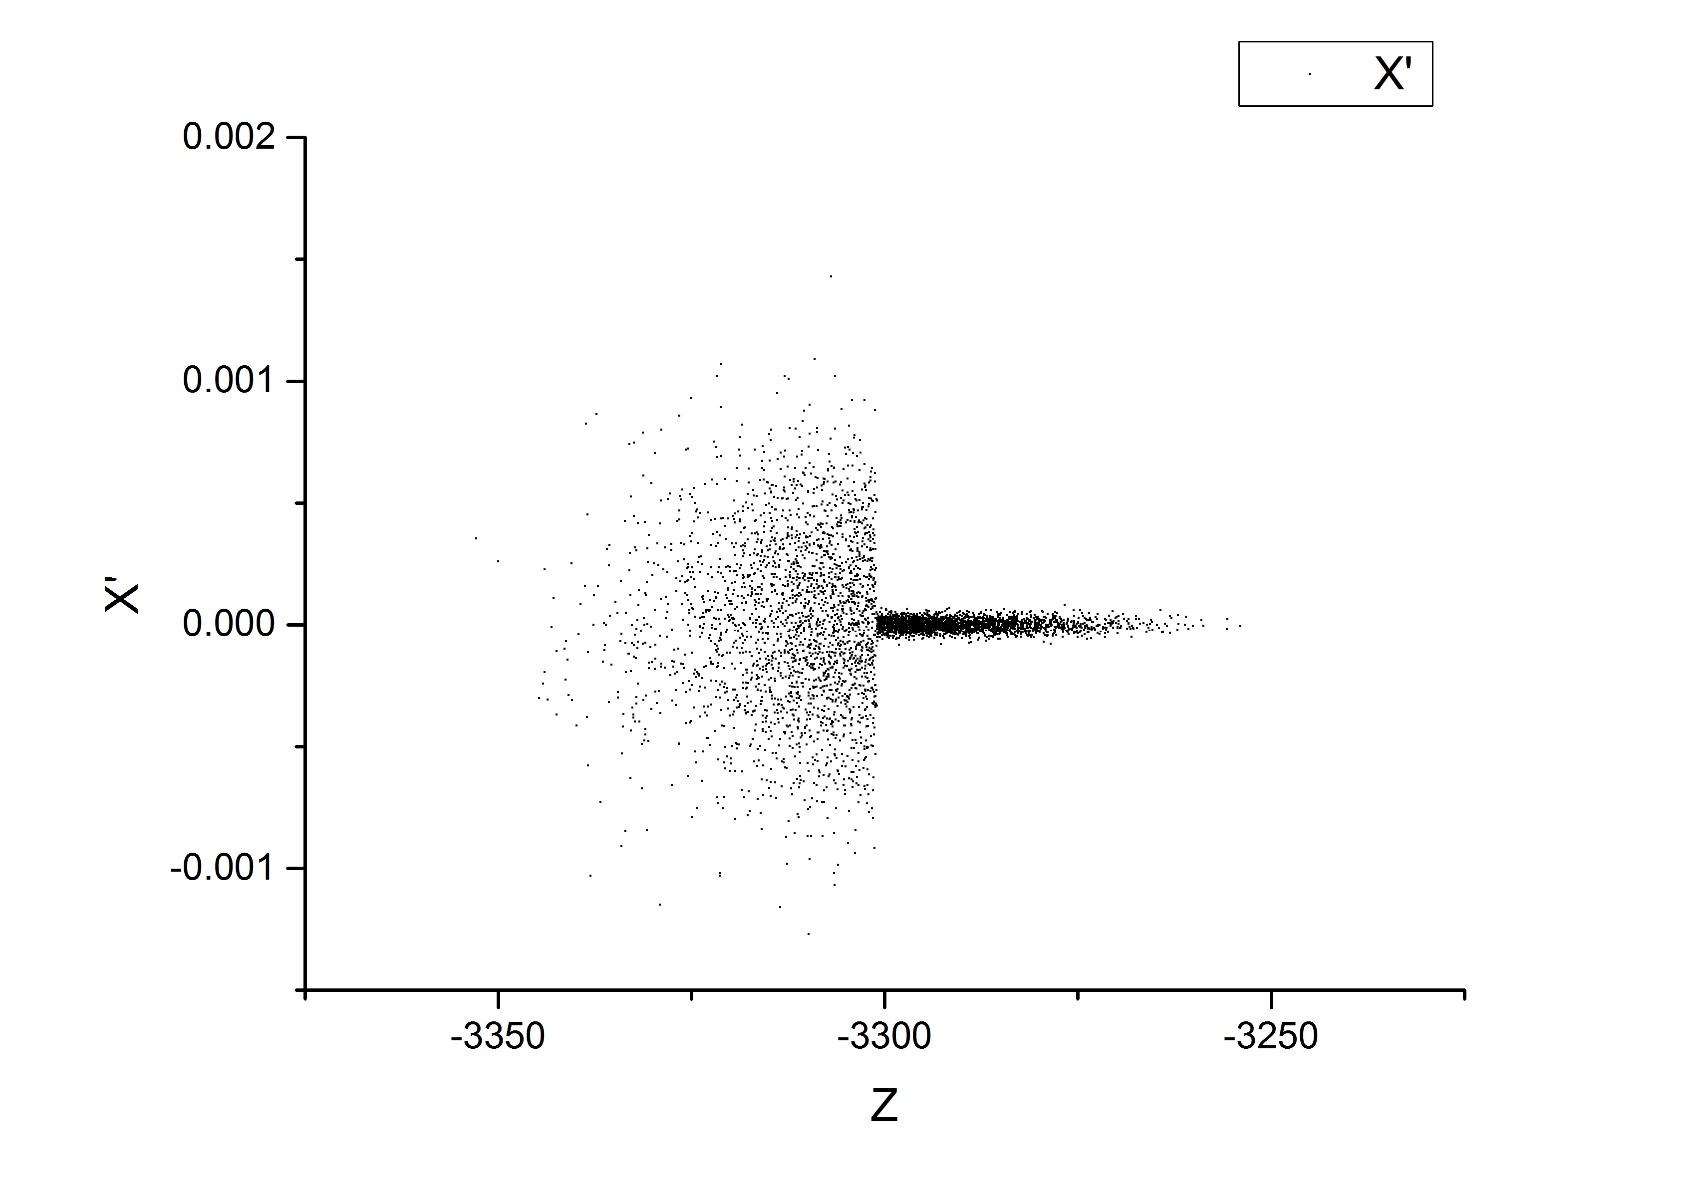
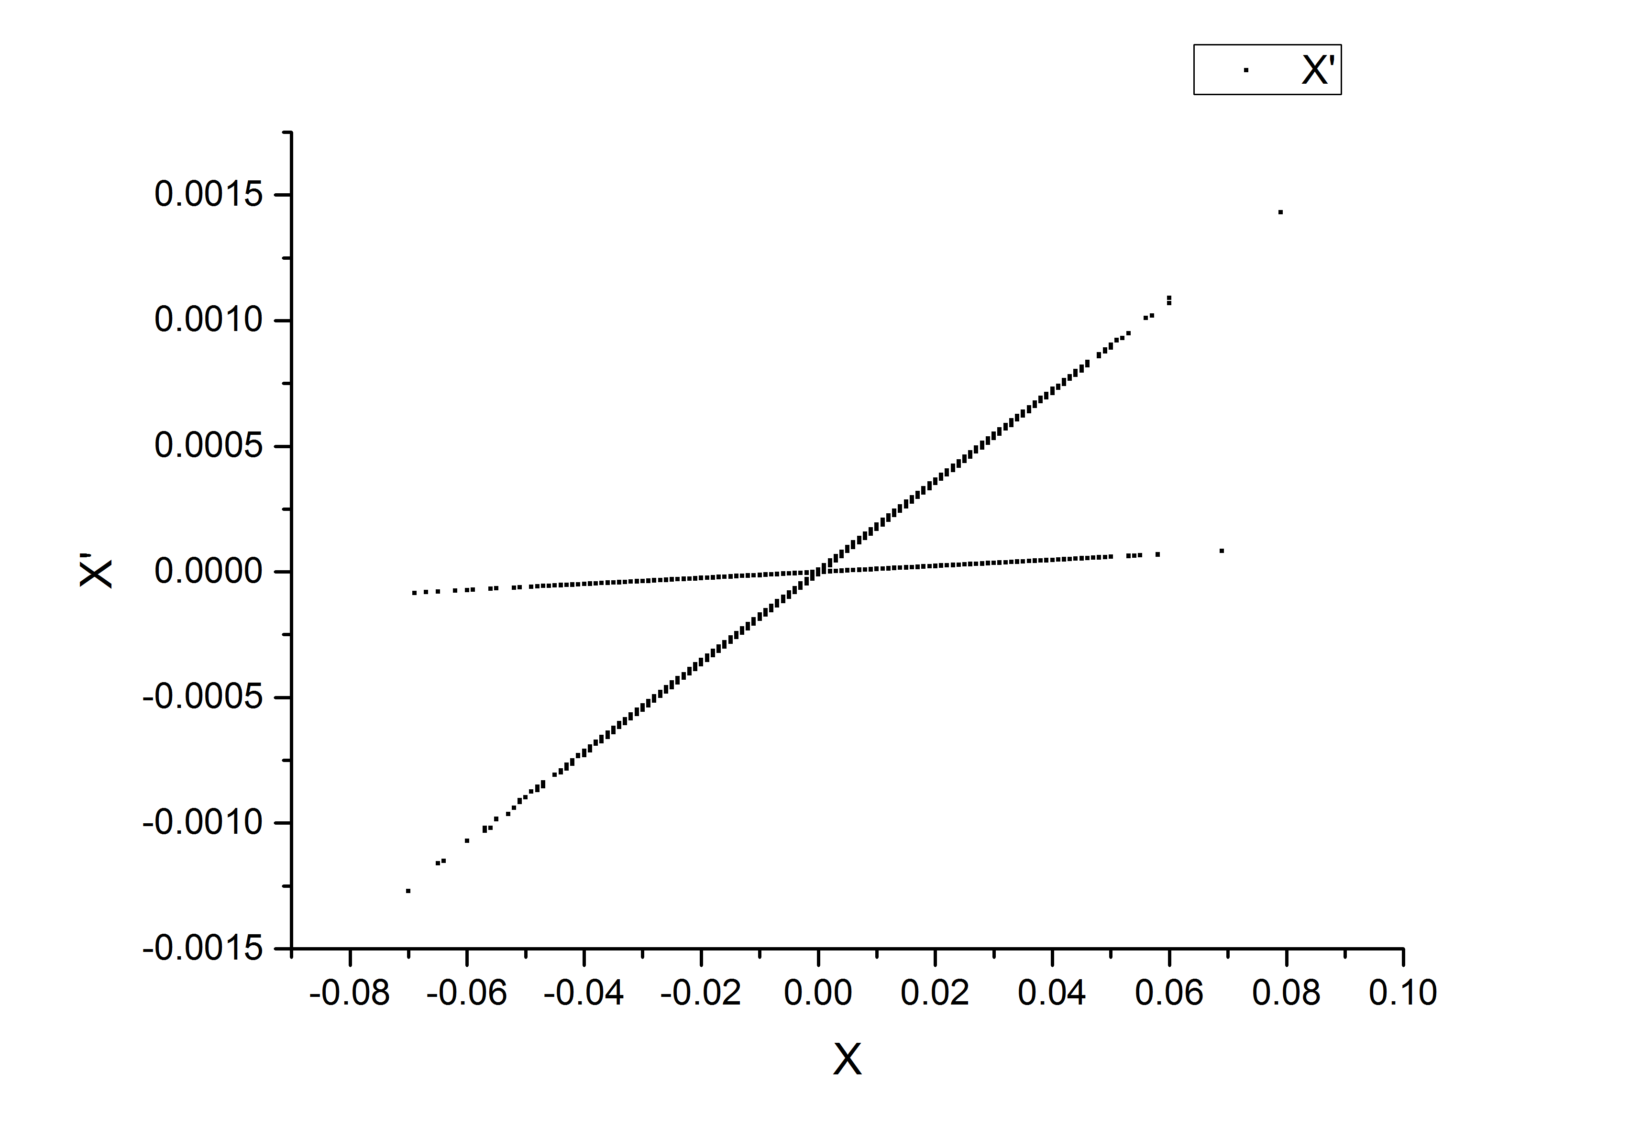
FLUKA implementation
Initial spatial distribution
σ_{z} 139 mm
σ_{x,y} 200 μm
0.36 mrad
Initial momentum distribution
ionized
0.024 mrad
Not-ionized

Slide 6
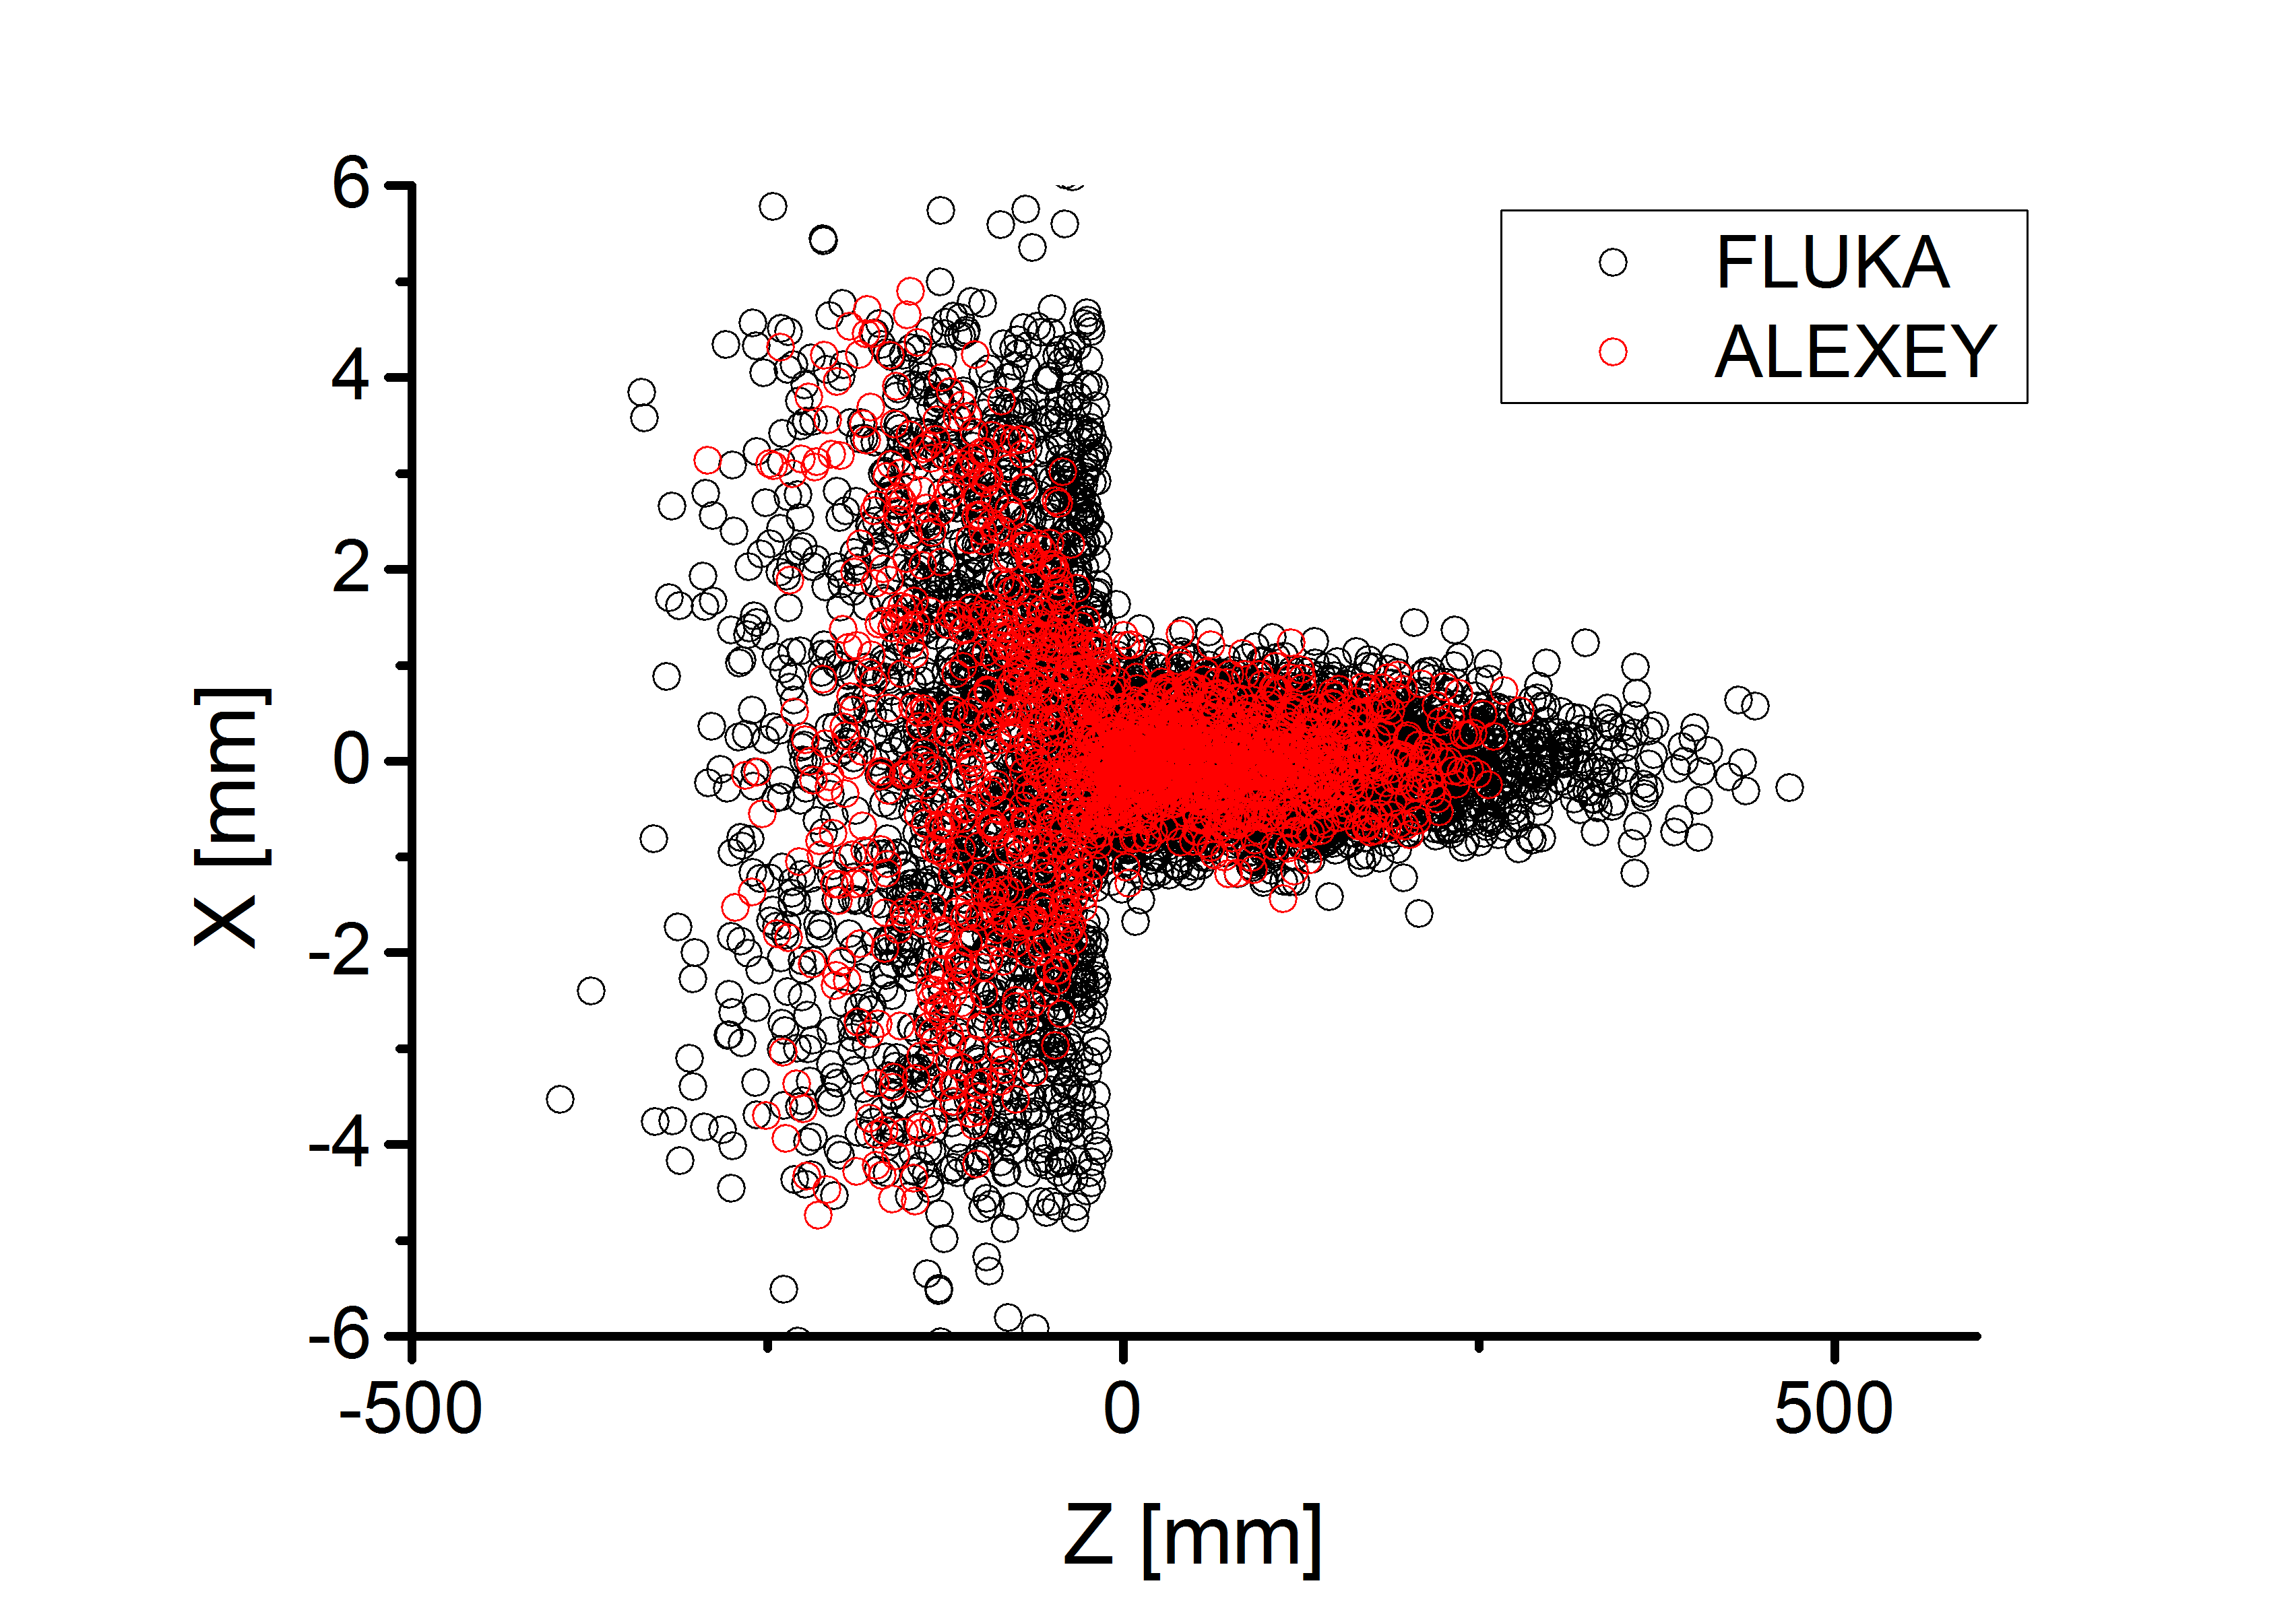
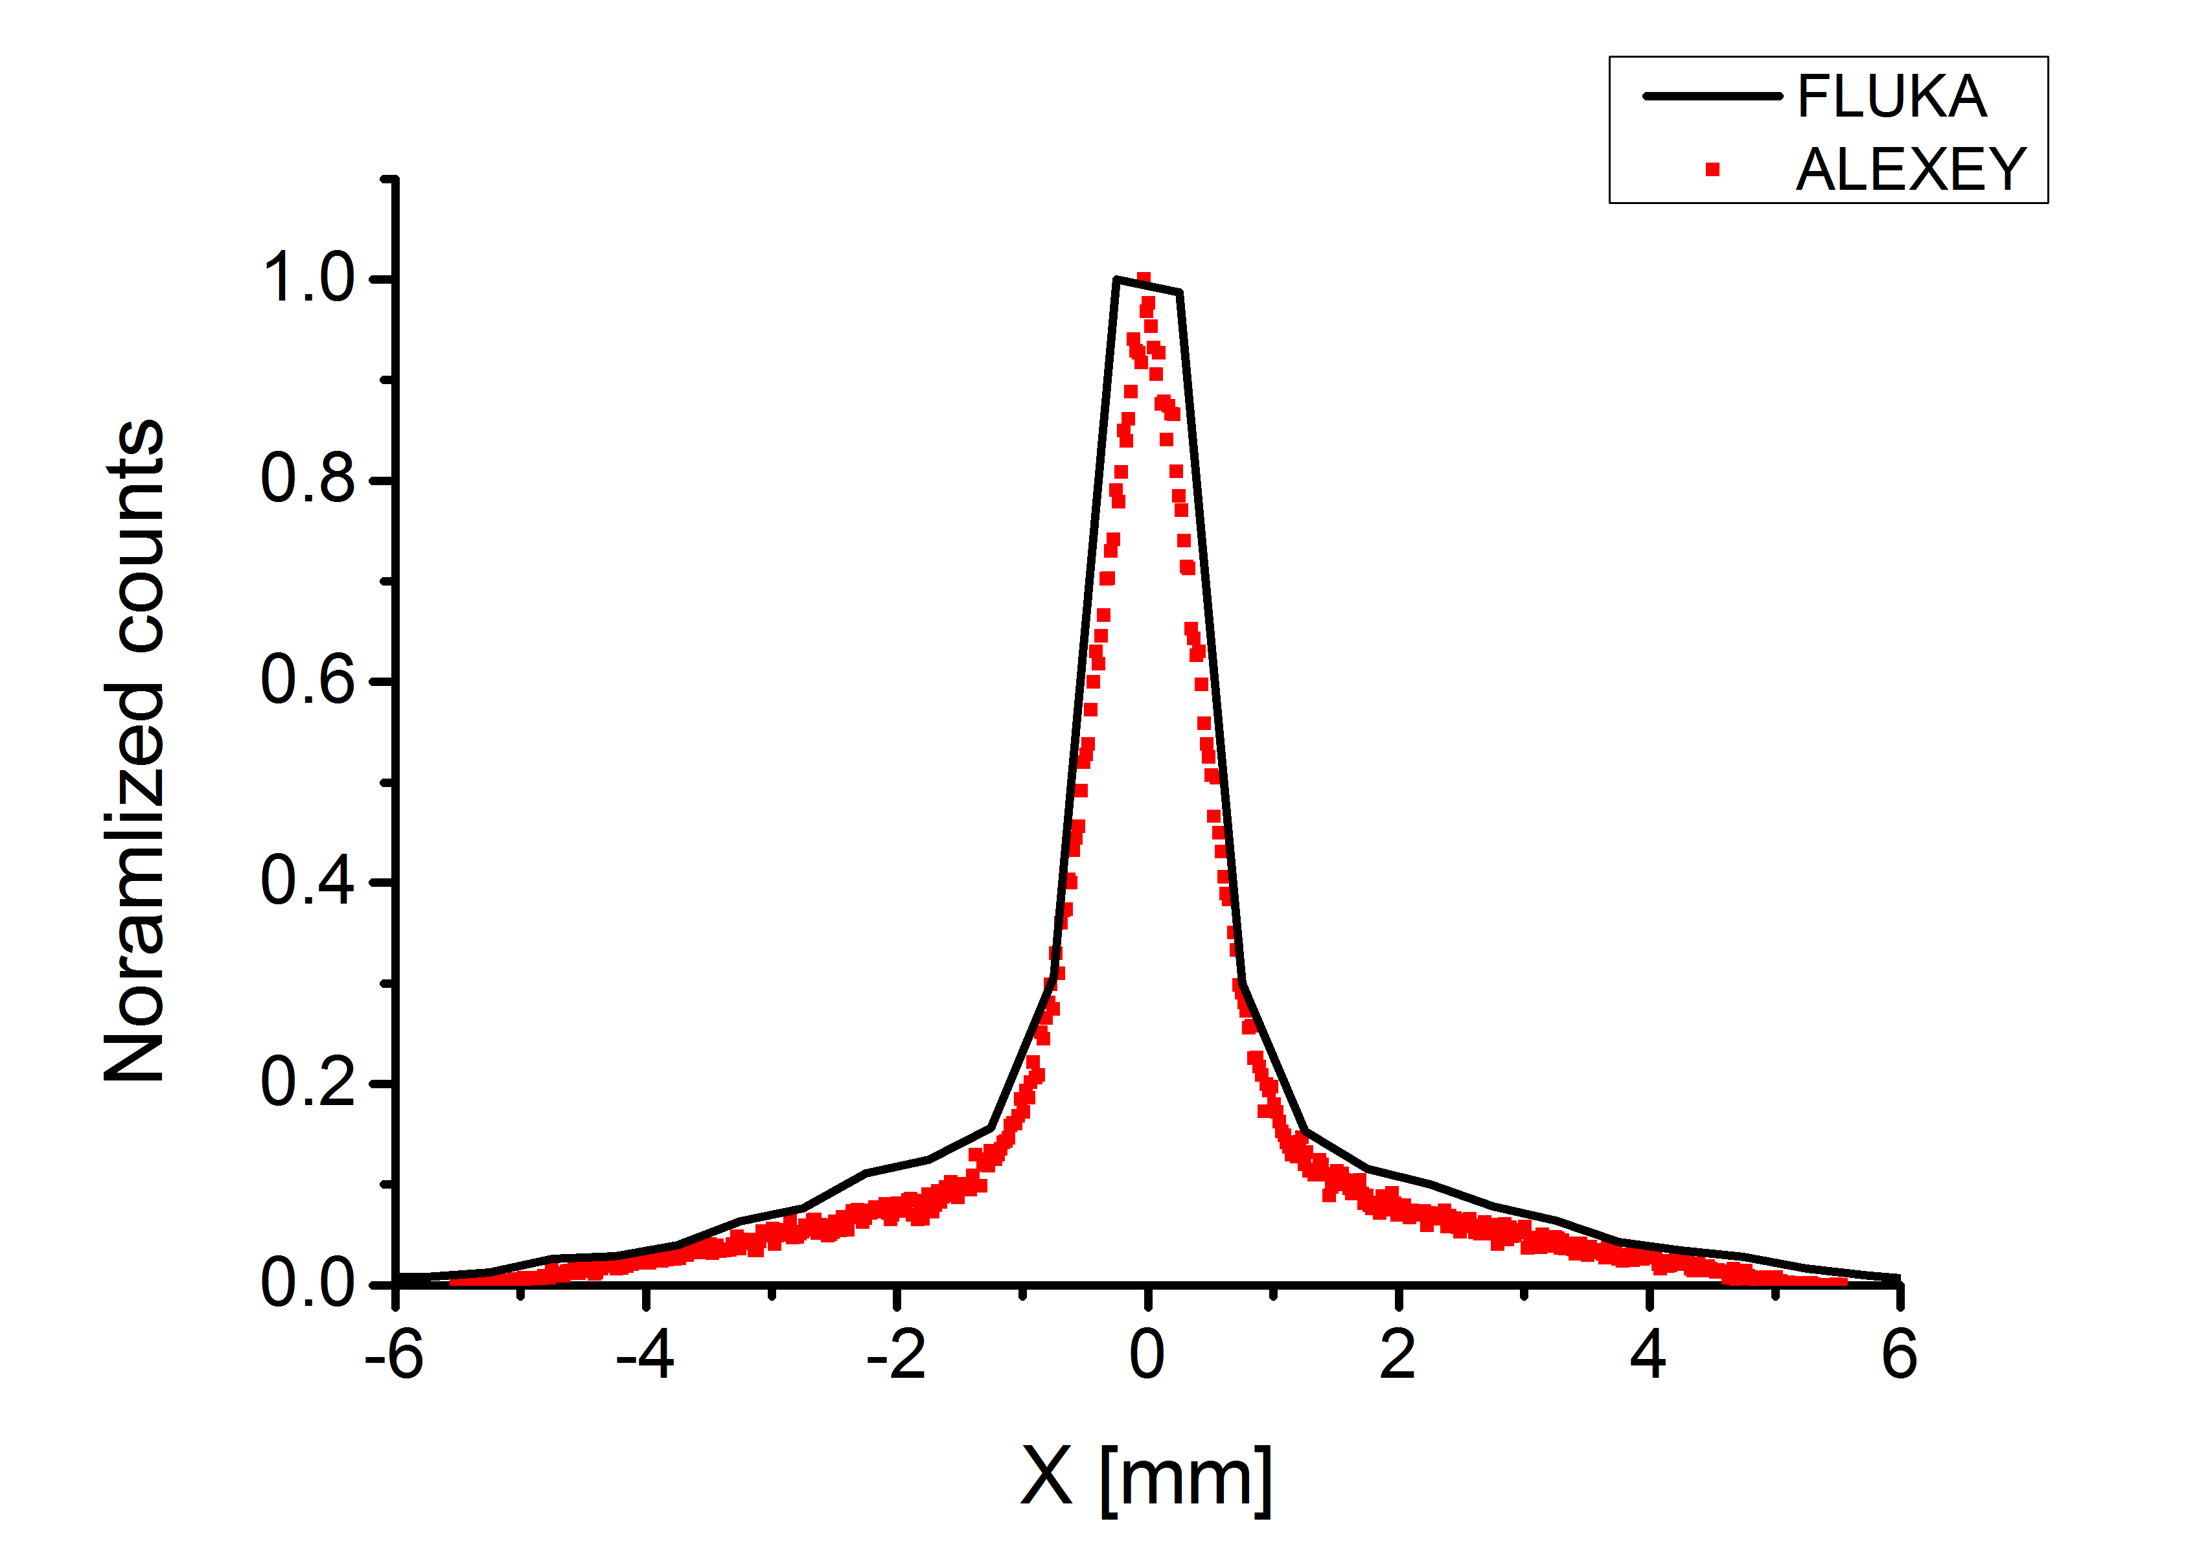
Alexey-FLUKA Comparison
Proton distribution after plasma cell

Slide 7
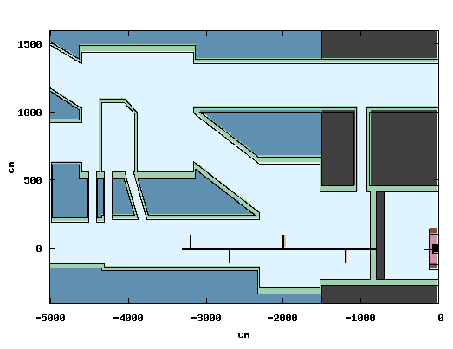
FLUKA simulations
Protons : 400 GeV, 0.3 % E-spread
Valve ‘opened’
Plasma cell
  10 m long
  10 cm Ø
  Rb vapor (10¹⁵ cm⁻³ ->1.4x10⁻⁷ g/cm³)
Metal shielding 2 mm think:
  3 mm radius steel 6 m long
  10 mm radius steel 6 m long
  10 mm radius steel 9 m long
  15 mm radius steel 9 m long
Plasma cell
Vacuum tube

Slide 8
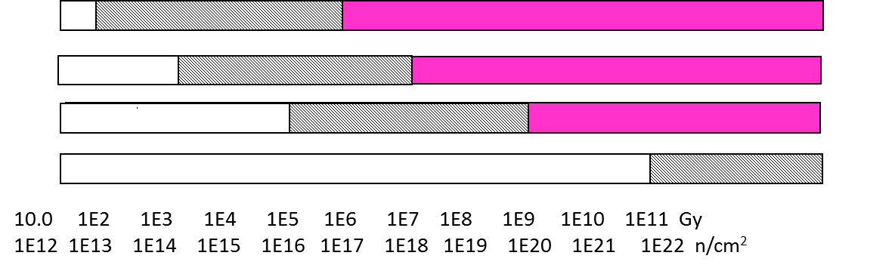
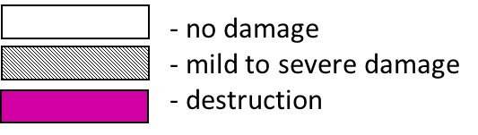
R2E recommendation
Cumulative damage
!!! A Rough Overview Only !!!
commercial COTS hardened electronics
accelerators
Semiconductors
Polymers
Ceramics
Metals and alloys
From M. Brugger presentation for Cern Fluka user meeting 2008
Stochastic damage
From M. Brugger ‘Radiation Damage to electronics at the LHC’, IPAC2012:
  Commercial equipment: ~10⁷ HEH/cm²/year

Slide 9
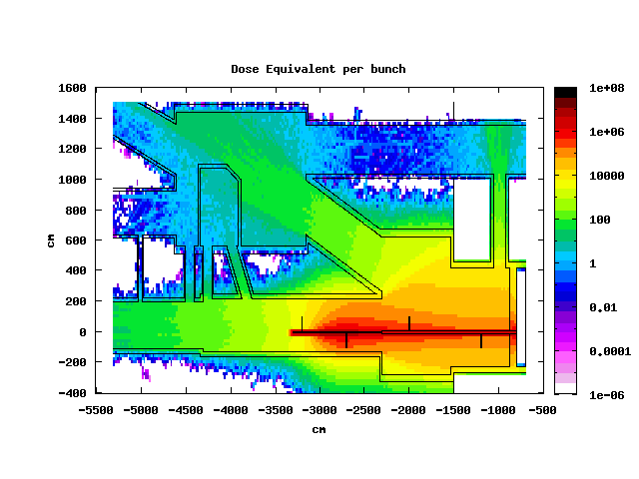
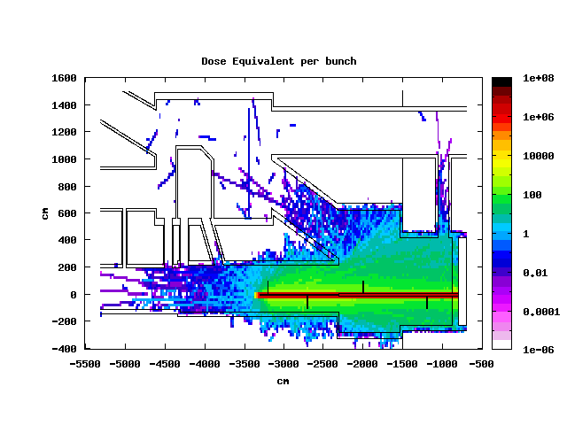
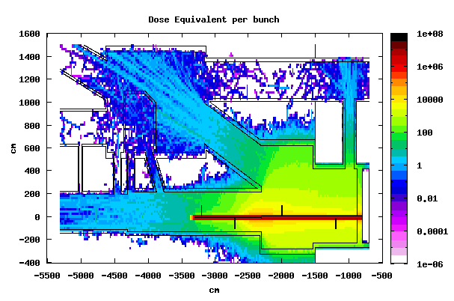
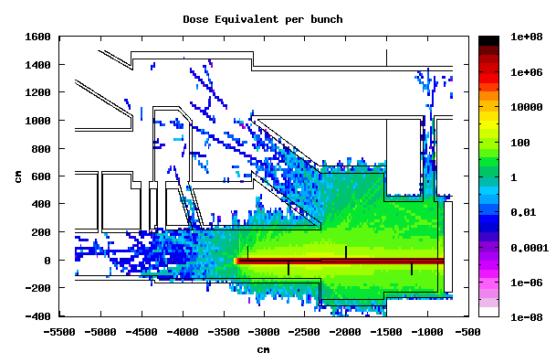
Dose equivalent
3 mm steel 6 m long
μSv/ bunch
10 mm steel 6 m long
10 mm steel 9 m long
15 mm steel 6 m long

Slide 10
Dose equivalent
shielding | pSv/p+ | error | μSv/h
3 mm-6m | 3.2e-5 | 29% | 1.15e+03
10 mm-6m | -.- | -.- | -.-
10 mm-9m | 3.6e-6 | 58% | 1.3e+02
15 mm-9m | -.- | -.- | -.-
>> 15 μSv/h
High error, proper evaluation needs biasing: just order of magnitude

Slide 11
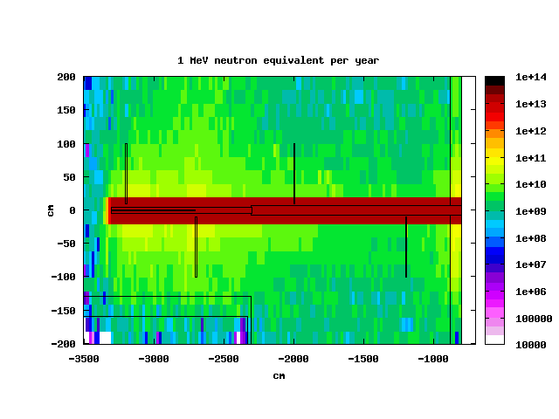
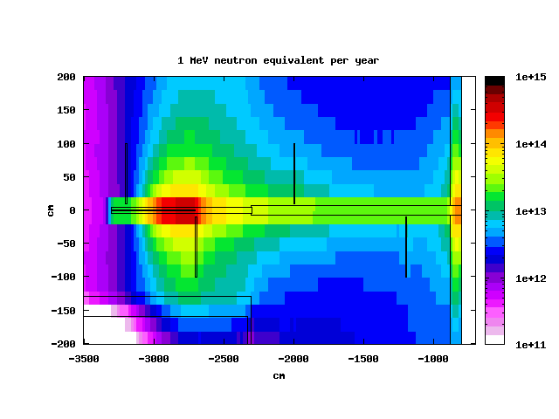
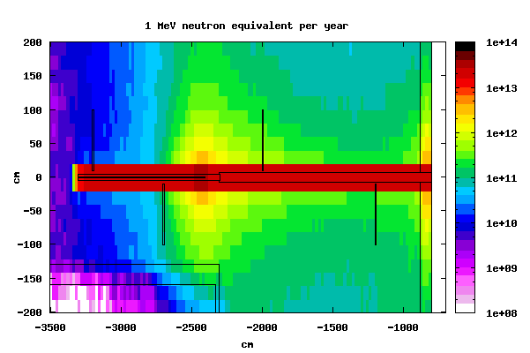
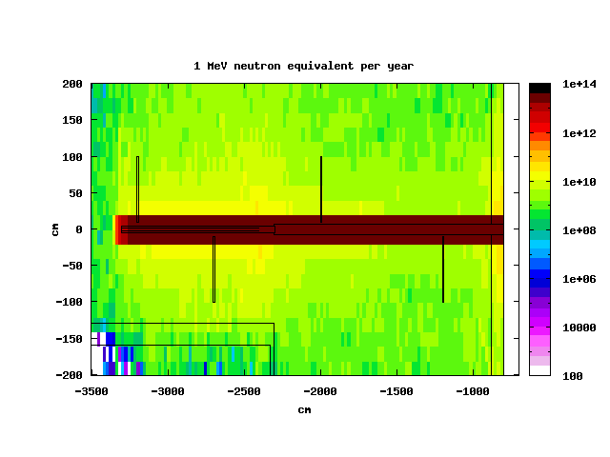
1 MeV neutron equivalent per year
“SAFE” limit: 10¹³ n/cm²
3 mm steel 6 m long
10 mm steel 6 m long
10 mm steel 9 m long
15 mm steel 9 m long

Slide 12
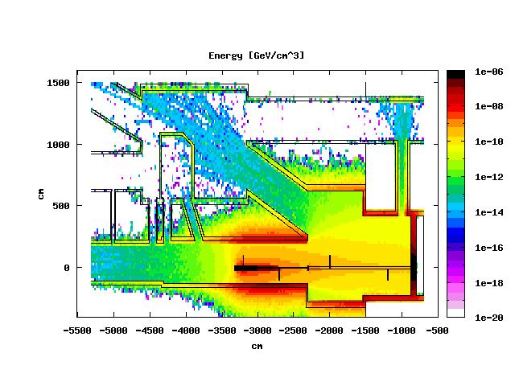
Energy deposition
10² -10⁶ GeV: from mild to severe damage (semiconductor)
Det 1
Det 2
Det 3
Det 4

Slide 13
Energy deposition per year
10² -10⁶ GeV: from mild to severe damage (semiconductor)

Slide 14
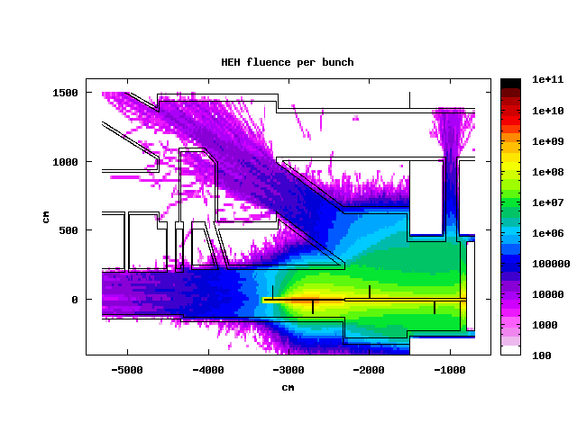
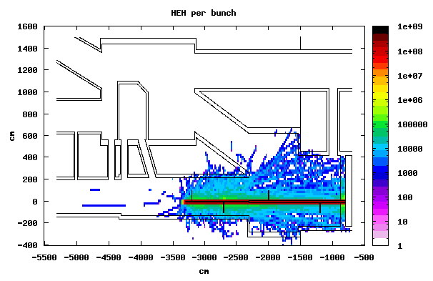
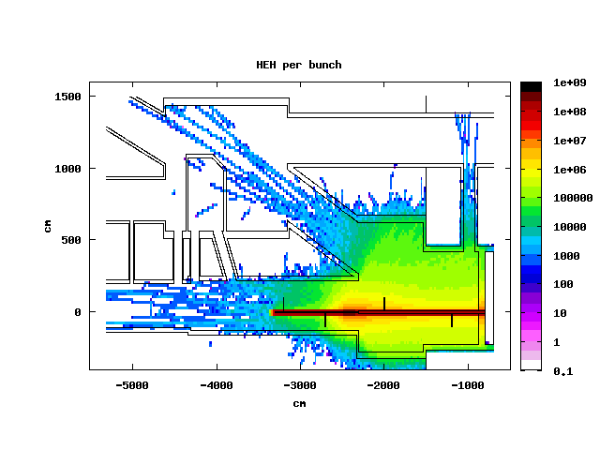
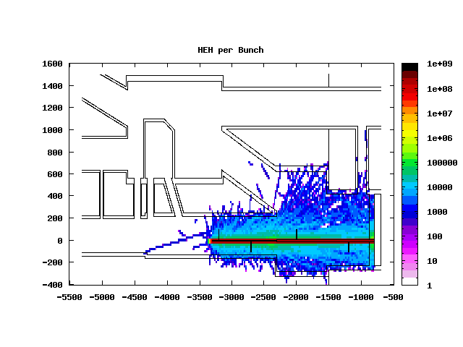
HEH Fluence per bunch
“SAFE” limit: 10⁷ HEH/cm² /year
3 mm steel 6 m long
10 mm steel 6 m long
10 mm steel 9 m long
15 mm steel 9 m long

Slide 15
HEH Fluence per year
“SAFE” limit: 10⁷ HEH/cm² /year
Values at the end of metal shielding 20 cm from proton axis
shielding | cm⁻²/p+ | cm⁻²/year
3 mm – 6m | 9.40E-04 | 4.55E+13
10 mm – 6m | 5.00E-07 | 2.42E+10
10 mm – 9m | 2.90E-05 | 1.40E+12
15 mm – 9m | 2.80E-07 | 1.35E+10
The value of the HEH flux is still 3 order of magnitude higher that recommended around plasma cell

Slide 16
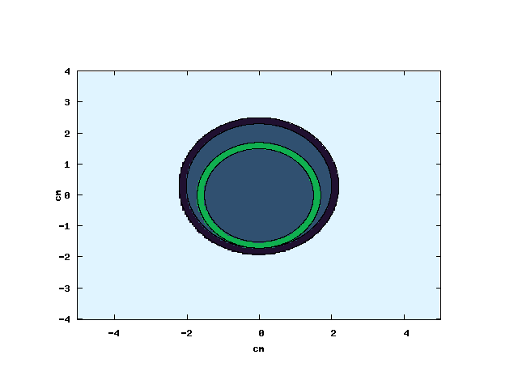
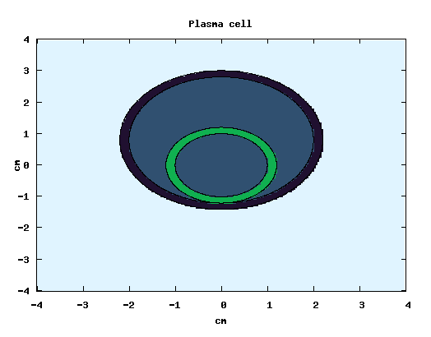
New Plasma cell implementation
New plasma cell 4 cm diameter
Metal shielding 6 m long different radii
2 m vacuum pipe before the plasma cell (in previous simulations air)
Electron beam big at the entrance of the plasma cell (still optimizing)
Rubidium vapour
Glass wall
Plasma cell 4 cm diameter: limit set by
Glass wall (? Which material?)
1.6 cm
0.6 cm
2.4 cm
Proton beam
3.4 cm
4 cm
Metal shielding

Slide 17
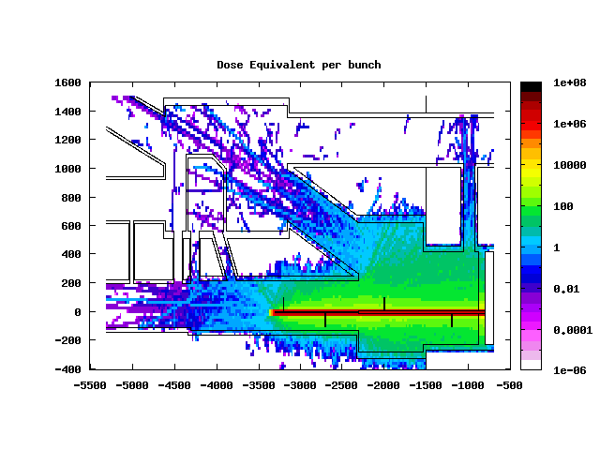
New Plasma cell implementation
10 mm shielding radius
10 cm diameter
4 cm diameter 2 mm glass wall
The smaller size of the plasma cell and the presence of the plasma cell wall change the dose deposition profile downstream

Slide 18
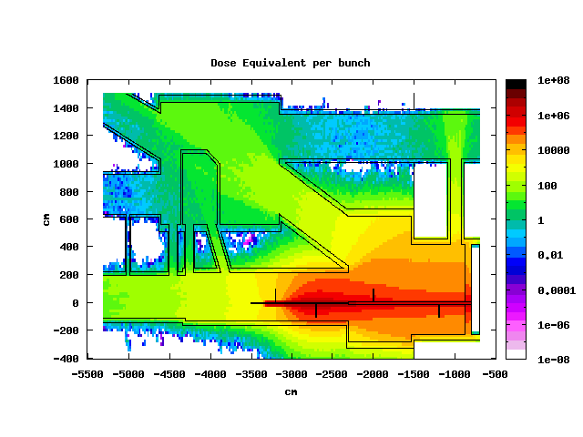
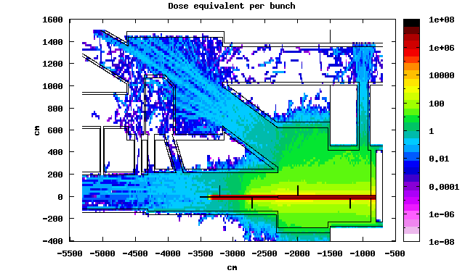
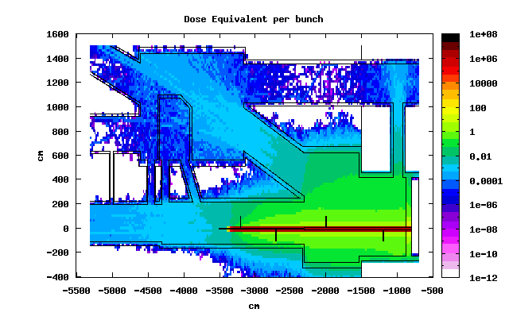
New Plasma cell: dose equivalent
3 mm steel 6 m long
3 mm steel 6 m long
10 mm steel 6 m long
15 mm steel 6 m long
Shielding radius [mm] | Shielding length [m] | Dose equivalent [pSv/p+] | Dose equivalent [μSv/h] | error
3 | 6 | 4.1e-5 | 1.5e3 | 18%
10 | 6 | 2.1e-7 | 7.56 | 70%
15 | 6 | 6.9e-10 | 2.45e-2 | 39%
>> 15 μSv/h

Slide 19
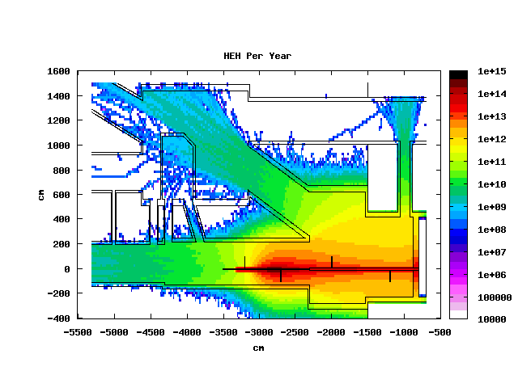
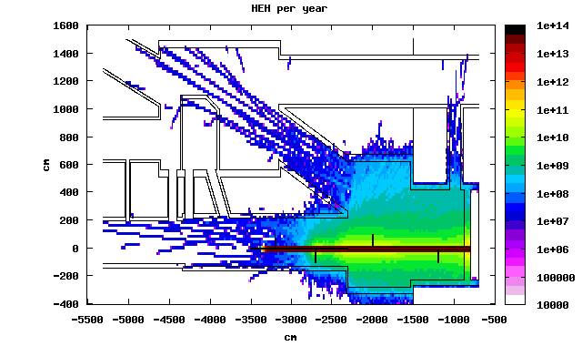
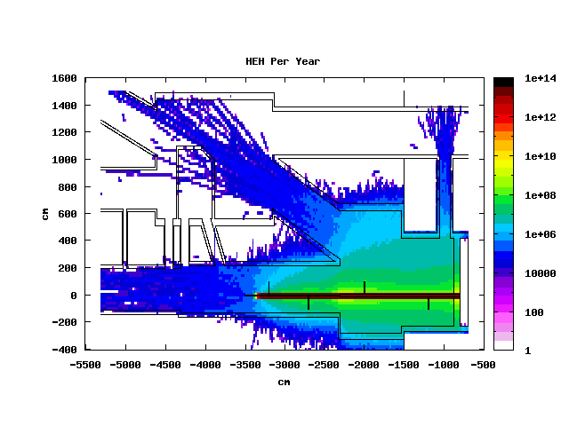
New Plasma cell: HEH fluence per year
3 mm steel 6 m long
10 mm steel 6 m long
15 mm steel 6 m long
Also for 15 mm radius around plasma cell 1-2 orders of magnitude higher than recommended value

Slide 20
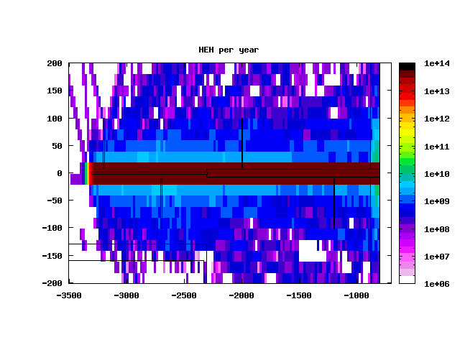
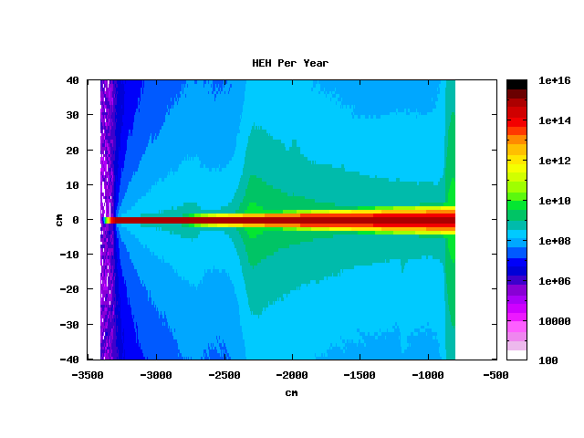
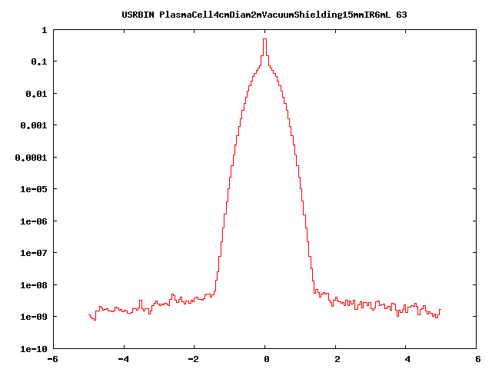
Metal shielding and gas effect
15 mm radius shielding
No metal shielding
Also without metal shielding around plasma cell HEH fluence higher than 10⁷ HEH/year
Looking at beam profile: halo due to the interaction of proton beam with gas:
Gas interaction length for 400 GeV p+: 10⁹ cm -> in 10 m 3x10⁵ p+ per beam interact with the gas and broaden the beam
Scattered particles

Slide 21
New Plasma cell implementation
HEH fluence summary:
shielding radius [mm] | plasma cell radius [cm] | Shielding length [m] | cm⁻²/p+ | cm⁻²/year
3 | 2 | 6 | 1.80E-03 | 8.71E+13
10 | 2 | 6 | 5.20E-07 | 2.52E+10
15 | 2 | 6 | 2.11E-09 | 1.02E+08
Still 1 order of magnitude too high
Energy deposition comparison:

Slide 22
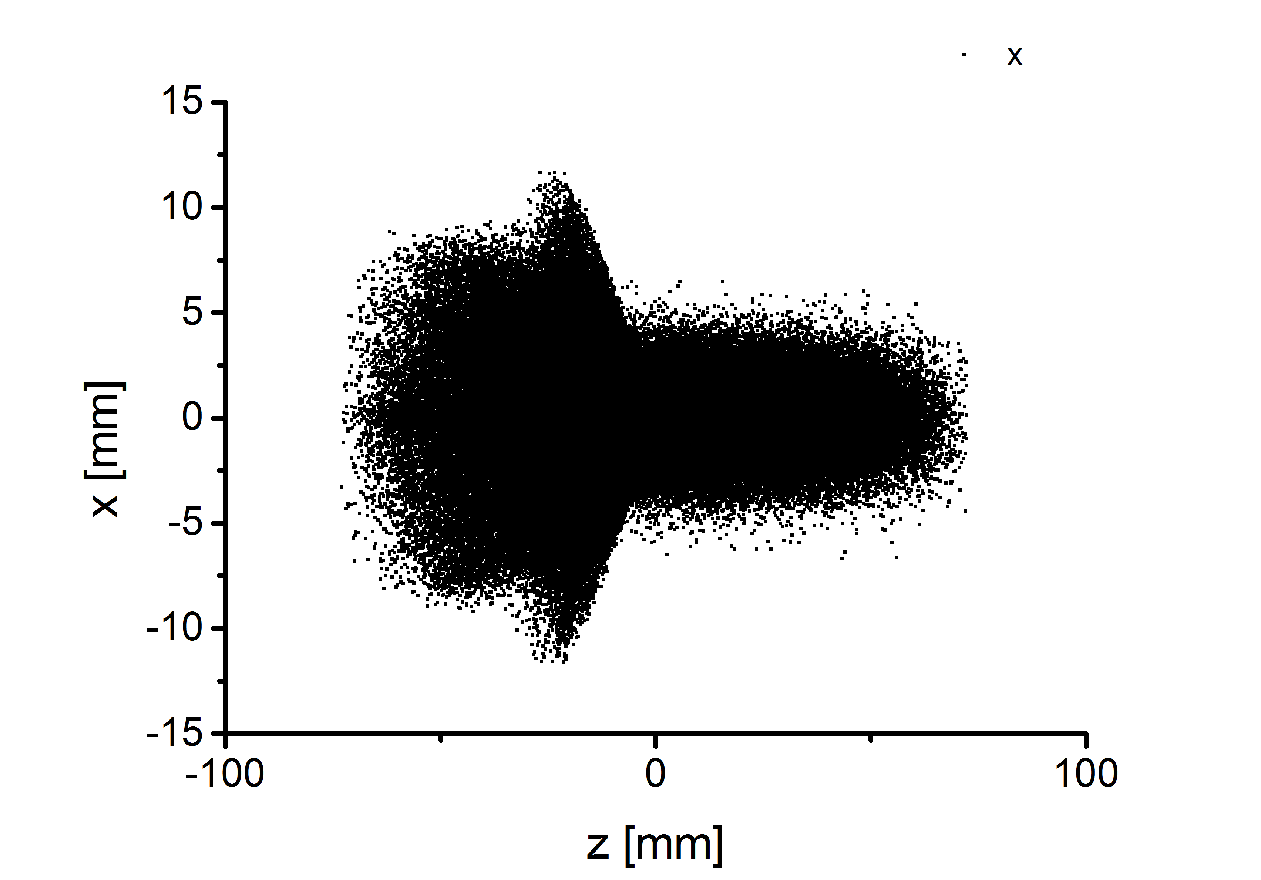
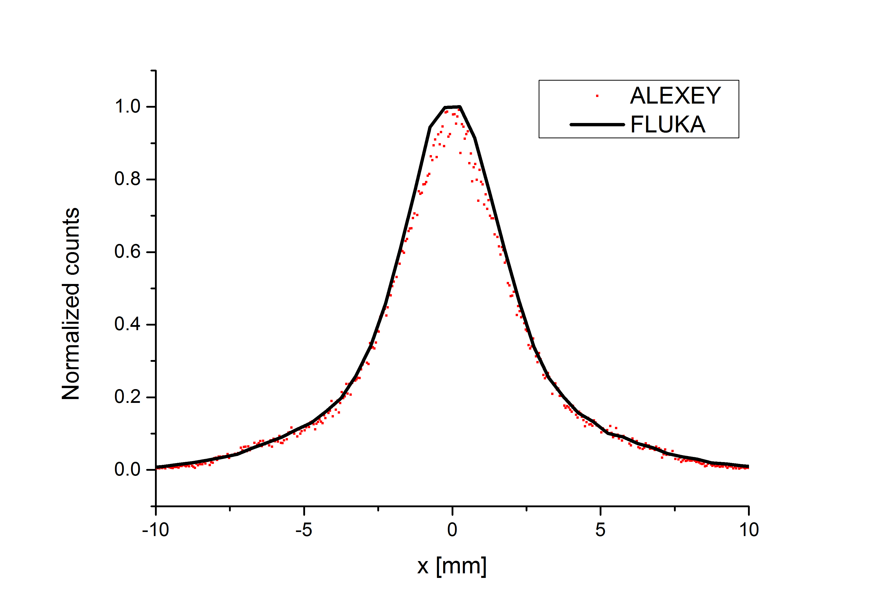
Compressed beam
Compressed
Un-compressed
Simulated beam profile after plasma cell
Not much difference expected:
max factor 2

Slide 23
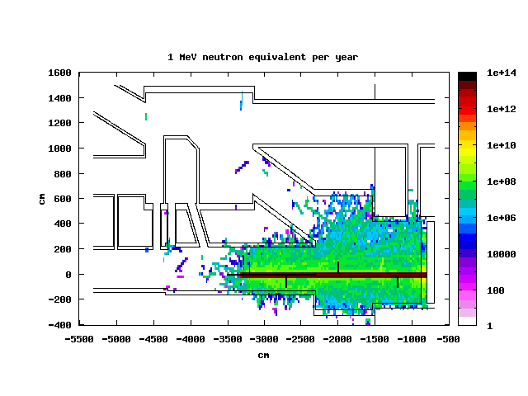
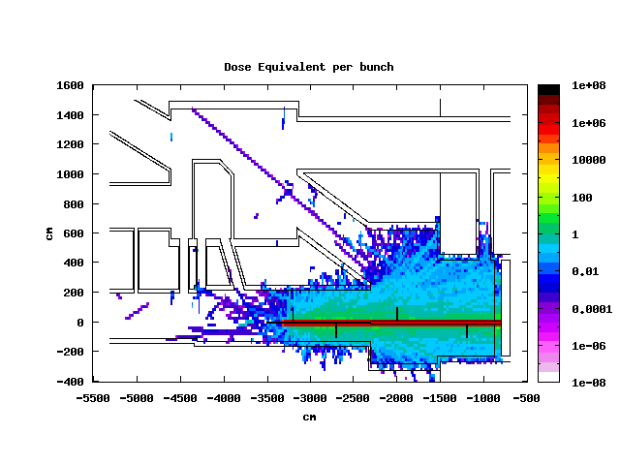
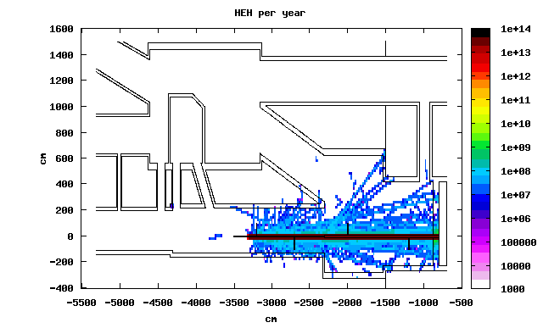
Compressed beam
Same order of magnitude than for un-compressed bunch (fast simulations just to check order of magnitude)

Slide 24


Proposed solution
Larger plasma cell with off set valve
Broad electron beam
ENTRANCE
Proton beam axis
EXIT
2 cm
4 cm
5.7 cm
3 mm
Metal shielding
Electron and proton beams have same axis
3 cm
More room at the entrance for large electron beam
Exit is not a problem: electrons and protons on the same axis

Slide 25
Conclusion
The presence of the metal shielding for the electron beam creates hard environment for electronics
The expected values for 1 MeV equivalent neutron, energy deposition and HEH fluence depend on the geometry of the shielding
The minimum level of HEH fluence is set by the interaction of the proton beam with the gas: still 1-2 orders of magnitude higher than recommended -> shielding may be required for diagnostic around plasma cell
Which material to use for the plasma cell wall? More details needed

