Slide 1
The Bias of the Unbiased Estimator
Julien Donini,
LPC/Univ. Blaise Pascal - Clermont-Ferrand
Luca Lista
INFN, Napoli

Slide 2
Introduction
The ATLAS+CMS combination of single-top production cross-section measurements in the t channel was performed using the BLUE (Best Linear Unbiased Estimator)[*] method, as many other similar combinations
  [*] L. Lyons et al. NIMA270 (1988) 110
Compared to its original formulation, relevant contributions to the total uncertainty are known as relative uncertainties
  Typically: systematic uncertainties
This spoils the Gaussian assumption of the original formulation and may introduce a bias in BLUE estimate in case of sizable uncertainties (~10% or more)
The iterative application of the BLUE method was proposed[**] in the case of a lifetime measurement to reduce such bias
  [*] L. Lyons et al. PRD41(1990)982985
  For each iteration, uncertainties known as relative contributions are rescaled to the combined value
We performed tests to motivate this choice for the single-top combination quantifying the bias in the two cases of the ‘plain’ vs iterative BLUE implementations

Slide 3


BLUE reminder
  Find linear combination of available measurements: x = Σ w_{i}x_{i}
    No bias implies Σ w_{i}=1
  Choose weights to minimize the variance of estimator
    Take properly into account correlations between measurements!
  Equivalent to χ² minimization or maximum likelihood for Gaussian uncertainties
    Simple example:
  Two measurements: x₁±σ₁, x₂±σ₂ with correlation ρ
  The weights that minimize the χ²:
    are:
    The uncertainty of the combined value is:
L.Lyons et al. NIM A270 (1988) 110
Cov. matrix
(w₁+w₂=1)

Slide 4
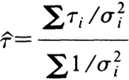
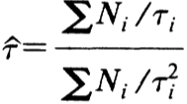
Iterative BLUE
Basic idea
  Consider simple weighted average
  Errors (σ_{i}) are supposed to be true errors
  But what are available are estimated errors
  ... that may vary with estimated central value (τ_{i})
  Violates ‘combination principle’: combination of partial combinations differs from combination of all results
Solution proposed
  LMS: Locally Matched Solution (we prefer iterative BLUE)
  Bias reduced if covariance matrix determined as if the central value is the one obtained from combination:
    Rescale uncertainties to combined value
    e.g.: if we know a relative uncertainty:
    σ^{rescaled} = σ ⋅ x_{blue} / x₁
    Iterate until central value converges to stable value
L. Lyons et al., Phys. Rev. D41 (1990) 982985

Slide 5
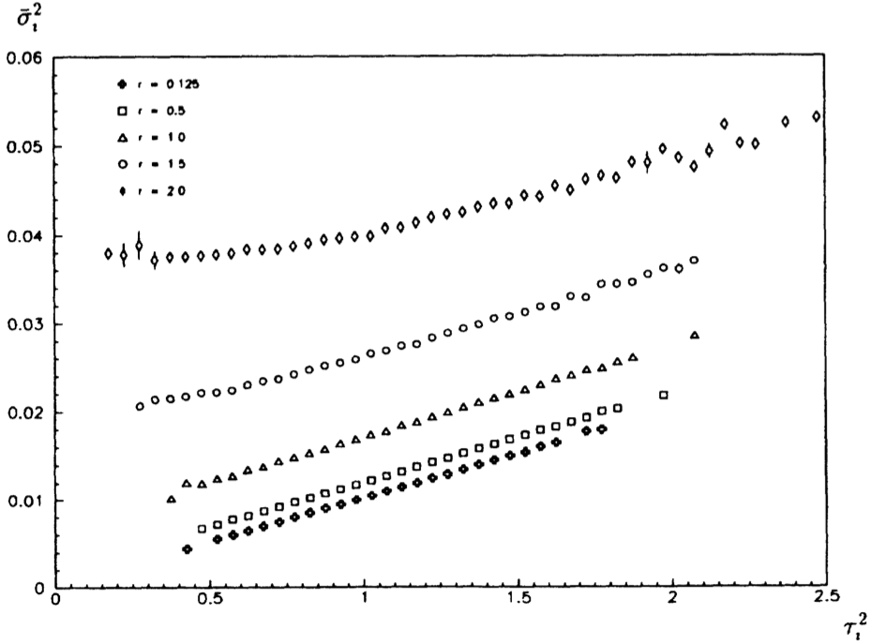
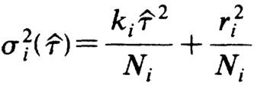
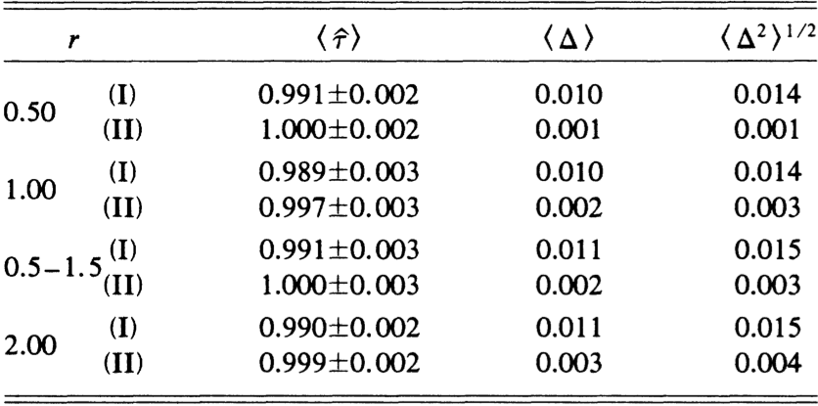
Application to B lifetime (Lyons)
Dependence of average estimated statistical uncertainties σ_{i} on lifetime estimate τ_{i} (squared) determined using toy experiments (100 decays each) and parameterized as:
Comparison of LMS method (II) with least square procedure (I).
Δ = τ_{fit} – τ with τ_{fit} the result from one single combined experiment
(‘combination principle’)
Resolution
Resolution improvement
Resolution

Slide 6
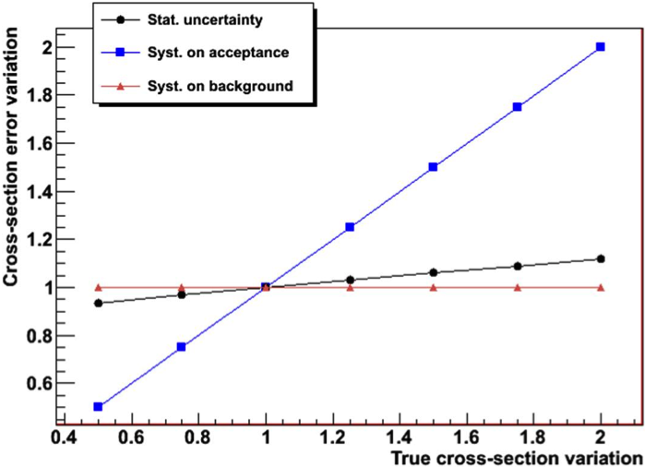
Application to single-top comb.
Cross section measurements given by:
sel. events
bkg. estimate
Int. lumi.
acceptance
σ varied from: 40 → 160 pb
B = 3000,
A = 0.25%
L= 5 fb⁻¹
δA =5%, δB =5%

Slide 7
ATLAS+CMS combination
ATLAS (ATLAS-CONF-2013-098):
  stat: 2.5% (fixed), syst.: 20% (relative uncert.)
CMS (CMS-PAS-TOP-12-002 ):
  stat: 7.1% (fixed), syst.: 15% (relative uncert.)
Correlation: ρ = 0.38 (total uncert.), ρ = 0.42 (syst. only)
Plain BLUE combination:
  σ_{t-ch.} = 83.6 ± 12.1 pb
Iterative BLUE combination:
  σ_{t-ch.} = 85.3 ± 12.2 pb

Slide 8
Plain BLUE method
Assuming as true uncertainties ATLAS and CMS estimates, with their correlation
Generate toys according including correlation and apply BLUE (plain)
Gaussian fit

Slide 9
Test with Toy Monte Carlo
To assess the possible bias using the two estimators, a simple toy generator was used:
Assume as true value the combined one: 85 pb
Assume as true fluctuations the nominal uncertainties of the two experiments with their correlation
  Nominal uncertainty: stat + syst added in quadrature of each experiment
Two central values are extracted for ATLAS and CMS according to the know uncertainties, their correlation and the true central value
  Fixed stat errors, rel. syst errors
Relative (systematic) uncertainties are rescaled to the extracted central values for ATLAS and CMS

Slide 10
Iterative vs plain BLUE
Bias: −0.32σ ~ 3.9pb (plain) → −0.13σ ~ 1.6pb (iterative)
RMS: 1.15 (plain) → 1.06 (iterative): uncertainty underestimate
Gaussian μ: 0.04 (plain) → 0.169 (iterative)
The iterative BLUE method reduces the bias by shifting the ‘core’ of the distribution and by shrinking the non-Gaussian tails
Gaussian fit
(‘core’)
Gaussian fit
(‘core’)

Slide 11
Dependence on syst. fraction
The systematic contribution was varied from the nominal values to zero rescaling it by a fraction f going from 0 to 1
Bias was measured varying the fraction f of the actual uncertainty
As expected, the bias goes to zero as f goes to zero
  Iterative BLUE is not an issue for precision measurements (e.g.: m_{t})
The iterative BLUE has in general smaller RMS and less bias

Slide 12
Dependence on correlation
Correlation between systematic uncertainties was varied from ρ=0 to ρ=1
Bias was measured varying the correlation ρ
The iterative BLUE has in general smaller RMS and less bias

Slide 13
What we have learned
Iterative BLUE method in general reduce biases
  Better behaved than standard BLUE method, but not perfect either
  In case of single top combination: difference is minor
Not all uncertainties should be rescaled
  Data-driven bkg. uncertainties
  Stat uncertainty (at 1st order)
  Others ?
More investigations ongoing…

