Slide 1
Markus, Michelangelo, Roberto
Outlook
TOPLHCWG open session, 28th-29th November 2013

Slide 2
Activities
The work of the TOPLHWG is already very diversified:
  Combination activities
    Five main axes providing results or being worked on (m_{t}, σ_{t}, σ_{tt}, W helicity, asymmetries)
  Comparison of results/agreement on conventions
    When combining existing measurements, new common conventions are agreed and will be followed for future measurements at ATLAS and CMS
    Define together acceptance and particle level quantities
  Critical review of combination tools
    BLUE, new ideas and tool standardization
    Started discussions about tools beyond linear approximation
  Harmonization of our dominant systematic errors
    Experimental: JES, b-tagging
    Theory: Radiation, generator difference, b-fragmentation
  Forum for TH-EXP discussions
    Best tools for our predictions for single top and top pair
    How to present results and best predictions to compare to
    Attack in time potential systematic effects (ex: top mass, b-fragmentation)
In this outlook
  Ideas about what we would like to see done by this WG in the next year

Slide 3
Harmonization of systematic errors
Radiation: we should make sure to understand the different sensitivities w.r.t. our conventions.
  Ongoing studies in ATLAS re-calculating radiation systematic errors using the ALPGEN samples with modified scales (‘a la CMS’).
  Possibly CMS tries ATLAS’ large/low IFSR settings
    benchmark analysis could be the di-lepton cross section @7 TeV
  Constrain radiation parameters with data and come to a closer set-up for the 13TeV run
Comparison of generators:
  decide whether (and when) the comparison of the central predictions of two calculations should also be quoted as an extra systematic error.
    Example: POWHEG vs MC@NLO – see yesterday’s discussion
b hadronization treatment:
  Test the assumptions about their inclusion in JES, try and avoid double countings.
  ATLAS is working on the jet re-calibration for this purpose.
Grouping of (other) experimental systematic errors.
  Bring to completion the harmonization of b-tag systematic errors and JES (also versus Tevatron).

Slide 4
Common acceptance and differential distributions
We should critically review the guidelines for defining a common acceptance for quoting our cross sections, and for the definition of pseudo top quarks.
  In their last form, they are documented in the last talk at the open session:
  https://indico.cern.ch/getFile.py/access?contribId=1&sessionId=0&resId=0&materialId=slides&confId=245769
  We should make sure they will be implemented in the next set of papers, either as references or as secondary results, by both Collaborations
We should understand our DT/MC (dis)agreements on differential distributions in the light of what presented at TOP2013 (and yesterday here).
  Work started for this workshop should be completed
In the longer run we should agree on the steps for performing a combination of differential distributions
  Agree to produce background-subtracted distributions unfolded to stable particles level (and implicitly we must use the same definition of variables at particle level, see above link).

Slide 5
Theory
Our common playground is given by the dominant TH systematic sources
  hard radiation, treatment of (b-)fragmentation, CR effects
Tuning/constraining Monte Carlos
  Techniques for constraining radiation in top pair and single top
  Techniques for studying b-fragmentation at the LHC
  UE and CR in top pair events
The issue of the mass of an unstable, coloured, non-hadronizing particle.
  Desirable to have conclusive discussions on this in the near future and mostly driven by TH (hope for a session at the next open meeting in Spring?)
  Discuss about the strategy for the incoming mass combinations versus the increasing number of indirect extractions (for instance the di-lepton endpoint analysis).
Keep regular reports and discussions on tools/computations/MCs
  Always keep the state-of-the-art comparison between measurements and predictions
  Understand (suspicious) differences in Monte Carlos(e.g. p_{T}(t))/drive new developments
  Important for giving guidelines in time on new measurements/combinations, and to strengthen links between TH and EXP.

Slide 6
Future combinations (I)
The scope of the WG in terms of combination of measurements will naturally extend in the long run.
This comprise the inclusion of more combinations for which both collaborations produce combinable^{(*)} results…
  Examples today (more in next slide):
    Spin correlations in ttbar
    Top polarization in ttbar
…as well as more “interpretation” tasks:
  constraints on |V_{tb}| and limits on anomalous couplings from single top measurements
    Four individual measurements so far, with
    different sensitivity. Worth starting a combination
    after the next updates?
    Tricky year/measurement/experiment correlations
    to account for
ATLAS [ATLAS-CONF-2013-101], 4.6 fb⁻¹: precision on A(ΔΦ) ~ 16%
ATLAS [arXiv:1307.6511], 4.7 fb⁻¹: precision on α∙p ~ 0.040
CMS [arXiv:1311.3924], 5.0 fb⁻¹: precision on A(ΔΦ) ~15%
precision on A_{P} ~ 0.025
 | ATLAS | CMS
t-channel 7 TeV | 11.9% | 4.8%
tW 7 TeV | 17.0% | 14.8%
t-channel 8 TeV | 10.1% | 8.6%
tW 8 TeV | 11.2% | 12.3%
(*) consistent measurements, similar sensitivities, common agreements where applicable, same center-of-mass energy
where applicable, scientific interest in performing a combination

Slide 7
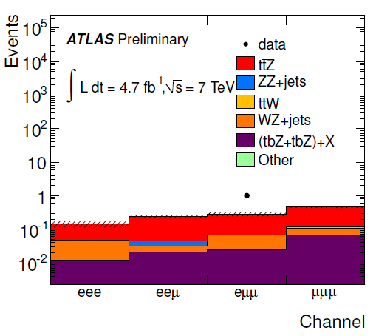
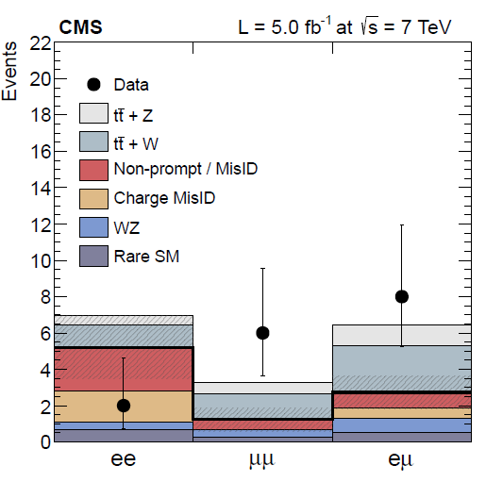
Future combinations (II)
ATLAS+CMS combinations will be particularly useful for channels/analyses suffering from low statistics. Next in-line:
  Single top Wt
  tt+Z/γ (tt+H as part of the Higgs
  combinations)
    Expect updates (a tt+Z cross section
    from ATLAS, tt+γ from CMS)
Extend discussions to domains more connected to new physics in top?
  E.g. FCNC, boosted domains,….
Inputs:
ATLAS [PLB717(2012)330], 2.05 fb⁻¹:
σ_{tW} = 83 ± 4(stat.) ⁺²⁰₋₁₉(syst) pb
ATLAS [ATLAS-CONF-2013-100], 20.3 fb⁻¹:
σ_{tW}(8TeV) = 27.2 ± 5.8 pb (4.2σ)
BDT analysis, e and μ channels.
CMS [PRL110(2013)022003], 4.9 fb⁻¹:
σ_{tW}(7TeV) = 16 ⁺⁵₋₄ pb (4σ)
CMS [CMS-PAS-TOP-12-040], 12.2 fb⁻¹:
σ_{tW}(8TeV) = 23.5 ^{+5.5}_{-5.4} pb (6σ)
BDT analysis, cut-based analysis as cross check. Both e and μ channels.
24%
28%
21%
23%

Slide 8
Conclusions…
Our future work is not a mere continuation of established combinations
  Harmonization of (TH/EXP) systematic errors – beneficial to all analyses -
  Understanding our differences (definition of observables/generation setup/…)
  Interpretation of our measurements (|V_{tb}|, anomalous couplings)
  New combinations
Please contribute your ideas and opinions, do not hesitate and contact us
… and announcements
Markus completed his mandate as ATLAS contact person of the TOPLHCWG
  Let us thank him for helping to make this WG a reality, and for all the accomplishments of the group so far
Will be replaced by Maria Costa from 1/12/2013: welcome !
We are aiming at having the next session in Spring 2014
  Thanks for participating/contributing

