Slide 1
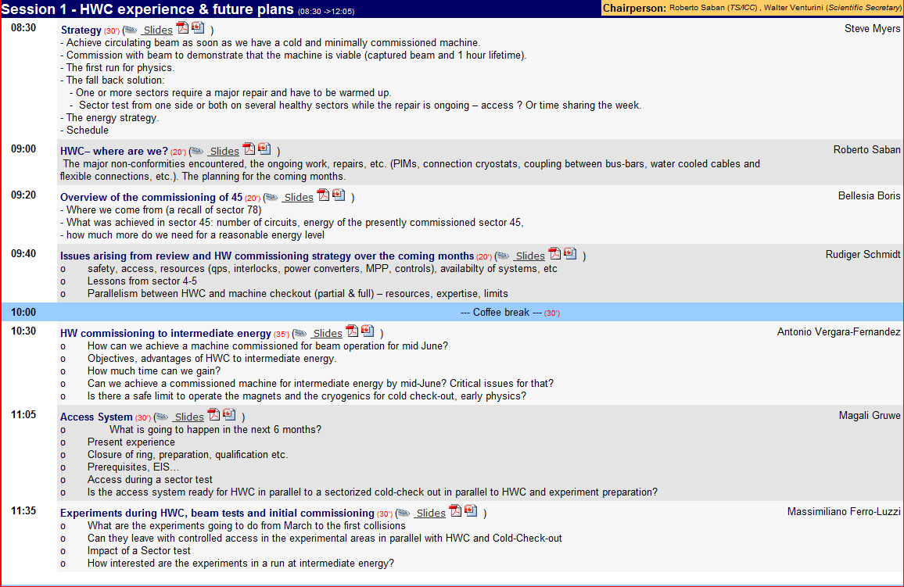
Session 1 – Hardware Commissioning experience & future plans
Chairperson Roberto Saban
Scientific Secretary Walter Venturini Delsolaro

Slide 2
The Strategy
Hardware Commissioning to a beam energy lower than 7 TeV as quickly as possible. Which energy?
Cold check-out in parallel to Hardware Commissioning.
Physics run with reasonable integrated luminosity at “high” energy
The sector test is the fall-back plan
Carry out a thorough examination of the complete process (from now to collisions in “summer”)
Find optimum parameters and procedures (e.g. propose beam energy with justification)
Understand the technical, the organisational and the manpower implications of the cohabitation between cold checkout and hardware commissioning
Fill “holes” resulting from incomplete understanding of what has to be done
Correct eventual “mismatches” between equipment groups and operational requirements
Steve Myers

Slide 3
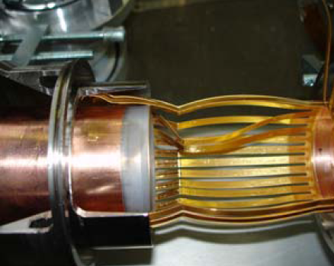
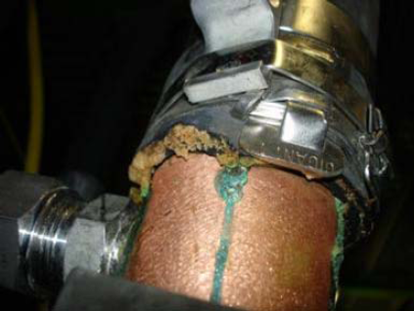
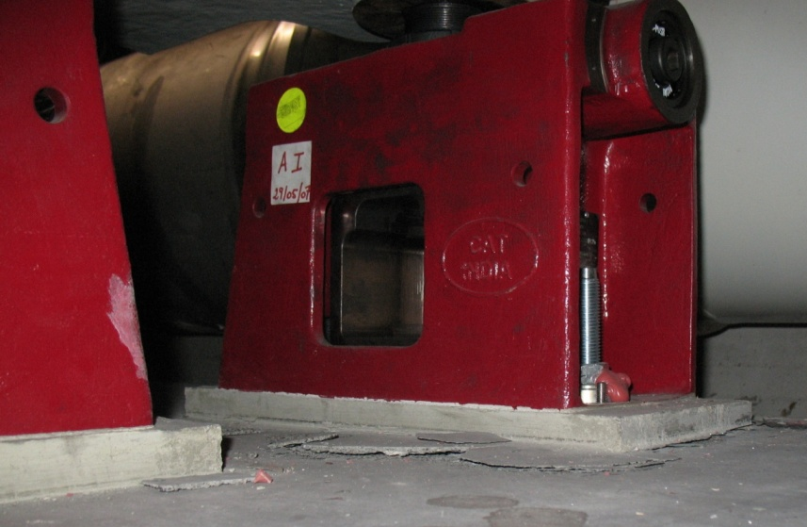
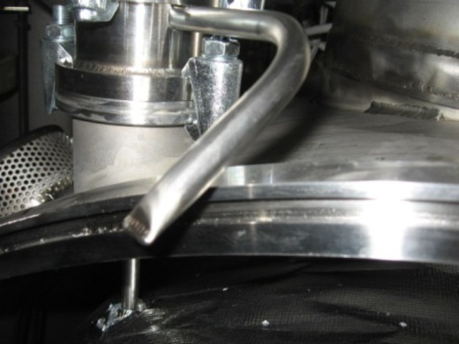
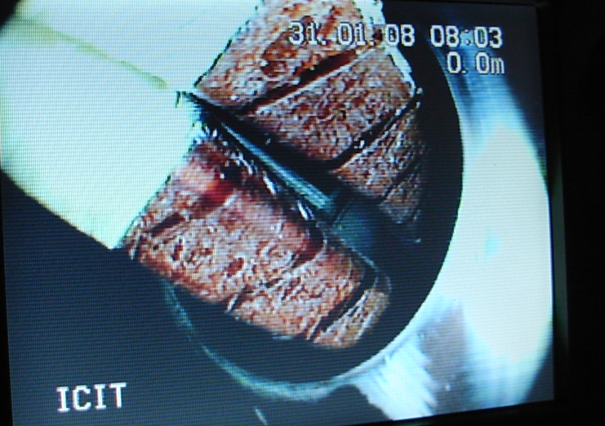
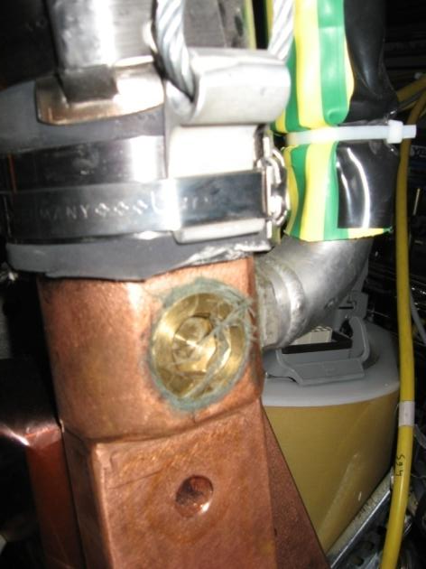
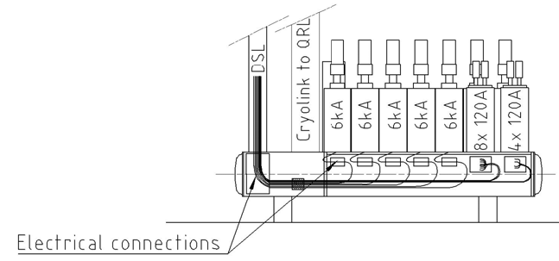
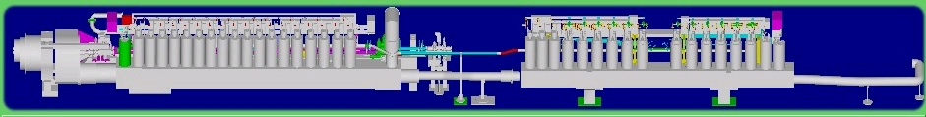
Hardware Commissioning : where are we?
Where do we stand with the non-conformities?
The helium guards of the level gauges of the SSSs
Connection cryostats
PIMs
The hoses of the water cooled cables
Connections of the flexible water pipes to the water cooled cables
Coupling between bus-bar cables in the DFBs
Jacks
we know how to repair the mechanical non conformities
there is a consolidation plan which is compatible with the present schedule
for the coupling between bus bars in some of the DFBs (which was not observed during the last commissioning campaign) a decision is pending
Roberto Saban
Q7
ATM
HCM

Slide 4
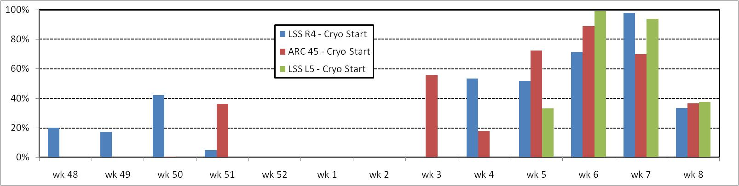
Overview of the Commissioning of Sector 45
 | Baseline | Target | Done
Main Circuits | 74 | 67 | 92
IPQ-D | 221 | 221 | 232
600A | 688 | 520 | 503
120A | 300 | 210 | 216
60A | 282 | 94 | 232
Total | 1565 | 1112 | 1275
On Monday of Week 6 the target was redefined in order to commission
  all the hardware (PC,PIC,QPS,EE) of every available circuit
  to a level sufficient to reveal all the non conformities
Number of test steps
Boris Bellesia
Problems with leaks to the subatmospheric circuits of the cryogenic system
Problems with level gauges of 4.5K LSS magnets
W48
W50
W52
W2
W4
W6
W8
w9
Cryo conditions

Slide 5
Overview of the Commissioning of Sector 45
Baseline
 | Baseline | Target | Done
Main Circuits | 74 | 67 | 92
IPQ-D | 221 | 221 | 232
600A | 688 | 520 | 503
120A | 300 | 210 | 216
60A | 282 | 94 | 232
Total | 1565 | 1112 | 1275
7TeV
Done
6TeV
Target
Boris Bellesia
~60 test/wday
Successful test steps
W48
W50
W52
W2
W4
W6
W8
w9
Cryo conditions

Slide 6
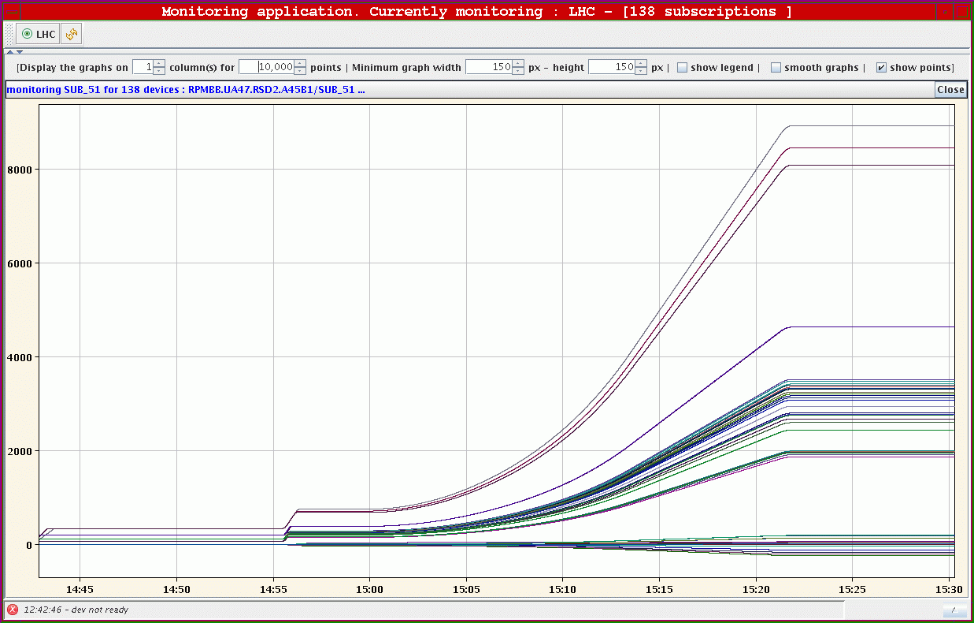
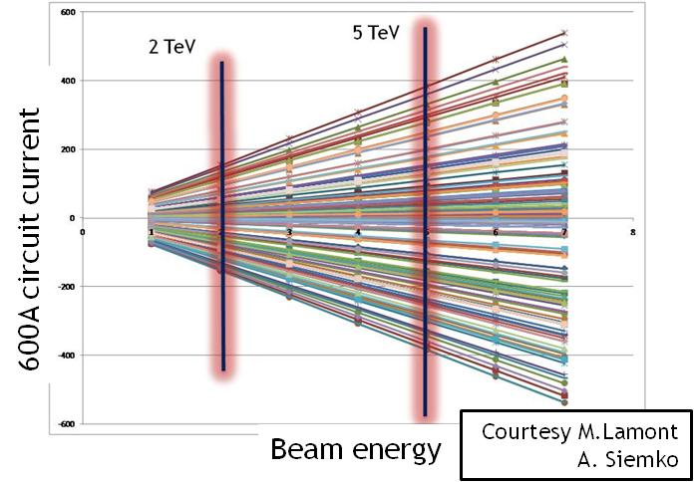
Sector 45 Ramp to 5.3 TeV
600
400
Sector 45 is
fully commissioned to below 3 TeV
partially commissioned to 5 TeV
all main circuits
large part 600A
partially commissioned to 6 TeV
all main circuits
few 600A
200
Boris Bellesia
-200
-400
-600

Slide 7
Issues arising from the review and the strategy over the coming months
Safety & access
The systems:
  Cryogenics, DFBs and current leads
  Powering, Power Converters, Quench Protection System, 600 A and 13 kA Energy Extraction
The tests and the analysis:
  Powering tests and Magnet Performance Panel
The tools:
  Post-Mortem, Logging, Sequencer, Tracking data and progress after the tests
Ruediger Schmidt
The miniteams are in place
    Safety & access
    Organisation
    Automation
    Optimisation
Big effort to
    Simplify the test procedures
    Widen the cryo conditions to allow testing
    Identify the current levels for each circuit

Slide 8
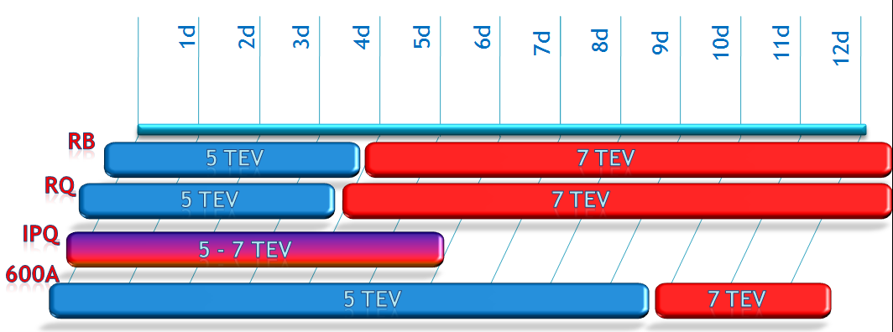
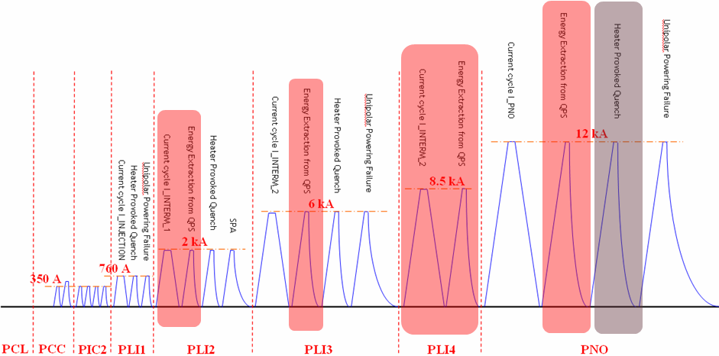
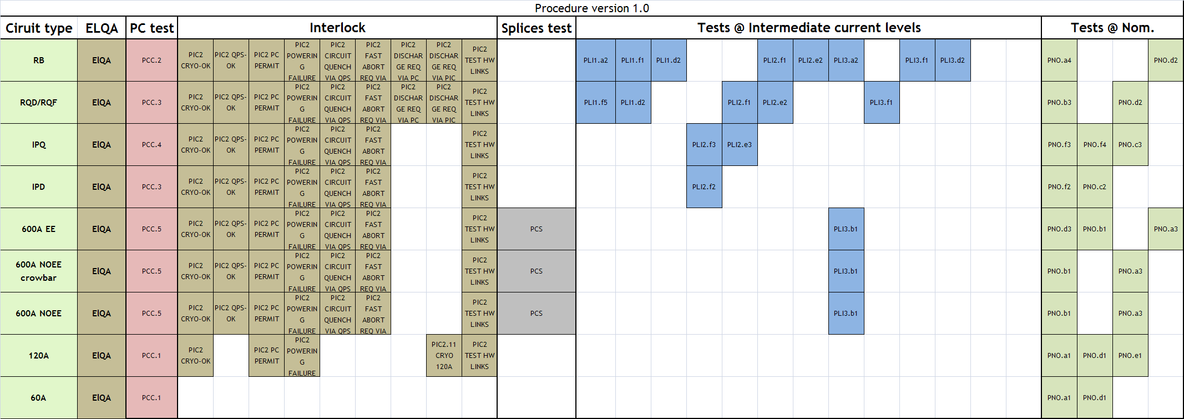
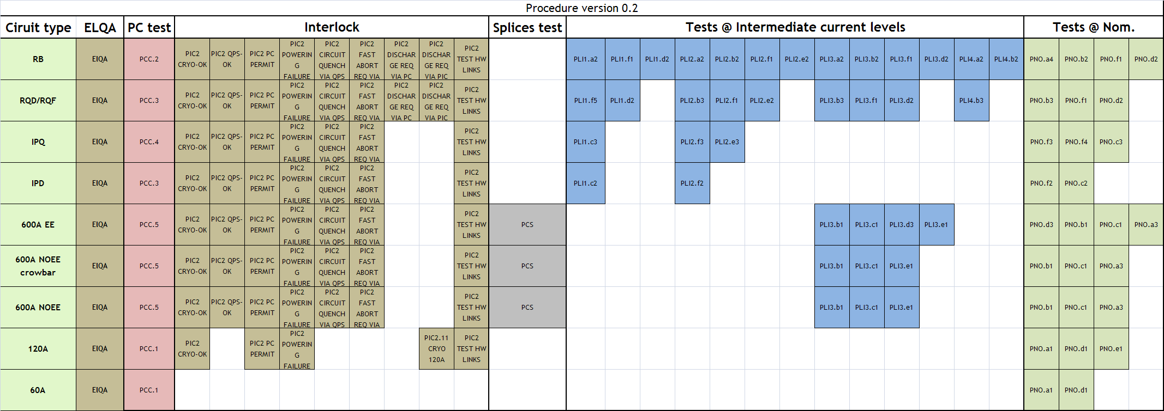
Commissioning the LHC to Intermediate Energy
Increase of parallelism
  by exploiting the distance and the sectorization
  large sets of orbit correctors
  automatic tools
Simplification of the test plan by MPP
  Removing steps
  Merging steps
  Avoiding provoked quenches at nominal
Commissioning the LHC at intermediate energy
    Widen the cryo conditions to allow testing at temperatures higher than nominal
Antonio Vergara-Fernandez

Slide 9
Access control
Experience :
  with the installation configuration
  during the access control system tests both in access and in beam mode
There is a need to re-establish a controlled access culture
Tests included: patrolling, monitoring a patrol from the CCC, monitoring accesses, giving access from the CCC
During the tests the access control system performed as expected with minor non-conformities detected and minor improvements suggested
More tests and more training are nevertheless needed
Magali Gruwé

Slide 10
Access control
Experience :
  with the installation configuration
  during the access control system tests both in access and in beam mode
Near future:
  Cool-down and powering tests
  Move the whole LHC to operation configuration
Currently being configured for
  general access during cool down or electrical quality assurance and
  restricted access for powering tests
Biometry is active
Either a personal dosimeter or a personal token is required
The system counts and identifies the personnel inside a given sector but close control of the activity by the EIC is required
Magali Gruwé

Slide 11
Access control
Experience :
  with the installation configuration
  during the access control system tests both in access and in beam mode
Near future:
  Cool-down and powering tests
  Move the whole LHC to operation configuration
Beam in LHC
A lot remains to be done
  Acceptance by AB-OP and
  Acceptance by the DSO
  Close a complete machine
  Define and document the patrol procedure
Magali Gruwé

Slide 12

Access control
Experience :
  with the installation configuration
  during the access control system tests both in access and in beam mode
Near future:
  Cool-down and powering tests
  Move the whole LHC to operation configuration
Beam in LHC
Some issues
Procedure for the reconfiguration and or the strapping of the EIS
Prepare for the situation after the LHC has seen beam
Magali Gruwé

Slide 13
Experiments during hardware commisioning, beam tests and initial commissioning
What are the experiments going to do from March to the first collisions?
Completing installation of initial detectors
  All heavy elements are in the caverns
  Main activities: cable up, check out
Commissioning of sub-detectors in parallel
Regular global commissioning runs
Massimiliano Ferro-Luzzi

Slide 14
Experiments during hardware commisioning, beam tests and initial commissioning
What are the experiments going to do from March to the first collisions?
Can they live with controlled access in the experimental areas in parallel with Hardware Commissioning and Cold-Check Out?
1st April all areas go to controlled access
Some worries for the experiments:
  Availability and distribution of badges
  Accessibility of machine areas containing equipment belonging to the experiments
  Use of PM lifts by the experiments
  Minor issue: doors throughput, maximum 2 persons / minute
Discussions between the TC and Hardware Commissioning Coordination are needed
Massimiliano Ferro-Luzzi

Slide 15
Experiments during hardware commisioning, beam tests and initial commissioning
What are the experiments going to do from March to the first collisions?
Can they live with controlled access in the experimental areas in parallel with Hardware Commissioning and Cold-Check Out?
Impact of a sector test
Experiments can not make any use of a sector test
Impact
  Radiological during and after the test
  Access
  INB tracing
Yet, if deemed very useful for the LHC commissioning, a low-intensity sector test of one or two weeks seems acceptable and will have minor impact on the experiments
Massimiliano Ferro-Luzzi

Slide 16
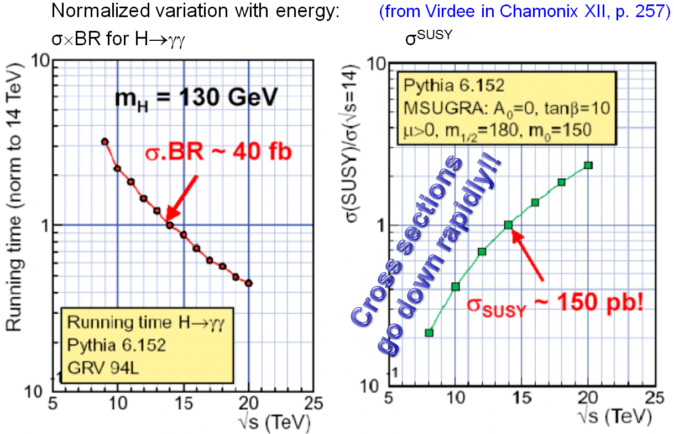
Experiments during hardware commisioning, beam tests and initial commissioning
What are the experiments going to do from March to the first collisions?
Can they live with controlled access in the experimental areas in parallel with Hardware Commissioning and Cold-Check Out?
Impact of a sector test
How interested are the experiments in a run at intermediate energy?
Massimiliano Ferro-Luzzi

Slide 17
Experiments during hardware commisioning, beam tests and initial commissioning
What energy?
What integrated luminosity ?
What "Stage" of commissioning before running ?
  what beta*
  how many bunches ?
  for how long ?
Again, the experiments would like to participate to the choice of all these conditions
A 2008 run at intermediate energy?
What are the experiments going to do from March to the first collisions?
Can they live with controlled access in the experimental areas in parallel with Hardware Commissioning and Cold-Check Out?
Impact of a sector test
How interested are the experiments in a run at intermediate energy?
Massimiliano Ferro-Luzzi
Yes, we are interested!

Slide 18
... in summary
The strategy | Initial commissioning to a beam energy lower than 7 TeV as quickly as possible. Which energy? Cold check-out in parallel to Hardware Commissioning. Physics run with reasonable integrated luminosity at “high” energy The sector test is the fall-back plan

Slide 19
... in summary
The strategy | Initial commissioning to a beam energy lower than 7 TeV as quickly as possible. Which energy? Cold check-out in parallel to Hardware Commissioning. Physics run with reasonable integrated luminosity at “high” energy The sector test is the fall-back plan
The non-conformities | Being resolved. What about the DFBs cables?

Slide 20
... in summary
The strategy | Initial commissioning to a beam energy lower than 7 TeV as quickly as possible. Which energy? Cold check-out in parallel to Hardware Commissioning. Physics run with reasonable integrated luminosity at “high” energy The sector test is the fall-back plan
The non-conformities | Being resolved. What about the DFBs cables?
The review of Sector 45 | A lot of progress in terms of safety, tools, procedures, organization, integration of the teams A reduction of the commissioning time was achieved mainly thanks to the automatic control and analysis tools as well as to the simplification of the procedures A further reduction is expected

Slide 21
... in summary
Open issues | Hot topics were identifed and are being dealt with by four teams which are presenting preliminary conclusions next week.

Slide 22
... in summary
Open issues | Hot topics were identifed and are being dealt with by four teams which are presenting preliminary conclusions next week.
Commissioning to an intermediate energy | Is the only option which can lead us to commissioning with beam this summer

Slide 23
... in summary
Open issues | Hot topics were identifed and are being dealt with by four teams which are presenting preliminary conclusions next week.
Commissioning to an intermediate energy | Is the only option which can lead us to commissioning with beam this summer
Access control | Is being gradually put in place to allow safe commissioning. Has an impact but is necessary

Slide 24
... in summary
Open issues | Hot topics were identifed and are being dealt with by four teams which are presenting preliminary conclusions next week.
Commissioning to an intermediate energy | Is the only option which can lead us to commissioning with beam this summer
Access control | Is being gradually put in place to allow safe commissioning. Has an impact but is necessary.
Experiments | Would like closer ties with the commissioning and the preparation of the run. Welcome the 5 TeV run! Welcome … any run!

