Slide 1
Commissioning the LHC to Intermediate Energy
Antonio Vergara for the HCC Team

Slide 2
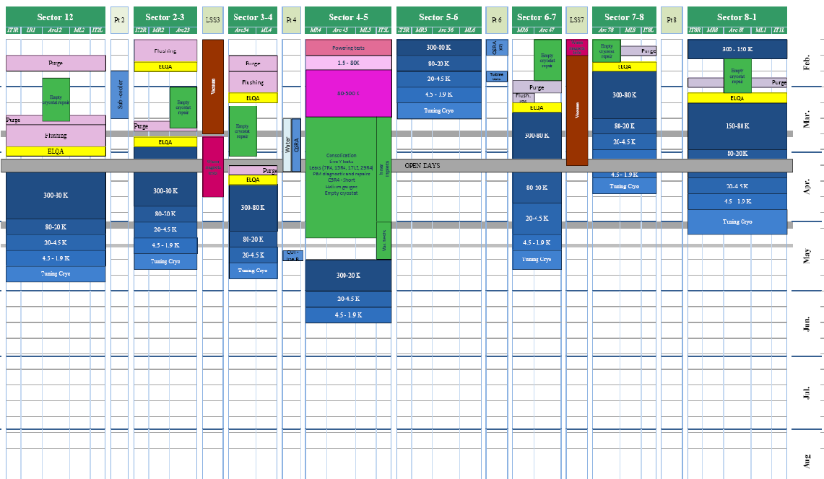
The boundary conditions
Courtesy E.Barbero
K.Foraz

Slide 3
How can we achive beam for summer?
Test automatisation - Parallelism
Simplification of
the test plan
4 FRONTS
Cryogenic conditions
Lower commissioning energy

Slide 4
Shortening the Powering Tests
Increase of parallelism:
(i.e. maximizing the work while the cryo_maintain is green)
  Main circuits and correctors powered in parallel while no quenches are expected
  Intelligent use of the arc geography while powering IPQs
  Simmultaneous quenches in distant magnets
  Large batteries of closed orbit correctors (up to 76)
  ONLY for exceptional cases and with operators from cryo in the CCC: masking of the arc cryo_mantain and selective powering of the cells with good cryo conditions.
  … all this has been possible thanks to the highly performant automatic tools (Sequencer, post-mortem analyser, etc.) that are being developed and tuned since sector 7-8.
  Last but not least… parallelism is needed, however, in some cases (some of them discovered in 4-5) quality and safety require individual powering so tempting shortcuts must be avoided by all means

Slide 5
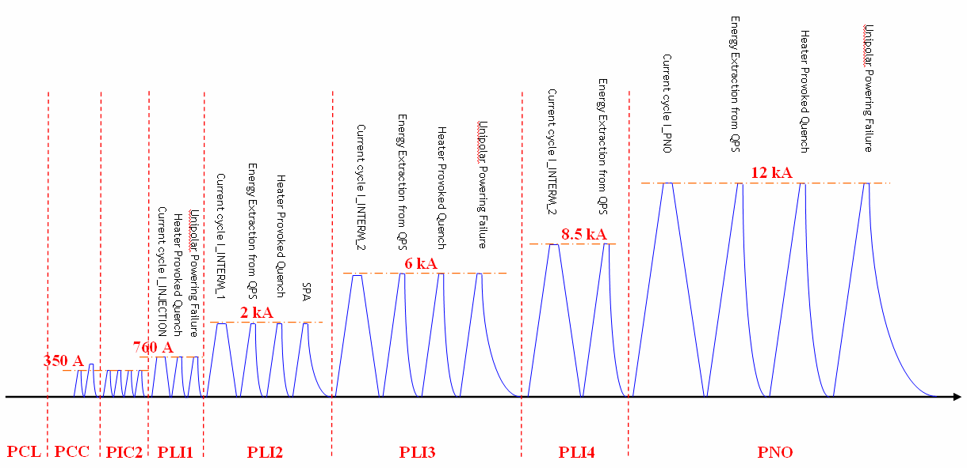
Shortening the Powering Tests
Simplification of the test plan by MPP.
  Removing steps
Bob Flora

Slide 6
Shortening the Powering Tests
Simplification of the test plan by MPP:
  Removing steps
  Merging steps
7 kA

Slide 7
Shortening the Powering Tests
Simplification of the test plan by MPP:
  Removing steps
  Merging steps
  Avoiding provoked quenches at nominal

Slide 8
Shortening the Powering Tests
Simplification of the test plan by MPP:
  Removing steps
  Merging steps
  Avoiding provoked quenches at nominal
A. Siemko

Slide 9
Shortening the Powering Tests
Commissioning the LHC at intermediate energy: RB, RQs
1 kA
2 kA
3 kA
4 kA
5 kA
6 kA
7 kA
8 kA
9 kA
10 kA
11 kA
12 kA
RB
PCC-PLI
PNO
RQF+
RQD
PCC-PLI
PNO
Quenches
Injection
1 TeV
2 TeV
3 TeV
5 TeV
7 TeV

Slide 10
Shortening the Powering Tests
Commissioning the LHC at intermediate energy: RB, RQs
1d
2d
3d
4d
5d
6d
7d
8d
9d
10d
11d
12d
RB
PCC-PLI
PNO
RQF+
RQD
PCC-PLI
PNO
Quenches
Injection
2-3 TeV
5 TeV
7 TeV
1 TeV

Slide 11
Magnet Performance History
3
1
2
SM-18: 175 quenches to reach 12 kA
in all 154 dipoles
Courtesy
A.Verweij

Slide 12
Shortening the Powering Tests
Commissioning the LHC at intermediate energy: RB, RQs
1d
2d
3d
4d
5d
6d
7d
8d
9d
10d
11d
12d
RB
PCC-PLI
PNO
RQF+
RQD
PCC-PLI
PNO
Quenches
Injection
2-3 TeV
5 TeV
7 TeV
1 TeV

Slide 13
Shortening the Powering Tests
Commissioning the LHC at intermediate energy: IPQs
1 kA
2 kA
3 kA
4 kA
5 kA
6 kA
7 kA
8 kA
9 kA
10 kA
11 kA
12 kA
PCC-PLI
PNO
PCC-PLI
PNO
8 IPQ
PCC-PLI
PNO
1 TeV
2 TeV
3 TeV
5 TeV
7 TeV

Slide 14
Shortening the Powering Tests
Commissioning the LHC at intermediate energy: IPQs
1d
2d
3d
4d
5d
6d
7d
8d
9d
10d
11d
12d
PCC-PLI
PNO
PCC-PLI
PNO
8 IPQ
PCC-PLI
PNO
Quenches
1 TeV
2-7 TeV

Slide 15
Shortening the Powering Tests
The 600A Correctors
5 TeV
2 TeV
Courtesy M.Lamont
A. Siemko

Slide 16
Shortening the Powering Tests
The 600A Correctors
Regardless of the chosen energy, most of the correctors will need to be commissioned at a current far below their nominal (550A)
however
experience in Sectors 7-8 and 4-5 shows that the bottle-neck with these circuits is not to ramp them up to nominal but to switch them on.

Slide 17
Shortening the Powering Tests
The 600A Correctors
Regardless of the chosen energy, most of the correctors will need to be commissioned at a current far below their nominal (550A)
however
experience in Sectors 7-8 and 4-5 shows that the bottle-neck with these circuits is not to ramp them up to nominal but to switch them on.
hence….
the first (critical) steps for the 600A correctors when experts presence in the CCC, calibration of the quench detectors and frequent intervention in the field are required should be carried out for ALL the 600A circuits as soon as possible once the cryogenic conditions are met
once all the detectors are calibrated and measurements in the energy extraction switches taken
remote commissioning should bring the different correctors to their required current for 1, 2, 3 or 5 TeV
commissioning time will not depend on the energy chosen as long as we stay in the area free of training quenches.

Slide 18
Shortening the Powering Tests
Commissioning the LHC at intermediate energy: 600A
1d
2d
3d
4d
5d
6d
7d
8d
9d
10d
11d
12d
PCC-PLI
PNO
PCC-PLI
PNO
PCC-PLI
PNO
600A
Quenches
PCC-PLI
PNO
PNO
1-5 TeV
7 TeV

Slide 19
Shortening the Powering Tests
Commissioning the LHC at intermediate energy
1d
2d
3d
4d
5d
6d
7d
8d
9d
10d
11d
12d
RB
5 TeV
7 tev
RQ
5 TeV
7 tev
IPQ
5 - 7 TeV
600A
5 TeV
7 tev

Slide 20
Shortening the Powering Tests
Commissioning the LHC at intermediate energy
1d
2d
3d
4d
5d
6d
7d
8d
9d
10d
11d
12d
RB
5 TeV
RQ
5 TeV
IPQ
5 - 7 TeV
600A
5 TeV

Slide 21
Shortening the Powering Tests
Commissioning the LHC at intermediate energy
13d
14d
15d
16d
17d
18d
19d
20d
21d
22d
23d
24d
Conclusion 1: Powering only to 5 TeV implies a remarkable improvement due
to the absence of training quenches
Conclusion 2: No big difference between commissioning at 450GeV or 5 Tev
BUT…
IPQ
5 - 7 TeV
5 TeV
600A

Slide 22
Shortening the Powering Tests
1d
2d
3d
4d
Many circuits can be commissioned below 2.6 K
Magnets can be operated at lower temperature
Cold compressor trips could become transparents
for some hours (even days)
Cryogenic conditions wouldn’t be lost after any heater
firing test – Parallelism could be largely increased
Higher test robustness
RB
PCC-PLI
PNO
RQF+
RQD
PCC-PLI
PNO
Same as above plus:
Faulty circuits found during ElQA @ cold may be
still powered without warming up the sector
Tunnel would be accessible during the whole tests
Simpler powering test preparation
Injection
5 TeV
2-3 TeV
1 TeV
A. Siemko
Although there are no significant differences among the times needed to commission
the machine at 1, 2, 3 or 5 TeV, the technical constraints may largely vary depending
on the energy chosen. This can be a key point if we want beam in the machine by
June 2008.

Slide 23
Just a guess towards the 5 TeV…

Slide 24
Conclusions
Aiming for a LHC commissioned up to an energy of 5 TeV or below is the only way to have colliding beams in summer 2008
There are no significant differences among the times needed to commission the machine at 1, 2, 3 or 5 TeV, however the technical constraints may largely vary depending on the energy chosen
Experience in powering Sectors 7-8 and 4-5 has given us many good ideas about how to speed up the powering tests (parallelism, organisation, automatisation tools, etc…), however resources will become a critical issue when trying to power so many sectors at such a high speed
The Powering Test goal is to commission the protection systems of the LHC superconducting circuits, HENCE short-cuts are forbidden and safety of the personnel and the equipment can never be compromised

