Slide 1
Overview of the commissioning of the S45
Boris Bellesia

Slide 2
Outline
1st Commissioning of S78: April-July 2007
Overview of the circuit commissioning procedure for S45
Achievements of S45 PT:
  Test progress by procedure steps
  Efficiency: PT and Cryogenics
  Results: Main circuits / Groups
  Results: energies
Main outcomes of the review of the 28th Feb 08
Conclusion

Slide 3
From S78 to S45
Jan. ‘07
Jul. ‘07
Cooldown/Warm up S78
PT S78
20th April
11th Jul.
Circuit types | Sector 78 n. Circuit | LHC
13 kA | 3 | 24
RQX | 1 | 8
Independently Powered Dipoles | 2 | 16
Independently Powered Quads | 7 | 78
600A with Energy Extraction | 27 | 202
600A Energy Extraction in the Converter | 20 | 136
600A no Energy Extraction | 9 | 72
80-120A Correctors | 37 | 284
60A Dipole Orbit Correctors | 94 | 752
Total | 199 | 1572
Minimum required - recommendations of Magnet Performance Panel (04/07)
Limited Current: RB (2 kA), RQD (6.5 kA), RQF (350 A) | 3 | OK
RD2 up to 6kA | 1 | OK
RQ4 and RQ5 up to nom. (3590A and 4210A) | 2 | Up to NOM
14 Line-N, 3 spool pieces, 2 MQTLH (600A w. EE) | 19 | DONE
Three Line-N Circuits (600A) NOEE | 3 | 2
Q4 and Q5 dipole orbit correctors | 7 | OK
60A dipole orbit correctors | 5 | OK (60)
Total | 40

Slide 4
Outline
Jan. ‘07
Jul. ‘07
Cooldown/Warm up S78
PT S78
20th April
11th Jul.
1st Review
Outcomes of the review implemented in the HC of the S45
Test automatization (sequencer optimization)
Organization improvement (Field and CCC)
Tools to optimize commissioning (e.g. the circuit viewer)
Procedures optimization (version released Nov.07)
Clear procedure for assure safety – equip. and people (Safety day Sep.07)

Slide 5
Commissioning of S45: circuit overlook
July. ‘07
Feb‘08
Jan. ‘07
Cooldown/Warm up S45
Cooldown/Warm up S78
PT S45
PT S78
26th Nov.
19th Feb
20th April
11th Jul.
Circuit types | Sector 45 n. Circuit | LHC | Sector 45 n. Circuit comm.
13 kA | 3 | 24 | 3
RQX | 1 | 8 | 0
Independently Powered Dipoles | 3 | 16 | 3
Independently Powered Quads | 13 | 78 | 13
600A with Energy Extraction | 24 | 202 | 24
600A Energy Extraction in the Converter | 14 | 136 | 14
600A no Energy Extraction | 9 | 72 | 2
80-120A Correctors | 35 | 284 | 29
60A Dipole Orbit Correctors | 94 | 752 | 94
Total | 196 | 1572 | 182
NOT Commissionable
IT circuits – RQX+ 6 DOC 600A, 1 600A, 5 120A corr. | 13
RCBYV5.R4B1 (120A DOC of Q5) | 1
Total | 14

Slide 6
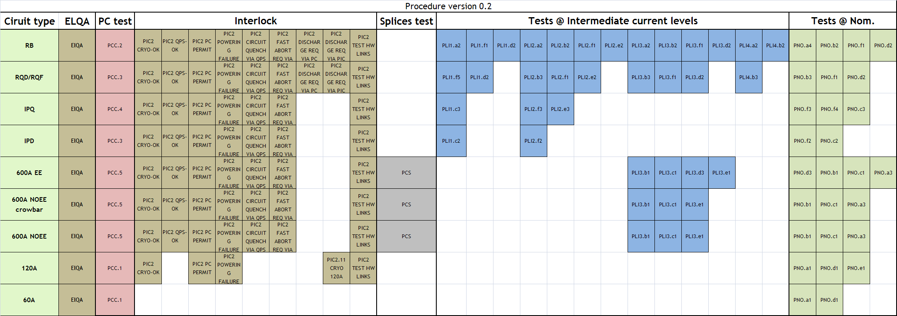
S45: Circuit commissioning procedures
Main circuits – RB/RQD-F/MS-DSquads/Separation Dipoles
Correctors – 600A w. and no EE/Dipole Orbit Correctors
Targets redefinition (W6):
  To commission all the hardware (PC,PIC,QPS,EE)
  To commission to a sufficient level that allows to reveal all the NCs

Slide 7
Achievements S45: Circuits status
Circuit type | # | Target
Main circuits | 3 | PNO (>10kA)
IPQuads and (5) IPDipoles (3) in the MS | 8 | PNO (3.6-5.5kA)
IPQuads in the DS regions | 8 | PNO (5.3kA)
600 A circuits NOEE crowbar + NOEE | 16 | PCS (200A)
600 A EE + undulator | 24 | PLI3(200A)
120A: Dipole Orbit Correctors | 29 | PIC2 (10A)
60 A: Dipole Orbit Correctors | 94 | PCC (10A)
Comm.
3
8
6
14
16
29
94
…a bit more in detail
120A– 30 cir.
29 | 100%
IPQ/D – 16 cir.
14 | 100%
2 | 90% (PNO)
600A EE – 24 cir.
16 | 100%
8 | 75%
600A without EE – 16
14 | 100%
2 | 50%
60A – 94 cir.
94 | 100%

Slide 8
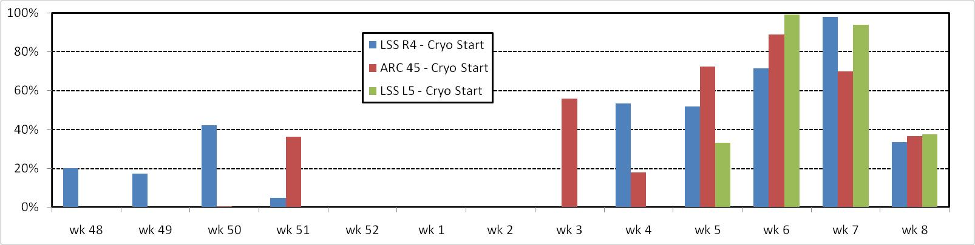
Achievements S45: Test Steps
procedure
 | procedure | targets | done
Main Circuits | 74 | 67 | 92
IPQ-D | 221 | 221 | 232
600A | 688 | 520 | 503
120A | 300 | 210 | 216
60A | 282 | 94 | 232
Total | 1565 | 1112 | 1275
7TeV
DONE
6TeV
targets
Successful test steps
~60 test/wday
Ack:
A. Marqueta
V. Zambrano
W48
W50
W52
W2
W4
W6
W8
w9
Cryo Starts
Ack:
M. Soubiran

Slide 9
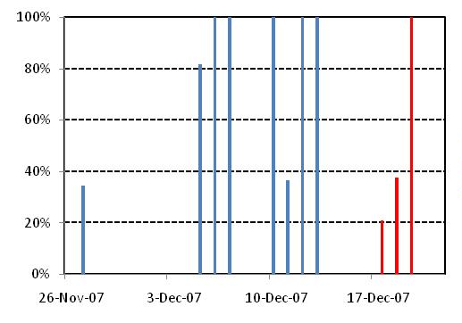
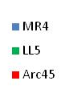
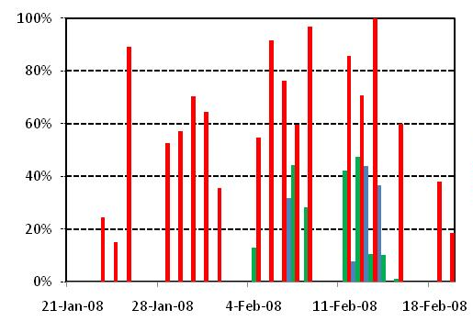
Achievements S45: Day efficiency
Testing_time
Eff_PT=
cryoSTART_avail_time
Arc: RB
Ack:
Jacek Szkutnik
MR4 DFBMG
MR4 DFBML
Arc: all
cryoSTART_avail_time
MR4 DFBMK
Eff_cryo=
= 0.7
Total_time
LL5 DFBMK
-Average Arc: 60% - Field activities
-Average MR4: 59% - Masking
Average LL5: 25% - Parallelism
Total: 70%
[S. Claudet]
Tot_eff= 0.5

Slide 10
Achievements S45: time per circuit type
1d
2d
3d
4d
5d
6d
7d
8d
9d
10d
11d
12d
RB
PCC-PLI
PNO
RQF/D
PCC-PLI
PNO
Ipq/d - 16
PCC-pli - 16
PNO - 16
600A ee - 24
PCC-pcc - 24
Pli - 16
PNO - 2
600A noee - 16
PCC-pcs - 14
Pli - 8
PNO - 5
120A/60a - 110
PCc - 110
pno - 92

Slide 11
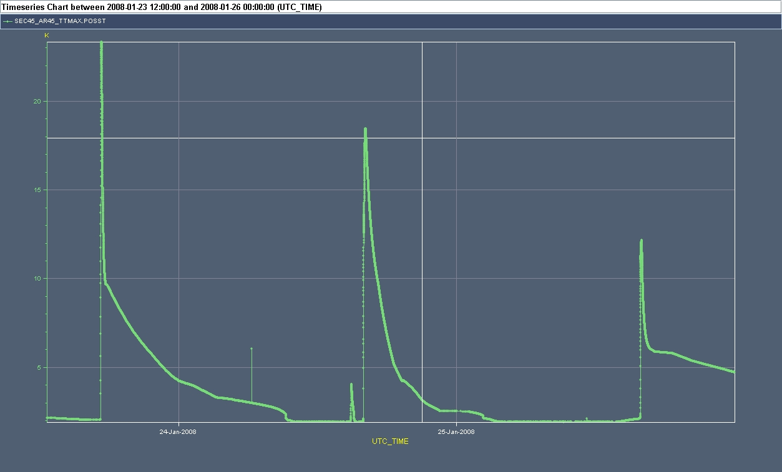
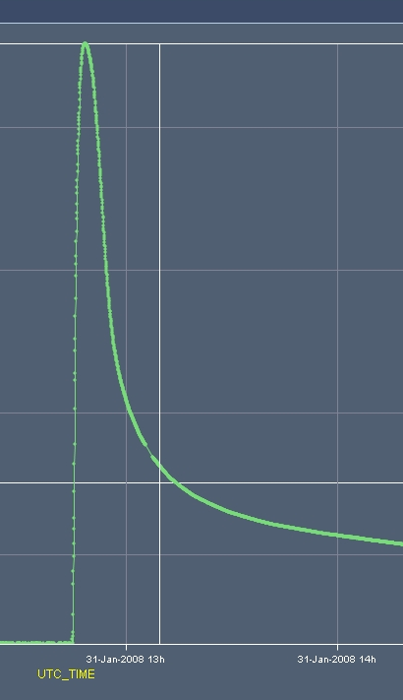
Achievements: Main Dipoles at 6TeV (>10kA)
9500A
17R4-B
Main Dipoles: 10.27kA – 6.1TeV – 7.25T
W4
W5
@10274A
27R4 (A-B-C) then 26R4 (C-B)
@9789 A
27L5 (C-B-A)
20
@9857A
22R4 (A-B-C) then 21R4 (C)
15
Max T in A45 [K]
10
5

Slide 12
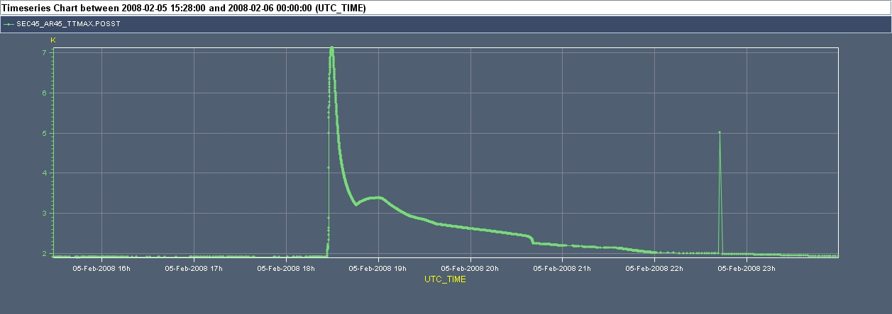
Achievements: Main Quads at 6TeV (>10kA)
Main Dipoles: 10.27kA – 6.1TeV – 7.25T
Main Quadrupoles: 10.8kA – 6.4TeV - 185T/m
@10899 A
Q28R4
6
Max T in A45 [K]
4
2

Slide 13
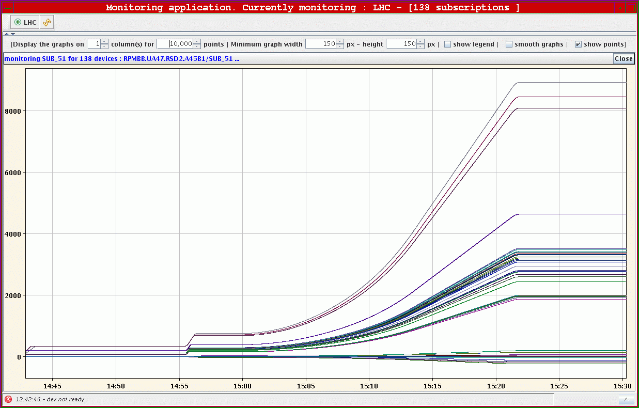
Achievements: Equivalent energy ramp 5.3TeV
Main Dipoles: 10.27kA – 6.1TeV – 7.25T
Main Quadrupoles: 10.8KA – 6.4TeV - 185T/m
Tests with Group of Circuits – PGC
  Test outline:
    Ramp to injection current (132 circuits, all high current circuits included)
      Problem found and solved on the Global Protection Mechanism for RB
      Trip of several 600A: QPS reconfigured
    Ramp to a current of 2 kA
      Circuit cross-talk investigation: selective Fast Power Abort on 600A
      Fast PA on RSD1.A45B1, and follow by RSD2.A45B1, RSF1.A45B1, RSF2.A45B1 (line N)
      NO cross-talk for the spool pieces
    Ramp to an energy that corresponds to a dipole current of 4 kA: OK
    Ramp to an energy of 5.3 TeV that corresponds to a dipole current of about 9 kA (138 circuits, all Main Circuits included @Nominal, a few 600A @200A)
      At 9 kA: ramp ok, RB trip with SlowPowerAbort after some 30 min (Fuse on the PC - repaired)
Commissioning Team
19th Feb. 2008

Slide 14
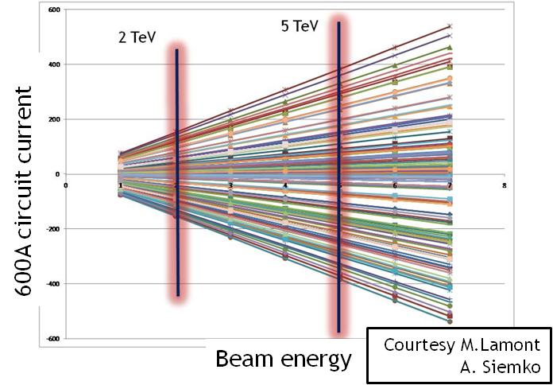
S45: Commissioning achievements vs energy
1d
2d
3d
4d
5d
6d
7d
8d
9d
10d
11d
12d
600
400
RB
PCC-PLI
PNO
RQF/D
PCC-PLI
PNO
200
Ipq/d - 16
PCC-pli - 16
PNO - 16
600A ee - 24
PCC-pcc - 24
Pli - 16
PNO - 2
600A noee - 16
PCC-pcs - 14
Pli - 8
PNO - 5
-200
120A/60a - 110
PCc - 110
pno - 92
-400
Sector fully commissioned for <=3 TeV
Sector partially commissioned for 5 TeV
all main circuits
large part 600A
Sector partially commissioned for 6 TeV
all main circuits
few 600A
3TeV
-600
5TeV
[A. Vergara – Time Estimation for 3/5/6 TeV]

Slide 15
HC S45 Review Outcome
July. ‘07
Feb‘08
Jan. ‘07
Cooldown/Warm up S45
Cooldown/Warm up S78
PT S45
PT S78
26th Nov.
19th Feb
20th April
11th Jul.
2nd Review
28th Feb.
Identification of the weak points:
  Procedures
  cryo-constrains
  Cryo operation
  HR
  Tracking tool
  …
  Procedures
  cryo-constrains
[see R. Schmidt]

Slide 16
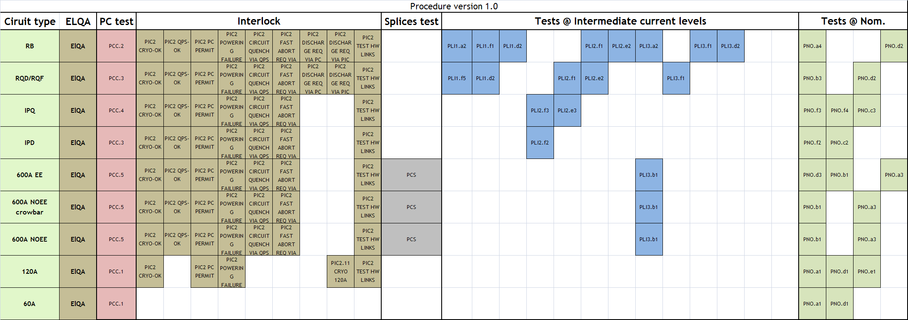
HC S45 Review Outcome: procedures
Powering procedures have huge influence on efficiency
Simplifications while securing a sufficient hardware qualification for operation of the LHC (increase the efficiency)
Nominal current (I_PNO) kept as a parameter. (energy?)
Ack:A.Siemko
W. Venturini

Slide 17
HC S45 Review Outcome: Temperature
Not all the commissioning activities need 1.9K
Necessity to differentiate and to investigate the granularity!
Ack:A.Siemko(MPP)

Slide 18
Conclusion
All the 182 commissionable SC circuits of S45 were tested
Total efficiency 50% - all the efforts of the review and the work now ongoing are aimed to increase it
A very important first milestone is however achieved
RECOMISSIONING of S45
  Clear strategy is being defined
  ALL interventions hardware/software (valves/ cables/ PLC/ PC modules/ cards/ updates…) must be declared to HCC.

Slide 19
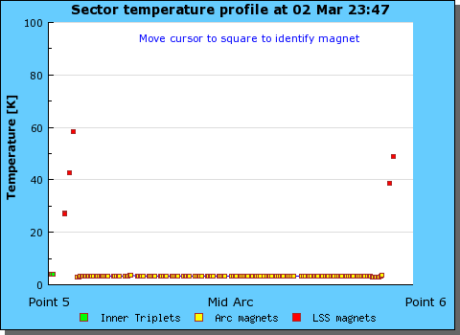
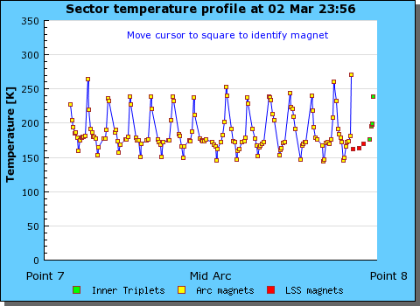
Next
Sector56 – PT: W12
Today w10
Av. 3.3K
Av. 185K
Sector78 – PT: W17

Slide 20
Overview of the commissioning of the S45
Boris Bellesia

Slide 21
Achievements S45: Test Steps
procedure
 | procedure | targets | done
Main Circuits | 74 | 67 | 92
IPQ-D | 221 | 221 | 232
600A | 688 | 520 | 503
120A | 300 | 210 | 216
60A | 282 | 94 | 232
Total | 1565 | 1112 | 1275
7TeV
DONE
6TeV
targets
Successful test steps
~60 test/wday
Ack:
A. Marqueta
V. Zambrano
W48
W50
W52
W2
W4
W6
W8
w9
Cryo Starts
Ack:
M. Soubiran

