Slide 1
Hardware Commissioning : where are we?
where do we stand with the non-conformities?
Roberto Saban

Slide 2
The major non-conformities
The helium guards of the level gauges of the SSSs
Connection cryostats
PIMs
The hoses of the water cooled cables
Connections of the flexible water pipes to the water cooled cables
Coupling between bus-bar cables
Jacks

Slide 3
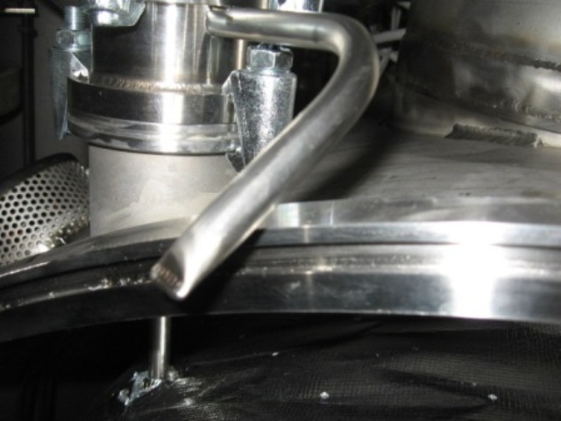
The helium guards of the level gauges in the SSSs
The pinch-off tube was blocking the closure of the interconnect. To progress, and transgressing the instructions given by CERN, IEG decided to rotate it to allow closure.
Suspected
Done
Courtesy JP.Tock

Slide 4
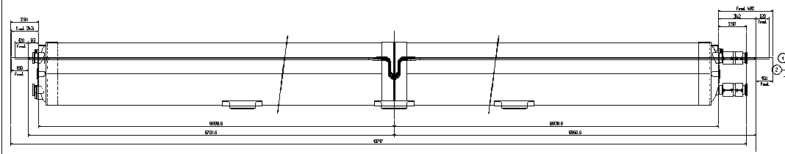
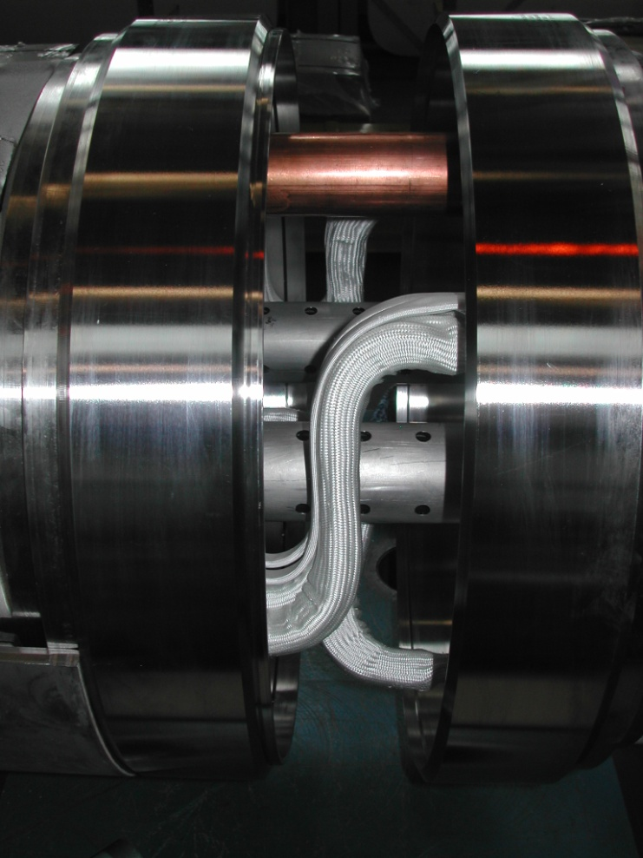
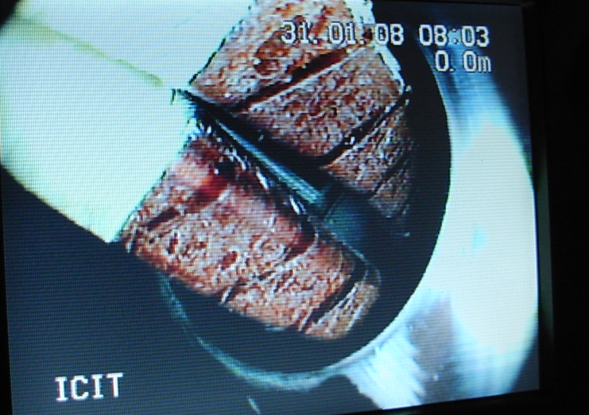
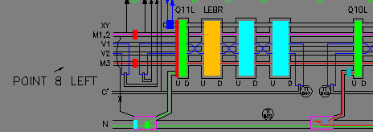
Connection cryostat
Courtesy JP.Tock

Slide 5
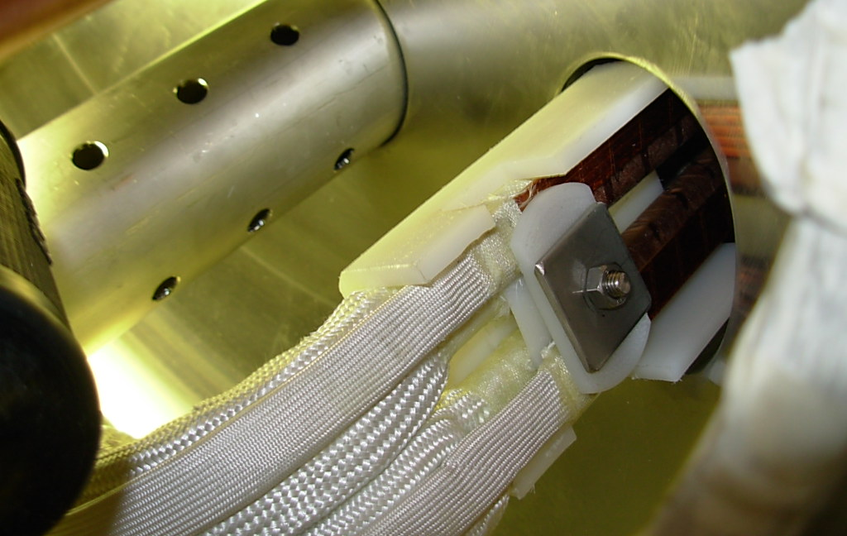
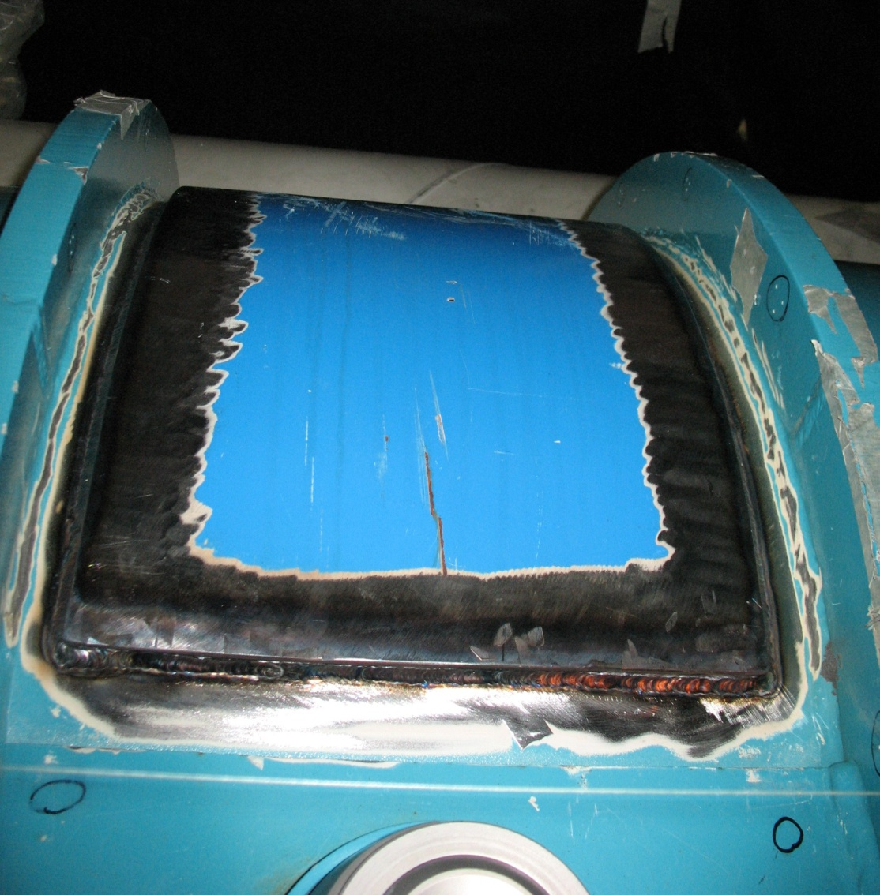
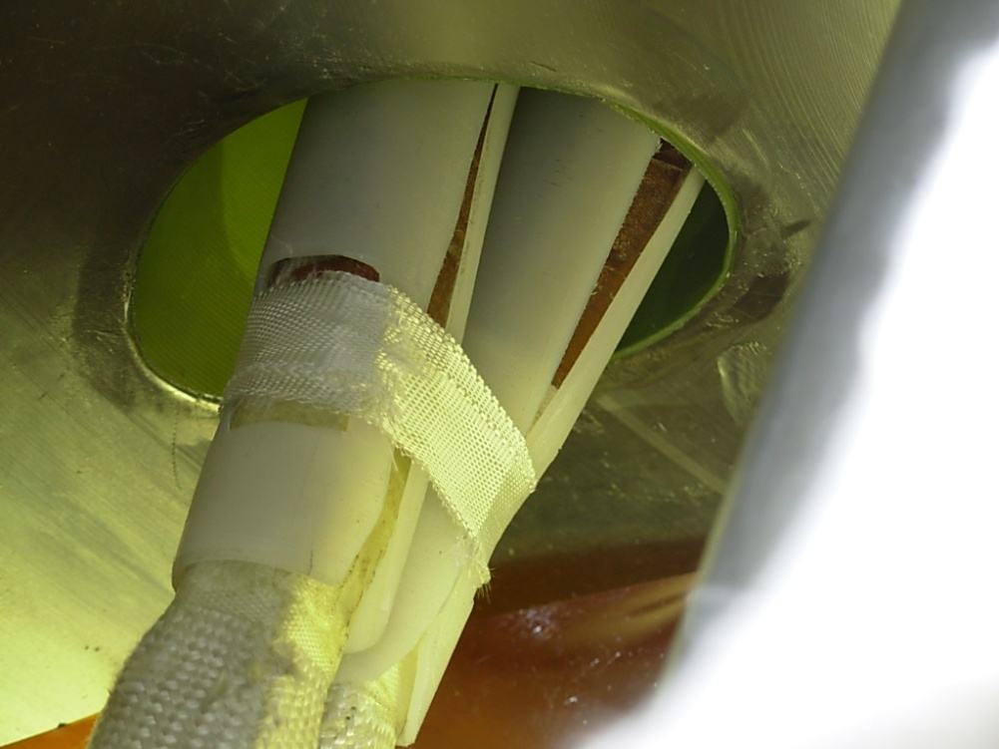
Connection cryostat
Courtesy JP.Tock

Slide 6
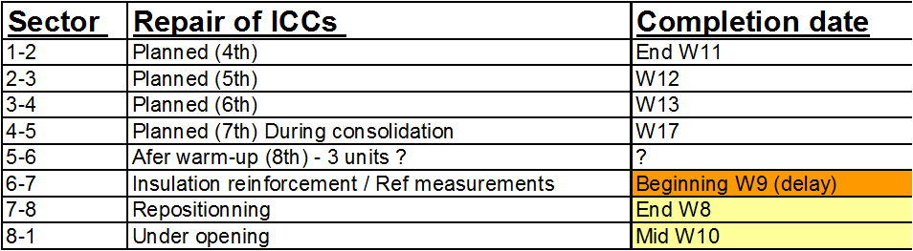
Connection cryostat
Measurement of displacement in SM18 on a test cryostat after the closure of a vacuum vessel (Displacement of about 1.5 mm). An attempt was made to compensate by welds on the other side but limited effect (0.3 mm)
≈ 1.5 mm
The delay in 6-7 is due to setting-up of measurement procedures in parallel with 7-8 and the fire brigade exercise
Courtesy JP.Tock

Slide 7
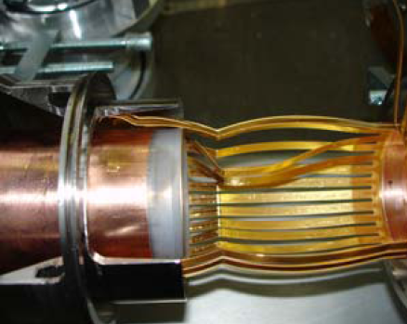
Sliding force measurements of the RF contact of the PIMs at 15 K and in UHV
The conclusion
The friction coefficient is low
No large differences with vacuum or temperature
For the 3 tested pairs only few indications of stick slip of a single finger
No buckled fingers BY CHANCE
... these friction tests give us
the last information needed to prove that the baseline design is safe. The simulations show that, for any given span within specification, much higher frictions would be needed to damage a conforming finger.
Courtesy K.Artoos

Slide 8
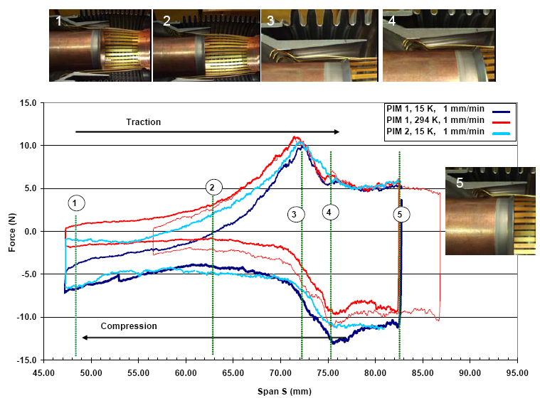
Sliding force measurements of the RF contact of the PIMs at 15 K and in UHV
Courtesy K.Artoos

Slide 9
Sector 45 consolidation: the PIMs
The most optimistic scenario foresees a number of up to 24 damaged PIMs. It was decided that in any case if a damaged PIM is to be replaced in one V-line, the second PIM of the same interconnect will also be replaced.
There are enough spares available at CERN to face even a pessimistic scenario. BINP have received the raw material for the production of some 500 spare sets of fingers, which will allow repairing two sectors before having to repair PIMs recovered from the LHC
Courtesy P.Strubin

Slide 10
Sector 45 consolidation: the PIMs
If a reasonable number of PIMs are found with buckled fingers:
Ball test to localise failed PIMs (2 per beam line) to an accuracy of one half cell
[Alternate V1/V2 everyday]
Venting of the concerned vacuum sector
Opening of the QQBI IC of this sector
Cutting of the PIM on the relevant line – Endoscopic inspection (+/- 100m)
Installation of a replacement or dummy PIM - In parallel radar type measurement
Gamma-ray of the other PIM
Loop to clear the whole sector
Test of the photometer using cut PIMs if possible
In parallel, preparation of replacing PIMs
Rewelding of PIMs – Ball test to validate the sector
Leak test of beam lines – Displace SSS downwards
Reclosure of IC
Pumping and leak test of insulation vacuum – RF reference measurements
Courtesy JP.Tock

Slide 11
Sector 45 consolidation: the plan
Scheduled to start on March 17, 2008
and last for 8 weeks
Courtesy JP.Tock

Slide 12
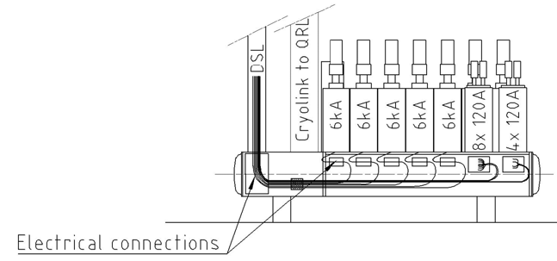
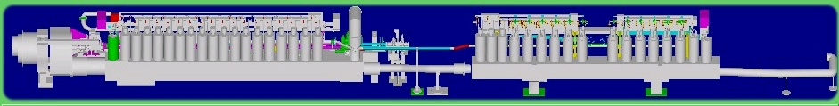
Coupling between bus-bar cables
Results from the mixing of circuits in three conductor superconducting bus bar cables
Q7
ATM
HCM
DFBL | Position
DFBLD | 5L
DFBLA | 1R
DFBLB | 1L
DFBA | Position
DFBAH | 4R
DFBAI | 5L
DFBAO | 8L
DFBAA | 1L
DFBAP | 8R
Decision to go ahead: pending!

Slide 13
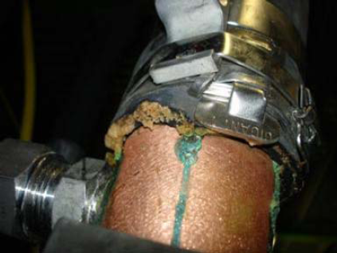
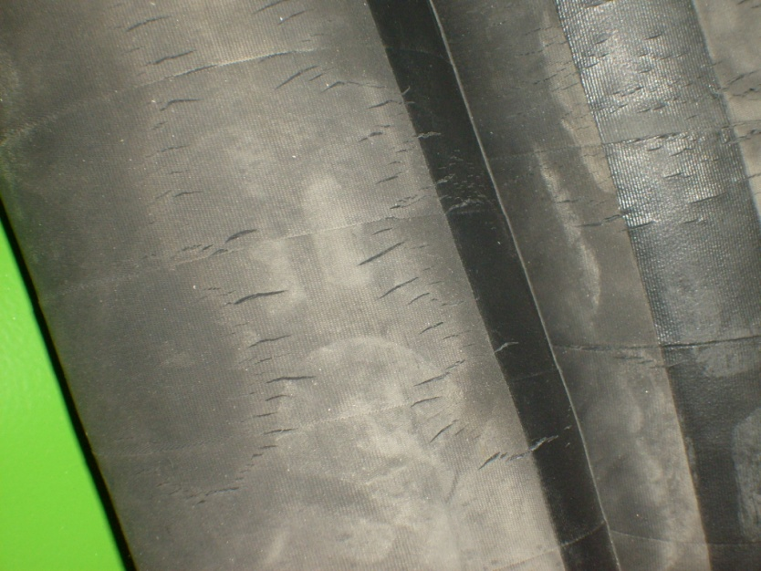
Water cooled cables
The corrosion observed on one of the cables of the DFBX right of Point 8 has not been observed elsewhere
Flohe and Continental have agreed to replace all the hoses since they are not compliant with the specs.
Nevertheless, in the light of the damage that could be caused to equipment (DFBs, power converters, etc), it was decided to postpone the campaign to when and if it becomes really necessary.
TS and purchasing are negotiating with Flohe an arrangement.

Slide 14
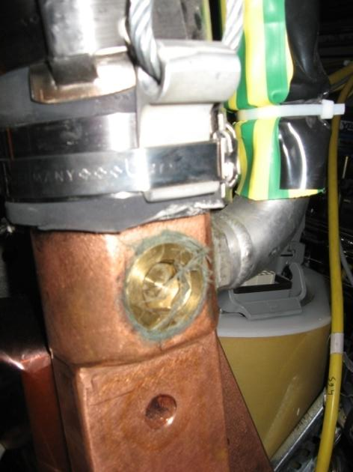
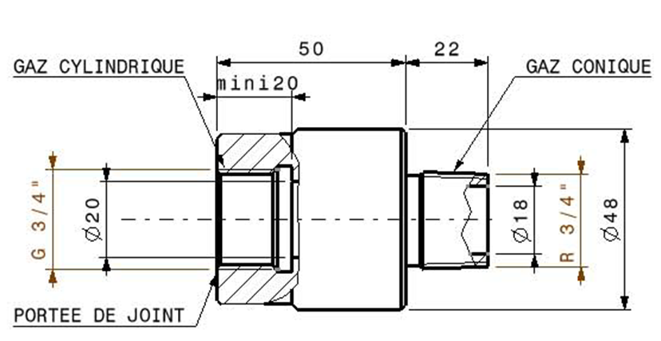
flexible water pipes and water cooled cables
The connection was glued with Loctite but because of the torque exerted by the flexible on the junction, they started to leak
The answer is a rotating union system which cancels the torque and is being installed everywhere in the machine.

Slide 15
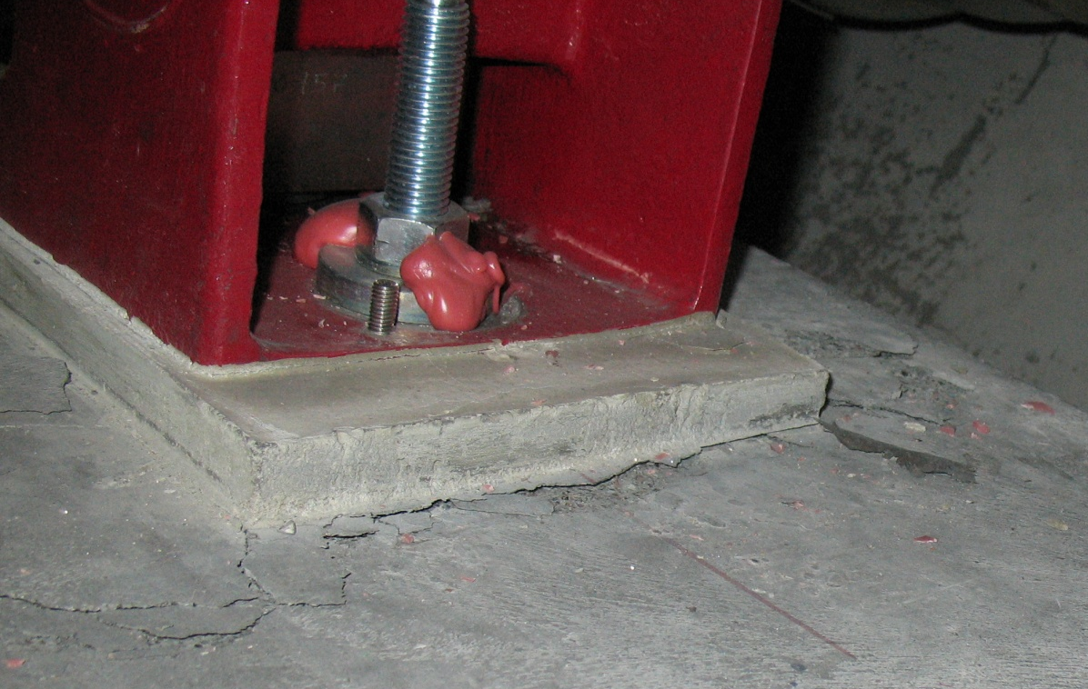
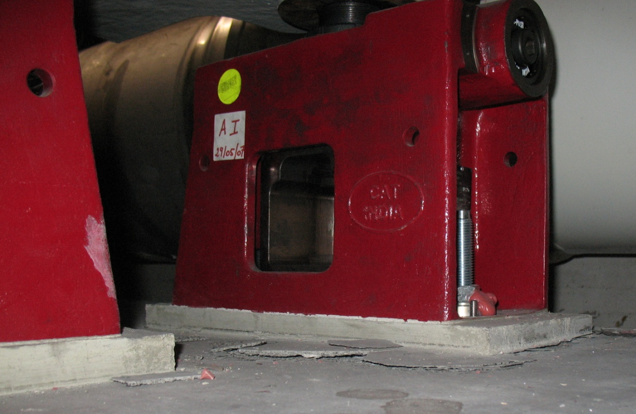
Jacks & concrete
Result in a tilt of 1.5 mrad and a longitudinal displacement of - 5 mm
Always in the neighbourhood of an SSS which contains a vacuum barrier

Slide 16
The Sector 45 Commissioning Review
The introduction
The overview of Sector 45
Safety & access
The systems:
  Cryogenics, DFBs and current leads
  Powering, Power Converters, Quench Protection System, 600 A and 13 kA Energy Extraction
The tests and the analysis:
  Powering tests and Magnet Performance Panel
The tools:
  Post-Mortem, Logging, Sequencer, Tracking data and progress after the tests
Summary and discussions

Slide 17
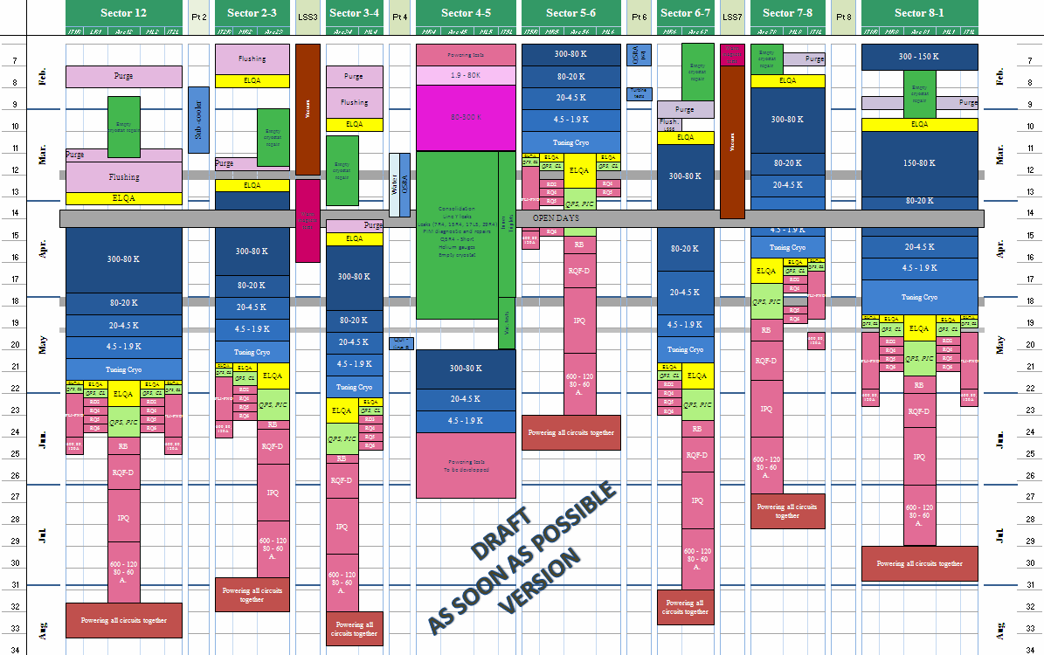
The months to come
few
The few months to come
ICC February 15th

Slide 18
The strategic questions
Sectors in parallel versus circuit types in parallel
7 TeV versus a lower value which is straightforward to achieve? What lower value?
Systematic commissioning of every circuit to nominal current versus maximum currents determined by the machine optics and the target beam energy
ICC February 15th

Slide 19
Non conformities: a summary
we know how to repair the mechanical non conformities
there is an intervention plan which is compatible with the present schedule
for the coupling between bus bars in some of the DFBs (which was not observed during the commissioning campaign) a decision is pending

Slide 20
The Sector 45 Review: a summary
A lot of progress in terms of safety, tools, procedures, organization, integration of the teams
A reduction of the commissioning time was observed mainly thanks to the automatic control and analysis tools which were developed and to the simplification of the procedures
A further reduction is expected to be achieved essentially by:
  Commissioning the circuits to an easily achievable lower beam energy
  Commissioning each circuit to a nominal current determined by the optics
  Further simplification of the commissioning procedures

