Slide 1
TLEP study news

Slide 2
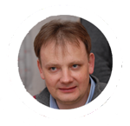
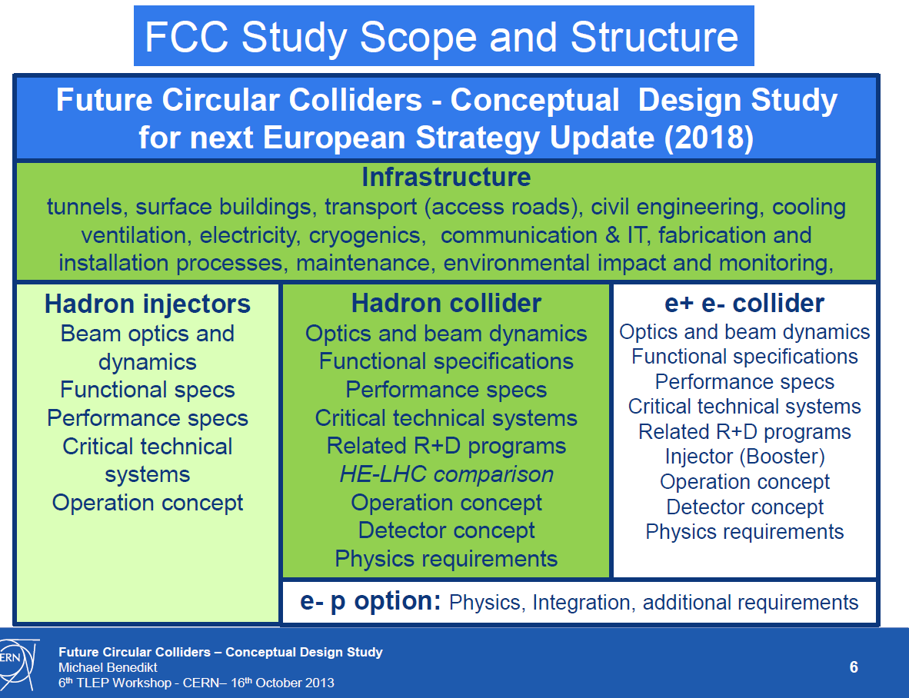
Michael
Benedikt
The two pillars: pp and e+e-
mandate is to deliver full CDR for both machines
with an extended cost review

Slide 3
The combination of TLEP and the VHE-LHC offers, for a great cost effectiveness, the best precision and the best search reach of all options presently on the market.
First look at The Physics Case of TLEP
arXiv:1308.6176v2 [hep-ex] 22 Sep 2013

Slide 4
Mark Palmer’s Personal (and Dispassionate) Comments (5 sept 2013)
The TLEP concept was generally viewed as very interesting, but still in the preliminary stages
  Considerable interest among HEP physicists, based on the potential cost and performance points
  The coupling to an Energy Frontier pp machine lends this option considerable weight
  There is a strong desire to let the Japanese Initiative proceed and then the situation can be re-evaluated
  Moving towards a large tunnel should not be allowed to interfere with taking full advantage of the LHC
  A full CDR is required
Thus more detailed consideration after seeing how events of the next few years unfold, and while a full CDR is developed, seems reasonable…
Japan science council 30 september: Not yet! Many questions, it will take several years

Slide 5
Team for kick-off and study preparation
Future Circular Colliders - Conceptual Design Study
Study coordination, host state relations, global cost estimate
Benedikt, Zimmermann
Hadron injectors
B. Goddard
VL Hadron collider
D. Schulte
Infrastructure, cost estimates
P. Lebrun
e+ e- collider
J. Wenninger
High Field Magnets
L. Bottura
Supercon-ducting RF
E. Jensen
Cryogenics
L. Tavian
Specific Technologies
(MP, Coll, Vac, BI, BT, PO)
JM. Jimenez
Physics and experiments
Hadron physic Experiments, infrastructure
A. Ball, F. Gianotti,
M. Mangano
e+ e- exper., physics
A. Blondel J.Ellis, P.Janot
e- p physics +
M. Klein
e- p option
Integration aspects O. Brüning
Operation aspects,
energy efficiency, OP & mainten., safety, environment.
P. Collier
Planning (Implementation roadmap, financial planning, reporting)
F. Sonnemann

Slide 6
Kick-off meeting Agenda
Wednesday 12 February | Thursday 13 February | Friday 14 February | Saturday 15 February
At University of Geneva |  |  | At CERN
 | 8:30 begin VLHC session | 8:30 begin infrastructure session | 9:00 at CERN
 |  |  | breakout sessions
 | 10:30 coffee | 10:30 coffee | 10:30 coffee
 |  |  | next steps session
12:00 registration opens | 12:30 end of plenary | 13:00 end of plenary | 13:00 end of meeting
 | Lunch | lunch | lunch at cern cafeteria
13:45 welcome address | 14:00 TLEP session | 14:00 breakout sessions
14:00 DG introduction and session
15:30 coffee | 16:00 coffee | 16:00 coffee
18:00 Welcome drink | 18:00 end of session | 18:00 end of break-out session
20:00 Public Lecture | 19:30 collaboration dinner
21:30 Vin de l'amitié

Slide 7
General TLEP VIDYO meetings
Time-slot:
Monday 15:00-17:00 CERN time; (6-8) am on Pacific time; 23:00-1:00 in Japan
Every two weeks, VIDYO, material on TLEP indico
Standing items: TLEP news, short reports from conveners, agenda for next time
+ a few feature items for information, discussion
Emphasis in alternance Accelerator / Physics
There will be a single room at CERN
First meeting 18 November with accelerator emphasis
for that date: aim at a first set of WP conveners so that work can begin in earnest
Comments suggestions and requests to the steering committee
tlep3-steering-group@cern.ch

Slide 8
Project baselining
We will need new parameter list for accelerator
and consistent running scenarios for physics studies
with version number and explanatory notes
Aim at doing this by mid January 2014 in view of FCC Kick-off meeting

Slide 9

Workshop on Future High Energy Circular Colliders
December 16-17, 2013 Beijing, China
at the Institute of High Energy Physics
The Program
The workshop will bring together people interested in high energy circular e+e- colliders as a Higgs factory as well as future high energy circular pp colliders beyond the LHC energy frontier, and will discuss critical issues for accelerator development and detector design, theoretical aspects of Higgs precision measurements, and the physics potential of pp colliders at 50-100 TeV.
Registration
Please register at http://indico.ihep.ac.cn/conferenceDisplay.py?confId=3813.
The registration is open until November 30, 2013. The registration fee is 900 RMB, covering meeting materials, lunches, a banquet, and coffee breaks. The registration fee must be paid in Chinese RMB at the registration desk on-site. Please note that the credit card payment cannot be accepted.
Visa
If you need a Chinese visa to attend this workshop, you can follow the instruction provided at the registration page to request a Visa Notification Letter to be used for the visa application at the embassy or a consulate of China.

Slide 10
Calendar (to my knowledge)
2013 Oct 23 Frascati Higgs Workshop
2013 Oct 28 UK IOP meeting on TLEP (UCL)
2013 Nov 18 TLEP general VIDYO Meeting: accelerator
2013 Dec 2 TLEP general VIDYO Meeting: Physics
2013 Dec 9 TLEP general VIDYO Meeting: Accelerator
2013 Dec 16-17 FHECC meeting in Beijing
2013 Dec 23 no meeting.
2014 Jan 6, 20 , 3 Feb etc... TLEP VIDYO (TBC)
2014 Feb 12-15 FCC Kick-off meeting
Next TLEP workshops TBD (Candidates to host?)

