Slide 1
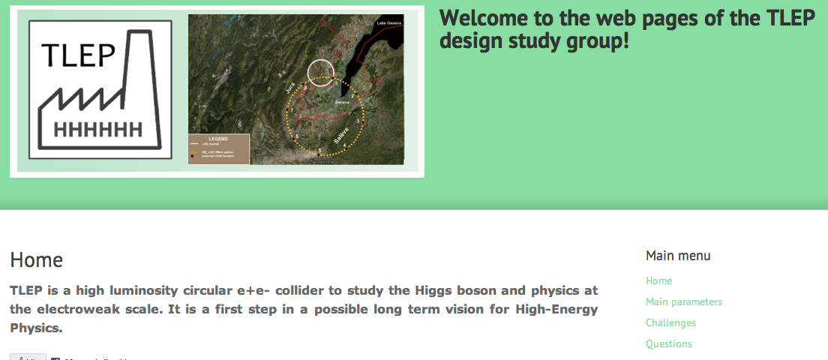
TLEP ... Lattice Design & Beam Optics
B. Holzer / B. Haerer
latest (good) news
Quo usque tandem abutere, Catilina, patientia nostra?
Parameter-List on TLEP-WEB Page is hopelessly out of date
and out of reality

Slide 2
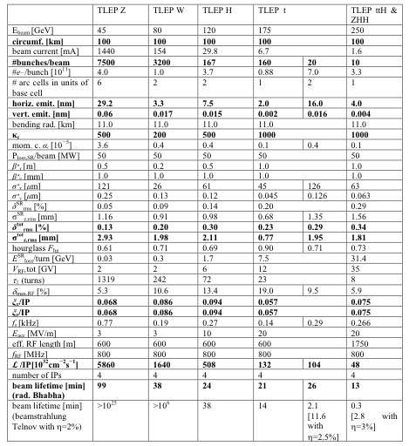
Present study case:
E=175 GeV,
ε = 2nm / 0.002nm

Slide 3
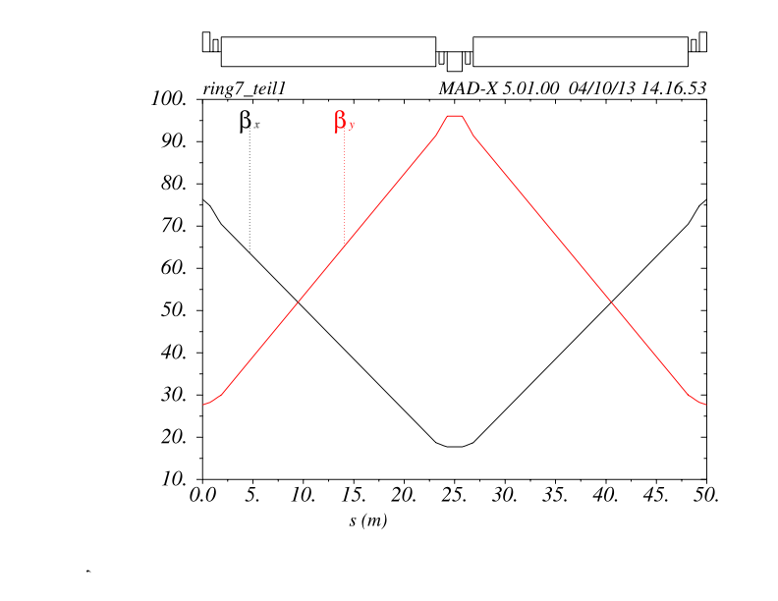
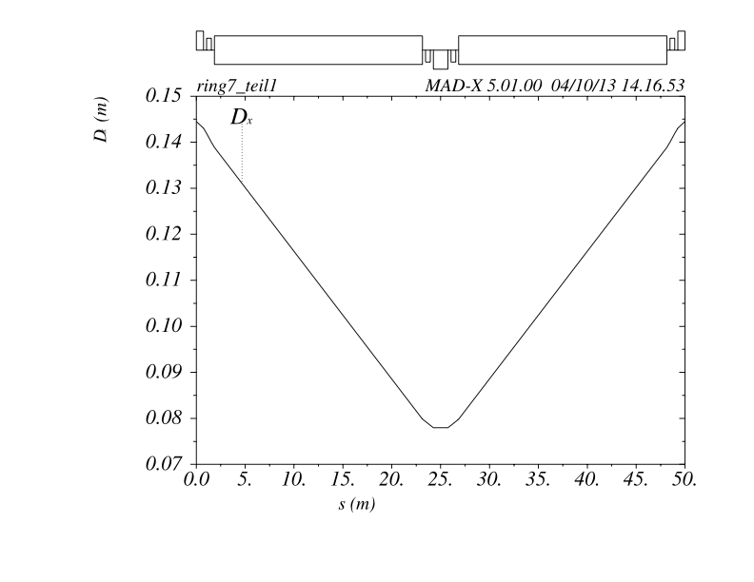
TLEP ... Lattice Design (175 GeV)
V9e -> V10
L_{cell}=50m
Dipole: N_{dipole} = 2932
L_{dipole} = 21.3 m
due to techn. reasons: 2 * 11 m
bending angle = 2.14 mrad
B₀ = 580 Γ
Quadrupole (arc):
L_{quadrupole} = 1.5 m
k=3.55*10⁻² m⁻²
g=20.7 T/m
aperture: r₀=30σ =11mm
B_{tip}= 0.23 T
β ≈ 100m, D_{x}= 15.3 cm
FoDo Cell
At present the dipole length is “symbolic”. Due to technical reasons we think of putting
2 dipoles of 11m length each between the quads

Slide 4
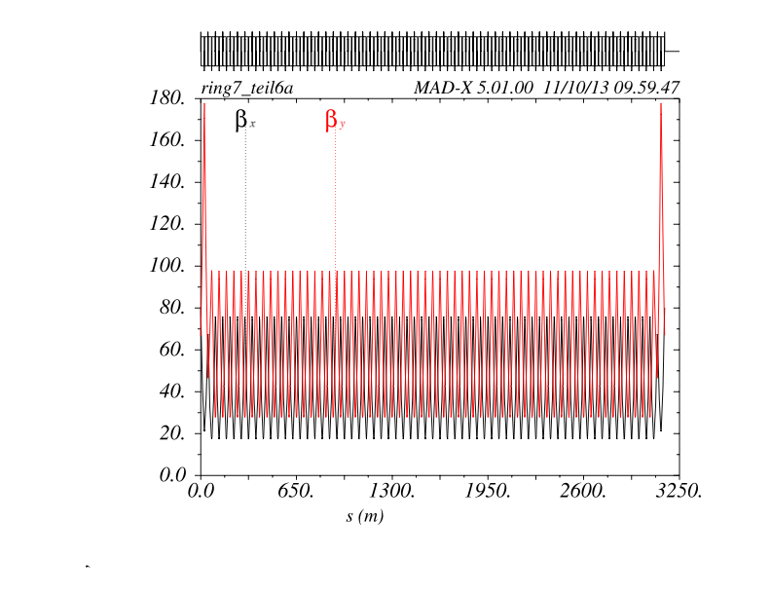
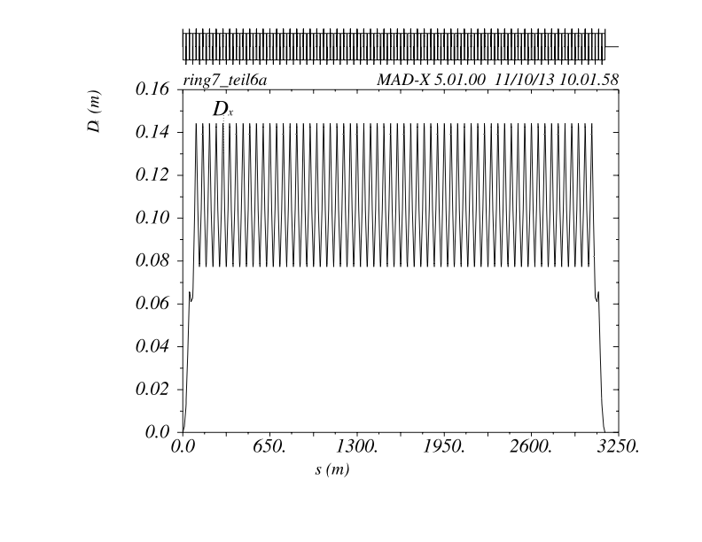
TLEP ... Lattice Design
24 Arcs : built out of 56 standard FoDo cells & 2 half bend cells at beginning and end
length of arc: ≈ 3.0km
each arc is embedded in dispersion free regions ...
arcs are connected by straight. sections ... 12 long (mini β and RF)
... 12 ultra shorties tbc
to be optimised

Slide 5
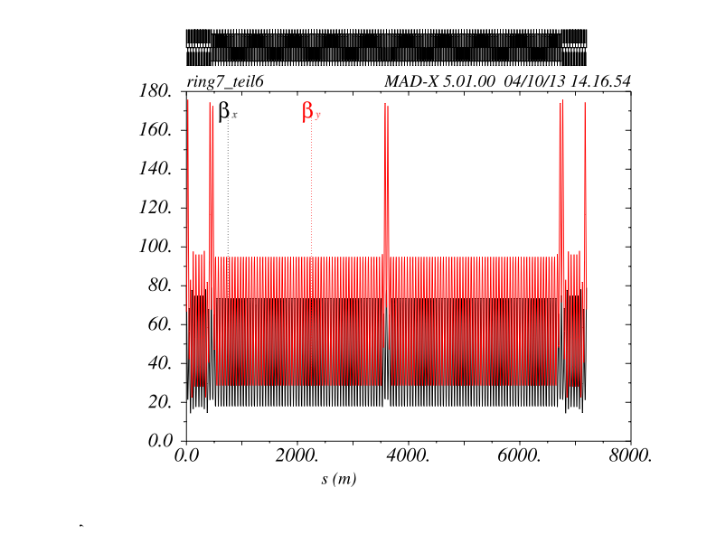
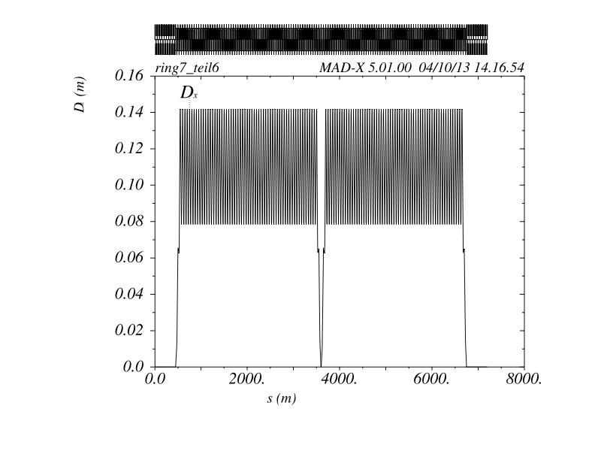
TLEP Octant
Straight – Arc – Arc – Straight
arcs are connected in pairs via a disp-free-empty cell
-> only reason: in case of additional insertions we get the boundary conditions for free.

Slide 6
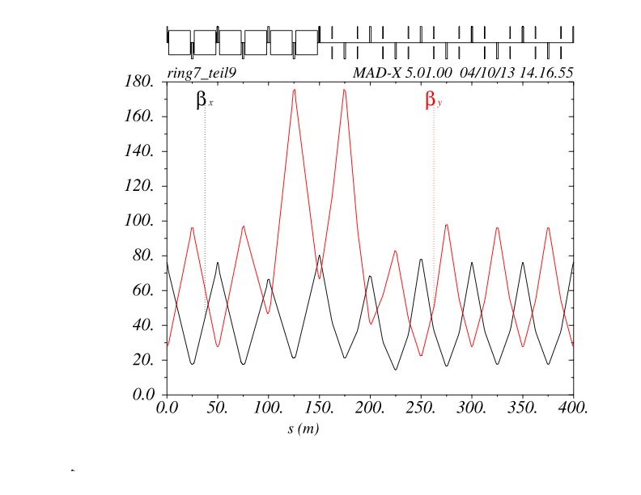
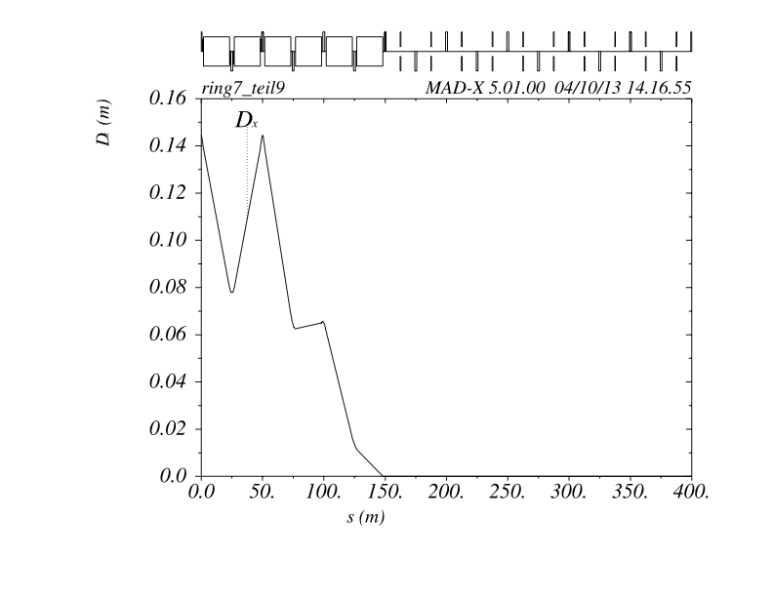
TLEP Arc-Straights
8 Straights : 9 empty (i.e. dispersion free) FoDo cells including matching sections
arc-straight, l = 450m
arc cells
empty cells
arc cells
empty cells
to be optimised: β_{y} at matching section,
needs an additional quadrupole lens → already built in but not used yet.
and / or optimisation of the lens positions

Slide 7
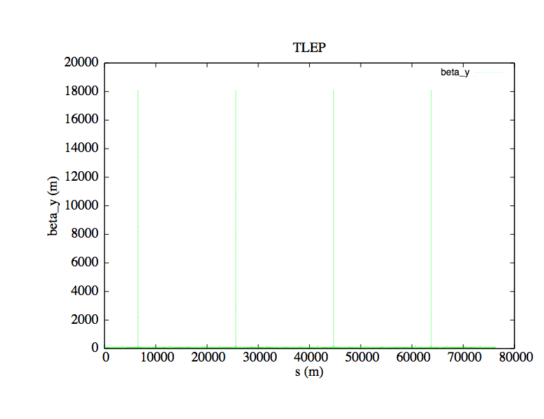
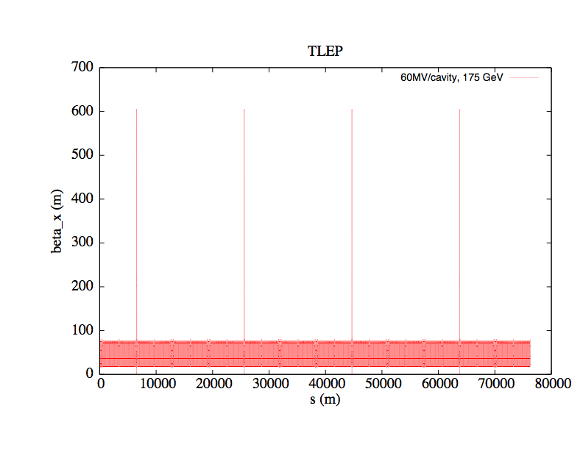
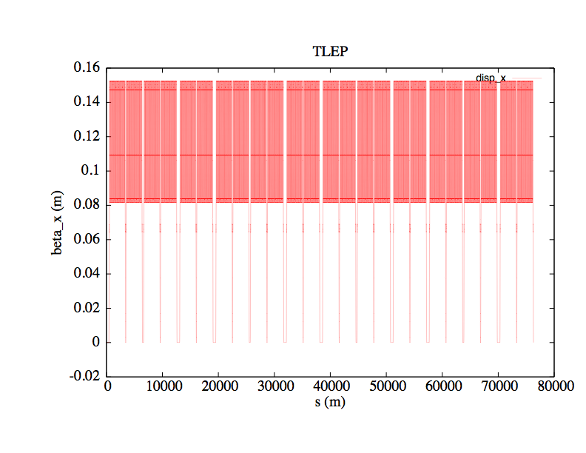
TLEP The Ring
rf-sections
L_{ring} = 79.9km
4 min- betas,
24 disp free straights, 12 long straights
8 for rf equipment, 4 for mini-betas & rf
*
*
*
*
*
*
*
*
*
*
*
*

Slide 8
TLEP Lattice ... converging to a realistic approach
Questions to answer:
* hardware of the lattice
e.g. LHeC type dipoles
* feasibility of the cell design
flanges / pumps / BPMs etc
* what about synchrotron radiation ... do we need absorbers and where ?
Fluka / Helmut / Manuela
* vacuum design
Mark, Roberto, Cedric
* tolerance considerations
do we get the hor & vert. emittance ????
BH & BH
* what kind of correctors & BPMs do we need and where to install them
Alexander (Petra 3), Francis, Montse (ALBA)
* do we need a weak bend at the end of the arc (YES) and how weak should it be ?
Helmut & family
* how does the lattice scale with cell length / phase advance
BH &BH

Slide 9
TLEP V9e
... first FLUKA results
FLUKA status and plan
Sixth TLEP workshop
CERN, 16 -18 October 2013
F. Cerutti#, A. Ferrari#, L. Lari*, A. Mereghetti#
power density in the dipole chambers has to be reduced
by installation of lead shield
power density along the dipoles
-> shorter dipole design

Slide 10
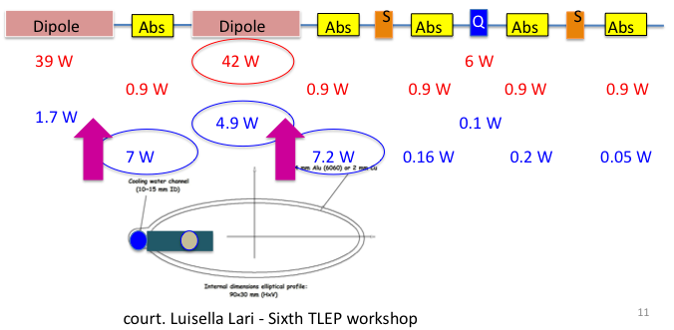
Peak Dose on the coils
TLEP V9e
... first FLUKA results
the ideal FLUKA world ;-))

Slide 11
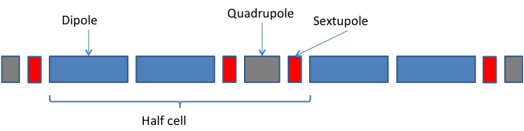
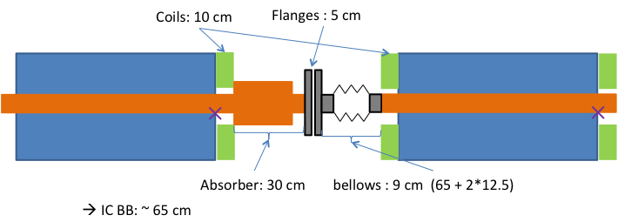
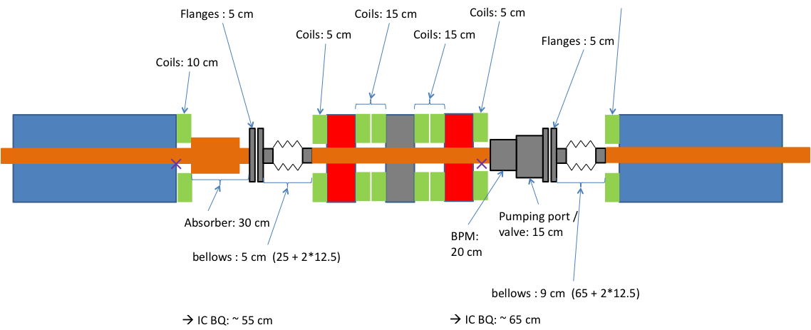
TLEP V9e
... first Vacuum Considerations (court. C. Garion, R. Kersevan)
schematic cell layout:
assuming “reasonable” drifts
realistic BB interconnects
Sy-Li Absorber
realistic BQ interconnects

Slide 12
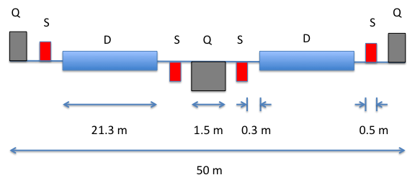
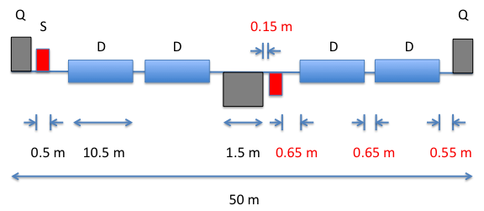
TLEP V10
..Lattice Modifications: court. B. Haerer
“old” Cell Layout
V9e cell
? ... do we keep the cell length ?
? ... do we cut the dipole length ?
? ... do we enlarge the FoDO length ?
V10 cell

Slide 13
Next steps:
1) Optics fine tuning: including vacuum design & Fluka
2) Tolerances & Emittances for a realistic machine
can we keep the small vertical ε
3) Include orbit corrections & BPMs (cell length ??)
PETRA3, ALBA ... nested correctors ?
4) Include a weak bend at the end of the arc
... how weak -> sy-li fan geometry, E_{crit}
5) Lattice for lower energies
scaling of ε -> re-shuffle FoDo structure
6) goto 1),
goto 2)

Slide 14
TLEP V.xxx ...Lattice Modifications for smaller energies
coarse tuning via cell length, fine tuning via phase advance & wigglers
equilibrium emittance
scaling of dispersion in a FoDo
scaling of D with phase advance
L_{cell} = 50m
90º
L_{cell} = 100m
L_{cell} = 150m

