Slide 1
ELENA Project
Status, Conclusions from the
ELENA Review, Planning and Budget …
C. Carli for the ELENA Team ADUC/ELENA Meeting, 14th January 2014
Technical Design Report
General Project Review (technical)
Some technical Topics (recent progress, discussed after review, not covered elsewhere …)
  Lattice Studies
  Electron Cooler
  Magnets
Status of the Annex Building 393
External Contributions to the ELENA Project
Summary and Outlook

Slide 2
Technical Design Report TDR
Aim
  Describe the machine we intend to build to fix ideas and make sure we all speak the “same language”
  Important step to make sure that plans from different groups are consistent
  Afterwards, proper follow-up of (small?) design changes mandatory (usage of Engineering Change Requests ECR)
Status
  All chapters received
  Thanks everybody for the effort to write their parts, thanks to the editor
  (N. Chohan) for pushing and putting everything together
  Proofreading (get section, figure, table .. numbers correct, polishing of english …) underway, resulting document expected this month
  Only (hopefully) minor changes afterwards
Final published document is expected in spring
as CERN yellow report

Slide 3
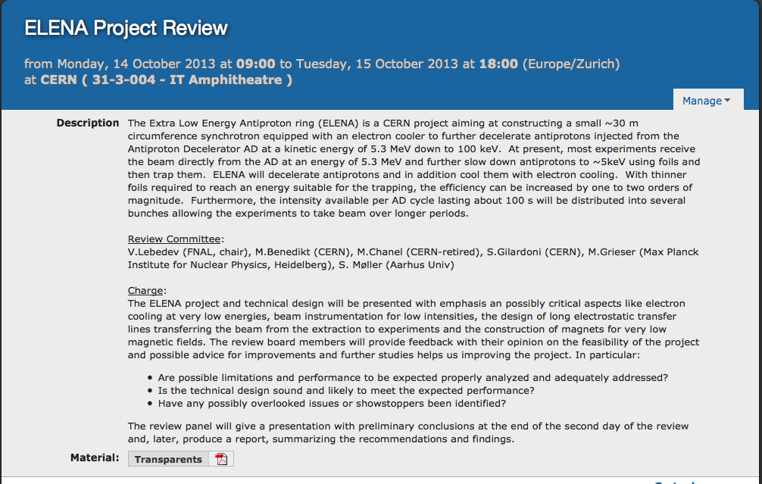
Project Review see: https://indico.cern.ch/conferenceDisplay.py?confId=268237

Slide 4
Report from Review Committee
General Comments
General Comments (from the Committee)
  The review committee would like to support the construction of low energy antiproton ring ELENA
  We find it greatly supportive for the CERN program with low energy antiprotons as well as an interesting project in the accelerator physics
  We would like to thank all presenters for good and coherent presentations
This means (… although not stated explicitly)
  Basic design is sound and no showstoppers or very critical issues identified
  Mandate to go on with the machine described for the implementation phase
  We will build a machine very close to what has been described during the review and in the TDR draft
However, many recommendations for improvements and studies
  List of (most) recommendations (re-ordered ..) with planned actions from our side in spare slides
  Some recommendations in next slides on selected technical topics

Slide 5
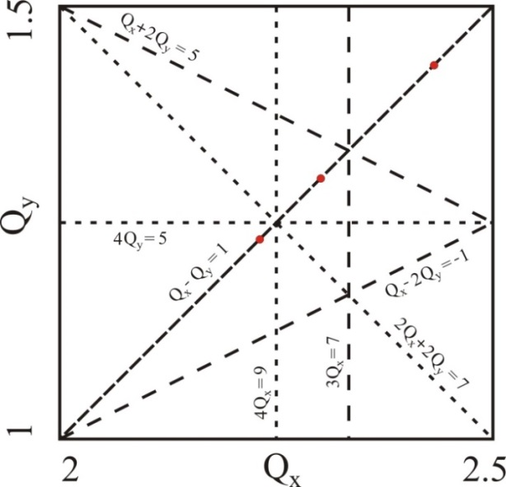
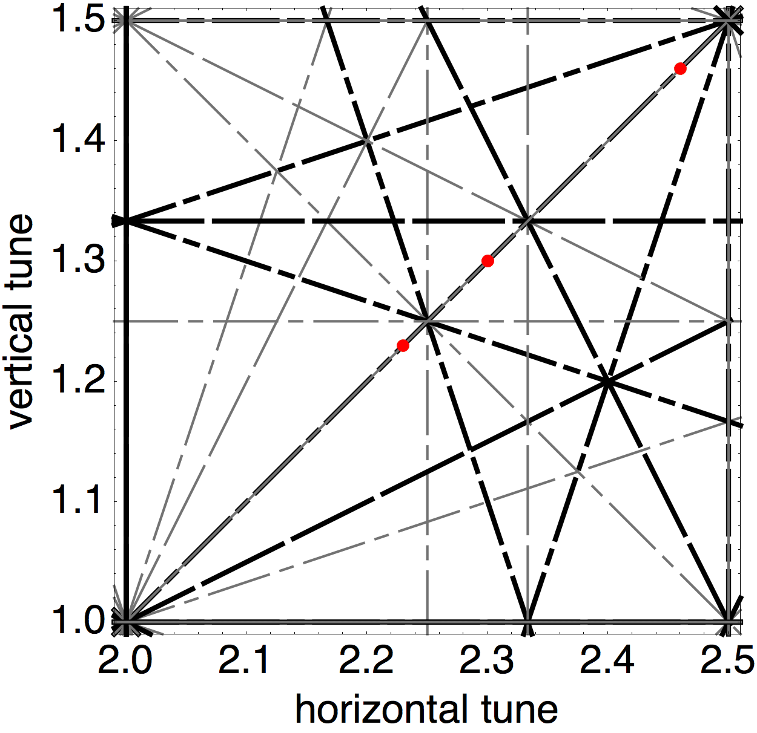
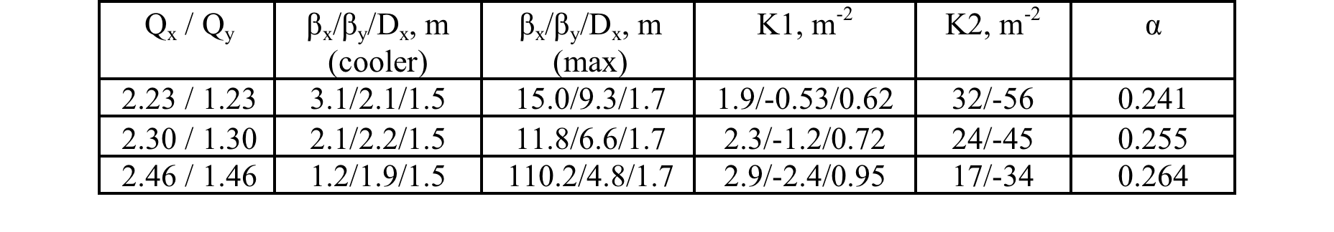
Lattice Tunability Studies
Work by and materiel taken from doc’s by P. Belochitskii
Motivation:
  Review committee: 4th order resonances close to working point excited by space charge
  Understand tunability – working points reachable with “reasonable” machine optics
Results
  Two more (bare machine without space charge) working points investigated – with space charge
  tunes are lowered
  Reasonable tuning range found
  Many discussions on impact of smaller acceptance with “low WP” and need to enlarge apertures
  Magnet apertures kept as defined for magnet design
Tune diagrams up to 4th order with
working points studied in detail and:
- resonances expected to be the
main limitation and
- all resonances
Some lattice properties with the three WPs studied

Slide 6
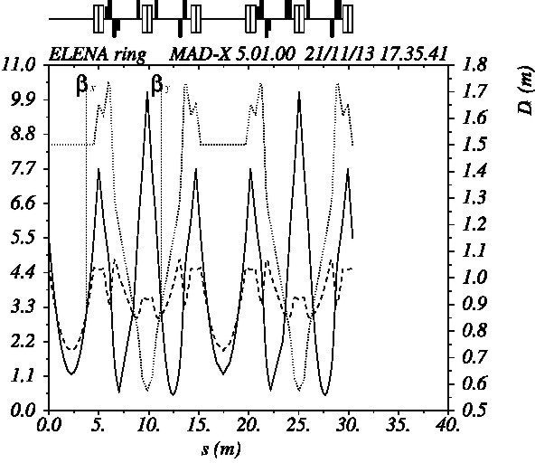
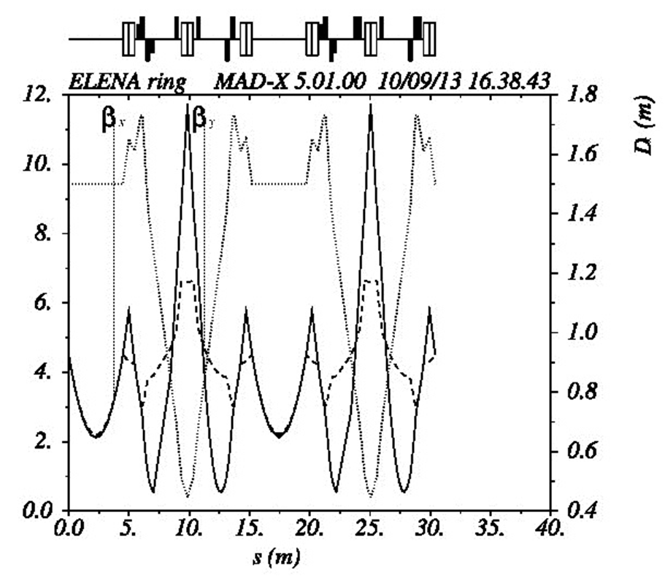
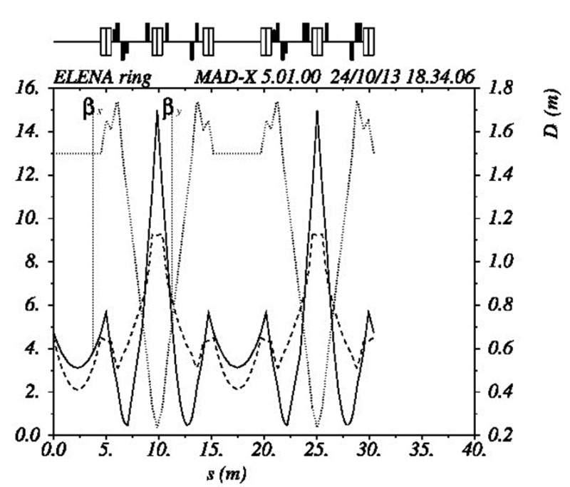
Lattice Tunability Studies
Based on work by P. Belochitskii
Tune diagram with working
points studied in detail

Slide 7
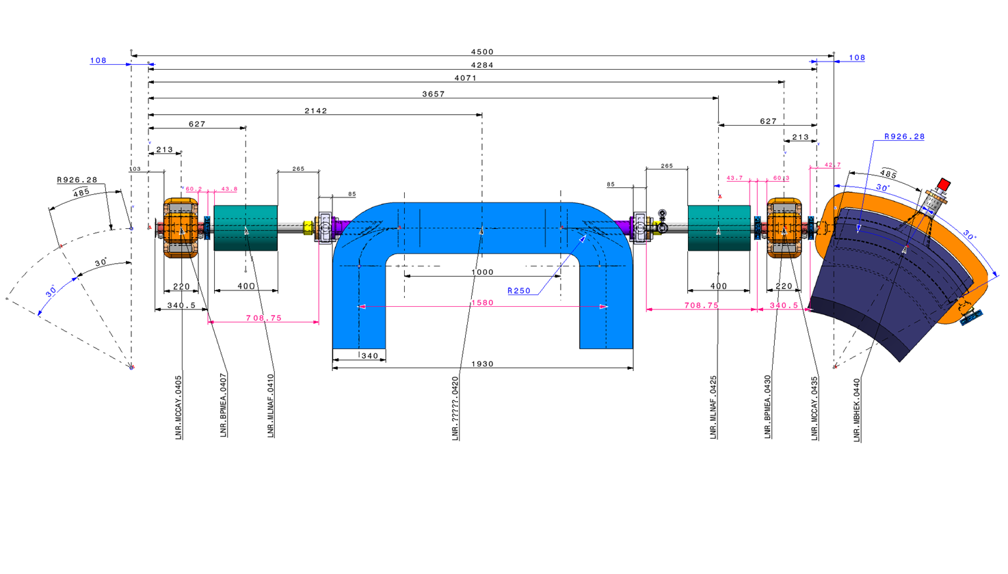
Electron Cooler
(Slides by G. Tranquille)
Compact cooler!
Must fit in Section 4 incl. solenoid compensators and correctors.
~ 2 meters available for the electron cooler.
Space constraints also necessitate 90°bends (toroids, i.e. bent solenoids)
on relatively small radius (25 cm)

Slide 8
Electron Cooler
(Slides by G. Tranquille)
Electron Cooler Parameters
Momentum (MeV/c) | 35 | 13.7
β | 0.037 | 0.015
Electron beam energy (eV) | 355 | 55
Electron current (mA) | 5 | 2
Electron beam density (m⁻³) | 1.38 x 10¹² | 1.41 x 10¹²
Bgun (G) | 1000
Bdrift (G) | 100
Expansion factor | 10
Cathode radius (mm) | 8
Electron beam radius (mm) | 25
Twiss parameters (m) | β_{h}≈2, β_{v}≈2, D≈1.5

Slide 9
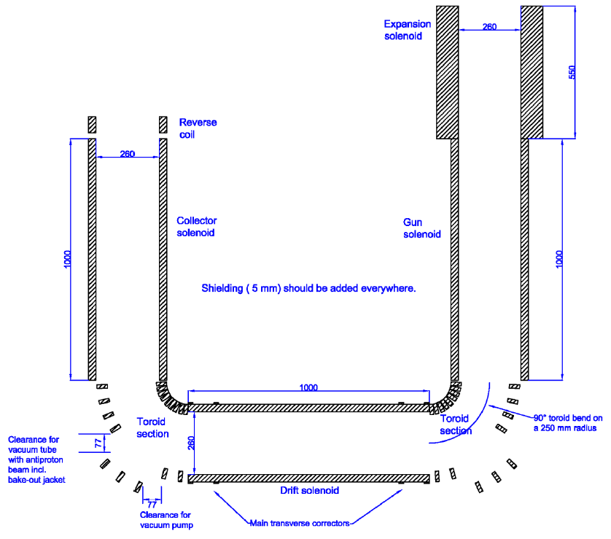
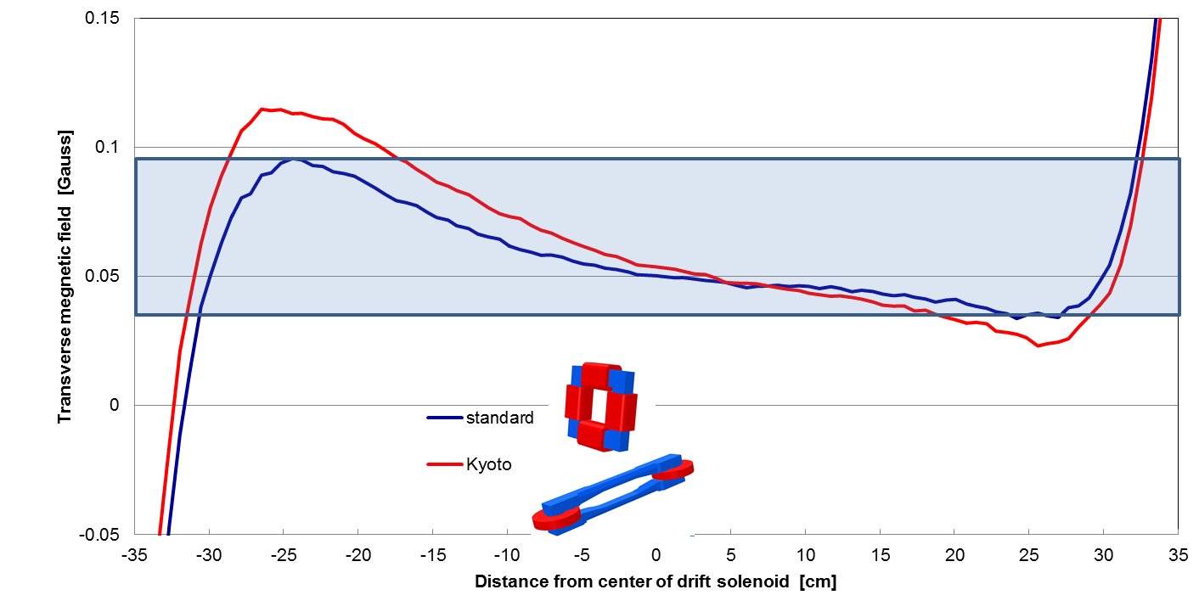
Electron Cooler
(Slides by G. Tranquille)
The Magnetic System
Main cooler solenoid
Gun solenoid
Collector solenoid
Expansion solenoid
Reverse coil at collector
2 x Toroid section consisting of
9 racetrack coils each
Various corrector coils to
ensure good field quality
Orbit correctors
Solenoid compensators
1m solenoid for drift, gun and collector solenoids
  Common spare
  Reduce influence of expansion solenoid

Slide 10
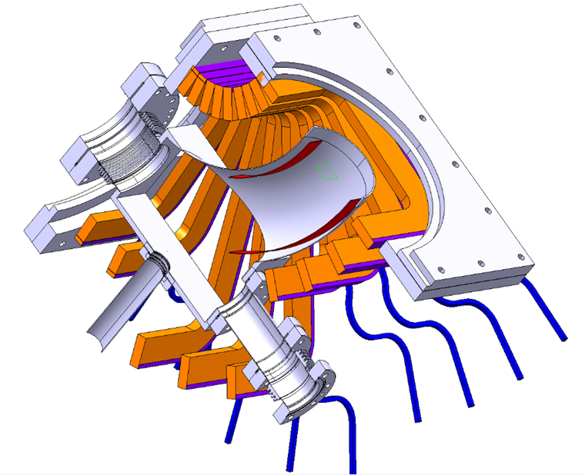
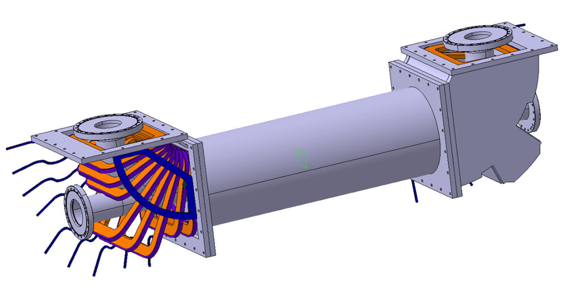
Electron Cooler
(Slides by G. Tranquille)
The Vacuum System
Vacuum system will be XHV compatible
  316 LN NEG coated vacuum chambers
  ST707 NEG cartridges at gun exit and
  collector entrance
  CF flanges, sliver coated seals
  Hydroformed bellows
  NEXTorr pumps (collector and 2 toroid chambers)
  System bakeable at 300°C for 24 hours
  Bakeout jackets
Whole mechanical structure
to be tilted by 90°
  Support with rails to slide
  out gun/collector solenoids

Slide 11
Electron Cooler
(Slides by G. Tranquille)
Status
Abandon construction of cooler by Toshiba.
Vacuum system to be designed by CERN.
Market survey for the “Design, manufacture, testing and delivery of the magnetic and vacuum components of an electron cooler for the ELENA ring” (IT-3995/BE/ELENA) initiated:
  Invitation to Tender scheduled for second quarter 2014.
  Specification drawings of the vacuum system to be prepared by EN/MME and BE/BI for April 2014 (80% of the job already done). Will be part of IoT.
  If 750 kCHF < cost < 1 MCHF go to Finance Committee in June 2014.
18 months estimated for design, manufacture, testing and delivery for the system.
  Leaves only a few months for installation on ELENA!!!!!!

Slide 12
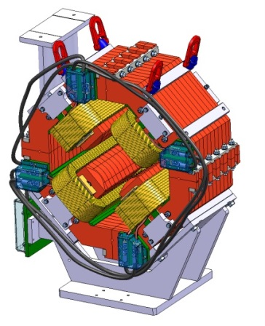
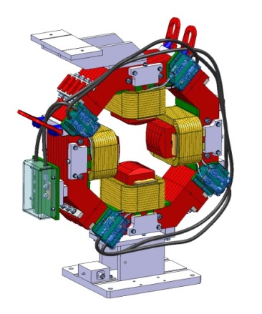
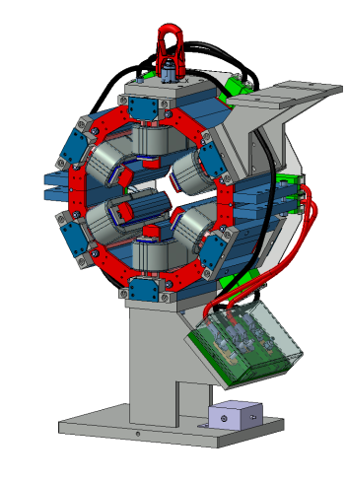
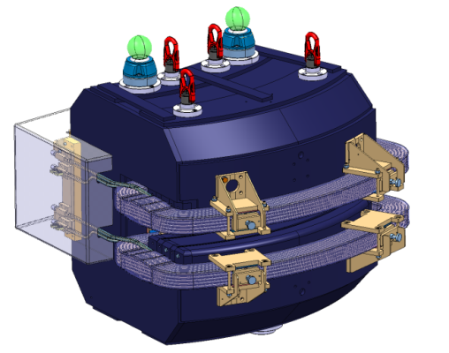
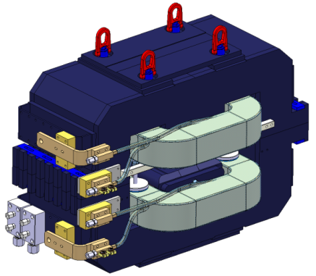
Magnets: Overview of Work Package
Slides provided by D. Schoerling
Findings of the review committee: The design of the magnets is in a good shape. The chosen magnetic material is good to minimize the remnant field.
Recommendations from the review committee
The low pole field asks for studying dilution in all magnets, not just in dipoles. The machine operation and the reproducibility could be greatly improved.
¼ of the strength of the corrector strength is sufficient (WP Beam Dynamic confirmed that around ½ of the strength is sufficient).
Actions taken by the WP Magnets
Designs of quadrupole and sextupole changed to make dilution of the magnetic material possible
Three quadrupole prototypes are being built in-house at CERN to study and better understand the effects of remnant fields in the quadrupole magnets (status: coils are finished and yoke production is started)
Corrector magnet re-designed as air-core magnets to take advantage of the relaxed field strength requirements. By using this design no remnant field in the corrector magnets will be present.

Slide 13
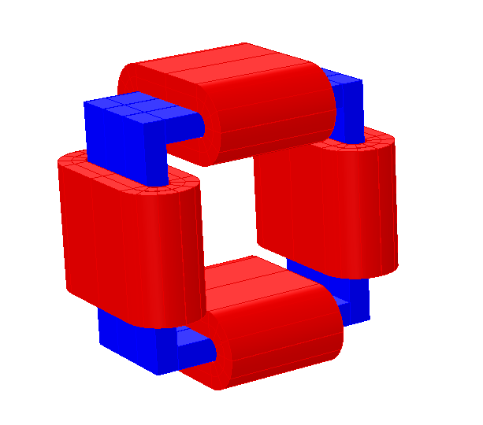
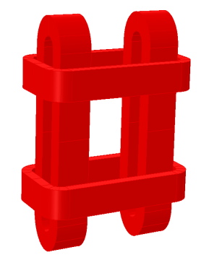
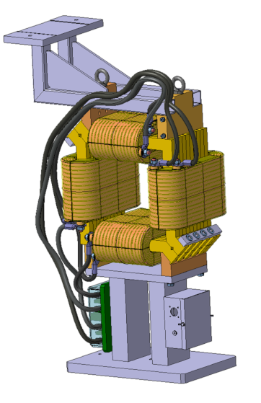
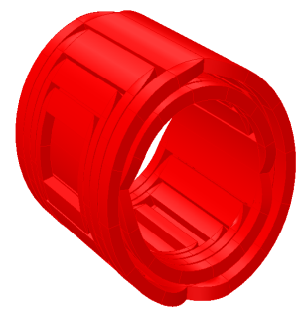
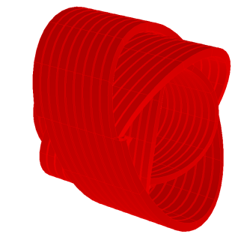
Magnets: Design of ELENA H/V Correctors
Slides provided by D. Schoerling
Standard design
Initial requirement
Iron-based design completed including mechanical design for corrector magnets with a field strength of 60 Gm.
Comments from the review committee
Reduction of required field strength to 25 Gm and risk of remnant field asked for studying air-core corrector designs
Actions taken by the WP Magnets
Different possible designs (cos θ -, double helix and Helmholtz-like design) are studied.
If all requirements are taken into account (power converter, vacuum, available space, etc.) the cos θ design seems most promising but requires further study to find an easy winding scheme and a feasible indirect cooling scheme.
Helmholtz-like design
Cos θ - design
Double helix- design

Slide 14
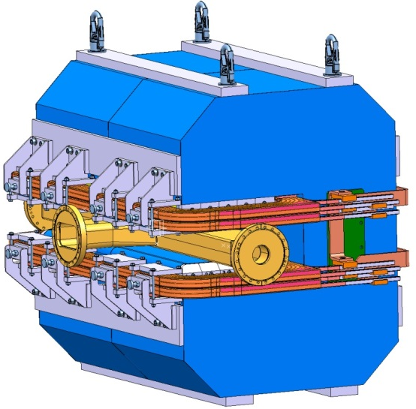
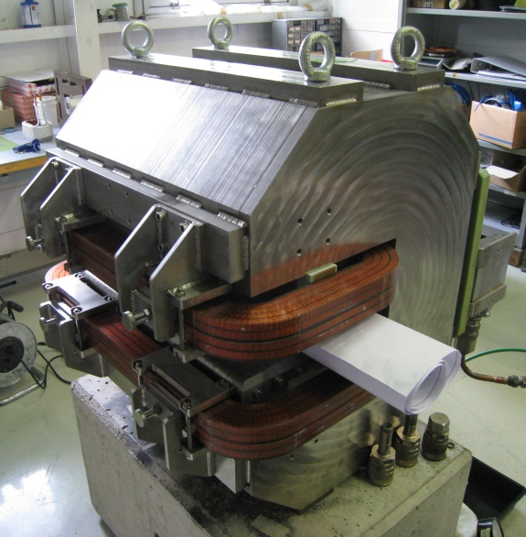
Magnets: ELENA Dipole Prototype
Slides provided by D. Schoerling
Challenge
Excellent and repeatable field quality is requested at very low field.
Solution
  Selection of high permeability electrical steel M270-50 A HP.
  Dilution of electrical steel with non-magnetic stainless steel to increase the magnetic induction in the iron and avoid working in the highly nonlinear area of the BH-curve.
  Prototype
  Manufacturing methods were studied.
  Magnetic measurements are performed to show that the magnet is within requirements.
See ATS report CERN-ACC-2013-0261. - 2013. - 34 p.

Slide 15
Magnets: ELENA Dipole Prototype Measurement
Slides provided by D. Schoerling
After one pre-cycle the field is extremely repeatable (better than 10⁻⁵).
The remanent field at zero excitation is below 1 mT after having excited the magnet at nominal field.
After around 0.1 s the integrated field is stable in the 10⁻⁴ level (similar time constant expected in the final magnet).
Field homogeneity is as expected. However, further investigation is required with a rotating coil measurement system to better study the variation of the sextupole component. Preliminary measurements show that the magnet is at the limit with a variation of 2.8±2 units for different field values (expected variation <1 unit, requested variation <4 units).
The preliminary measurement results show excellent results close to the simulation results presented in the ATS report CERN-ACC-2013-0261. - 2013. - 34 p.
 | Current [A] | B [T] | dB/B [10⁻⁴]
 | 0
Cycle 1 | 100 | 0.051399 | /
 | 900 | 0.411017 | /
Cycle 2 | 100 | 0.052770 | 259.8
 | 900 | 0.411045 | 0.7
Cycle 3 | 100 | 0.052770 | 0.0
 | 900 | 0.411044 | 0.0
Cycle 4 | 100 | 0.052770 | 0.0
 | 900 | 0.411044 | 0.0

Slide 16
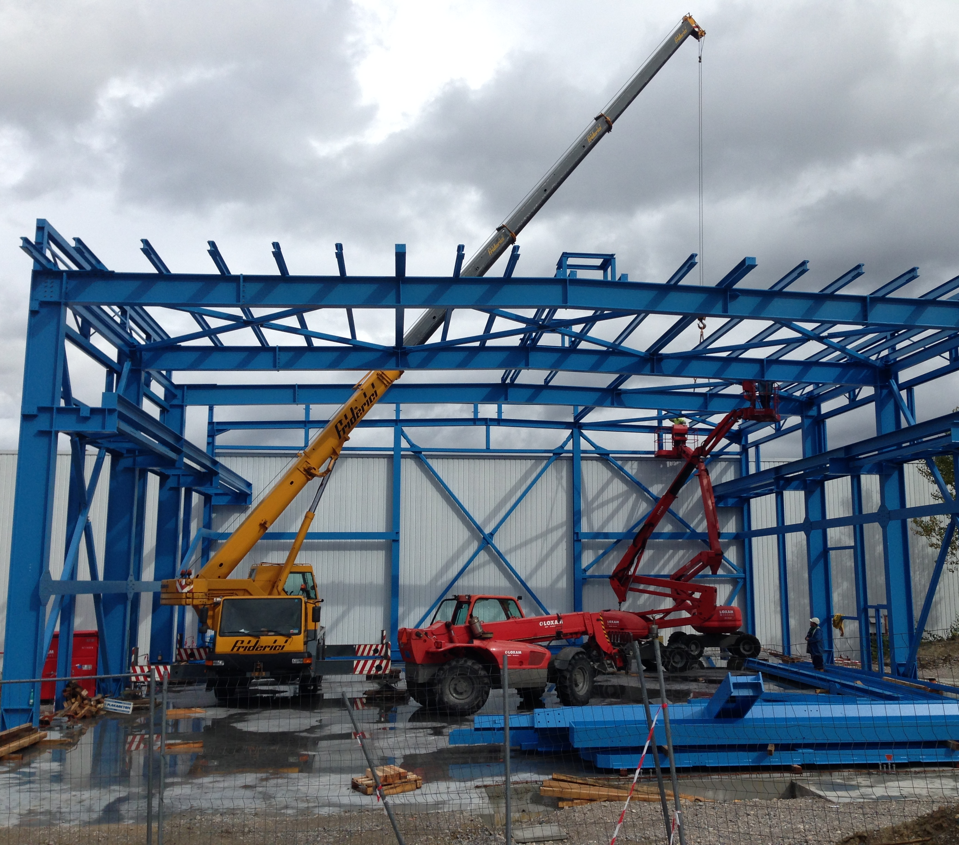
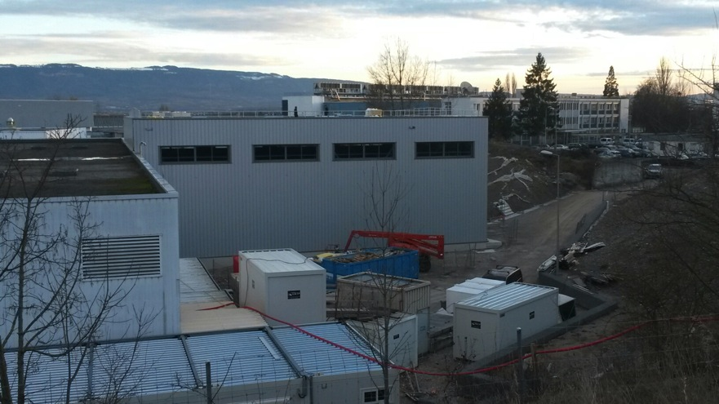
Construction of Annex Building 393
Construction of building close to completion
  Delivery expected in February (ahead of schedule)
To be followed by Infrastructure Installation (CV, electrical distribution, access system, crane …)
Needed for installation of kicker equipment from late autumn 2014
AD hall
Annex building 393
Situation end of September 2013
Recent Photograph

Slide 17
Status of external Contributions
Univ. Tokyo and MPQ-MPI:
- Profile monitors for lines
- Other contributions to be discussed after decision (our side) that cooler construction in house
- Manpower to work on electrostatic transfer lines (devices), electron cooling ..
Cockcroft Institute & Univ’s and Swansea University:
- Started working on beam dynamics and physics related subjects
- Plans for more work with enlarged team (team with full time postdocs and doctoral students)
Denmark: Funds (580 kCHF, thanks!!!) for the construction of the bending magnets transferred to CERN in autumn 2013
IKP-FZ Julich:
- Work on external source for commissioning going on - contacts with transfer lines and integration.
Univ. Brescia:
- 25 kEuros transferred and 25 kEuros to be transferred soon
- Collaboration on electronics design for position Pick-Ups
RIKEN (since last ADUC)
- Manpower (student) discussed last autumn
TRIUMF: Help for design of electrostatic transfer lines
Hemholtz Institute Mainz: Construction of supports – agreement to construct “jacks” for support and precise alignment of heavy bending magnets last autumn, others items may follow
Manne-Siegbahn Laboratory: Plans to help with ELENA commissioning

Slide 18
Summary and Outlook
Outcome of Review
  Basic ELENA machine design presented is sound and expected to meet the requirements
  No overlooked showstoppers identified
  Several interesting recommendations and suggestions for further improvements
Machine to be built is known
  .. it is the machine described at the review and in the TDR, which had evolved since the feasibility study and project approval
  Some (hopefully small) modifications to be expected
    As a result of the recommendations from the review and problems encountered
Ongoing now and outlook
  Completion of TDR – draft from proofreading expected this month
  Revision of budgets and planning
    Collecting input from Work Package holders
    Setting up of an EVM structure for project follow-up
  Construction, installation, commissioning …
  First 100 keV beam for experiments from ELENA expected during 2nd half of in 2017

Slide 19
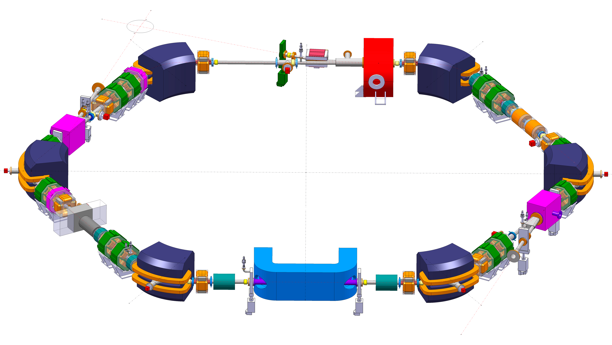
Thanks for your attention !

Slide 20
Report from Review Committee
Recommendations and actions to take them into account
Optics, longitudinal and transverse Dynamics
  Recommendation: revise working point to avoid 4th order resonances excited by direct space charge
    Comment: understanding before review was that working point will be found
    empirically “somewhere close to” Q_{x} = 2.3 and Q_{x} = 1.3
    Action: optics solutions for lower (q = 0.23) and higher (q = 0.46) fractional tunes
    have already been investigated since, consequences on aperture under discussion (avoid increasing magnet apertures!!) .. better understanding of lattice tunability obtained
  Recommendation: 6D tracking with electron cooler (effect of non-linearities experienced by circulating antiproton beam under the “toroid” of the electron cooler)
    Comment: had been planned since discussions with one of the reviewers (M. Grieser) at
    the Cool workshop in June (very important and high priority!)
    Action: to be done when a field map of the cooler (with orbit correction) is available
  Recommendation: evaluation and, if possible, measurement of impedances of every element,
  even though collective instabilities expected not to be an issue
    Comment and action: started well before review with PhD student and help from ABP/ICE
  Recommendation: double harmonic RF system to mitigate direct transverse space charge effects
    Comment: plan to keep low level RF system flexible for implementation later (with large bandwidth cavity foreseen anyhow no impact on other hardware to be constructed)
  Recommendation: evaluate effect of (switch mode) power converter noise on beam (blow-up)
    Comment & action: important and tricky problem … to be discussed with priority

Slide 21
Report from Review Committee
Recommendations and actions to take them into account
  Possible issues related to very low magnetic fields, closed orbit studies
  Recommendation: magnetic stray field measurement in AD hall at ELENA position
    Comment: has been done long ago with AD pulsing, crane moving … not presented at review due to lack of time
  Recommendation: simulations of closed orbit with random errors
    Comment: simulations with expected field in AD hall (only earth magnetic field) presented at the review (orbit distortions and their correction)
    Action: simulations with random magnet (alignment) errors as soon as time permits
  Recommendation: Evaluate effect of supercycle operation and remanence effects
    Comment: planned to (i) execute repetitive hysteresis cycles (always ramp currents up and down to the same reference currents) and (ii) to quantify hysteresis effects during magnetic field measurement campaigns
  Recommendation: “Thinning” (mixing of magnetic and stainless steel laminations) not only for bending magnets, but also quadrupoles etc. for field quality and mitigation of remanence
    Action: magnet experts (i) launched ordering of different prototype quadrupole yokes for systematic studies and (ii) proposed and study orbit correctors without yoke
  Recommendation: revise ring orbit corrector strengths (reduction by a factor ≈4)
    Action: Strength reduced by factor 2.4 (to keep compatibility with bumps around the electron cooler) makes it easier to adopt yoke free magnets (see above)

Slide 22
Report from Review Committee
Recommendations and actions to take them into account
Electron Cooling
  Comment: electron cooling of antiprotons in ELENA is expected “not to be a problem”
  …e.g. extrapolating from measurements with ³¹P⁺ beams (same relativistic β) at TSR
  Comment: details of electron collector, clearing electrodes (removing ions otherwise trapped
  in electron beam) and position pick-ups not presented
    Comment: pick-ups under study now and clearing electrodes were foreseen anyhow
  Comment: design of cooler (magnetic system) behind of what was done for ring magnets
    Comment & action: lengthy discussion with Toshiba without result; meeting on 8th November organized by BI with agreement to (i) launch a market survey and (ii) discuss vacuum system between BI and design office
  Recommendation: reduce size of electron beam to simplify gun design
    Comment & action: reduction of electron current considered by team working on cooler
  Recommendation: A proof of accuracy of BetaCool should be done (using AD and TSR data)
    Comment & action: effort based on LEIR and AD data will continue
  Further recommendation: effect of “toroids” on antiproton dynamics, IPM
    Comment: see other topics under which these recommendation were made as well
Vacuum system
  Recommendation: valves on both sides of injection kicker
    Action: valve to be added upstream of the kicker, downstream very difficult
  Recommendation: design of vacuum of cooler with differential pumping for gun & collector

Slide 23
Report from Review Committee
Recommendations and actions to take them into account
Instrumentation
  Recommendation: “micro-wire” profile monitors in injection line as well
    Comment & action: excellent proposal, details (where, number ..) to be discussed
  Recommendation: “micro-wire” profile monitor be of interest for ring with kicked beam?
    Comment: Extracted beam can be measured with first monitor in extraction line
  Ionization Profile Monitor in ring, ~1 s integration time & pressure bump (by factor 10)
    Comment: excellent news if IPMs are really feasible (had been foreseen, but then abandoned) as little transverse diagnostics (only destructive scraper) is available in ring
    Action: to be studied by a fellow
  Recommendation: position pick-ups in electron cooler
    Comment: has been discussed before, feasibility under study (works well at other machines)
Transfer (extraction) lines
  Recommendation: Full tracking simulation trough complete line/sensitivity to errors
    Comment: tracking studies through complete line planned as external contribution by the Cockcroft institute
  Recommendation: review (momentum) acceptance
    Comment & action: surprise! … conservative margins will be better documented
  Recommendation: shielding studies for lines passing close to experiments
    Comment: partly done, plan for simple tests (field inside shielded tubes)

