Slide 1
ELENA Beam Instrumentation
Lars Søby
On behalf of G. Tranquille and many other people

Slide 2
AD – ELENA transfer line
Profile & position: 2 * GEM,
2 * uWire
2 * BTV
ELENA ring
Position: 12 * BPM
Tune: 1* BBQ
Profile: 1 * Scraper +Scintilator
Cooling performance: 1 * Recombination monitor
Intensity + longitudinal: LF + HF magnetic Schottky
Sum of BPM’s CCC
Experimental zones
Profile & position: ~ 40* uWire
Intensity 2 * LF magnetic PU

Slide 3
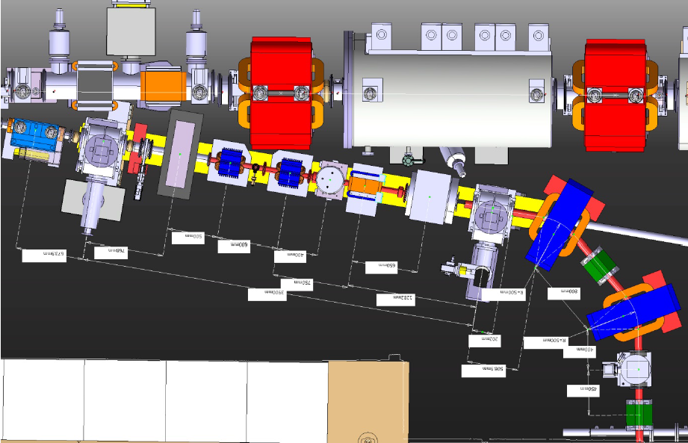
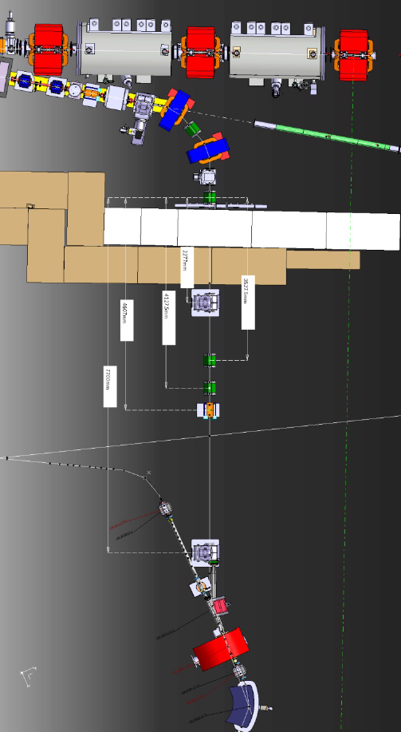
AD-ELENA transfer line
Modification of the existing 7000 line
New line from 7000 line to ELENA
GEM
uWire
BTV

Slide 4
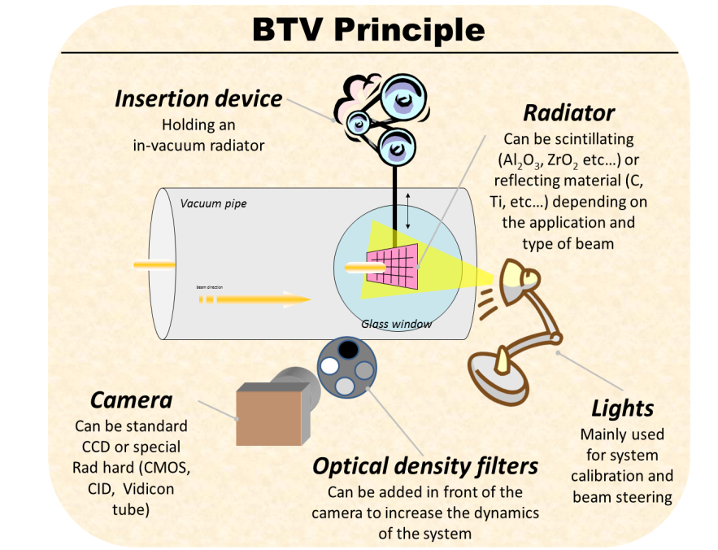
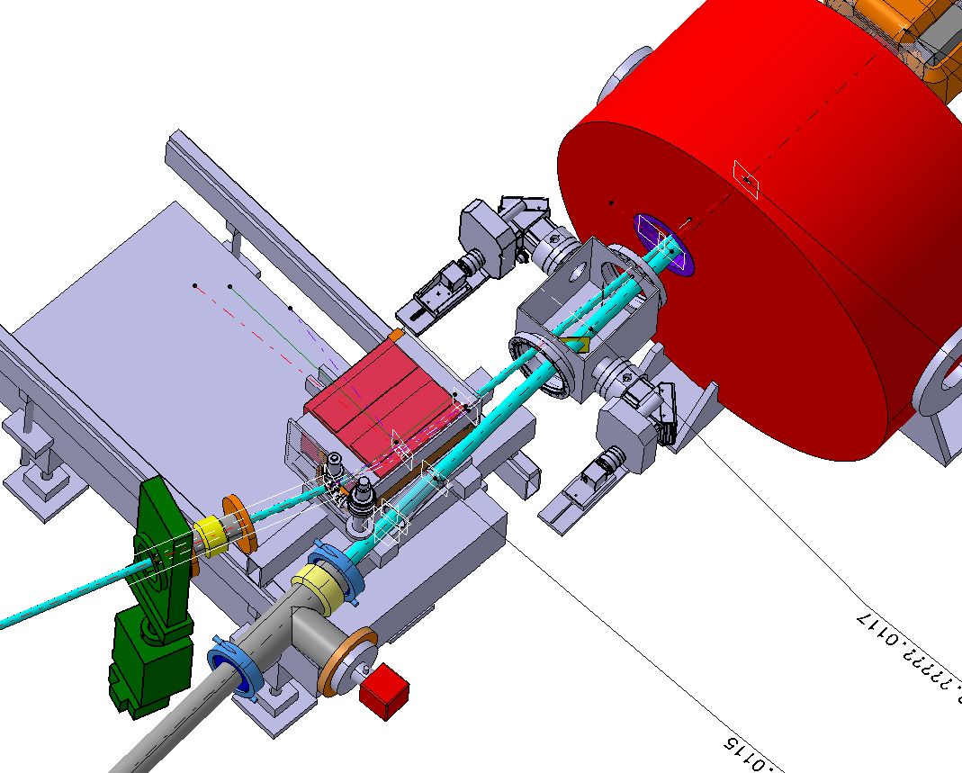
BTV
At present in the AD, Al₂O₃ scintillating screens are installed in the transfer lines. High sensitivity CCD cameras gives sufficient S/N-ratio in the AD extraction lines .
One such device will be moved from its current location in the 7000 line and will be installed after the second bending magnet that will deflect the antiproton beam from the AD to ELENA.
A new system is also being developed that will be capable of measuring just before the injection kicker and at the first turn in the ring. It consists of two distinct systems each incorporating a 6 cm x 4 cm screen. Study ongoing to eliminate bellow.

Slide 5
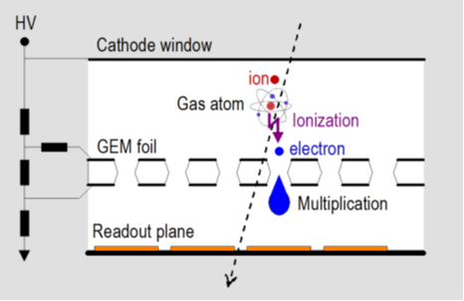
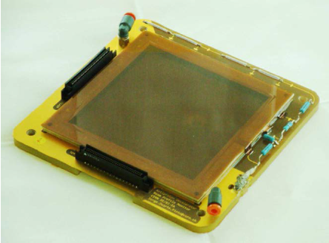
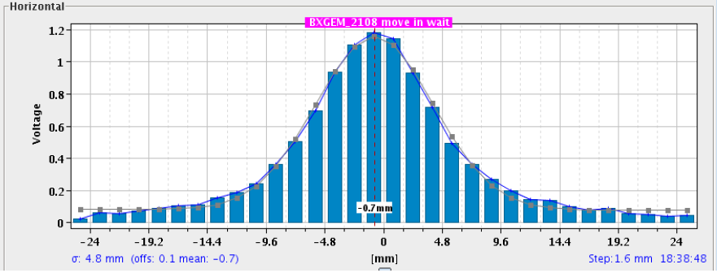
GEM
GEMs have been deployed extensively in the present AD experimental areas and give excellent results for both position and profile measurements. They are destructive.
A GEM is a 50 µm thick foil of Kapton, copper clad on both sides, pierced with microscopic holes at a high density (our 10×10 cm² foils have about a million holes).
A voltage of a few hundred volts applied to the top and bottom copper layers causes an electric field that focuses in the centre of these holes.
Ionization electrons enter the holes from one side, are multiplied inside the holes, and then exit on the other side where they are collected by a strip pattern that integrates the charge and reads out the profile.
4-6mm resolution

Slide 6
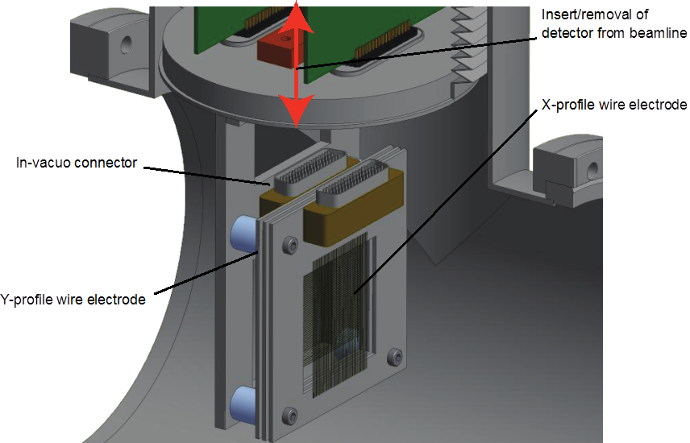
μWire Monitor
This semi-non destructive monitor is based on the devices used by the ASACUSA collaboration since 1999 to measure 100-keV antiproton beams. The device is sensitive to antiproton, proton, and H⁻ beams of energies between 10 keV and 5.3 MeV.
It consists of two position-sensitive photocathode grids (GND) providing the X and Y projections of the beam, sandwiched between three anode grids (50V).
Each grid consisted of between 32 and 48 gold-coated tungsten wires of diameter of 5–20 μm stretched over a ceramic frame, with a pitch 0.5–1.5 mm between neighbouring wires.
The beam profile is obtained by using charge-sensitive preamplifiers to measure the charge Q_{i} ejected from the cathode wires on the X- and Y-grids with high sensitivity.

Slide 7
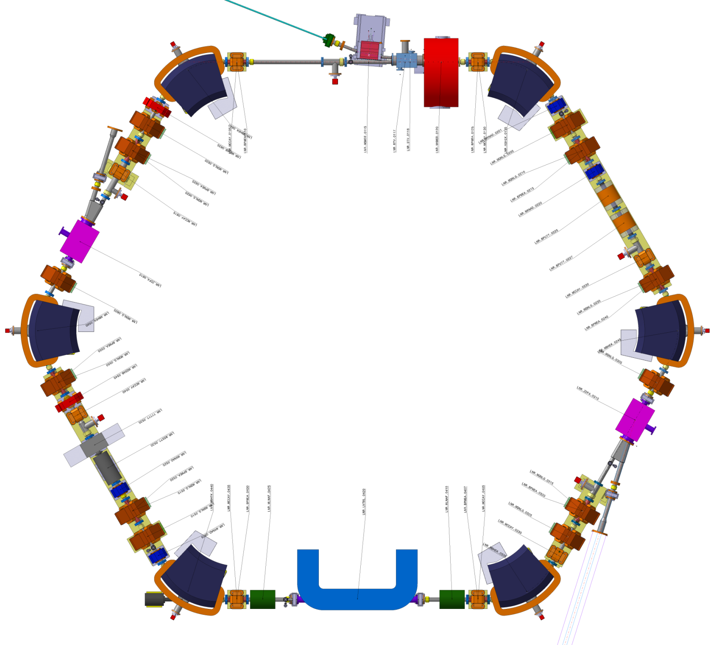
ELENA ring
BTV*2
LF-Schottky
BPM
BPM
BPM
BPM
LF+HF
Schottky
BPM
BPM
Profile
monitor
BPM
BPM
BPM
BPM
BPM
BPM
Recombination
monitor
LF-Schottky

Slide 8
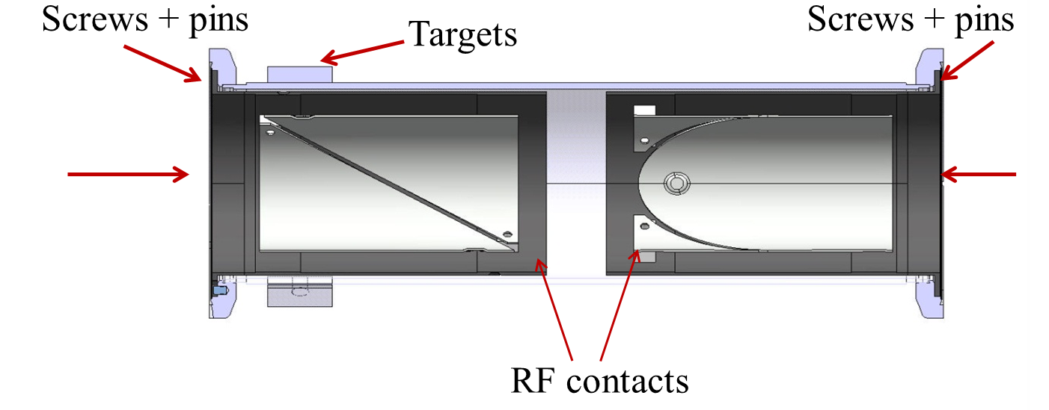
Beam Position
The ELENA orbit measurement system will be based on 24 circular BPMs made out stainless steel with vacuum as dielectric, and mounted inside quadrupoles , dipoles and the electron cooler.
Design of PU, analogue electronics as well as digital acquisition is optimized in view of using the 20 BPMs as one big Schottky PU.
Resolution | 0.1mm
Accuracy | 0.3-0.5mm
Precision | 0.1mm
Max. beam displacement | 33mm
Time resolution | ~10ms
Overall maximum length | 400mm
Inner diameter | 66mm
Bake out temperature | 250°C
Vacuum | 3 × 10⁻¹² Torr

Slide 9
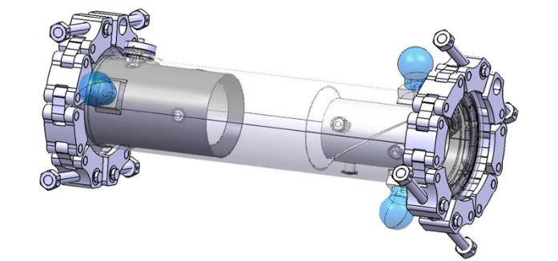
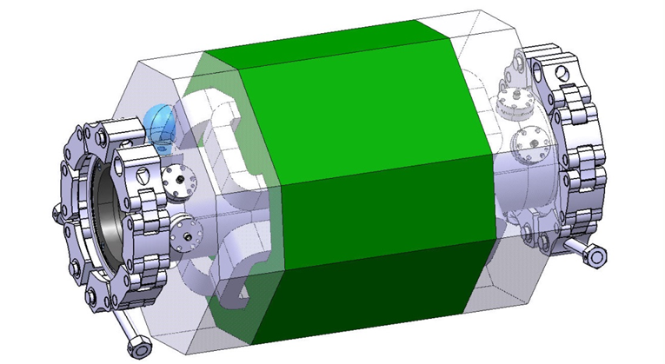
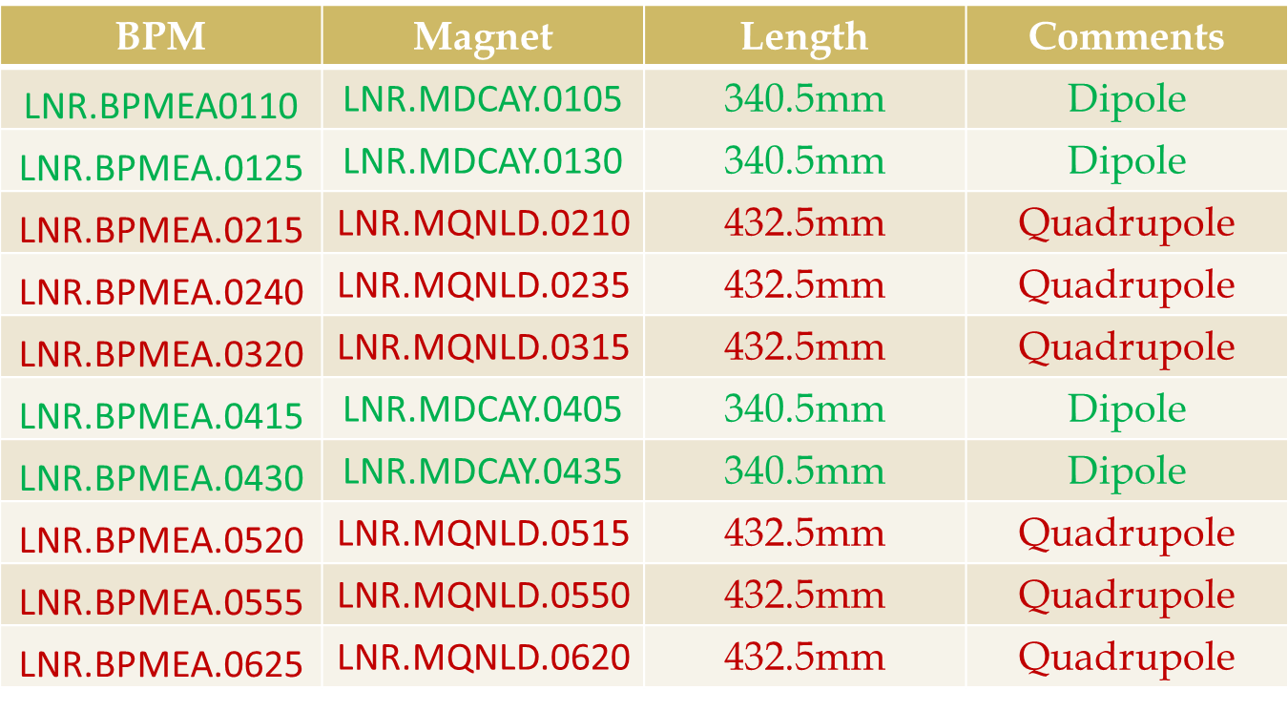
Beam position
H+V PUs
Electrode length | 120mm
Electrode area | 1.24E-02 m²
Electrode capacitance | 17pF
Cable capacitance (20cm, 75Ω) | 10pF
Amplifier input capacitance | ~20pF
Number of charges | 1E7
Bunch length | 1.5m
Bunching factor | 20
Max. input signal amplitude | 3.0mV
Transverse sensitivity | ~90µV/mm
Another two PUs to be added inside electron cooler

Slide 10
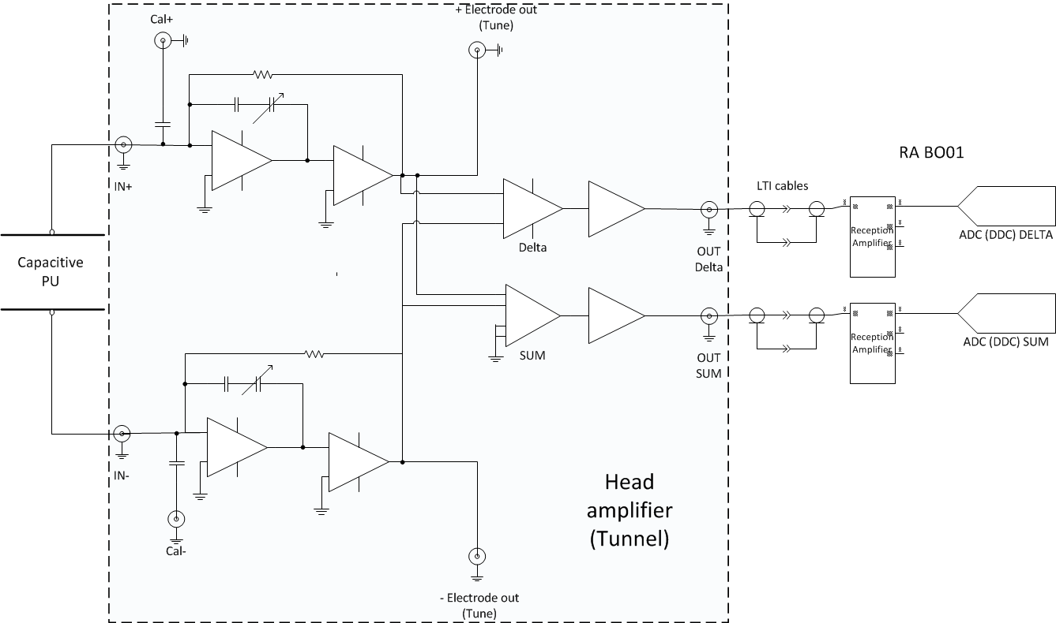
Beam position
Front-end electronics developed in collaboration with Brescia university.
First prototype foreseen March 2014

Slide 11
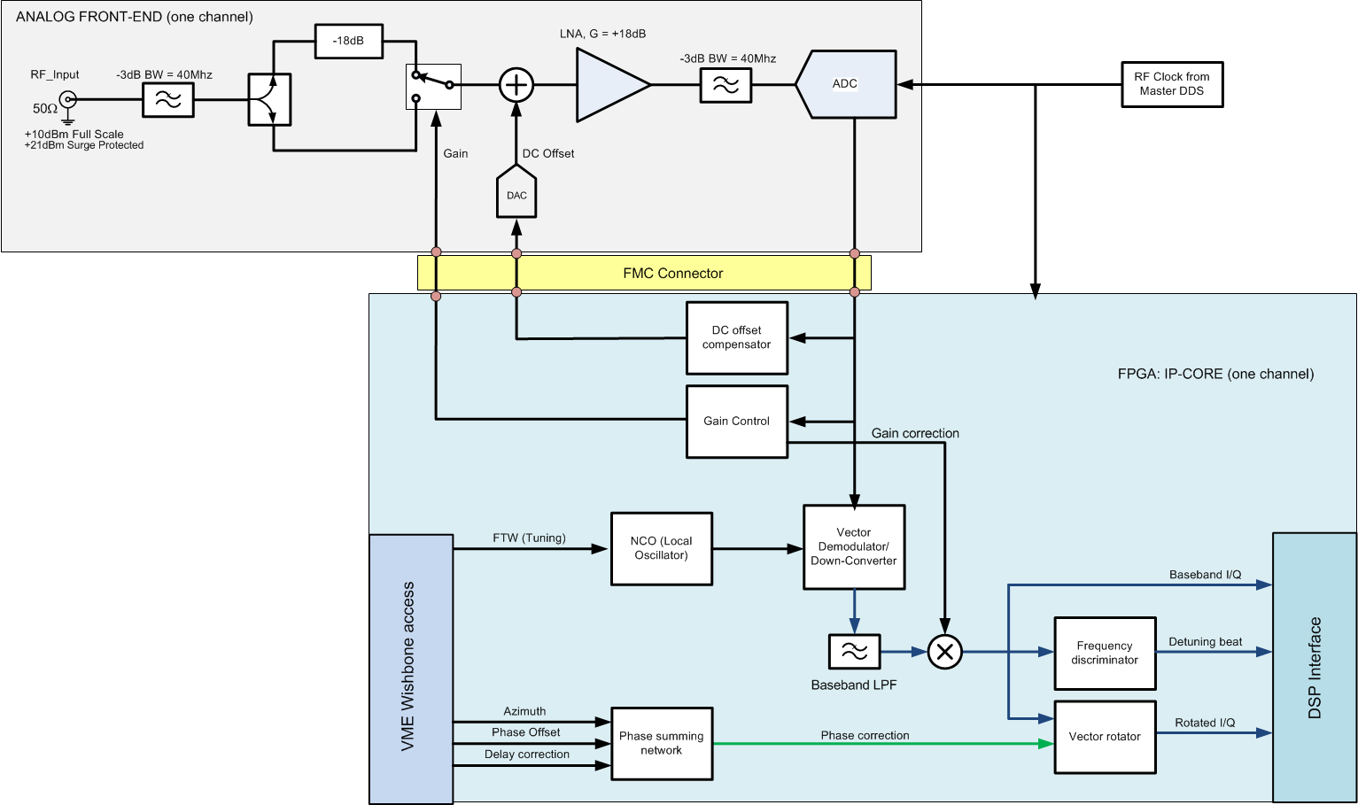
Digital acquisition system
    DDC of first or second harmonic, input from RF MDDS
    Baseband Δ/Σ- processing, also on ramp
FMC cards + ADC mezzanine developed by BE/RF.
One VXS chassis with switches for inter FMC communication using SUSHI train, for Schottky measurements.

Slide 12
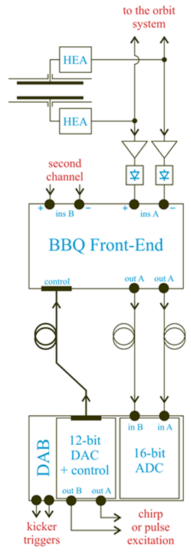
Tune
Base-Band Tune (BBQ) measurement systems are highly sensitive and based on a direct diode detection principle. Can use orbit PU-signals, but dedicated PU preferable.
•Diode detectors, converting beam-induced pulses from electrodes of a position pick-up to slower varying signals.
•An analogue front-end amplifying and filtering the detector signals. Digitized by 2 16-bit ADC’s
•A VME, FPGA based Digital Acquisition Board (DAB) providing the read-out and processing of the ADC samples.
•Two 12-bit DACs implemented, used to generate signals for beam chirp excitation, independently for horizontal and vertical machine planes.
Dedicated strip line kicker (and PU?) still to be integrated in the layout.
100 turn resolution in the order of 0.3µm is expected

Slide 13
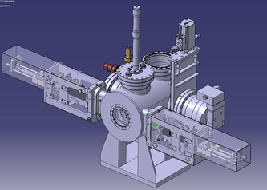
Beam Profile
The profile of the circulating beam will be measured destructively using a scraper + scintillator system.
A simultaneous detection of the intensity of the particle shower outside the vacuum chamber with a scintillator/photomultiplier assembly and the blade position gives an image of the beam profile.
For ELENA, 4 scraper blades (2 horizontal and 2 vertical) will be installed in a vacuum tank in section 5 of the ring .
Their design is based on the Linac 4 beam stopper and will consist of a 50 mm X 20 mm aluminium plate fixed on a rigid arm which is moved into the beam by a stepping motor or a pneumatic jack.
The exact position is read via LVDT sensors and end switches. The movement control will be done using standard PLC based controls
Ionisation Profile Monitor is being studied as well, for non destructive measurements.

Slide 14
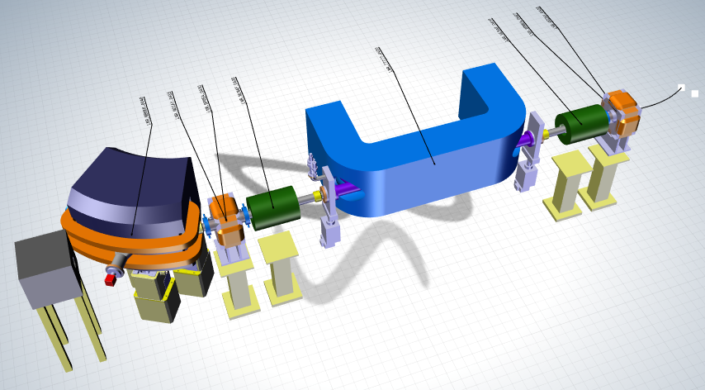
Recombination Monitor
For commissioning at 100 keV with the proton source, optimisation of the electron cooler can be performed by measuring the recombination rate of electrons with the circulating protons (H0).
A scintillator coupled to a photomultiplier can be used to measure the recombination rate. A maximum signal is obtained when the beams are correctly aligned.
Using an imaging monitor (MCP with strip read-out) one can derive the profile and position of the ion beam from the profile and position of the recombined beam.
The detector will be installed in an extension of the bending magnet vacuum chamber downstream from the electron cooler. It’s design will be started soon.
Magnets in reverse polarity
Recombination
Monitor (H0)

Slide 15
Intensity and longitudinal diagnostics
Three stage implementation:
  Start-up with known (AD design) magnetic Schottky PU (LPU) .
  Use Σ of sum signals of 20 orbit PUs as one Schottky PU. Need continuous phase alignment of signals
  Replace magnetic PU by Cryogenic Current Comparator (CCC).
    High sensitivity (10nA) and accuracy, can be calibrated

Slide 16
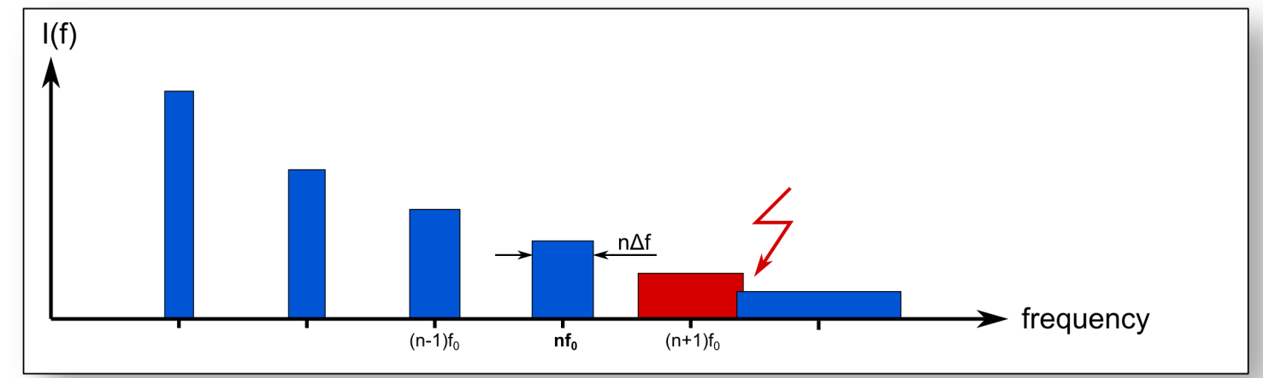
Longitudinal diagnostics:
Output: longitudinal beam signal for LLRF
Bunched beam: Intensity,
Debunched beam from Schottky scans:
Intensity
Frev
Δp/p (main ecooling diagnostics)
<p>
Averaged beam spectra
High Schottky harmonics needed

Slide 17
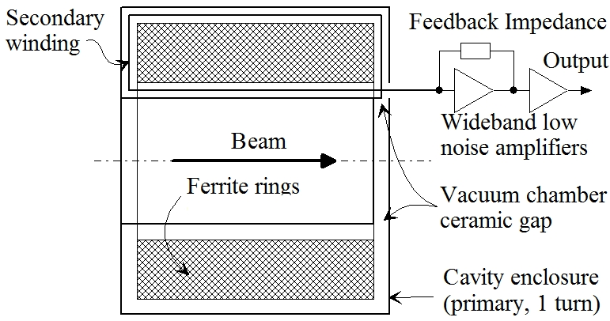
Magnetic LPU: principle
Make pick-up resonant with high Q to reduce the thermal noise current of the transducer itself.
Use low noise high impedance amplifier (Si JFET's) and regain broad band properties by strong active feedback without deteriorating the signal to noise ratio .
Head amplifier
Schematic view of the high-sensitivity longitudinal beam transformer .
Courtesy M. E . Angoletta

Slide 18
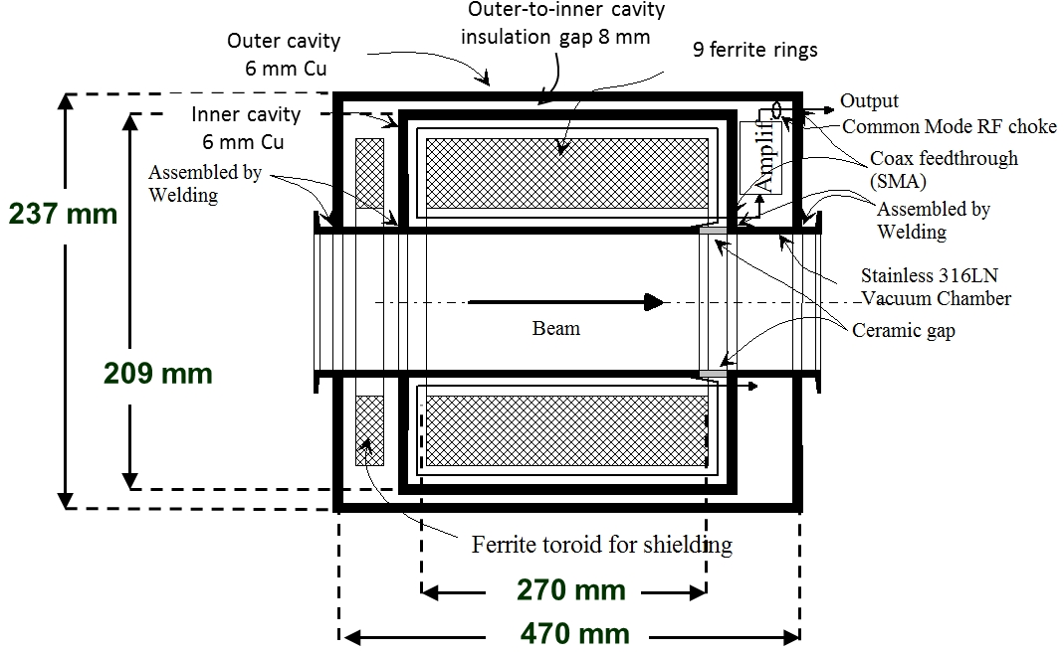
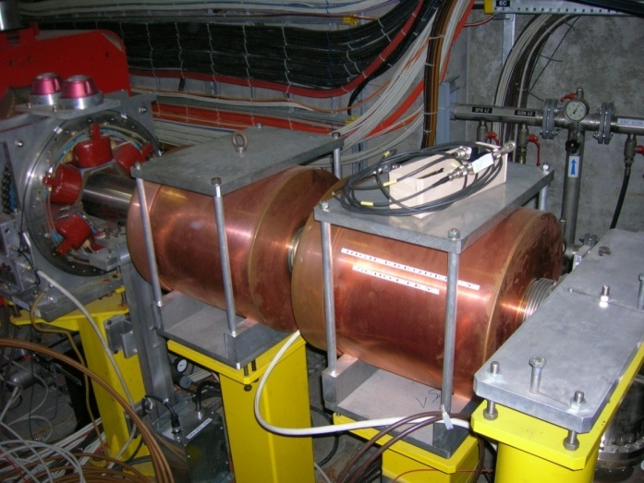
Magnetic LPU: design
Modification of AD design due to:
Shorter length allocated (1 m in ring, 50 cm in extraction lines)
Smaller vacuum pipe diameter
Bake ability (200°).
Double-shielded copper cavity with dimensions
Courtesy M. E . Angoletta

Slide 19
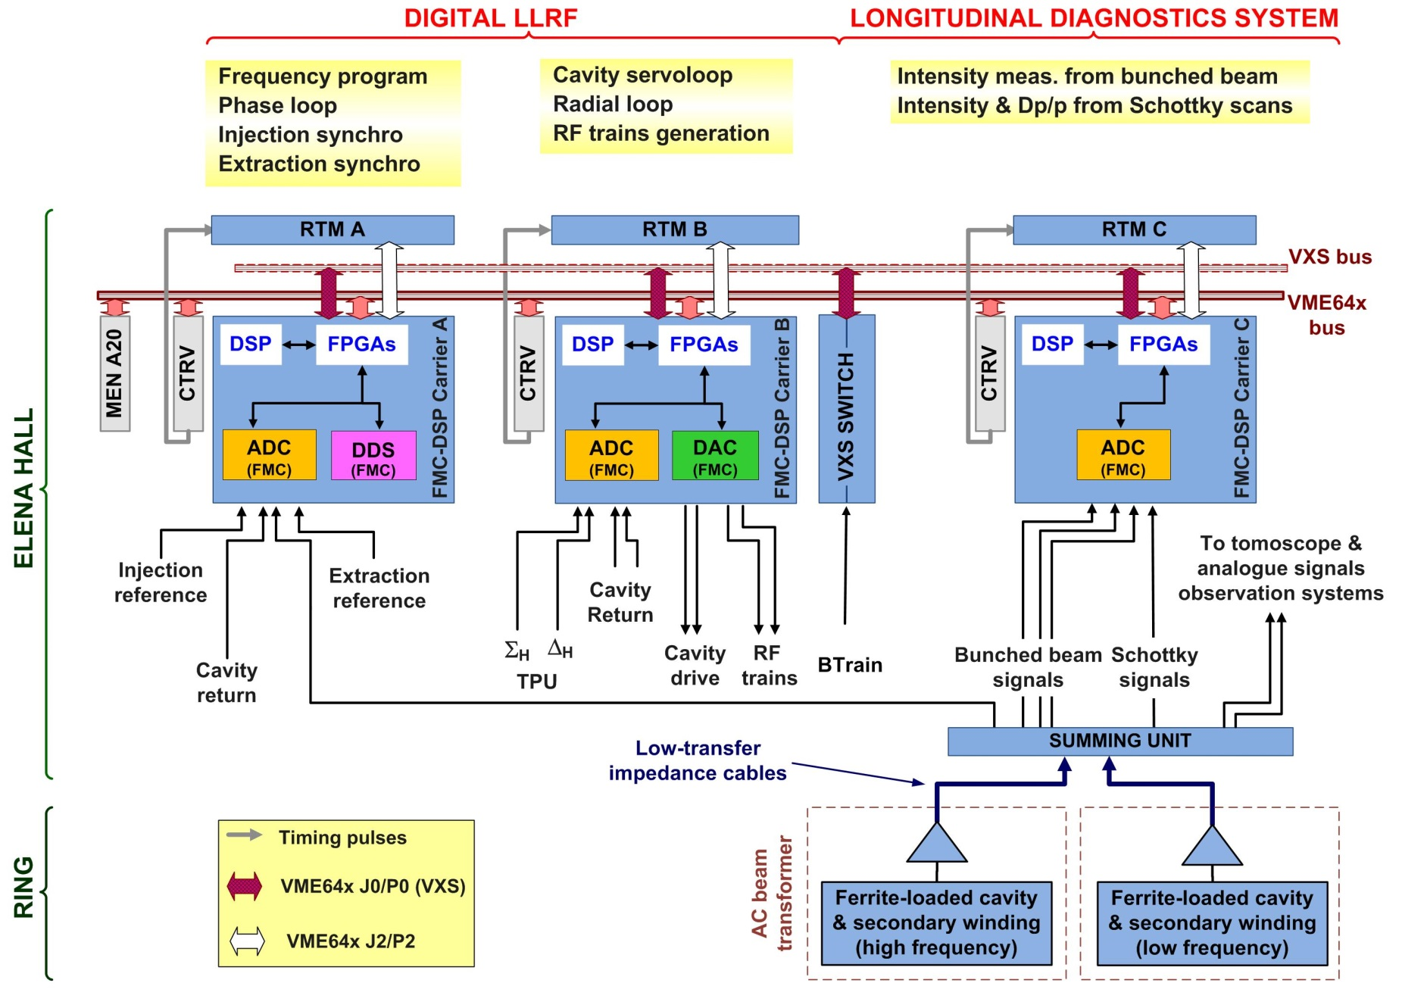
Longitudinal diagnostics
Summed BPM signal
(2nd phase)

Slide 20
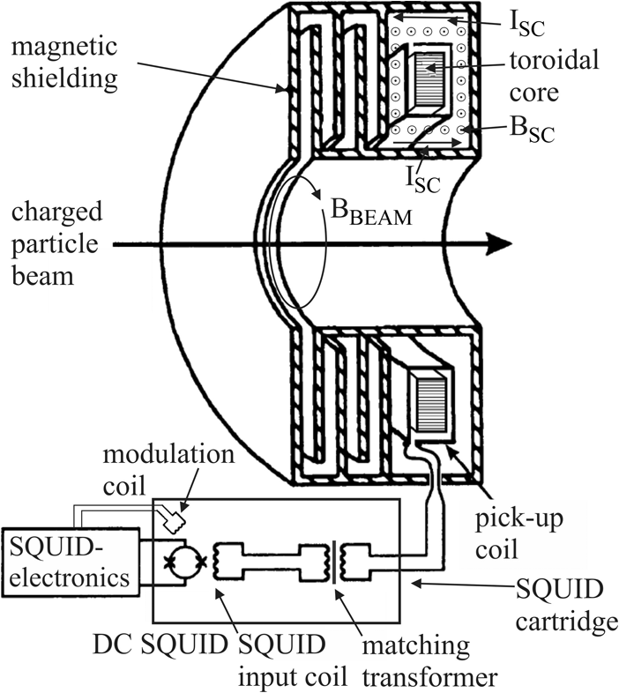
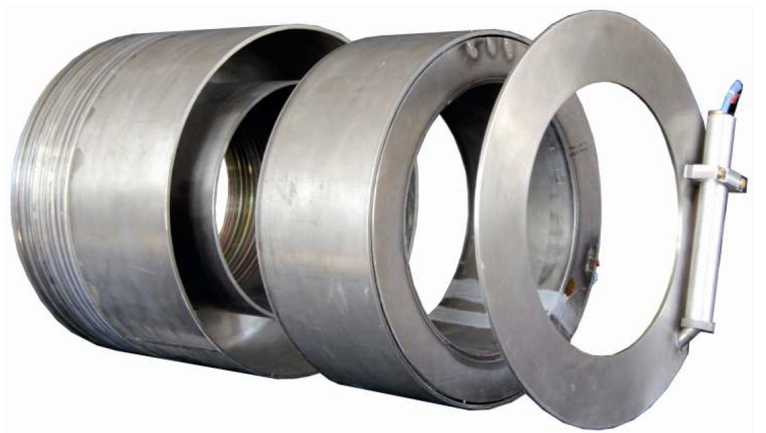
Cryogenic Current Comparator
Working principle similar to that of Beam Current Transformer
Requires ceramic gaps to let magnetic fields pass.
Negligible heat load from cold mass
Geometry:
  Inner radius: 90 mm
  Outer radius: 140 mm
  Length: 180 mm
  Weight: 43 (Nb) – 50 (Pb) kg
BBeam: 2-0.5pT
200dB attenuation
Cold parts, 4.2°k
Installation and tests of proto type foreseen in AD beginning 2015. Collaboration with GSI, Darmstadt
shield (SC)
SQUID (SC)
coil (SC) + core (Nanoperm)

Slide 21
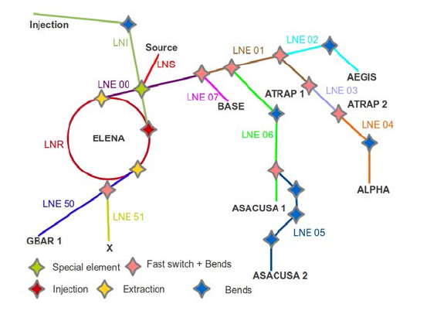
Experimental Lines
The 100-keV antiproton beam extracted from ELENA will be transported to seven experiments using electrostatic beam lines of total length >100 m. The dipoles and quadrupoles comprising the beam lines must be precisely tuned to focus the antiprotons into the acceptance of the trap experiments.
Two low frequency magnetic PUs are foreseen to monitor the extracted intensities.
Around 40 u-Wire grids foreseen to monitor the profiles and position along the lines.

Slide 22
Consequences for the experiments
You will get a nice and well defined beam…. ☺
 | Resolution | Accuracy | Comments
Orbit | 0.1mm | 0.5mm | 1mm single turn
Tune | 0.3um |  | 100T
BTV | 0.2-0.4mm |  | Destructive
GEM | 4-6mm |  | Destructive, res can be smaller
uWire | 0.5-1.5mm |  | 97-99% transmission
Scraper | < 0.1mm?
Intensity (Schottky) |  | 5-10%
Intensity CCC | 10nA | 1% | Not before 2017-2018

Slide 23
Summery
The main ELENA parameters will be measured with equipment's which we know very well from the AD and believe in:
Orbit Electrostatic PUs
Tune BBQ
Profile and positions BTW, µwire, GEM, Scraper
Longitudinal diagnostic Magnetic PU, Schottky
However very interesting and challenging developments are still in front of us:
Use of BPM PUs for longitudinal Schottky measurements on de-bunched beams as well as intensity and position of bunched beams.
Cryogenic current comparator (CCC) based on a superconducting quantum interference device (SQUID) for a precise measurement of the circulating beam intensity.
Investigate the possibility to use residual gas ionisation or luminescence for circulating beam profile measurements.

