Slide 1
CALET Document Server
Doug Granger
LSU
CALET TIM Nov 2013

Slide 2
Purpose
The purpose of this server is to create a system where all CALET documentation can be
  Stored
  Organized
  Displayed
  Simple user-friendly Interface
  Uploaded and Downloaded by any authorized CALET researcher
  Mirrored for redundant archiving

Slide 3
Requirements
System Requirements
  Support all file types used by Collaboration
  Restrict access to Collaboration members only
  Mirroring to remote site capable
Document Submissions
  Members must be allowed to upload submission and all relevant files
  Members must be allowed to update submission
Document Labeling
  All uploaded documents have a unique Document ID number
Display of Documents
  Submissions must be in a simple logical method for easy access
Document Retrieval
  Submission and all ancillary files must be easily accessible by Members
Redundancy
  Data and documents can be archived on remote machines and other software packages

Slide 4
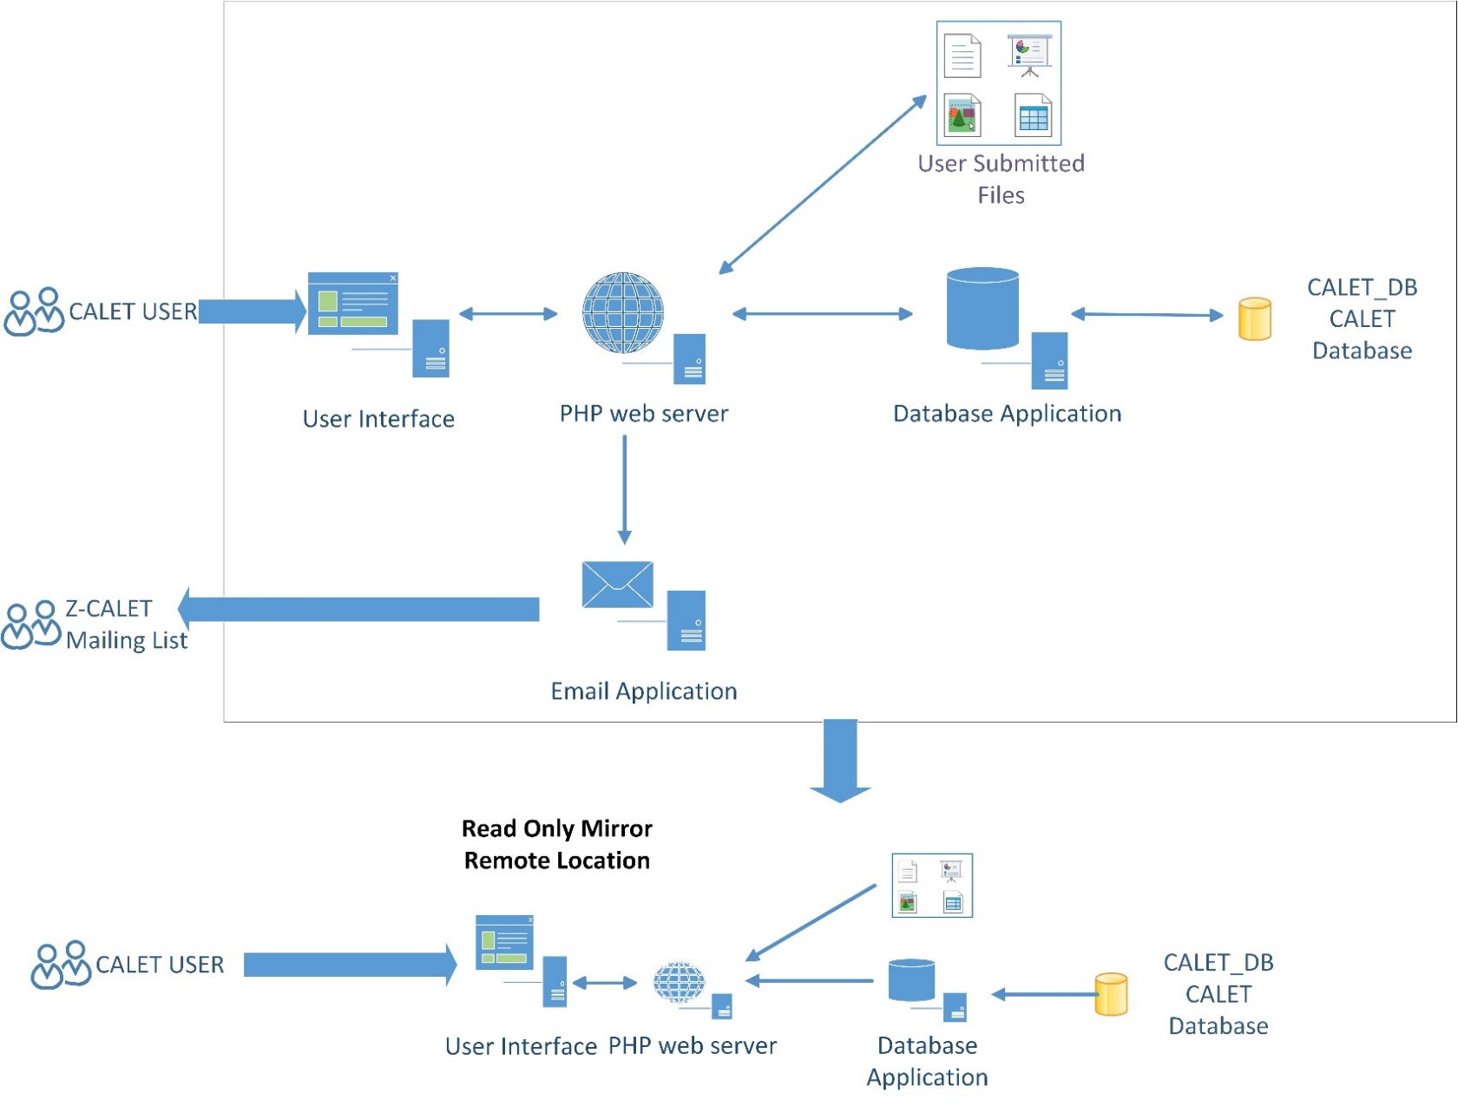
Server Design

Slide 5
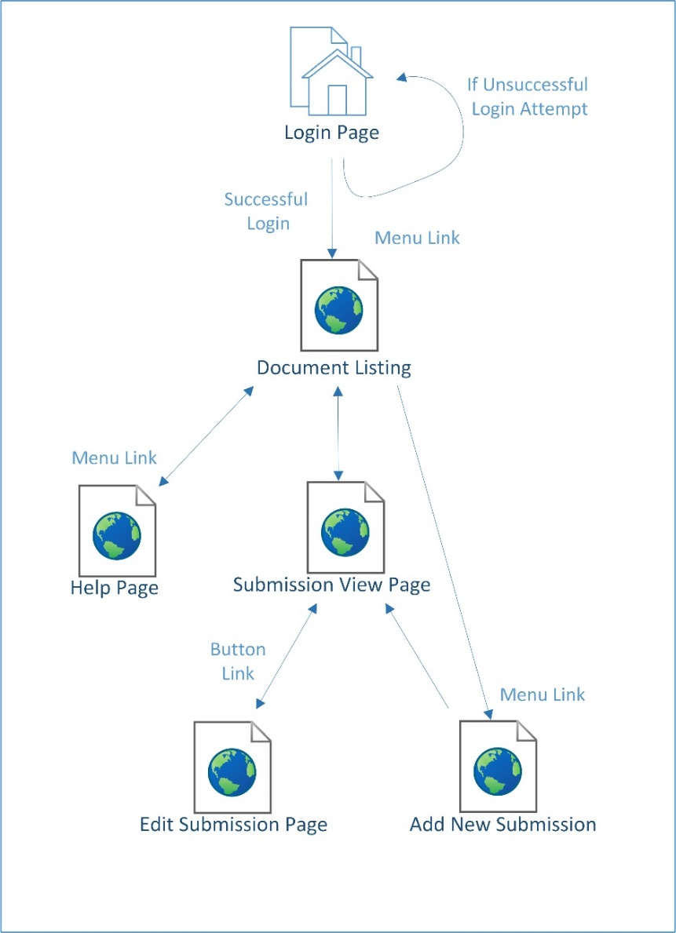
Website Flow
Site is designed for ease of use
The Document list Page will be the main page for authenticated users
All pages will have a menu link for
  The Main Document List
  The Add Submission Page
  The Help Page
  Logout
Links on the List page will take the user to the Individual Submission View page
The Edit Submission page will only be accessible from the Individual Submission page

Slide 6
User Login
Initially all users will be (Science Team Oct 2013) members
New Users will be approved by CALET Executive committee
User Login setup
  Username: lastname_first initial ( i.e. granger_d)
  Password: lastname
Login Page will allow the user to change and save their password. (under construction)

Slide 7
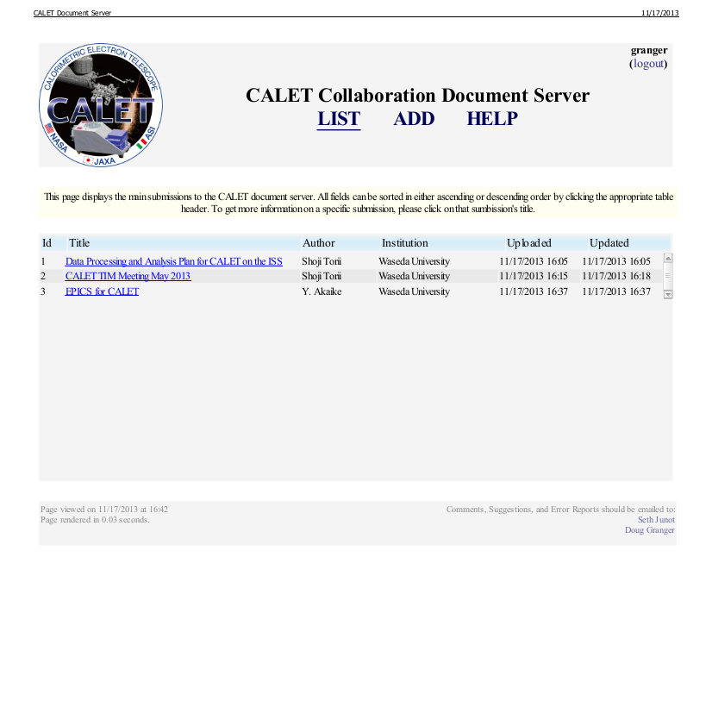
Submission Listing
First page viewed after login
Table View of all Submissions
  Document ID
  Title
  Author
  Institution
  Submission Date
  Date of last Update
  Link to Submission Information
Table is sortable on fields listed above

Slide 8
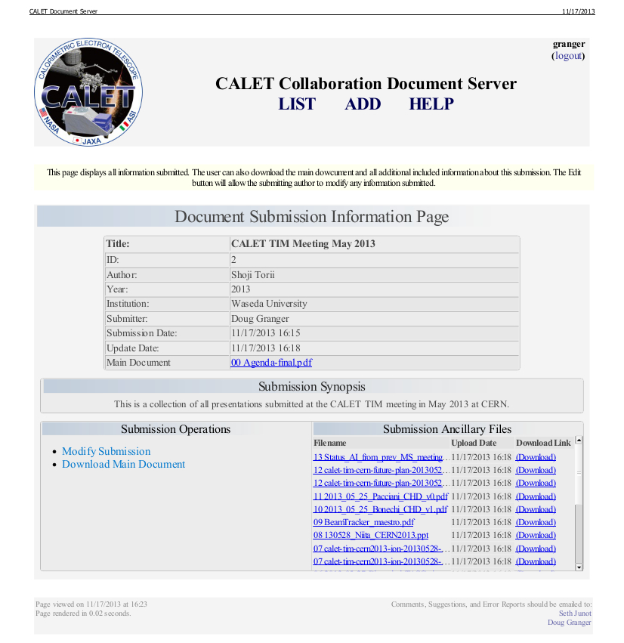
Individual Submission View
The Individual View will allow a user to display information on a submission including
  Document ID
  Title
  Author
  Submission Date
  Updated Date
  Synopsis
  Submission and ancillary files
  Multiple versions of uploaded files will be sorted by upload date
The User will also be allowed to download individual files from this interface
The User will also be allowed to download a zip of all files from this interface
Modify Submission link to allow user to modify the information saved

Slide 9
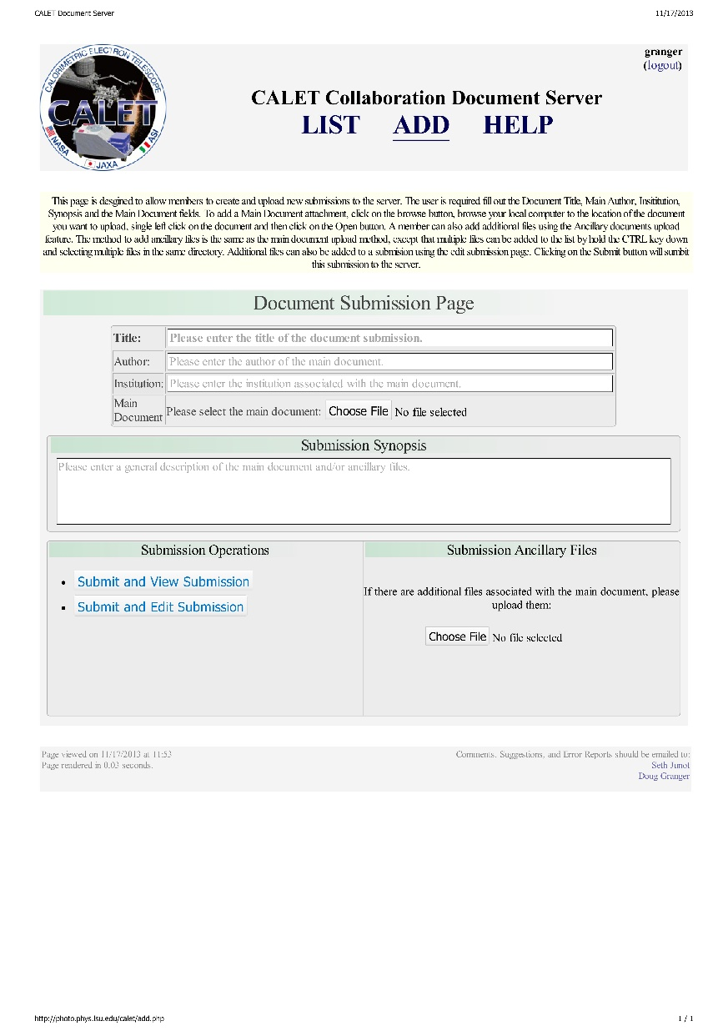
New Submissions
Will allow user to upload new submissions to the server
User will be asked to provide the following information
  Title
  Author
  Institution
  Synopsis
  Main Submission document
The user will be allowed to upload additional support documents, if needed
Document ID will be assigned on new submission. ID is a unique incremented number assigned by the server.
Email Notice sent to z-calet on all new submissions

Slide 10
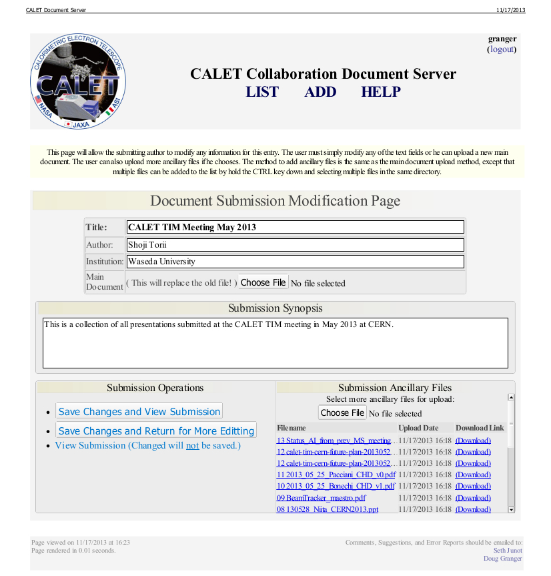
Submission Edit
On this page the user will
  be able to edit the following fields
    Title
    Author
    Institution
    Synopsis
  Upload a new main submission
  Upload additional ancillary files
  New file versions will be stored along with old versions.
  Email Notice to z-calet mailing list option

Slide 11
Future Updates
Search Features
  Search the database entries
  Search the contents of uploaded files
User account Modifications
  In progress
Ability to Differentiate between
  Tech notes
  Journal Submissions
  Conference papers and presentations
  Posters

Slide 12
Demonstration http://photo.phys.lsu.edu/calet

Slide 13
Questions/Comments

