Slide 1
CALET document handling system based on Indico
Paolo Maestro
University of Siena
TIM @ WUSTL 20-22 Nov. 2013

Slide 2
Requirements and implementation
We need a system to handle and archive CALET documents and share them among the collaboration members.
Which type of documents? Conference talks and proceedings, internal notes,
presentations at TIM’s, materials for telecons, scientific papers, etc.
I investigated the possibility to use for our purposes the Indico (Integrated Digital Conferencing) software.
Outline
  Indico: what is it? Which are its features?
  CALET Indico site
  Handling CALET meetings and telecons
  Handling documents: conference talks/proceedings and internal notes
Notes:
Online document library based on Indico. Description and demo

Slide 3
Indico features
Indico is a web-based, multi-platform conference storage and management system. It allows to store and display large amounts of documents and metadata related to real events (conference, meetings, lecture). The participants to an event can easily submit materials and share them with others.
Indico is a free software licensed under terms of GNU General Public License, developed and intensively used at CERN http://indico.cern.ch
Tree-like structure, organized into categories. Each category may either contain other categories, or contain simple events.
Automatic web page creation for the events.
Automatic notifications (i.e., automatically remembering all the participants in a meeting that it will take place today);
Document submission and reviewing.
Integrated support for videoconferencing software
Exportation of information in different formats: RSS feeds, iCal and MARCXML …
Support for different time zones.
Many others…

Slide 4
CALET Indico site
As a CERN recognized experiment, CALET has a site on the CERN Indico server https://indico.cern.ch/categoryDisplay.py?categId=3738
Current managers (allowed to modify the site) are: Maestro, Marrocchesi, Mitchell, Torii. Administrative control can be extended on request to other members.
At the moment all the CALET Indico pages are restricted, i.e. they can be viewed only by members who are registered by the administrator on the access control list. Registered members can sign in the site with a CERN account.
However we can choose to make some page public, i.e. freely viewable on the web.
Automatic backup and restore of the site is provided by the CERN-IT Backup Infrastructure.
  Indico has been already used for CALET meetings in the past.
  I have modified some features of Indico events to work on contents instead of meetings/conferences.

Slide 5
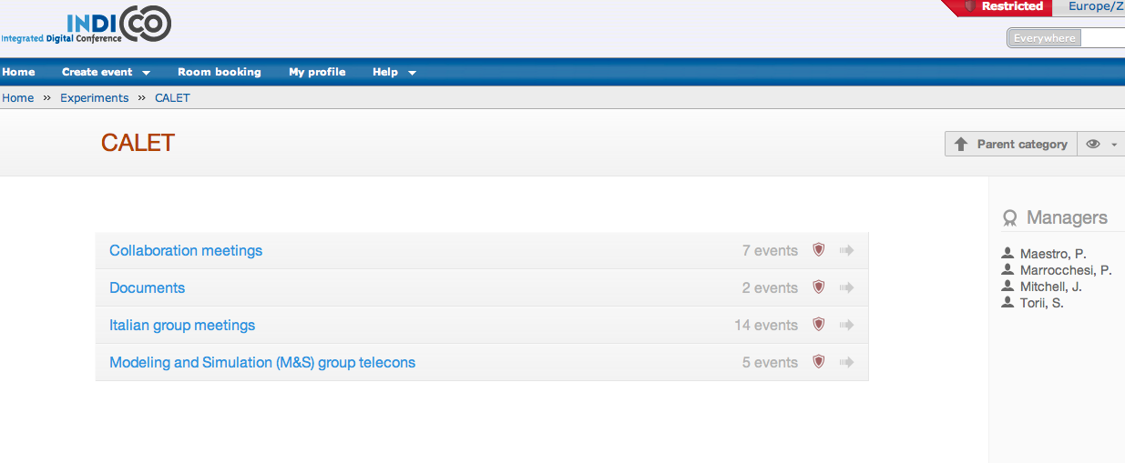
At the moment there are four categories in the main page of the CALET Indico site:
three are used to handle real events (meetings, telecons)
one (i.e. Documents) to archive documents (talks, conference proceedings, notes).

Slide 6
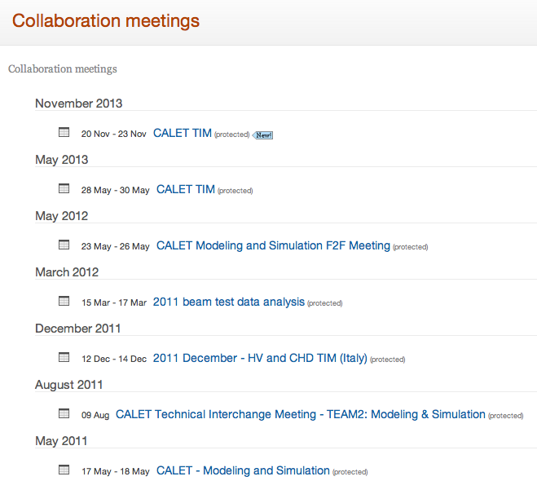

Slide 7
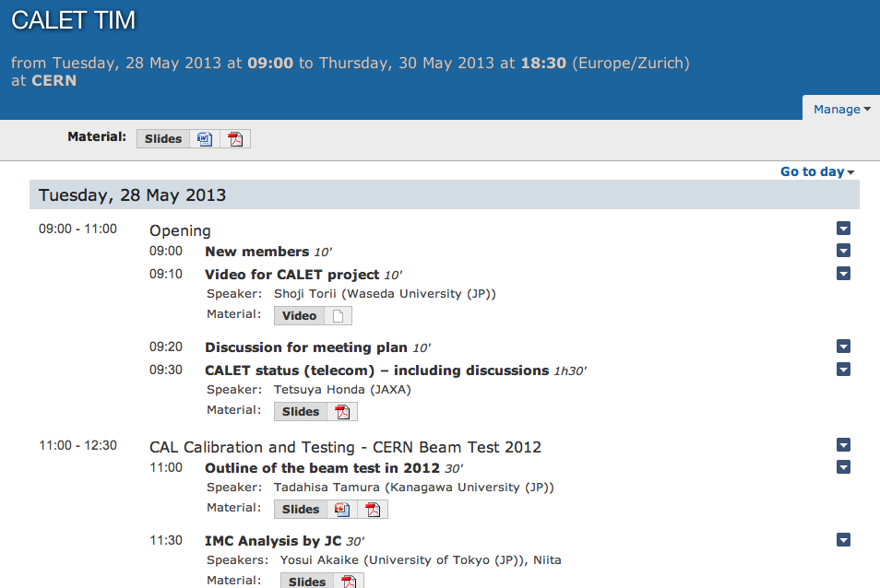

Slide 8
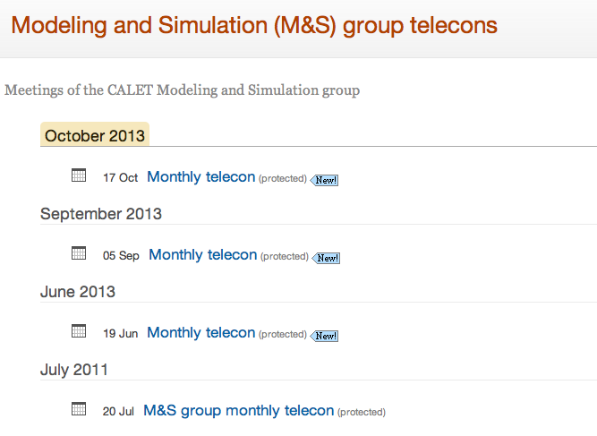

Slide 9
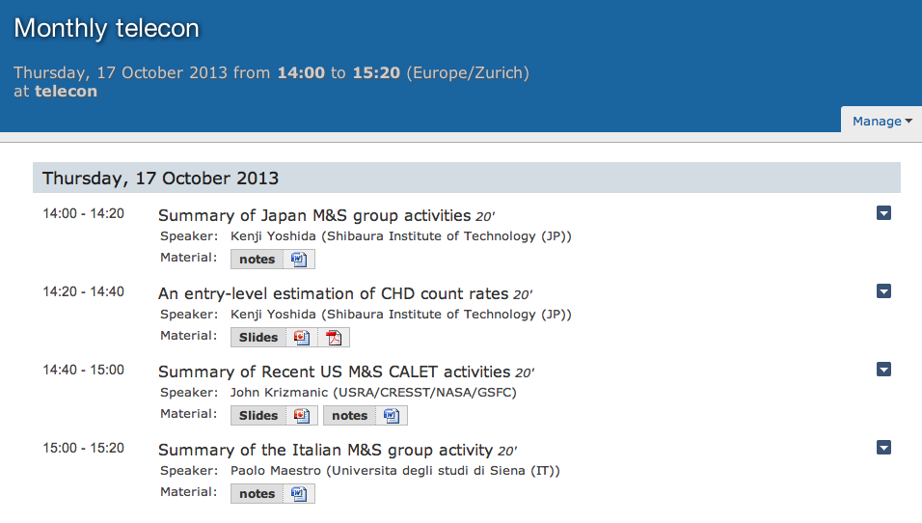

Slide 10
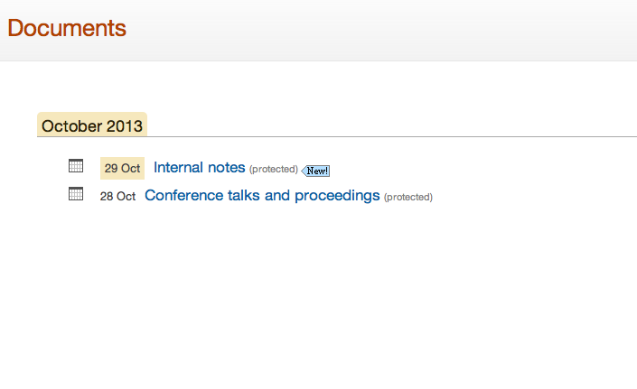
  I have modified this part to work on content instead of meetings/events

Slide 11
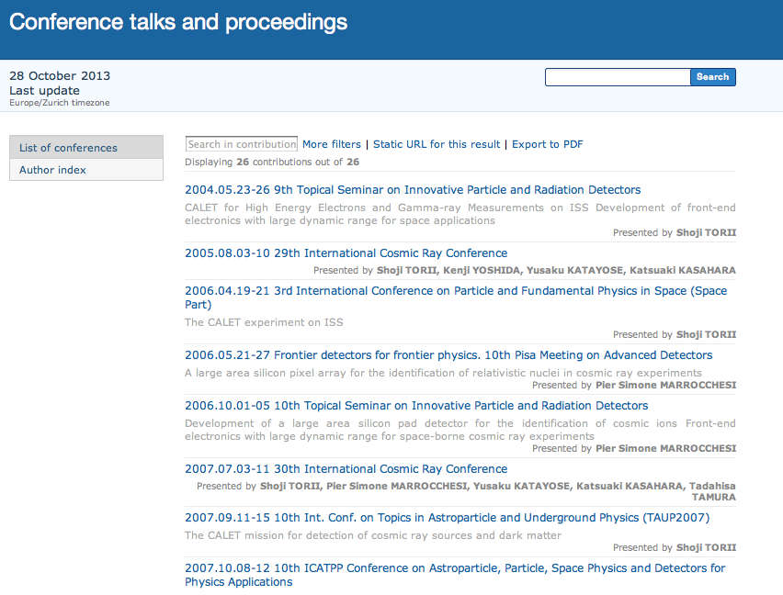
Conferences are
sorted by date
For each conference
the title of the talk
and the speaker
are shown

Slide 12
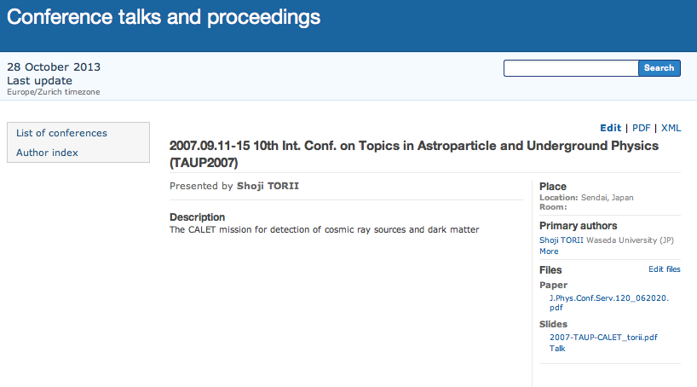
Example of webpage for a conference with one CALET speaker.
Both papers and slides can be uploaded.

Slide 13
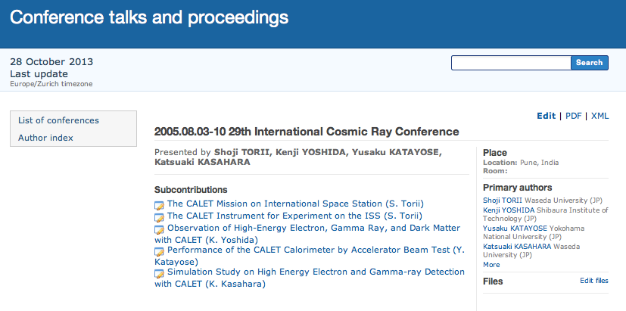
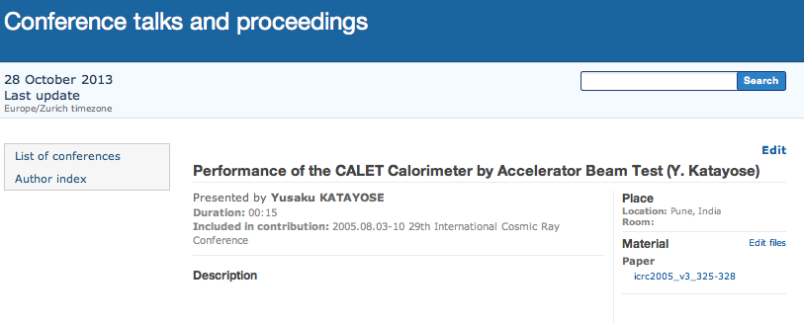
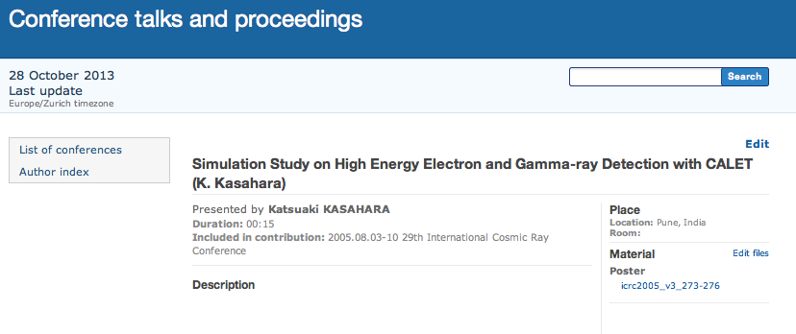
Example of webpage for a conference with several CALET speaker.

Slide 14
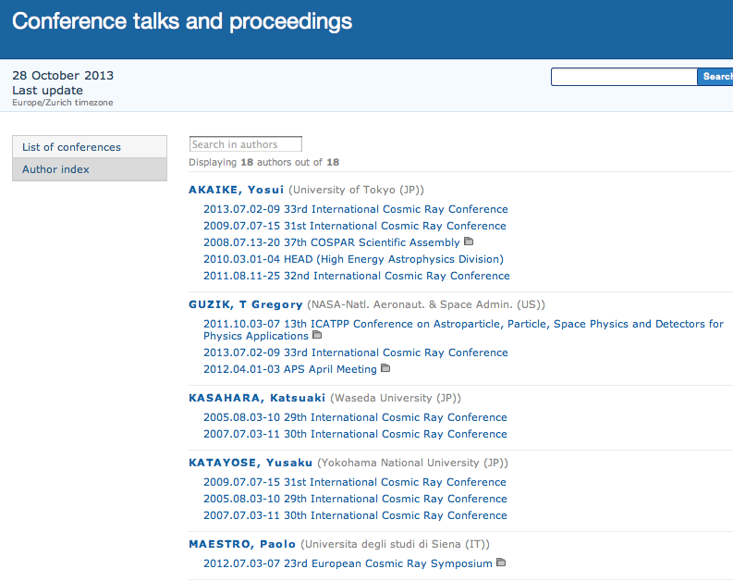
For each member,
the conferences he attended and his contributions can be listed.

Slide 15
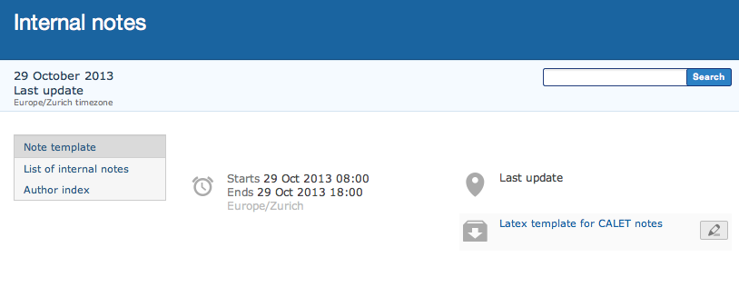
The scheme and layout implemented for the conference talks is replicated for the internal notes repository.
A Latex template for the CALET notes can be downloaded from the web page.
The note Identifiers are progressive numbers (ID=0, 1, 2, 3, …) . Each ID will be assigned (by me) on request of the authors. I will keep track of the numbers already in use.
After a note is released and published on the site, it can be replaced by an updated version. In this case its ID remains the same, but the revision number changes.

Slide 16
