Slide 1
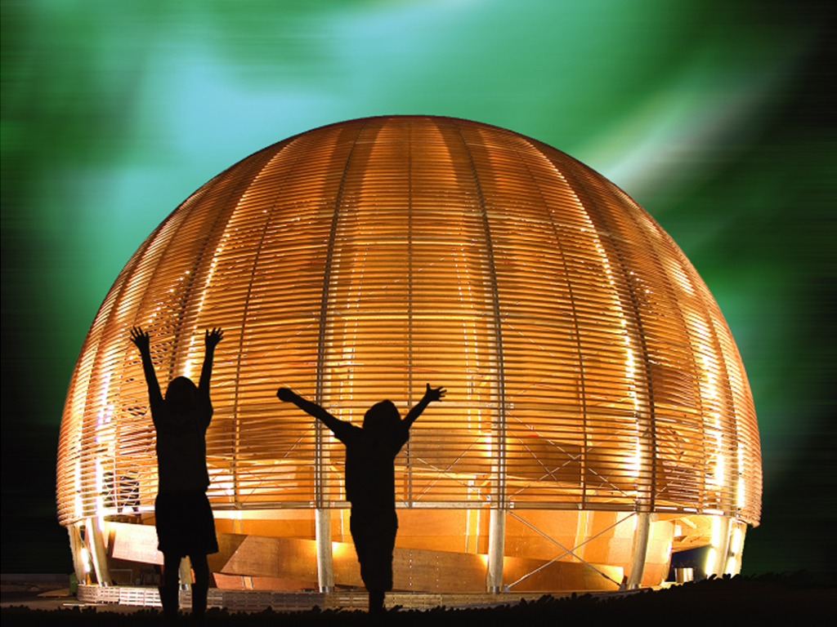
A Physicist Journey from CERN to the Financial Industry
Dr. Maneesh Wadhwa
SIX Swiss Exchange AG

Slide 2
Flash Back of last 12 years working at CERN
Integrate

Slide 3
Why I am telling you all this?
Do you realize?
  Skills and qualifications you attain while working at CERN are countless.
  You are able to do everything.
But still getting a job outside CERN is difficult?
Work with 5 different generations of computers and software
Application Engineer/ IT Developer
Business Analyst
Defend your Results in a conference and write your paper in Physics Letter B
Sales Manager
Marketing Manager
Collect large data and perform data analysis
Participate in Outreach activities; educate people why fundamental research is important
Upgrade or build new detectors
Strategy and Risk Management
Run experiment 24hr, 7/7
Operations

Slide 4
Why?
Corporate houses don’t believe that you can do everything?
Even your own Spouse doubts?
What is the magic to get a job outside CERN?
  Look for Ex-Brotherhood or Ex-Sisterhood through your network
  Use today’s social network LinkedIn, XING, Facebook, Orkut, etc
  Ex- understand your Intellectual and Emotional level
  This is your best point of entry
If you search on LinkedIn, your Brotherhood and Sisterhood with Past company “CERN”
*Source LinkedIn 06 December 2013

Slide 5
My exit to SIX Swiss Exchange
Mini CERN Exists
Through a colleague from Basel University Dr. Guido Polivka
At SIX Swiss Exchange, Geneva office, we have mini CERN:
  Dr. Torsten Layda started Geneva office in 1994
  7 colleagues from CERN (in the past it was 10)
  Physicists and Engineers from Dirac, LEP, WA79 (Charm II) and Computing Division
  Spouses of 3 are still working at CERN
  Servers are called Lepton, Boson, Higgs, Tachyon, etc
Physics is still on our menu everyday!
UBS
SwissRe
Swissquote
Credit Suisse
Julius Baer
Lombard Odier
Etat de Geneve
Cisco
BKW Energie
Microsoft
Google
Shell
SIX Swiss Exchange

Slide 6

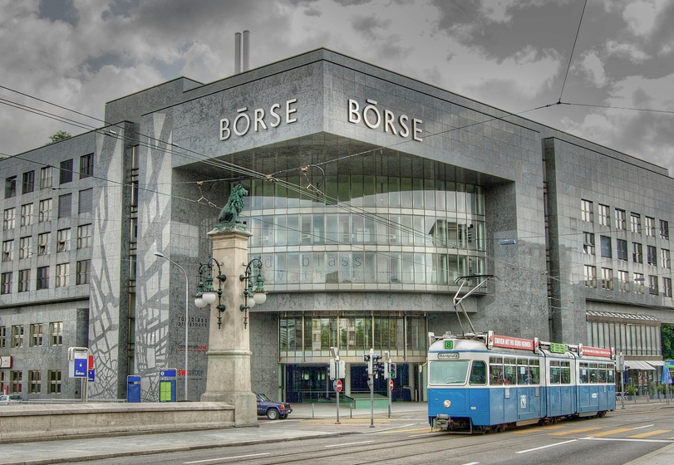
Brief overview of SIX Swiss Exchange (1)
SIX Swiss Exchange is based in Zurich is Switzerland’s principal stock exchange, trading
  Stock options (Equities, Exchange Traded Funds)
  Government Bonds
  Derivatives
SIX Swiss Exchange was the first exchange in the world to incorporate a fully automated trading in 1995.
Exchange is prominent known principally for the Swiss Market Index (SMI) - Blue Chip Index
Presently fastest exchange in the world
  37μsec is all it takes to execute a trade on the trading platform
SIX Swiss Exchange Video

Slide 7
Brief overview of SIX Swiss Exchange (2)
What we do
  launching innovative new products
  improvement in technology to connect to the Exchange
  making sure regulatory requirements are met
With one goal to be the leader in the world of Exchanges
  producing excellent results, increase EBIT every year
  success for our customers
Customer success is our success
versus
CERN bring success to mankind !

Slide 8

Typical day at SIX Swiss Exchange
Every day 8:30 hrs of trading from 9:00 – 17:30 :
  During trading, Up’s and Down’s
  Strange events also take place especially when there is breaking news
  Bullish = Market is Charming and everyone is happy
  Bearish= The confidence in the market reaches Bottom
  There is hope market will Topple the very next day..
And you all know how difficult it has been to discover Top Quark.
Toppling takes time:
  Europe is going through recession
  New Standard Model is required to rescue Europe!
  Economic Bosons W, Z and Higgs are still not discovered!!
z
W
H

Slide 9
Step Ahead
Your skills are very important in changing the world
Marketing Manager
Strategy and Risk
IT Developer
Operational Manager
Business Analyst
Application Engineer
Physicist = Singularity
“Any fool can know. The point is to understand.”
- Albert Einstein

Slide 10
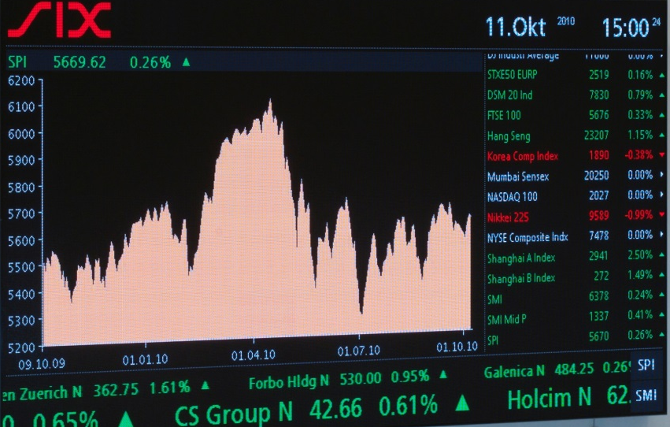
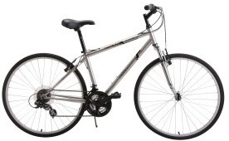
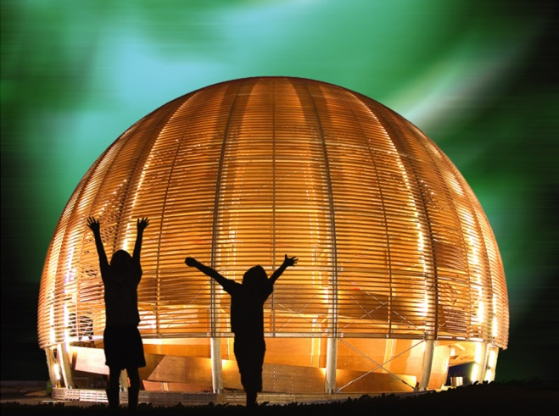
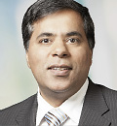
Thank You
Dr. Maneesh Wadhwa

