Slide 1
ESnet Update: A somewhat random collection of (hopefully) interesting topics.
Brian L Tierney
ESnet, Lawrence Berkeley National Laboratory

Slide 2
ScienceDMZ and other ESnet Updates

Slide 3



Science DMZ Summary
Consists of three key components, all required:
“Friction free” network path
  Highly capable network devices (wire-speed, deep queues)
  Virtual circuit connectivity option
  Security policy and enforcement specific to science workflows
  Located at or near site perimeter if possible
Dedicated, high-performance Data Transfer Nodes (DTNs)
  Hardware, operating system, libraries all optimized for transfer
  Includes optimized data transfer tools such as Globus Online and GridFTP
Performance measurement/test node
  perfSONAR
  Details at http://fasterdata.es.net/science-dmz/

Slide 4

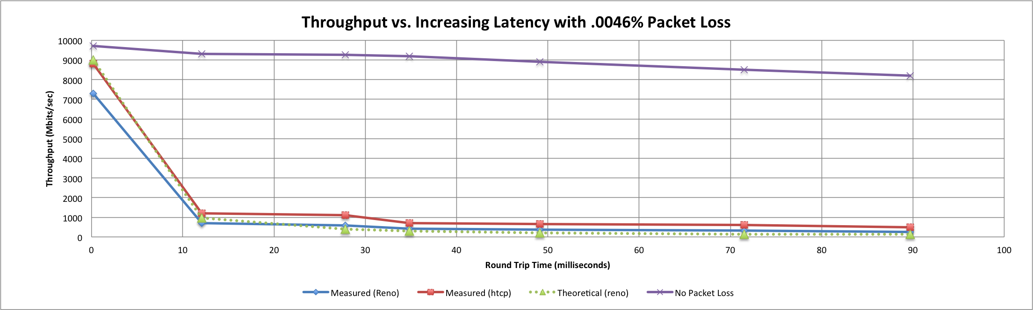
A small amount of packet loss makes a huge difference in TCP performance
Local
(LAN)
With loss, high performance beyond metro distances is essentially impossible
International
Metro Area
Regional
Continental
Measured (TCP Reno)
Measured (HTCP)
Theoretical (TCP Reno)
Measured (no loss)
Notes:
Beyond your metro area, zero loss is essentially required for performance
Where are your collaborators? Where are your users?
When global collaboration is the norm, nobody can afford to be a local-only resource

Slide 5
The Data Transfer Trifecta:
The Science DMZ Model
Dedicated Systems for Data Transfer
Performance Testing & Measurement
Network Architecture
  Data Transfer Node
High performance
Configured for data transfer
Proper tools, such as Globus Online
Science DMZ
Dedicated location for DTN
Proper security
Easy to deploy - no need to redesign the whole network
Additional info: http://fasterdata.es.net/
perfSONAR
Enables fault isolation
Verify correct operation
Widely deployed in ESnet and other networks, as well as sites and facilities
Notes:
This is a bit different than the way a lot of folks do things
Many collaborations are beyond the point where the default system and network configurations will work for data transfer.
Several groups at the ALS are adopting these techniques.
You wouldn’t expect to be able to use a supercomputer without investing some time in figuring out how to drive it – the same goes for high-performance data transfers. Supercomputer centers have consultants to help you do that – so do networks (that’s us, the outreach group)

Slide 6

ESnet Outreach Program
Education/Consultation
  Science DMZ Architecture
  perfSONAR
  Network performance troubleshooting
  Data Transfer Nodes
    data transfer tools
  Tutorials
  Fasterdata.es.net
  Contact: engage@es.net

Slide 7
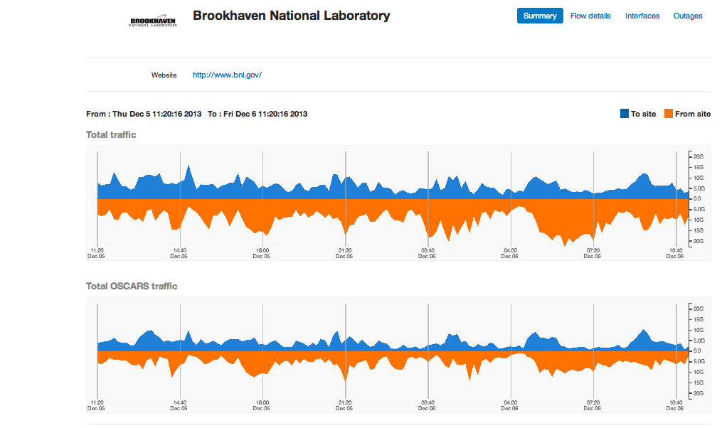
my.es.net example: BNL

Slide 8
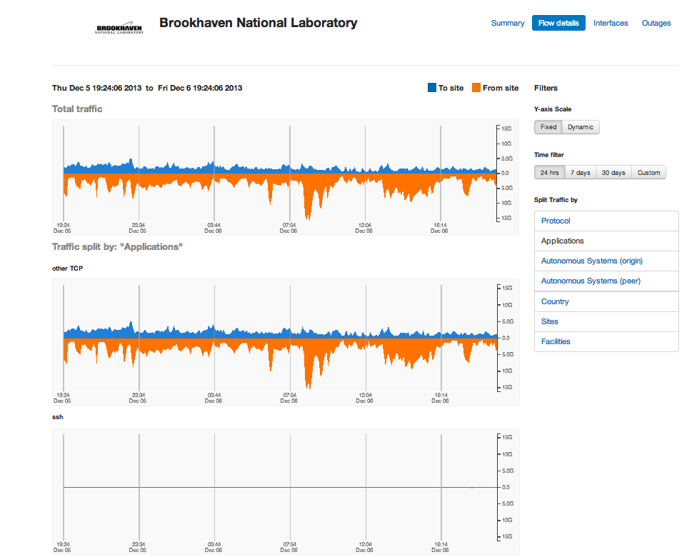
my.es.net example: BNL

Slide 9
US LHC 100G sites (currently or very soon)
Tier-1 Sites:
  BNL
  FNAL
Tier-2 Sites:
  University of Chicago
  Indiana University
  Boston University
  Harvard University
  University of Nebraska
  University of Michigan
  University of Illinois
  Caltech
  Univ Florida
  UCSD
  others?

Slide 10
bwctl + iperf3 example
bwctl -T iperf3 -c nettest.lbl.gov -i1 –v
[ ID] Interval Transfer Bandwidth Retransmits
[ 16] 0.00-1.00 sec 109 MBytes 912 Mbits/sec 129
[ 16] 1.00-2.00 sec 109 MBytes 912 Mbits/sec 0
[ 16] 2.00-3.00 sec 98.8 MBytes 828 Mbits/sec 0
[ 16] 3.00-4.00 sec 93.8 MBytes 786 Mbits/sec 0
[ 16] 4.00-5.00 sec 88.8 MBytes 744 Mbits/sec 24
[ 16] 5.00-6.00 sec 85.0 MBytes 712 Mbits/sec 0
Test Complete. Summary Results:
Sent: [ 16] 0.00-10.00 sec 950 MBytes 797 Mbits/sec 161
Recvd: [ 16] 0.00-10.00 sec 955 MBytes 801 Mbits/sec
Host CPU Utilization: 98.0%
Remote CPU Utilization: 71.5%
iperf Done.

Slide 11
perfSONAR Update

Slide 12
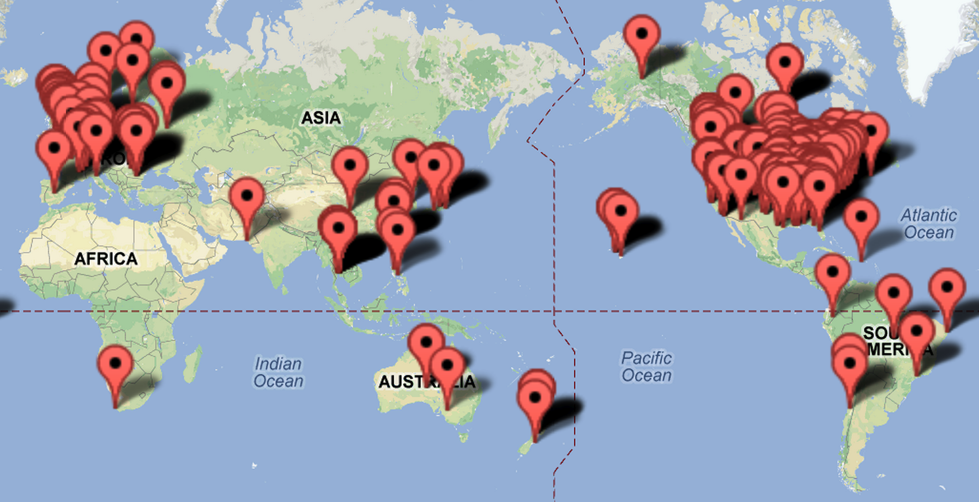
World-Wide perfSONAR-PS Deployments:
695 bwctl, 734 owamp registered nodes as of Dec ‘13

Slide 13
perfSONAR Update
perfSONAR-PS 3.3.2 rc1 came out this week
Includes a few bug fixes, and some security enhancements
iptables now on by default
fail2ban host IDS
updated versions of bwctl, iperf3, and nuttcp
http://psps.perfsonar.net/toolkit/releasenotes/pspt-3_3_2rc3.html

Slide 14
Increase in perfSONAR developers
Internet2 has re-added the 1FTE that went away for a while
Indiana GR-NOC will be providing 1.5FTE starting next year
perfSONAR-PS and perfSONAR MDM will likely be combined
  will be just called ‘perfSONAR’ in the future
  more developers in Europe
    exact role TBD

Slide 15
perfSONAR Roadmap https://code.google.com/p/perfsonar-ps/wiki/RoadMap
perfSONAR node Cost Reduction: Support both latency testing and throughput testing on the same host
Extensibility and Ease of Use: Adding REST APIs for all components will make it much easier for others to extend perfSONAR.
Documentation overhaul
Additional Troubleshooting Capabilities: e,g.: ability to collect and store TCP retransmit information. Better GUIs are needed as well, but we still need to find a good GUI developer.
Enhanced NOC support: details TBD based on discussions with various NOCs.
Enhanced Release Management: utilize automated build/test systems such as OSG uses
Release Roadmap
3.3.2: Bug Fix release, December 2013
3.4: Next major release that includes deliverable #1 and part of #4: March 2014
3.4.1 Bug fix release: May 2014
3.5 Next major release that includes deliverable #2, #5, July 2014
3.6: Next major release that includes deliverables #4, #6, Fall 2014

Slide 16
Iperf3: https://code.google.com/p/iperf/
iperf3 is a new implementation from scratch, with the goal of a smaller, simpler code base, and a library version of the functionality that can be used in other programs.
Some new features in iperf3 include:
  reports the number of TCP packets that were retransmitted
  reports the average CPU utilization of the client and server (-V flag)
  support for zero copy TCP (-Z flag)
  JSON output format (-J flag)
  “omit” flag: ignore the first N seconds in the results
More at: http://fasterdata.es.net/performance-testing/network-troubleshooting-tools/iperf-and-iperf3/

Slide 17
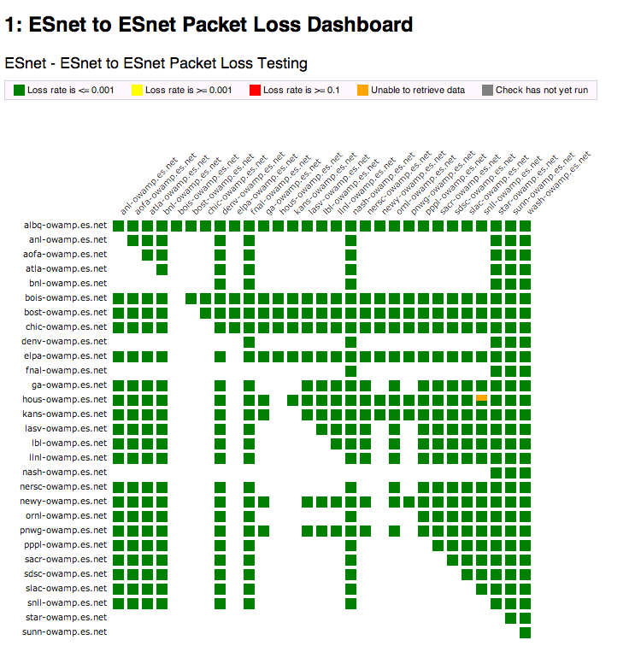
perfSONAR Dashboard
Status at-a-glance
Packet loss
Throughput
Current live instance at http://ps-dashboard.es.net/
Drill-down capabilities
Test history between hosts
Ability to correlate with other events
Very valuable for fault localization

Slide 18
SC13 Results
(slides from Azher Mughal, Caltech)

Slide 19
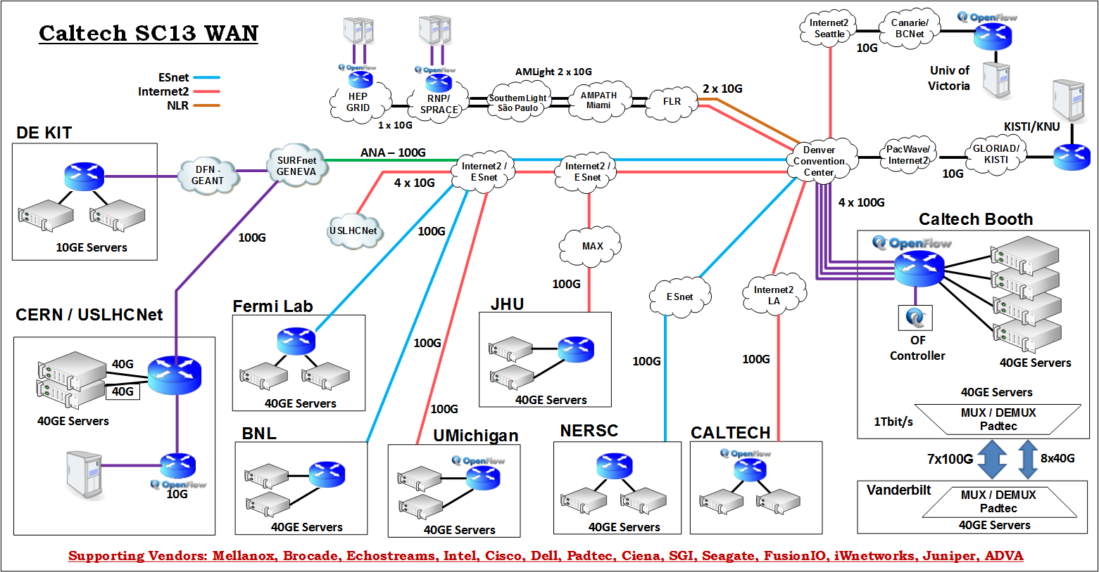
WAN Network Layout

Slide 20
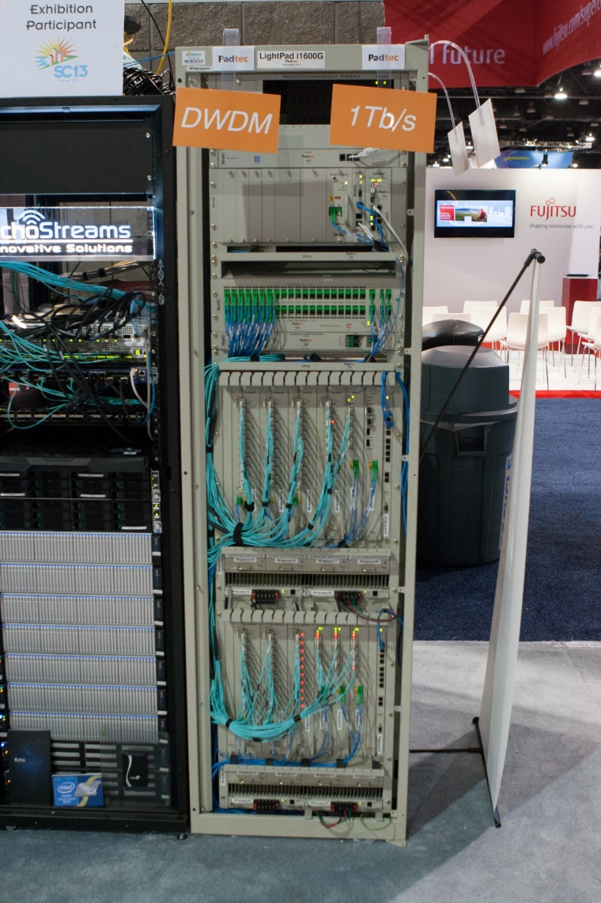
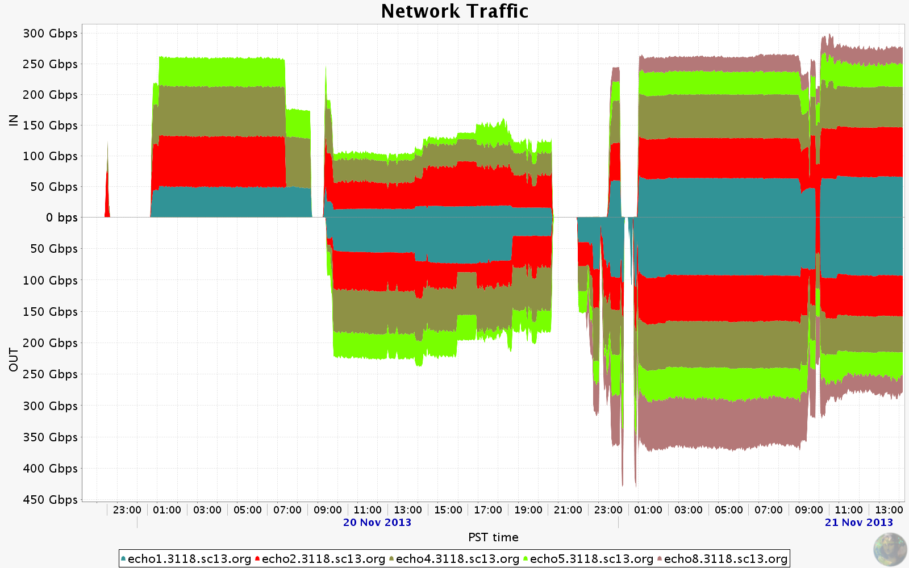
TeraBit Demo
7x 100G links
8 x 40G links

Slide 21
SC13 Results
SC13 – DE-KIT
- 75Gb from Disk to Disk (couple of servers at KIT – Two servers at SC13)
SC13 BNL over ESnet:
- 80G over two pair of hosts, memory to memory
NERSC to SC13 over ESnet:
- Lots of packet loss at first, then removed the Mellanox switch from the path, and then the path was clean
- Consistent 90Gbps, reading from 2 SSD host sending to single host in the booth.
SC13 to FNAL over ESnet:
- Lots of packet loss; TCP max around 5Gbps, but UDP could do 15G per flow.
- Used 'tc' to pace TCP, and then at least single stream TCP behaved well up to 8G.
But using multiple streams was still a problem. This seems to indicate something in the path with too small buffers, but we never figured out what.
SC13 – Pasadena Internet2:
- 80G read from the disks and write on the servers (disk to memory transfer). Link was lossy the other way.
SC13 – CERN over ESnet:
- About 75Gb memory to memory. Disks about 40Gb

Slide 22
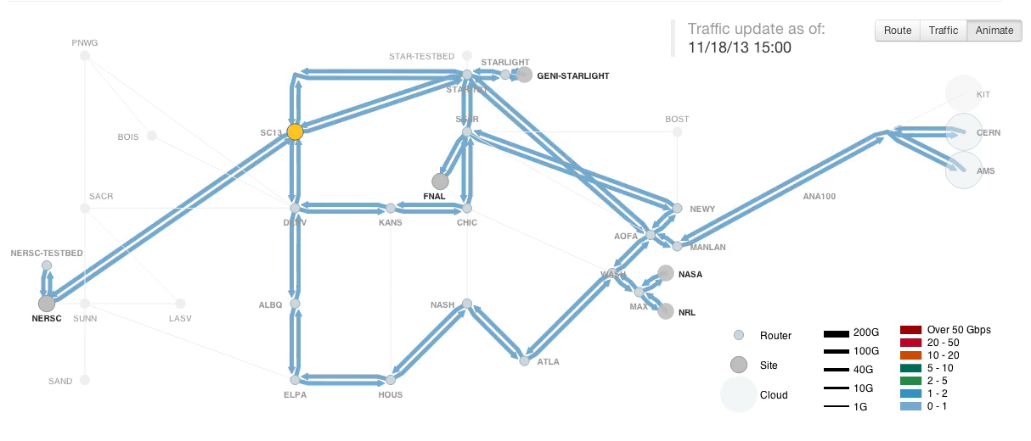
SC13 Traffic Animation: https://my.es.net/demos/sc13

Slide 23
Other Technical Topics

Slide 24
Speed Mismatch Issues
More and more often we are seeing problems sending from a faster host to a slower host
  This can look like a network problem (lots of TCP retransmits)
  The network is rarely the bottleneck anymore for many sites
This may be true for:
  10G to 1G host
  10G host to a 2G circuit
  40G to 10G host
  Fast host to slower host
Pacing at the application level does not help
The linux ‘tc’ command does help
  But only up to speeds of 8Gbps
  And perhaps this will just mask problems with under-buffered switches?
http://fasterdata.es.net/host-tuning/packet-pacing/

Slide 25
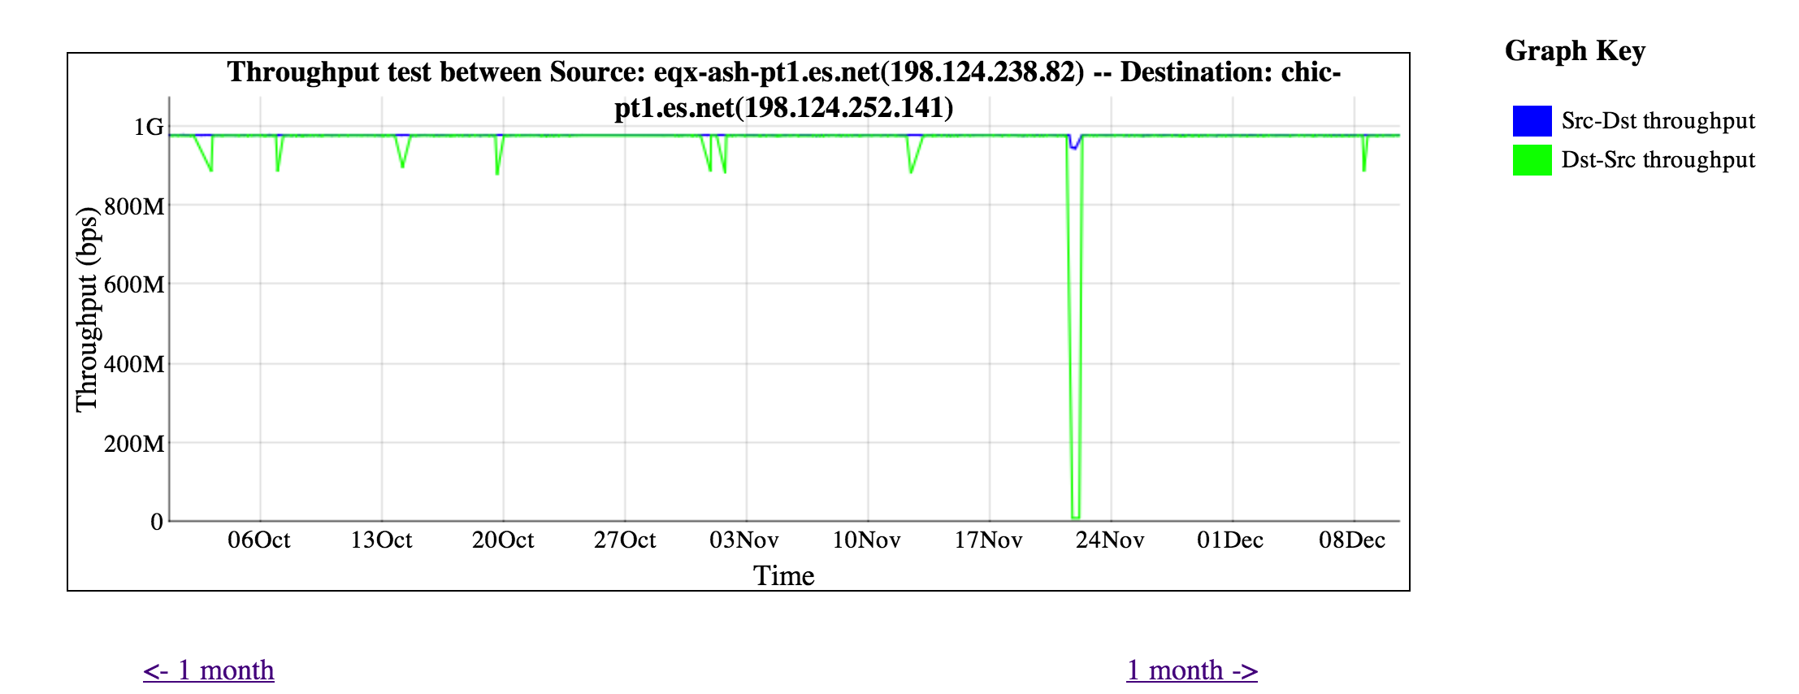
But 10G to 1G can work just fine too….

Slide 26
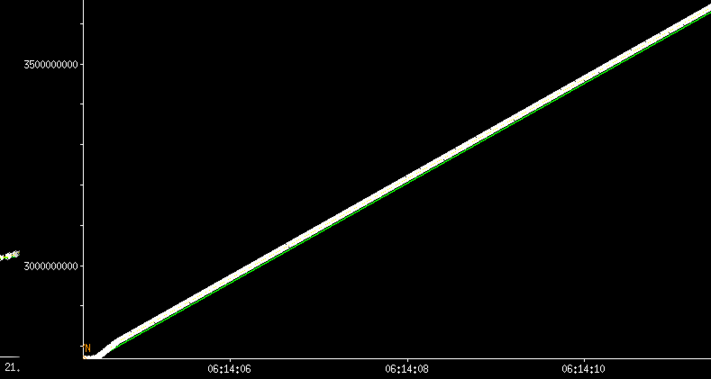
Compare tcpdumps: kans-pt1.es.net (10G) to eqx-chi-pt1.es.net (1G)

Slide 27
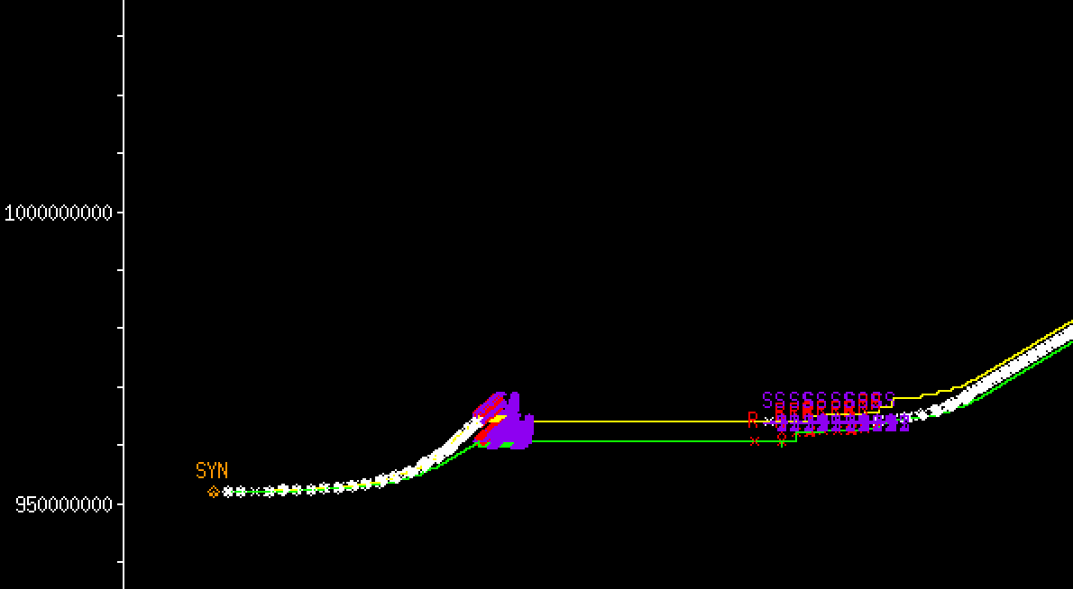
Compare tcpdumps kans-pt1.es.net (10G) to uct2-net4.uchicago.edu (1G)

Slide 28
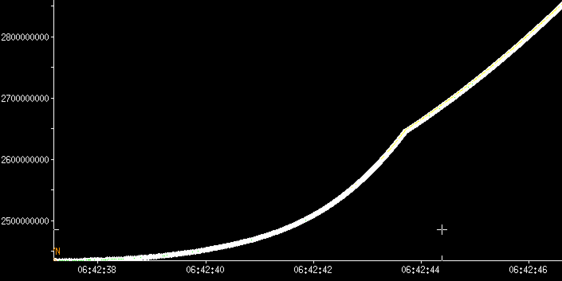
Compare tcpdumps kans-pt1.es.net (10G) to uct2-net4.uchicago.edu (1G) with pacing

Slide 29
40G Lessons Learned
Tuning for 40G is not just 4x Tuning for 10G
Some of the conventional wisdom for 10G Networking is not true at 40Gbps
e.g.: Parallel streams more likely to hurt than help
UDP needs to be tuned too
“Sandy Bridge” Architectures require extra tuning as well
Lots of details at http://fasterdata.es.net/science-dmz/DTN/tuning/

Slide 30
Sample results: TCP Single vs Parallel Streams
1 stream: iperf3 -c 192.168.102.9
[ ID] Interval Transfer Bandwidth Retransmits
[ 4] 0.00-1.00 sec 3.19 GBytes 27.4 Gbits/sec 0
[ 4] 1.00-2.00 sec 3.35 GBytes 28.8 Gbits/sec 0
[ 4] 2.00-3.00 sec 3.35 GBytes 28.8 Gbits/sec 0
[ 4] 3.00-4.00 sec 3.35 GBytes 28.8 Gbits/sec 0
[ 4] 4.00-5.00 sec 3.35 GBytes 28.8 Gbits/sec 0
2 streams: iperf3 -c 192.168.102.9 -P2
[ ID] Interval Transfer Bandwidth Retransmits
[ 4] 0.00-1.00 sec 1.37 GBytes 11.8 Gbits/sec 7
[ 6] 0.00-1.00 sec 1.38 GBytes 11.8 Gbits/sec 11
[SUM] 0.00-1.00 sec 2.75 GBytes 23.6 Gbits/sec 18
……
- - - - - - - - - - - - - - - - - - - - - - - - -
[ 4] 8.00-9.00 sec 1.43 GBytes 12.3 Gbits/sec 8
[ 6] 8.00-9.00 sec 1.42 GBytes 12.2 Gbits/sec 7
[SUM] 8.00-9.00 sec 2.85 GBytes 24.5 Gbits/sec 15
- - - - - - - - - - - - - - - - - - - - - - - - -
[ 4] 9.00-10.00 sec 1.43 GBytes 12.3 Gbits/sec 4
[ 6] 9.00-10.00 sec 1.43 GBytes 12.3 Gbits/sec 6
[SUM] 9.00-10.00 sec 2.86 GBytes 24.6 Gbits/sec 10
- - - - - - - - - - - - - - - - - - - - - - - - -
[ ID] Interval Transfer Bandwidth Retransmits
[ 4] 0.00-10.00 sec 13.8 GBytes 11.9 Gbits/sec 78 sender
[ 4] 0.00-10.00 sec 13.8 GBytes 11.9 Gbits/sec receiver
[ 6] 0.00-10.00 sec 13.8 GBytes 11.9 Gbits/sec 95 sender
[ 6] 0.00-10.00 sec 13.8 GBytes 11.9 Gbits/sec receiver
[SUM] 0.00-10.00 sec 27.6 GBytes 23.7 Gbits/sec 173 sender
[SUM] 0.00-10.00 sec 27.6 GBytes 23.7 Gbits/sec receiver
iperf3: https://code.google.com/p/iperf/

Slide 31
Sample results: TCP On Intel “Sandy Bridge” Motherboards
30% Improvement using the right core!
nuttcp -i 192.168.2.32
2435.5625 MB / 1.00 sec = 20429.9371 Mbps 0 retrans
2445.1875 MB / 1.00 sec = 20511.4323 Mbps 0 retrans
2443.8750 MB / 1.00 sec = 20501.2424 Mbps 0 retrans
2447.4375 MB / 1.00 sec = 20531.1276 Mbps 0 retrans
2449.1250 MB / 1.00 sec = 20544.7085 Mbps 0 retrans
nuttcp -i1 -xc 2/2 192.168.2.32
3634.8750 MB / 1.00 sec = 30491.2671 Mbps 0 retrans
3723.8125 MB / 1.00 sec = 31237.6346 Mbps 0 retrans
3724.7500 MB / 1.00 sec = 31245.5301 Mbps 0 retrans
3721.7500 MB / 1.00 sec = 31219.8335 Mbps 0 retrans
3723.7500 MB / 1.00 sec = 31237.6413 Mbps 0 retrans
nuttcp: http://lcp.nrl.navy.mil/nuttcp/beta/nuttcp-7.2.1.c

Slide 32
Sample results: TCP On Intel “Sandy Bridge” Motherboards: Fast host to Slower Host
Intel(R) Xeon(R) CPU 2.90GHz to 2.00GHz
nuttcp -i1 192.168.2.31
410.7500 MB / 1.00 sec = 3445.5139 Mbps 0 retrans
339.5625 MB / 1.00 sec = 2848.4966 Mbps 0 retrans
354.5625 MB / 1.00 sec = 2974.2888 Mbps 350 retrans
326.3125 MB / 1.00 sec = 2737.3022 Mbps 0 retrans
377.7500 MB / 1.00 sec = 3168.8220 Mbps 179 retrans
nuttcp –r -i1 192.168.2.31 (reverse direction)
2091.0625 MB / 1.00 sec = 17540.8230 Mbps 0 retrans
2106.7500 MB / 1.00 sec = 17672.0814 Mbps 0 retrans
2103.6250 MB / 1.00 sec = 17647.0326 Mbps 0 retrans
2086.7500 MB / 1.00 sec = 17504.7702 Mbps 0 retrans

Slide 33
LHCONE
(slides from Mike O’Conner, ESnet)

Slide 34
LHCONE Collaborating NSPs
and Compute Centers
CANET(6509)
BCNET(271)
UTORONTO(239)
UVIC(16462)
MCGILL(15318)
TRIUMF(36391)
UALBERTA(3359)
ESNET(293)
FNAL(3152)
BNL(43)
SLAC(3671)
I2(11537)
UIUC(38)
UNL(7896)
MIT(3)
AGLT2(229)
MICH-Z(230)
UOC(160)
CSUNET(2153) ULTRALIGHT(32361)
VANDERBILT(39590)
INDIAN(19782)
IUPUI(10680)
CERN-LHC1(20641)
CERN-WIGNER(61339)
CERN(513)
DFN(680)
KIT(34878)
DESY(1754)
GEANT(20965)
ROEDUNET(2614)
ASGARR(137)
ARNES-NET(2107)
CZECH-ACAD-SCI(2852)
LHC1-RENATER(2091)
IN2P3(789)
CEA-SACLAY(777)
NORDUNET(2603)
NDGF(39590)
North America
Europe

Slide 35
Migration to 100GE Substrate
LHCONE is deployed primarily over shared infrastructure.
All participating NSPs have either upgraded, or are in the process of upgrading their core networks to 100GE circuits.
Single 10GE circuits that transport LHCONE along with other traffic are likely to experience periods of saturation.
NSPs should identify their remaining non-aggregated10GE segments and plan to eliminate them, this includes inter domain connections used for BGP peering.
A 100G network substrate will be essential for deploying various kinds of virtualized networks to address the needs of the growing number of distributed scientific collaborations world-wide.

Slide 36
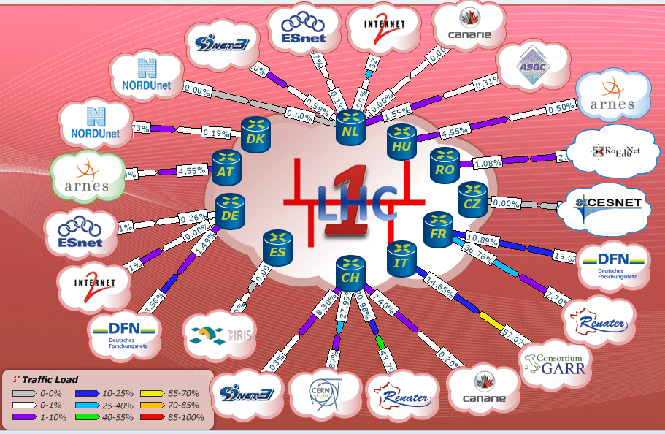
LHCONE in Europe: GEANT:
(from Mian Usman’s talk at last week’s LHCONE meeting: http://indico.cern.ch/conferenceDisplay.py?confId=269840
Notes:
36

Slide 37
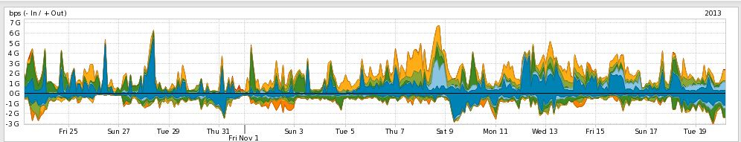
LHCONE and ESNet
Configured as L3VPN VRF and connects following sites:
  BNL (Atlas T1) FNAL (CMS T1) SLAC (ATLAS T2)
ESNet LHCONE VRF peers with Internet2, GEANT, NORDUNET, CERNLight and CANARIE LHCONE VRF
ESNET is present at StarLight, MANLAN, WIX and PNWG
Aggregate peak traffic in ESNET LHCONE VRF ~10Gbps
Notes:
37

Slide 38
LHC perfSONAR MPs
Tier | Type | Hostname | IP address
RAL | Latency: | perfsonar-ps02.gridpp.rl.ac.uk | 130.246.179.197
 | Bandwidth: | perfsonar-ps01.gridpp.rl.ac.uk | 130.246.179.196
CC-IN2P3 | Latency: | ccperfsonar2-lhcopn.in2p3.fr | 193.48.99.78
 | Bandwidth: | ccperfsonar-lhcopn.in2p3.fr | 193.48.99.79
CERN | Latency: | perfsonar-ps2.cern.ch | 128.142.223.237
 | Bandwidth: | perfsonar-ps.cern.ch | 128.142.223.236
TRIUMF | Latency: | ps-latency.lhcopn-mon.triumf.ca | 206.12.9.71
 | Bandwidth: | ps-bandwidth.lhcopn-mon.triumf.ca | 206.12.9.70
SARA | Latency: | ps.lhcopn-ps.sara.nl | 145.100.17.9
 | Bandwidth: | ps.lhcopn-ps.sara.nl | 145.100.17.9
ASGC | Latency: | lhc-latency.twgrid.org | 117.103.105.188
 | Bandwidth: | lhc-bandwidth.twgrid.org | 117.103.105.187
BNL | Latency: | lhcperfmon.bnl.gov | 192.12.15.26
 | Bandwidth: | lhcmon.bnl.gov | 192.12.15.23
CNAF | Latency: | perfsonar-ps.cnaf.infn.it | 131.154.254.11
 | Bandwidth: | perfsonar-ow.cnaf.infn.it | 131.154.254.12
NDGF | Latency: | perfsonar-ps.ndgf.org | 109.105.124.86
 | Bandwidth: | perfsonar-ps2.ndgf.org | 109.105.124.88
PIC | Latency: | psl01.pic.es | 193.109.172.188
 | Bandwidth: | psb01.pic.es | 193.109.172.187
FNAL | Latency: | psonar2.fnal.gov | 131.225.205.141
 | Bandwidth: | psonar1.fnal.gov | 131.225.205.139
KIT | Latency: | perfsonar2-de-kit.gridka.de | 192.108.47.12
 | Bandwidth: | perfsonar-de-kit.gridka.de | 192.108.47.6
LHCONE
Reachable
None of these MPs are located within NRENs.
Note: ESnet is considering deployment of dedicated LHCONE perfSONAR Infrastructure at STARLIGHT, MANLAN, and WIX.

Slide 39
LHCONE Summary
LHCONE is critical to get to EU sites
with new Atlas compute model that is less hierarchal, this is even more important
More 100G sites are coming online soon
Need to redesign your site architecture to deal with this?
do you have a Science DMZ?
Email engage@es.net if you want help

Slide 40
Questions?
Thanks!
Brian Tierney, bltierney@es.net or engage@es.net
http://www.es.net/
http://fasterdata.es.net/

Slide 41
Extra Slides

Slide 42
100Gbps Networks
Network Engineering Perspective
Eli Dart, Joe Metzger
100 Gbps transatlantic science trials workshop at SC13
Denver, CO
November 18, 2013

Slide 43
Experience With 100G Equipment
ESnet experiences
  Advanced Networking Initiative
  ESnet5 production 100G network
  Helping other people debug their stuff
Important takeaways
  R&E requirements are outside the design spec for most gear
    Results in platform limitations – sometimes can’t be fixed
    You need to be able to identify those limitations before you buy
  R&E requirements are outside the test scenarios for most vendors
    Bugs show up when R&E workload is applied
    You need to be able to troubleshoot those scenarios

Slide 44
Platform Limitations
We have seen significant limitations in 100G equipment from all vendors with a major presence in R&E
  100G single flow not supported
    Channelized forwarding plane
    Unexplained limitations
    Sometimes the senior sales engineers don’t know!
  Non-determinism in the forwarding plane
    Performance depends on features used (i.e. config-dependent)
    Packet loss that doesn’t show up in counters anywhere
If you can’t find it, nobody will tell you about it
  Vendors don’t know or won’t say
  Watch how you write your procurements
Second-generation equipment has proven to be much better
Vendors have been responsive in rolling new code to fix problems

Slide 45
They Don’t Test For This Stuff
Most sales engineers and support engineers don’t have access to 100G test equipment
  It’s expensive
  Setup of scenarios is time-consuming
R&E traffic profile is different than their standard model
  IMIX (Internet Mix) traffic is normal test profile
    Aggregate web browsers, email, YouTube, Netflix, etc.
    Large flow count, low per-flow bandwidth
    This is to be expected – that’s where the market is
  R&E shops are the ones that get the testing done for R&E profile
    SCinet provides huge value
    But, in the end, it’s up to us

Slide 46
New Technology, New Bugs
Bugs happen.
  Data integrity (traffic forwarded, but with altered data payload)
  Packet loss
  Interface wedge
  Optics flaps
Monitoring systems are indispensable
Finding and fixing issues is sometimes hard
  Rough guess – difficulty exponent is degrees of freedom
    Vendors/platforms, administrative domains, time zones
Takeaway – don’t skimp on test gear (at least maintain your perfSONAR boxes)

Slide 47
Design For Easy Debug
International circuits often have special circumstances
  Undersea cables
  Multiple administrative domains for one circuit
These things can make debugging harder than for terrestrial circuits
TCP loss impact and other issues are more damaging
It must be easy to run tests on international circuits
  Regular monitoring with perfSONAR
  As-needed testing for debugging specific issues

Slide 48
Workflow Decomposition
Many people still think in terms of one program running inside one system image on one computer
Workflows that process tens of terabytes of data must work differently
What does your workflow look like?
  What produces the data?
  Where is the storage?
  What does the analysis? (What storage goes with analysis?)
  Where can data be reduced?
  What can be automated?
Different components have different requirements
Proper decomposition can have significant benefits

Slide 49
Component Reuse
Many people understand about software reuse
Not many people understand workflow component reuse
Do you really want to re-invent the wheel?
  High-speed data transfer (Globus)
  Integration of virtualized components (OpenStack)
  Volume rendering, feature detection, FFT, CFD, …
Many scientists/experiments think they are a unique snowflake
  In some ways they are
  However, there is a set of tasks common to many workflows
Find your commonalities and exploit them – we can’t scale otherwise

Slide 50
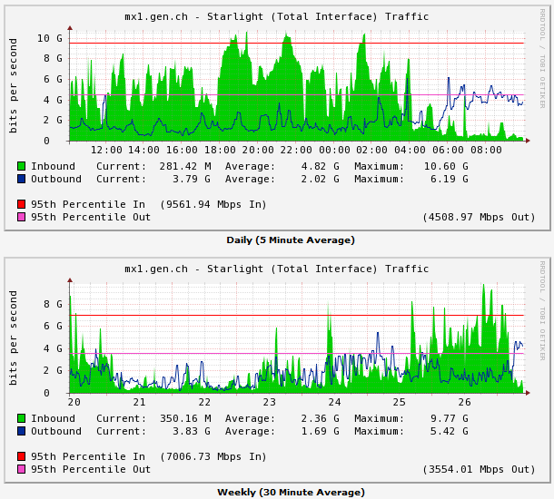
Trans-Atlantic Links
NORDUNET ~ 1.5Gbps peaks
NREN funded LHCONE dedicated links ~12Gbps peaks
ACE and GEANT funded shared links ~8Gbps
USLHCNET LHCONE dedicated link ~
Notes:
50

Slide 51
LHCONE in Open Exchanges
 | MANLAN | StarLight | WIX | NetherLight | CERNLight
GEANT
NORDUnet
Internet2
ESnet
CANARIE
ASGC

Slide 52
  The LHC’s Open Network Environment – LHCONE
LHCONE provides a private, managed infrastructure designed for LHC Tier 2 traffic (and likely other large-data science projects in the future)
The approach is an overlay network whose architecture is
  A collection of routed “clouds” using address spaces restricted to subnets that are used by LHC systems
    The clouds are mostly local to a network domain (e.g. one for each involved domain – ESnet, GEANT (“fronts” for the NRENs), Internet2 (fronts for the US universities), etc.
  The clouds (VRFs) are interconnected by point-to-point circuits provided by various entities (mostly the domains involved)
In this way the LHC traffic will use circuits designated by the network engineers
  To ensure continued good performance for the LHC and to ensure that other traffic is not impacted – this is critical because apart from the LHCOPN, the R&E networks are funded for the benefit of the entire R&E community, not just the LHC

Slide 53




















LHCONE: A global infrastructure for the LHC Tier1 data center – Tier 2 analysis center connectivity
SimFraU
NDGF-T1a
UVic
UAlb
NDGF-T1a
NDGF-T1c
UTor
NIKHEF-T1
NORDUnet
Nordic
TRIUMF-T1
CANARIE
Canada
McGilU
SARA
Netherlands
Korea
CERN-T1
KISTI
Korea
UMich
CERN
Geneva
UltraLight
Amsterdam
TIFR
India
Geneva
Chicago
KNU
DESY
KERONET2
Korea
GSI
DE-KIT-T1
SLAC
DFN
Germany
ESnet
USA
New York
India
Seattle
FNAL-T1
BNL-T1
ASGC-T1
GÉANT
Europe
ASGC
Taiwan
UCSD
Caltech
NE
Washington
UWisc
UFlorida
SoW
CC-IN2P3-T1
NCU
NTU
PurU
UNeb
MidW
Sub-IN2P3
TWAREN
Taiwan
MIT
GLakes
GRIF-IN2P3
RENATER
France
CEA
Internet2
USA
Harvard
PIC-T1
INFN-Nap
CNAF-T1
RedIRIS
Spain
GARR
Italy
UNAM
LHCONE VRF domain
End sites – LHC Tier 2 or Tier 3 unless indicated as Tier 1
Regional R&E communication nexus
Data communication links, 10, 20, and 30 Gb/s
See http://lhcone.net for details.
CUDI
Mexico
NTU
Chicago
April 2012

Slide 54
  The LHC’s Open Network Environment – LHCONE
LHCONE could be set up relatively “quickly” because
  The VRF technology is a standard capability in most core routers, and
  there is capacity in the R&E community that can be made available for use by the LHC collaboration that cannot be made available for general R&E traffic
LHCONE is essentially built as a collection of private overlay networks (like VPNs) that are interconnected by managed links to form a global infrastructure where Tier 2 traffic will get good service and not interfere with general traffic
From the point of view of the end sites, they see a LHC-specific environment where they can reach all other LHC sites with good performance
See LHCONE.net

Slide 55
LHCONE is one part of the network infrastructure that supports the LHC
A Network Centric View of the LHC
detector
O(1-10) meter
1 PB/s
CERN →T1 | miles | kms
France | 350 | 565
Italy | 570 | 920
UK | 625 | 1000
Netherlands | 625 | 1000
Germany | 700 | 1185
Spain | 850 | 1400
Nordic | 1300 | 2100
USA – New York | 3900 | 6300
USA - Chicago | 4400 | 7100
Canada – BC | 5200 | 8400
Taiwan | 6100 | 9850
Level 1 and 2 triggers
O(10-100) meters
Level 3 trigger
O(1) km
CERN Computer Center
500-10,000 km
50 Gb/s (25Gb/s ATLAS, 25Gb/s CMS)
Universities/
physics
groups
Universities/
physics
groups
LHC Tier 1
Data Centers
Universities/
physics
groups
Universities/
physics
groups
Universities/
physics
groups
Universities/
physics
groups
Universities/
physics
groups
Taiwan
Canada
USA-Atlas
USA-CMS
Universities/
physics
groups
Universities/
physics
groups
Nordic
CERN
France
The LHC Open Network Environment
(LHCONE)
UK
Spain
Universities/
physics
groups
Universities/
physics
groups
Netherlands
Germany
Italy
This is intended to
indicate that the physics
groups now get their data
wherever it is most readily
available
Universities/
physics
groups
The LHC Optical Private Network (LHCOPN)
Universities/
physics
groups
Universities/
physics
groups
Universities/
physics
groups
Universities/
physics
groups
Universities/
physics
groups
LHC Tier 2 Analysis Centers

Slide 56
LHC Site Map

