Slide 1
Tier-3 Implementation Committee (T3IC)
US ATLAS Distributed Computing Workshop University of Arizona
December 11, 2013
Mark Neubauer
University of Illinois at Urbana-Champaign
Jason Nielsen
University of California at Santa-Cruz

Slide 2
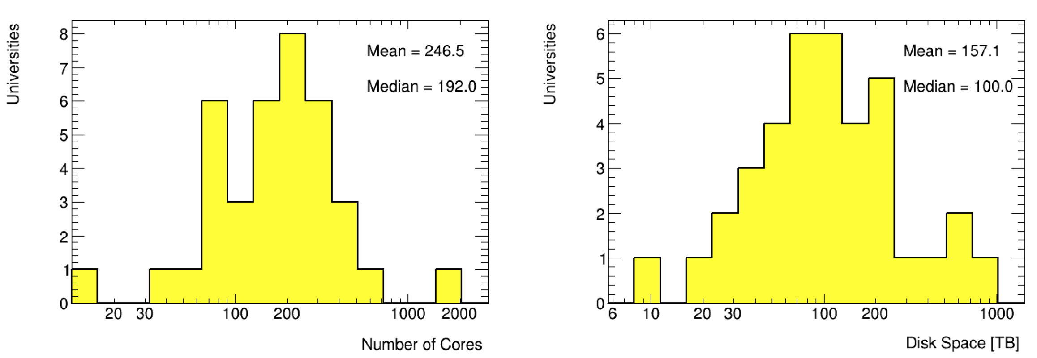
US ATLAS Tier-3s
90% of US universities consider Tier-3 computing as critical to their group’s productivity in ATLAS
The current deployment of the US Tier 3 computing was purchased using ARRA, MRI and university funds
  The majority of equipment was purchased in 2010, w/o replacement
Two committees reviewed the Tier-3s and produced a report
  2009 Tier-3 Task Force. Chair: Chip Brock
  2013 Tier-3 Task Force: Chairs: Jianming Qian and Gabriella Sciolla

Slide 3
2013 T3TF Report
Six recommendations, paraphrased below:
  Support the LT3Cs and make strong case for continued LT3C funding
  Provide mechanisms for Tier-3 jobs to expand onto resources outside of the LT3Cs when the LT3C resources are fully utilized. Invest in technologies that give Tier-3 functionality to institutions w/o an LT3C
  Support the use of WAN data access for Tier-3s
  Provide all users a sufficient amount of guaranteed storage space located at Tier-1/Tier-2s (where the batch computing resources are)
  Provide capability for users to direct, upon submission, their output from Grid jobs back to their local storage. Output should be retrievable with minimal delay after the batch job is completed
  Provide documentation and organize comprehensive tutorials to train interested users on how to take advantage of new analysis resource
Report also included needs estimates and possible solutions

Slide 4
Tier-3 Implementation Committee
Formed in November 2013 by US ATLAS Operations Program
Need for such a committee driven primarily by
  Desire from the US ATLAS Operations Program to formulate a specific plan-of-action to implement the core T3TF report recommendations, with estimates of any Ops-supported resources required
    The technological solutions discussion in the T3TF Report was deliberately short and vague, so as to leave that work to our committee where the expertise in the relevant areas is concentrated
  Desire from the funding agencies to receive a clear message from US ATLAS regarding needs and how future Tier-3 funding should be spent
Chairs: Mark Neubauer (Illinois) and Jason Nielsen (UCSC)
Members: D. Benjamin, K. De, M. Ernst, R. Gardner, G. Sciolla, E. Varnes, T. Wenaus.
Ex-officio: J. Cochran, S. Rajagopalan (Ops), C. Brock (US IB)

Slide 5
T3IC Charge
To carry out a comprehensive study that proposes a cost-effective implementation plan to address the T3 challenges. […] Among the questions and issues you should address are:
  Provide a best estimate of the computing capacities required to satisfy the physics analysis activities in the U.S. over the next five years
  Address how far the existing T3 infrastructure goes to accomplish these goals and how to make better use of all existing resources to support the U.S. physics analysis requirements
  Address the incremental capacities that are needed to provide adequate support for U.S. physics analysis
To be addressed in an interim report by December 15, 2013

Slide 6
T3IC Charge (cont.)
[…] Among the questions and issues you should address are:
  Identify potential implementation plans that address the T3 needs of U.S. ATLAS physicists and evaluate their cost-effectiveness. Your evaluation of the cost-effectiveness should take into account and identify any synergies, efficiencies, institutional or laboratory leveraging, potential for existing or additional funding sources, and possibly other intangibles. A final ranked comparison table should summarize the cost effectiveness of these plans.
  Identify how the T3 computing resources and personnel would be managed for (centrally, institutionally, etc) for each plan. This is important for any solutions that require Operations Program funds.
  Identify what can be accomplished within the current Operations Program budget guidance and prioritize additional requests if supplemental funding materializes (from Operations or other sources).
Full report due by February 28, 2014

Slide 7
T3IC Activities
The T3IC has met four times (~weekly) since being formed
It has been difficult at times to get everyone together for the weekly meeting due to busy travel schedules (particularly of late), but very productive discussions at meetings
Use of Google Drive to allow Committee members to upload material and other members to browse is working well
  Can easily pull this material for our reports and status talks
Primary activities thus far have been consideration of
  Estimate of resources required for physics analysis
  How extra resources help satisfy the analysis needs
  Cost-effectiveness of possible solutions
  Detailed implementation plans
First three charges

Slide 8
Resource Estimate
To address the first three points in the charge regarding the required resources for physics analysis, Doug, Kaushik, Mark, and Anyes were asked to provide more information on their typical analysis workflow. In particular,
  required (or actual) turnaround time (wall clock time)
  location of input
  size and location of output
  typical number of remote or local job slots used
  additional requirements or constraints on remote vs. local data
and, for each of the following analysis stages:
  skim of group D3PD to secondary D3PD (or small ntuple)
  loop over small ntuple to tune cuts, etc., and make plots
Several of these are now in the T3IC Google Drive area

Slide 9
Resource Estimate (cont.)
To scale to 100 fb⁻¹ of 14 TeV data, we need best estimates
  To be useful, estimates should be accurate to ~20-50%.
  We guess the scaling will be less than a simple x4 factor, but probably more than x2.
  What are some things we could do differently with x4 data?
  We will need a multiplicative factor for the number of workflows, including information on how they are shared among analyzers
    A rough way to do this is to count the number of analyses being performed in the US, which is not easy. We have a count of the number of notes with US contacts; maybe this is close enough
  What about MC generation, toyMC (pseudo-exp’s for stats interp?), etc?
    MC production on Tier-3 is probably small, given ATLAS central prod for MC
    Toy MC may not be small, also others like ME calculation, MVA training, etc
    Could lead to non-linear scaling w/ lumi. Decided to do linear estimate 1st
  Analysis model changes from AMSG need to be considered carefully

Slide 10
Resource Estimate (cont.)
In Dec 5 meeting, two of these workflows were discussed
  UC Irvine (Anyes): Detailed breakdown on a SUSY multilepton analysis
      Analysis workflow shared among 5-6 UCI analyzers who produce different results
      1st step is to produce skims from ~200 TB of NTUP_SUSYSKIM input
        Output of these grid jobs is ~0.8 TB, 60% of which is MC; Output brought to T3
      2nd step is to produce a private ntuple for plotting
        Desire ~2 hr turn-around, so that multiple passes can be made per day, requiring several 100 parallel jobs using 100 CPU-hours to accomplish
      3rd and final step is the plotting or limit calculation step, always on the Tier-3
  Duke (Doug): Overview of Top/SM dilepton analysis (AIDA)
      This analysis also performs a skim down to private ntuples that are about 6% of the NTUP_COMMON size. This skimming takes 800 CPU-hours on the Grid.
      Then the derived ntuple analysis on the Tier 3 takes about 6 CPU-hours. Input/output dataset sizes will be provided soon.
Kaushik get SUSY jet+MET input; Mark on UIUC analysis flow

Slide 11
Resource Estimate (cont.)
Some very preliminary conclusions based on workflows studied
  Space at the Tier-3 is not a limitation now or in the future. Access, latency, and reliability bigger concerns to users than volume
  Computing power is the limiting factor. At the moment, the analysis framework is tuned so that the turnaround time is at the upper limit of convenience.
    With 4x the data, it may not be possible to achieve a reasonable turnaround time on the Tier-3 alone. This implies that either the analysis needs to be more efficient or we need to find computing cycles outside of the Tier-3.
  One concern expressed about moving some jobs off of the Tier-3 into other facilities: losing a lot in reliability and workflow control (e.g. checking files for failures, following up on lost files, etc.).
We need a wider range of analysis workflows before drawing preliminary conclusions about resource estimates

Slide 12
Satisfying Analysis Needs
Need to show how extra resources (beyond current Tier-3 resources) help satisfy the analysis needs.
The workflows will point to specific cases, but we should also include the laundry list of enabling technologies. It could include some “best practices” examples of how those technologies can be used to enable analysis
This list will be used to motivate in part the computing requirements, when the technologies imply a change from current resources

Slide 13
Cost-effectiveness
The “cost-effectiveness” criterion likely boils down to bang/$$.
The baseline expectation is that this would be the cost of extra hardware, with little or no additional personnel cost
To 1st order, about how much additional resources should go into L3TCs for Run 2 (to 2nd-order, exactly where and when) vs. using the beyond-pledge resources (BPRs) at the facilities
  Of course, BPRs are already being used for “US physics”, but more for official MC production and not so much for T3-like workflows
  Since the BPRs exist right now and could be brought into play with ~zero additional cost, a concern is that all plans that maximize cost-effectiveness might favor BPRs exclusively as the “T3 solution” if they do not take into account some less “tangible” aspects of the L3TCs (most notably, in-kind contributions, convenience, and accessibility)
    Needs to be defined and quantified before constructing the set of plans

Slide 14
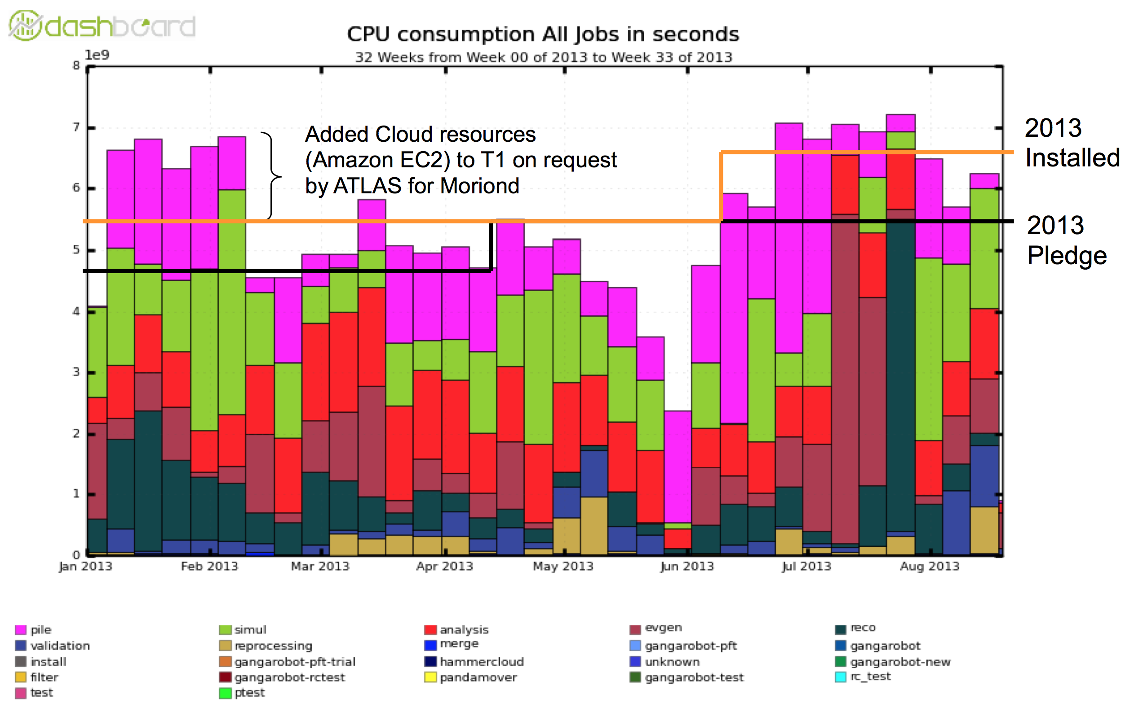
Tier-1 Usage (2013)

Slide 15
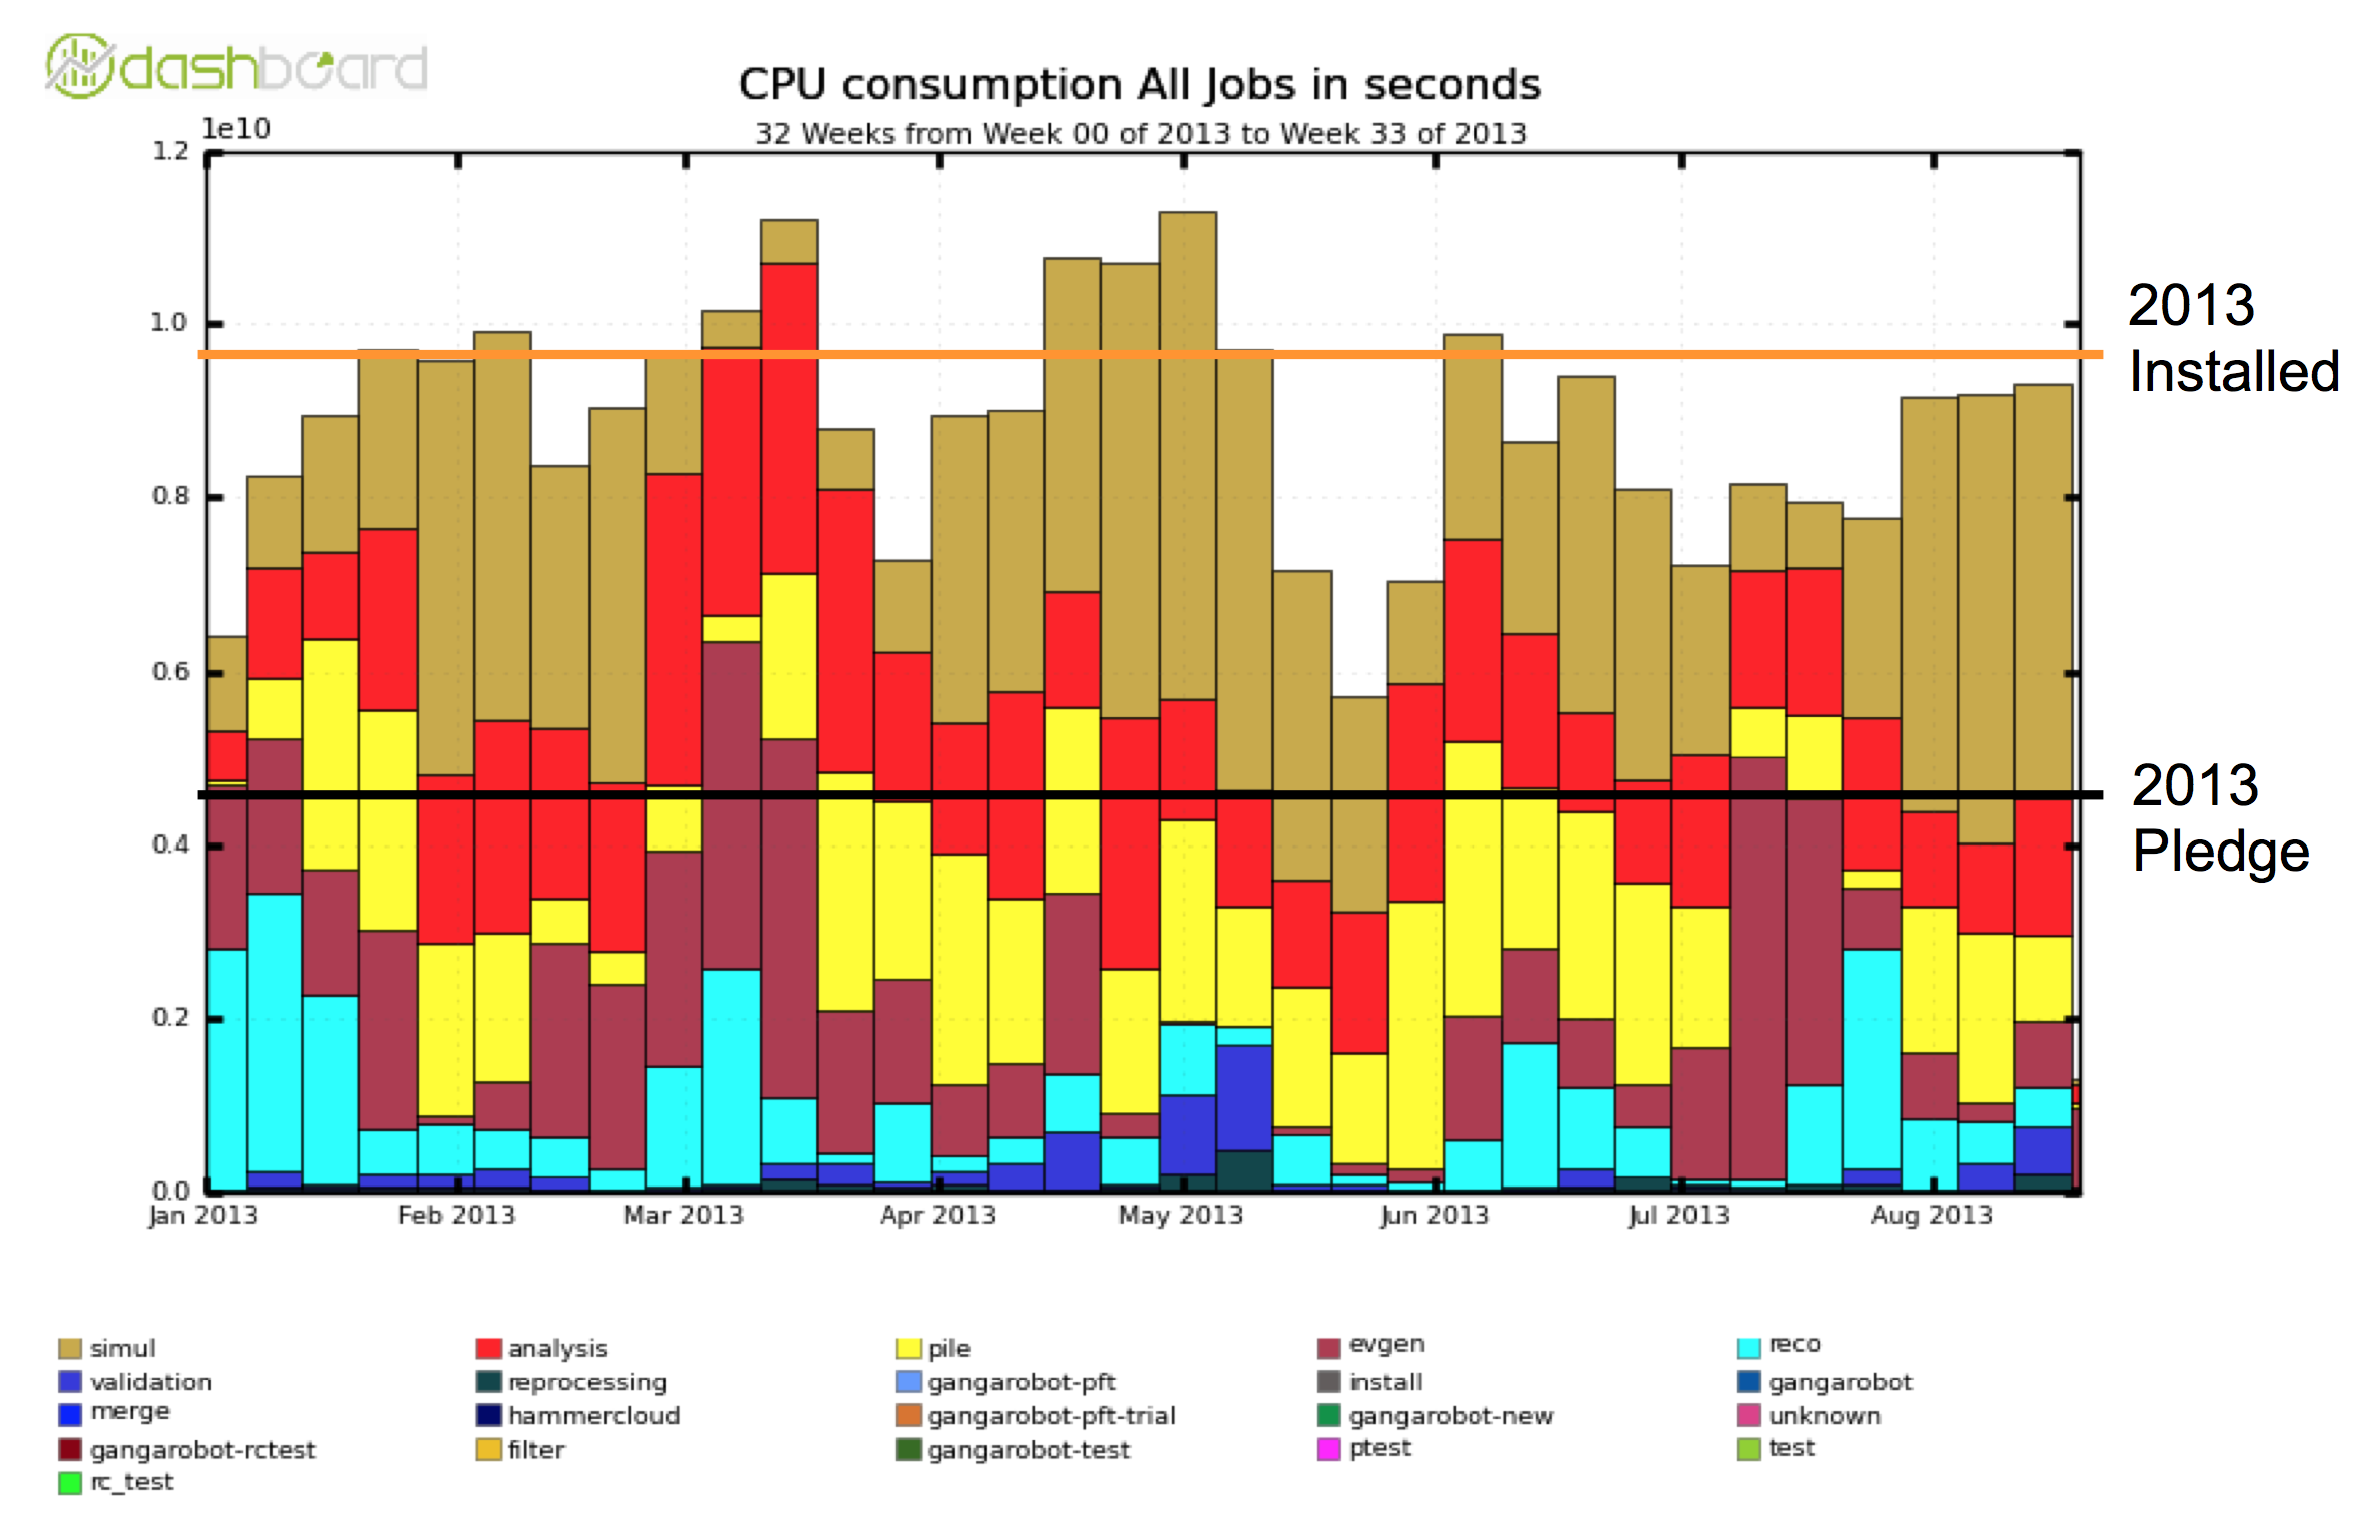
Tier-2 Utilization (Jan-Aug 2013)

Slide 16
Implementation Plans
There are a few contributed implementation plans so far in the T3IC Google Drive area
  Agile infrastructure
  ATLAS Connect / Condor flocking / FAXBox
  PandaAtTier3
More detailed plans for future Tier-3 functionality forthcoming
Fortunately, we have a couple of very promising enabling technologies for future Tier-3 workflows which should not require an large amount of additional manpower
  Suggest that we include these in our planning; ultimately, users will settle into using the ones that work best for their physics output
It was agreed that we would also look at the resources available at the FNAL LPC-CAF

Slide 17
Summary
The T3IC is now very active
We need a wider range of analysis workflows before drawing preliminary conclusions about resource estimates.
The first workflow studies indicate that CPU will be a scarcer resource than disk. The CPU availability will probably drive the implementation plans.
Anecdotal evidence from users indicates that job failures or larger-than-anticipated latencies could push people away from distributed computing in favor of Tier-3.
Development of implementation plans well progressed; Documentation of these plans progressing in parallel with the resource/cost estimates
  Want use of BPRs and user feedback to be available by Agency review

Slide 18
Bonus Material

Slide 19
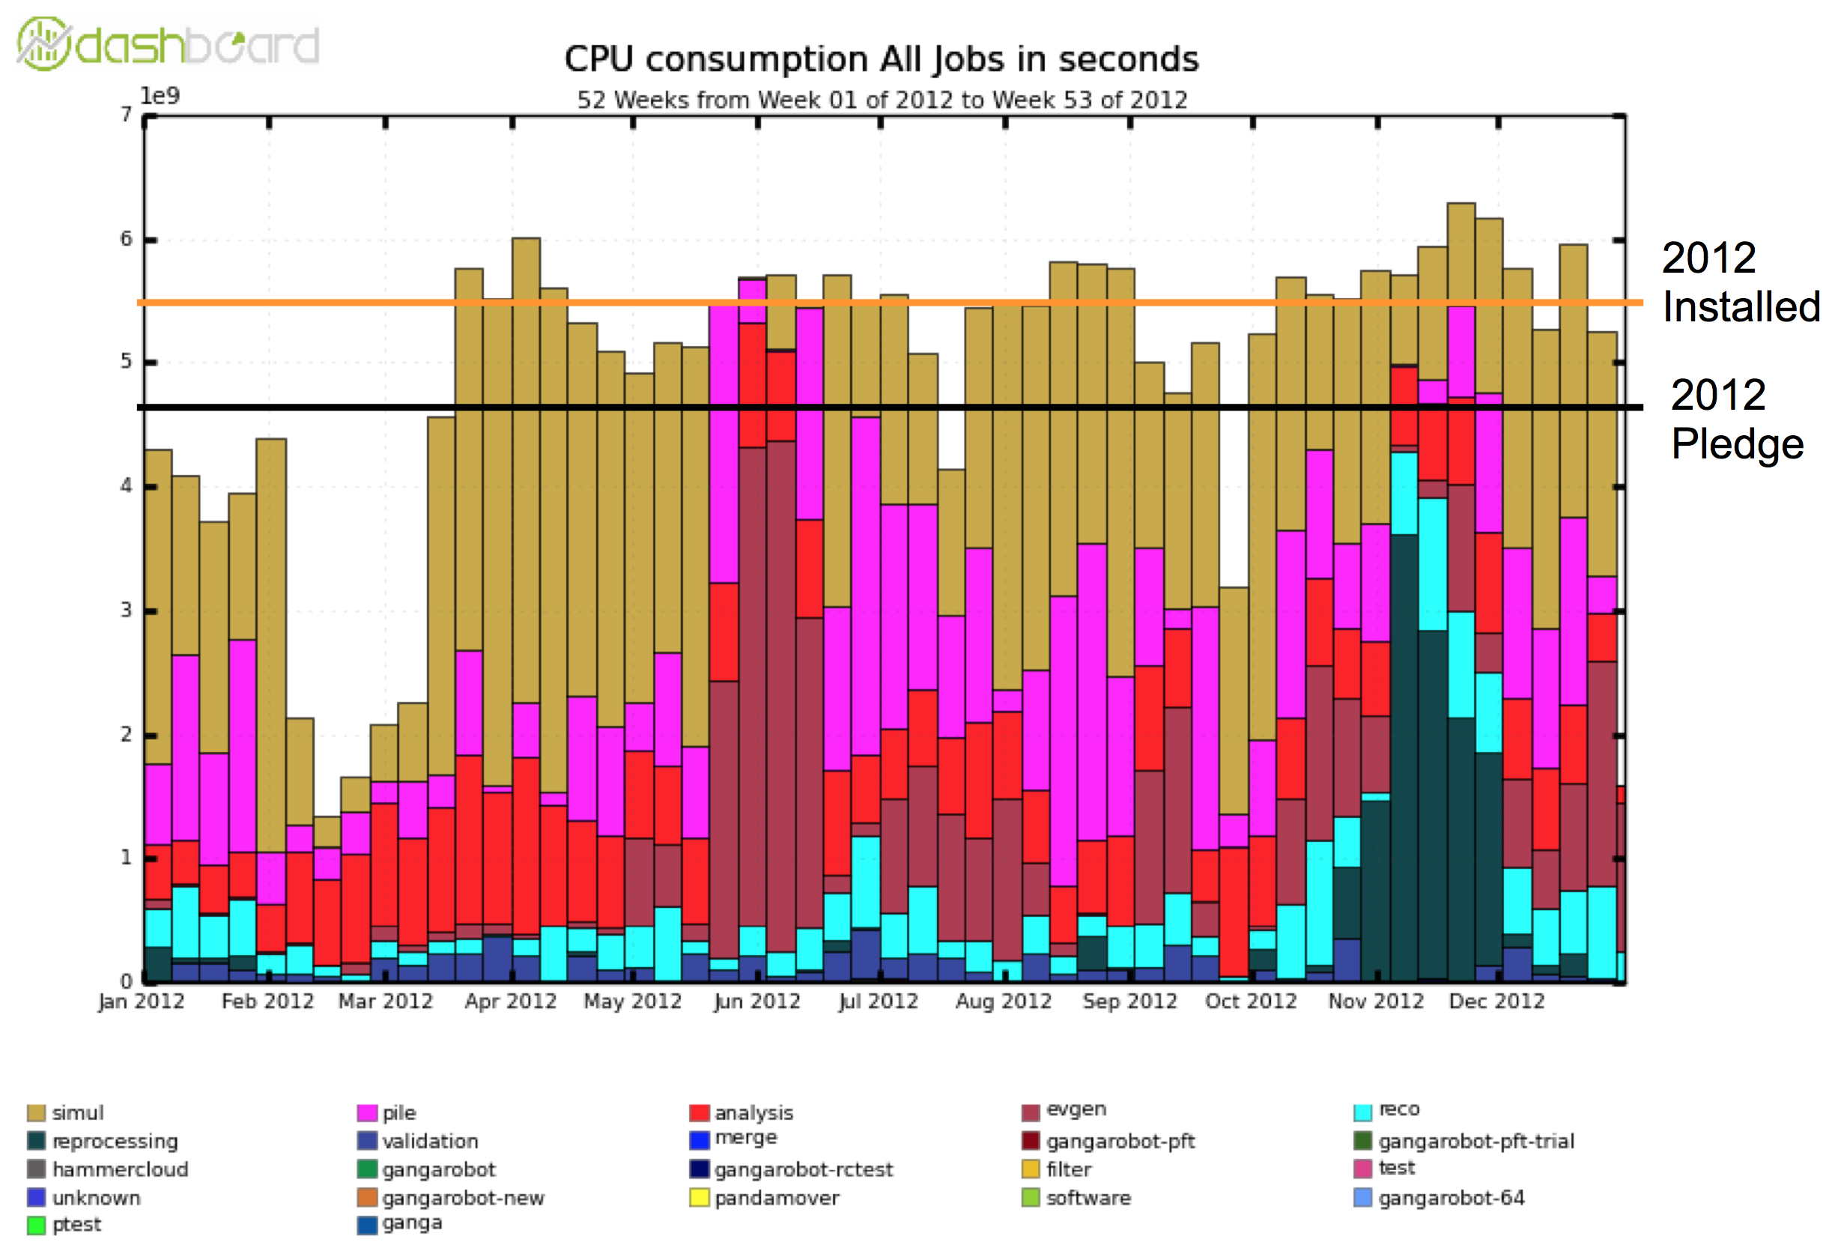
Tier-1 Usage (2012)

Slide 20
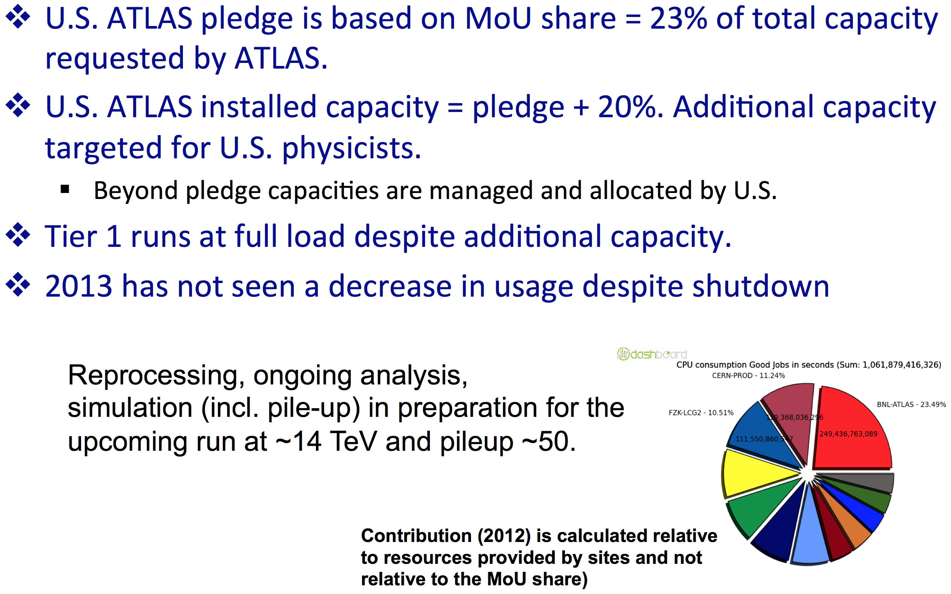
Tier-1 Comments

Slide 21
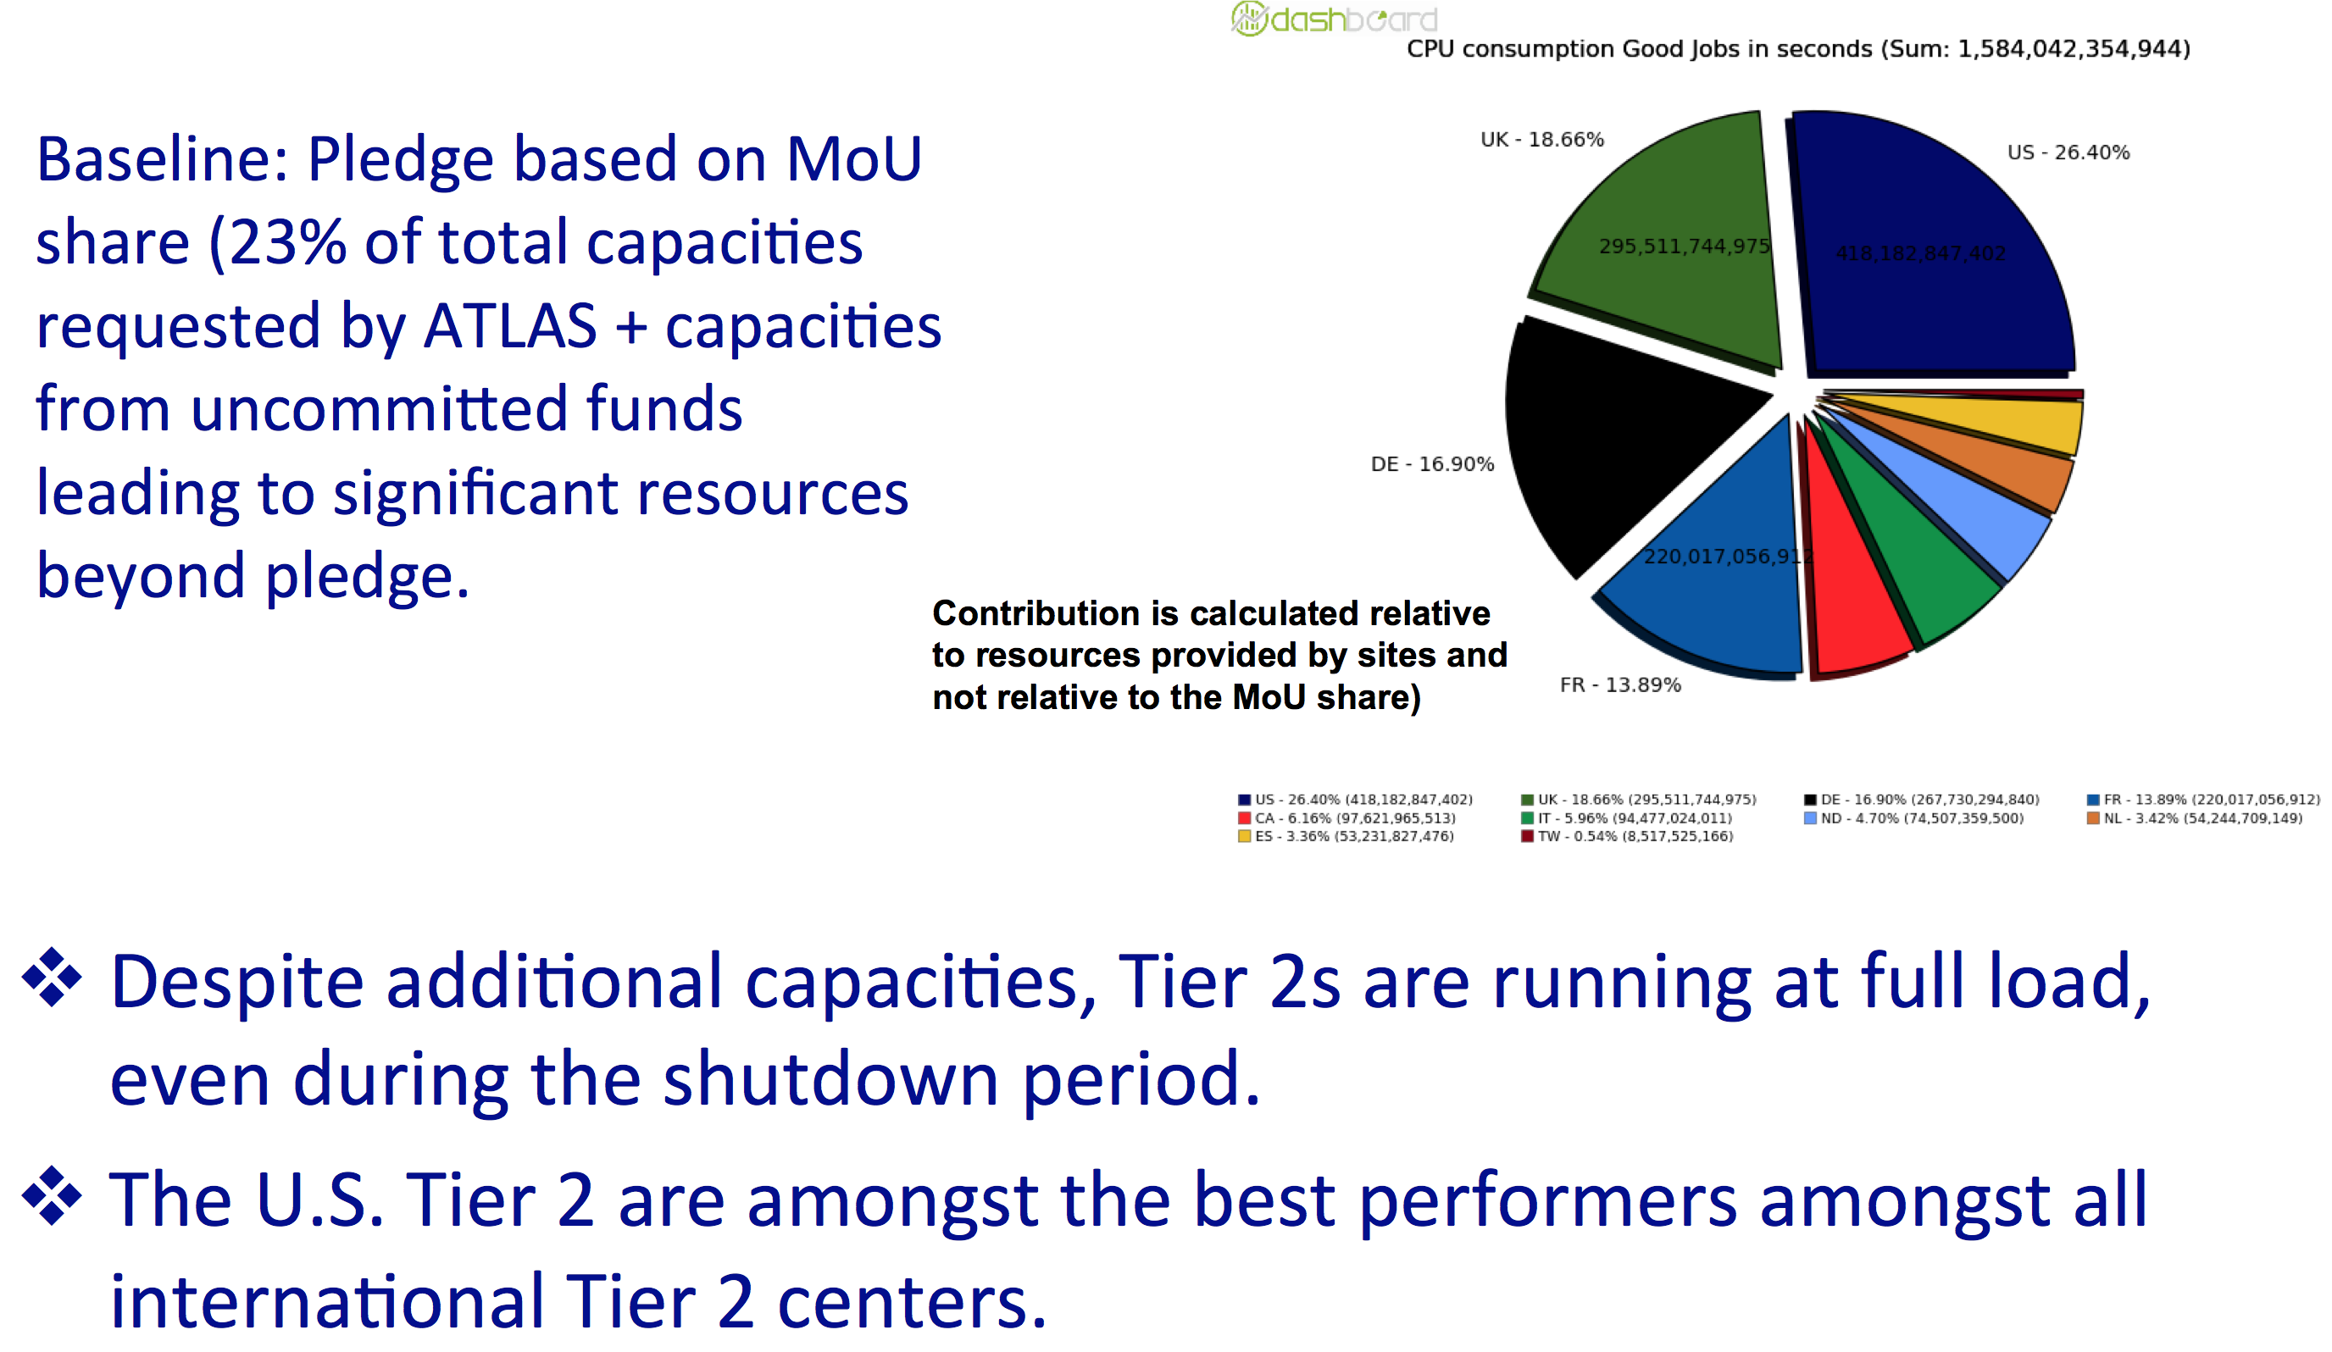
Tier-2 Utilization (cont)

Slide 22
Comments on US ATLAS BPRs
While they are ~100% utilized, a question of optimizing future hardware deployment vs. software development (see Torre’s talk)
Their existence is very defensible (see utilization plots), but they are in constant need of defensing
  US has large BPR, but CPU consumption by US is in line in MOU share
  Regular talking point of funding agencies
    They are very sensitive to the prospect that the US is subsidizing computing for ATLAS beyond their “fair share” (not the case)
  There is some risk of reduction if we do not make sufficient use of these resources for US physicists and provide clear accounting
I’ve focused on CPU, but disk over-pledge is also substantial

Slide 23
Usage of US ATLAS BPRs
Dedicated requests (mostly for MC) to RAC (handled by E. Varnes) from US physicists
  Seems that requests well accommodated but are sporadic (by the nature of the requests)
  Q: For production requests, can we do any more than encourage and reassure the community?
Panda brokerage for jobs identified as being from US people
  Q: How well has this been working? Can we improve this? How is fair-share among US physicists done?
  Q: Is there monitoring of this to allow for transparency and feedback for tuning?

Slide 24
Usage of US ATLAS BPRs (cont)
US Tier-3s
  At most institutions, T3 hardware was purchased ~3 years ago with ARRA and MRI funds (T3TFv2 Observation 4) → at a level not likely to repeated any time soon
    Hardware-wise, US ATLAS T3s are aging w/o funds to refresh
    Physics-wise, T3s are critical resources for effective participation by the US in ATLAS (T3TFv2 Observation 1)
  CPU BPRs could augment the T3 capacity given challenging T3 funding
    Panda dedicated queues to access these resources
    Using flocking capability in HTCondor
    Both of these have been demonstrated to work. Users would like to retain their T3 “look-and-feel”
    Q: What would be the fair-share policy? How would the accounting work?
  Disk BPRs could provide T3/WAN-accessible read/write scratch space (e.g. via Faxbox). Archiving service?

